Slide 1

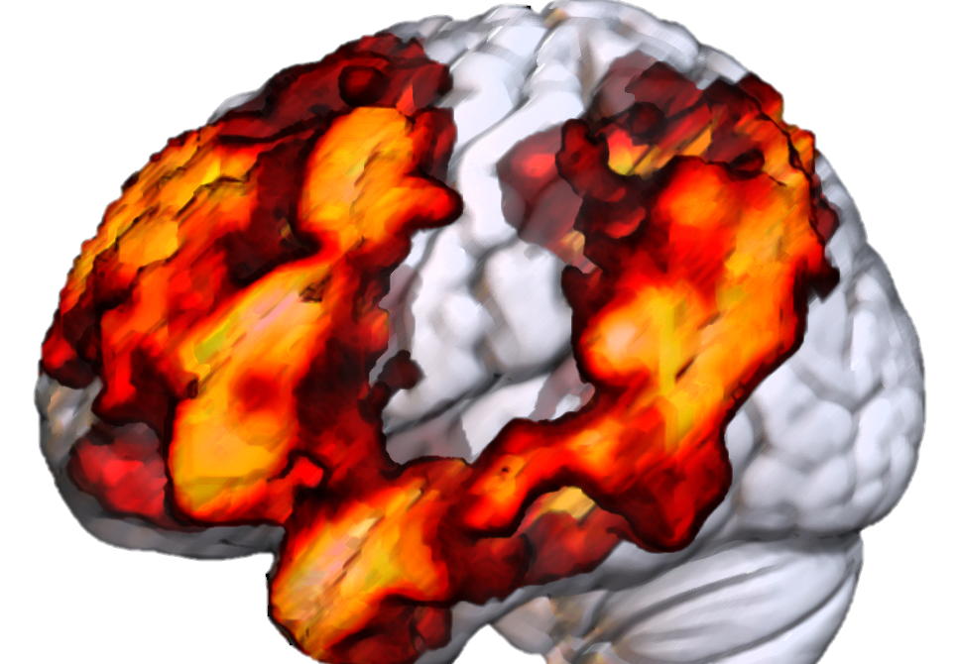

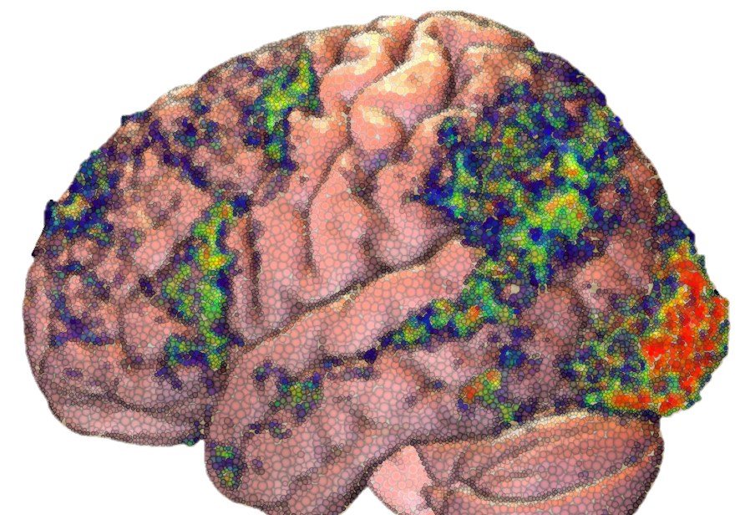
So You Want to do an fMRI Study…?
James Fodor
20th January 2023

Slide 2
Background and Motivation

Slide 3
Why fMRI?
Suggestions?

Slide 4
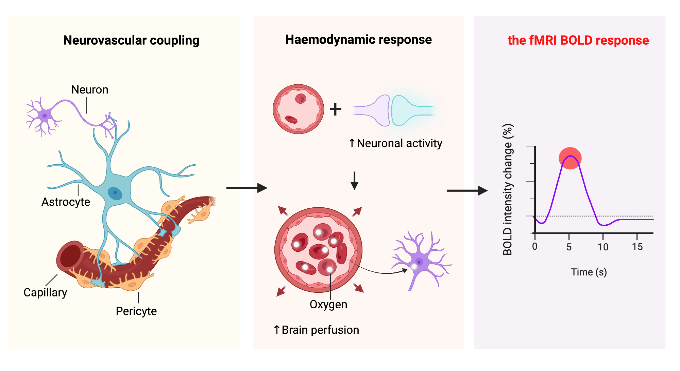
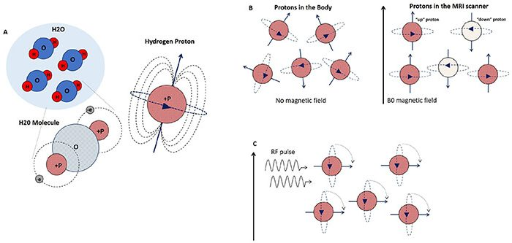
What is fMRI?
EM pulses -> blood oxygenation -> neural activity -> thinking

Slide 5
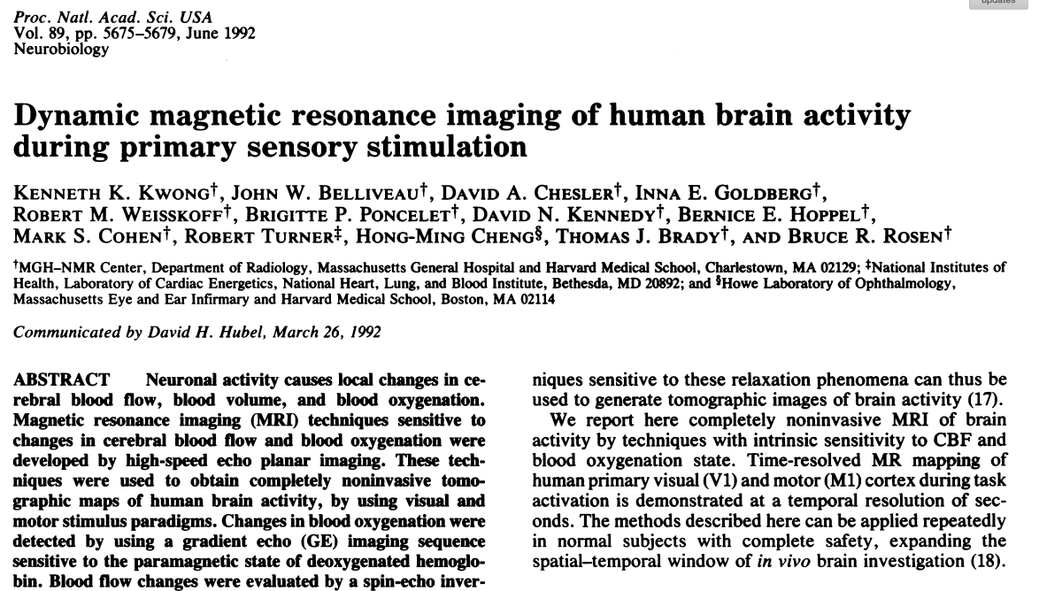
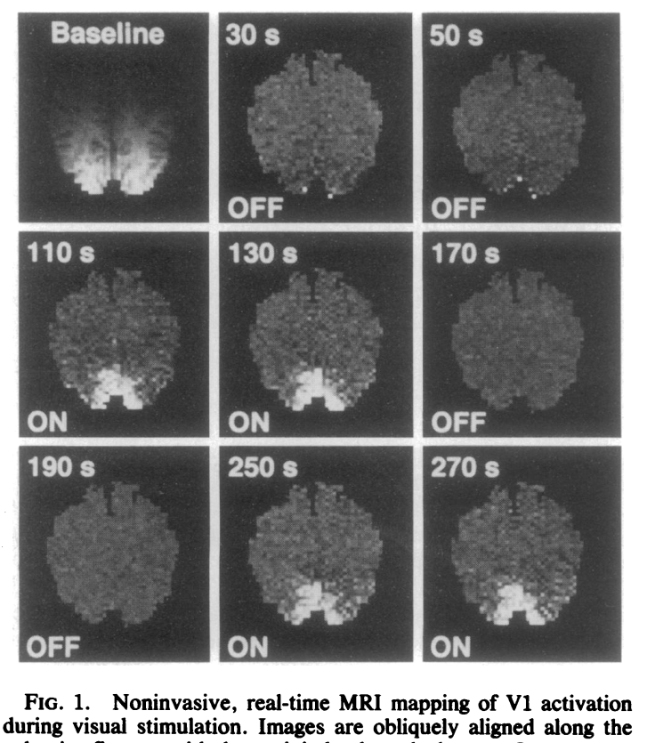
History of fMRI
First use of fMRI to study cognition in humans (1992).
Showed increased V1 activity when presented with light flashes.

Slide 6

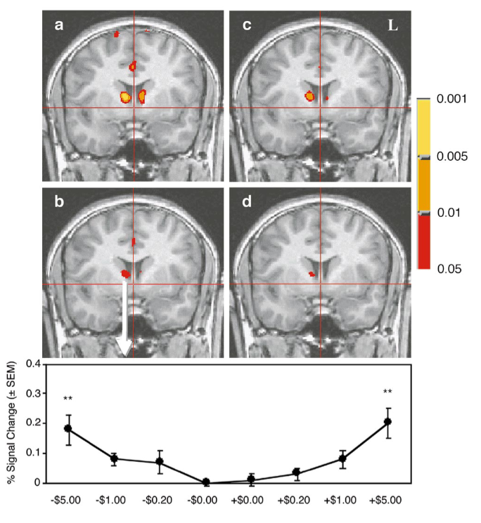
History of fMRI
Early work on decision-making (2001).
Found correlation of nucleus accumbens activity with reward value.

Slide 7
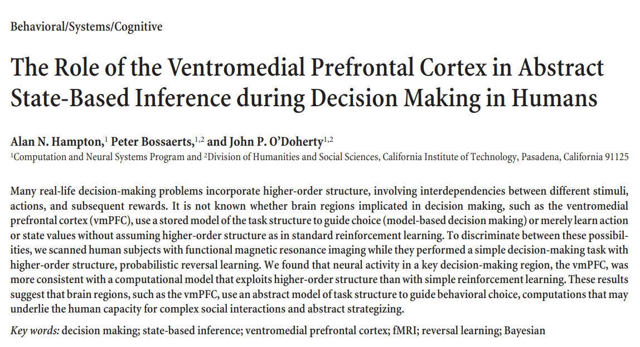
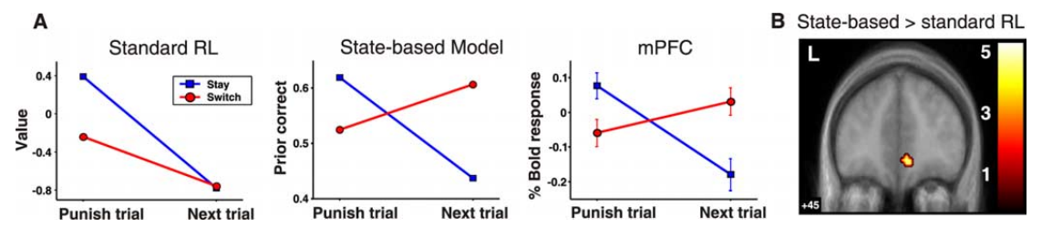
History of fMRI
Early model-based work in decision-making (2006).
Found pattern of vmPFC activity was more consistent with state-based learning.

Slide 8
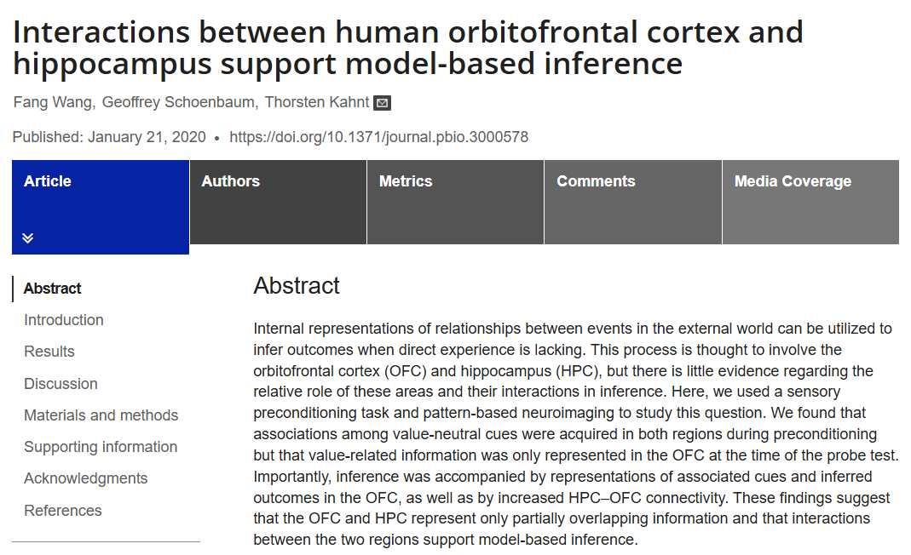
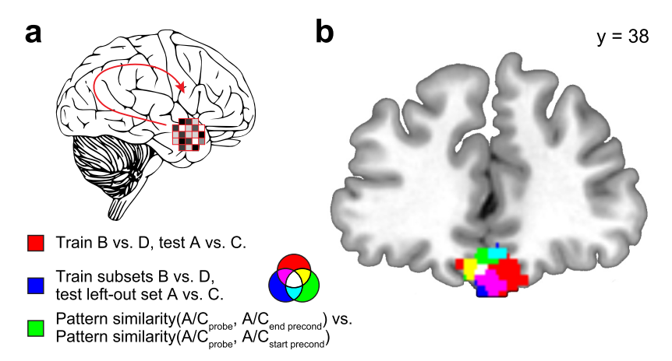
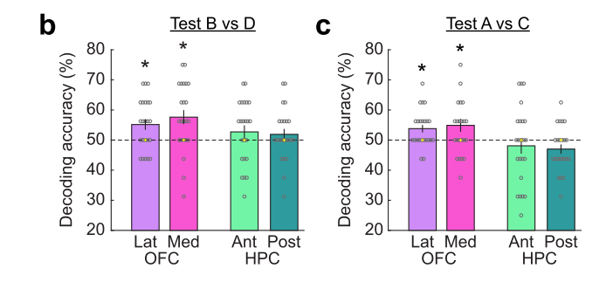
History of fMRI
Contemporary example of representational model-based methods (2020).
Showed the OFC and hippocampus represent different stimulus information.

Slide 9
Why fMRI?
To test computational models of how information is processed in the brain.
To test neurobiological models of how information is processed in the brain.

Slide 10
Study Pipeline: Data Collection

Slide 11

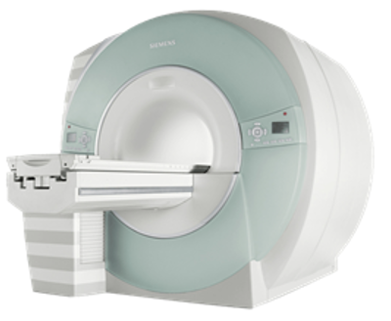
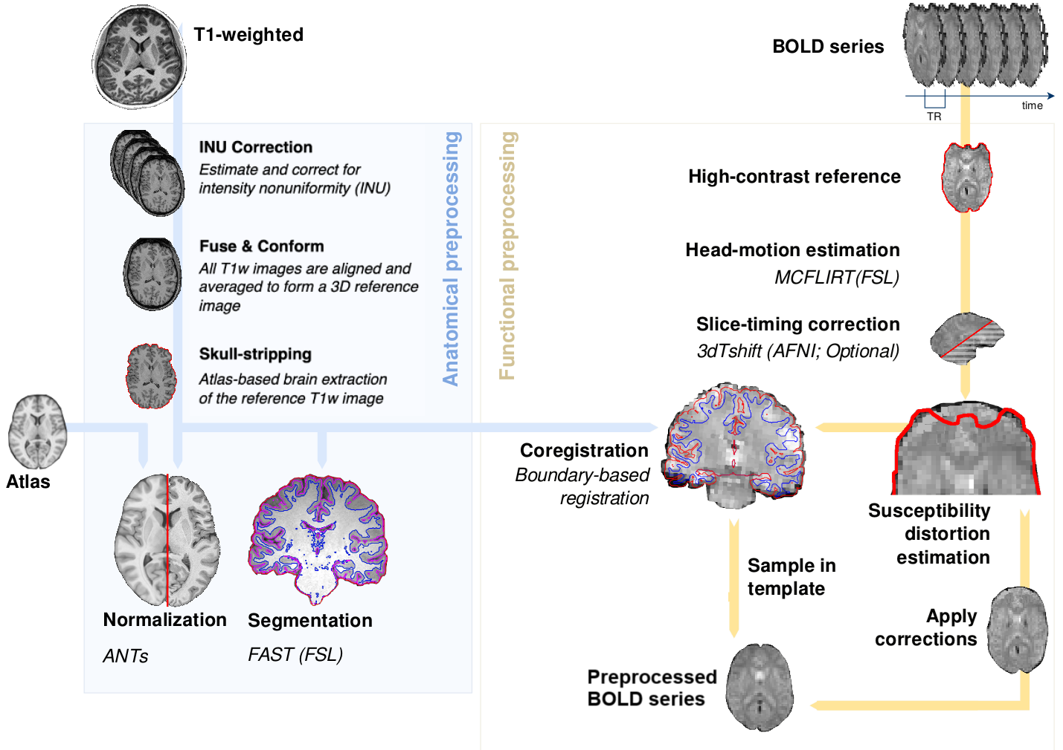
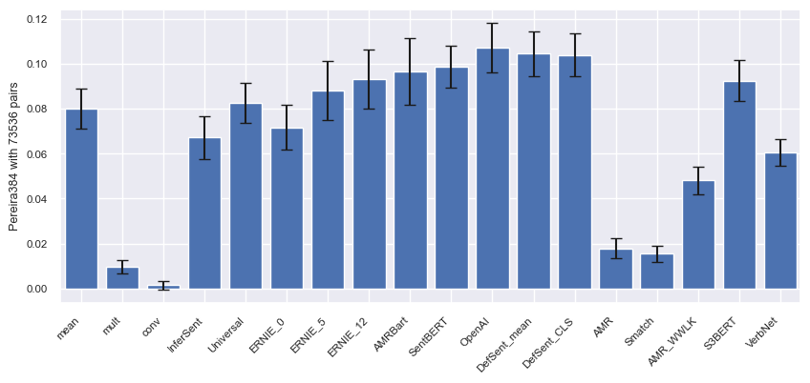
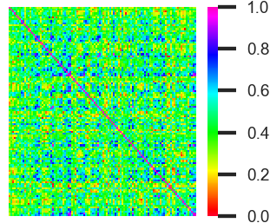
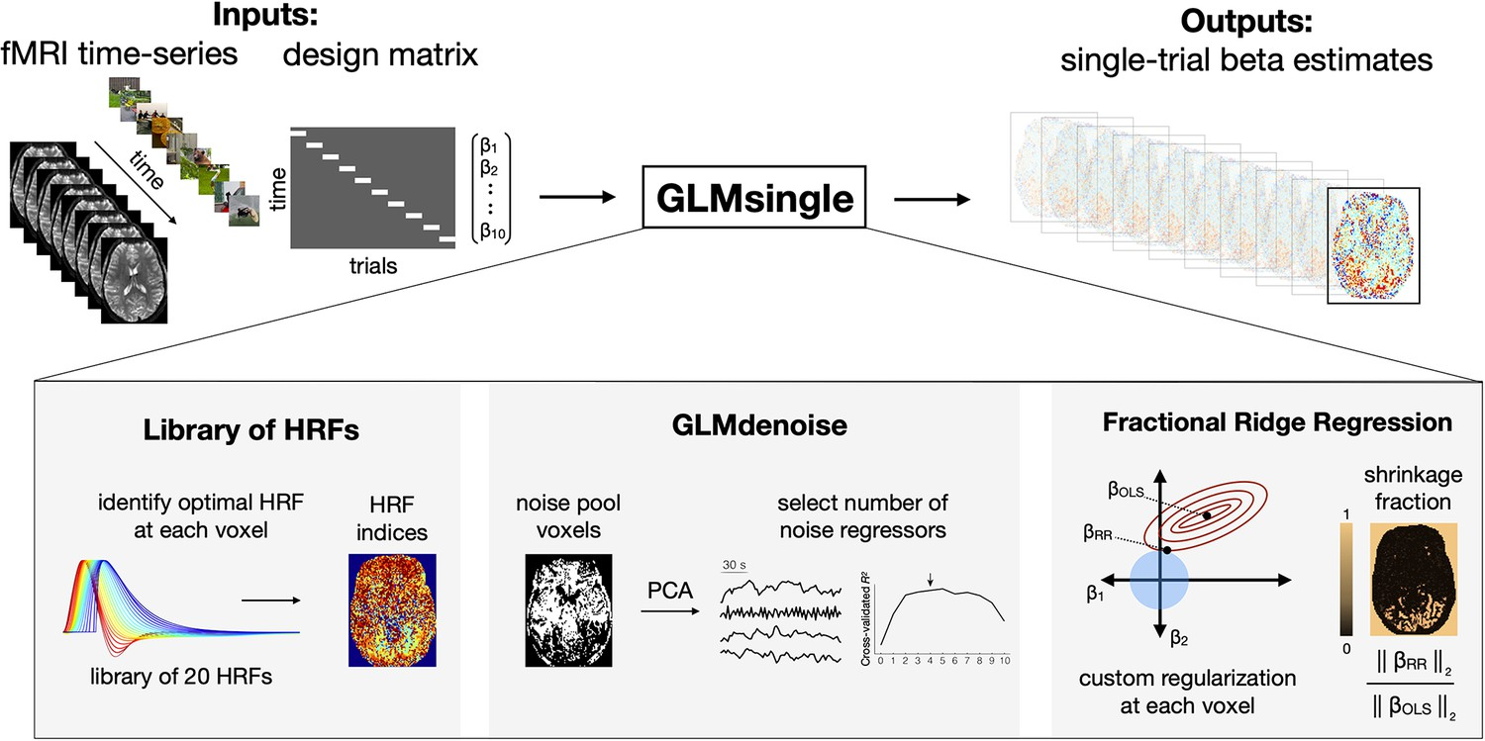
Study Pipeline
The cameraman brought the equipment to the director.
The cameraman brought the new equipment to the director.
A painter brought the equipment to the director.
Every morning the cameraman brought the equipment to the impatient director.
A team of cameramen brought all the necessary equipment to the busy director.
1. Sentences
2. PsychoPy task
3. fMRI scan
4. fMRIprep preprocessing
7. Model/brain correlations
6. RSA matrix
5. GLM regression

Slide 12
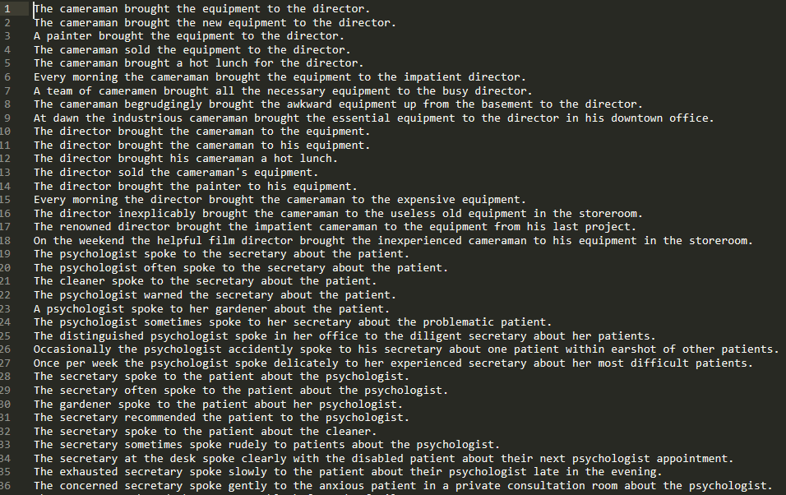
1. Formulate Your Stimuli
Select based on theoretical considerations.
Want to distinguish between computational models.

Slide 13
2. Design Your Task
I constructed my task using PsychoPy.
Test exhaustively to get timing and flow correct.

Slide 14
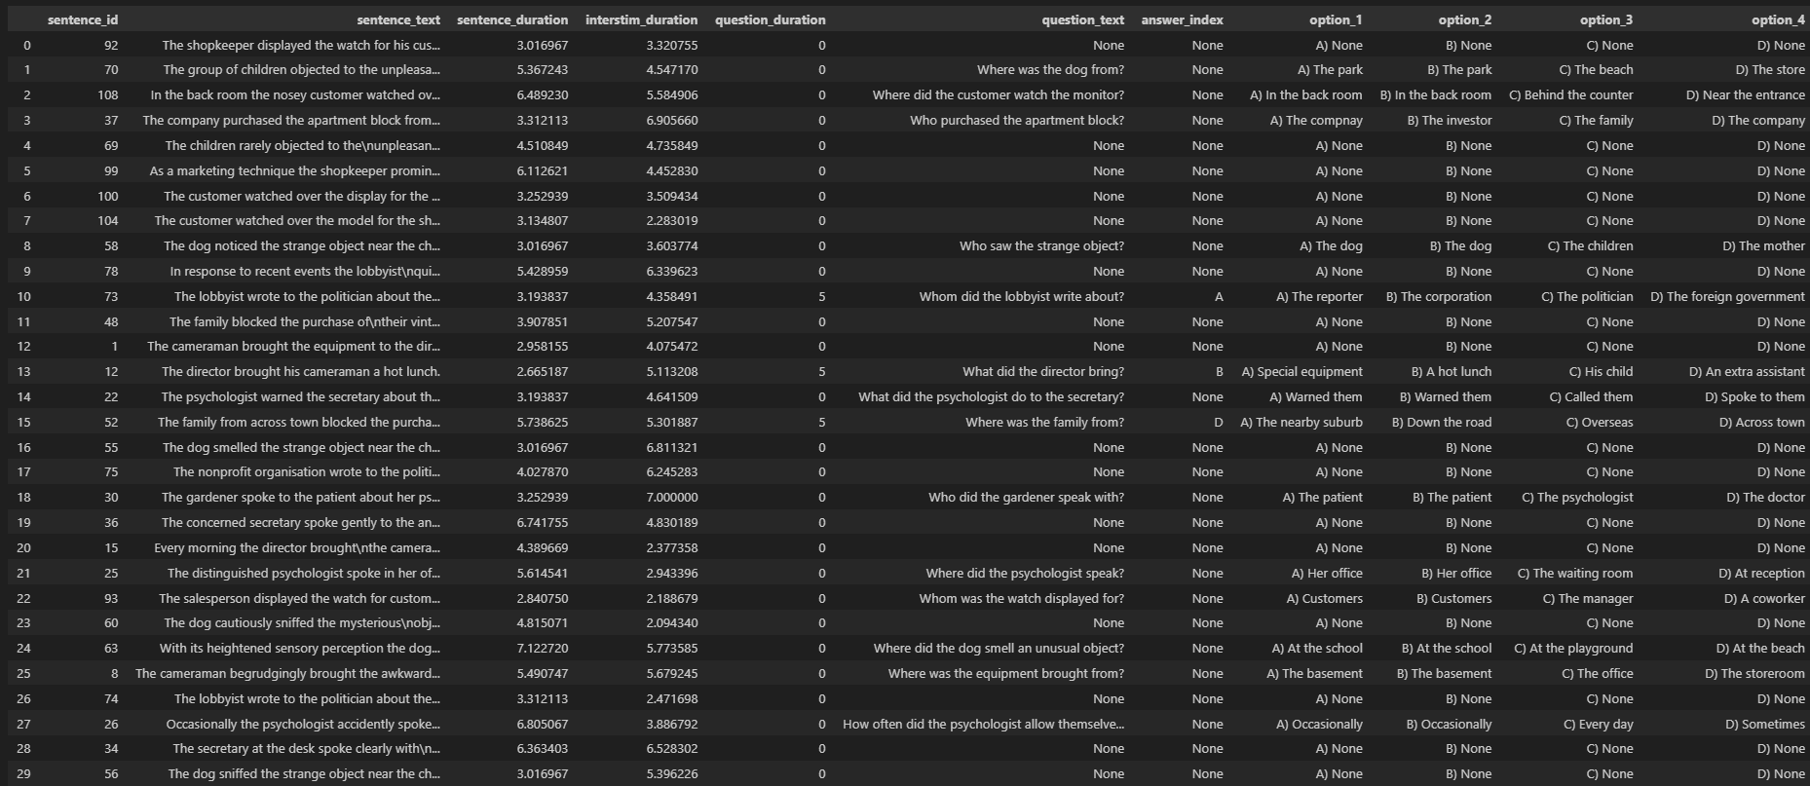
3. Prepare Task Inputs
Pre-randomise order of stimuli.

Slide 15

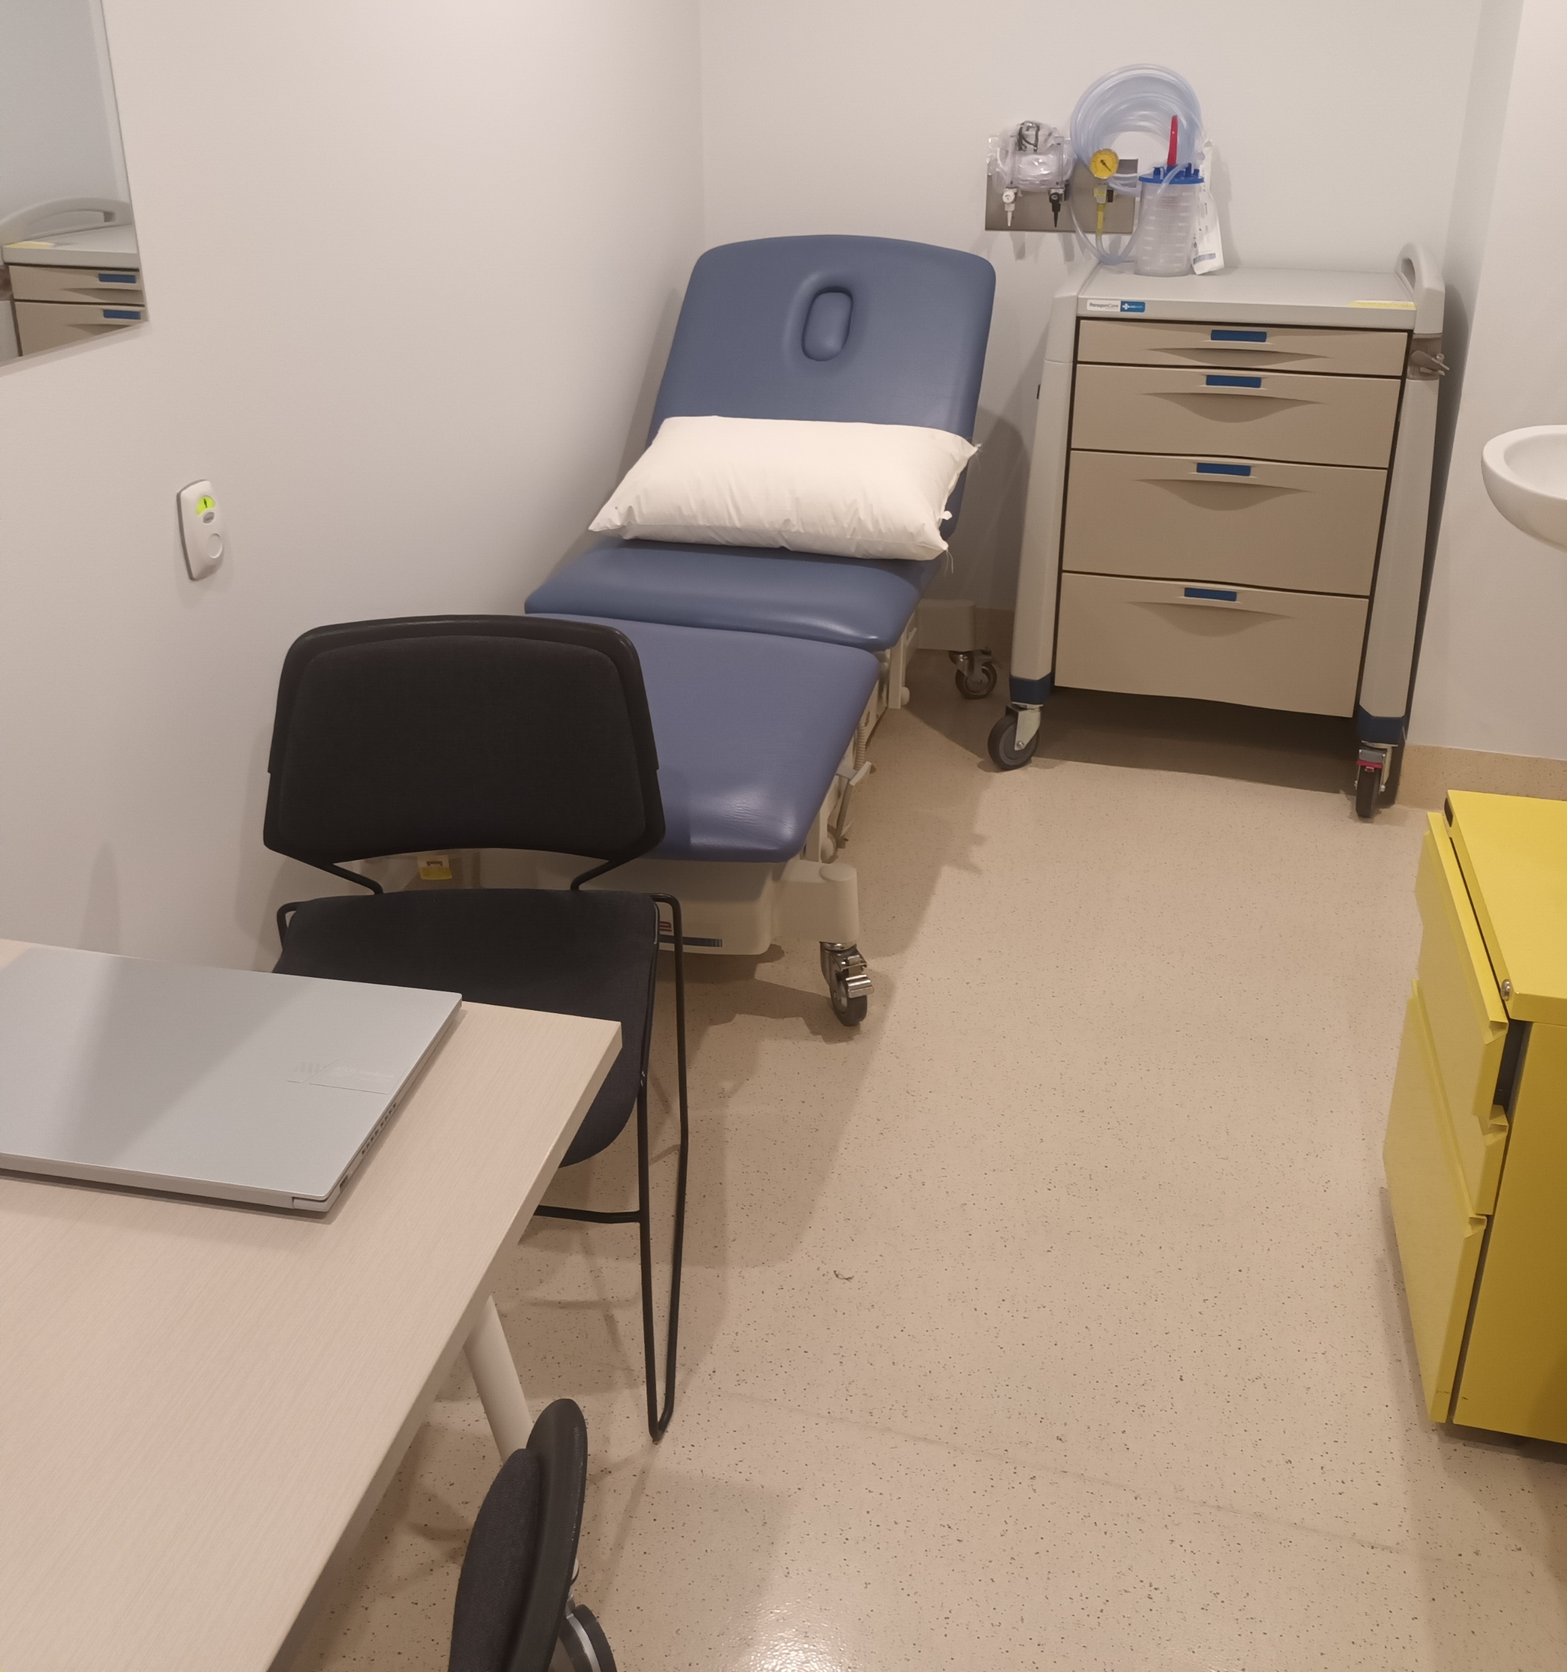
4. Collect the Data

Slide 16
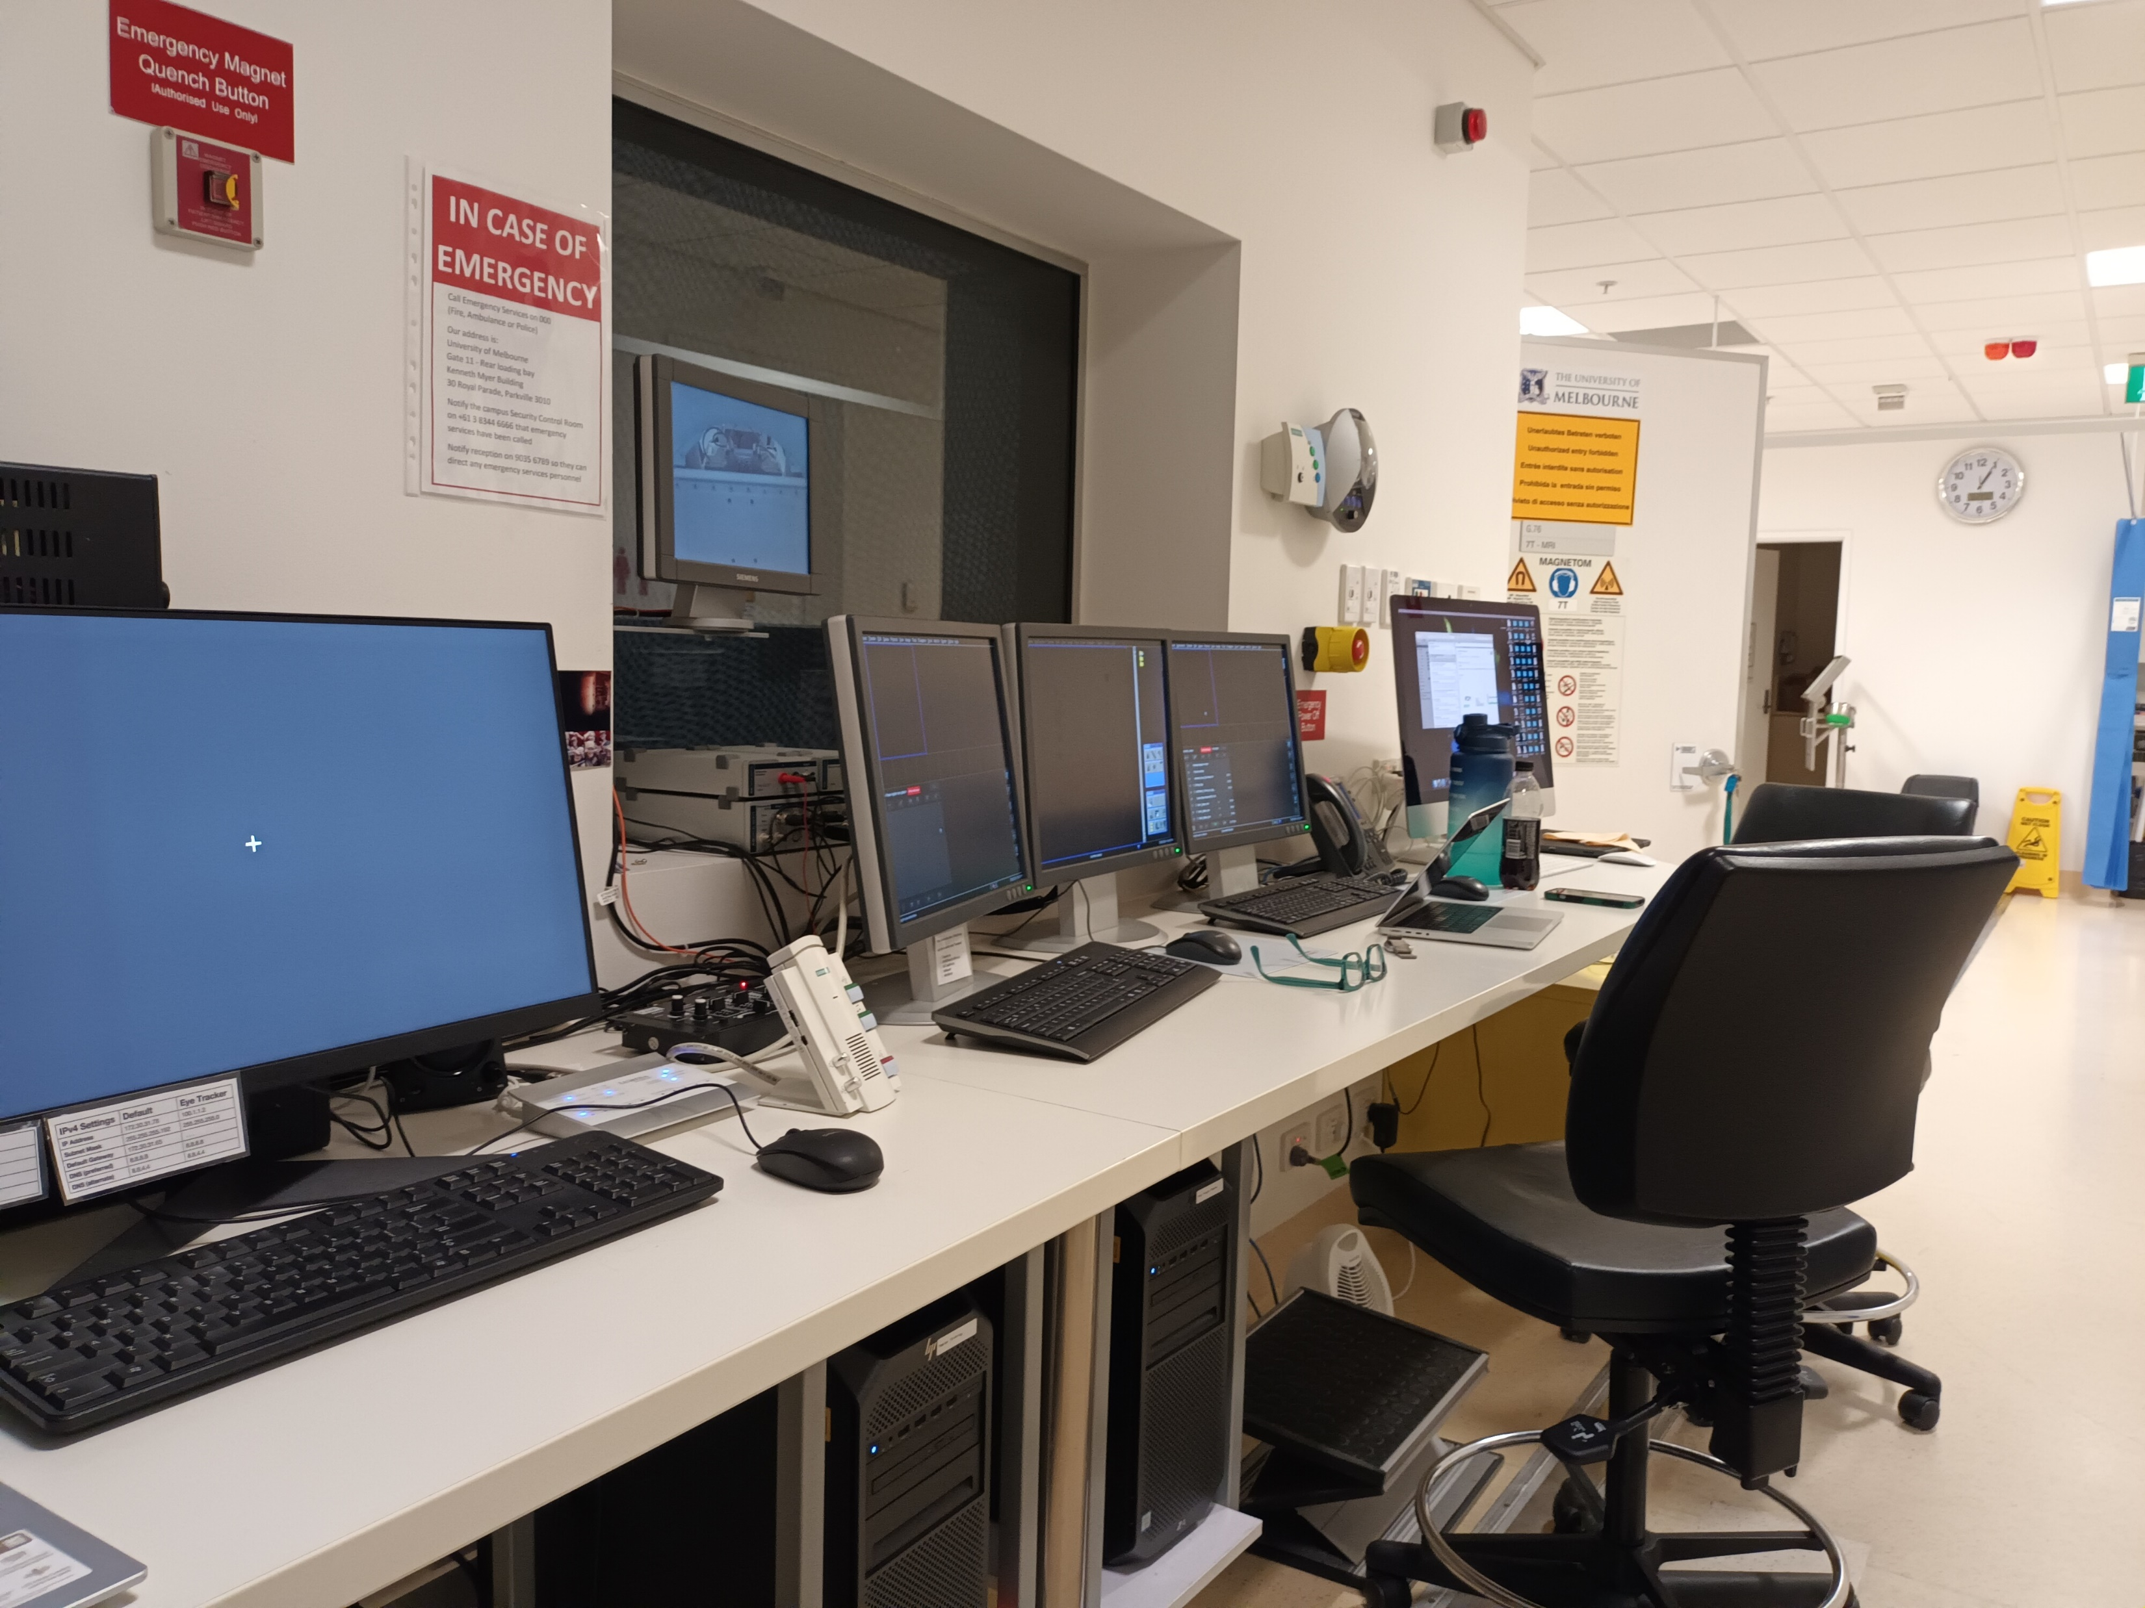
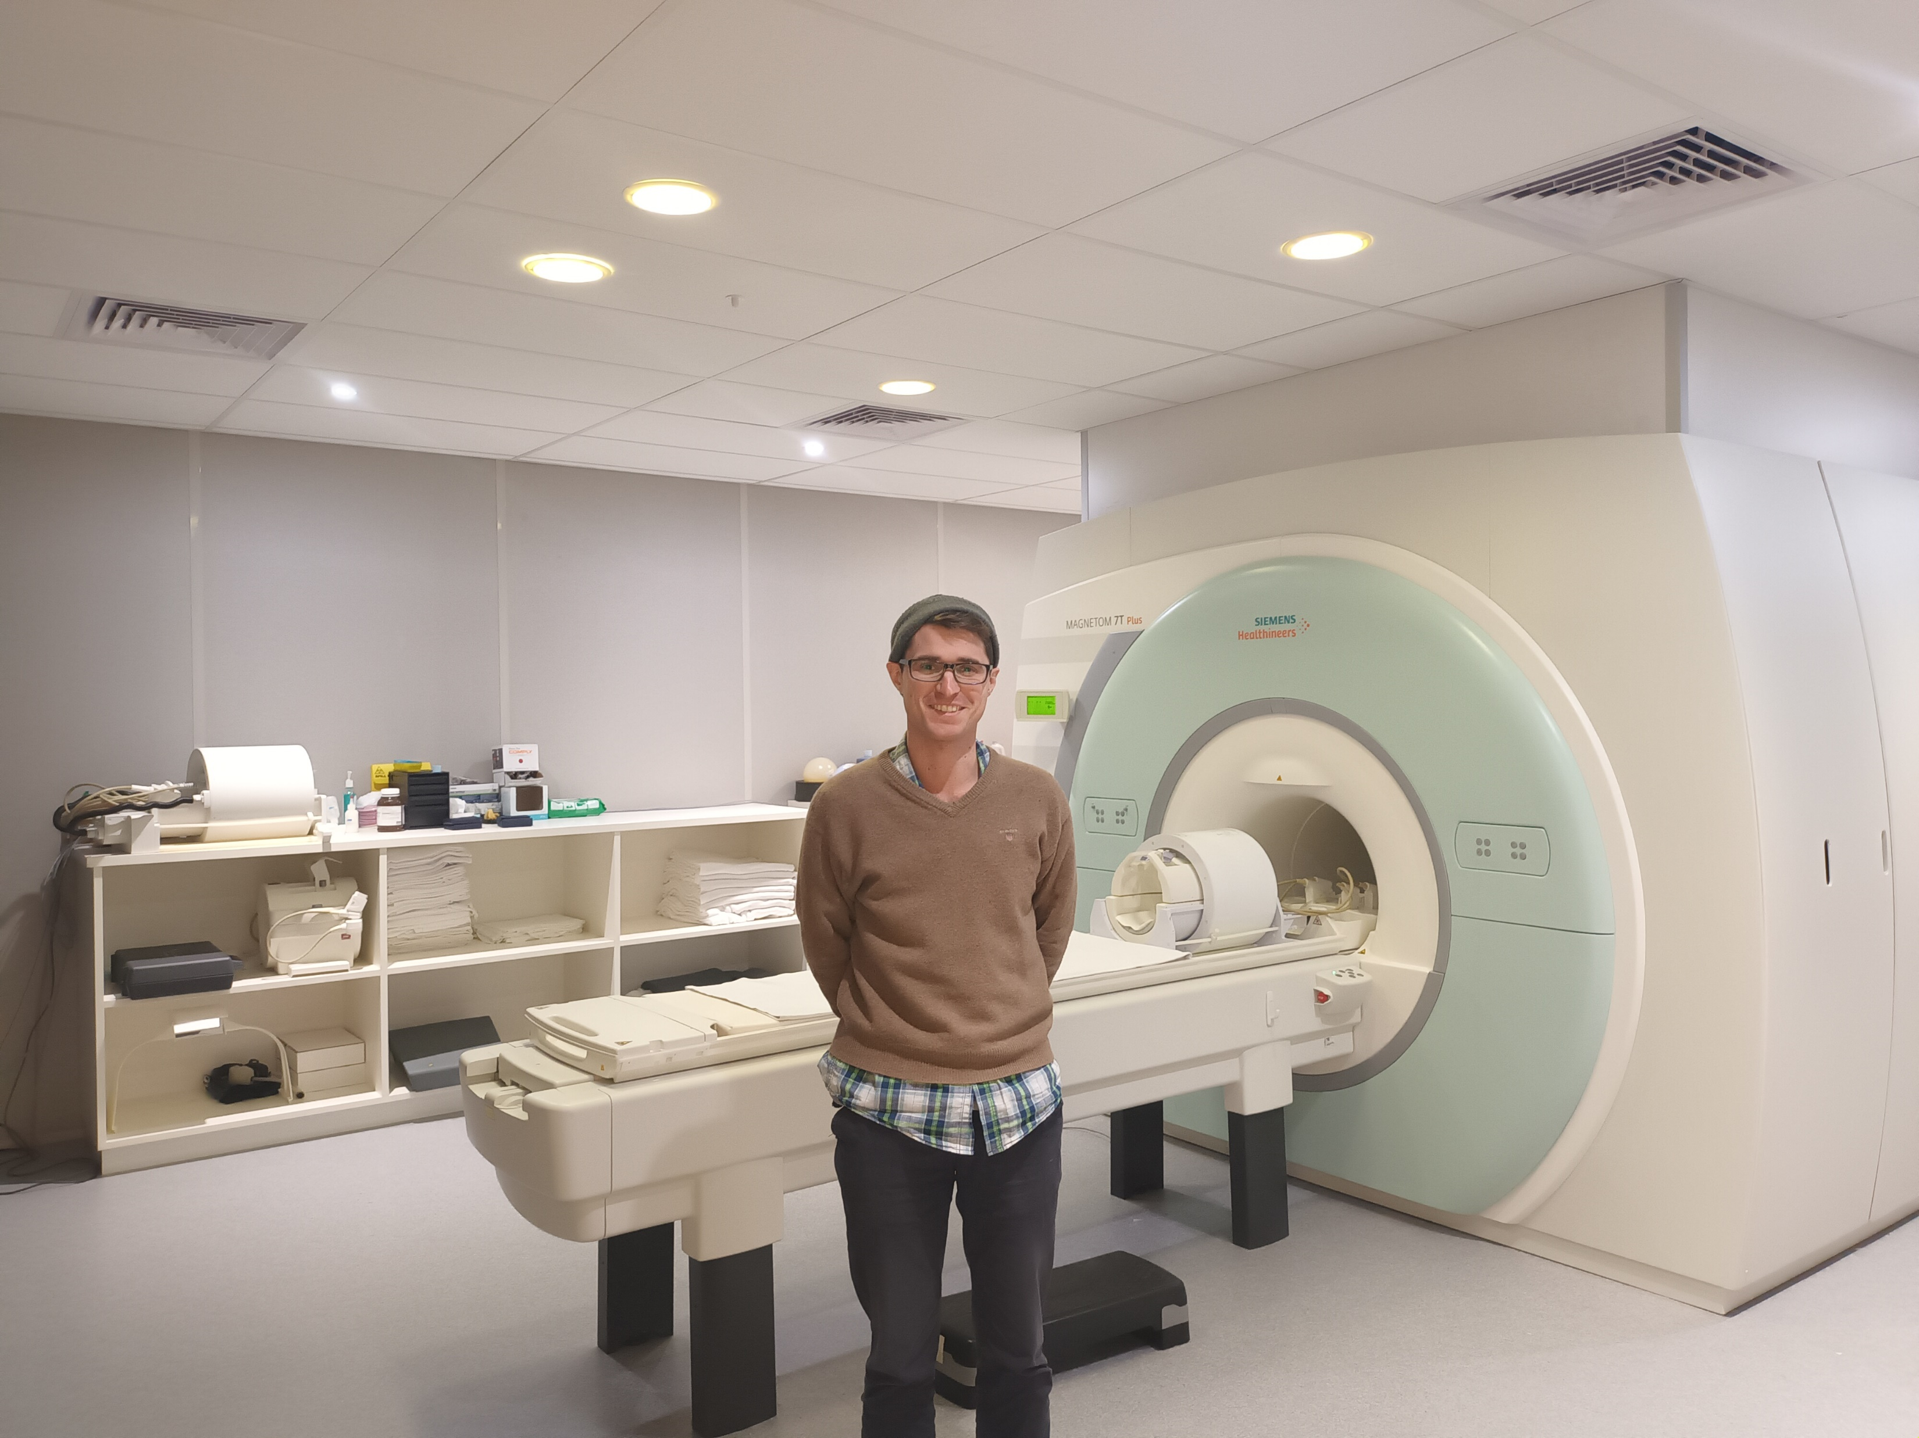
4. Collect the Data

Slide 17
Study Pipeline: Data Analysis

Slide 18
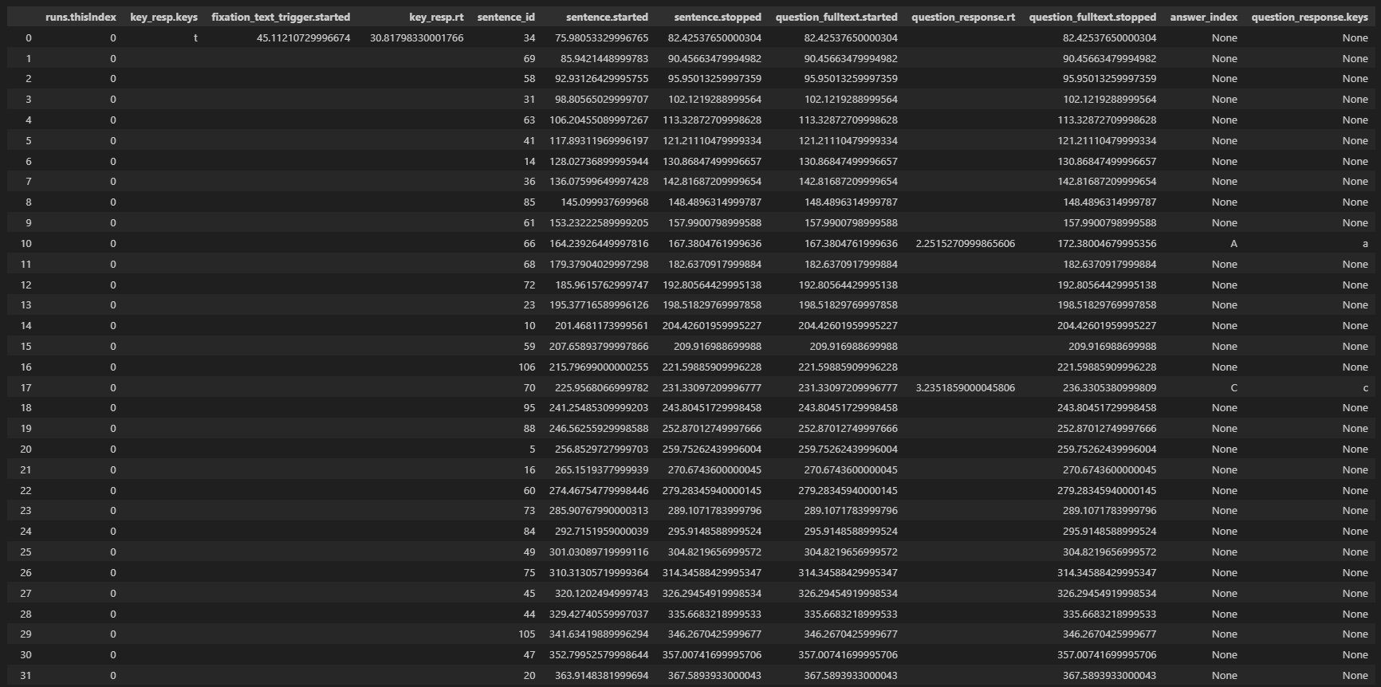
5. Extract Task Results
Ensure timings make sense.

Slide 19
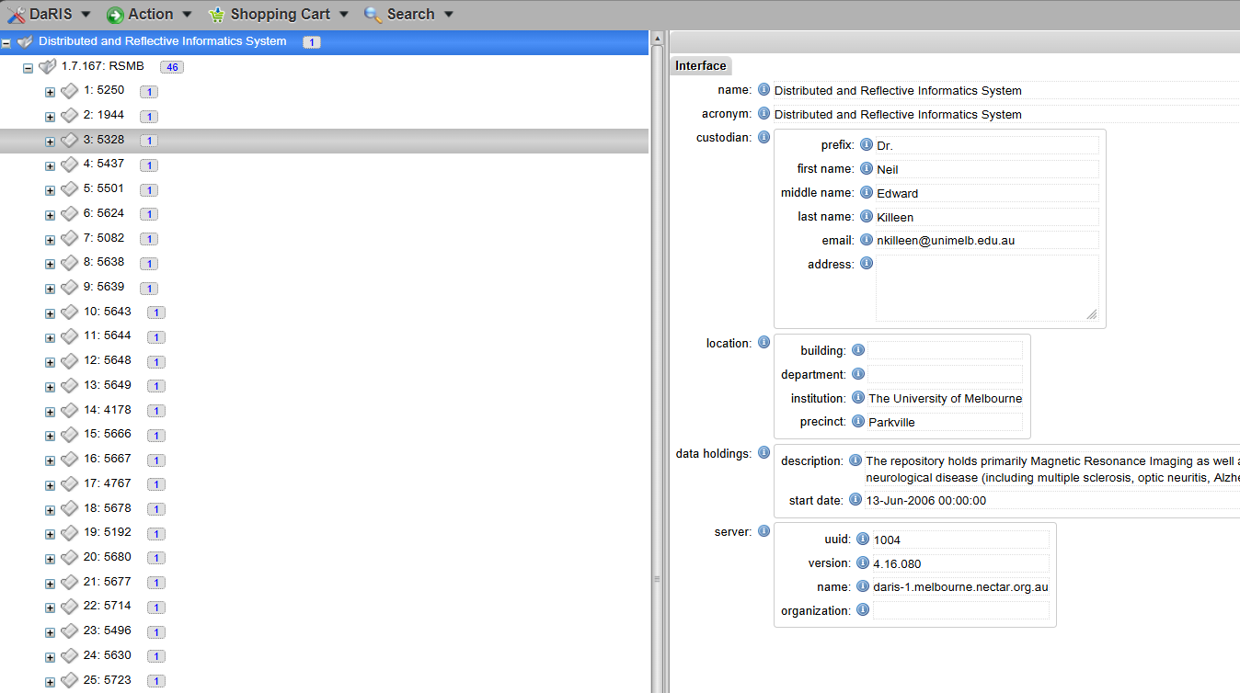
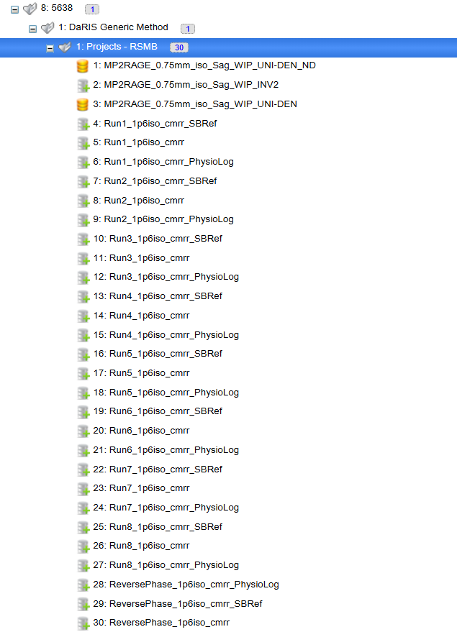
6. Extract Files from DaRIS
“Our re-analysis shows that the classification results reported are probably inflated due to the presence of information leakage somewhere in the feature selection process.”
anat
func
fmap

Slide 20
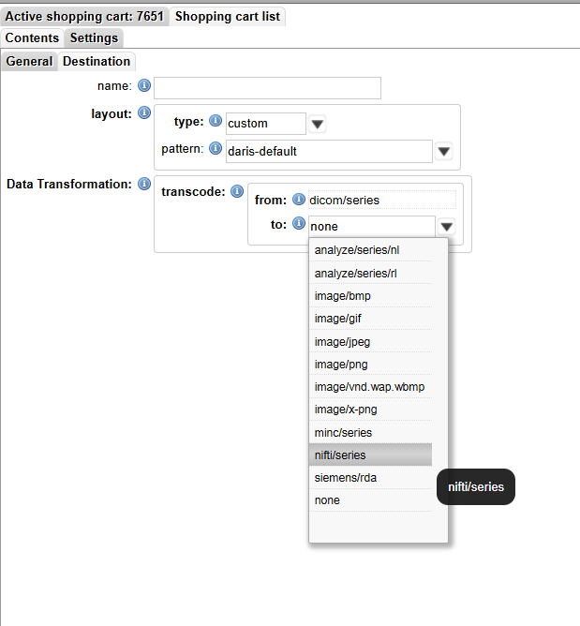
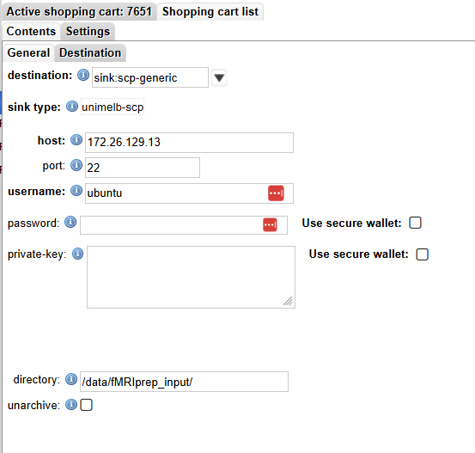
6. Extract Files from DaRIS

Slide 21
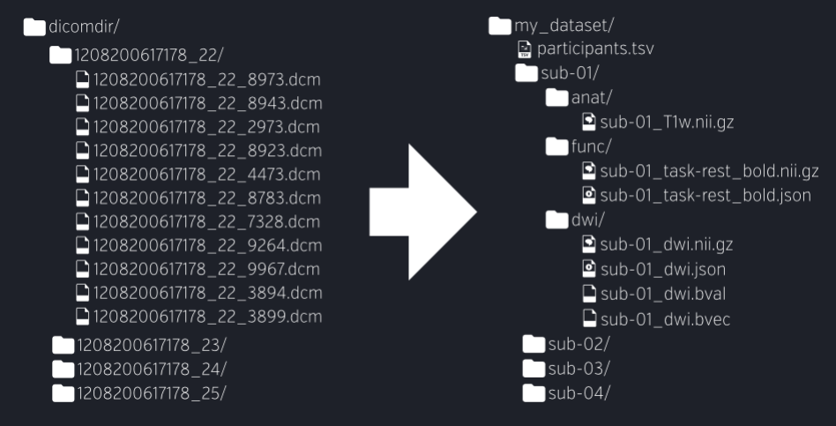
7. Convert Files to BIDS
Need to convert DICOM to NIFI format.
Need to ensure files are in Brain Imaging Data Structure (BIDS) compliant.

Slide 22
8. Perform Preprocessing
Preprocessing performed using fMRIPrep.
Motion correction, skull-stripping, coregistration, normalisation.

Slide 23
9. Perform GLM Regression
General Linear Model estimated using GLMSingle.
Automatically extracts noise signals from BOLD data.
Fits HRFs to each voxel from a library based on data.

Slide 24
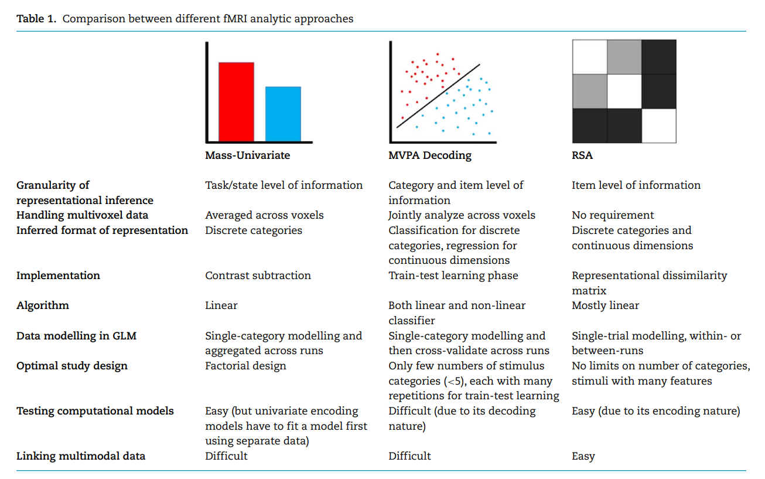
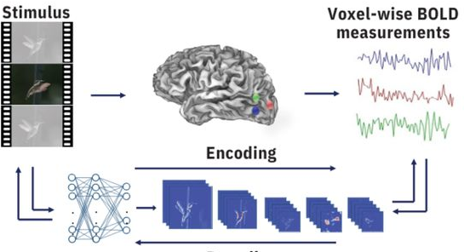
10. Approaches to Model-Based fMRI
Comparison of approaches to analysing fMRI data.
Voxelwise Encoding
Continuous stimulus information
Individual voxels
Continuous stimulus variation
Train-test learning phase
Linear
No requirement
Natural stimuli
Easy (due to its encoding nature)
Easy

Slide 25
The Lesson
Use simple and clear procedures.
Clearly identify all assumptions or parameter choices.
Pre-register analysis methods.
Use cross-validation.

Slide 26
Discussion?

