Slide 1

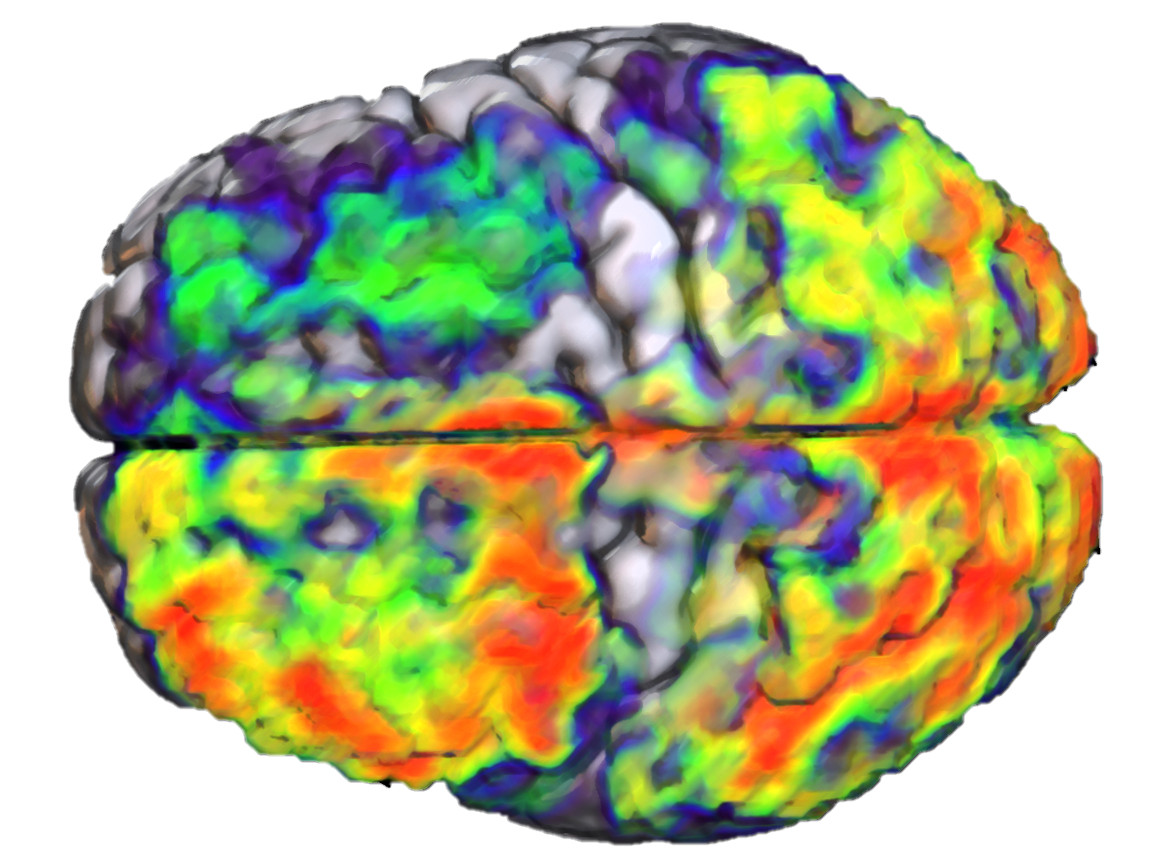
Computational Models of Compositional Semantics in the Mind and Brain
James Fodor
September 2025

Slide 2
Background

Slide 3
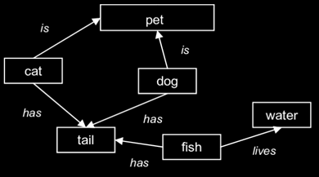
What is Semantics?
Semantics is the study of meaning.
How does the mind/brain represent the meaning of individual words?
How are word representations combined to form into sentence representations?

Slide 4
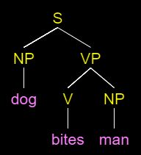

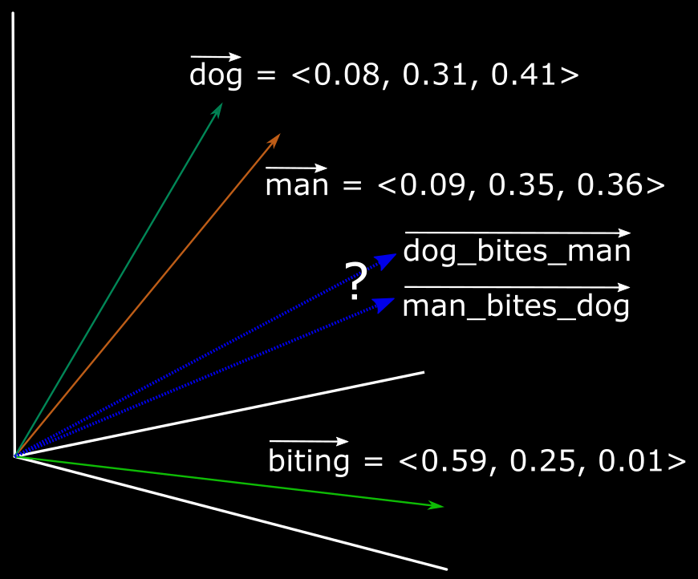
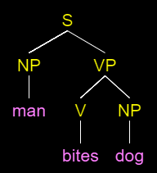

Compositionality
How to represent an entire sentence or phrase?
Compositionality: method for combining word representations together to construct a sentence representation.
Bite(DOG,MAN)
Bite(MAN,DOG)

Slide 5
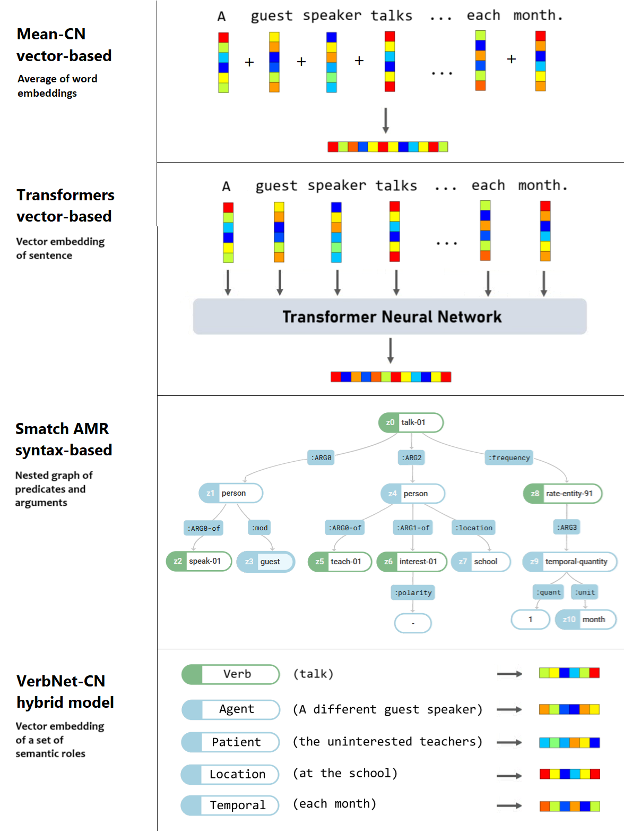
Ways to Represent Sentences
Many proposals for how to form sentence representations.
Example sentence: “A different guest speaker talks to the uninterested teachers at the school each month.”
Four basic classes:
  Simple word-averaging models.
  Connectionist/vector-based.
  Parse trees/syntax-based.
  Hybrid models.

Slide 6
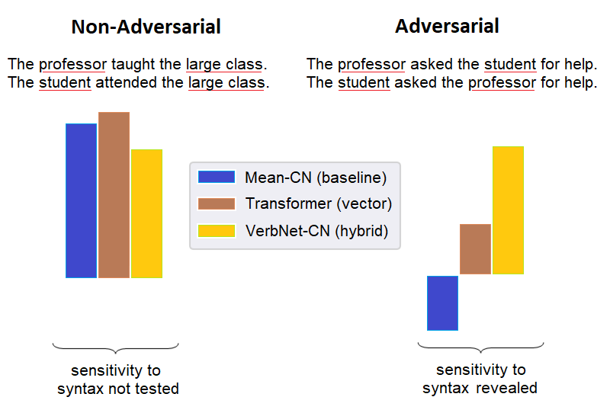
Lexical Interchange Approach
Sentences with different words have different meanings.
How to distinguish lexical from structural/compositional differences?
Easy
Hard

Slide 7
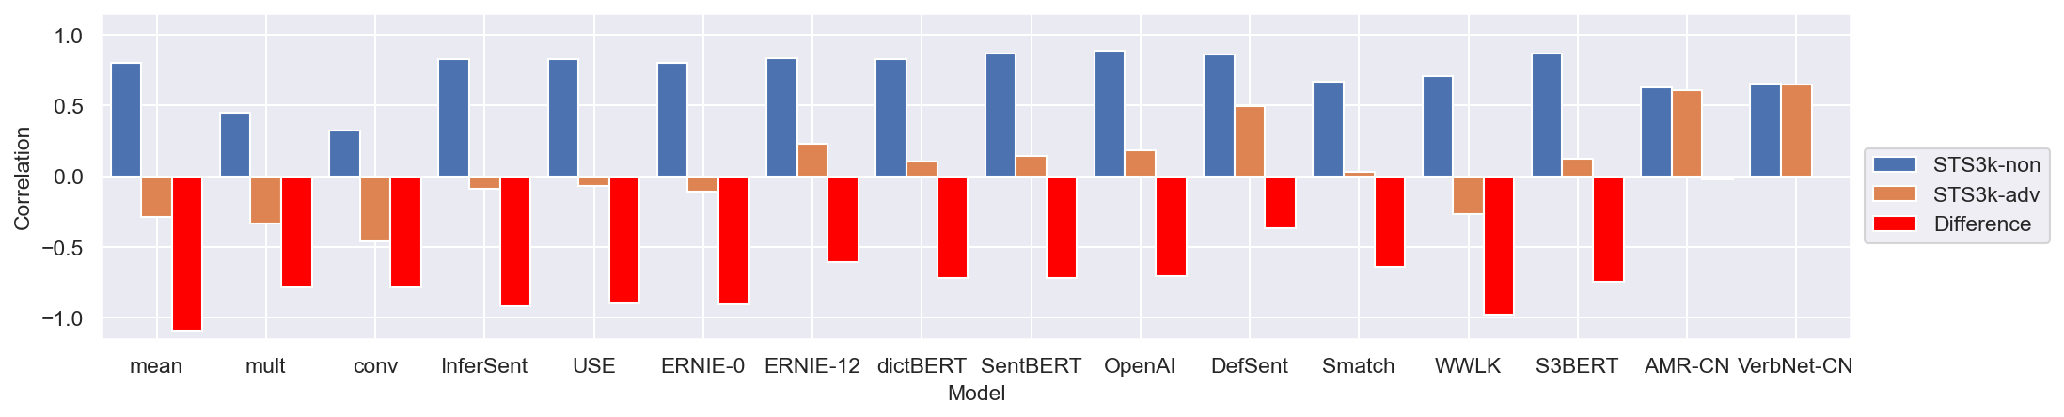
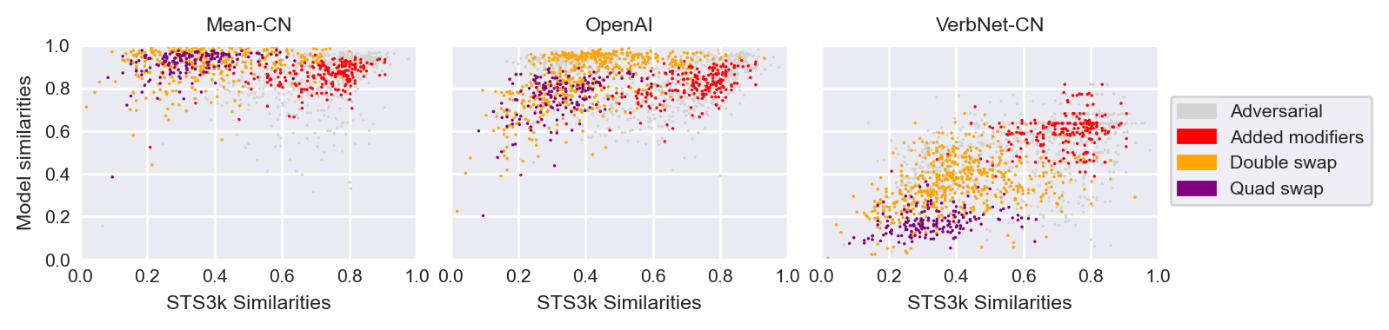
Results from STS3k Behavioural Dataset
Most models do fine with ‘easy’ sentences but fail with ‘hard’ ones.
How to distinguish lexical from structural/compositional differences?

Slide 8
Study 1

Slide 9
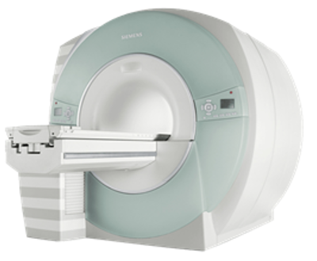
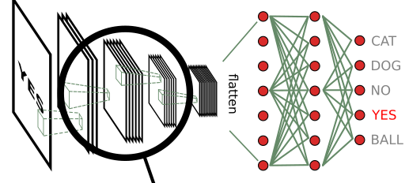
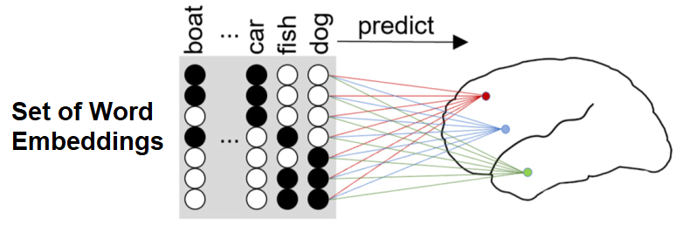
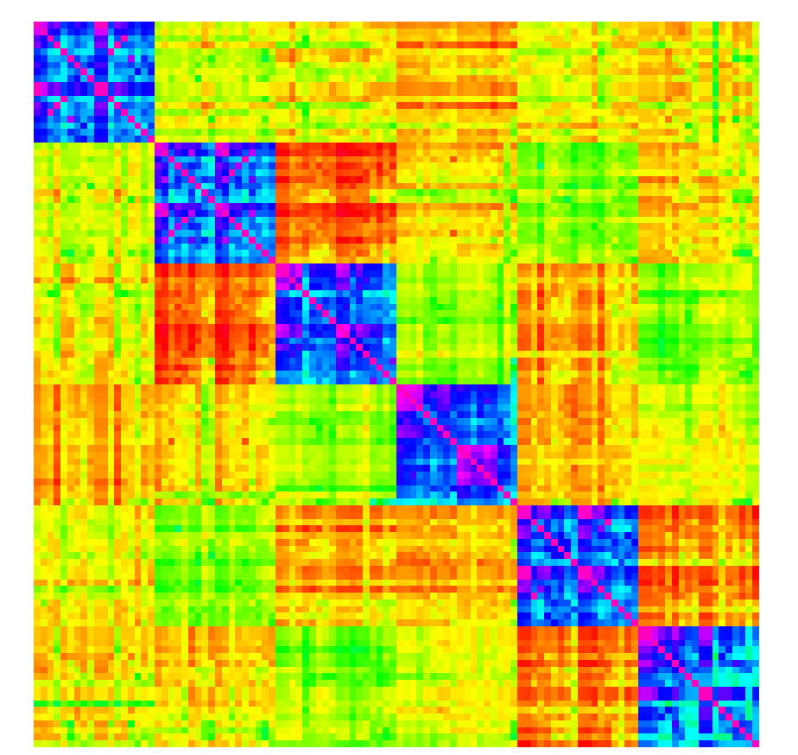
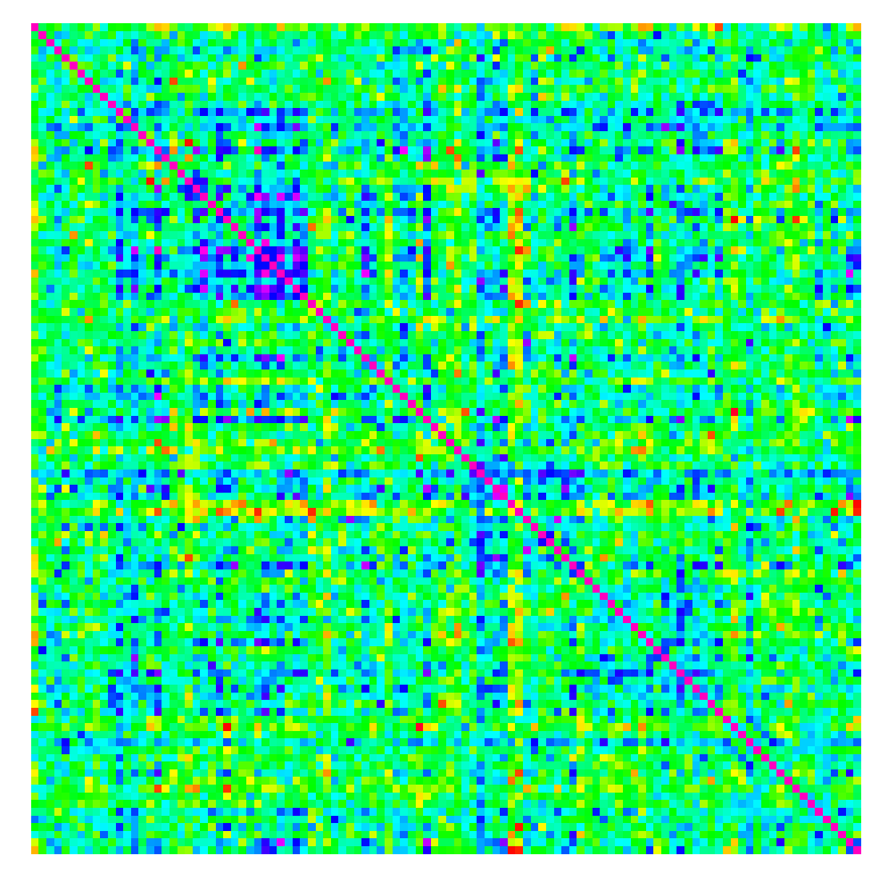
VEM vs RSA
Present written sentences while participant is in the scanner.
Compare brain activity to predictions of different sentence models.
Fit linear model for each voxel
Compute similarities from fMRI voxel data
Compute similarities from model representations
Compute correlation
Model RSM
Brain RSM

Slide 10
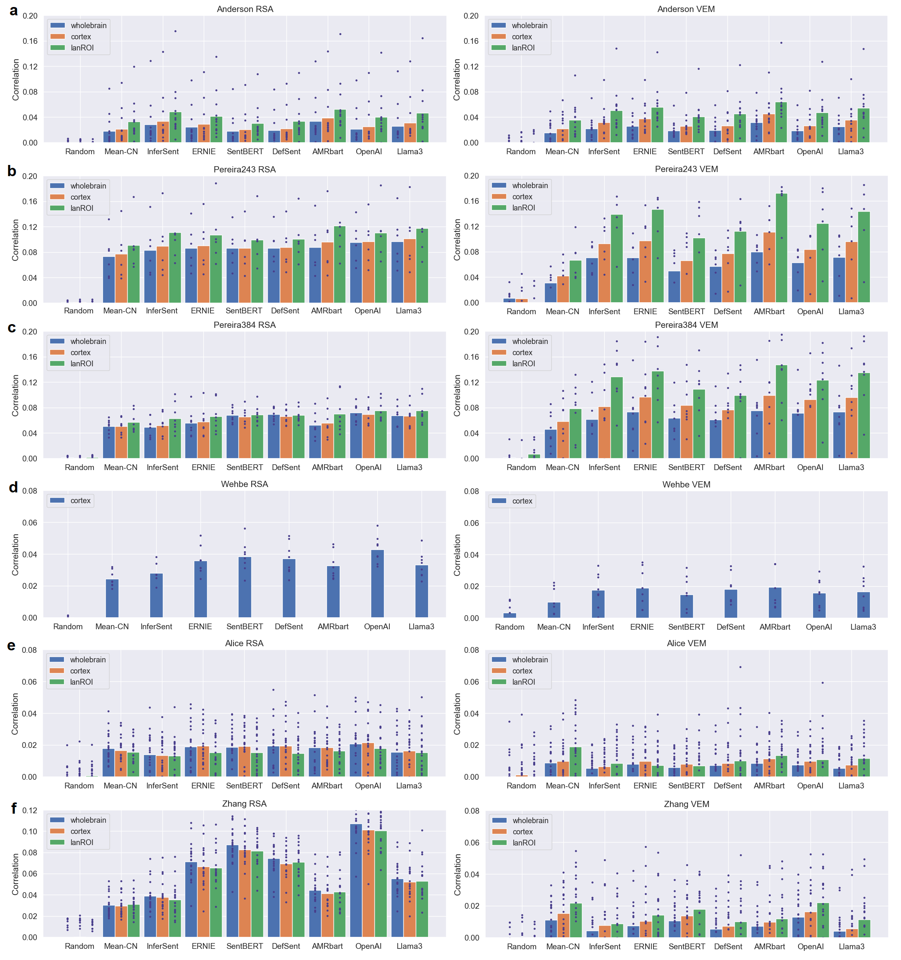
Results from Existing Datasets 1
Existing fMRI language datasets show a lexical confound.
This means we can’t infer much about how the brain does composition.

Slide 11
Results from Existing Datasets 2
Existing fMRI language datasets show a lexical confound.
This means we can’t infer much about how the brain does composition.

Slide 12
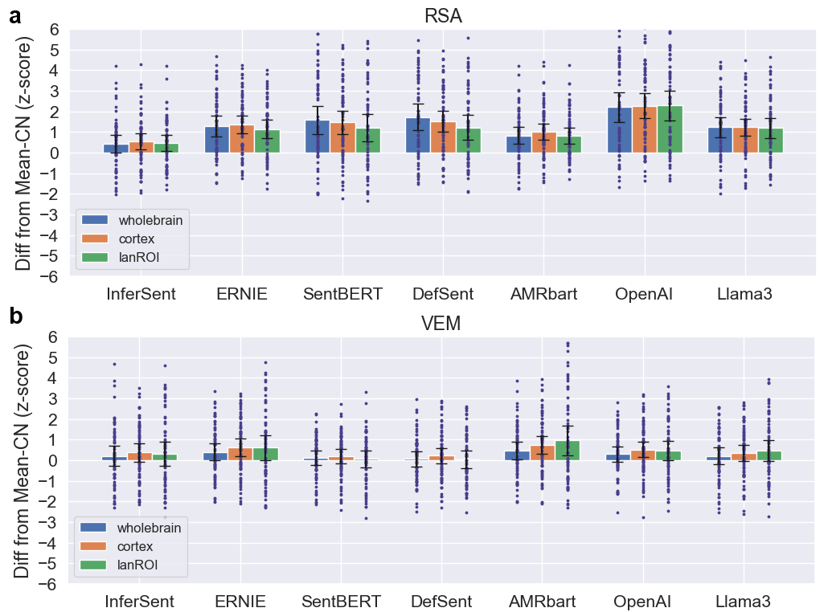
Results from Existing Datasets 3
Existing fMRI language datasets show a lexical confound.
This means we can’t infer much about how the brain does composition.

Slide 13
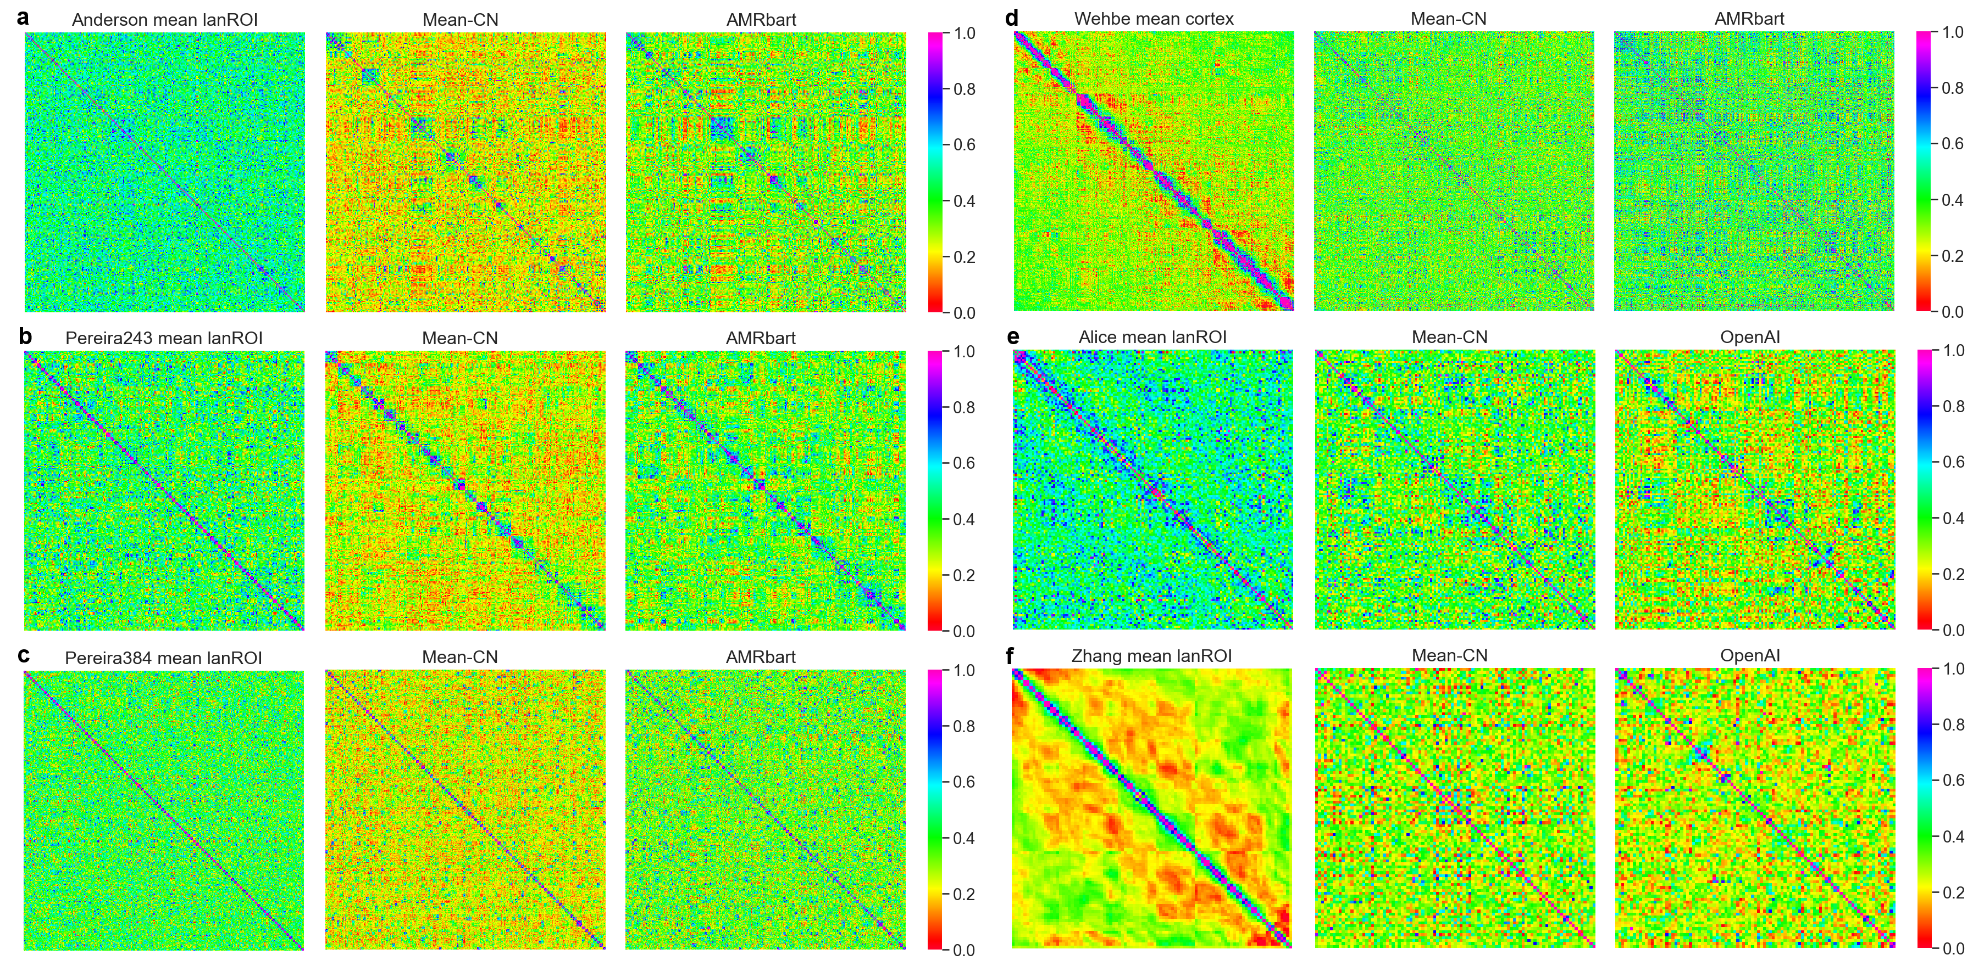
RSA for All Six Datasets
Existing fMRI language datasets show a lexical confound.
This means we can’t infer much about how the brain does composition.

Slide 14
Preliminary Conclusions
Transformer embeddings better capture brain representations than static word embeddings, but the difference is modest and inconsistent.
Existing datasets are not well suited to assessing compositionality owing to lexical and other confounds.

Slide 15
Study 2

Slide 16
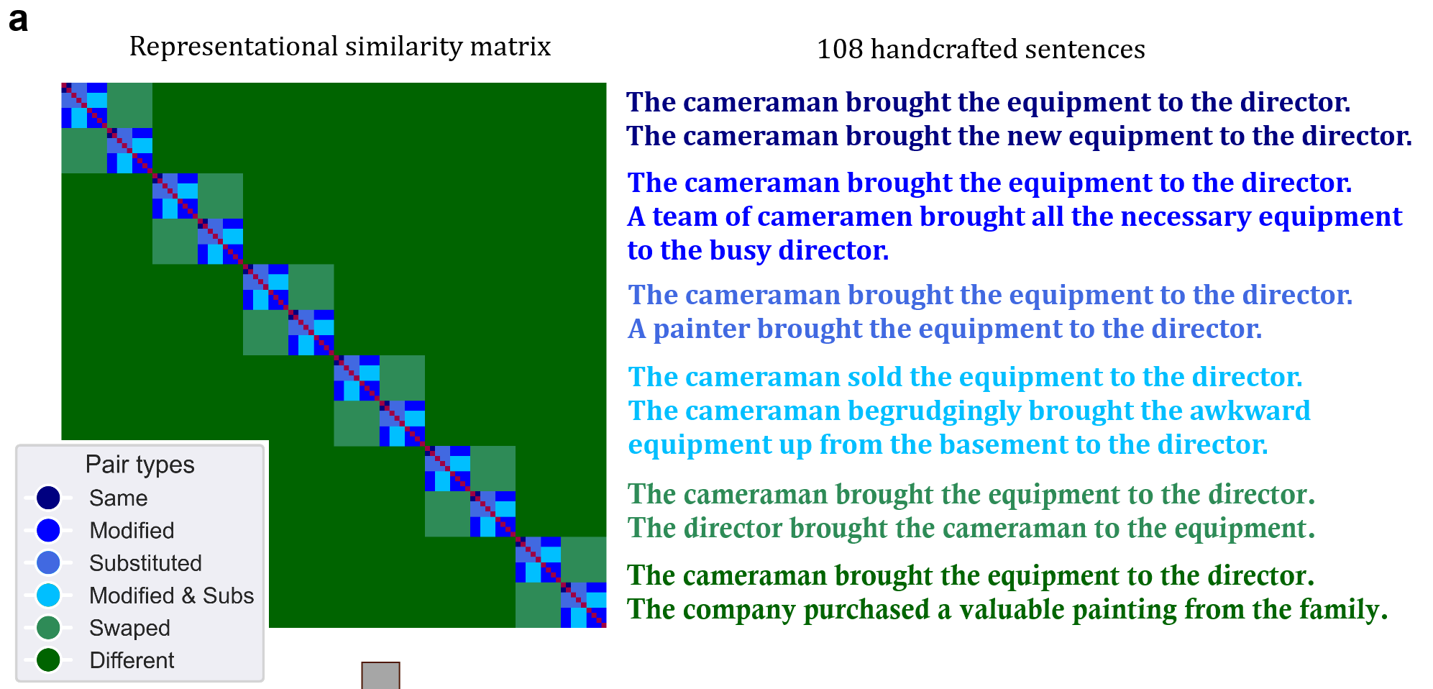
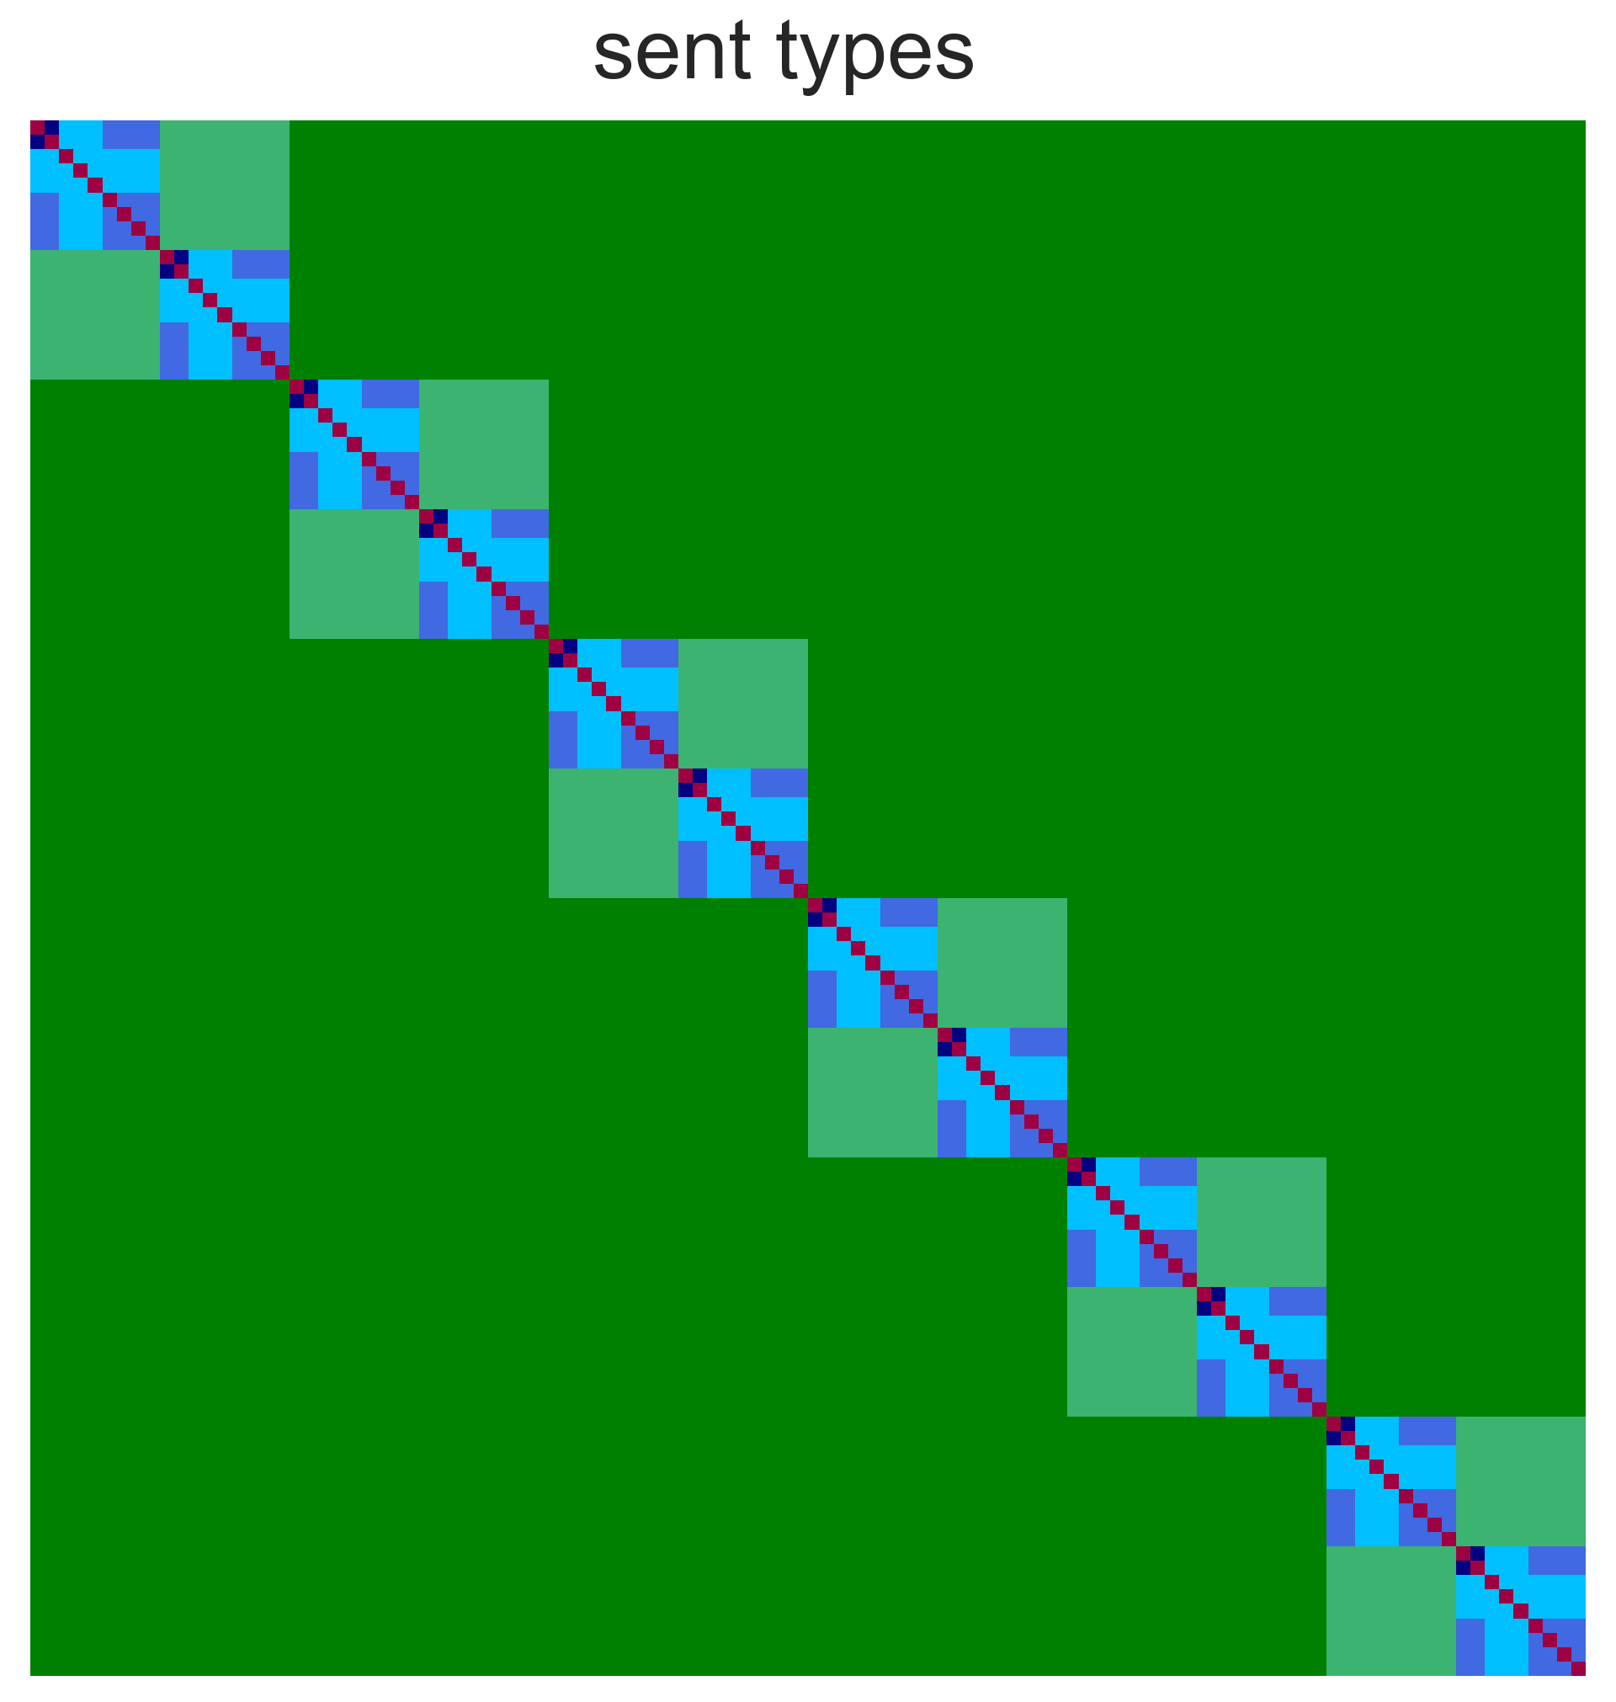
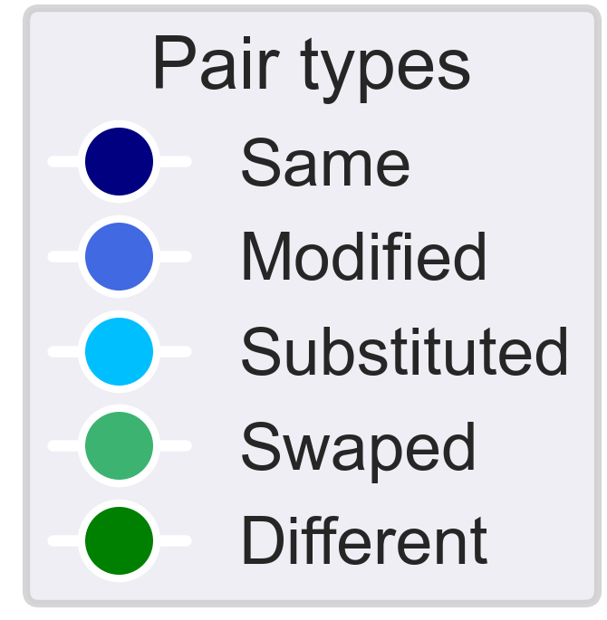
The Fodor2024-108 Dataset
Systematically vary sentence structure to achieve model discrimination.
RSA matrix: each element is the similarity value for one sentence pair.
The cameraman brought the equipment to the director.
The director brought the cameraman to the equipment.
The cameraman brought the equipment to the director.
The company purchased a valuable painting from the family.
(RSA matrix: each element is the similarity value [0-1] for one sentence pair)
The cameraman brought the equipment to the director.
The cameraman brought the new equipment to the director.
The cameraman brought the equipment to the director.
A team of cameramen brought all the necessary equipment to the busy director.
The cameraman brought the equipment to the director.
A painter brought the equipment to the director.
The cameraman brought the equipment to the director.
The director brought the cameraman to the equipment.
The cameraman brought the equipment to the director.
The company purchased a valuable painting from the family.
The new sentences shows better model discrimination due to varying sentence structure.

Slide 17
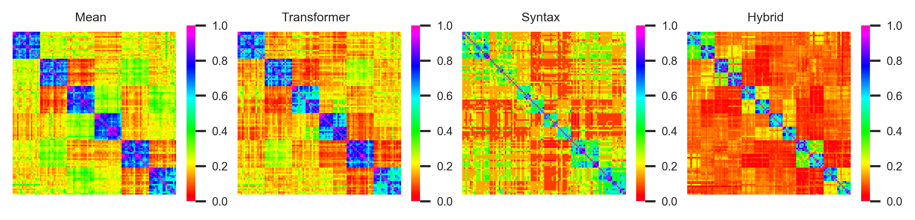
Model RSA Matrices
Clear block-diagonals structure visible.
Coverage from dissimilar to very similar sentences.
Able to distinguish between models.

Slide 18
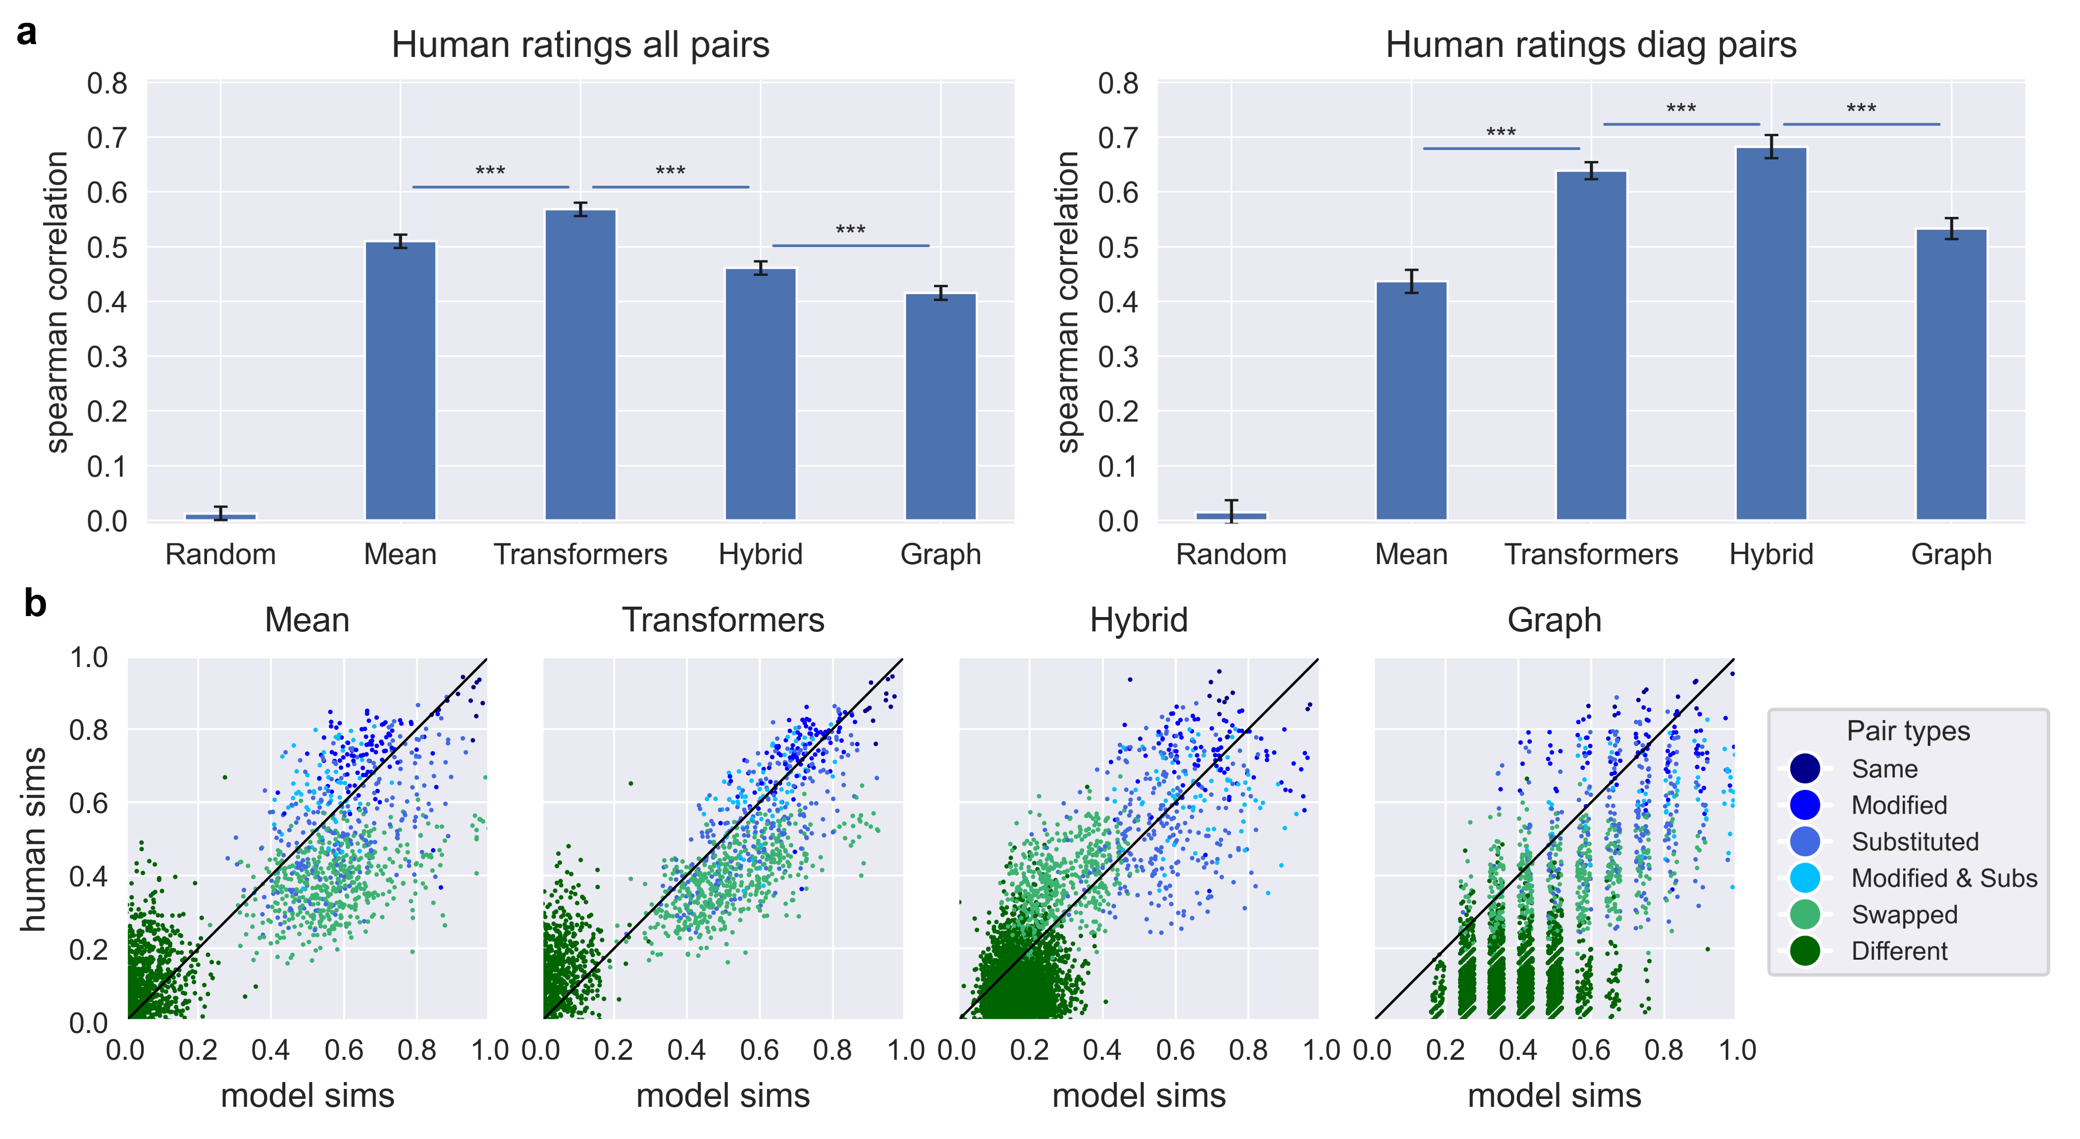
Behavioural Ratings

Slide 19
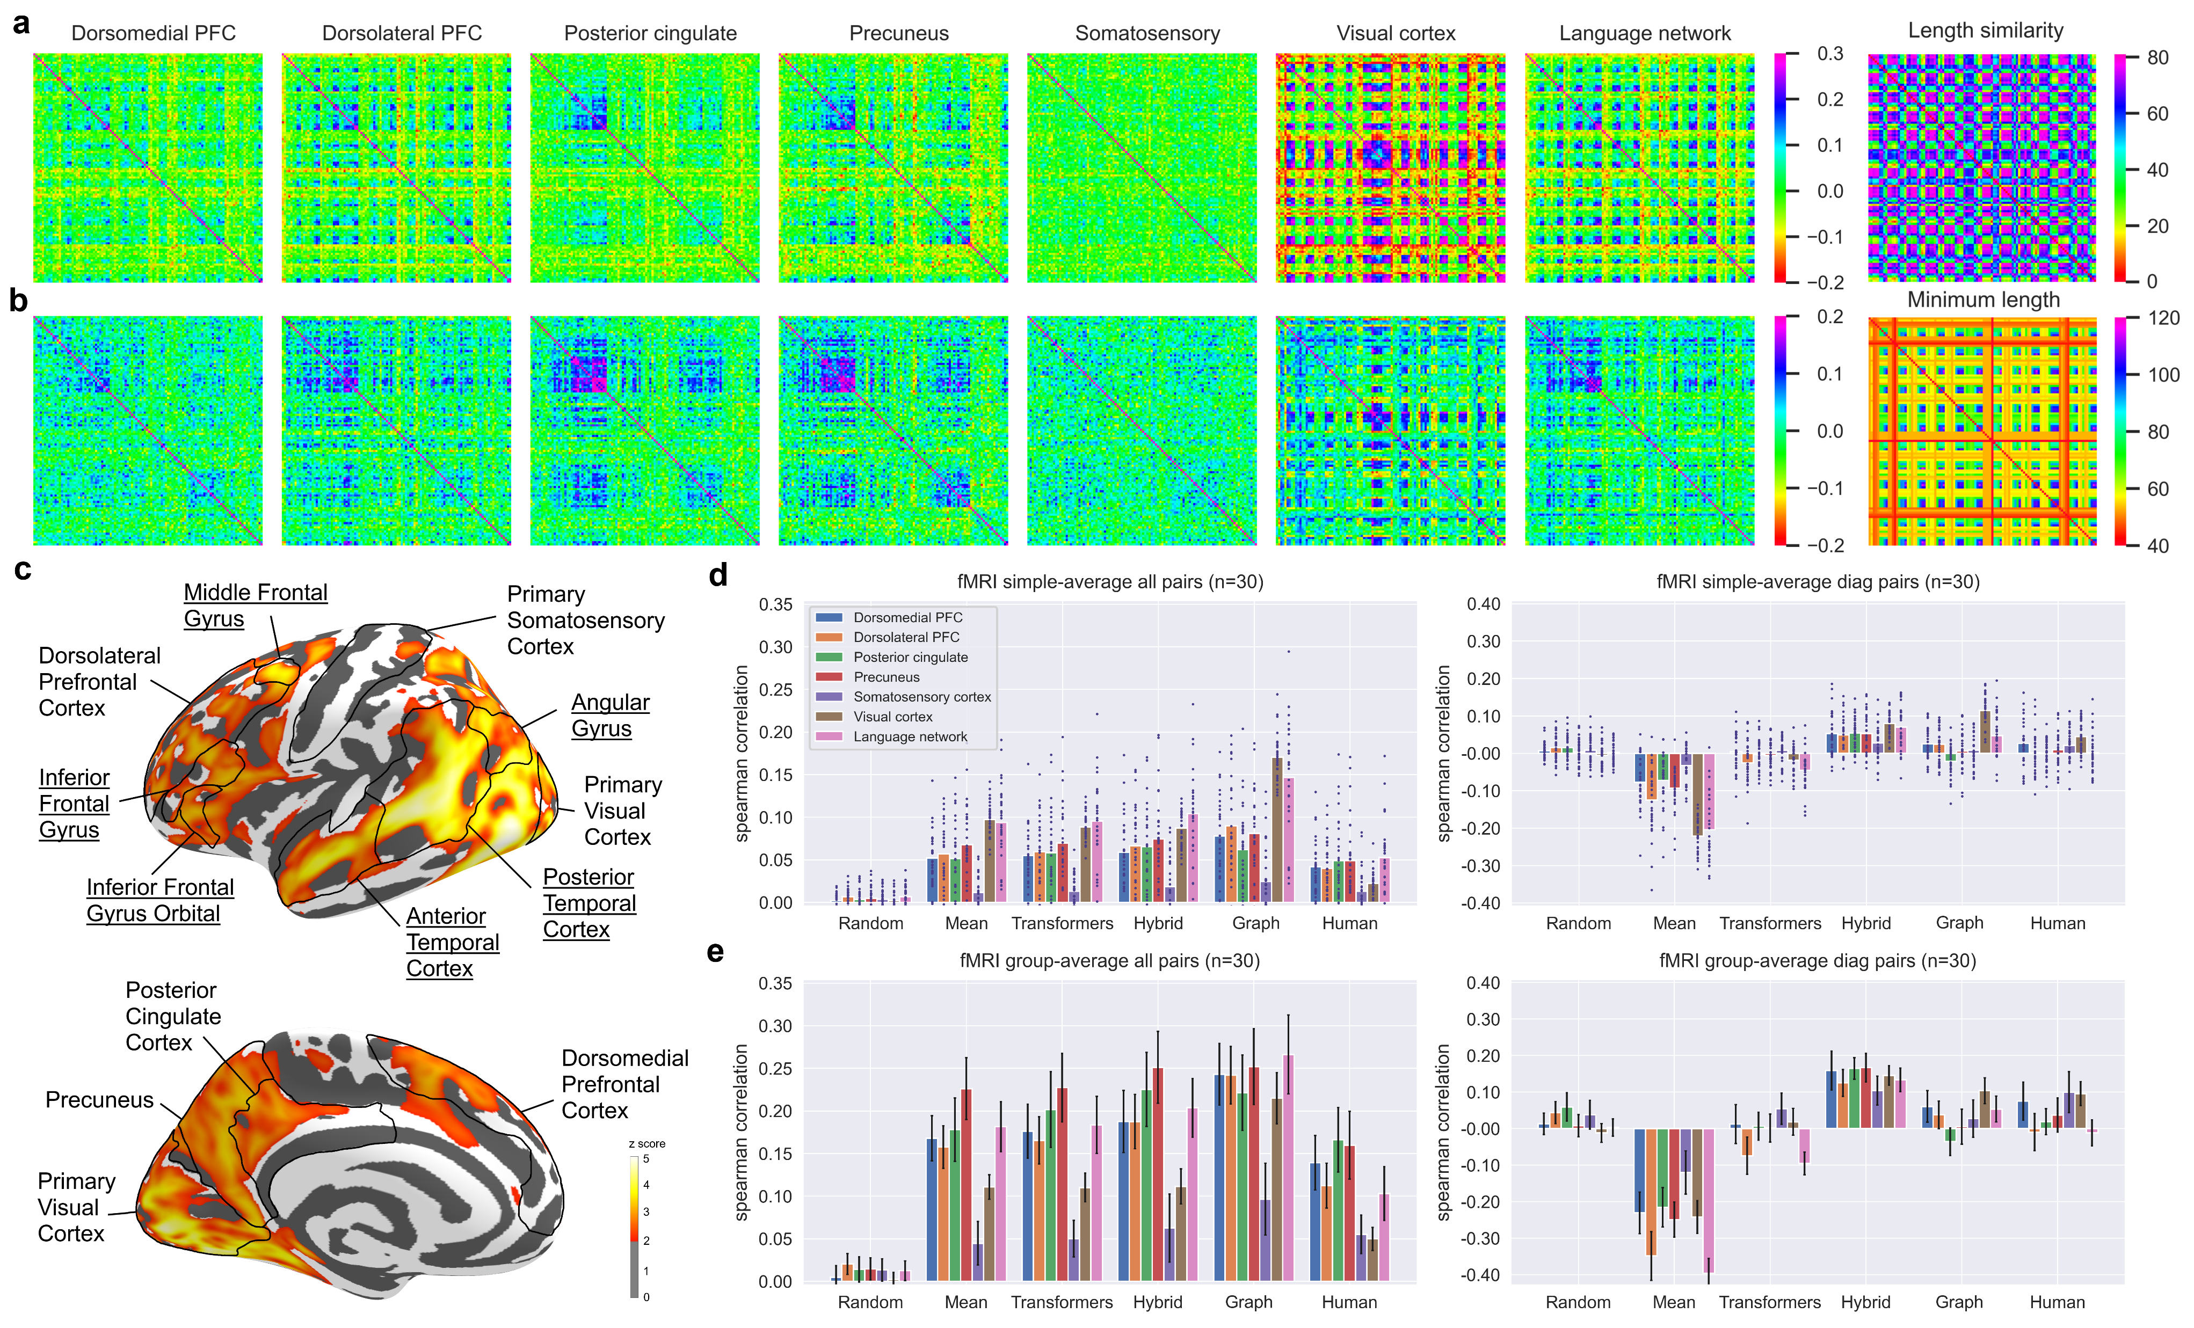
Brain RSA Matrices
Block structure (noisily) visible.
Different regions show different patterns of representation.
‘Minimum length’ effect observed.

Slide 20
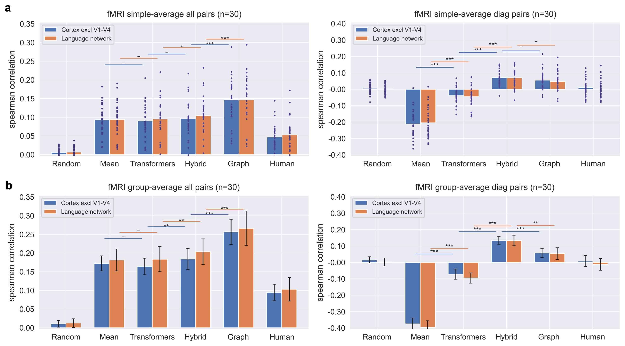
Model vs Brain Correlations

Slide 21
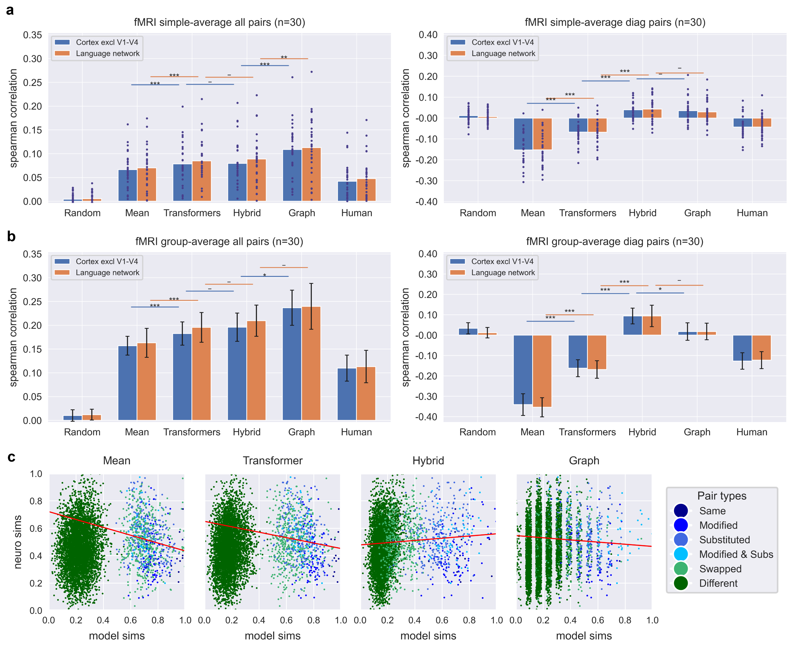
Model vs Brain Correlations

Slide 22

Model vs Brain Correlations
Relative similarities of ‘swapped’ and ‘modified’ pairs leads to model differences.
Warning: regression lines only indicative!

Slide 23
Regions of Activation
Cortical surface map shows regions that correlate with model representations.
Named areas show regions in language network.

Slide 24
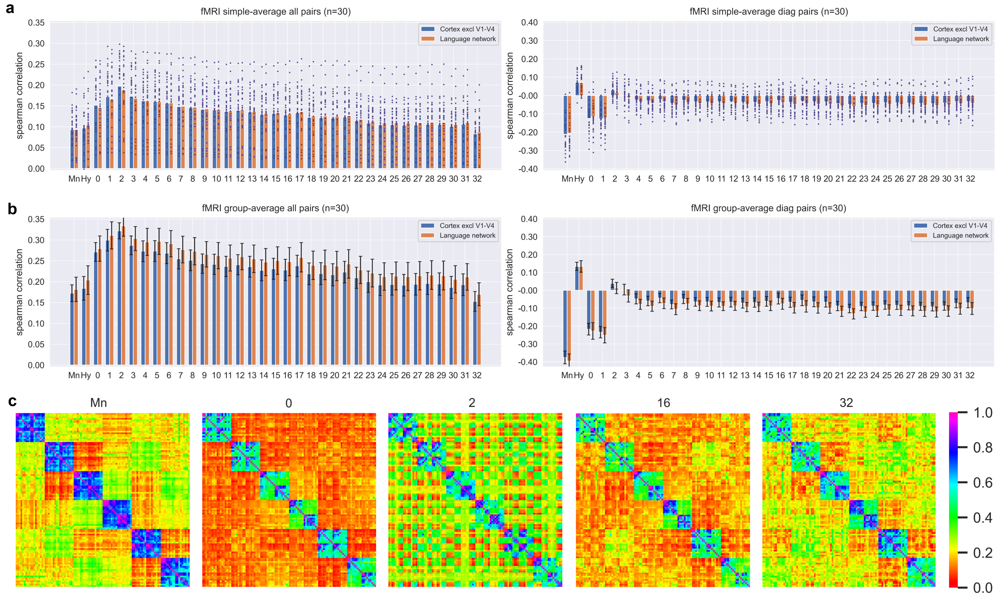
Llama Layerwise Analysis

Slide 25
Discussion

Slide 26
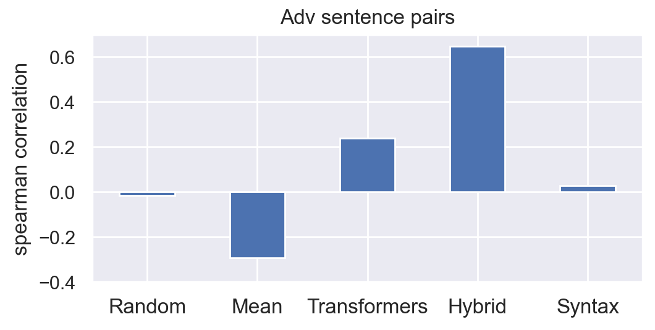
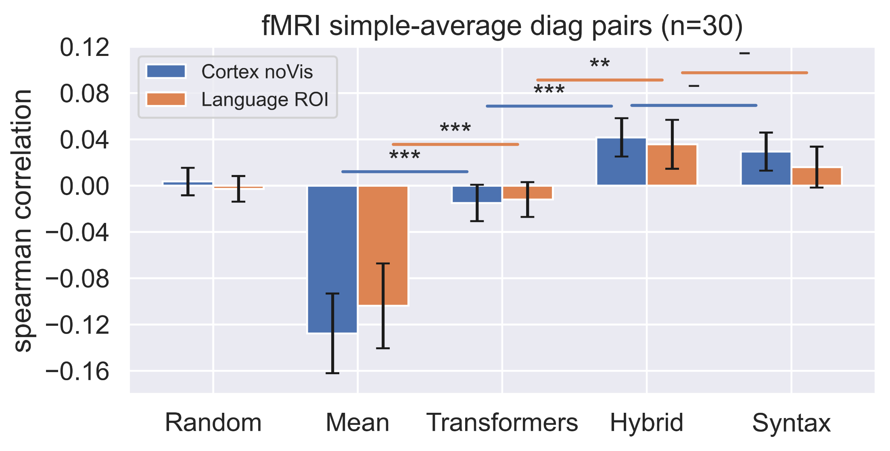
Interpreting Results
Behavioural and fMRI results both highlight the importance of sentence structure for semantic representation and processing.
The mean model consistently performs worst on difficult pairs of sentences.
Transformer representations are better than the mean model but still inferior to the hybrid model.
LLMs have access to all necessary information, but do not seem to combine it to form human-like semantic representations.
May explain why LLMs do well at many language tasks but can fail in unexpected ways, especially when making generalisations.

Slide 27
Next Steps
Investigate more sophisticated hybrid models.
Extend approach to a wider range of sentence types.
Expand analysis to additional fMRI datasets.

Slide 28
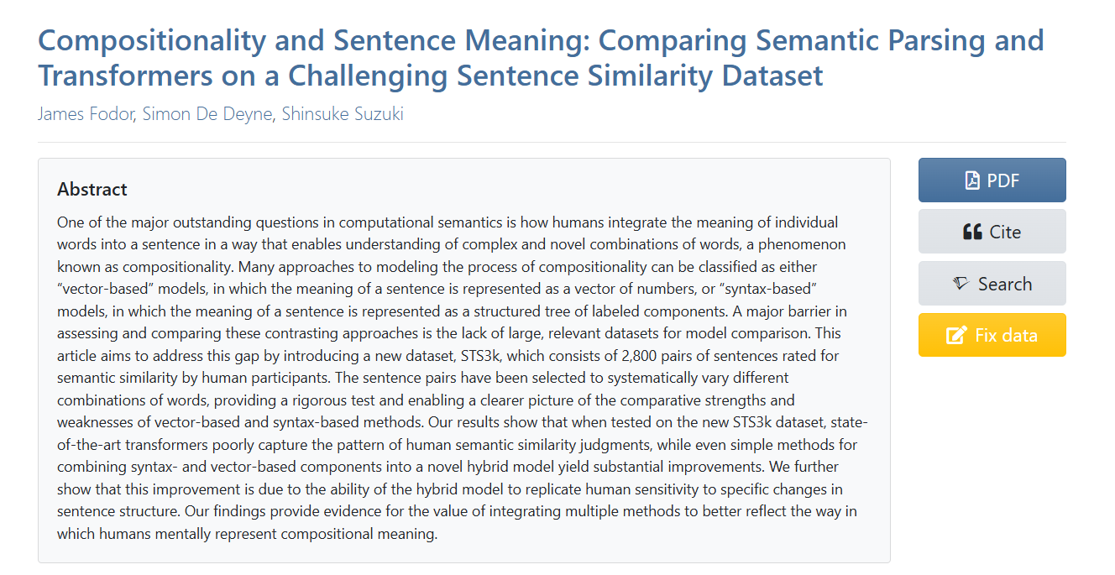
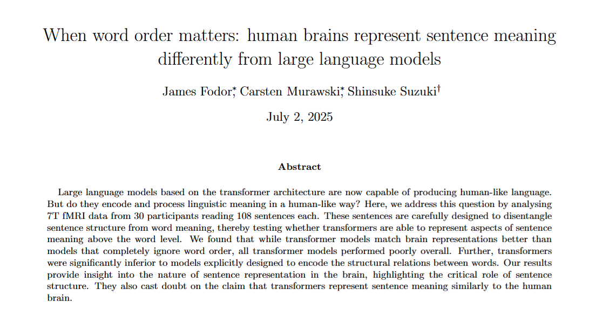
Papers

Slide 29
Questions?

Slide 30
Transformers Analysed
Mean-ConceptNet (Mean-CN) | Average of token-wise ConceptNet embeddings after pre-processing to remove non-content words.
InferSent | Bi-directional LSTM trained on a variety of natural language inference tasks. Sentence encoder.
ERNIE 2.0 | Transformer based on the BERT architecture. Average of tokens in final layer.
SentBERT-mpnet | Based on the mpnet-base transformer model, with additional training to predict paired sentences from a large dataset. Sentence encoder.
DefSent | Based on RoBERTa-large transformer model fine-tuned using about 100,000 words paired with their dictionary definitions. Sentence encoder.
AMRbart | Transformer specially trained on parsing AMR graphs. Sentence encoder.
OpenAI Ada embeddings | Embeddings from the OpenAI API, derived from GPT 3 architecture with additional fine-tuning from human feedback. Sentence encoder.
Llama 3.0 8B | A decoder-only transformer architecture trained using multi-task learning, with fine-tuning from human feedback. Average of tokens in final layer.

Slide 31
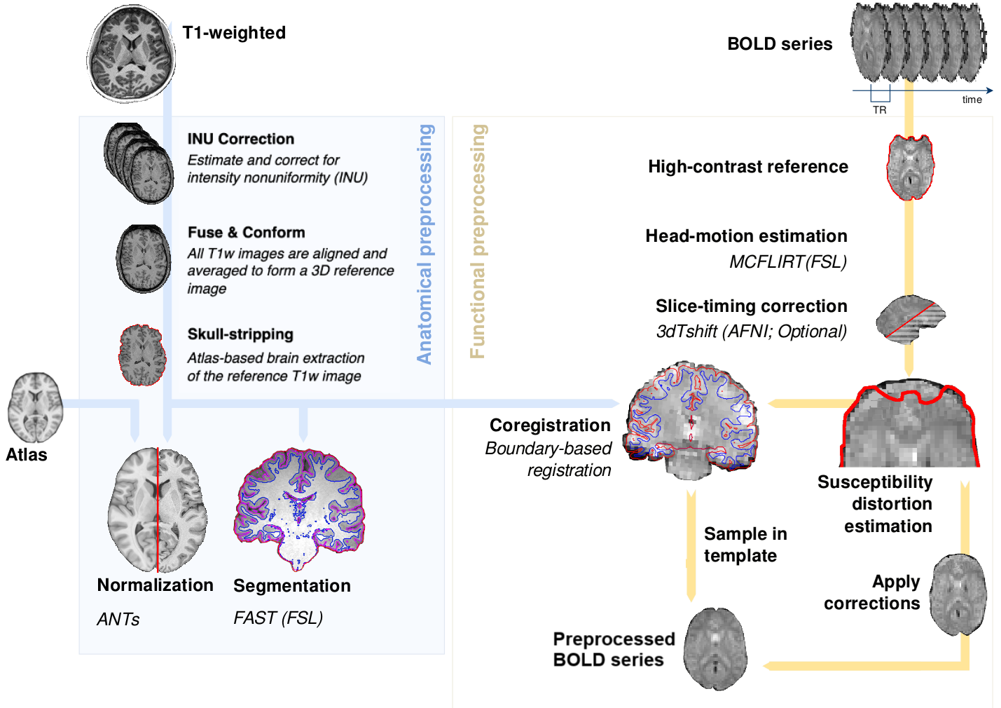
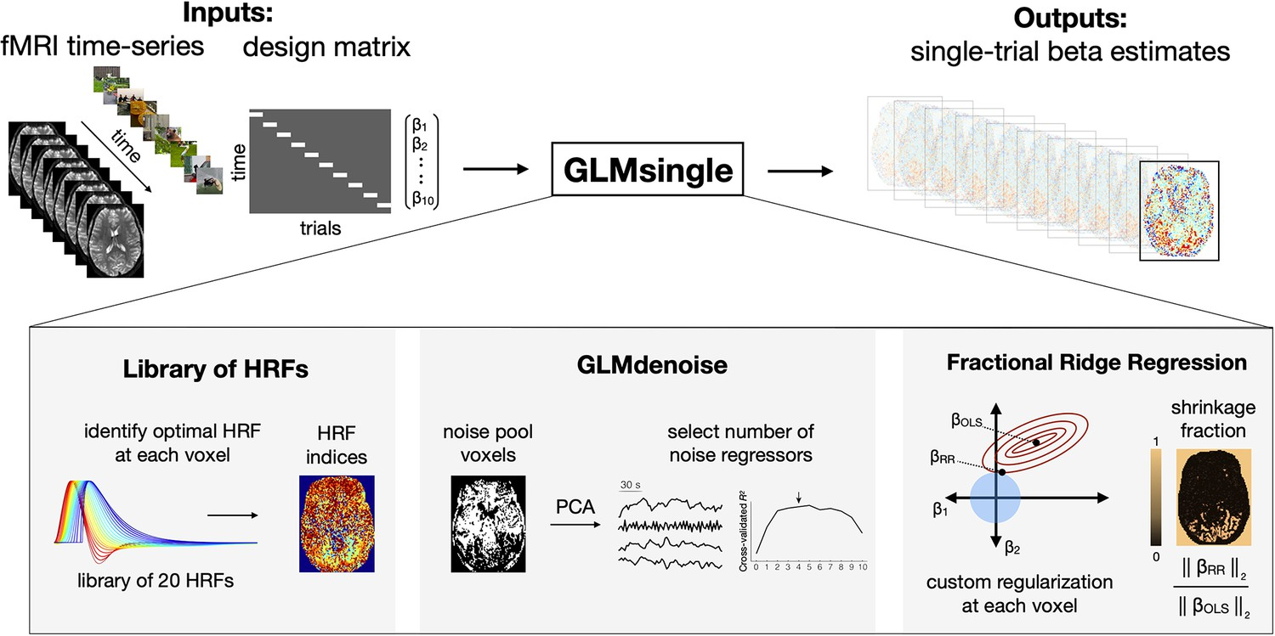
fMRI Preprocessing and GLM
Each sentence shown four times over 8 runs.
Preprocessing done using fMRIprep.
Beta coefficients for each sentence estimated using GLMSingle.
Voxels were selected using ROI and stability score (correlation over repeats).

Slide 32
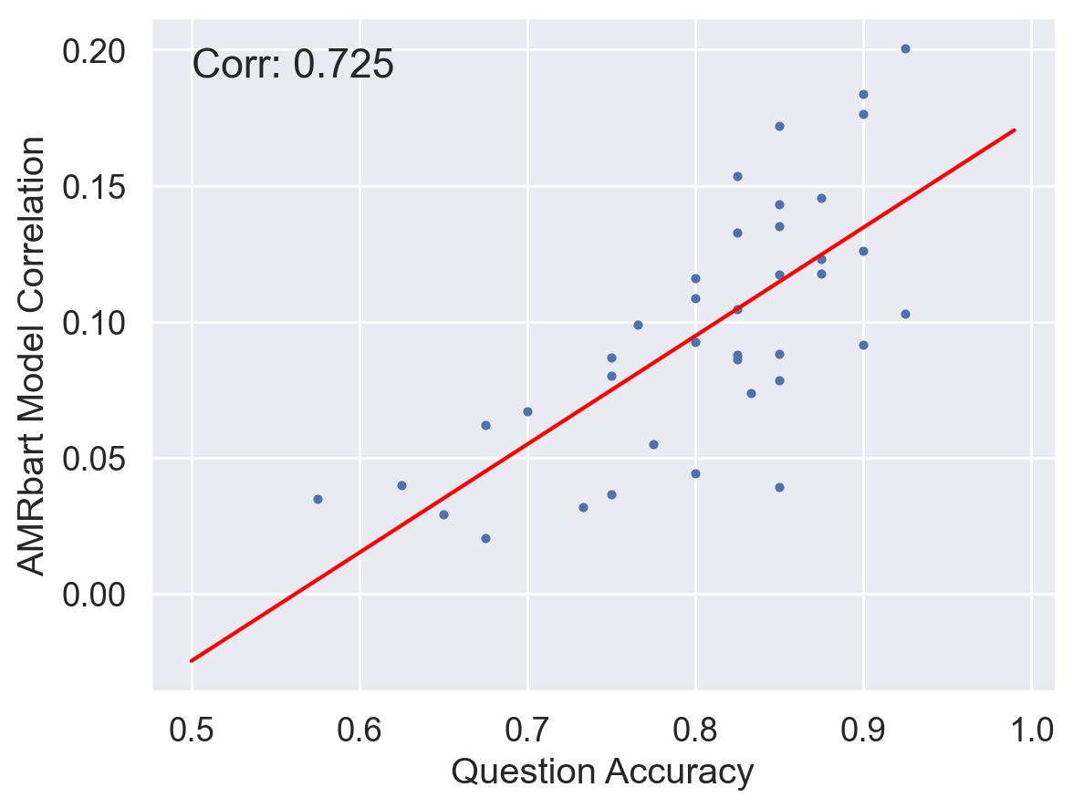
Participant Quality
Attention matters!

