Slide 1


The Language Network and Object Categorisation
James Fodor
30th July 2024

Slide 2
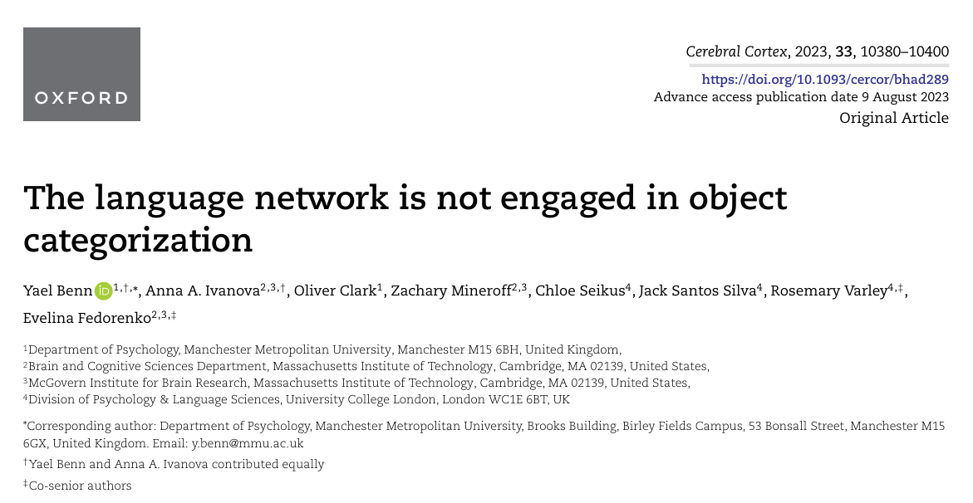
Background
Paper for Today

Slide 3
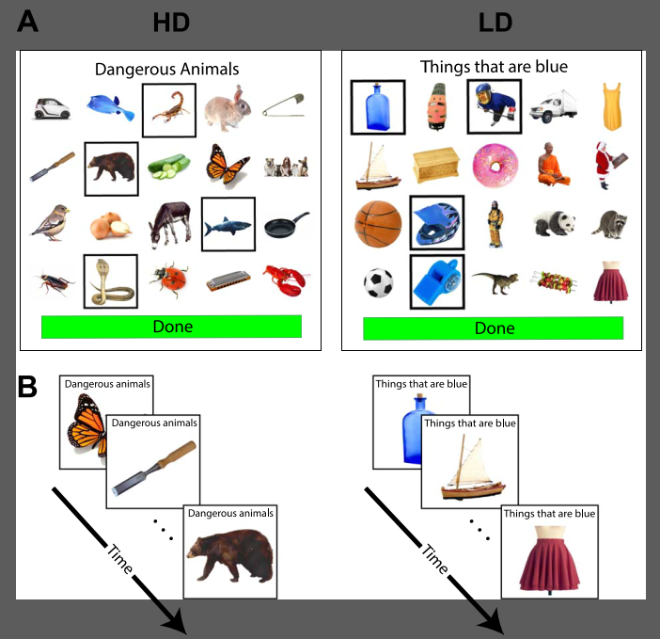
Paper for Today
“High-dimensional” (HD): members share many features.
“Low-dimensional” (LD): members share few few features.
Claim: “language plays a special role in LD categorization… only one to two features are relevant to the task, whereas the rest of the features interfere and have to be inhibited… a verbal label can help maintain focus on the relevant criterion and reduce interference.” (p. 10381)
Experiment: test whether LD-selective categorization impairment holds in a sample of individuals with severe anomia.

Slide 4

Next Steps
BNT is the Boston Naming Test, a behavioural test based on giving the names of line drawings.
Poor performance indicates problems with lexical access. This can be due to problems with lexical representations or problems with retrieval (or both).
“Based on Study 2, we therefore concluded that lexical retrieval is not necessary for successful categorization, including categorization based on single features.” (page 10395)

Slide 5
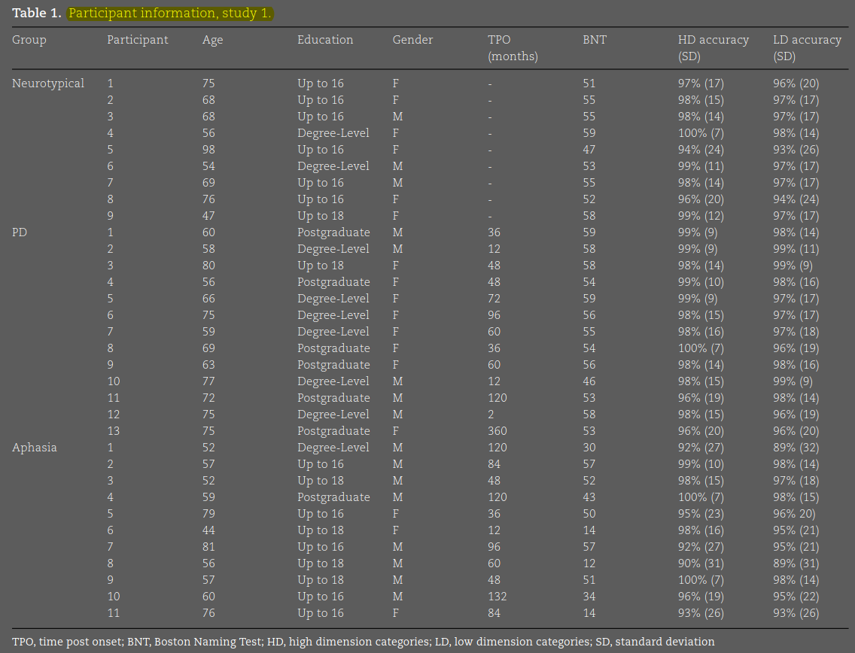
Results: Study 1

Slide 6
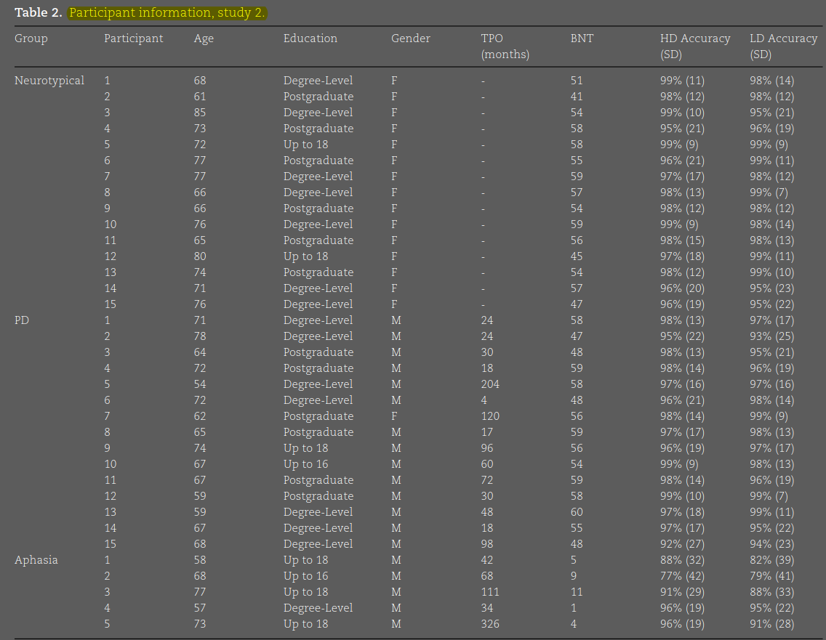
Results: Study 2

Slide 7
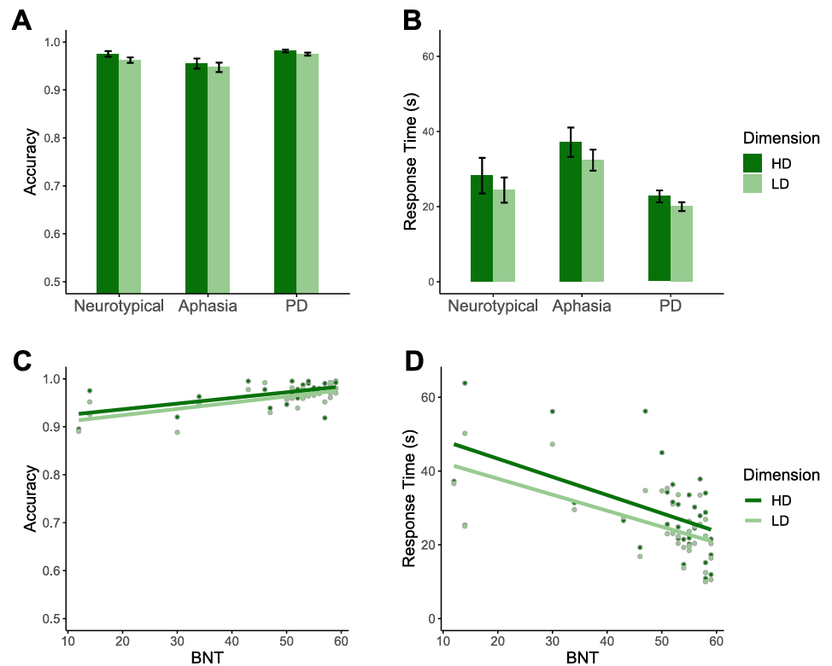
Results: Study 1

Slide 8
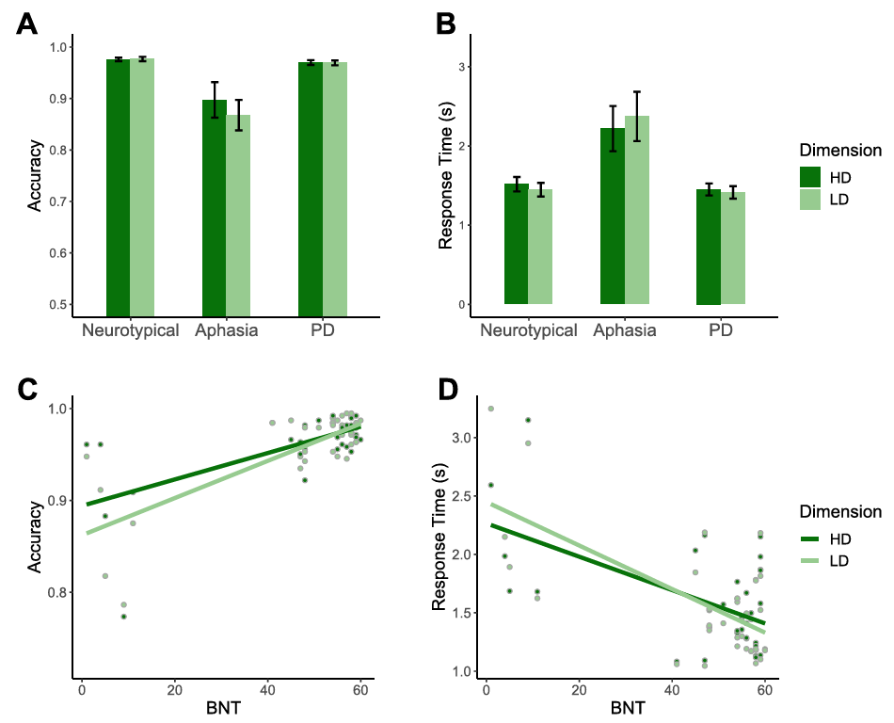
Results: Study 2

Slide 9
Interpretation of Aphasia Results
“Based on Study 2, we therefore concluded that lexical retrieval is not necessary for successful categorization, including categorization based on single features.” (page 10395)
This is a fair interpretation, but note that lexical retrieval is not the same as general language capability.

Slide 10
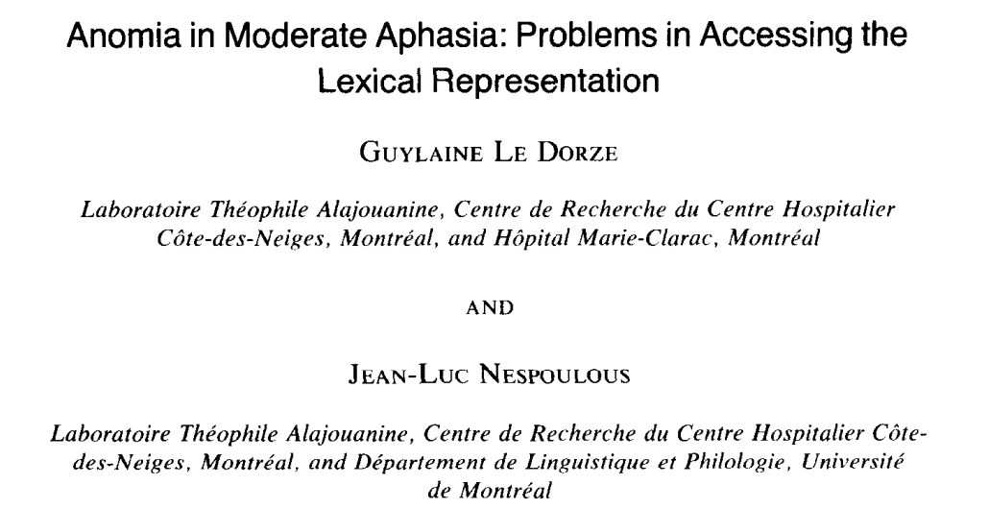
Next Steps
“All groups showed a good performance on the conceptual and the semantic subtests, suggesting preservation of high-level cognitive and semantic processes. In contrast, subjects evidenced poorer performances in syllabic identification, indicating a disruption of lower level mechanisms which are assumed to retrieve and process formal lexical representations. Results support the view that aphasic anomia originates from a difficulty in accessing the formal lexical representation and not from a semantic problem.”

Slide 11
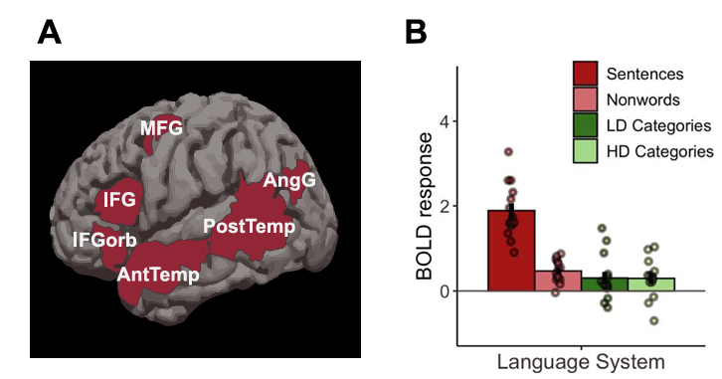
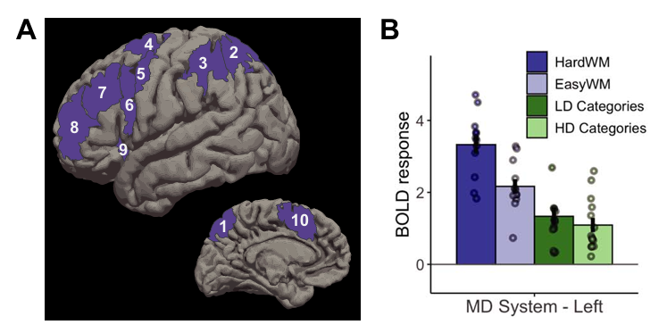
Results: Study 3
fMRI imaging of healthy participants reading sentences, nonwords, a working memory task, and performing categorisation task.
Found that the language network is much more responsive to sentences than the categorisation task.

Slide 12
Interpretation of fMRI Results
They define language as “meaningfully structured word sequences” (Language is primarily a tool for communication, 575)
“The language network exhibited low responses to both categorization tasks, which did not differ from activations elicited by reading of nonword sequences (a low-level control condition)…. Thus, we conclude that … the language network is not at all engaged in object categorization, highlighting a dissociation between linguistic processing and non-linguistic semantic cognition.” (page 10393)
“If access to linguistic representations were necessary for categorization, categorizing images would take longer than categorizing words; instead, they take approximately the same amount of time.” (page 10396)

Slide 13
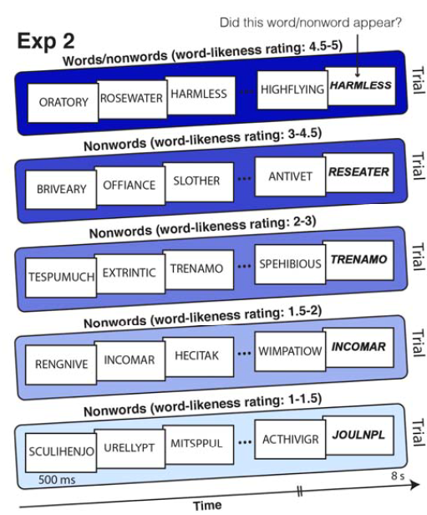
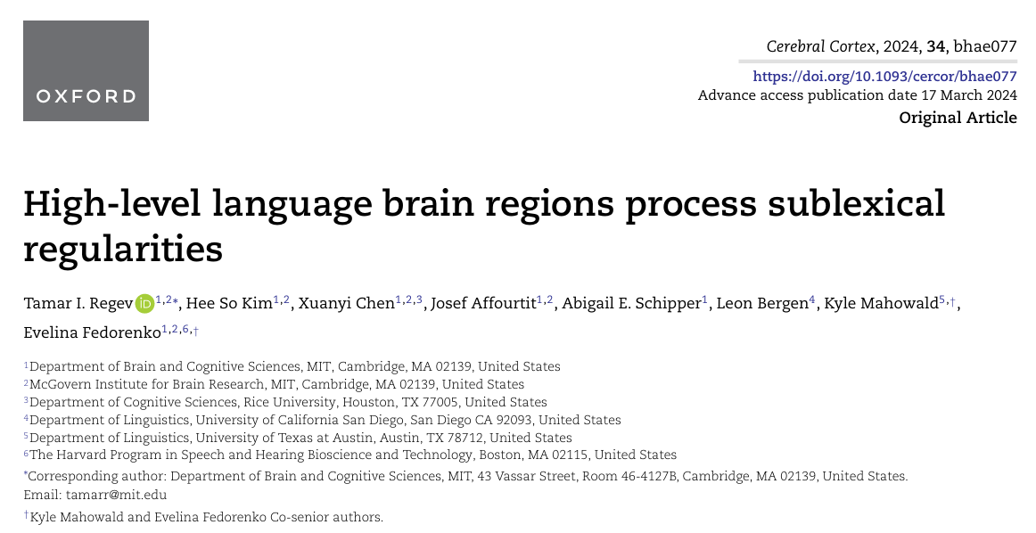
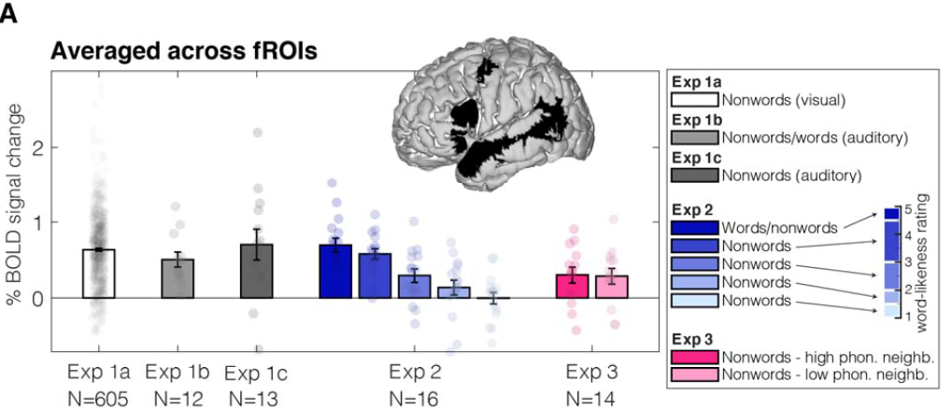
Additional Background
More word-like nonwords elicit higher activity.
Word-likeness determined by online participant rating.

Slide 14
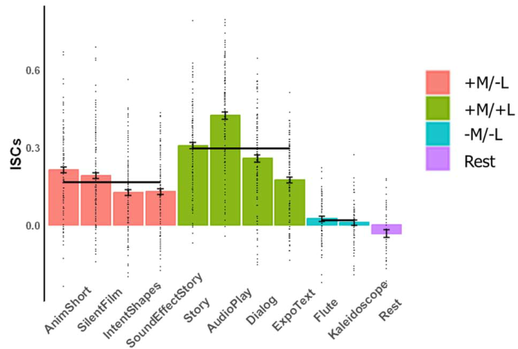
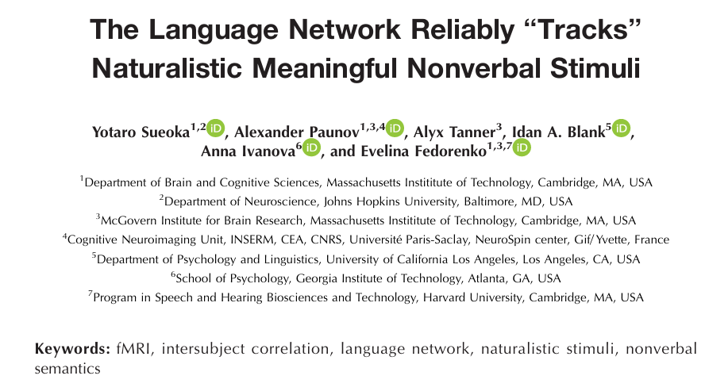
Additional Background
Non-linguistic but meaningful stimuli activate the language network.

Slide 15
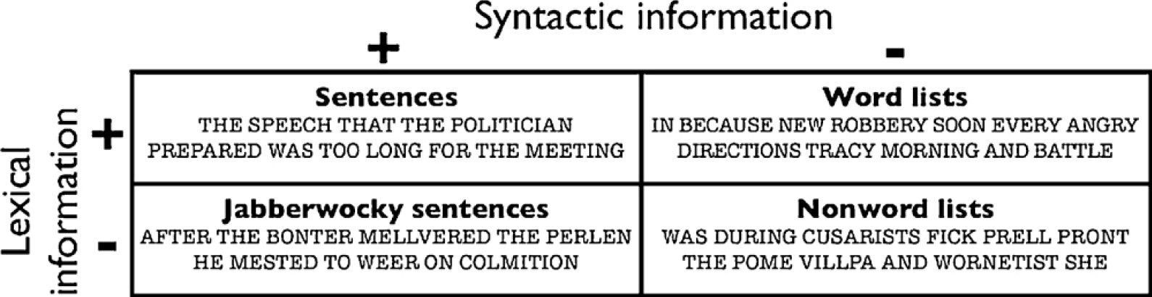
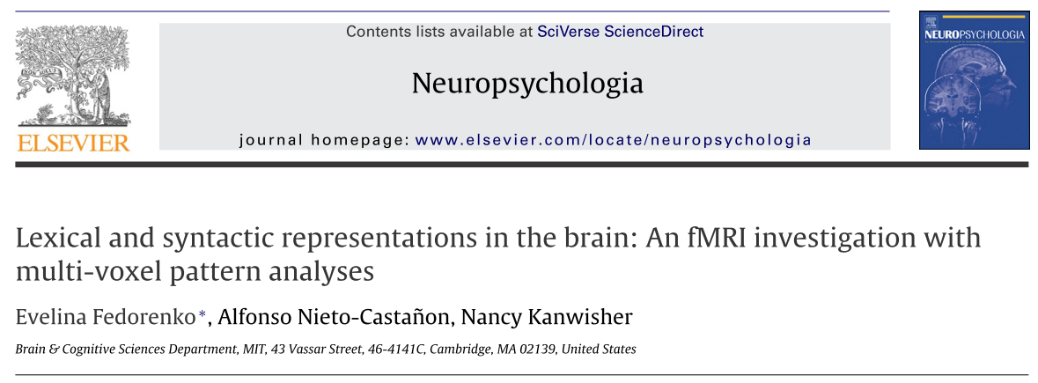
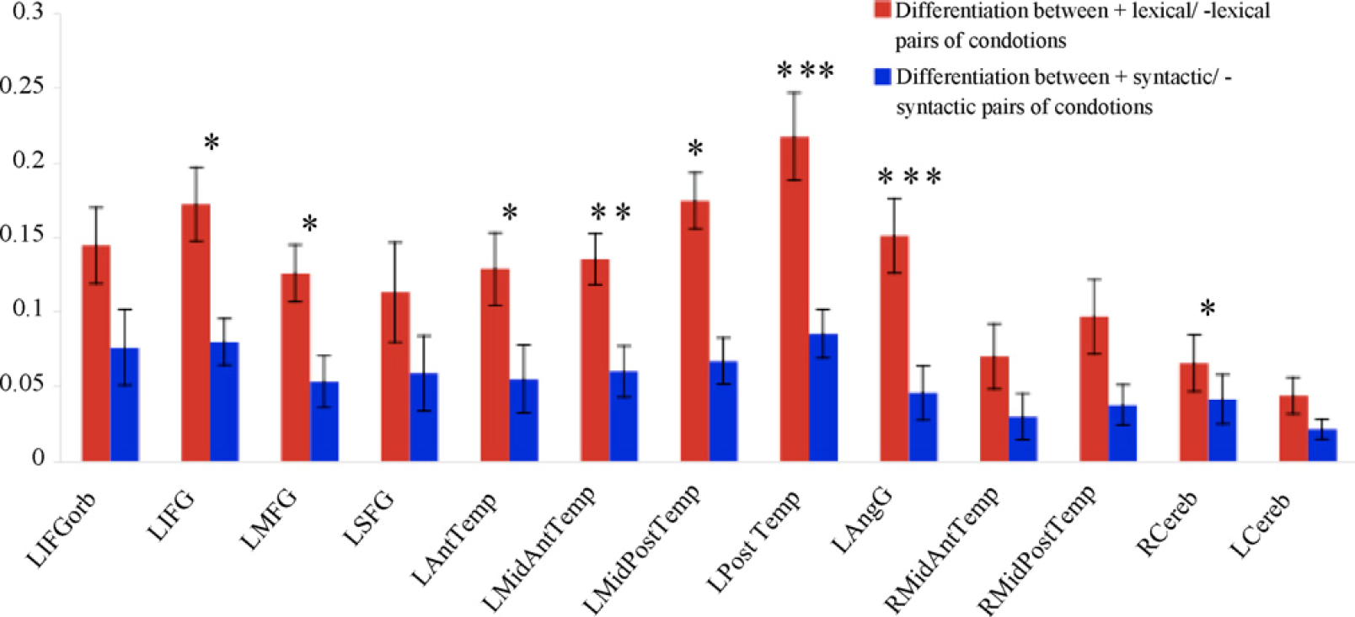
Additional Background
Syntax and semantics separately increase language network activation.

Slide 16
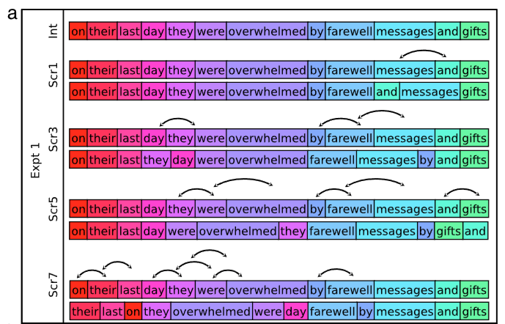
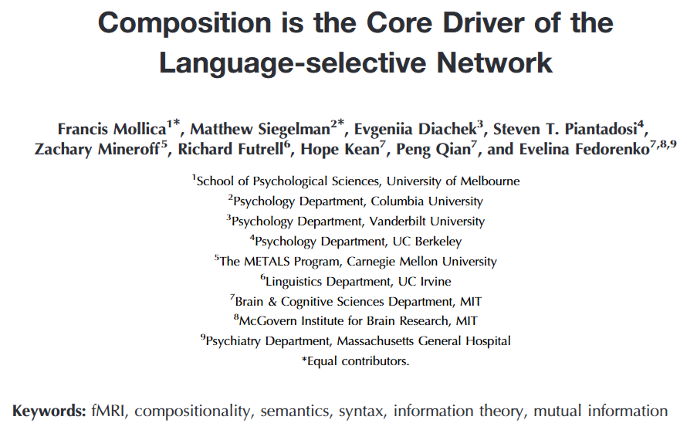
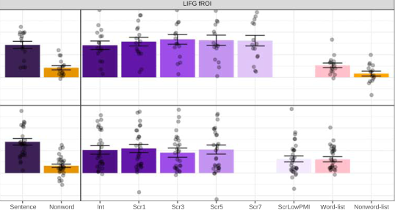
Additional Background
Syntax and semantics separately increase language network activation.

Slide 17
My Interpretation of Results
Aphasia results: on an easy task, severely anomic patients perform somewhat worse. This is consistent with modest language network involvement in the task.
fMRI results: on a superficial semantic task, healthy participants show small but non-zero activation of language network. This is expected given the non-linguistic stimuli.
Conclusion: all evidence points to graded response of language network to aspects of natural language. As such, a small but non-zero response to an easy semantic task is not evidence of non-engagement of the language network.

