Slide 1

Philosophy of Mind and Theism:
Cognitive Science and Immaterial Minds
James Fodor
27th March 2025

Slide 2
Introduction

Slide 3
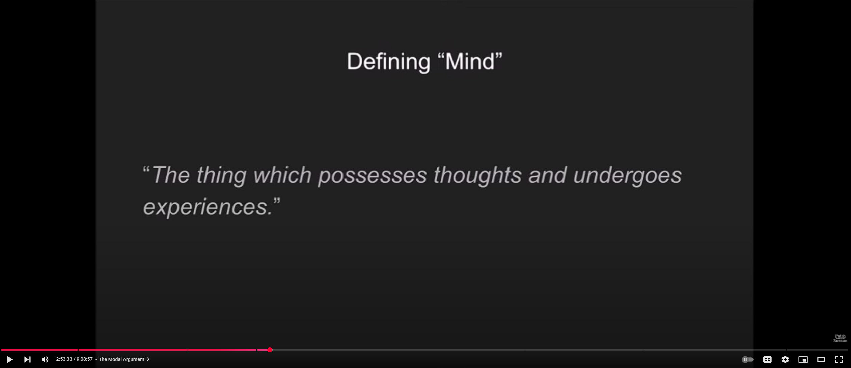
What is a Mind?

Slide 4
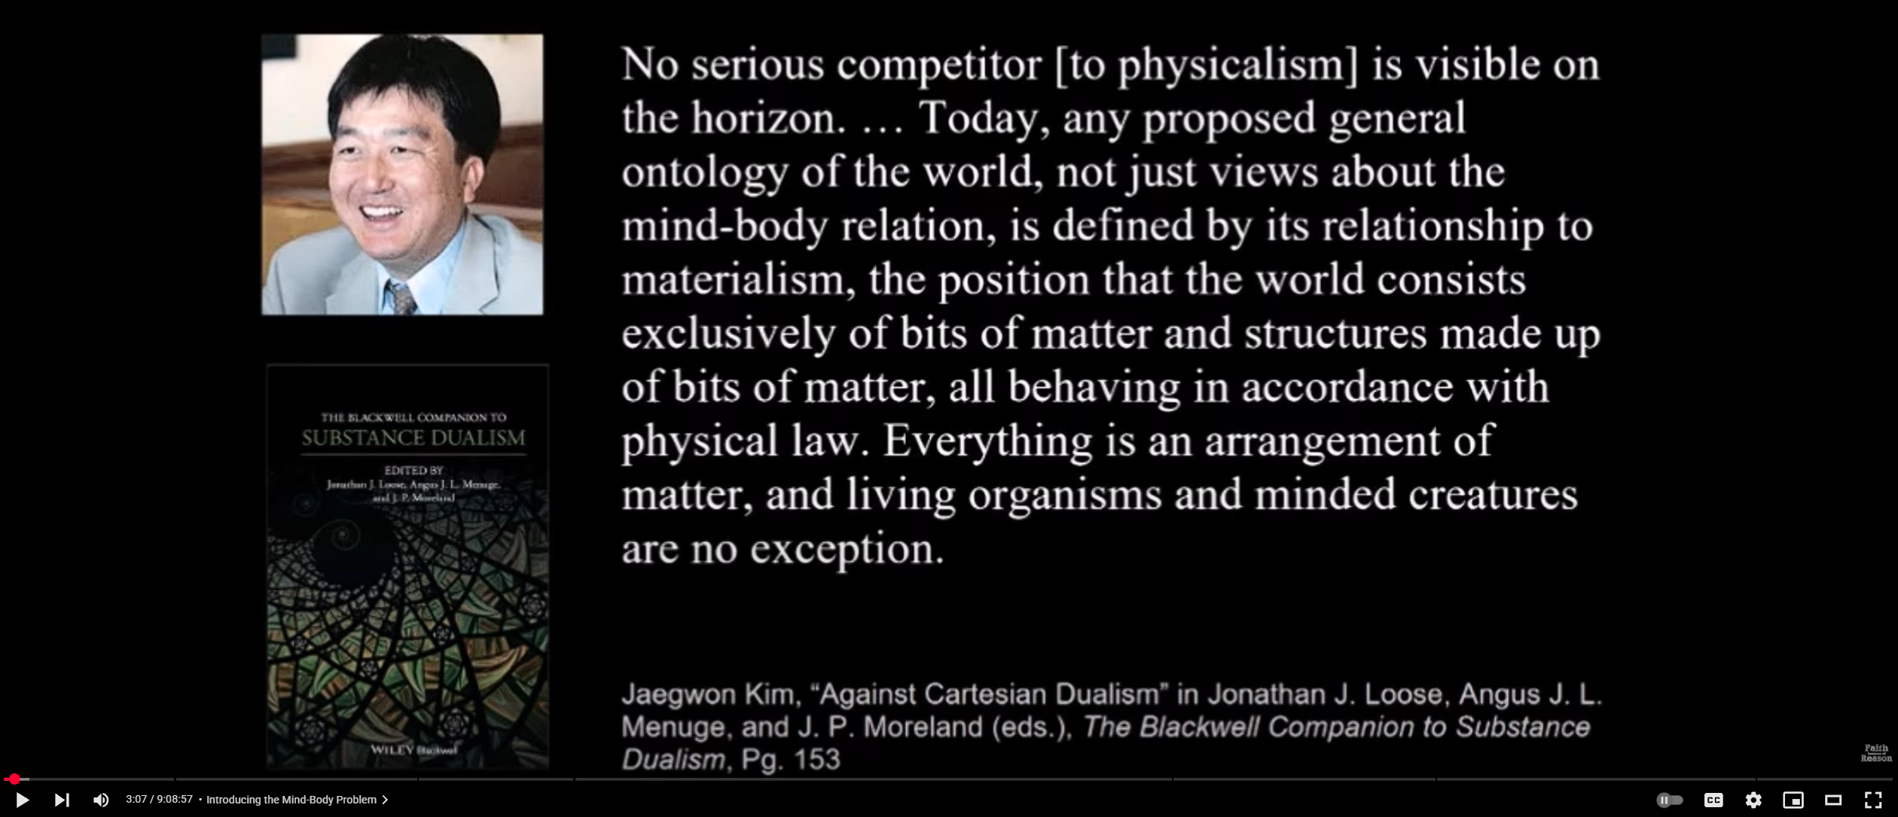
What is Physicalism?

Slide 5
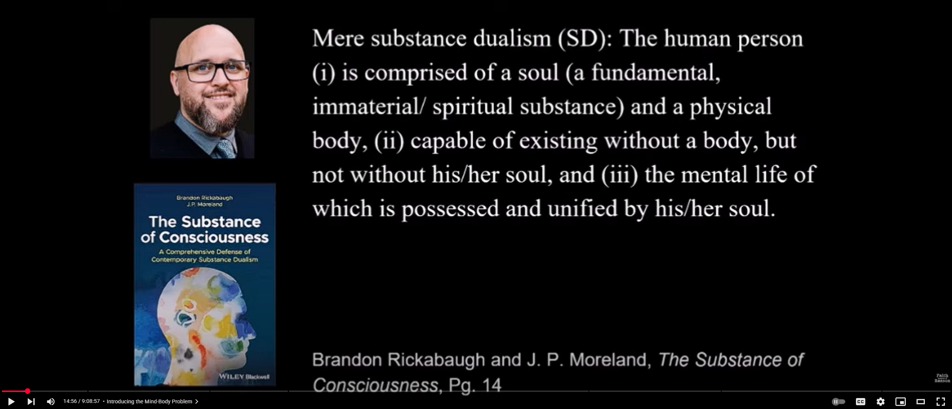
What is Substance Dualism?
Notes:
Here i) and ii) seem to be in tension, since if a person is comprised of soul and body, but can exist without one but not the other, it sounds like the person is really just the soul and not the body.
This presents a massive problem for dualism because it seems to imply the body is not causally necessary for mental function, which demonstrably it is.

Slide 6
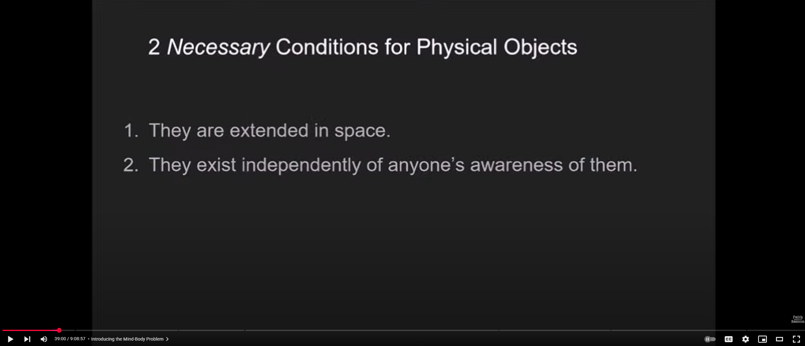
What is the Physical?
Notes:
Not very good criteria since physical entities my pre-exist time and space, and some physical states my be essentially subjective (e.g. pain states).
I would say instead that physical states are comprised entirely of the fundamental entities (like particles, fields, or the like) postulated by our best physical theories. For our purposes here, anything made of protons, electrons, and neutrons is probably sufficient.

Slide 7
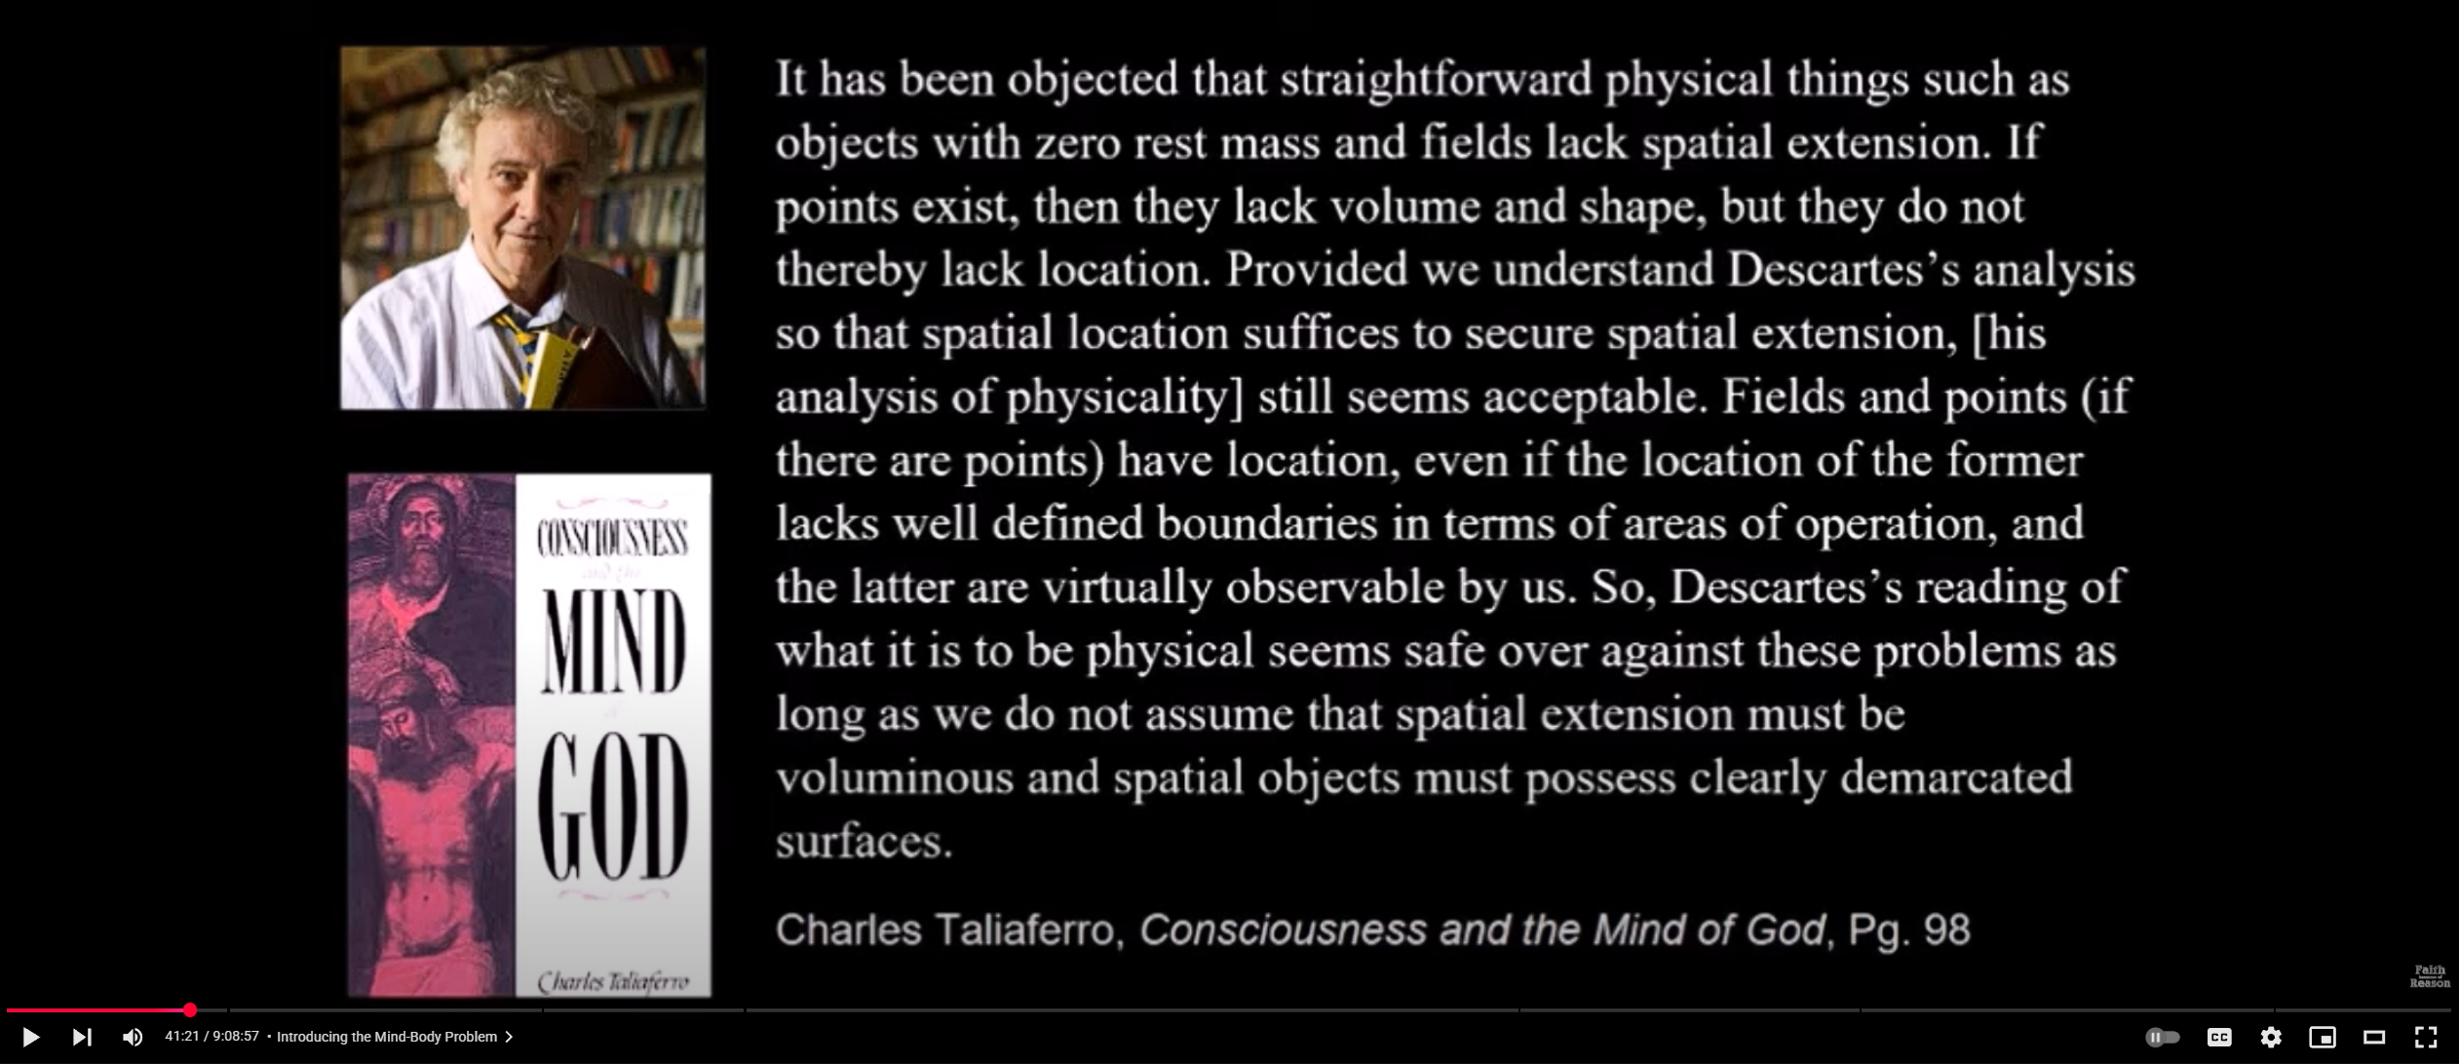
What is the Physical - Clarification
Notes:
This clarification that location need not be extended or precisely demarked will be important for later.

Slide 8
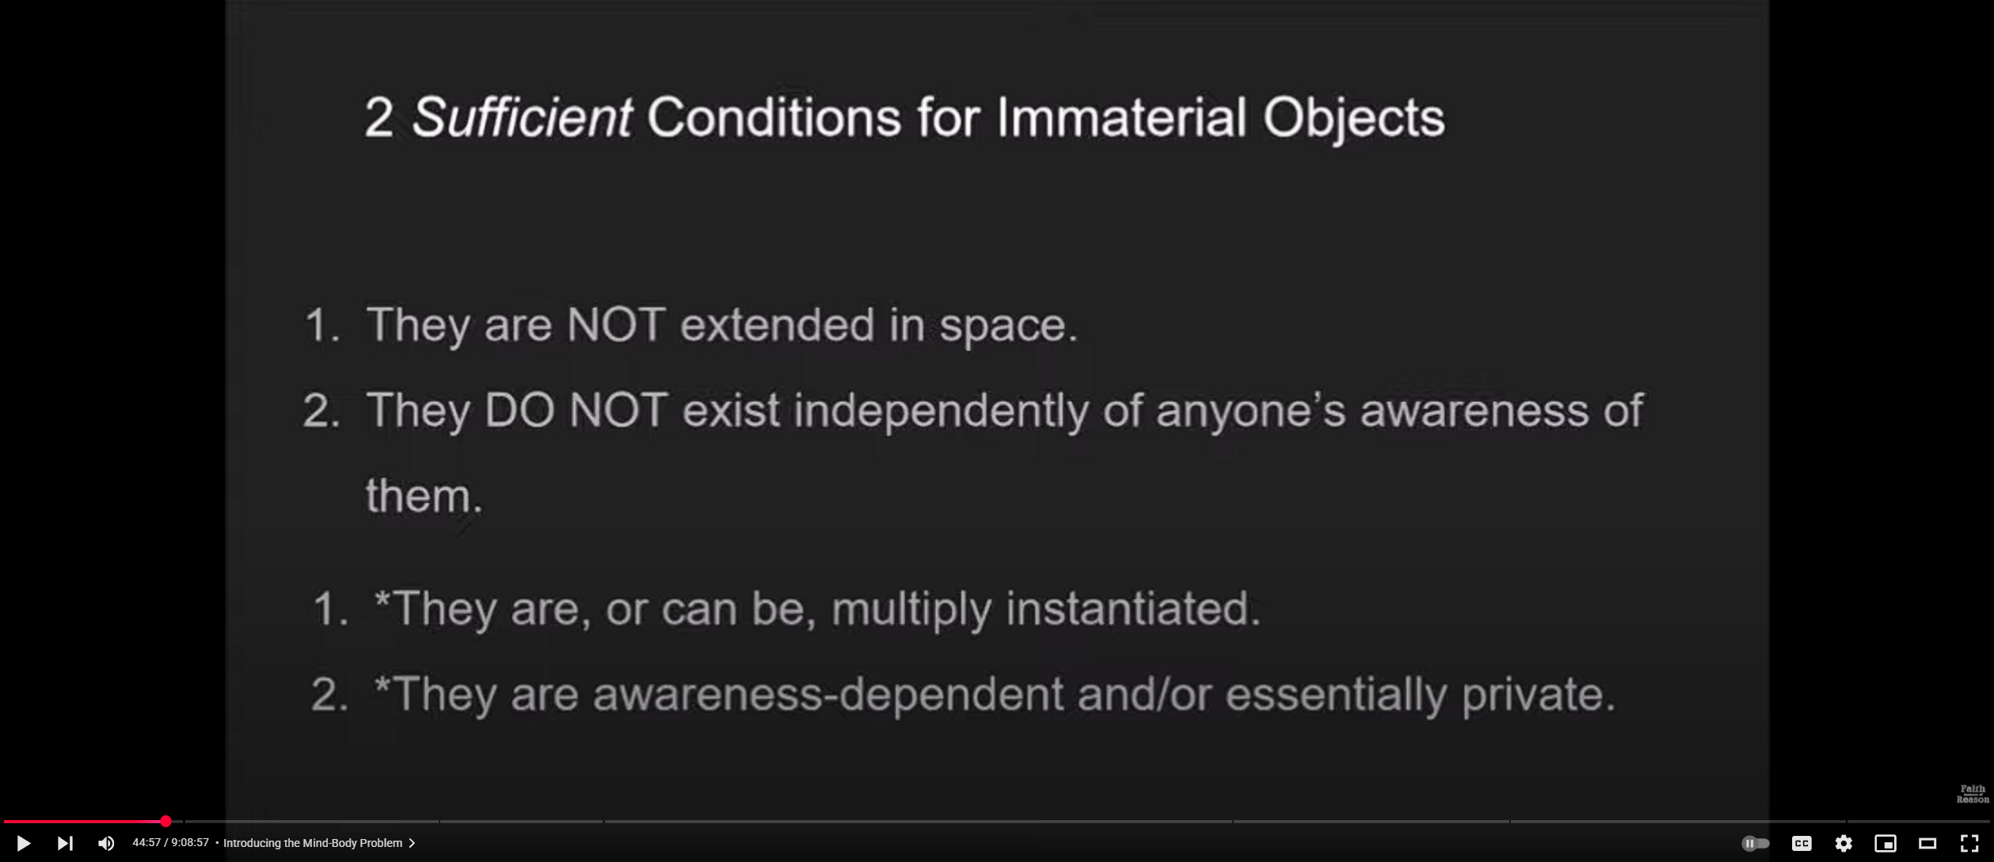
What is the Non-Physical?

Slide 9
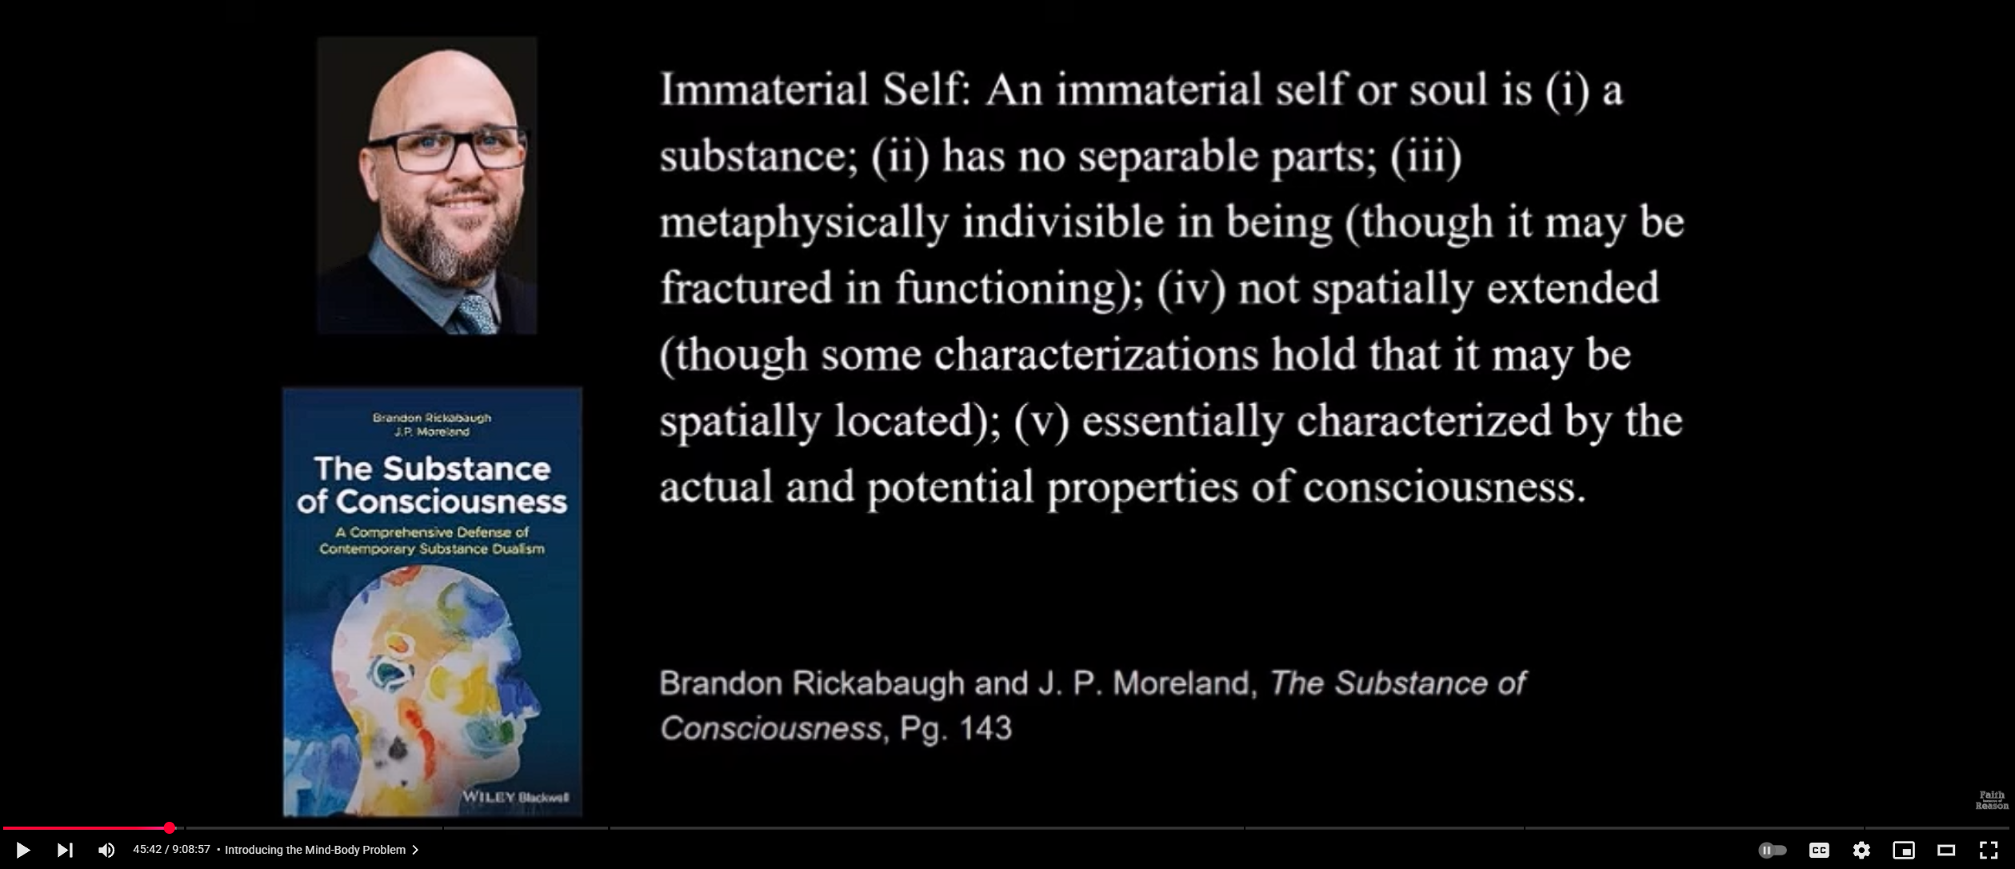
What is the Non-Physical?
Notes:
No idea what iii) means.

Slide 10
The Argument from
The Nature of the Self

Slide 11
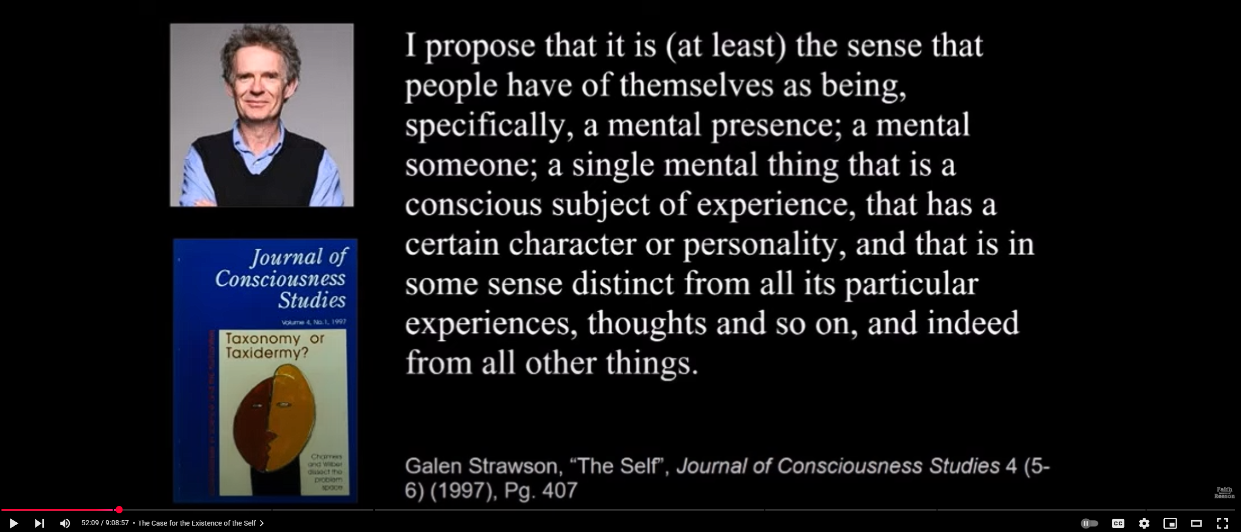
What is a Self?
Notes:
I would call this self-consciousness or self-awareness, a capability that certain animals have. Not sure we need a term ‘self’ for this, or everyone experiences it the same way.
Hereafter follows a long defence of the existence of a ‘self’. While I don’t agree with a lot of these arguments I’m not much interested inthem because I’m happy to accept that there are subjects of mental experiences distinct from one another. So I’m happy to say there are ‘selves’.

Slide 12
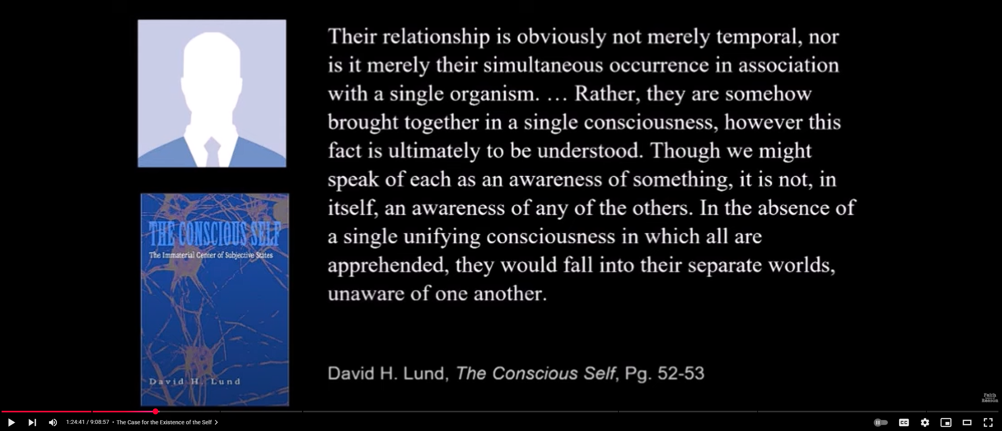
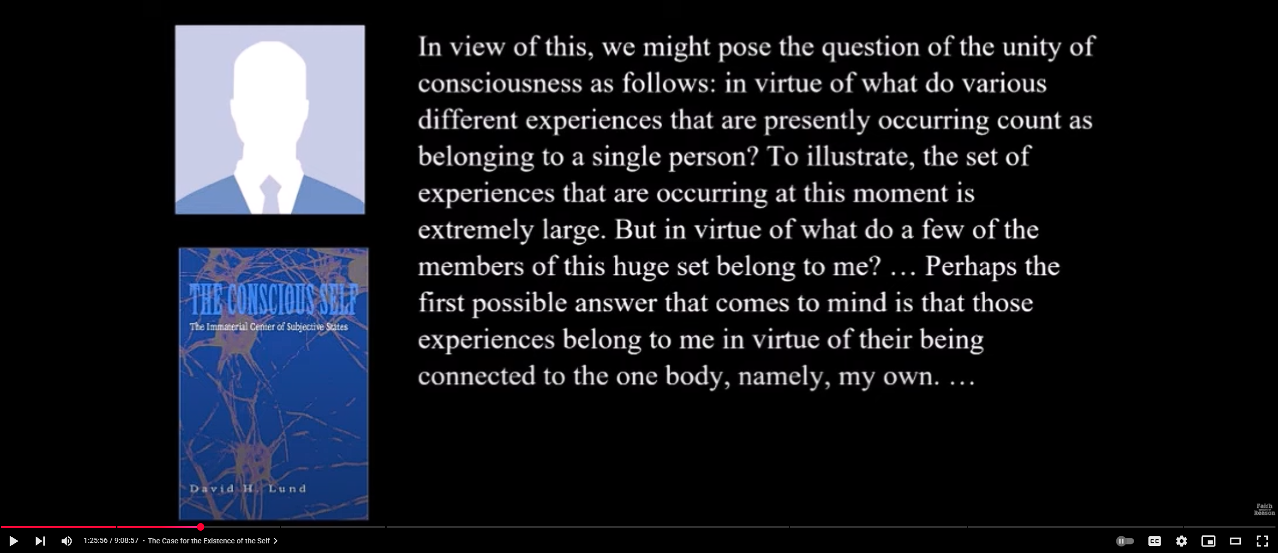
Argument from the Unity of the Self

Slide 13
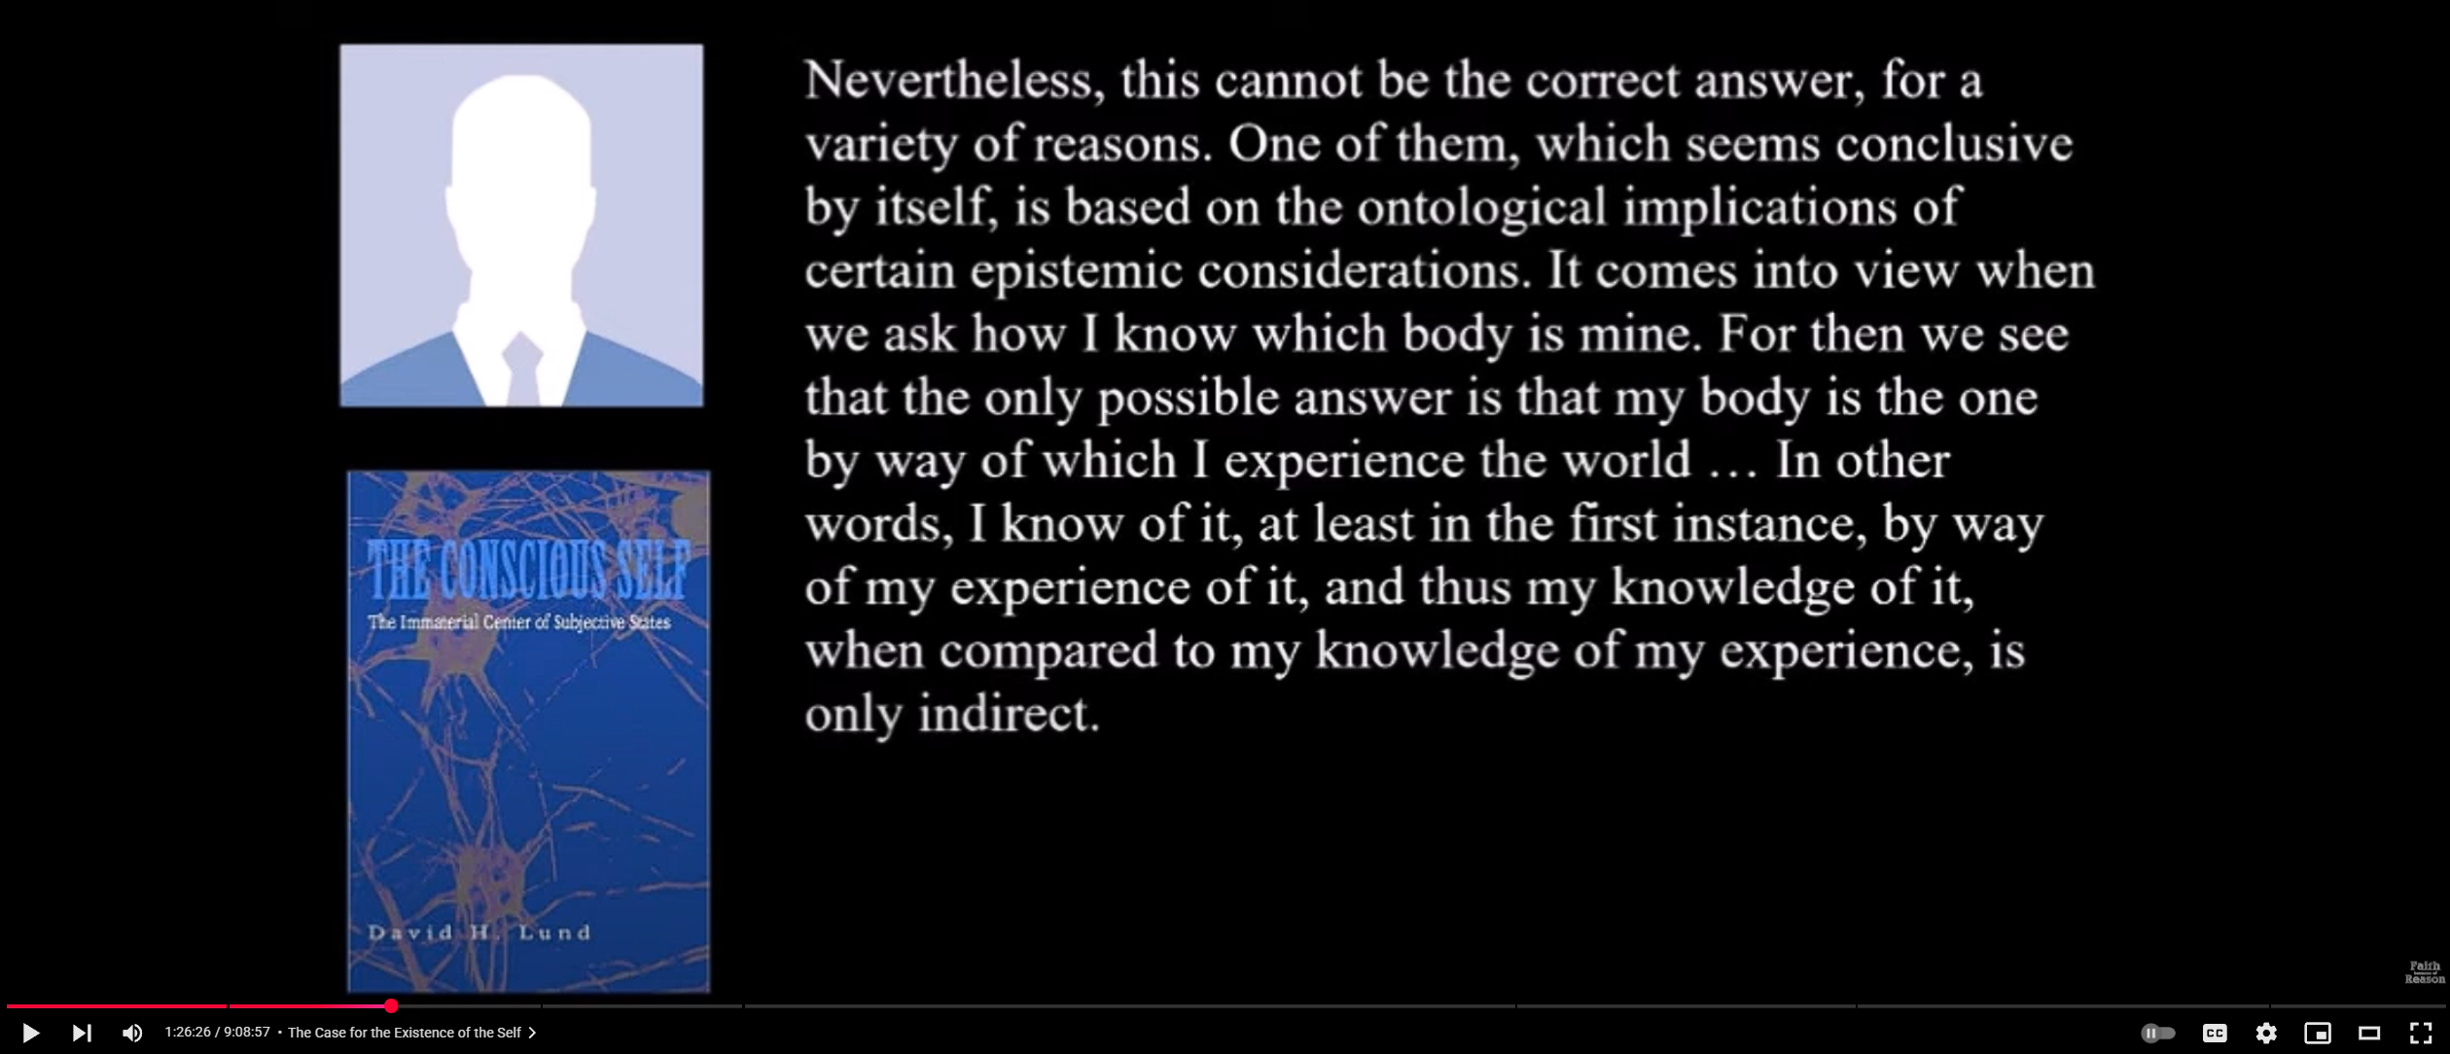
Argument from the Unity of the Self

Slide 14
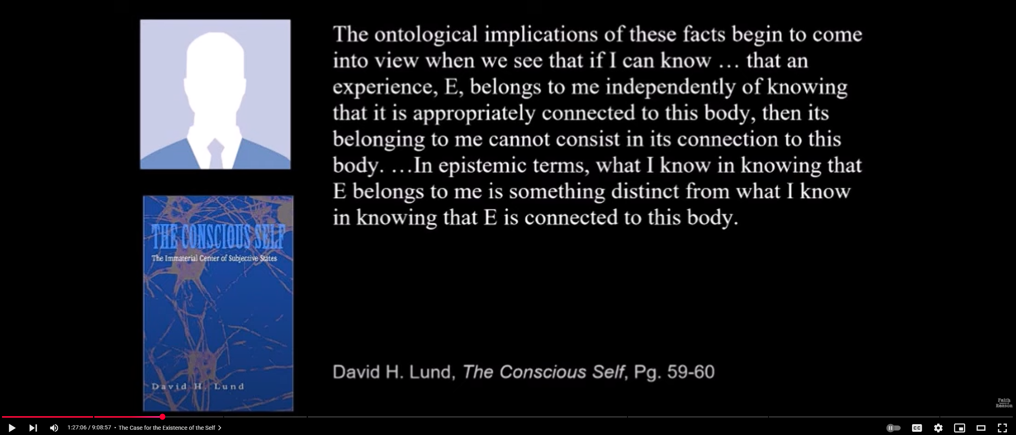
Argument from the Unity of the Self
Notes:
This argument is bafflingly dumb. Just because knowing that E belongs to me is different than knowing E belongs to my body doesn’t mean those facts cannot in fact be made true by the same state of affairs. This is the basis of the well-known distinction between sense and reference. The morning and the Evening star are the same thing (Venus), but you can know that one is Venus without knowing that the other is.

Slide 15
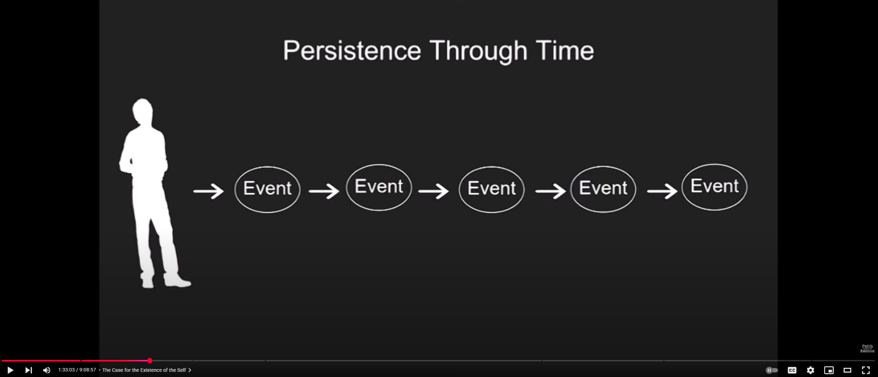
Identity Over Time

Slide 16
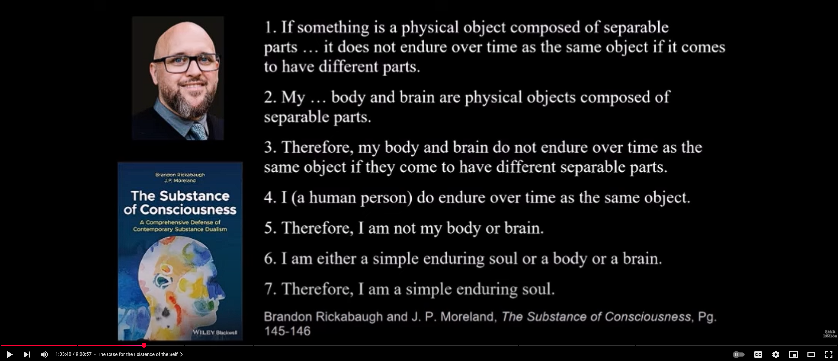
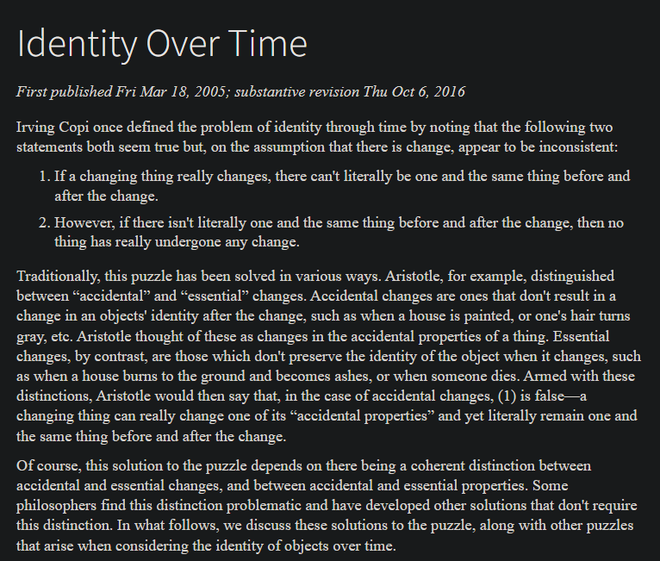
Argument from Self Identity Over Time
Notes:
David thinks the first premise cannot be challenged. This is strange because the problem of identity over time is a very old philosophical issue, and a variety of responses are available. Relative identity, temporary identity, loose identity, and four-dimensionalism (perdurantism) are all postulated solutions. A simple immaterial self is a terrible solution because it only solves the problem for one type of entity, not everything else.

Slide 17
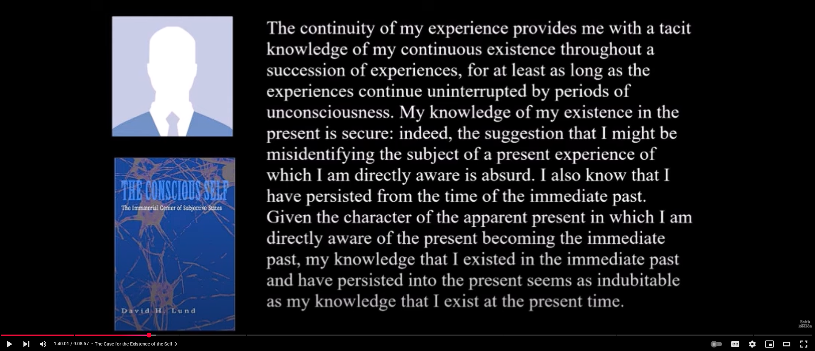
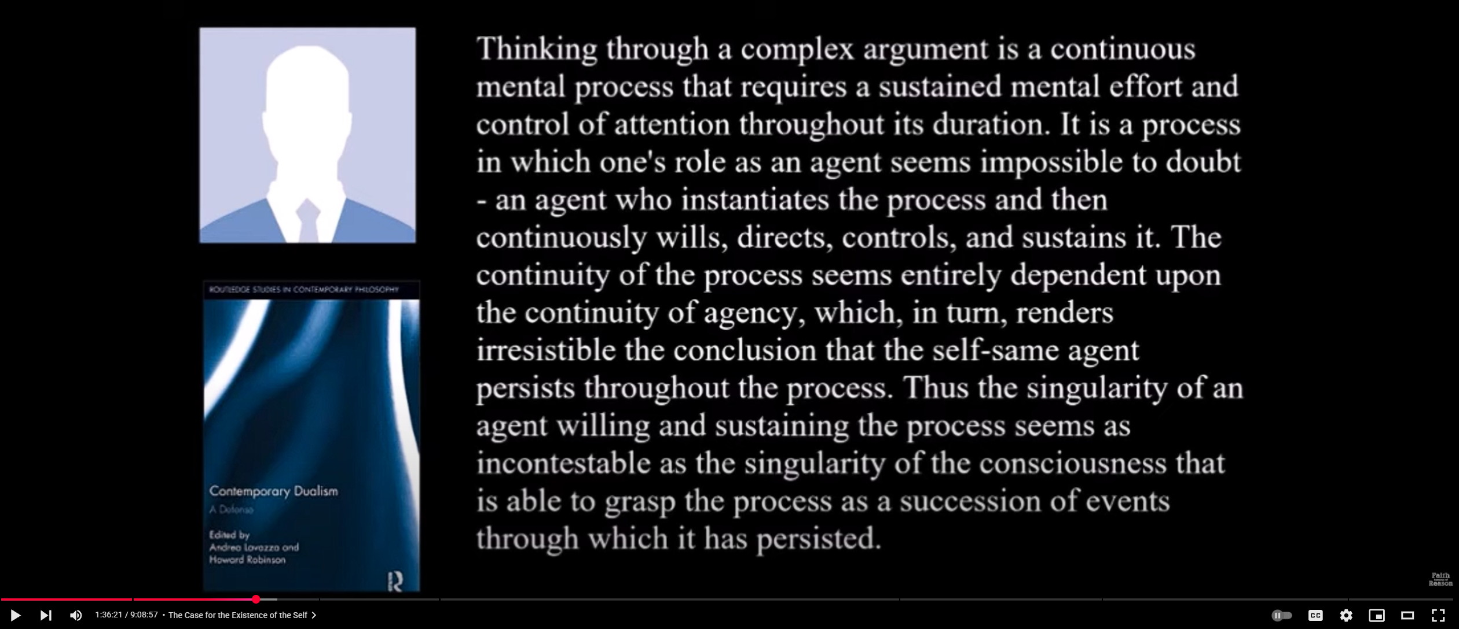
Argument from Self Identity Over Time
Notes:
Note the subtle switch here between continuity and identity (persistence). All arguments involving thought or memory can establish is continuity. They can’t establish identity unless you make the assumption that every single property or aspect of our consciousness/experiences/memory is infallibly accessible to us at all times. That is the only way you could check for identity conditions over time.

Slide 18
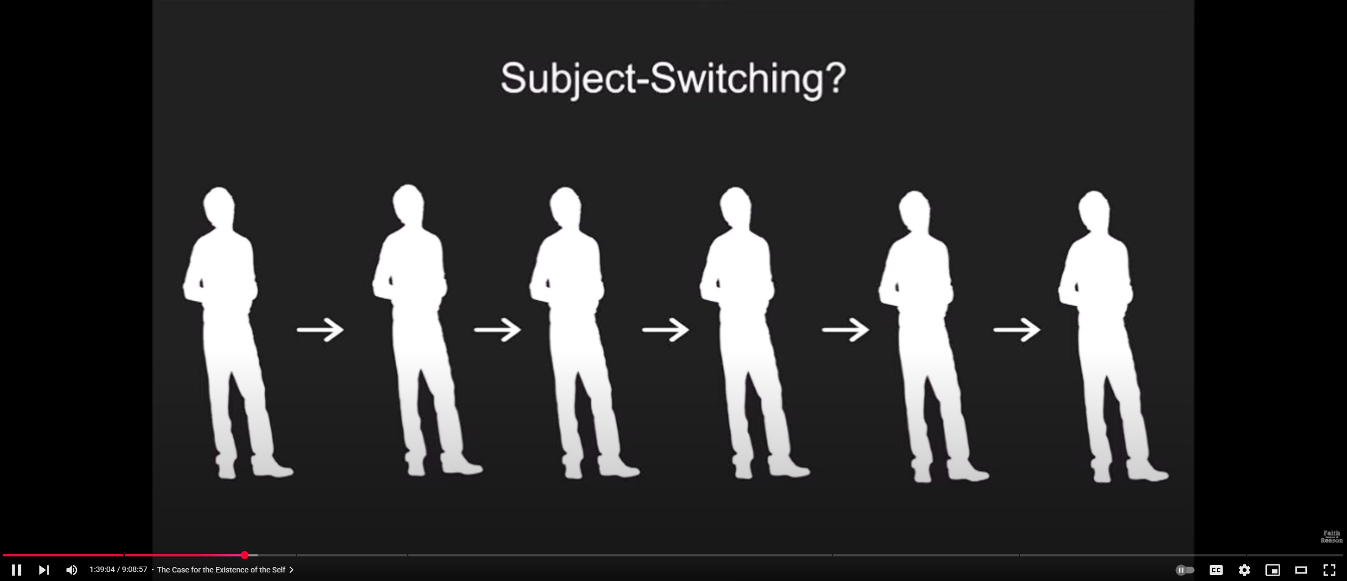
Argument from Self Identity Over Time
Notes:
David says this idea “looks like the premise for a rather fantastic science fiction film”. Its not clear to me why. The idea is simply that the subject progressively changes over time and passes its memories and experiences onto very similar but slightly different subjects. The relationship between them is one of continuity not identity. Presumably this happens for many other objects that don’t have souls, like bacteria, plants, mountains, rivers, and human artifacts. So why can’t it happen with selves?

Slide 19
Argument from Self Identity Over Time
Notes:
How exactly are we immediately aware of the present ‘becoming the immediate past’? We are aware of the present. We aren’t aware of the past, unless you think we can simultaneously be aware of two different times at once. The statement that we are somehow aware of the past because we are aware of the present ‘becoming the past’ is ludicrous. What exactly are we supposed to be aware of when we are aware of this ‘becoming’? What does it feel or look like? All we in fact experience are a collection of experiences at each moment, which have a temporal relation to one another of before, during, and after. Whether we as a subject are identically the same at each of these present moments is never accessible to us because we only experience one such moment at a time.

Slide 20
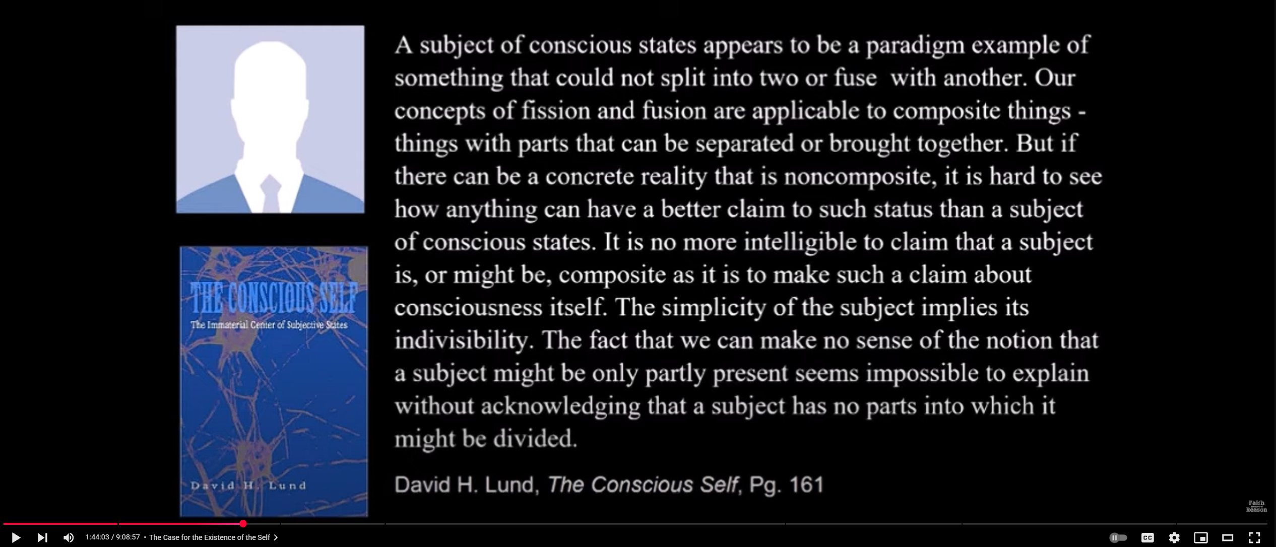
Argument from Indivisibility of the Self
Notes:
Split brain patients provide evidence that consciousness absolutely can be divided. Even aside from this example, this is pure assertion. Why can’t a self by divided? There’s just no argument here.

Slide 21
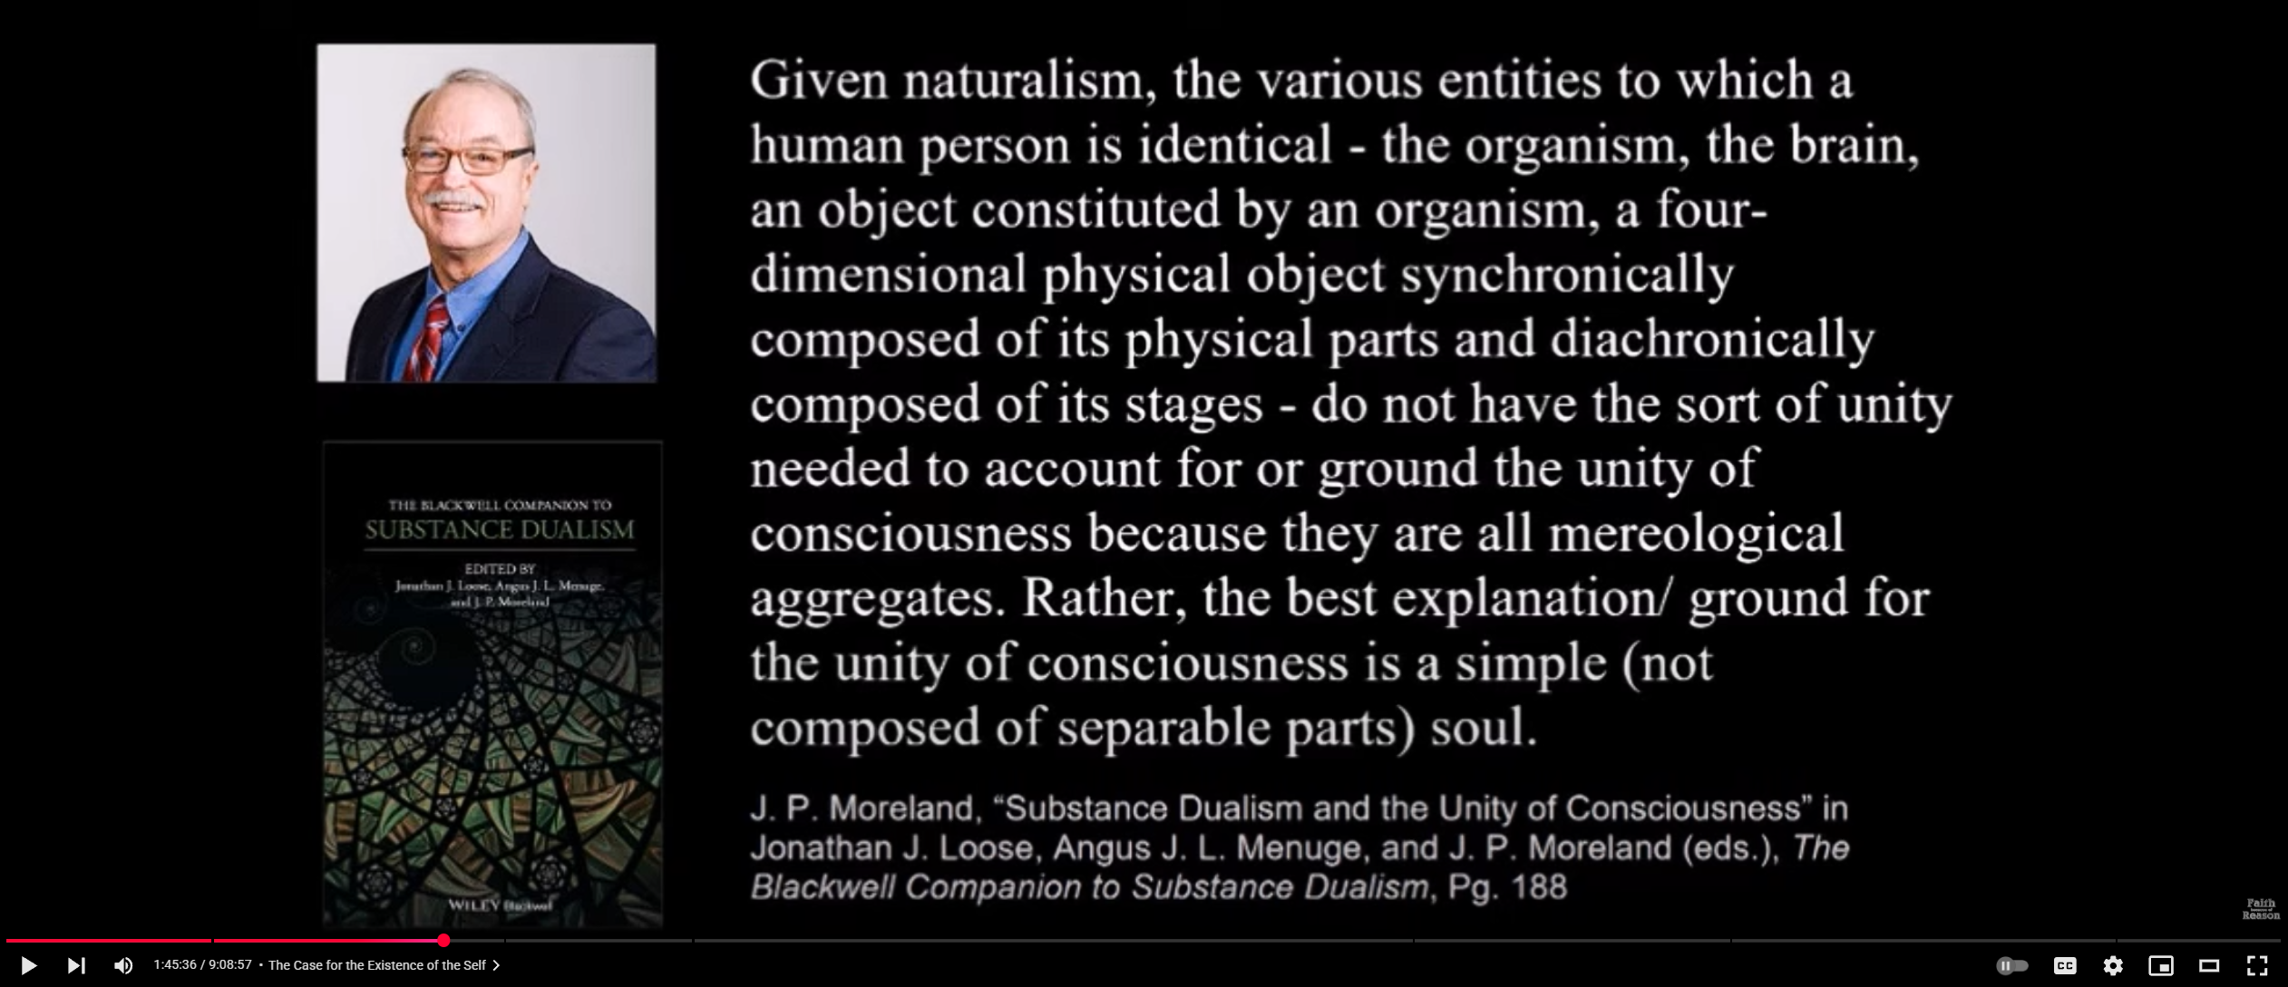
Argument from Indivisibility of the Self
Notes:
Why can’t an aggregate be unified through physical processes? Is a biological organism not unified through metabolic processes like homeostasis and shared genetic material? Is a river not unified by the geometry of its banks and the forces acting on the mass of water is it winds down towards the ocean? Likewise for a tornado, or a planet. What even is Moreland talking about?

Slide 22
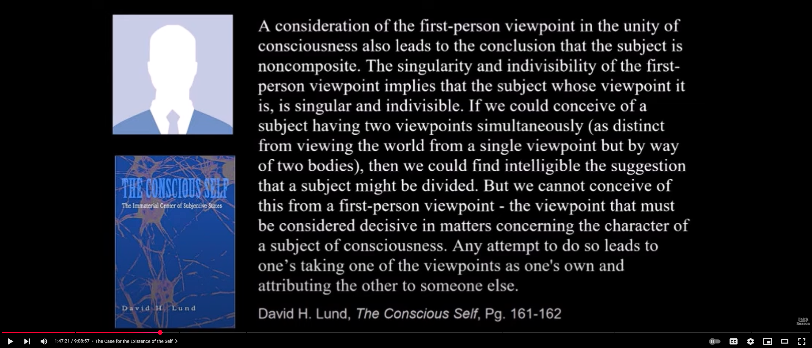
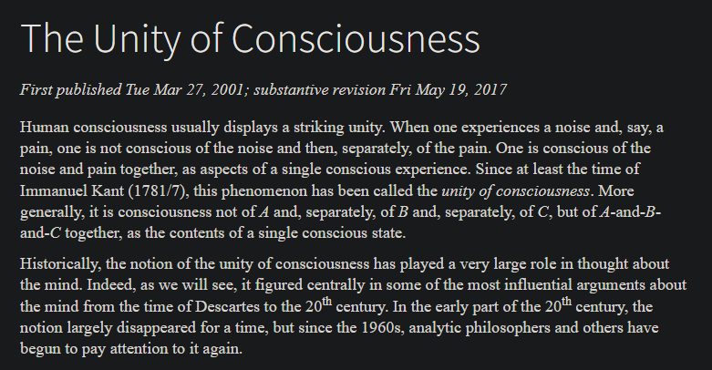
Argument from (???)
Notes:
Lund here might be talking about perceptual viewpoints, but David’s narration implies this passage is about viewpoints as in opinions or beliefs. The idea that a single subjects can’t have to different or conflicting viewpoints at once is so baffling to me that I don’t know what else to say in response.
Disorders of consciousness also show that it is possible to have non-integrated conscious perceptions (e.g. severe schizophrenia, dysexecutive syndrome, anosognosia, and simultagnosia).

Slide 23
The Argument from Introspection

Slide 24
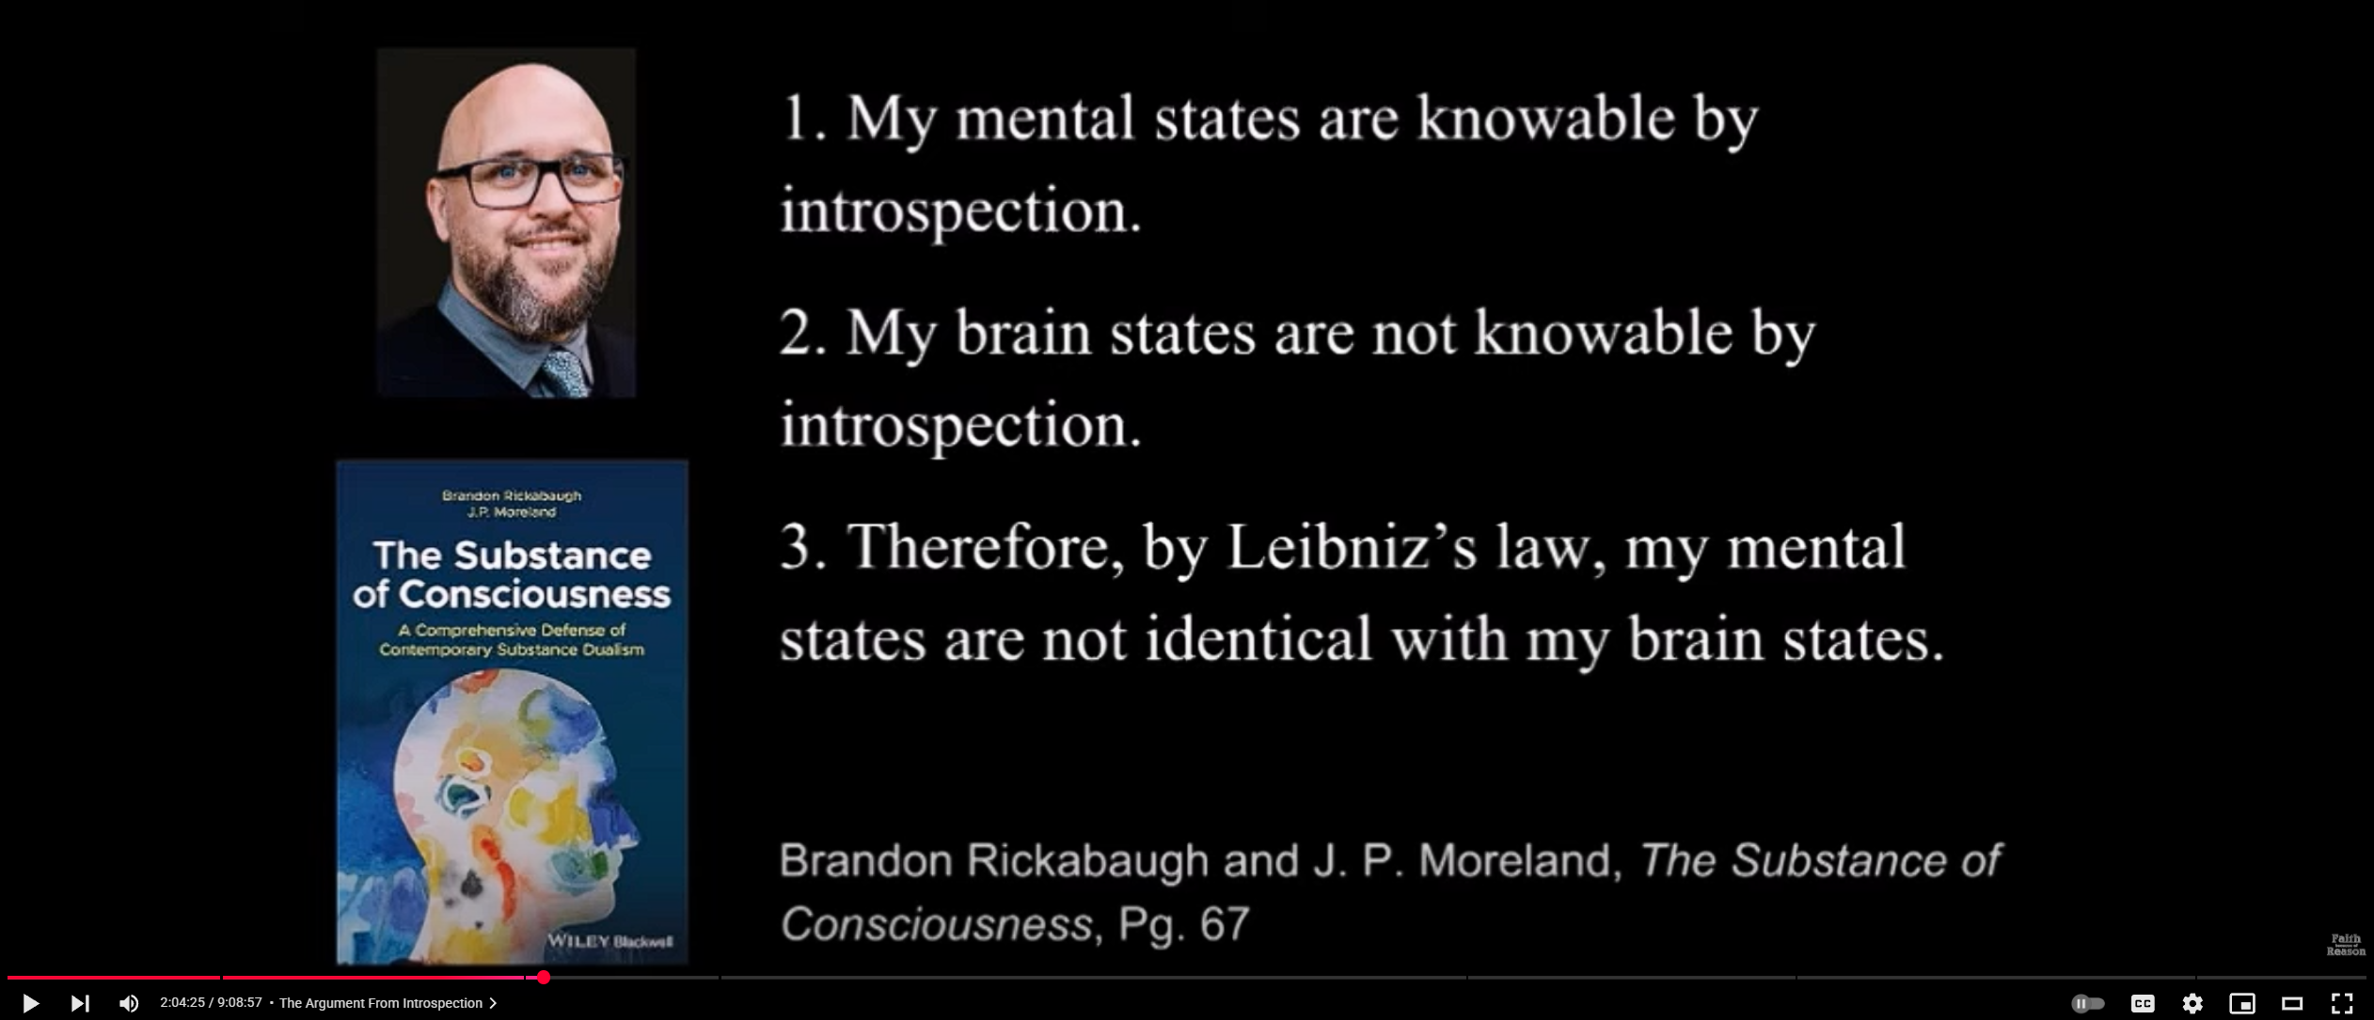
Argument from Introspection 1a

Slide 25
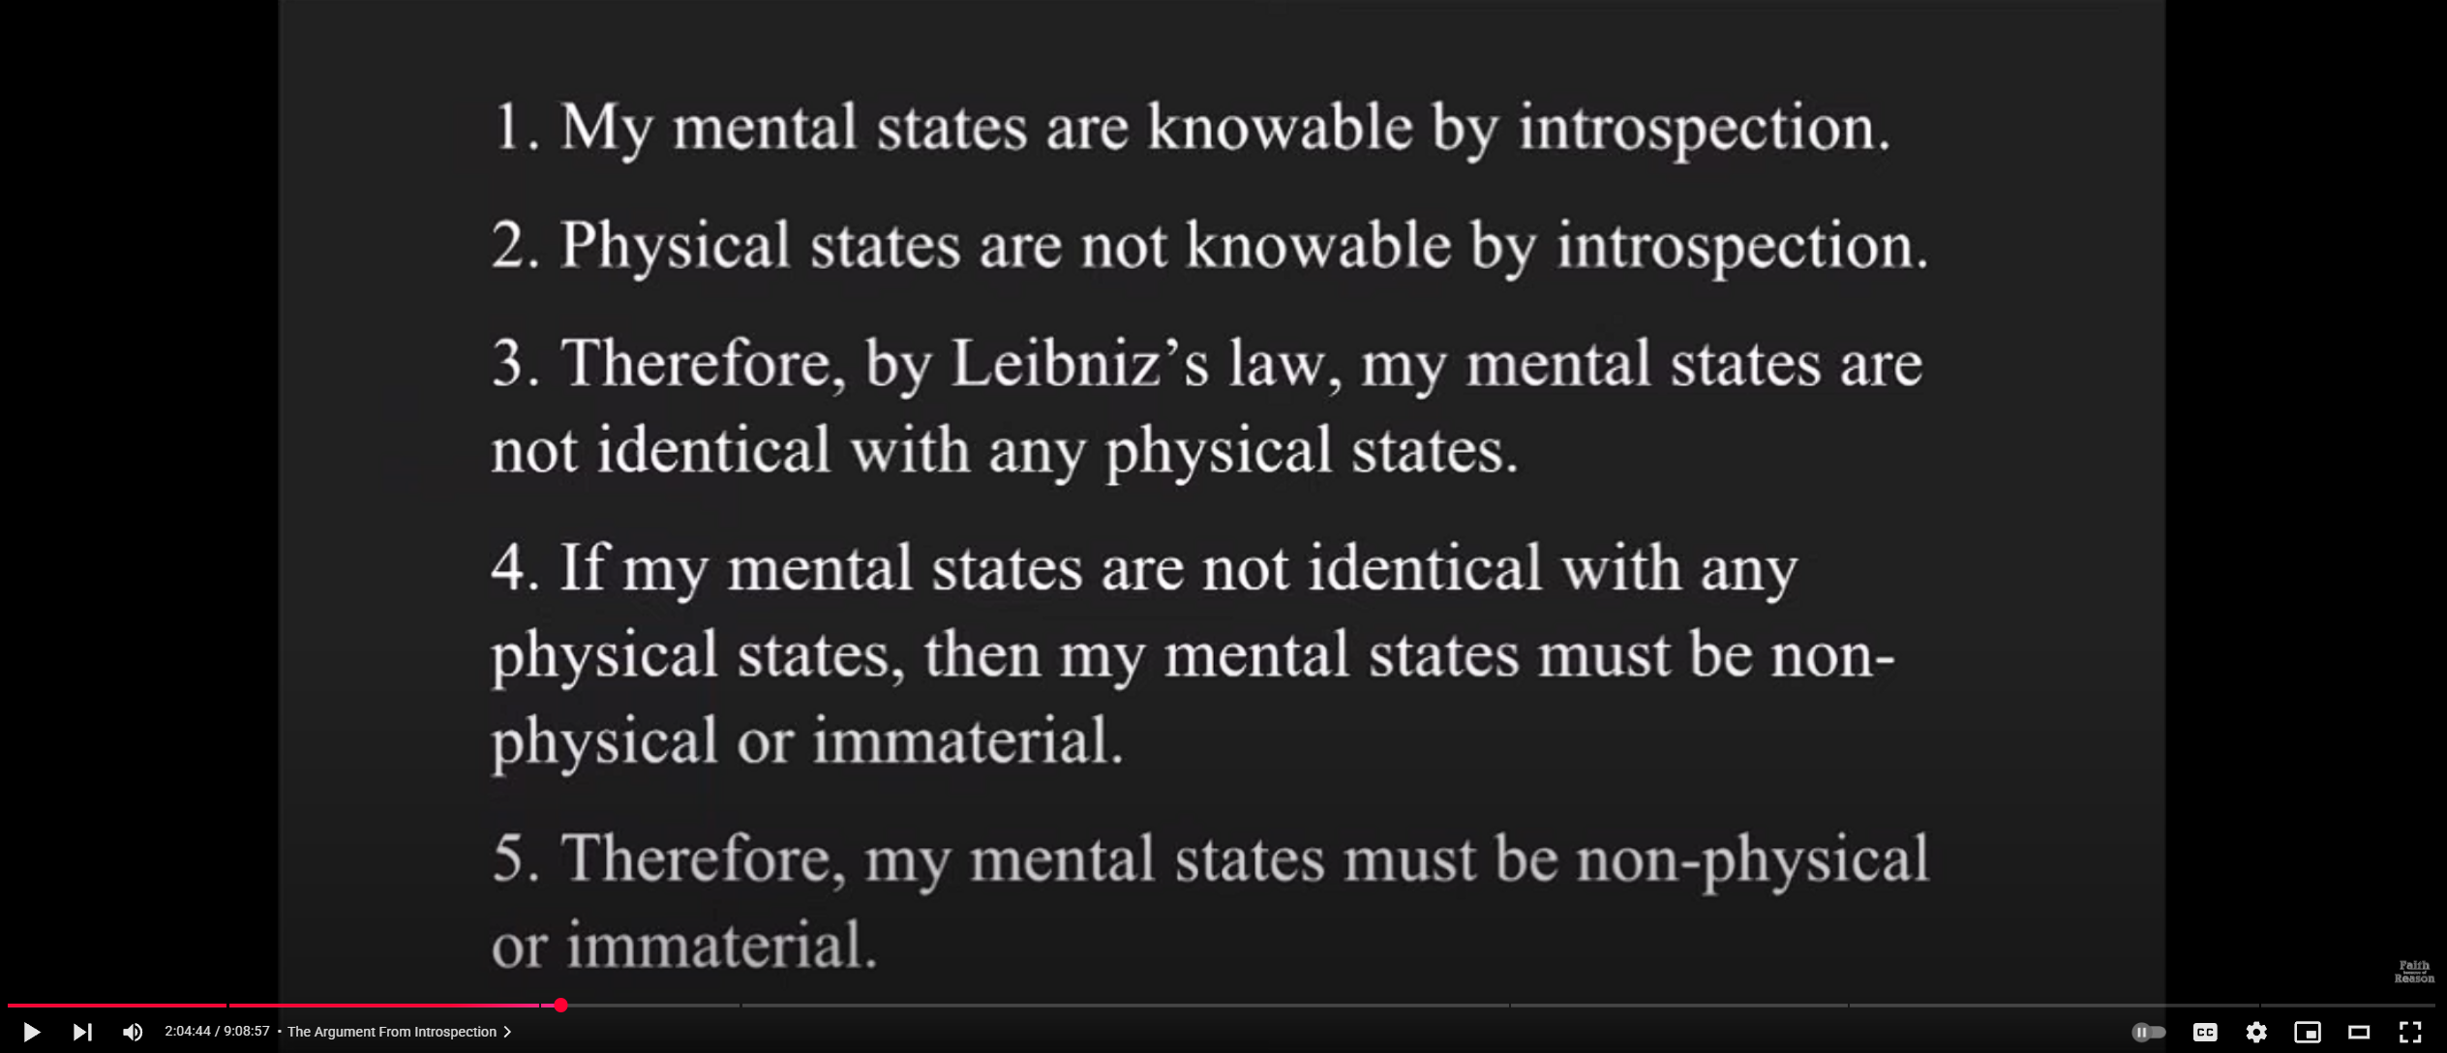
Argument from Introspection 1b

Slide 26
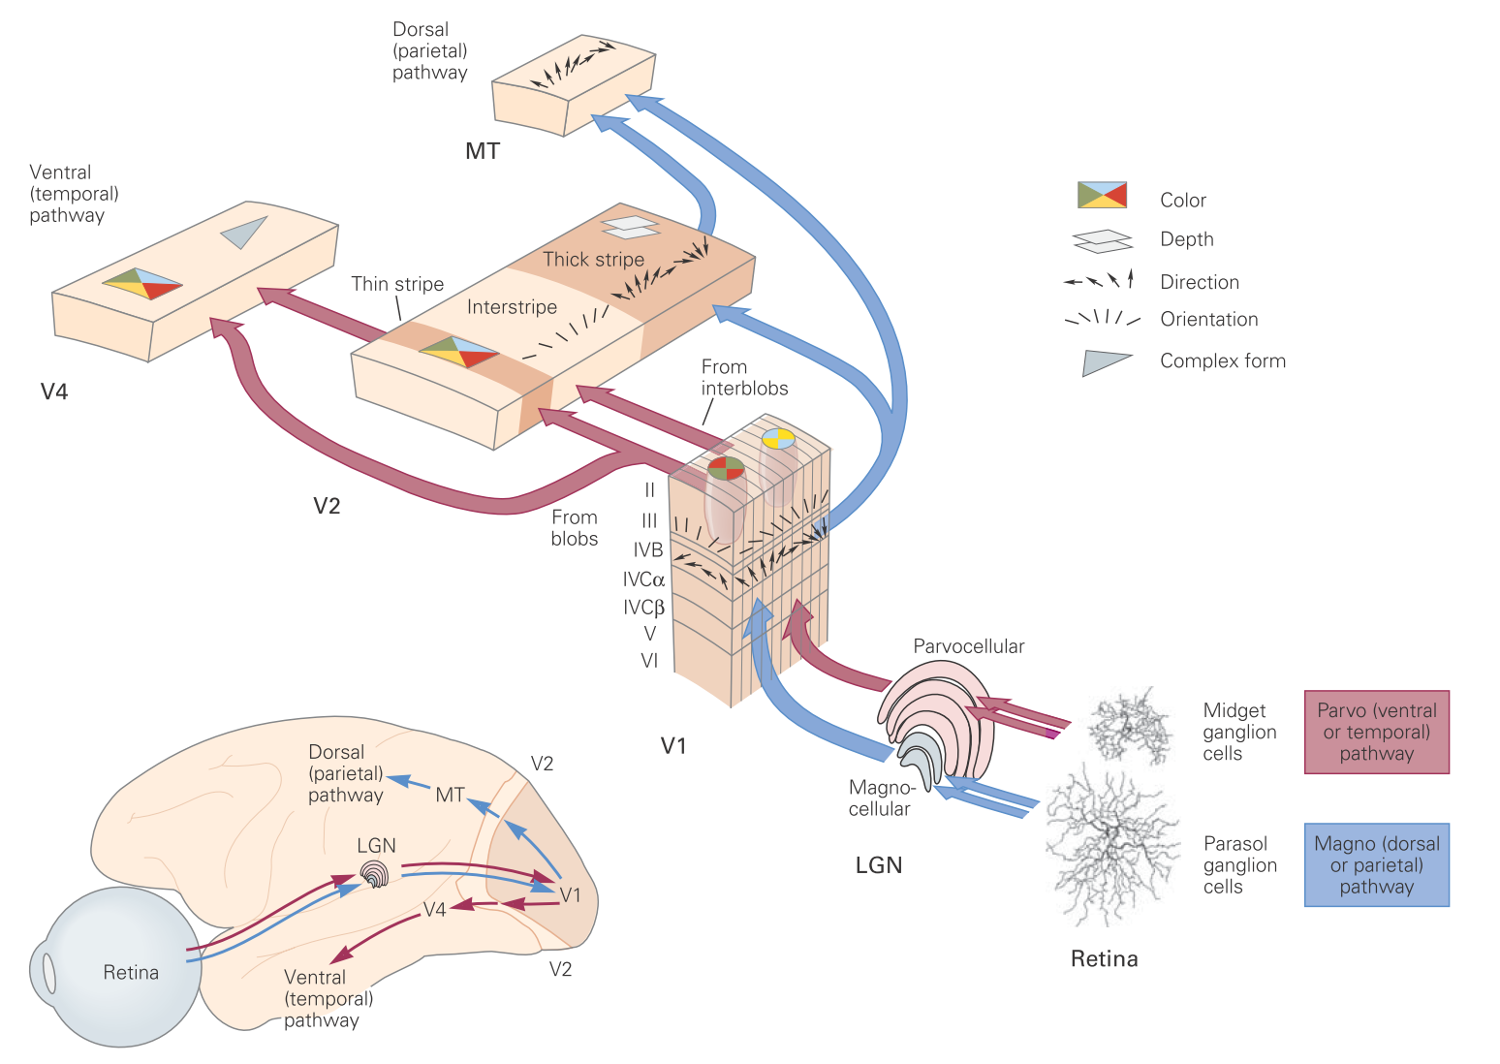
Arguments for Premise 2
“It makes little sense to ask how far (in space) one of my mental states extends” (2:07:10)
“When I close my eyes and imagine a blue sky, I am seeing things which have properties which are not possessed by my brain or any other part of my body. The blueness of the sky is not to be found in my brain.” (2:07:38)
Notes:
Remember before what David said? Physical states don’t need to be precisely spatially located or extended. In fact this is incredibly obvious, since nearly every physical object has fuzzy boundaries. Where is the weather located? Where is the economy located? The English language? There is YouTube located? The US army? Your family?
David claims that blueness is not found in his brain. How does he know this? Neuroscience of perception would indicate that colour representations are very much constructed by and found in the brain (or at least activity of the brain). What does he think the visual system does? He may argue that the brain is necessary to generate the mental state of blueness but that state itself is not found in his brain. But how exactly can he know that by introspection? What is the argument supposed to be?

Slide 27
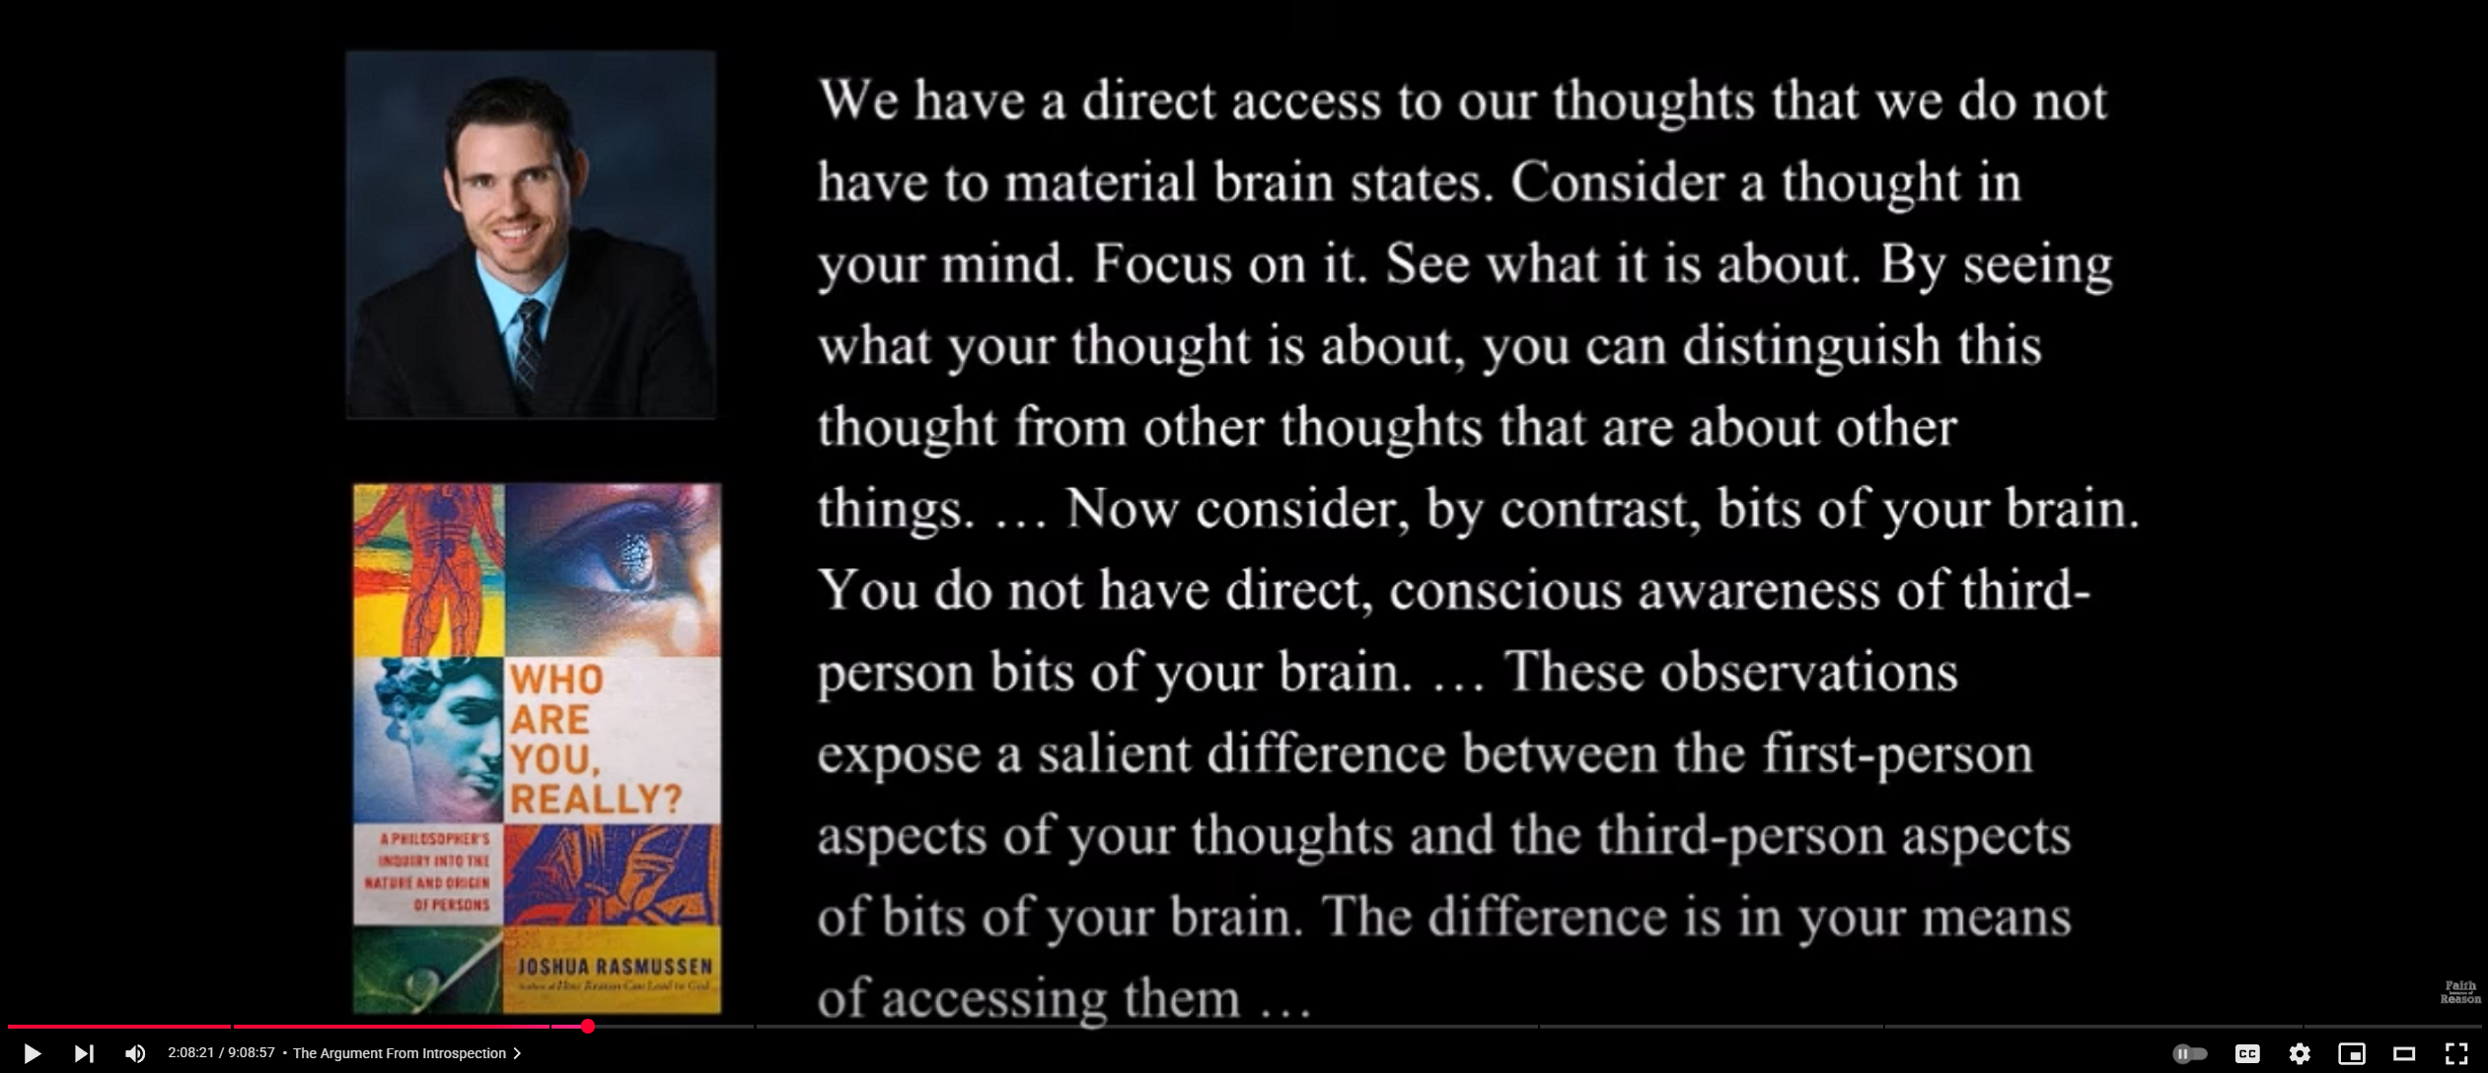
Arguments for Premise 2
Notes:
Rasmussen, like many substance dualists, doesn’t seem to understand much about cognitive science of physicalist philosophy of mind. He doesn’t know how to think about the mind as a set of interaction mechanisms and subsystems for processing information and forming representations. These complex and dynamic networks of interactivity and computation, realised in the neural networks of the brain, constitute the mind. It isn’t “a bit of our brain”. The mind isn’t a physical object.

Slide 28
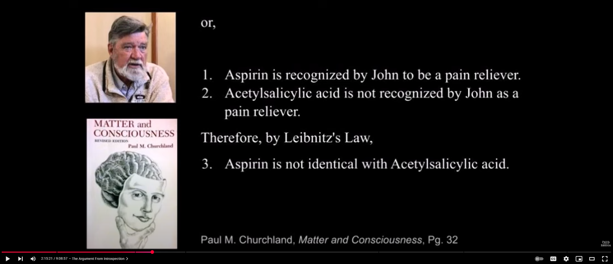
A Counter by Churchland
Notes:
A good analogy

Slide 29
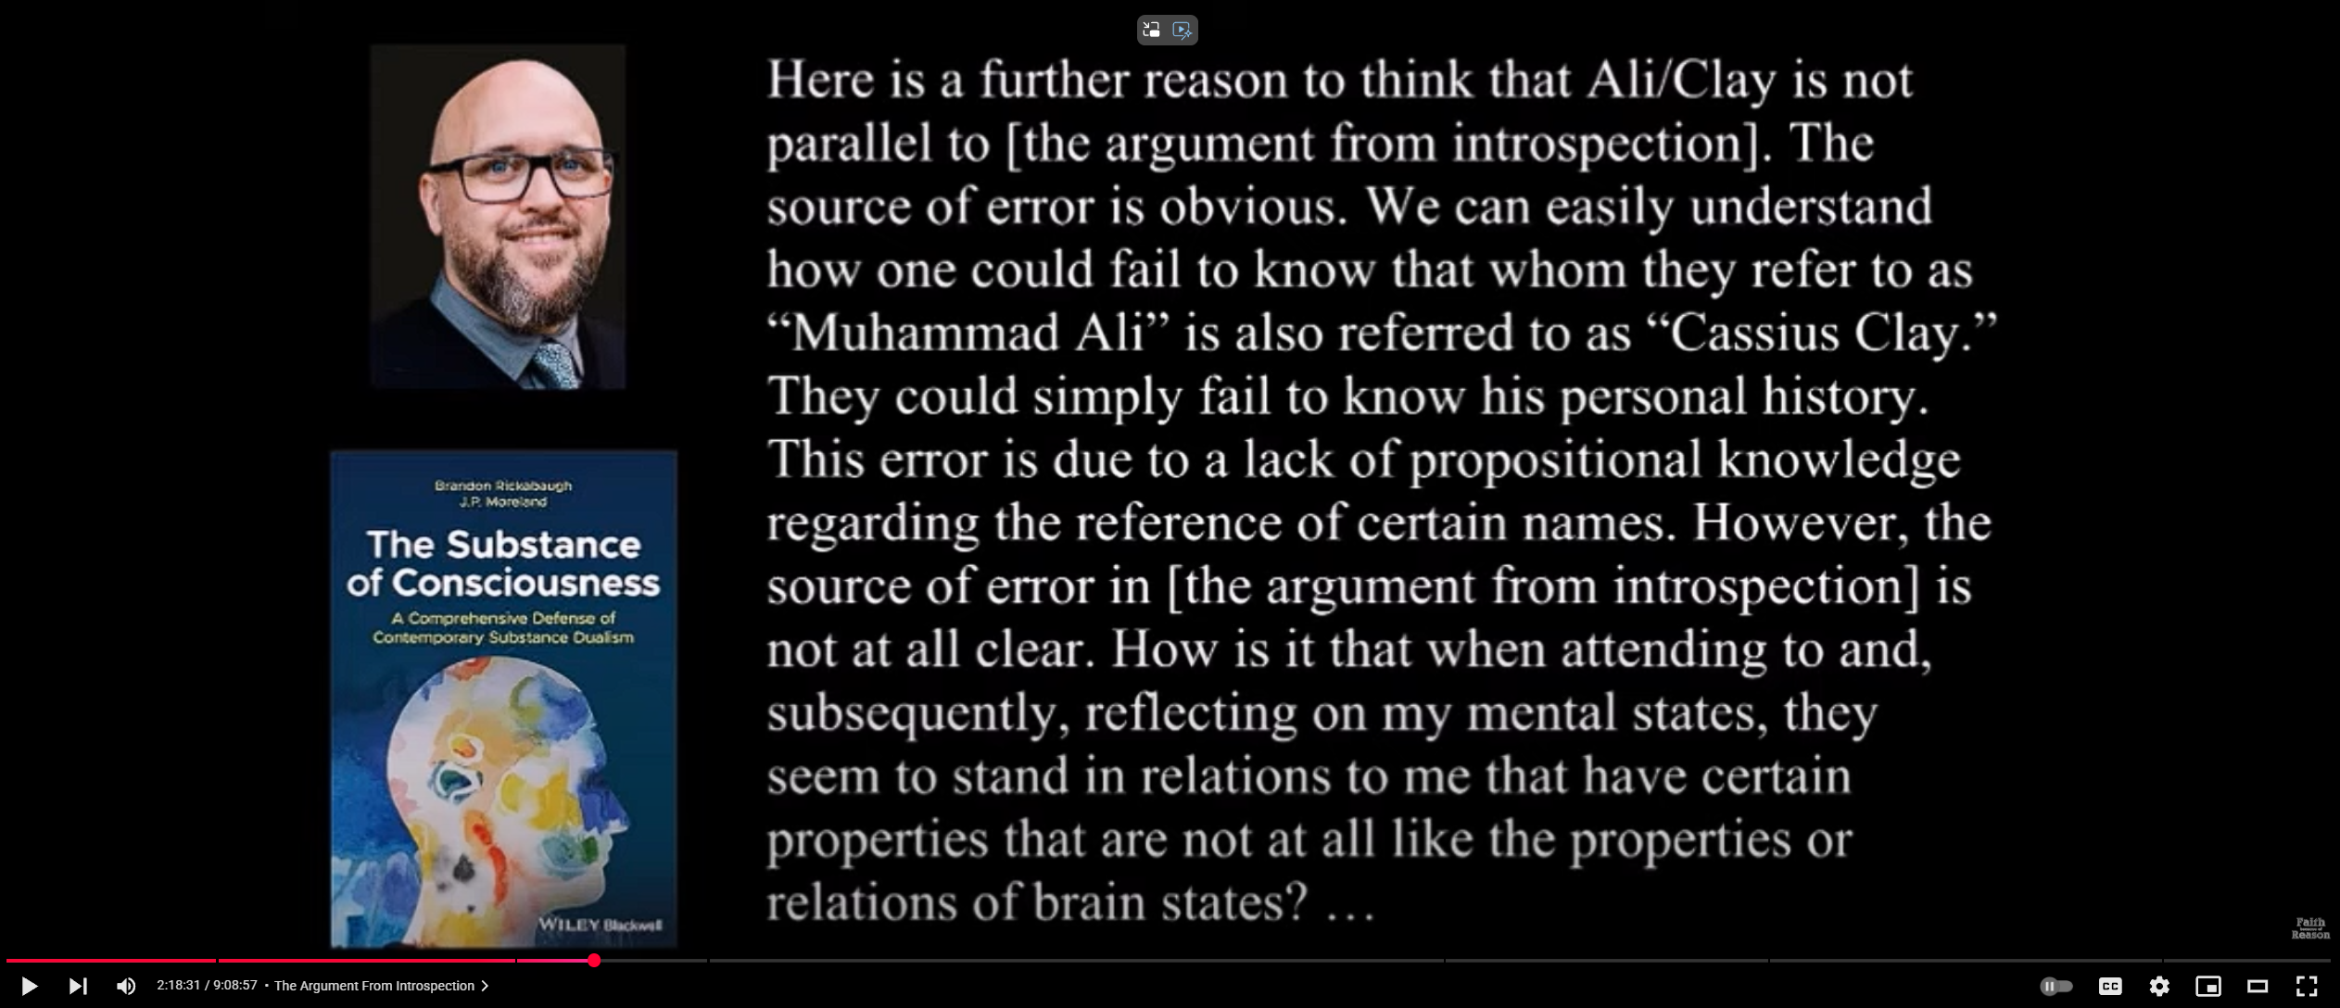
Responding to Churchland
Notes:
I think this is a plausible diagnosis.

Slide 30
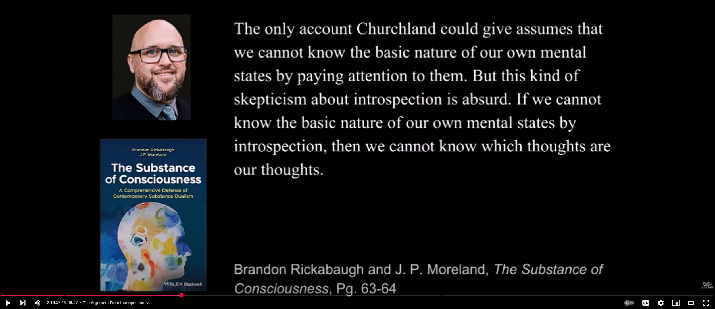
Responding to Churchland
Notes:
Rickabaugh seems to have forgotten that the argument from introspection makes two claims, one about the mental and one about the physical. We cannot know the physical by introspection, so how can we know what properties it has?

Slide 31
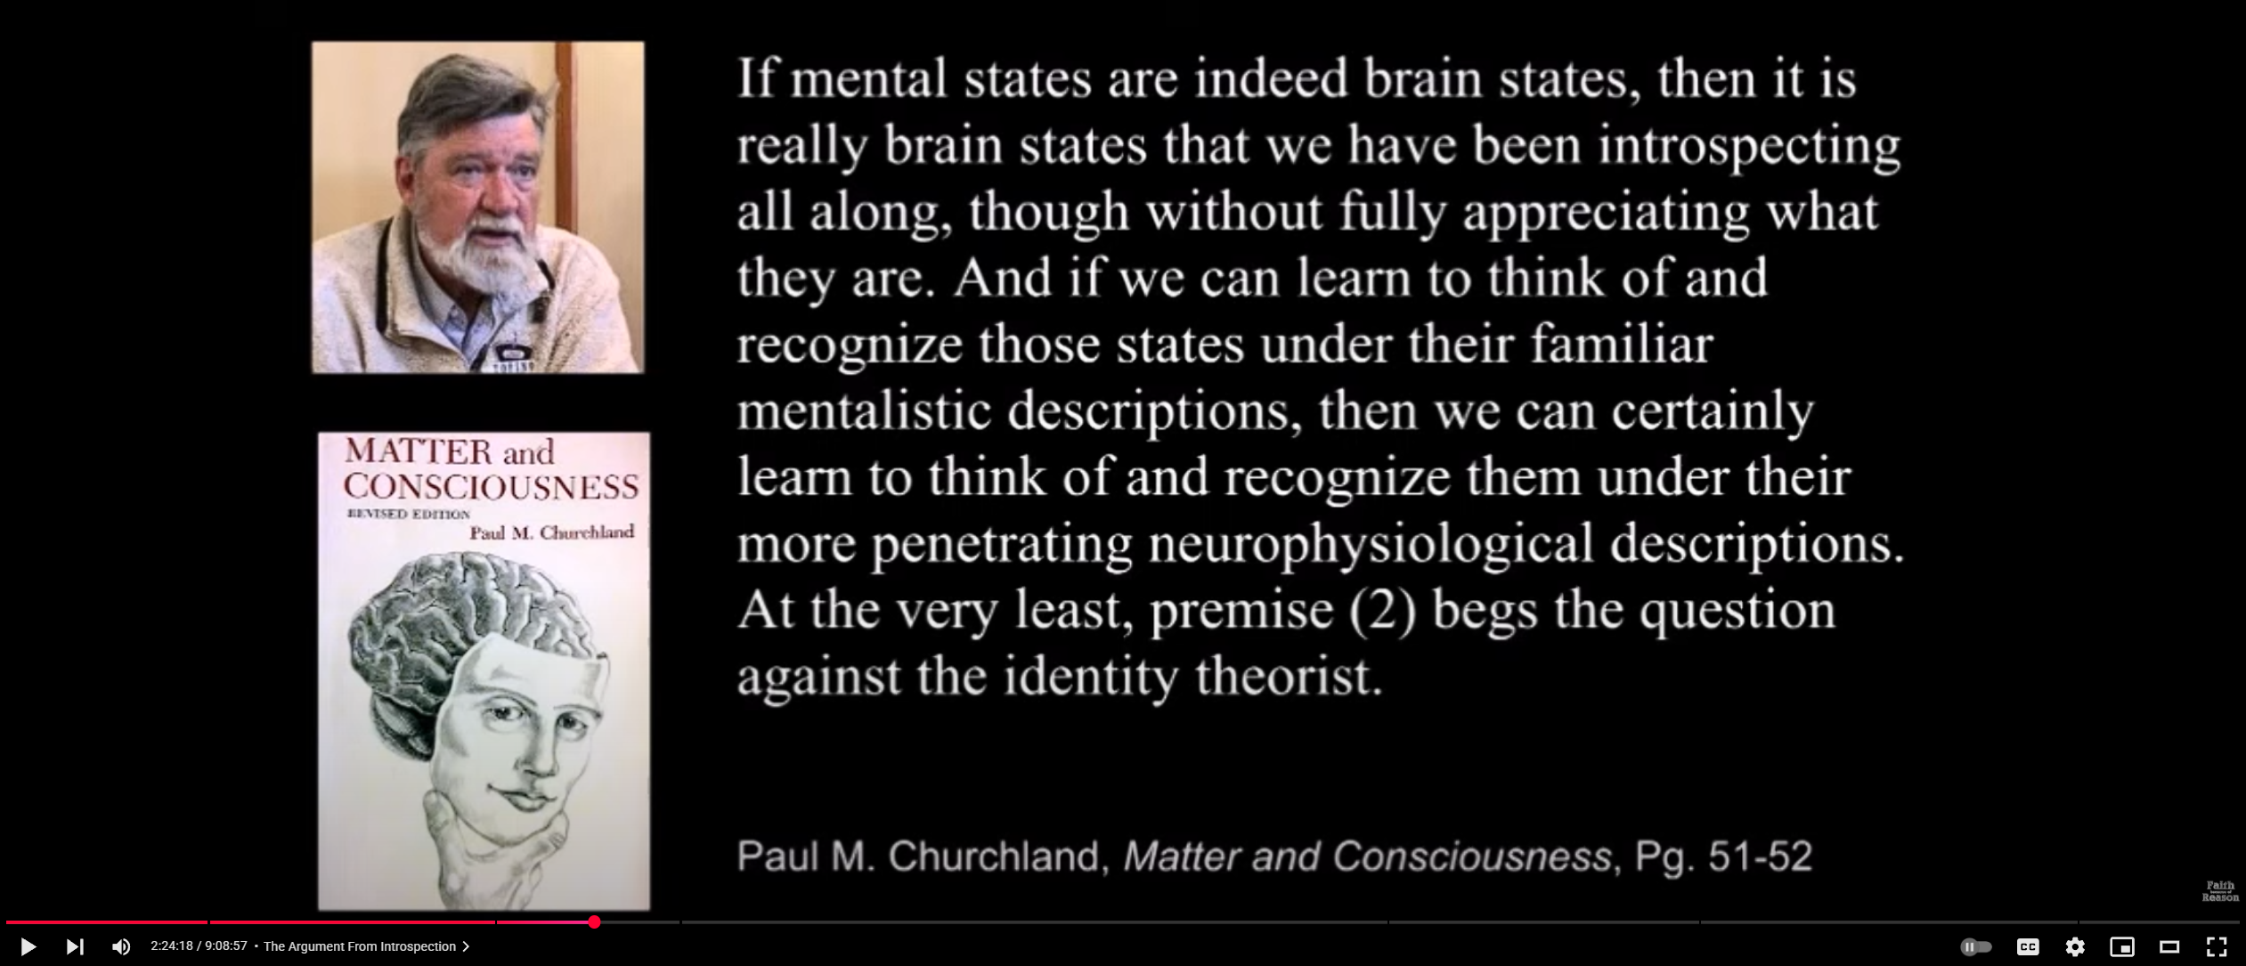
Churchland Gives the Obvious Answer…

Slide 32
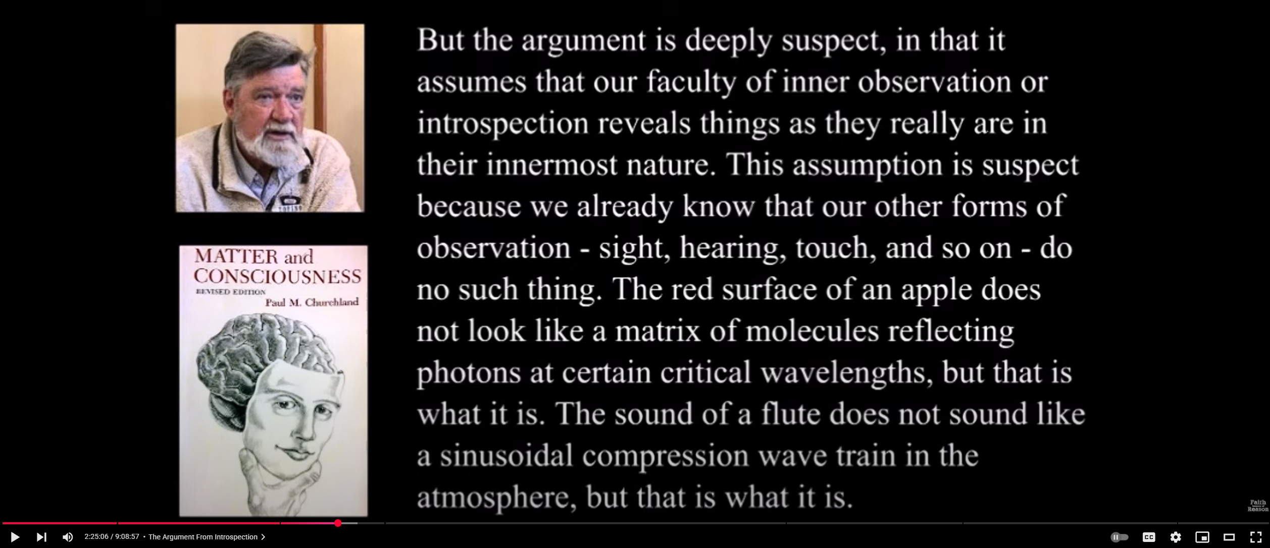
…But it is Skipped Over!
Notes:
David moves on to a different objection and proceedes to respond to this, but never comes back to the first objection.

Slide 33
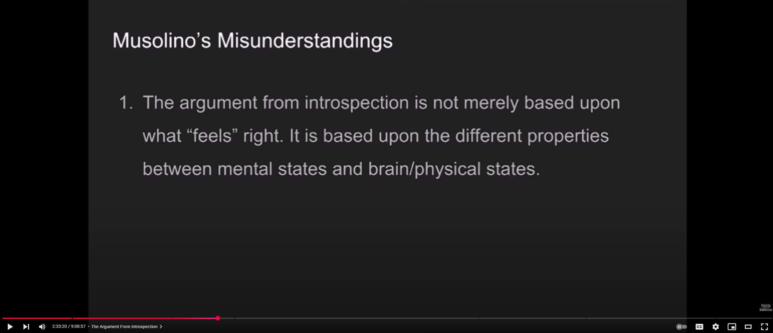
The Introspection Red Herring
Notes:
Note this clarification shows that introspection has little to do with the argument at all. The real issue is incompatible properties. Introspection is largely superfluous because (as David himself argues) physical states are not accessible to introspection (I would say that most physical states are not accessible to introspection, but some are). The issue here is whether our propositional knowledge about physical states is accurate. We can’t know this by introspection.

Slide 34
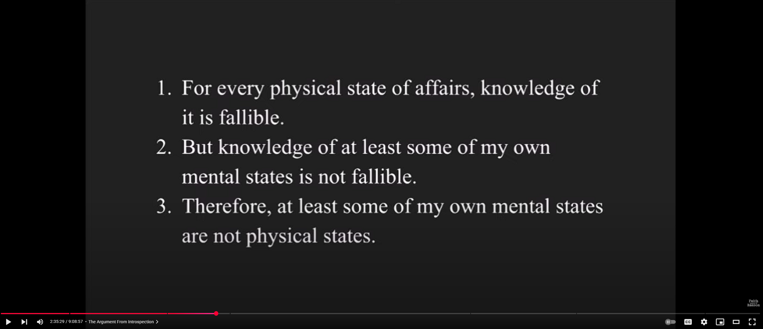
Argument from Introspection 2

Slide 35
Argument from Introspection 2
“I have never yet come across any objection to (this premise), let alone an account of how one might obtain infallible knowledge of physical objects. Presumably, whatever knowledge we have of physical objects is mediated by sensory experience.” (02:36:00).
Notes:
Obviously the physicalist will deny premise 1, since they think mental states are physical states. We can gain infallible knowledge of certain physical states by being the subject which experiences those states (i.e. mental states). Note the slippage in language between physical states and physical objects. As before, dualists don’t seem to know how to think about the mind as a physical entity. They think only of objects in space, not of complex physical processes evolving over time.

Slide 36
The Modal Argument

Slide 37
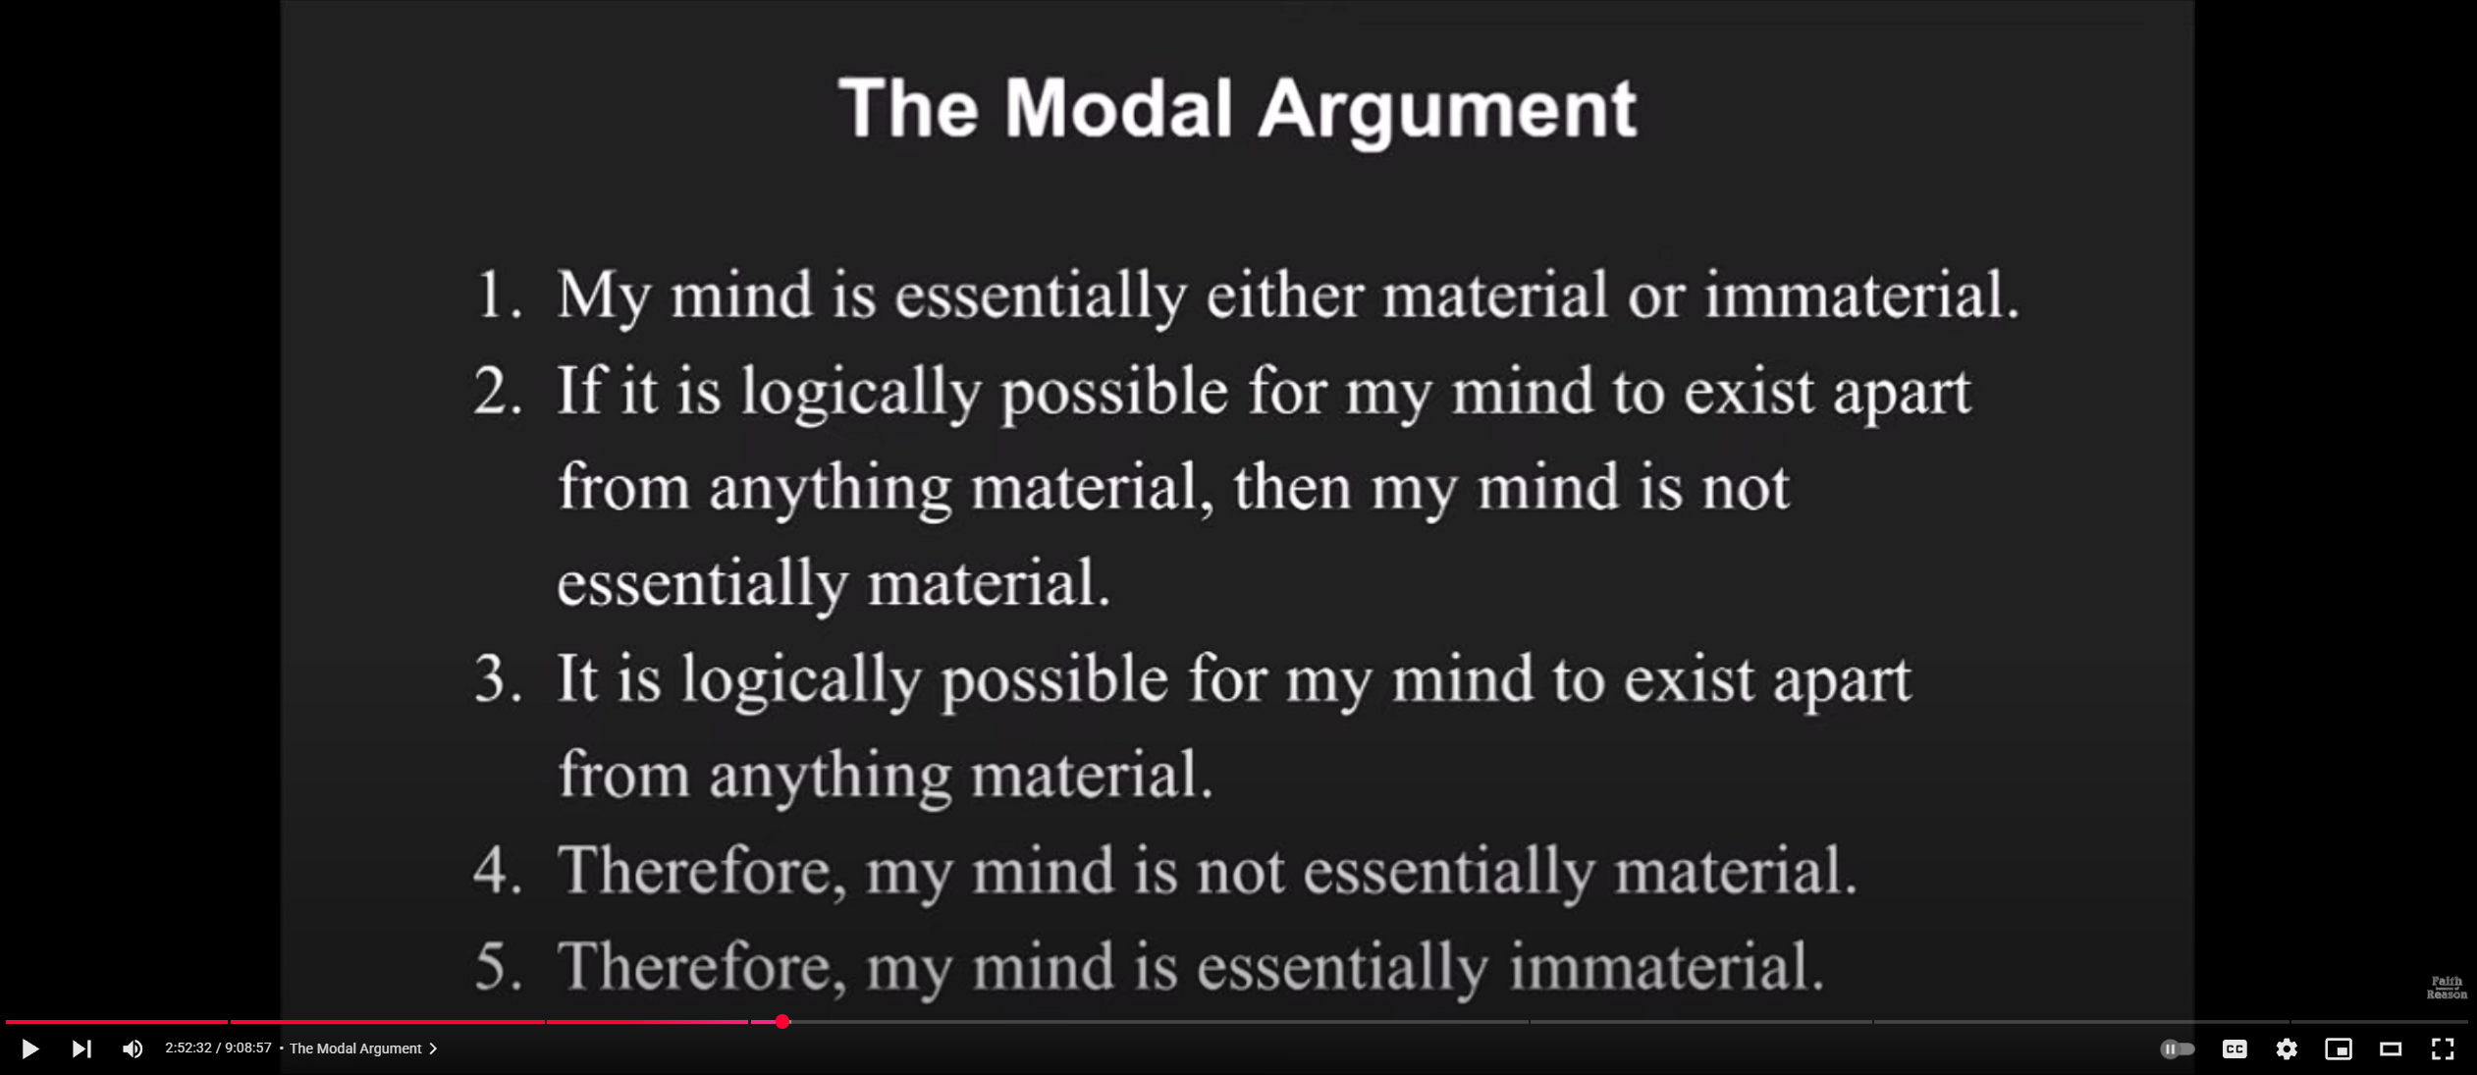
The Modal Argument
Notes:
The mind need not be ‘essentially’ either material or immaterial, it could be both or neither. Saying a property is essential means it couldn’t be different while retaining its identity. It is very strong for a materialist to claim this as an essential property of minds. They could simply say the mind is neither essentially material nor essentially immaterial – there is no necessary fact about its constitution or nature.
I think the type of modality being appealed to here is metaphysical rather than logical. Essential properties are usually understood as those which it would be metaphysically impossible for an entity not to have. Logical impossibility is much stronger.

Slide 38
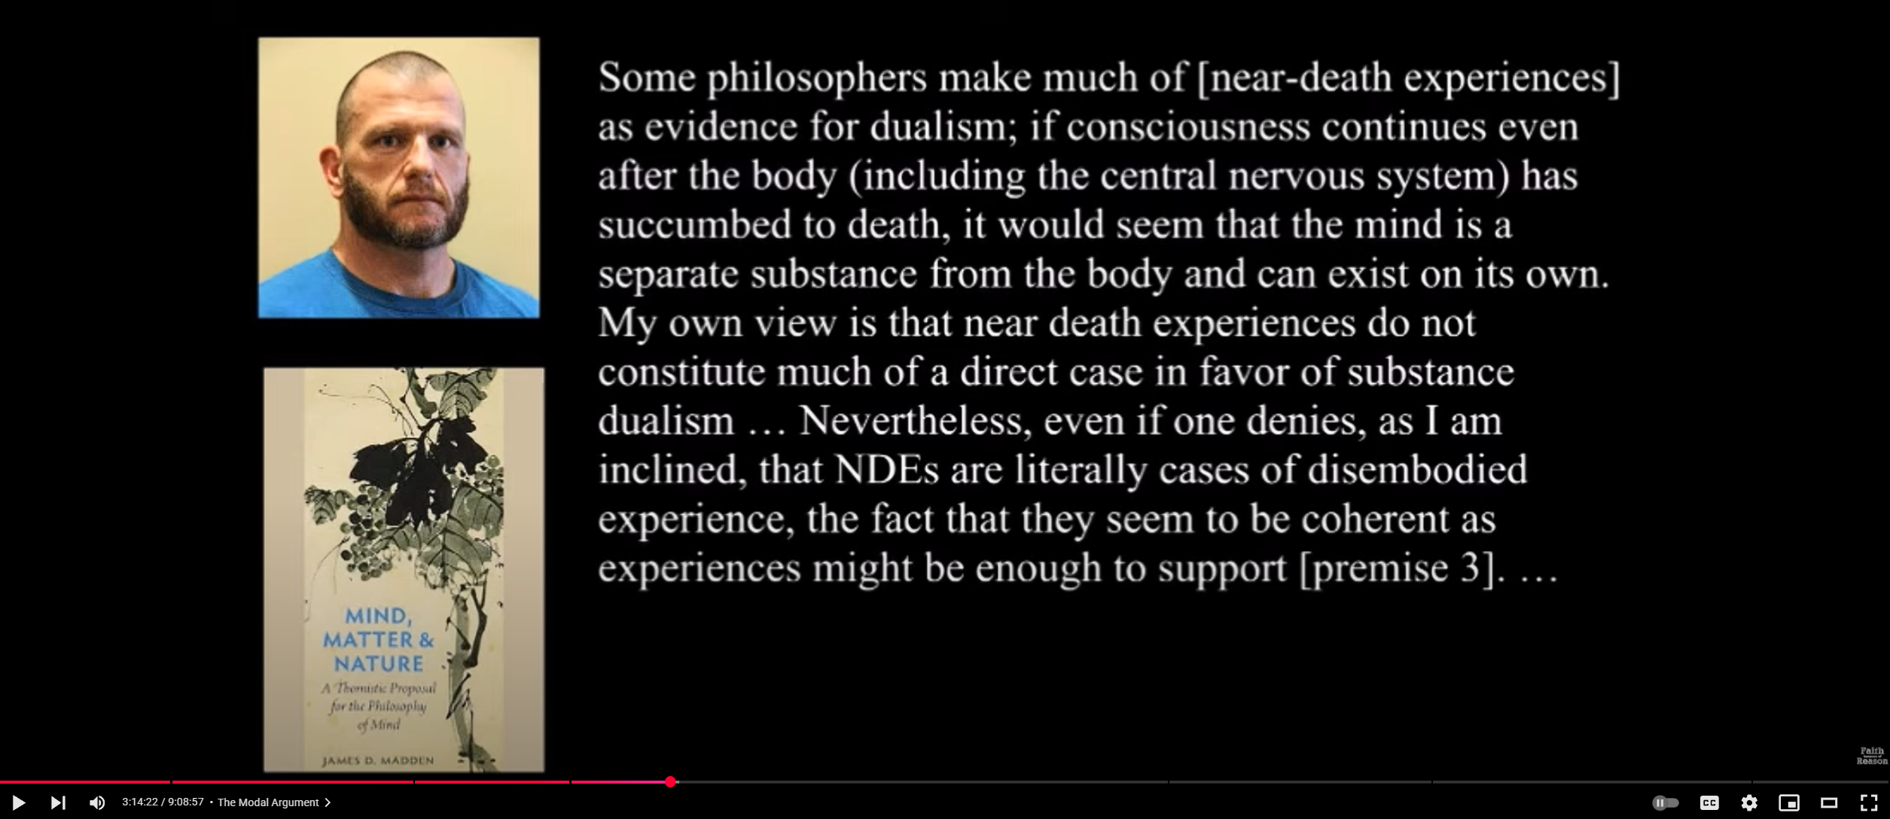
Defence of Premise 3

Slide 39
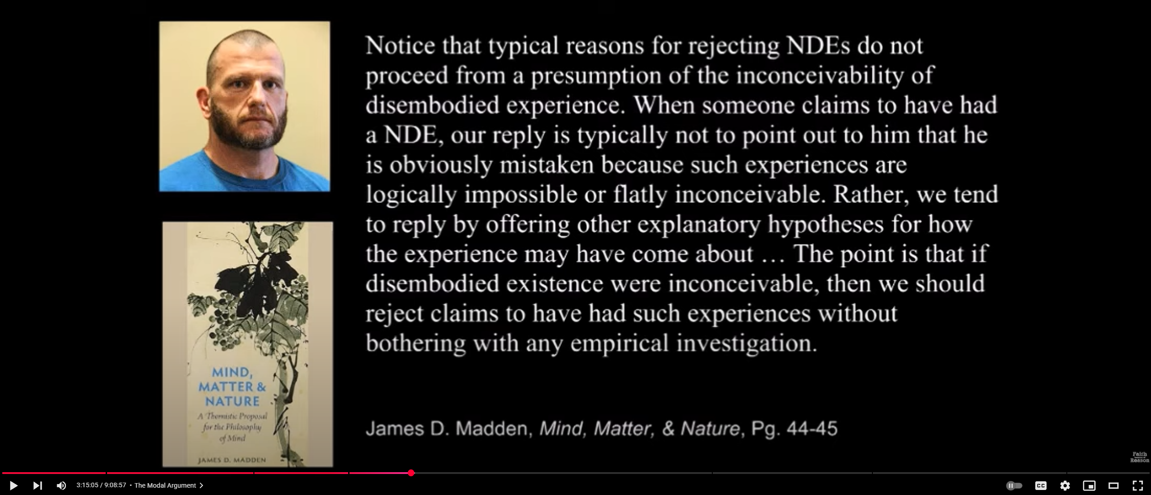
Defence of Premise 3
Notes:
I am incredibly skeptical of the notion that conceivability implies possibility. What is conceivable is dependent upon our epistemic status, so has no necessary connection to modal possibilities. For someone who knows nothing about biology, it is conceivable that a human body (without mechanical aids) could still walk around about react to stimuli after being dead (i.e. a Hollywood zombie). To someone who knows about biology this is simply not conceivable, because the chemical reactions that facilitate movement and perception are impossible without a reliable source of ATP, which requires oxygen from breathing and energy from eating. The philosopher who conceives of mind without any physical instantiation is like the person watching the Hollywood zombie movie without any idea of how biology works.

Slide 40
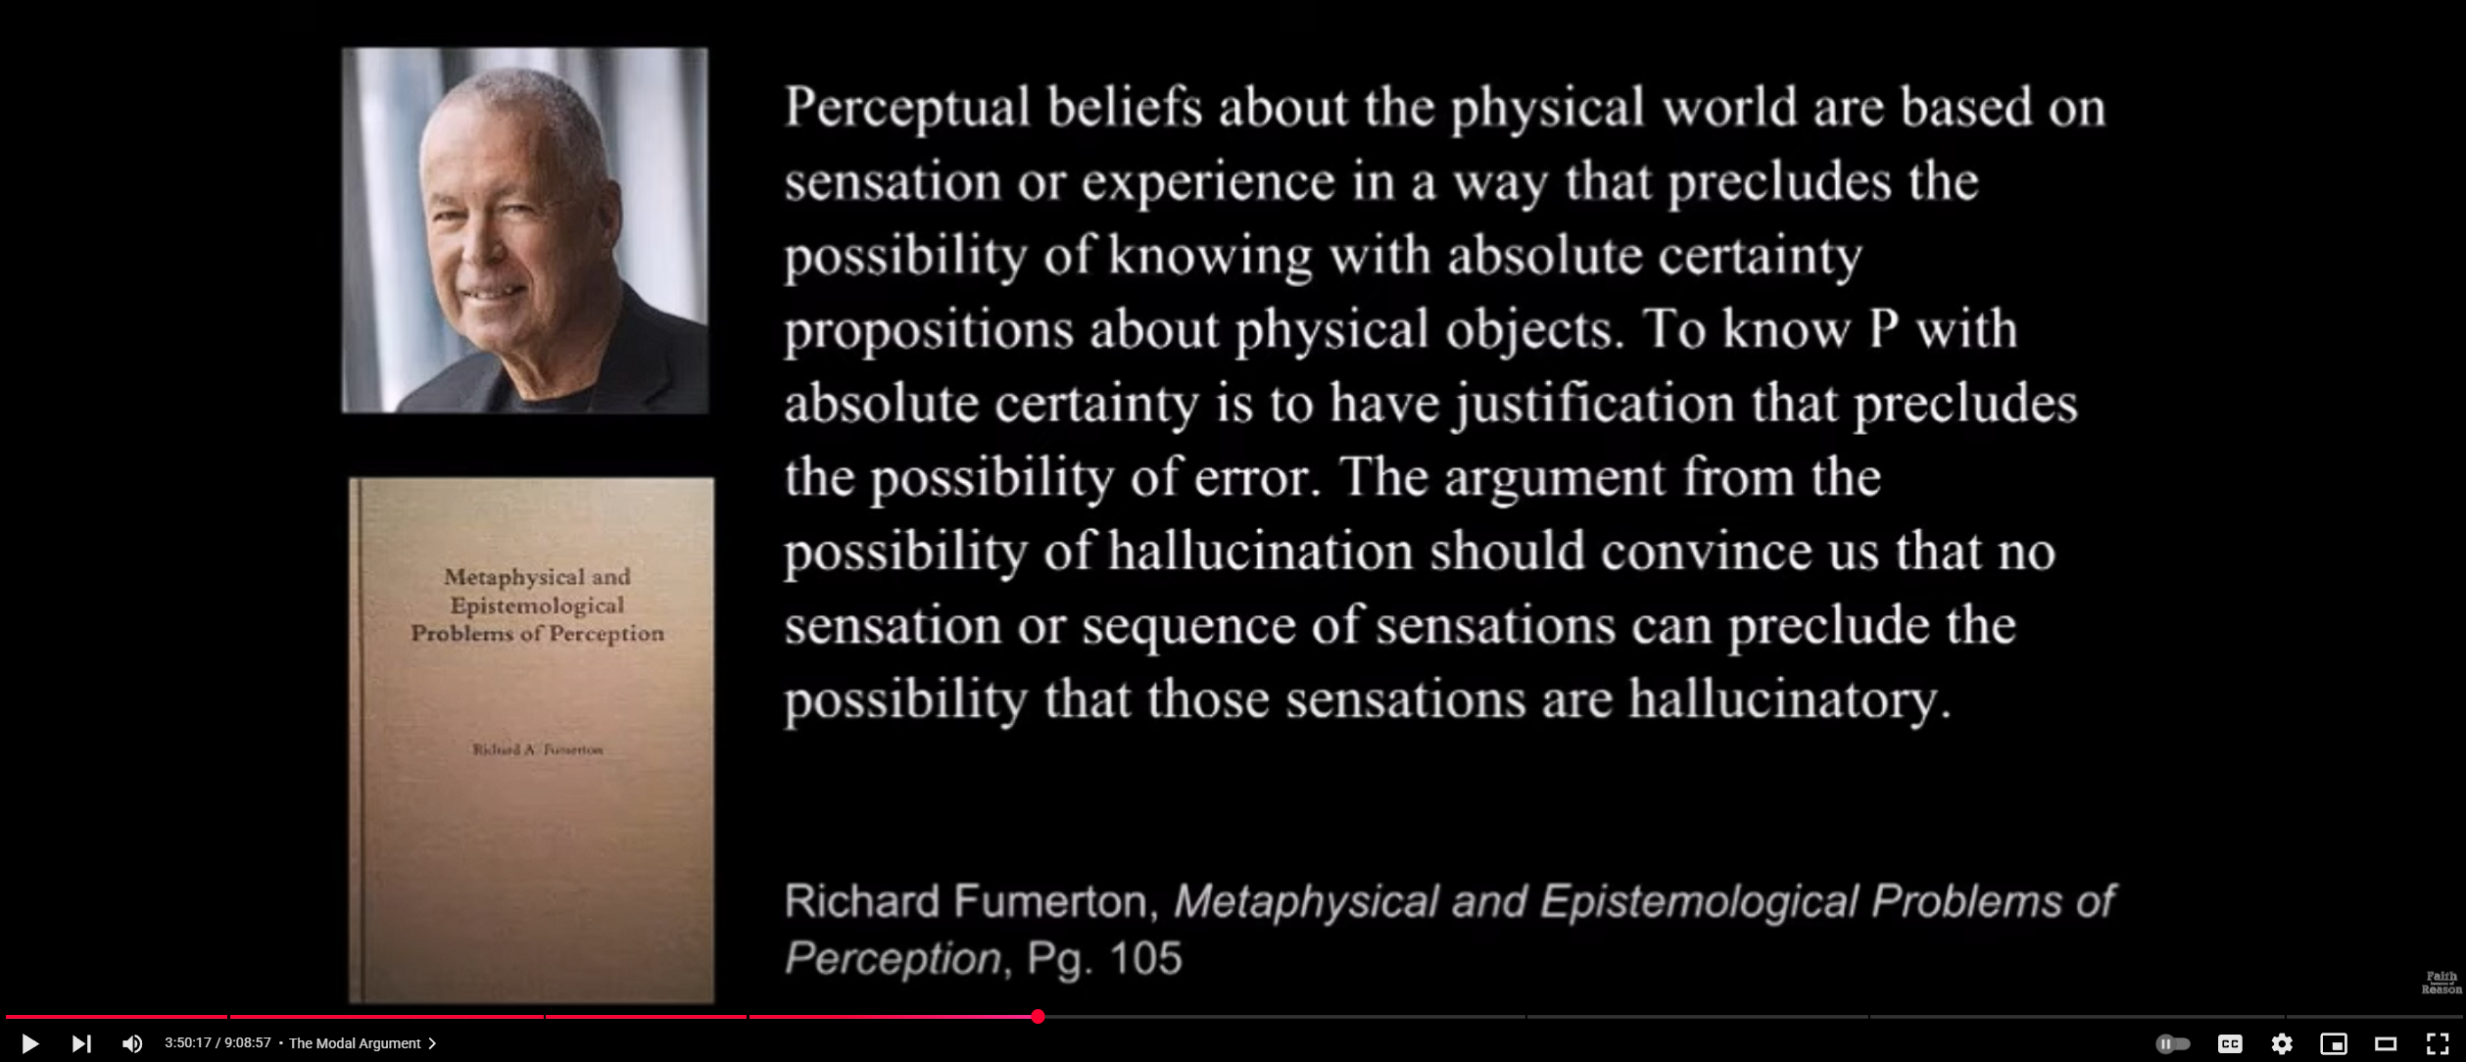
Defence of Premise 3

Slide 41
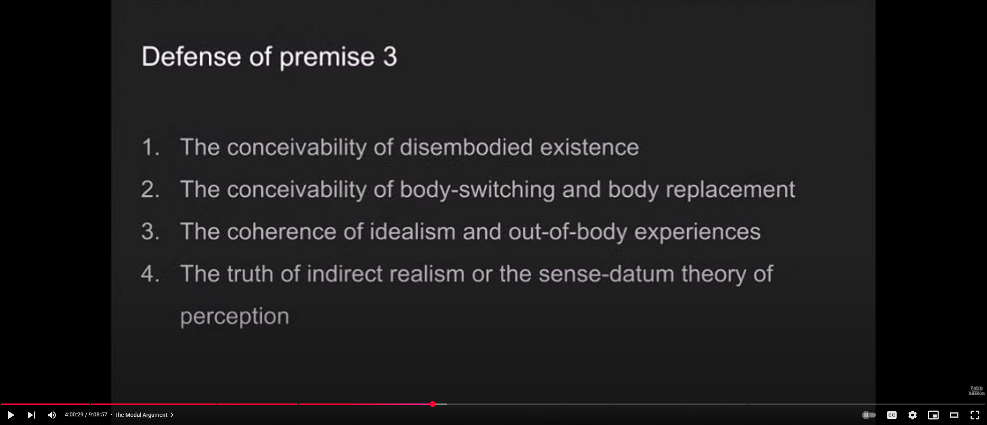
Defence of Premise 3

Slide 42
Defence of Premise 3

Slide 43
Defence of Premise 3

Slide 44
Conclusions

