Slide 1

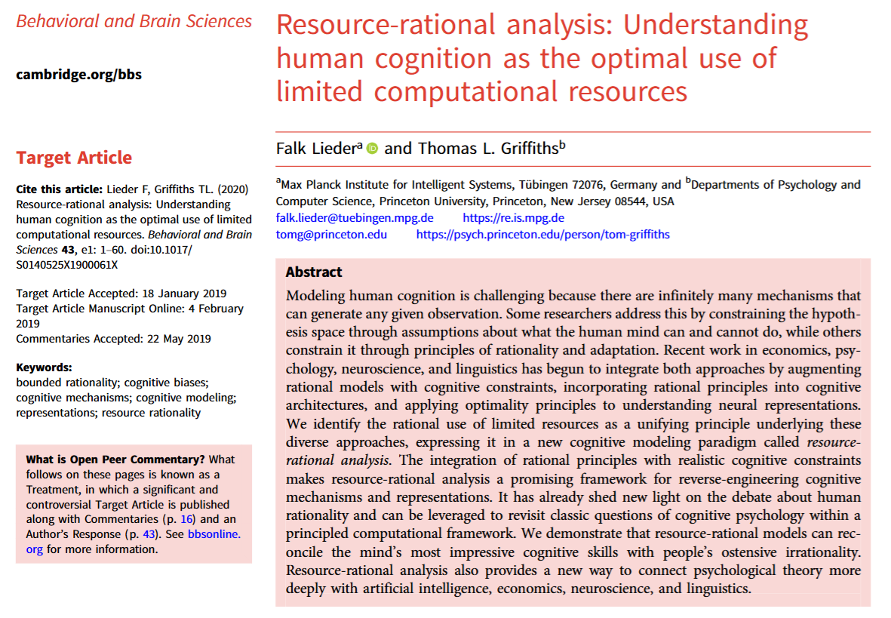
Resource-rational analysis
James Fodor
29th Oct 2024

Slide 2
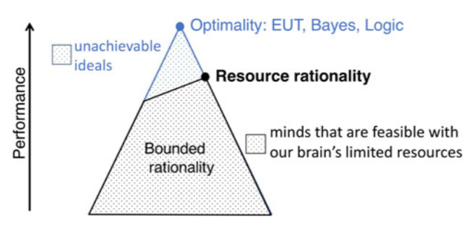
Background
How to infer the cognitive mechanisms underpinning any given behaviour?
“Inferring cognitive mechanisms and representations from limited experimental data is an ill-posed problem, because any behavior could be generated by infinitely many candidate mechanisms.”
Need some framework to generate and evaluate hypotheses.
Approach: combine rational choice approach with cognitive limitations.

Slide 3
Key Idea
“Rational analysis capitalizes on the functional constraints imposed by goals and the structures of the environment rather than the structural constraints imposed by cognitive architectures…
Its inductive bias toward rational explanations is often rooted in the assumption that evolution and learning have optimally adapted the human mind to the structure of its environment.”
“RRA’s assumption of bounded optimality is not a substantive claim about the mind but a methodological device to efficiently search through the endless space of possible mechanisms”

Slide 4
The Core Equation
Choose heuristic h to maximise net utility
Utility of the result of decision or judgement
Cost of using cognitive resources
S₀: information about initial state
B: brain
i: information about environment E
Distribution of environments E
Distribution of results
Utility of result
Distribution of resources ρ and times t
Cost of resources ρ for time t
NOTE: “This is a problem to be solved by evolution, cognitive development, and life-long learning.”

Slide 5
Five Steps
1. Start with a computational-level description of an aspect of cognition formulated as a problem and its solution.
2. Posit which class of algorithms the mind’s computational architecture might use to approximately solve this problem, the cost of the computational resources used by these algorithms, and the utility of more accurately approximating the correct solution.
3. Find the algorithm in this class that optimally trades off resources and approximation accuracy (Core Equation).
4. Evaluate the predictions of the resulting model against empirical data.
5. Refine the computational-level theory (step 1) or assumed computational architecture and its constraints (step 2) to address significant discrepancies, and then reiterate.

Slide 6
Is the Theory Normative?
“We can … derive the optimal heuristic h* that a person should use to make a single decision or inference in a particular situation.”
“Bounded optimality provides a realistic normative standard for cognitive strategies and representations.”
“Bounded optimality might … provide a normative standard against which human performance can be compared to characterize in which ways people’s heuristics deviate from resource-rational strategies.”
“Resource rational minds are optimal because they maximize the agent’s utility in the long run within the limits of what the agent is capable of.”
“Resource rationality is not a fully fleshed out theory of cognition, designed as a new standard of normativity against which human judgments can be assessed, but a methodological device that allows researchers to translate their assumptions about cognitive constraints into precise mathematical models of cognitive processes and representations.”

Slide 7
What are Cognitive Constraints?
“Our theory assumes that the cognitive limitations inherent in the biologically feasible minds include a limited set of elementary operations (e.g., counting and memory recall are available but applying Bayes’ theorem is not), limited processing speed (each operation takes a certain amount of time), and potentially other constraints, such as limited working memory.”
“Resource limitations reflect anatomical, physiological, and metabolic constraints on neural information processing as discussed below as time constraints, but they can be modelled at a higher level of abstraction (e.g., in terms of processing speed or multi-tasking capacity)”
“We acknowledge that, to date, measuring cognitive constraints remains challenging and often requires additional assumptions.”

Slide 8
Concerns and Complications
Is it really easier to independently characterise cognitive constraints?
Is it plausible for evolution/experience to optimise over contemporary environments?
Theory does not specify how information about the environment is learned.
Theory seems to imply there is a single optimal heuristic across all environments.
The optimal heuristic may depend on the form of the utility function.

Slide 9
Discussion?

