Slide 1

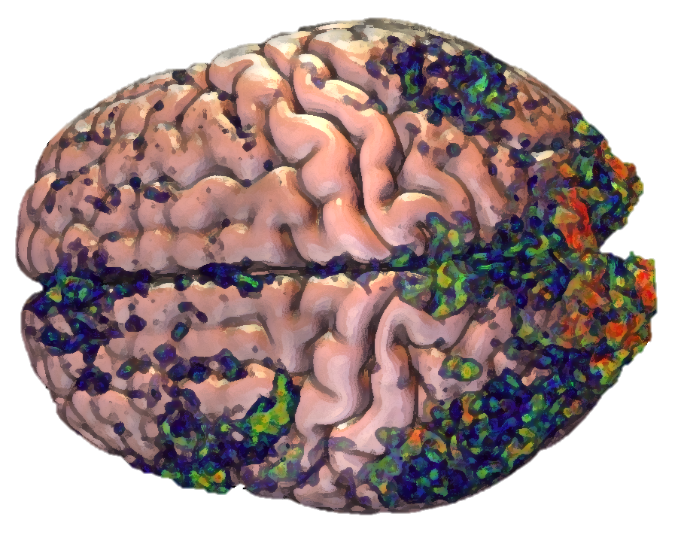
Representations of Sentence Meaning in the Brain
James Fodor
24th July 2024

Slide 2
Background

Slide 3
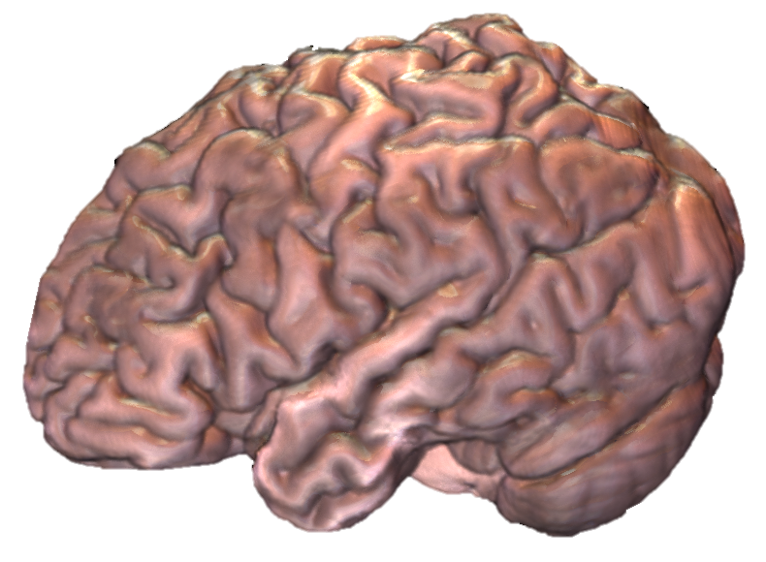
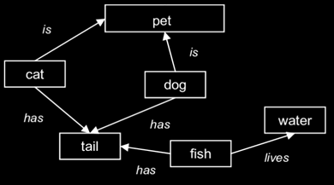
What is Semantics?
Semantics is the study of meaning.
How does the brain represent the meaning of a word?
How does the brain combine words into sentences?

Slide 4
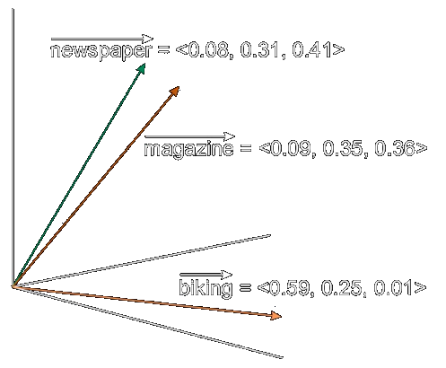
Word Embeddings
Word embeddings represent the meaning of a word as a vector of numbers.
Embeddings live in ‘semantic space’.
More similar vectors = more similar meaning.
Basis for LLMs like ChatGPT.

Slide 5
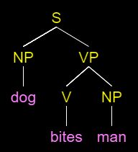

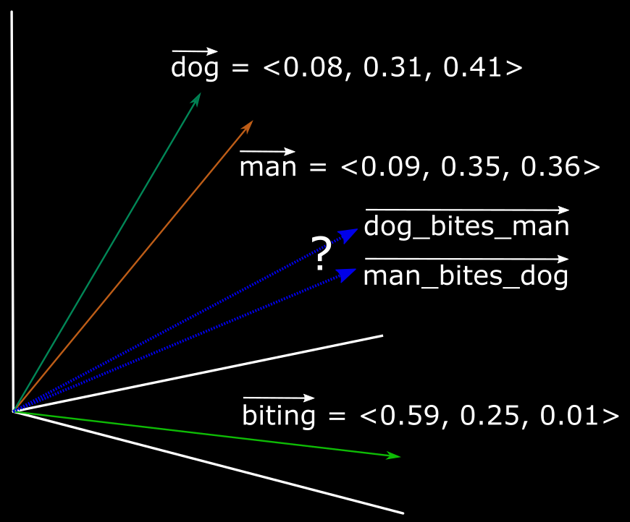
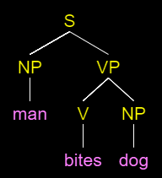

Compositionality
How to represent an entire sentence or phrase?
Order and context of words matter.
Bite(DOG,MAN)
Bite(MAN,DOG)

Slide 6
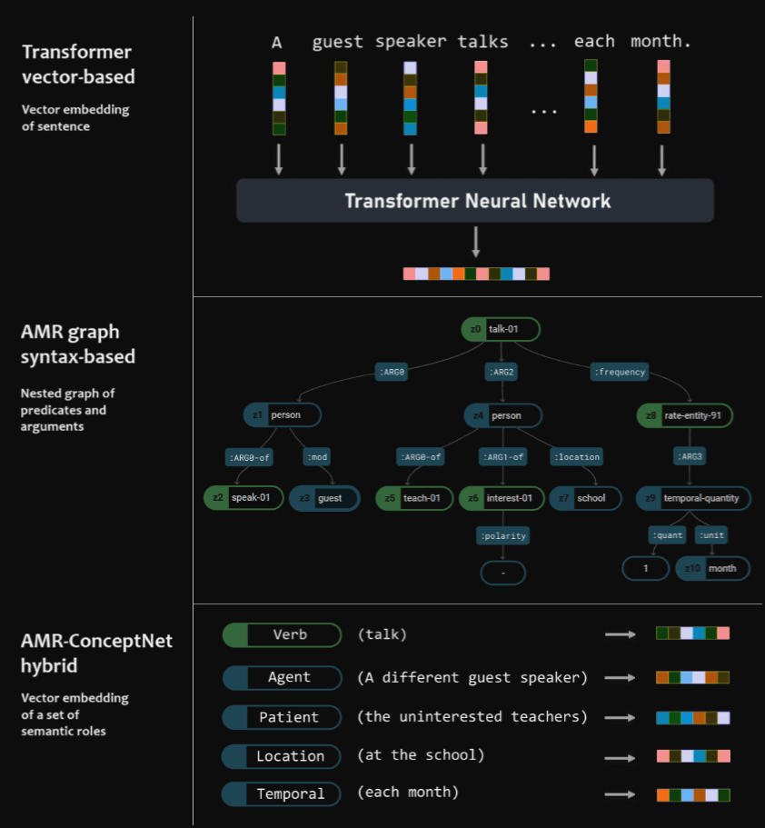
Ways to Represent Sentences
Many proposals for how to represent sentences.
Three basic classes:
  Connectionist/vector-based.
  Parse trees/syntax-based.
  Hybrid models.
Example sentence: “A different
guest speaker talks to the uninterested teachers at the school each month.”

Slide 7
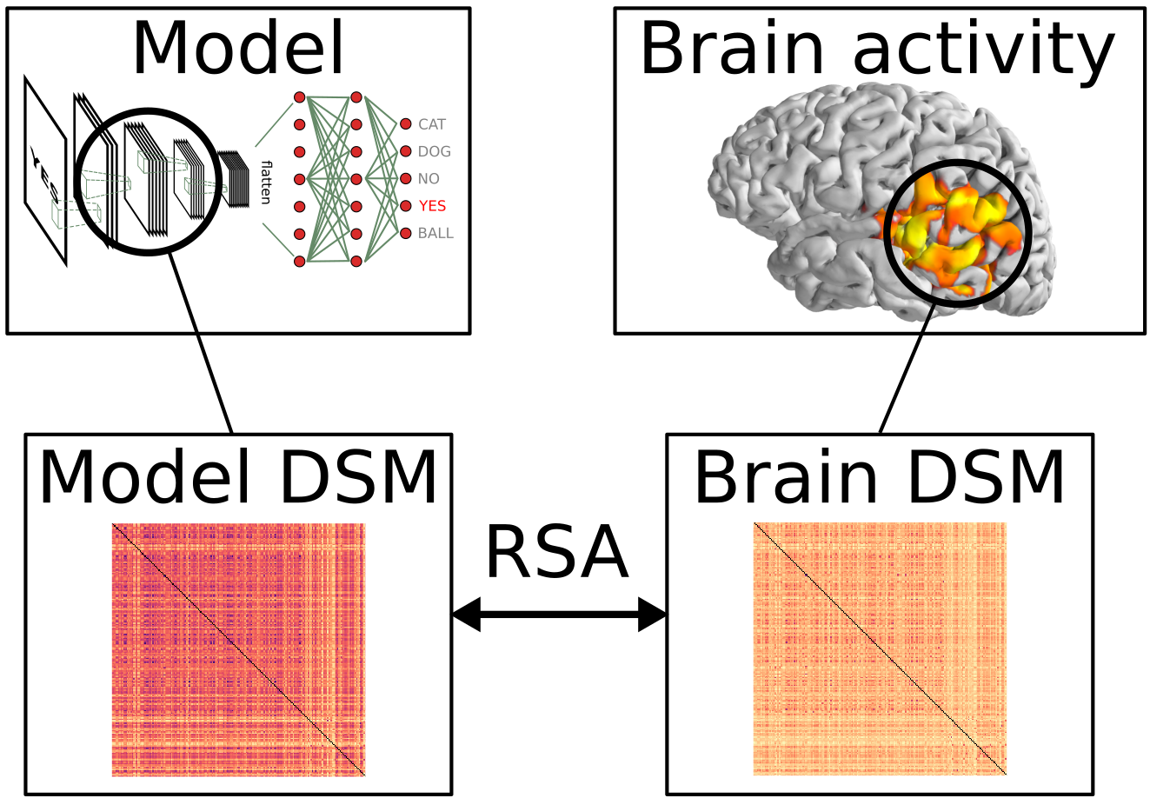
Testing Models Against the Brain
Present stimuli as text or audio while participant in scanner.
Compare brain activity to predictions of different sentence models.

Slide 8
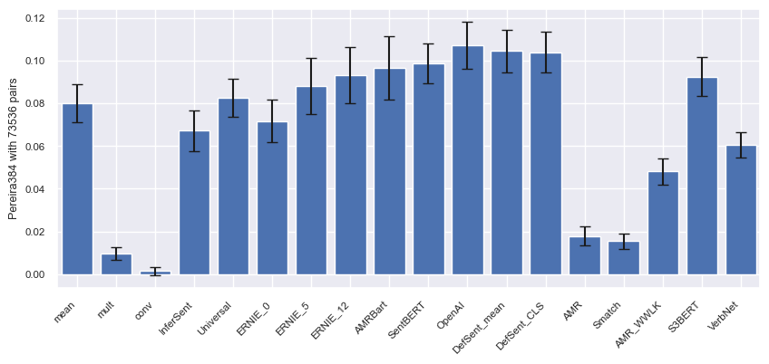
Results by Model (Pereira 2018)
Correlation of pairwise sentence similarities for brain data and models.
Most models perform similarly to ‘mean’ baseline.

Slide 9
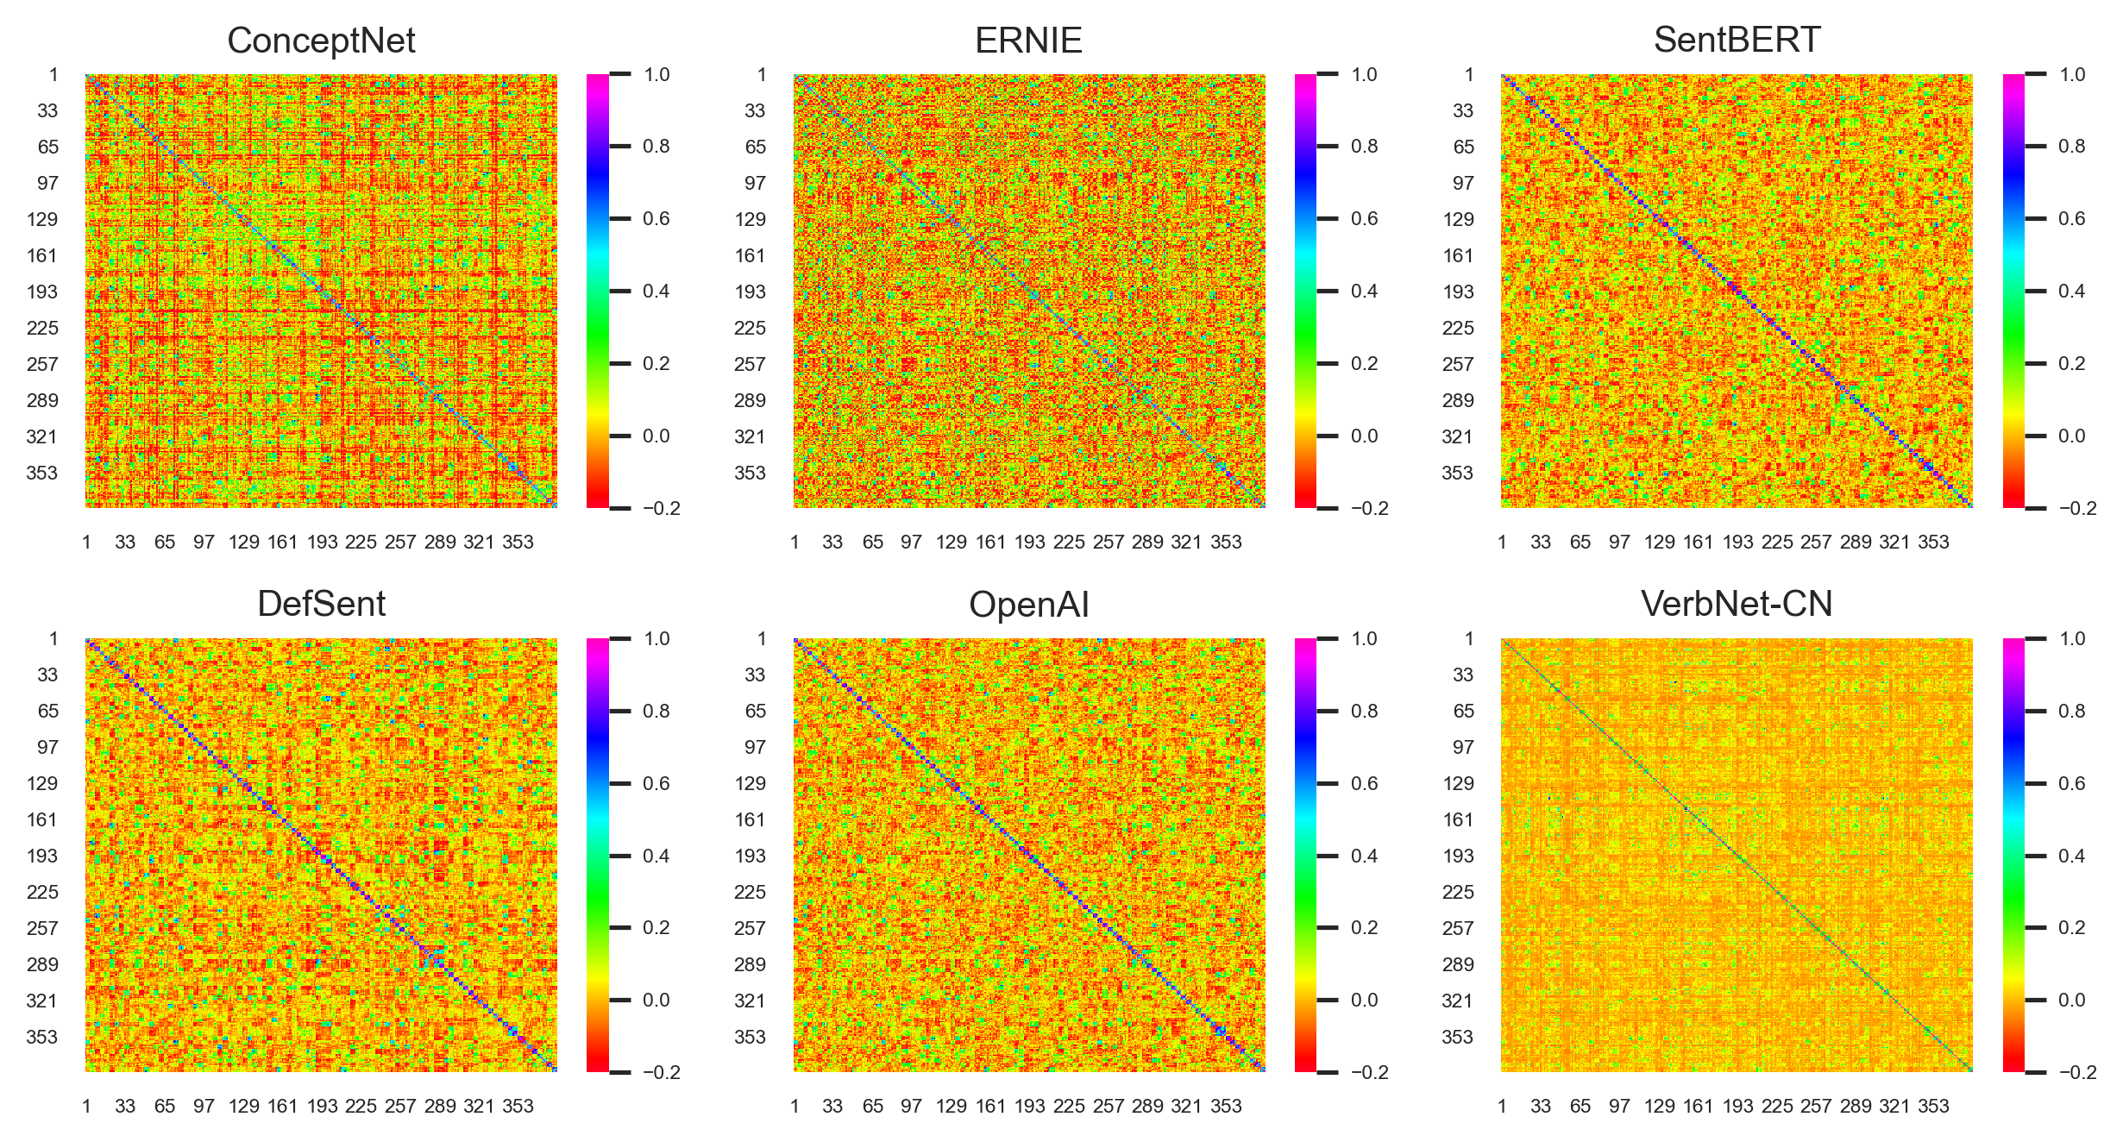
Why no Better Results?
Representational Similarity Matrix for six models for set of 384 sentences.
Sentences too dissimilar, and don’t vary systematically.

Slide 10
Methods

Slide 11
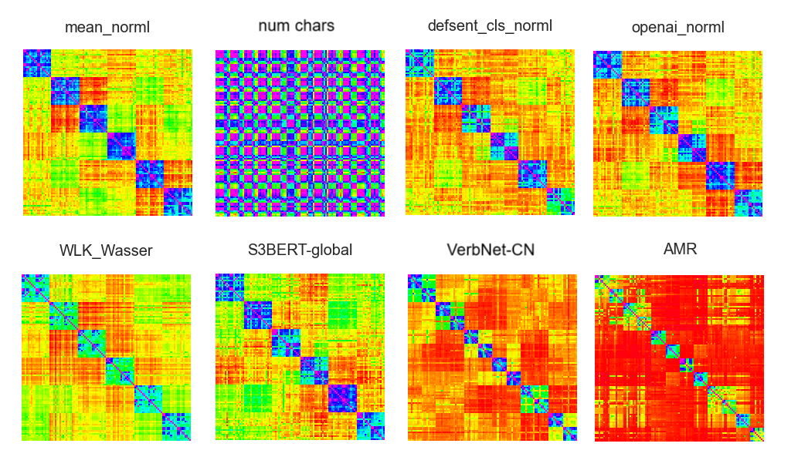
The Need for Better Data…
The company purchased the apartment block from the family.
The family blocked the purchase of the apartment by the company.

Slide 12

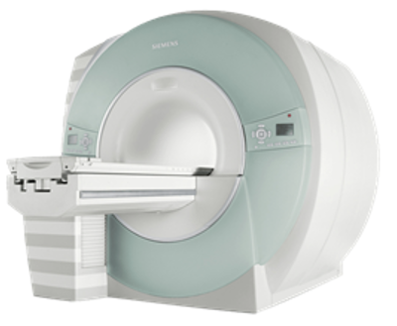
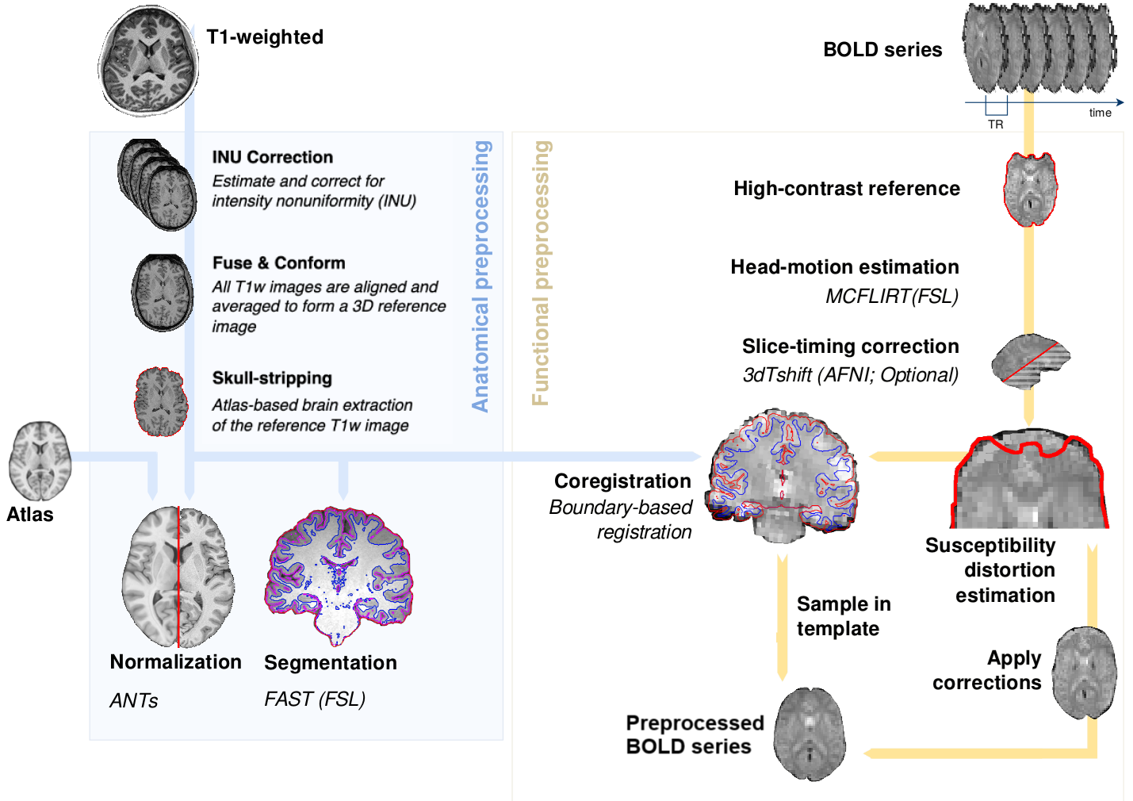
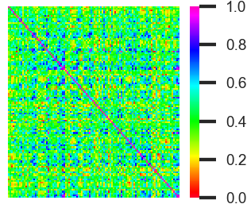
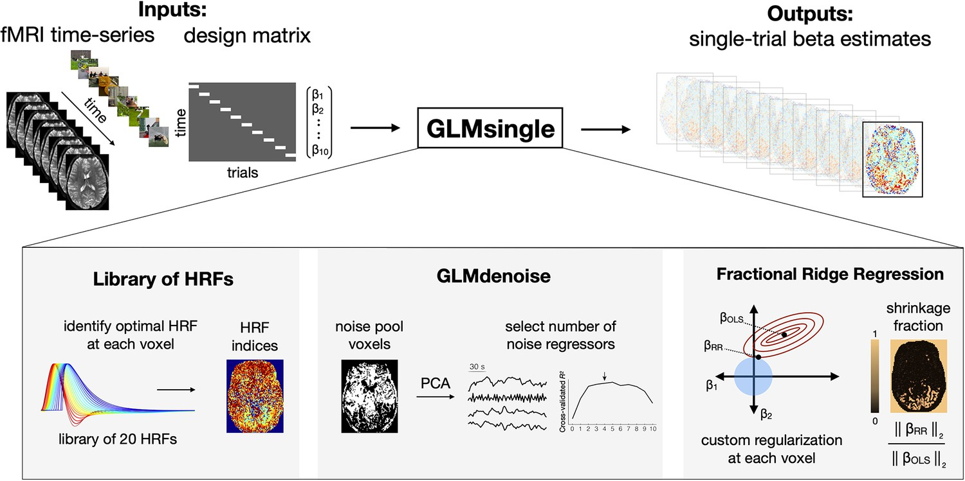
Study Pipeline
The cameraman brought the equipment to the director.
The cameraman brought the new equipment to the director.
A painter brought the equipment to the director.
Every morning the cameraman brought the equipment to the impatient director.
A team of cameramen brought all the necessary equipment to the busy director.
1. Sentences
2. PsychoPy task
3. fMRI scan
4. fMRIprep preprocessing
7. Model/brain correlations
6. RSA matrix
5. GLM regression

Slide 13
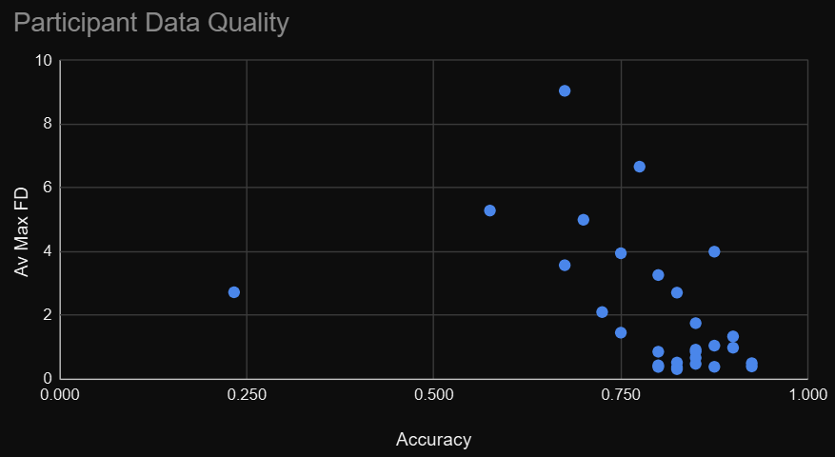
Participant Recruitment
Right-handed native English speakers aged 18-40.
33 participants recruited, of which 29 scanned.
Average age: 23; Gender: 20 women, 12 men, 1 other.
6 excluded due to low accuracy and/or head motion, leaving 23 so far.

Slide 14



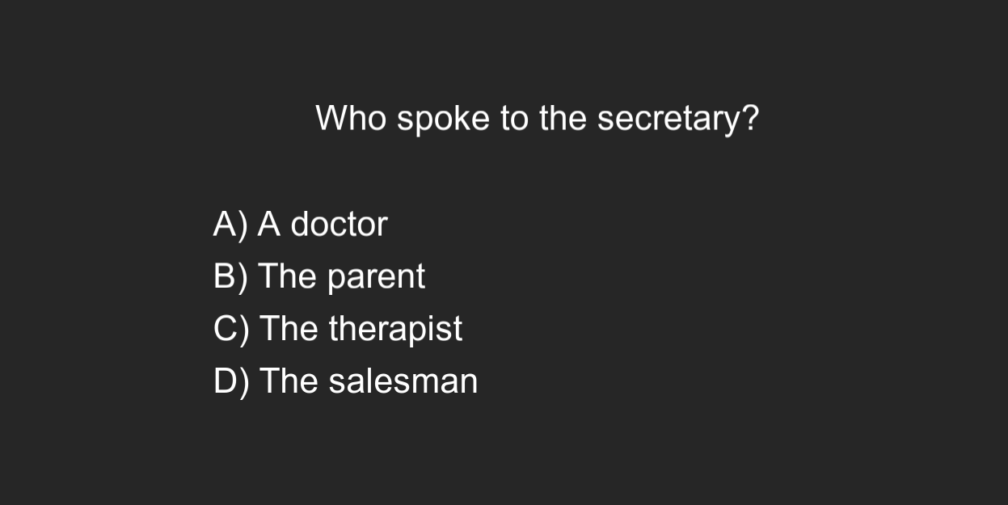
Sentence Reading Task
108 sentences each shown four times over eight runs.
Five multi-choice questions each run (5 second).
Entire sentence shown at once on a timer (~3-8 seconds).
The cameraman brought the equipment to the director. | The director brought the cameraman to the equipment.
The cameraman brought the new equipment to the director. | The director brought the cameraman to his equipment.
A painter brought the equipment to the director. | The director brought his cameraman a hot lunch.
Every morning the cameraman brought the equipment to the impatient director. | Every morning the director brought the cameraman to the expensive equipment.
A team of cameramen brought all the necessary equipment to the busy director. | The director inexplicably brought the cameraman to the useless old equipment in the storeroom.
The cameraman begrudgingly brought the awkward equipment up from the basement to the director. | The renowned director brought the impatient cameraman to the equipment from his last project.

Slide 15
Preprocessing
Preprocessing performed using fMRIPrep.
Motion correction, skull-stripping, coregistration, normalisation.

Slide 16
GLM Regression
General Linear Model estimated using GLMSingle.
Automatically extracts noise signals from BOLD data.
Fits HRFs to each voxel from a library based on data.

Slide 17
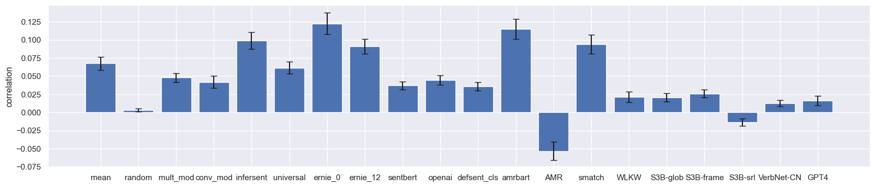
Representational Similarity Analysis
Voxels selected using a cortical mask and a language ROI mask.
Stability score: measures consistency of voxel response over repeated trials.
Set of pairwise cosine similarities of voxel activation patterns computed for each pair of sentences.
Compute correlation between set of similarities between models and data.

Slide 18
Results

Slide 19
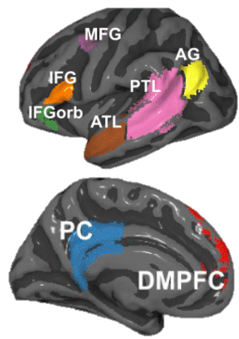
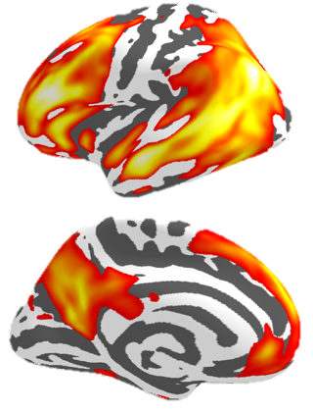
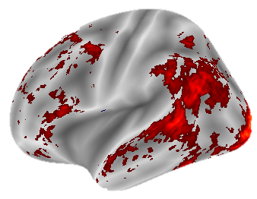
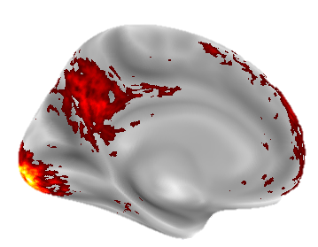
Model vs Brain Correlations
Language regions strongly activated.

Slide 20
Model vs Brain Correlations
Stable cortical voxels, all sentence pairs.

Slide 21
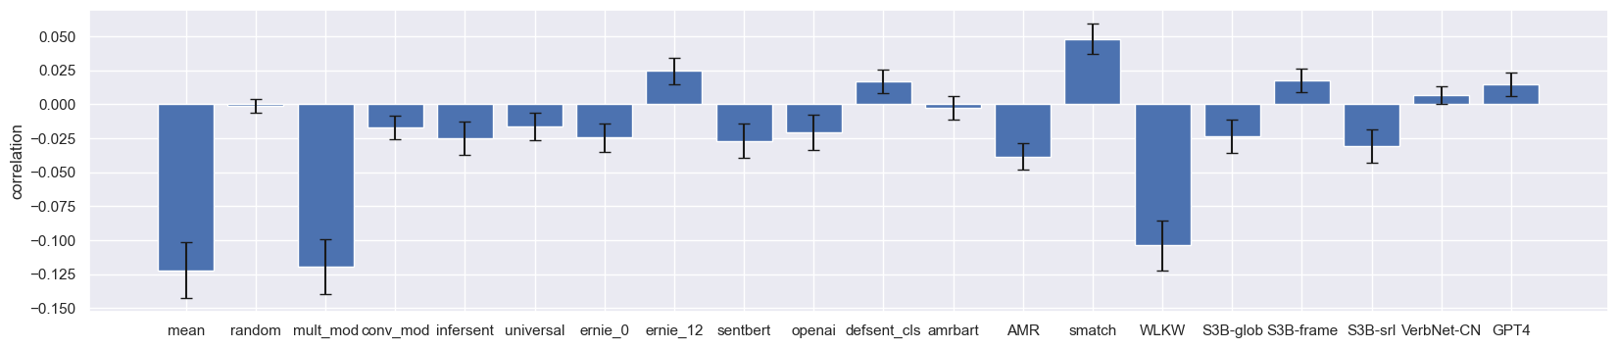
Model vs Brain Correlations
Stable cortical voxels, only diagonal sentence pairs.

Slide 22
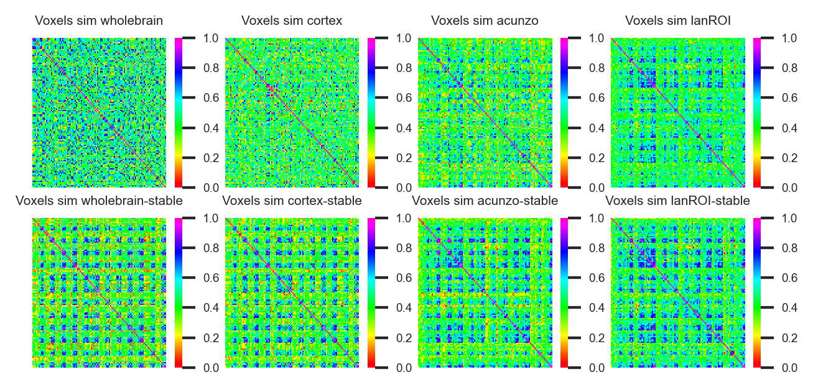
Surface Projections of Stability Scores
All sentence pair RSA matrices averaged over all participants.

Slide 23
Discussion

Slide 24
Interpreting Results
Consistent evidence that transformers outperform other methods for all sets of sentences.
BUT: the newest transformers are not consistently the best.
The adversarial manipulation succeeded in confounding the mean model.
Structure-sentence models do best on the diagonal (“tricky”) sentences.
Evidence for encoding of syntax or structure separately from meaning.

Slide 25
Next Steps
Finish collecting data for remaining ~10 participants.
Explore RSA searchlight techniques.
See if there is a correlation between question accuracy and model correlation.
Implement some more complex hybrid models.
Investigate additional subsets of sentence pairs.
Collect and evaluate complementary behavioural data.

Slide 26
Questions?

