Slide 1

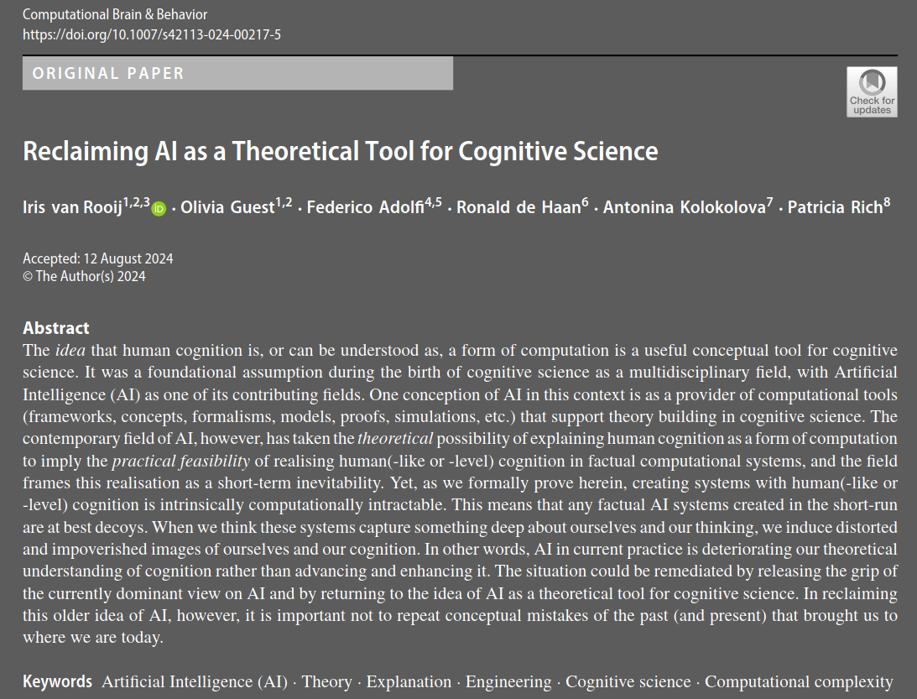
Is AI Provably Intractable?
James Fodor
20th May 2025

Slide 2
Act 1: The Background

Slide 3
What is AI?
This domain generality can be seen as a key property of human intelligence, so that AGI would be human-level AI, able to incorporate arbitrary beliefs to solve arbitrary new problems.
Among the more troublesome meanings of ‘AI’, perhaps, is the ideology that it is desirable to replace humans (or, specifically women) by artificial systems and, generally, ‘AI’ as a way to advance capitalist, kyriarchal, authoritarian and/or white supremacist goals.
We set out to release the grip of the currently dominant view on AI (viz., AI-as-engineering aiming at a human-level AI system).

Slide 4
Goal of the Paper
This practice has taken the theoretical possibility of explaining human cognition as a form of computation to imply the practical feasibility of realising human(-like or -level) cognition in factual computational systems, and it is framing this realisation as a short-term inevitability.
In this paper, we undercut these views by presenting a mathematical proof of inherent intractability (formally, NP-hardness) of the task that these AI engineers set themselves.
This intractability implies that any factual AI system created in the short-run (say, within the next few decades or so) is so astronomically unlikely to be anything like a human mind that claims of ‘inevitability’ of AGI within the foreseeable future are revealed to be false and misleading.

Slide 5
The Setup
We do this by introducing a thought experiment in which a fictive AI engineer, Dr. Ingenia, tries to construct an AGI under ideal conditions.
Dr. Ingenia has perfect data, sampled from the true distribution.
They also have access to any conceivable ML method—including presently popular ‘deep learning’ based on artificial neural networks (ANNs) and any possible future methods—to train an algorithm (“an AI”).
We then present a formal proof that the problem that Dr. Ingenia sets out to solve is intractable (formally, NP-hard).

Slide 6
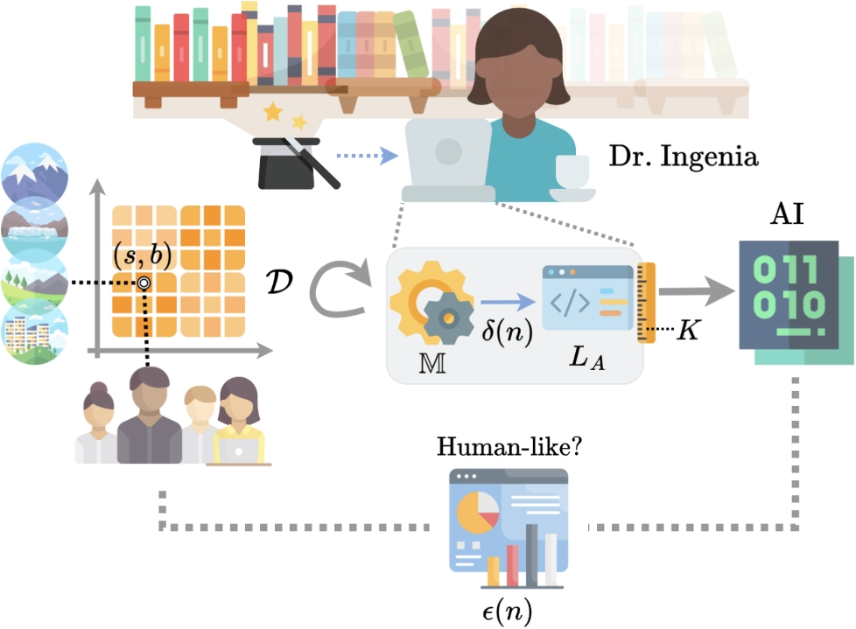
The Setup
Take samples from (situation, behaviour) pairs.
Use them to train the AI.
Check against new samples.

Slide 7
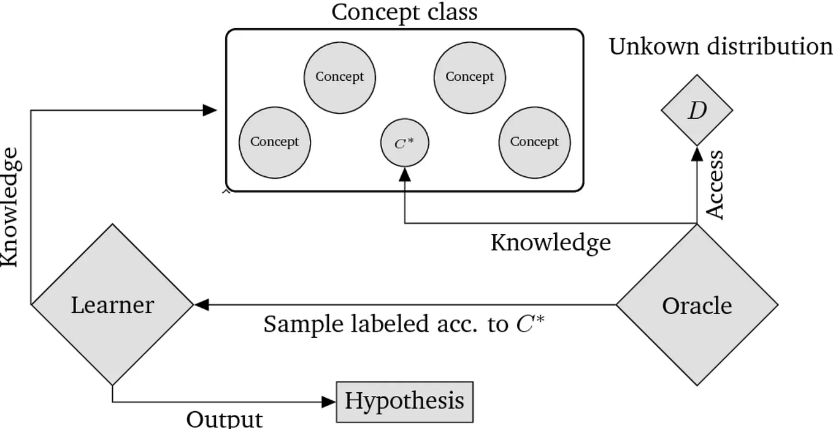
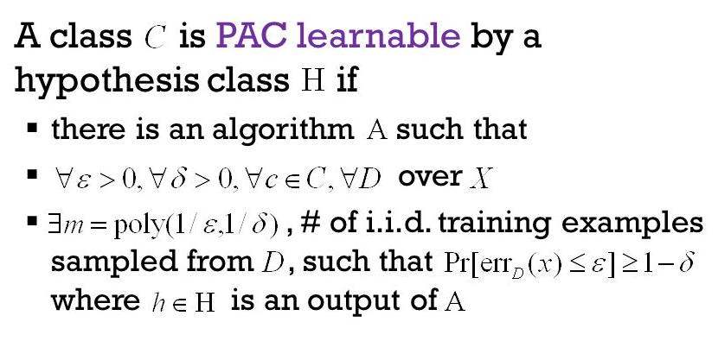
Probably Approximately Correct Learning
Take samples from (situation, behaviour) pairs.
Use them to train the AI.
Check against new samples.

Slide 8
Act 2: The Theorem

Slide 9
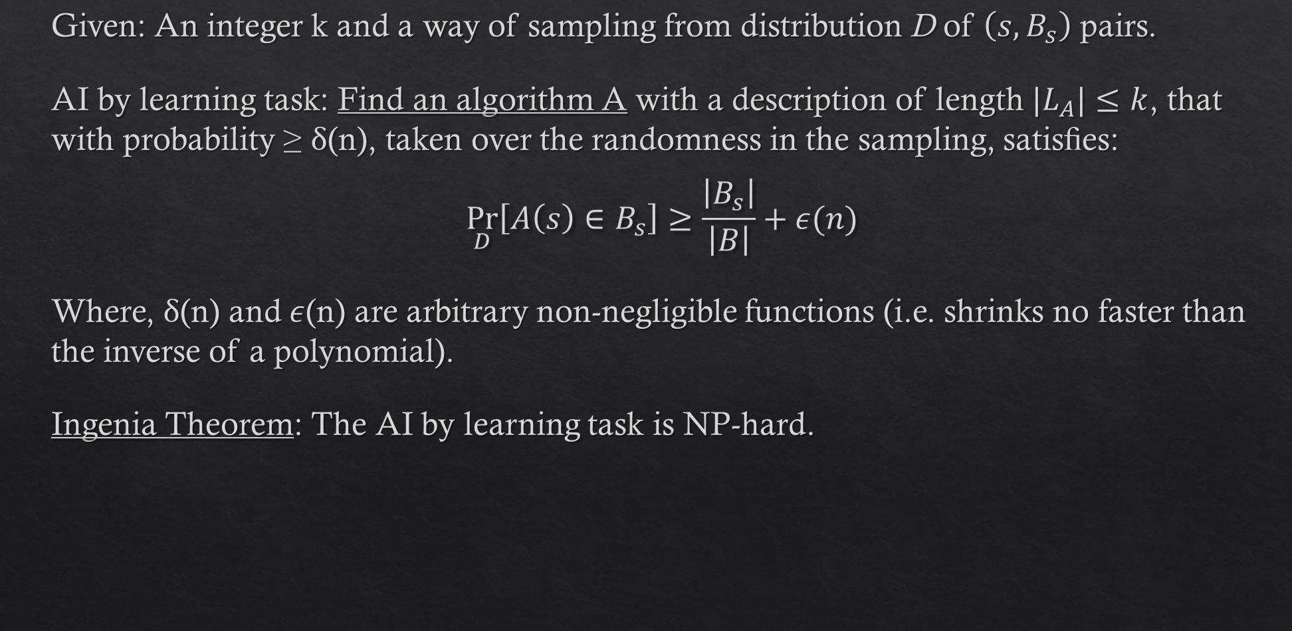
The Theorem
Given: An integer k and a way of sampling from distribution D of $\left(s,B_{s}\right)$ pairs.
AI by learning task: Find an algorithm A with a description of length $|L_{A}|≤k$, that with probability ≥ δ(n), taken over the randomness in the sampling, satisﬁes:
$$\underset{D}{Pr}\left[A\left(s\right)∈B_{s}\right]≥\frac{\left|B_{s}\right|}{\left|B\right|}+ε(n)$$
Where, δ(n) and $ε$(n) are arbitrary non-negligible functions (i.e. shrinks no faster than the inverse of a polynomial).
Ingenia Theorem: The AI by learning task is NP-hard.

Slide 10
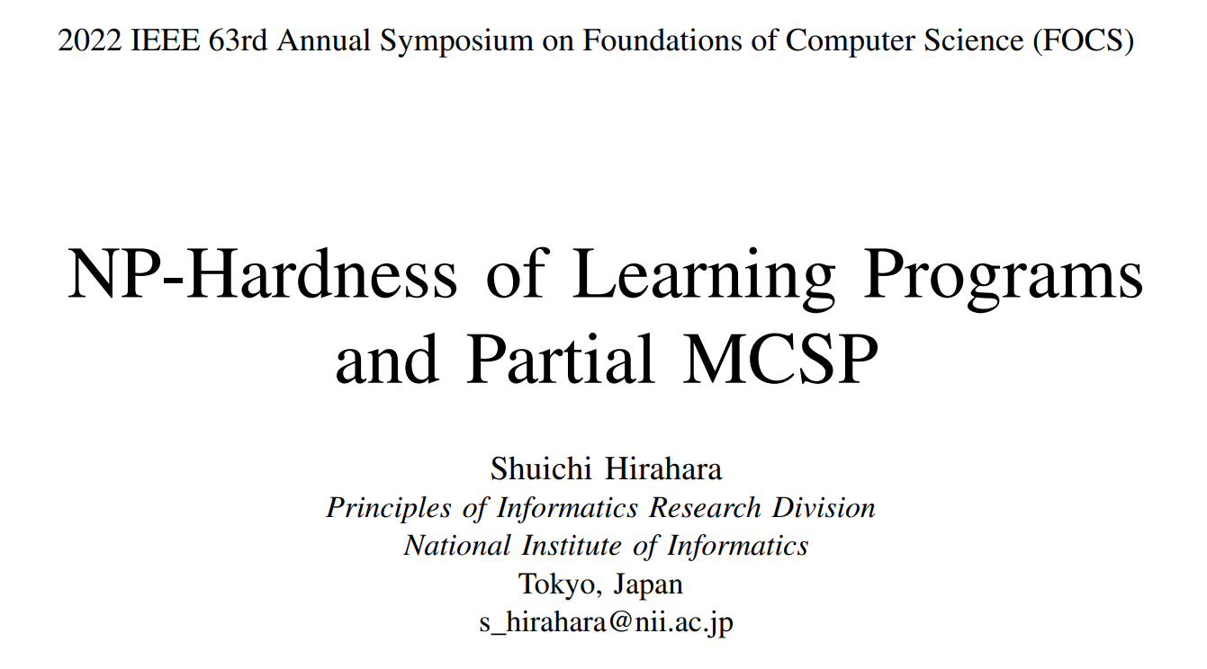
The Proof
Proof is by reduction to ‘perfect vs chance’ problem.
If you can tractably solve AI by learning, then you can tractably solve perfect vs chance. But tractably solving perfect vs chance is impossible. So you can’t tractably solve AI by learning.

Slide 11
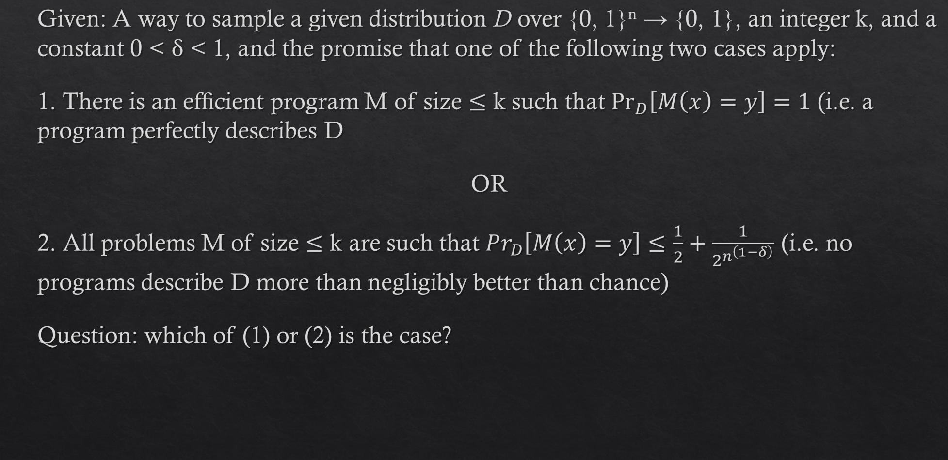
Perfect vs Chance Problem
Given: A way to sample a given distribution D over {0, 1}^{n} → {0, 1}, an integer k, and a constant 0 < δ < 1, and the promise that one of the following two cases apply:
1. There is an efﬁcient program M of size $≤$ k such that $\underset{D}{Pr}\left[M\left(x\right)=y\right]=1$ (i.e. a program perfectly describes D
OR
2. All problems M of size $≤$ k are such that $Pr_{D}\left[M\left(x\right)=y\right]≤\frac{1}{2}+\frac{1}{2^{n^{\left(1−δ\right)}}}$ (i.e. no programs describe D more than negligibly better than chance)
Question: which of (1) or (2) is the case?

Slide 12
Minimum Circuit Size Problem
“A problem closely related to PAC learning is the Minimum Circuit Size Problem (MCSP). The input of MCSP consists of a Boolean function f : {0, 1}^{n} → {0, 1} represented as the truth table of length 2^{n} as well as a size parameter s ∈ N, and the task is to decide whether there exists a circuit of size s that computes f.
Although it is easy to see that MCSP ∈ NP, it is a long-standing open problem to prove NP-hardness of MCSP.”

Slide 13
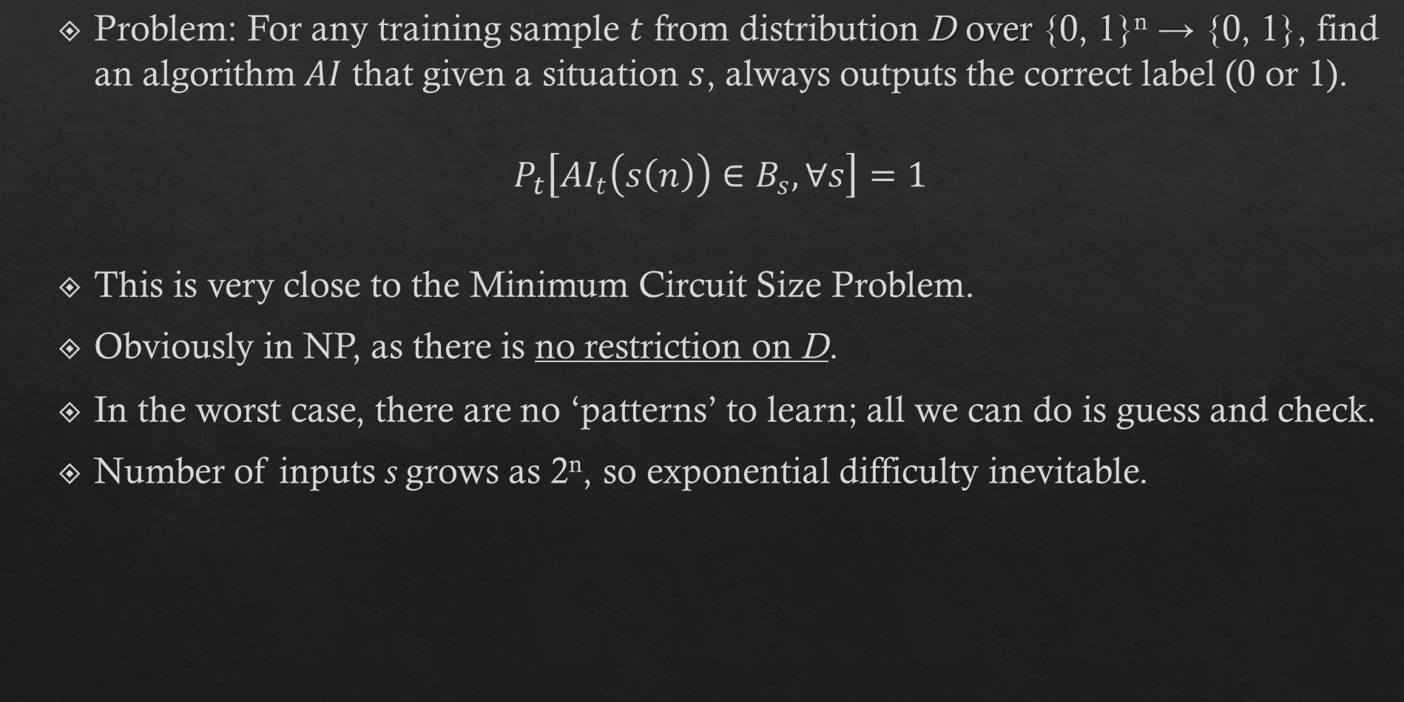
Definitely Exactly Correct Version
Problem: For any training sample $t$ from distribution D over {0, 1}^{n} → {0, 1}, find an algorithm $AI$ that given a situation $s$, always outputs the correct label (0 or 1).
$$P_{t}\left[AI_{t}\left(s\left(n\right)\right)∈B_{s},∀s\right]=1$$
This is very close to the Minimum Circuit Size Problem.
Obviously in NP, as there is no restriction on D.
In the worst case, there are no ‘patterns’ to learn; all we can do is guess and check.
Number of inputs s grows as 2^{n}, so exponential difficulty inevitable.

Slide 14
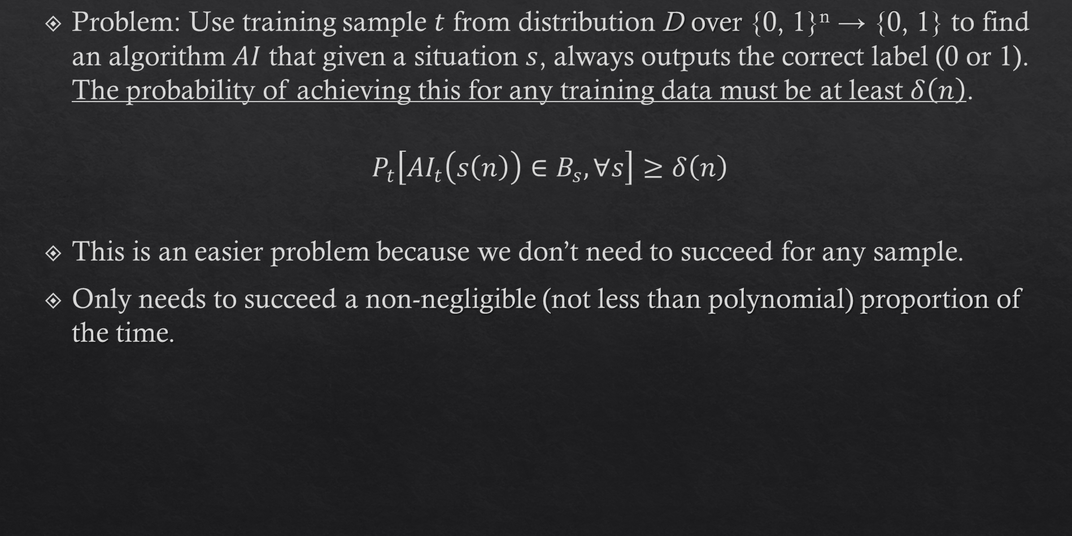
Probably Exactly Correct Version
Problem: Use training sample $t$ from distribution D over {0, 1}^{n} → {0, 1} to find an algorithm $AI$ that given a situation $s$, always outputs the correct label (0 or 1). The probability of achieving this for any training data must be at least $δ\left(n\right)$.
$$P_{t}\left[AI_{t}\left(s\left(n\right)\right)∈B_{s},∀s\right]≥δ\left(n\right)$$
This is an easier problem because we don’t need to succeed for any sample.
Only needs to succeed a non-negligible (not less than polynomial) proportion of the time.

Slide 15
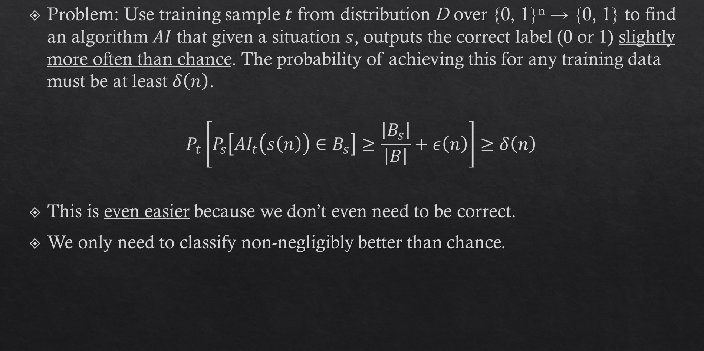
Probably Approximately Correct Version
Problem: Use training sample $t$ from distribution D over {0, 1}^{n} → {0, 1} to find an algorithm $AI$ that given a situation $s$, outputs the correct label (0 or 1) slightly more often than chance. The probability of achieving this for any training data must be at least $δ\left(n\right)$.
$$P_{t}\left[P_{s}\left[AI_{t}\left(s\left(n\right)\right)∈B_{s}\right]≥\frac{\left|B_{s}\right|}{\left|B\right|}+ε\left(n\right)\right]≥δ\left(n\right)$$
This is even easier because we don’t even need to be correct.
We only need to classify non-negligibly better than chance.

Slide 16
Stated Implications
“(Current AIs) necessarily fail to solve the intractable learning problem. Concretely, this means that they make lots of errors, deviating substantially from human behaviour, and fail to meet the low standard set in the Ingenia Theorem.”
“Our results imply that no matter how much ‘better’ AI gets, it will be off by light-years, wrong in exponentially many situations.”
“In light of our demonstration that the task of creating cognition in computers is unfeasible, it is not surprising that among early researchers pursuing this project, enthusiasm waned and many people moved on.”
“Despite the current hype surrounding ‘impending’ AGI, this practical infeasibility actually ﬁts very well with what we observe (for example, running out of quality training data and the non-human-like performance of AI systems when tested rigorously).”

Slide 17
Act 3: The Twitter Drama

Slide 18
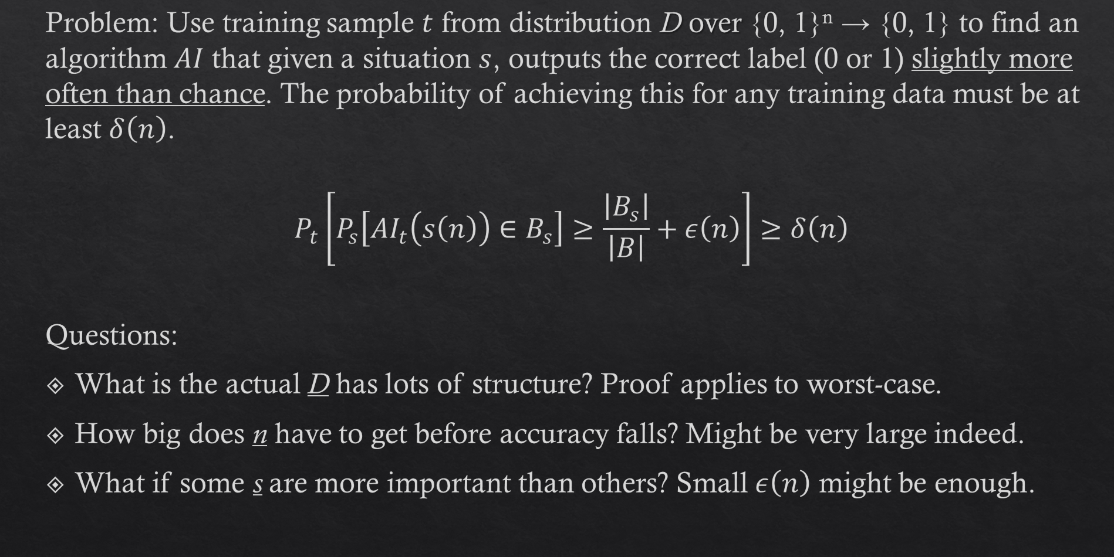
Interrogating the Theorem
Problem: Use training sample $t$ from distribution D over {0, 1}^{n} → {0, 1} to find an algorithm $AI$ that given a situation $s$, outputs the correct label (0 or 1) slightly more often than chance. The probability of achieving this for any training data must be at least $δ\left(n\right)$.
$$P_{t}\left[P_{s}\left[AI_{t}\left(s\left(n\right)\right)∈B_{s}\right]≥\frac{\left|B_{s}\right|}{\left|B\right|}+ε\left(n\right)\right]≥δ\left(n\right)$$
Questions:
What is the actual D has lots of structure? Proof applies to worst-case.
How big does n have to get before accuracy falls? Might be very large indeed.
What if some s are more important than others? Small $ε\left(n\right)$ might be enough.

Slide 19
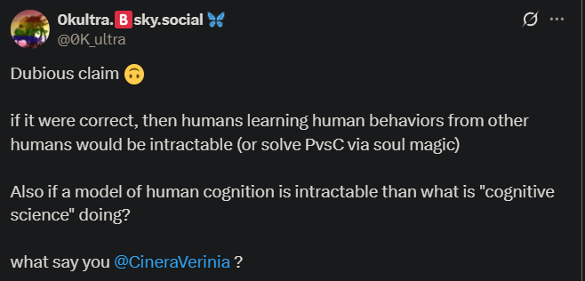
Does the Theorem apply to Humans?

Slide 20
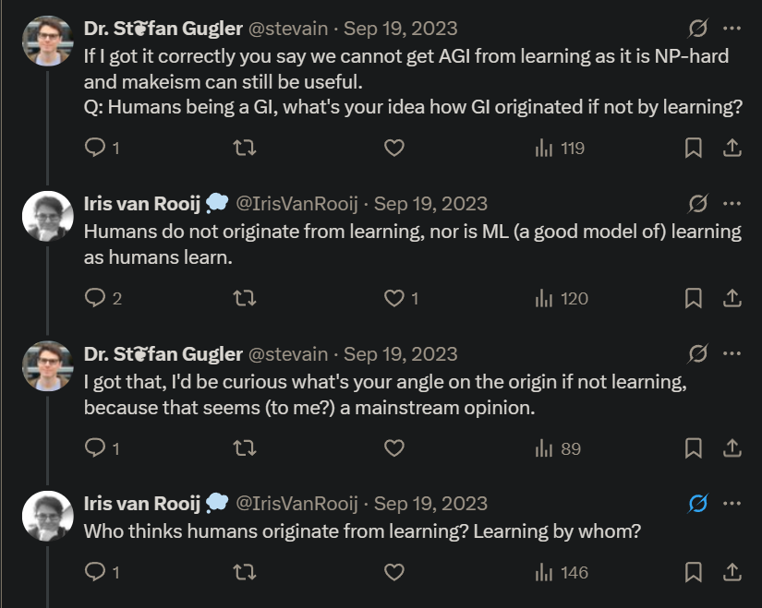
Does the Theorem apply to Humans?

Slide 21
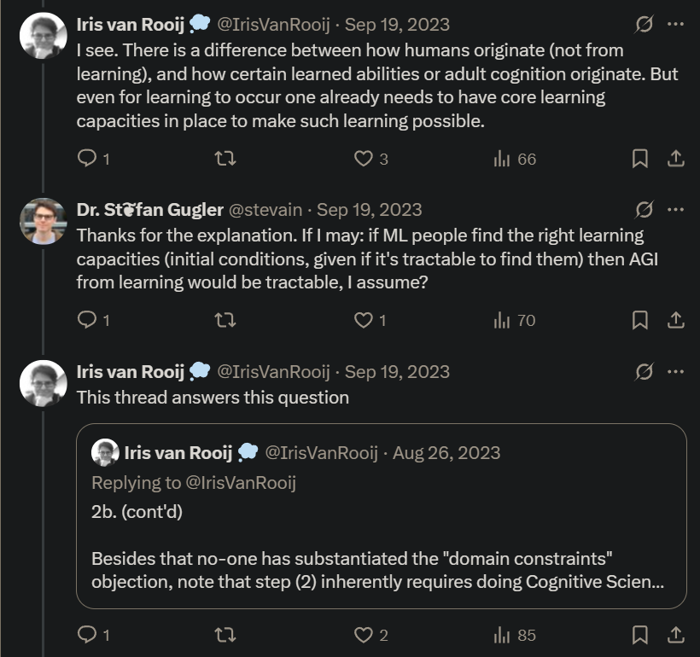
Does the Theorem apply to Humans?

Slide 22
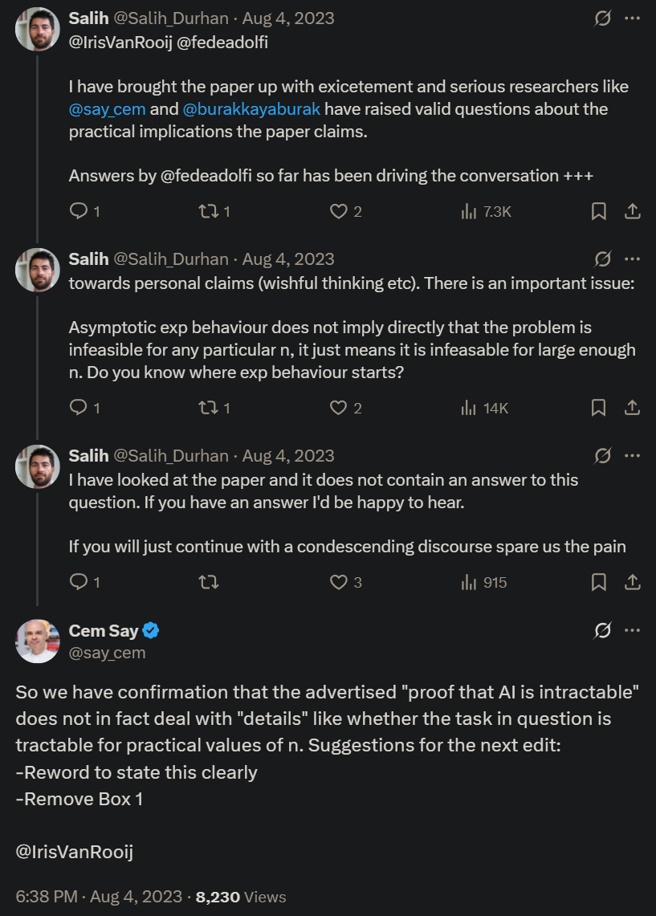
Are Asymptotic Results Important?

Slide 23
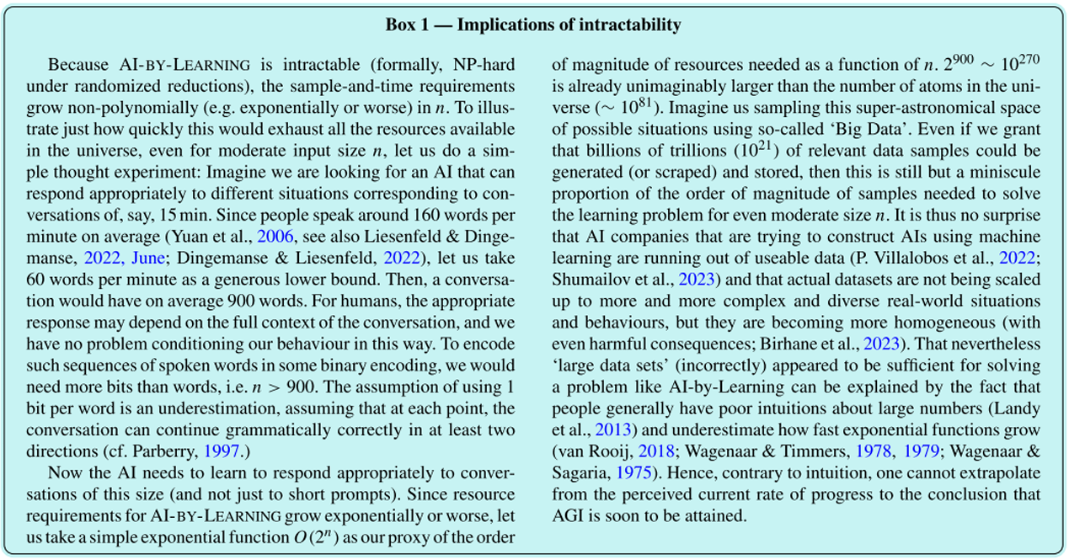
The Curious Case of Box 1

Slide 24
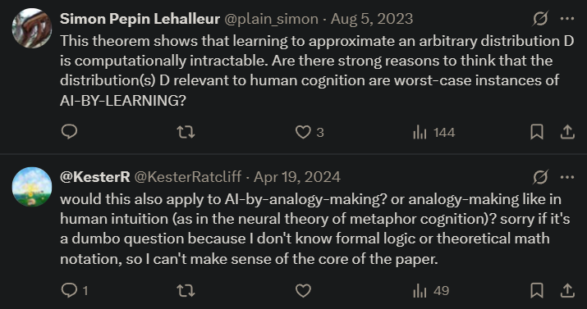
Are Worst-Case Results Important?

Slide 25
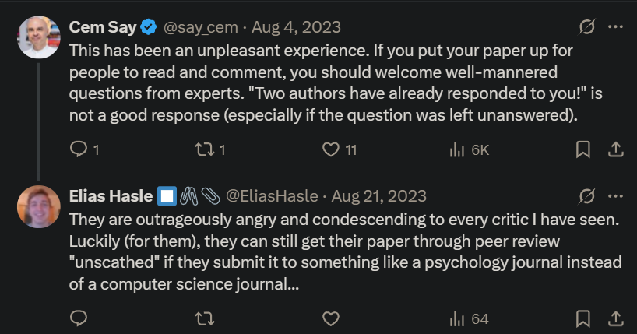
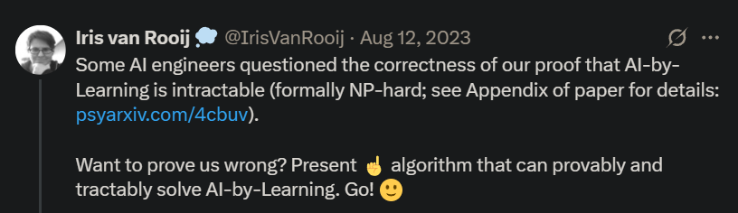
Drama Continues…

Slide 26
Discussion?

