Slide 1

Philosophy of Mind and Theism:
Cognitive Science and Immaterial Minds
James Fodor
27th March 2025

Slide 2
Introduction

Slide 3

Outline of the Argument
God is supposed to be an immaterial mind.
But minds (almost certainly) cannot be immaterial.
Therefore God (almost certainly) does not exist.
Argument applies more generally to other types of immaterial minds (souls, demons, nature spirits).
God is distinct from other minds in important ways.

Slide 4
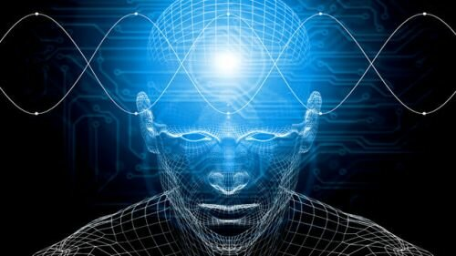
What is a Mind?
“The mind is that which thinks, feels, perceives, imagines, remembers, and wills.”
Note the list of functions rather than a substantive definition.
Humans and animals have minds.
Artificial, alien, and supernatural minds may also exist.

Slide 5
What is an Immaterial Mind?
An immaterial mind, or soul, is a mind without a body.
Distinct from mind/body dualism, which says mind=soul+brain.
Won’t go into the arguments for an immaterial mind here.
Accounts of an immaterial mind:
  Ectoplasm account: a new type of substance.
  Bundle theory: mind as a bundle of ideas/perceptions.
  Consciousness account: the mind is just a distinct consciousness.

Slide 6

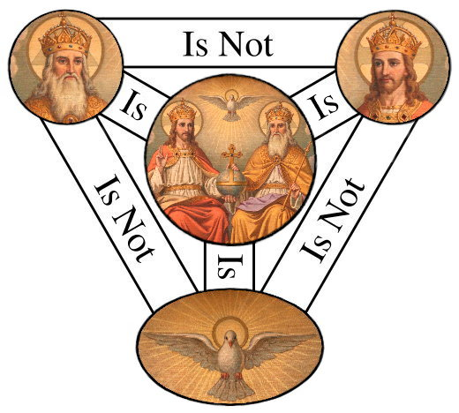
What is a Divine Immaterial Mind?
God is supposed to be an immaterial mind with divine attributes.
Usually said to be omnipotent, omnibenevolent, omniscient, omnipresent.
Distinction between classical theism and theistic personalism.
Dispute whether God is impassive, immutable, and eternal.

Slide 7
Appeal to General Theory

Slide 8
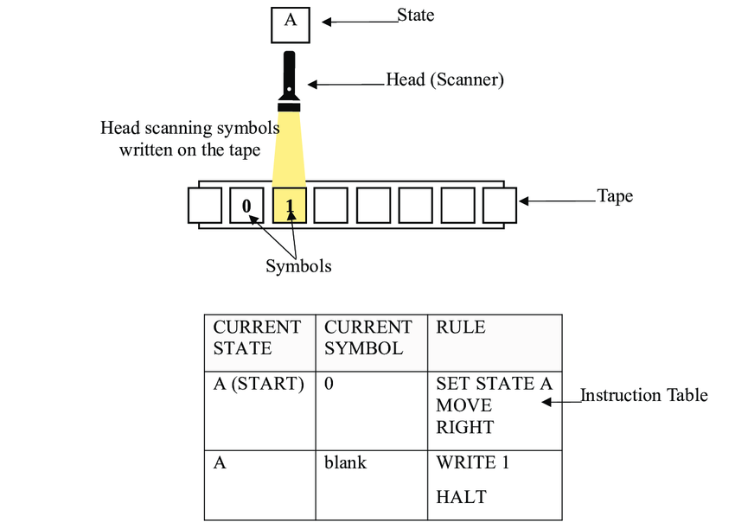
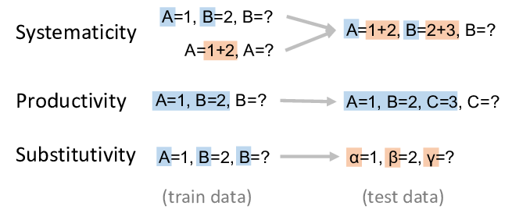
The Computational Theory of Mind
Dominant view in cognitive science and neuroscience.
Holds that the mind is a computational system.
What is computation?

Slide 9
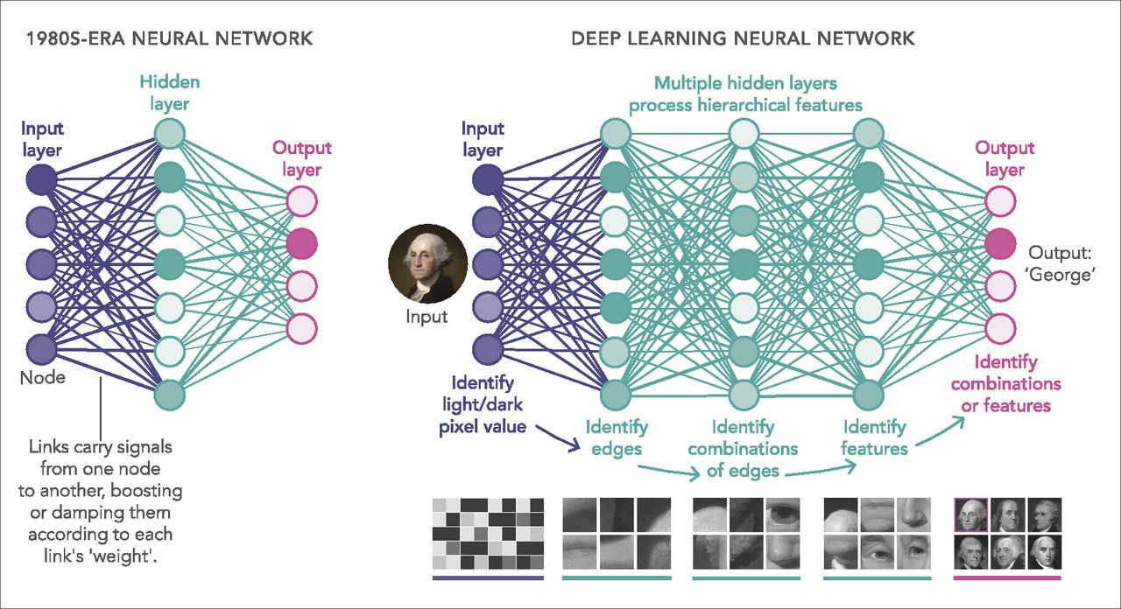
Connectionism
Connectionism is a computing approach to computation.
Lacks symbols or rules, instead using interconnected nodes and spreading activation.
Seen as either a rival or complement to classical computation.

Slide 10
Computation and the Physical
Classical computation requires:
  Set of discrete symbols.
  Set of discrete states.
  A mechanism for recording and reading symbols.
  Mechanistic rules for recording symbols and changing states.
Connectionist computation requires:
  Set of nodes.
  Set of weighted connections between nodes.
  Method for computing activations.
  Rule for updating weights.
All require physical instantiation!

Slide 11
Computation and the Physical
Physical substrate needed to differentiate states.
Physical substrate needed to embody mechanistic rules.
Bundle of ideas just won’t do.

Slide 12
Appeal to Specific Faculties

Slide 13
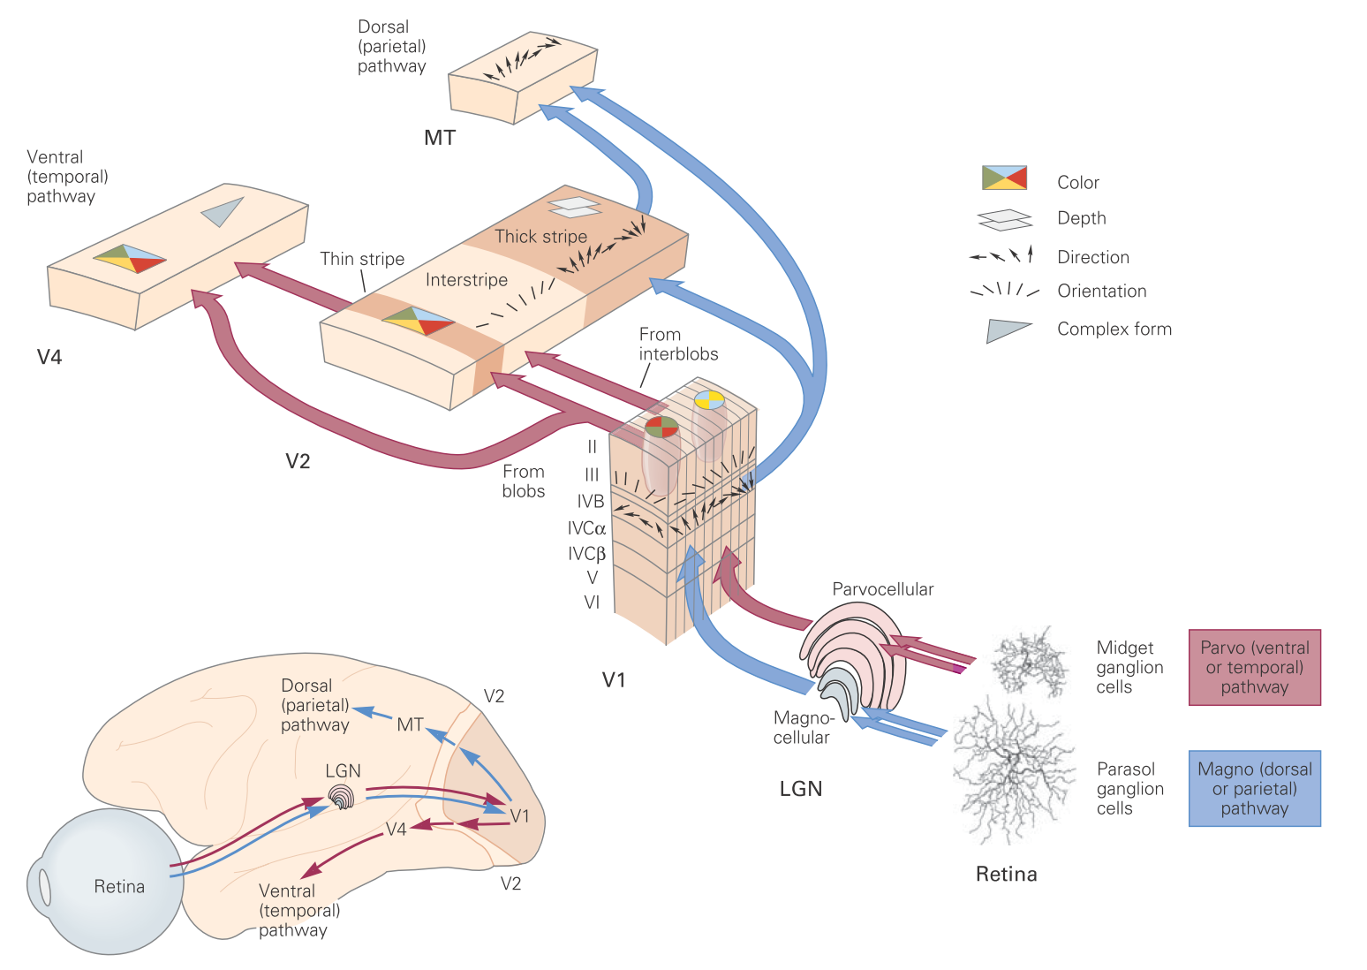
Perception
Vision
Audition
Gustation
Olfaction
Object recognition
Voice recognition

Slide 14
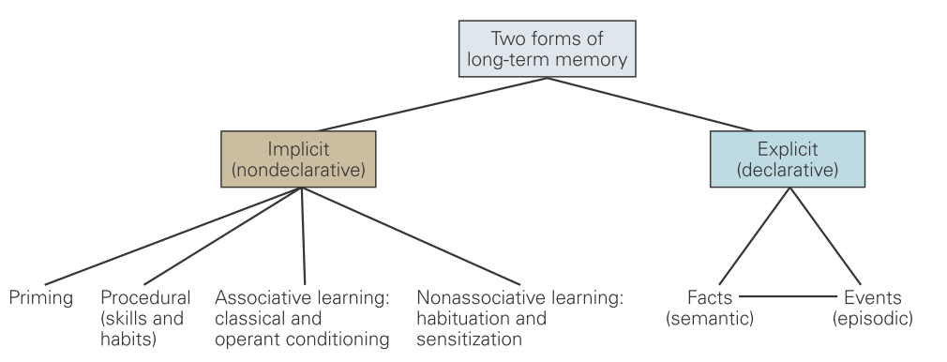
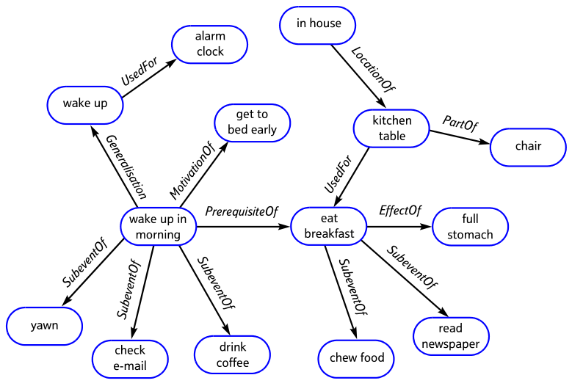
Memory
Conditioning
Episodic memory
Semantic memory
Knowledge representation

Slide 15
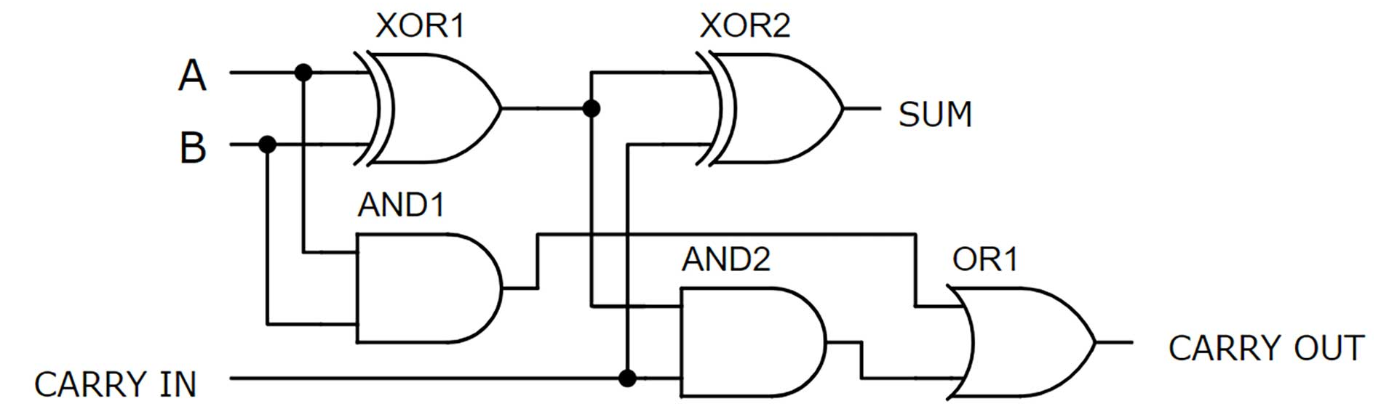
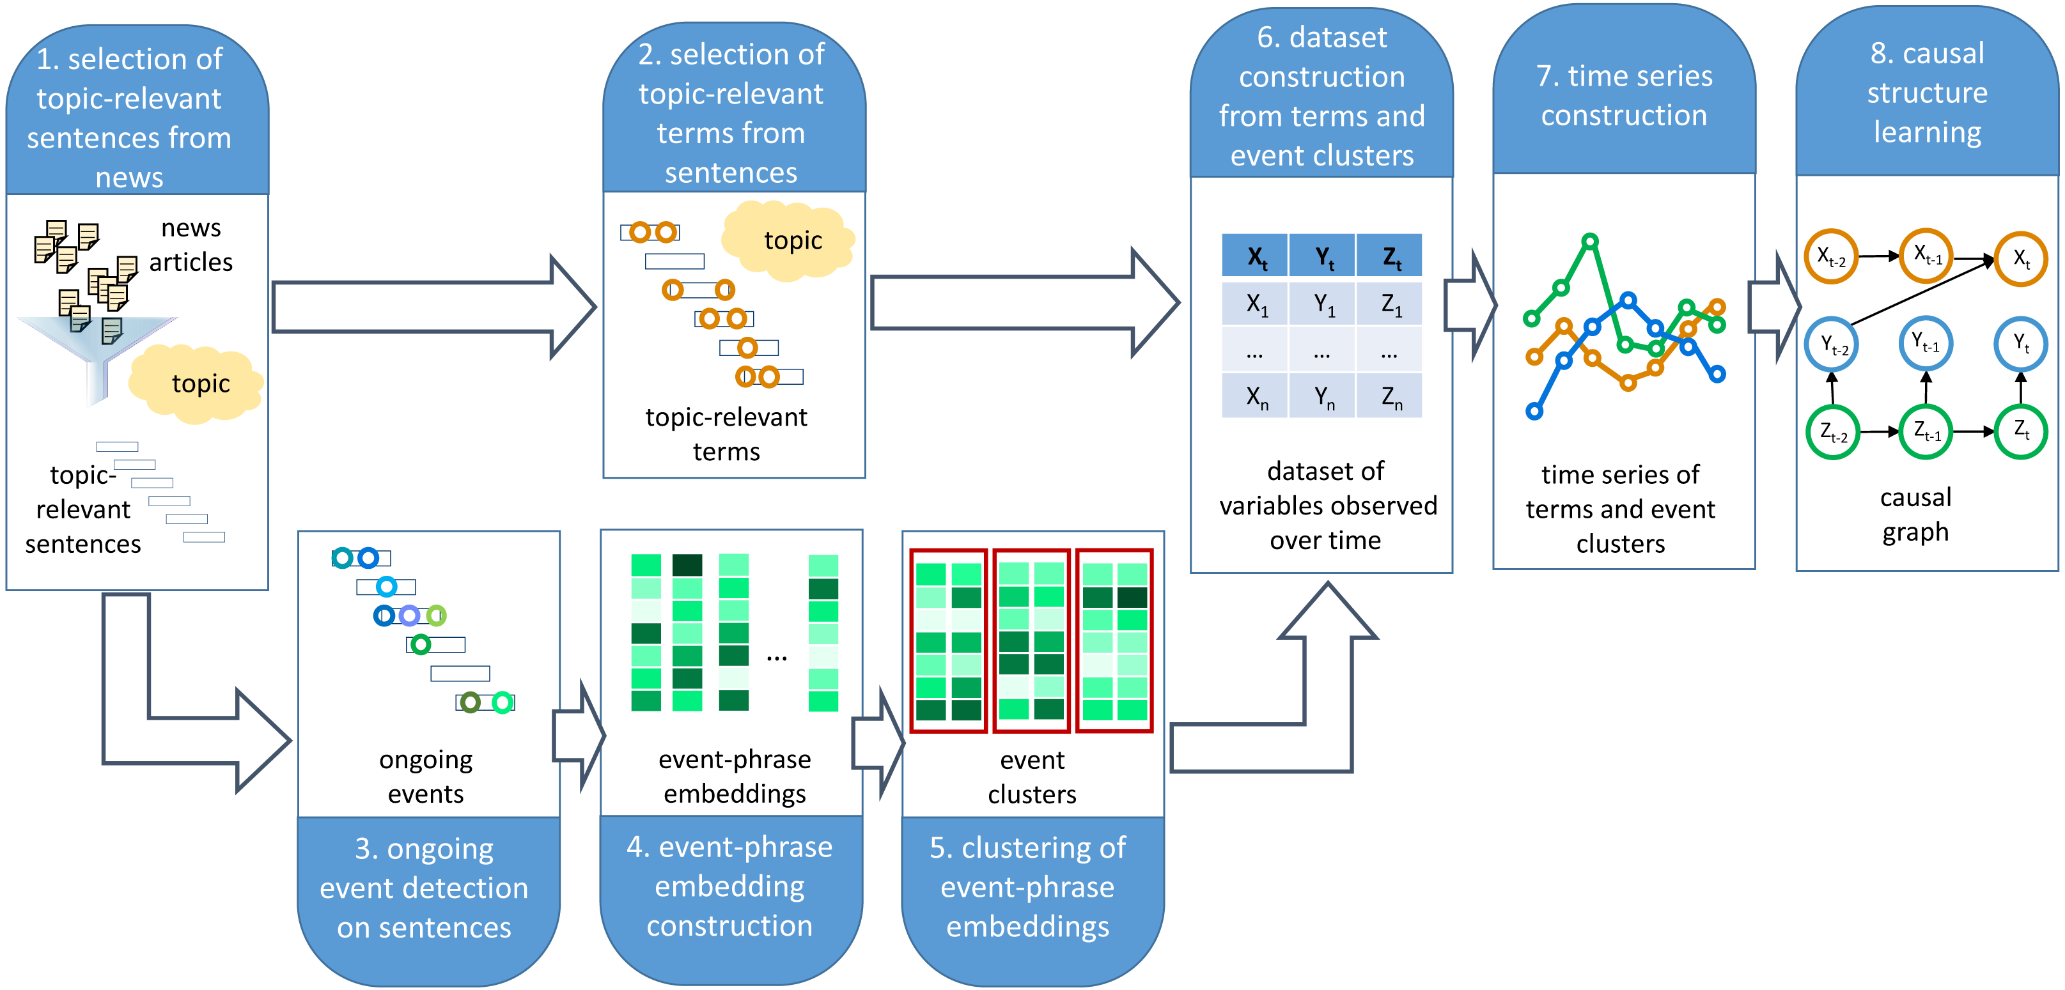
Inference
Logical deduction
Analogical reasoning
Causal learning
Abductive inference
Problem solving
Mathematical reasoning
Creativity

Slide 16
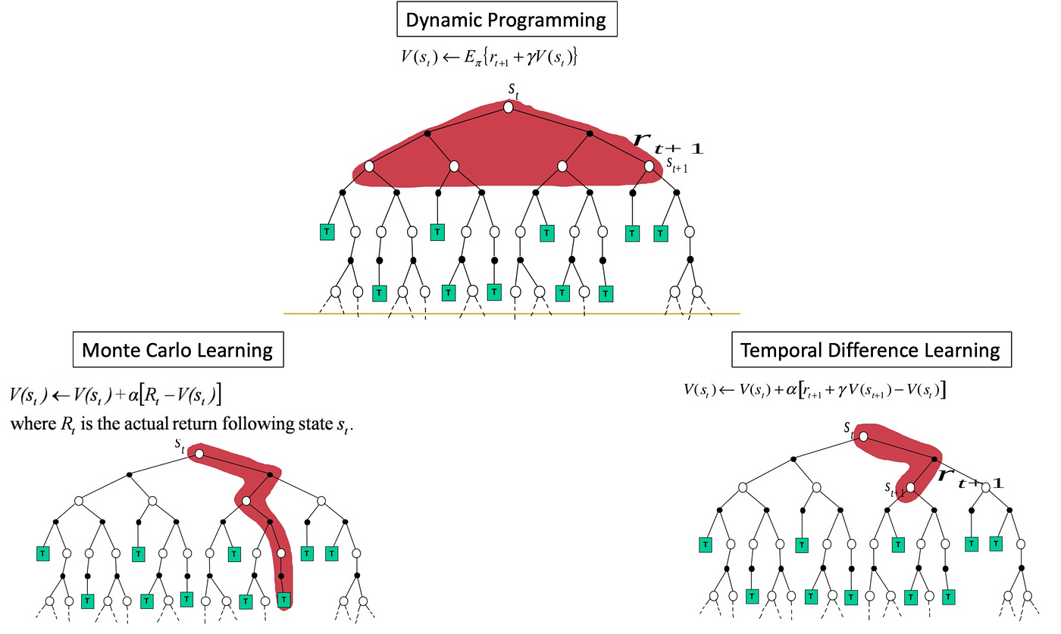
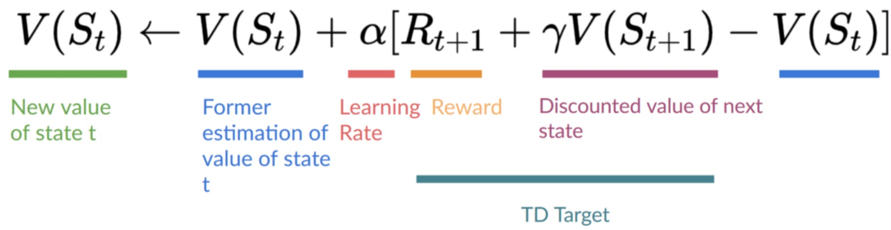
Decision Making
Motivation
Attention
Reward representation
Action selection
Executive control

Slide 17
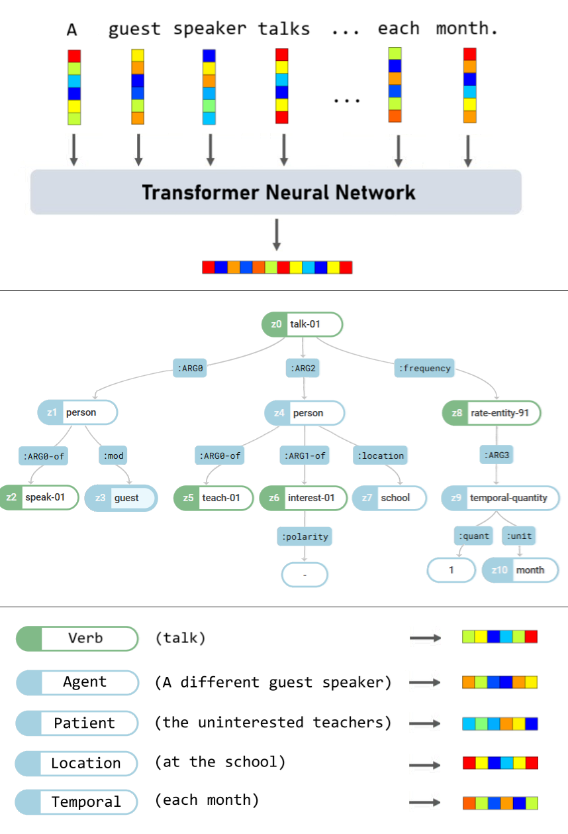
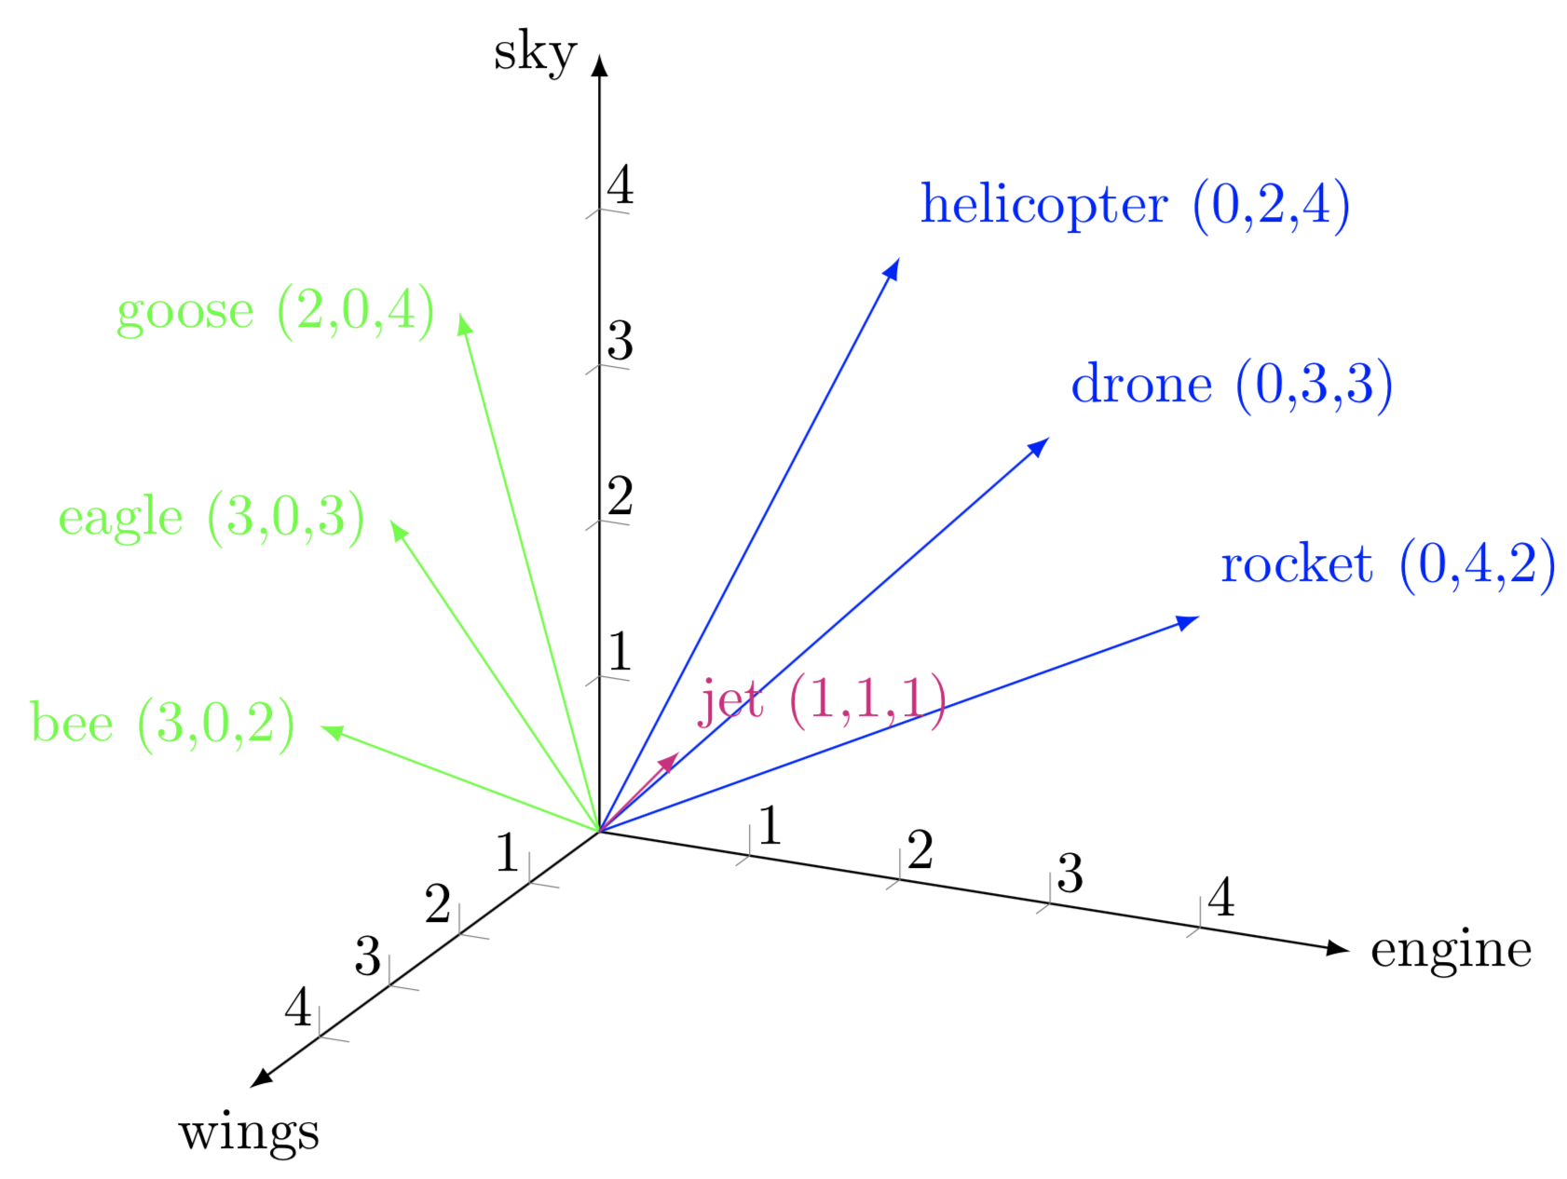
Language
Speech perception
Reading
Lexical semantics
Compositional semantics
Narrative comprehension

Slide 18
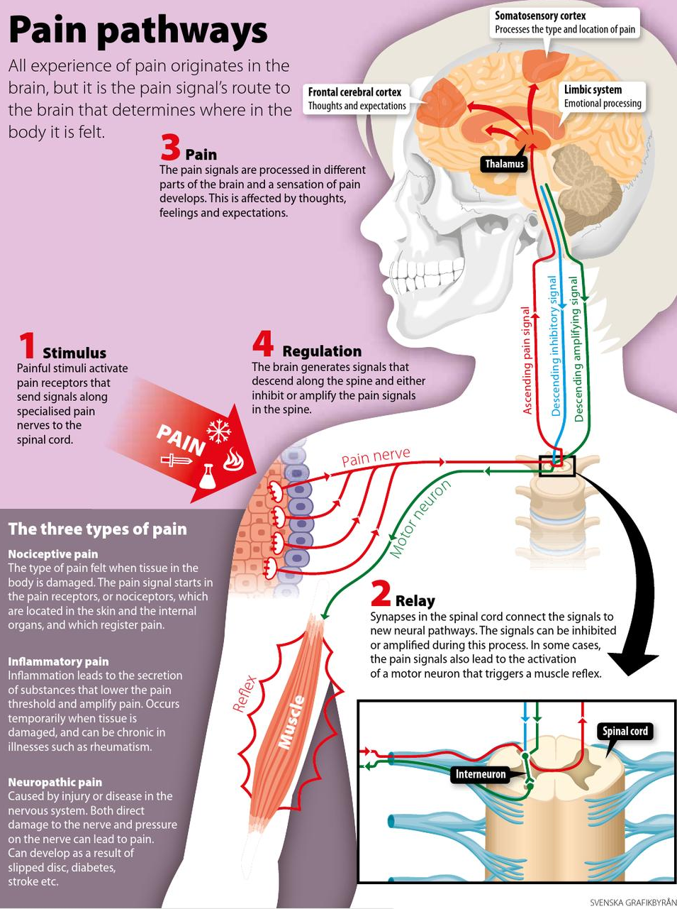
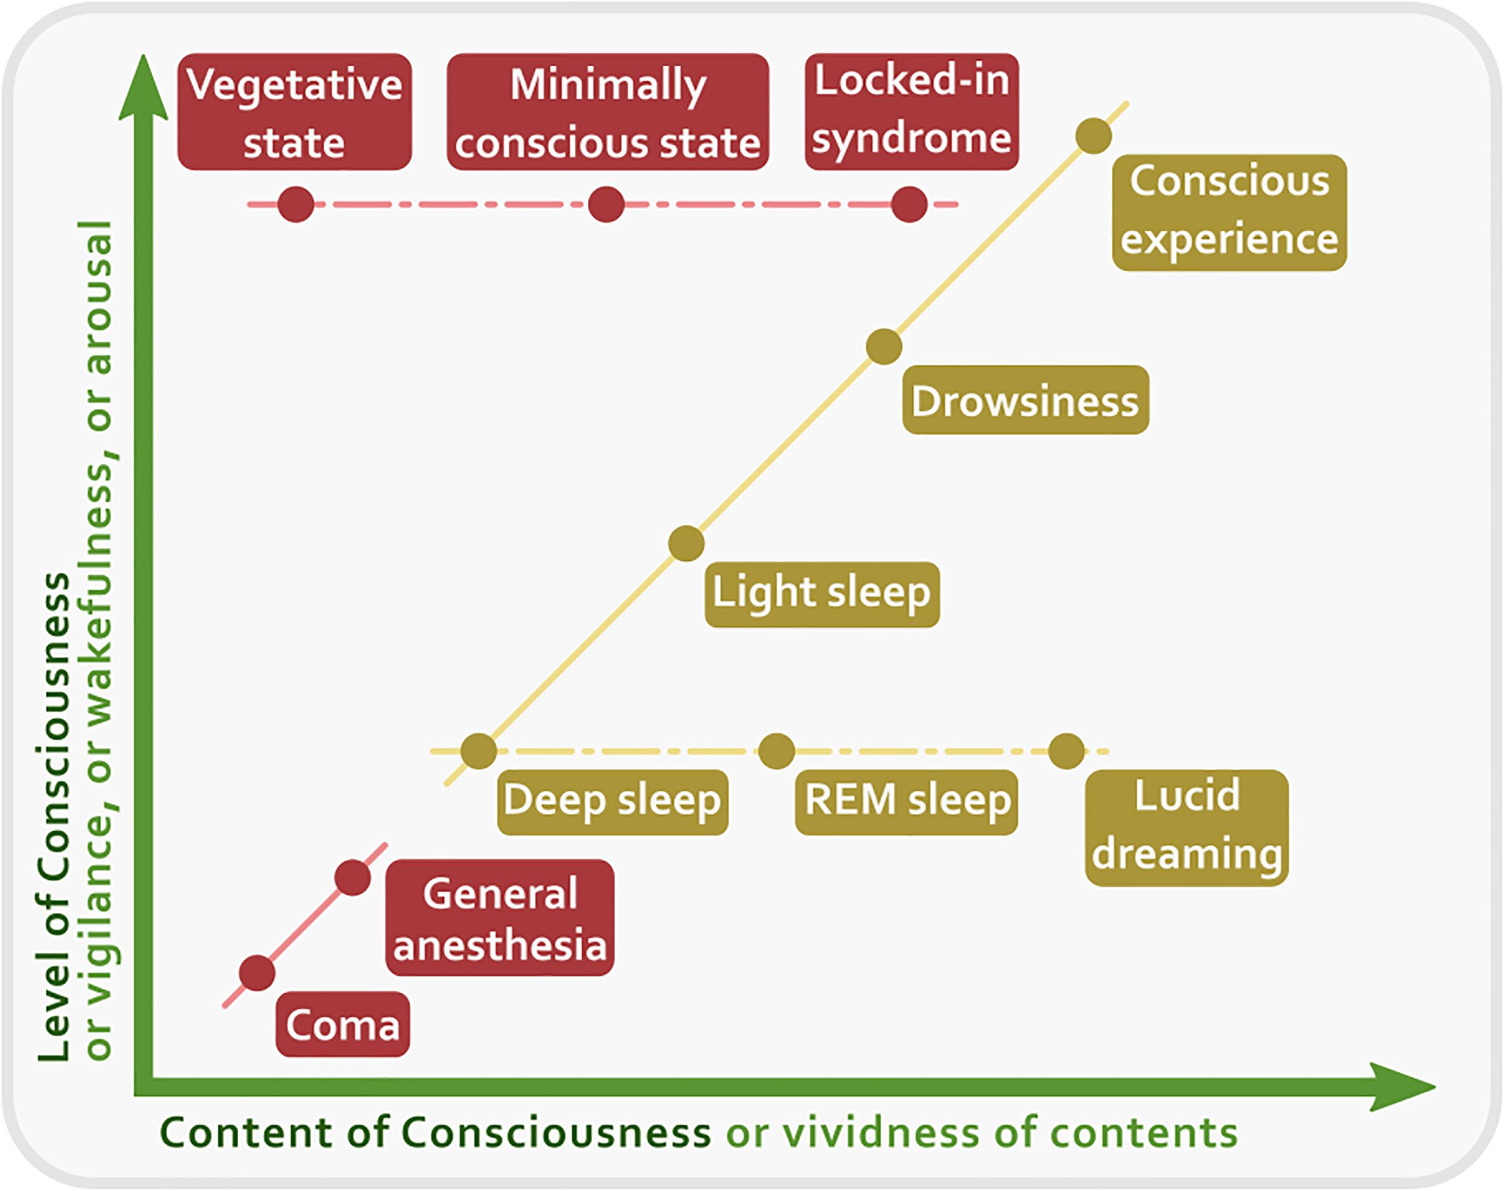
Affective States
Emotion
Mood
Pain
Reward
Conscious

Slide 19
What About God?
Vision
Audition
Gustation
Olfaction
Object recognition
Voice recognition
Conditioning
Episodic memory
Semantic memory
Knowledge representation
Logical deduction
Analogical reasoning
Causal learning
Abductive inference
Problem solving
Mathematical reasoning
Creativity
Motivation
Attention
Reward representation
Action selection
Executive control
Speech perception
Reading
Lexical semantics
Compositional semantics
Narrative comprehension
Emotion
Mood
Pain
Reward
Conscious

Slide 20
What About God?
Vision
Audition
Gustation
Olfaction
Object recognition
Voice recognition
Conditioning
Episodic memory
Semantic memory
Knowledge representation
Logical deduction
Analogical reasoning
Causal learning
Abductive inference
Problem solving
Mathematical reasoning
Creativity
Motivation
Attention
Reward representation
Action selection
Executive control
Speech perception
Reading
Lexical semantics
Compositional semantics
Narrative comprehension
Emotion
Mood
Pain
Reward
Conscious
God knows and wills, and that’s about it.

Slide 21
Conclusions

Slide 22
Summary
(Almost) everything we know about minds implies a physical substrate.
Immaterial souls lack the structure needed to perform computations.
Nearly all mental faculties also require physical instantiation.
In the case of God, divine attributes rule out nearly all faculties.

Slide 23
Potential Counters
Objection: There are non-computational approaches to cognition.
Response: The main rivals are embodied cognition and dynamical systems theory. Both are in some ways even more physicalist than computationalism.
Objection: We can’t compare a divine mind to a mere human mind.
Response 1: What happened to made in the image of God?
Response 2: If we are using the same word, there should be enough parallels to warrant this. Just say God is a mysterious all-knowing thing.
Objection: Immaterial minds don’t fit with our theories.
Response: All the more reason to reject them!

Slide 24
Discussion?

