Slide 1


Philosophy, Critical Thinking, and Misinformation
James Fodor
14th November 2024

Slide 2
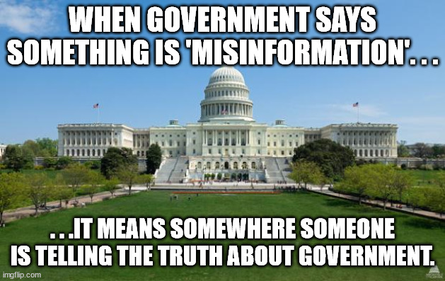
Why do People Believe Nonsense?
Lack of knowledge/education.
To fit with an identity group/community.
Provide emotional comfort or outlet.
Coherence with an ideology/worldview.
Personality or demographic characteristics.

Slide 3
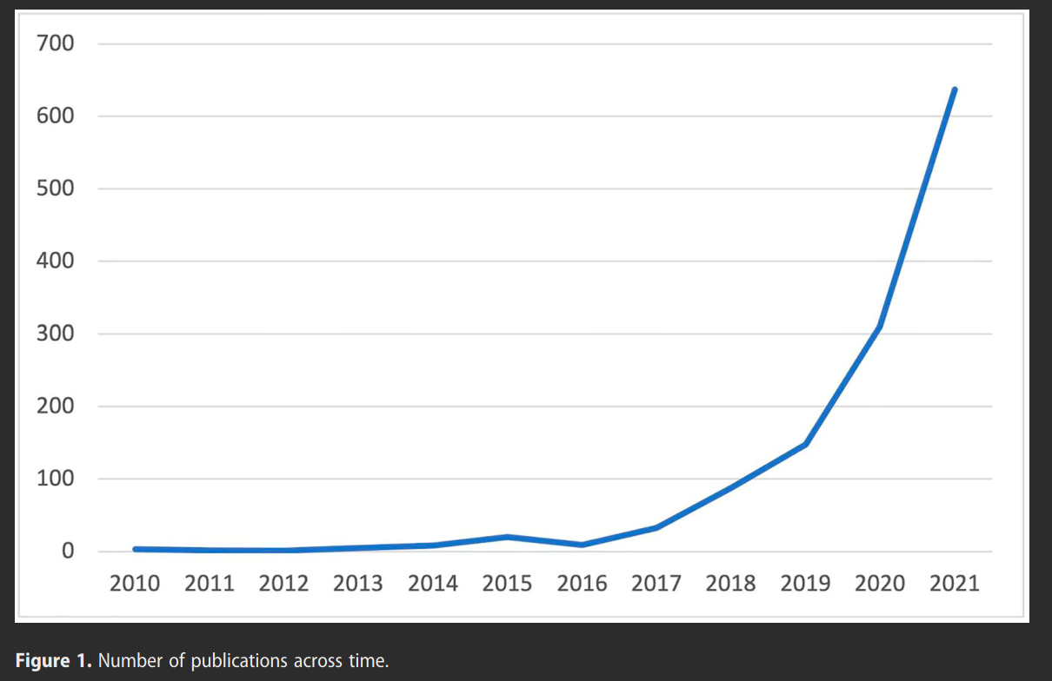
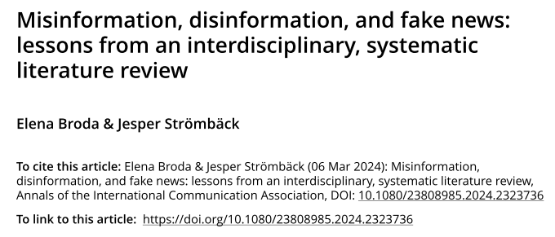
Research Interest Over Time
Number of peer-reviewed articles on misinformation, disinformation, or fake news (excluding those with historical focus).

Slide 4
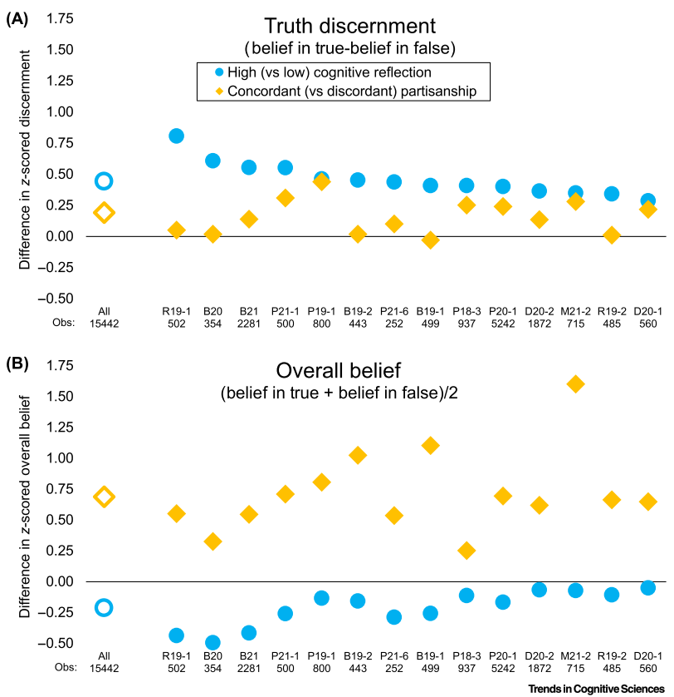

Attention and Effort
People simply do not pay attention, or spend enough time thinking.
“Data from 14 studies in which US participants were asked to rate the accuracy of actual news posts from social media… More-reﬂective participants had a somewhat lower overall belief than less-reﬂective participants, whereas overall belief was higher for politically concordant headlines than for politically discordant headlines.”

Slide 5
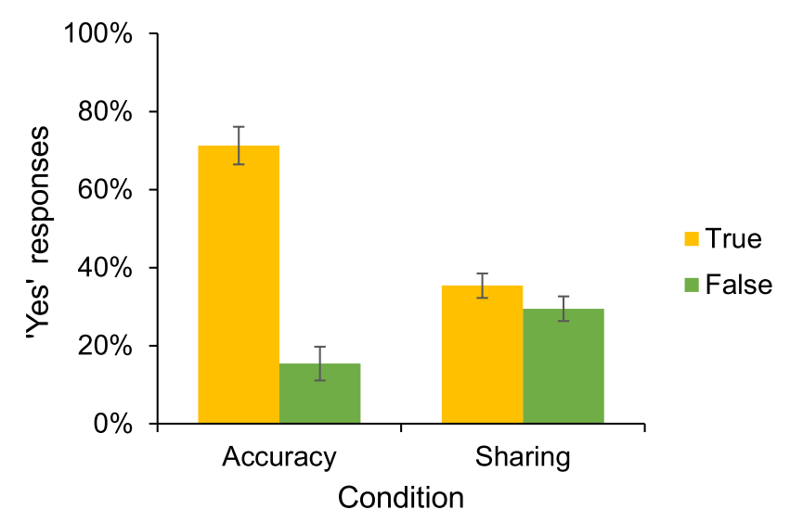
Attention and Effort
“The inattention-based account argues that people have a strong preference to only share accurate content, but that the social media context distracts them from this preference. Consistent with this account, asking participants to rate the accuracy of each headline before deciding whether to share it decreased sharing of false headlines by 51% relative to the baseline condition – suggesting that inattention to accuracy was responsible for roughly half of the misinformation sharing in the experiment.”

Slide 6
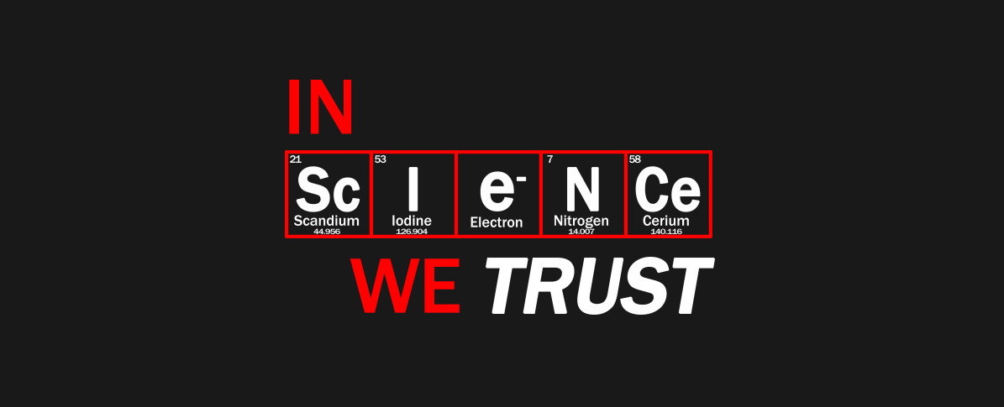
Science and Appeals to Authority
We lack the time and knowledge to assess most scientific claims ourselves.
We must trust the expertise of scientists.
But why should we?
What makes ‘science’ more trustworthy than anecdote, religious texts, mystical experiences, political debate, or introspection?

Slide 7
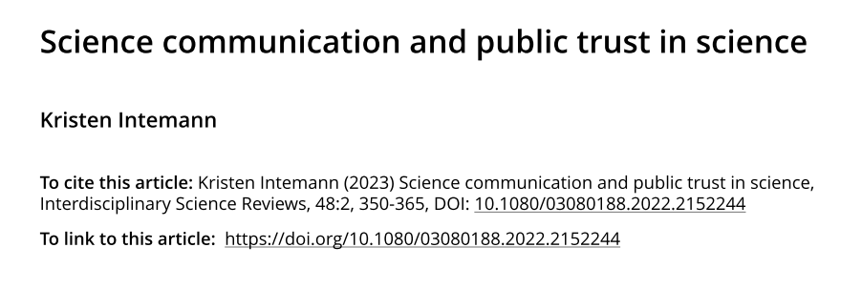
Science and Appeals to Authority
“Some laypersons concluded that scientists simply don’t know when they were confronted with apparently contradictory messages about masking, or conﬂicting studies about whether a particular treatment was eﬀective or not against COVID-19. This is in part because there often false assumptions about how science works that can impact trust. For example, when people believe (wrongly) that science is about proving theories true or false with certainty, they can think that a study that seems to contradict a widely held ﬁnding implies that scientists ‘just don’t know.’”
Important to understand how science (really) works and why it can be trusted.

Slide 8
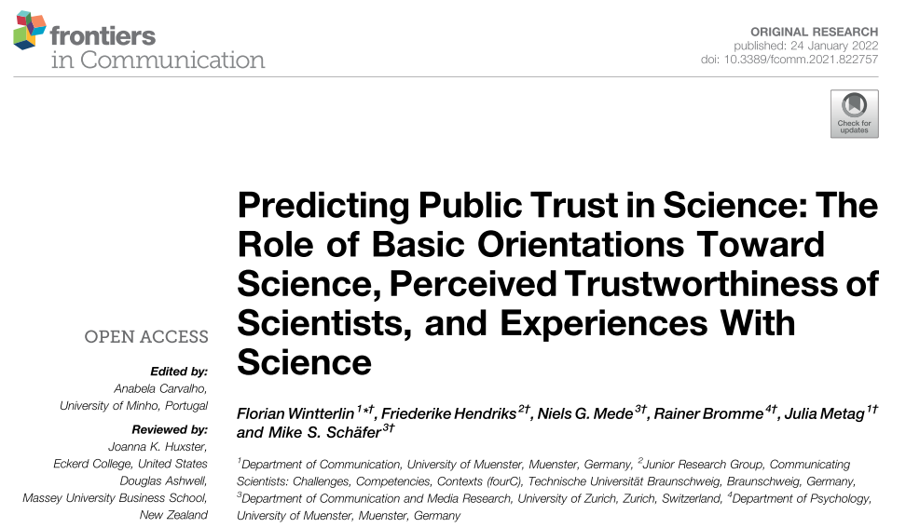
Science and Appeals to Authority
“We developed a model for the public’s trust in science, and we tested this model in a nationally representative survey in Switzerland (N =1,050). The analysis reveals that trust in science was best predicted by positivistic attitudes toward science (β=0.33) and to a lesser extent by trustworthiness assessments of scientists (β=0.24). Experiences with science did not predict trust in science (β=0.07).
Mere exposure to science is not sufficient for trust.

Slide 9
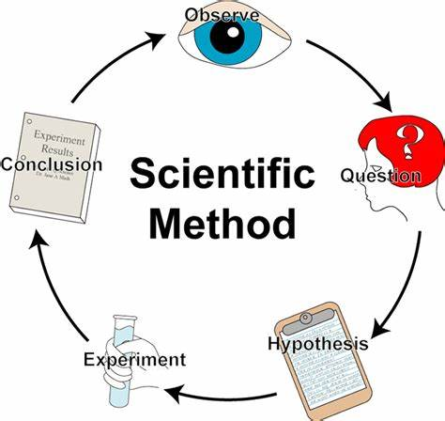
Why Trust Science: Some Bad Answers
Scientists follow the ‘scientific method’.
  Not really any such thing.
  Would need to establish the method was justified.
Individual scientists are responsive to new evidence.
  Scientists are often as stubborn and biased as other people.
  Fields can change very slowly with new evidence or techniques.
Science is based on observable facts rather than speculations or dogma.
  Observations must be interpreted in light of a theory.
  Theologians, mystics, and paranormal investigators also use ‘observable facts’.

Slide 10
Why Trust Science: Some Better Answers
Science is a (fairly) open intellectual endeavour.
  Do not need to sign statements of belief or join a religious order.
  Evidence is presented for public evaluation and comment.
Science takes a critical viewpoint and requires evidence.
  Many fields take a credulous viewpoint and do not have standards of evidence.
  In science nothing is ‘sacred’ or beyond reproach or doubt.
Science has self-correcting mechanisms.
  Findings that cannot be replicated become suspect.
  Research programs that don’t yield results are abandoned.

Slide 11

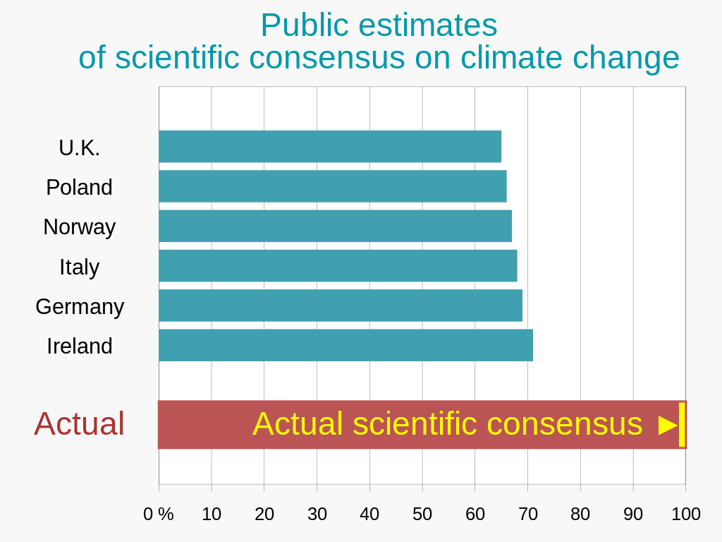

Example: Climate Change
Focus on broad range of agreement of researchers across the world.
Discuss the methods used (historical, surface, satellite, modelling).
Emphasise that no plausible alternative explanation to recent warming can be provided by climate deniers.
Challenge claims of bias by asking for specifics of what research is wrong, and why no one with different biases hasn’t shown this.

Slide 12
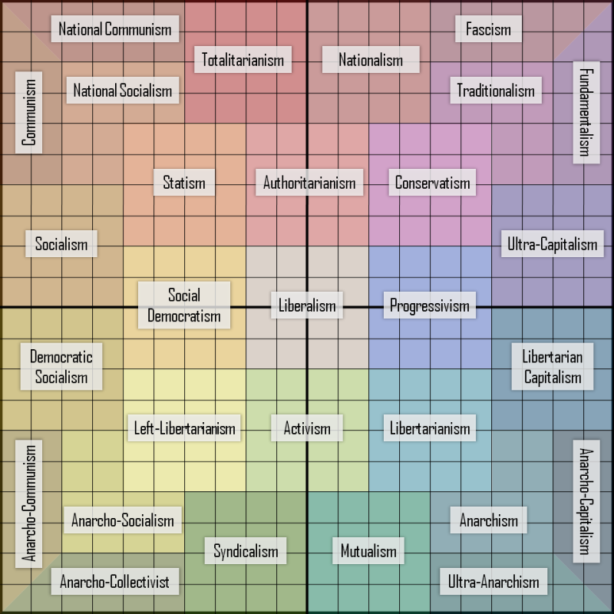
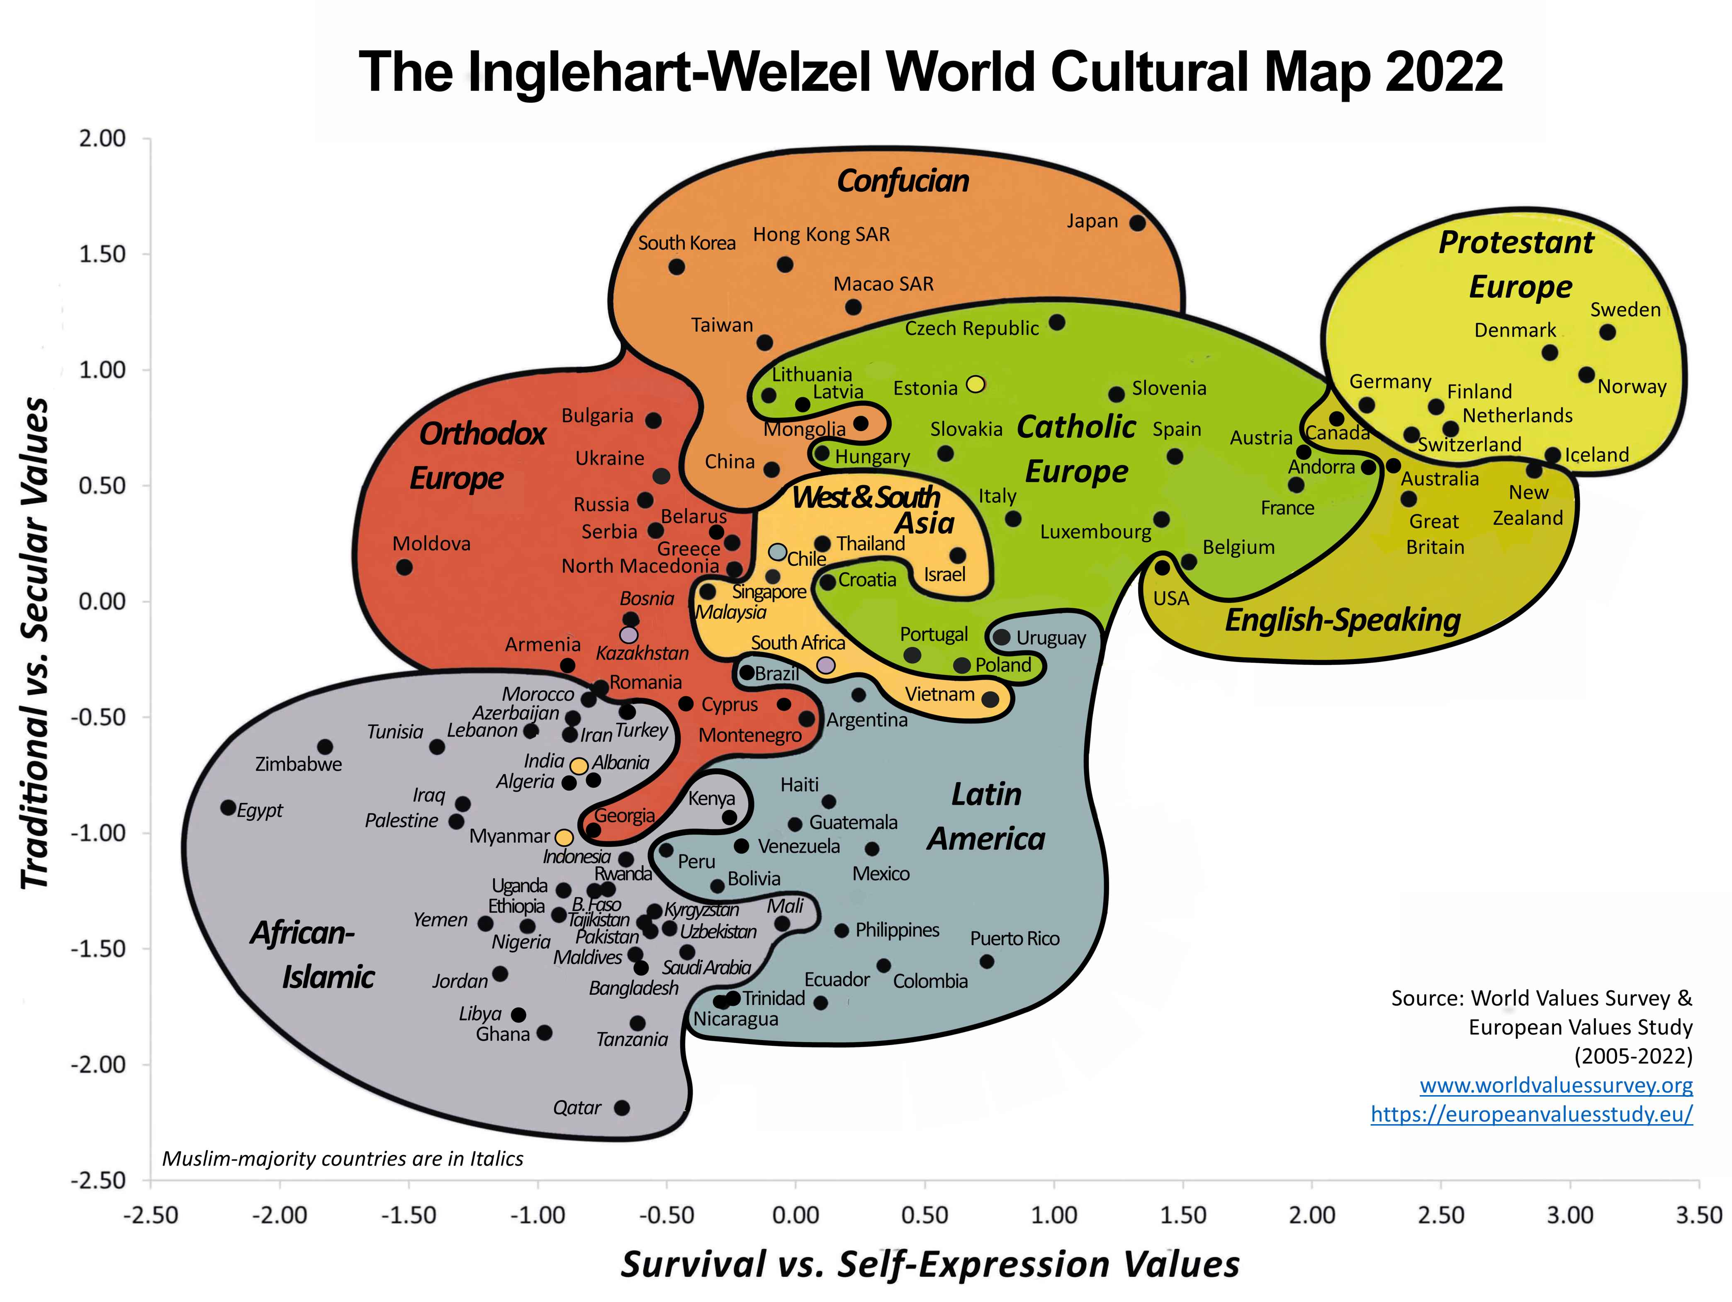
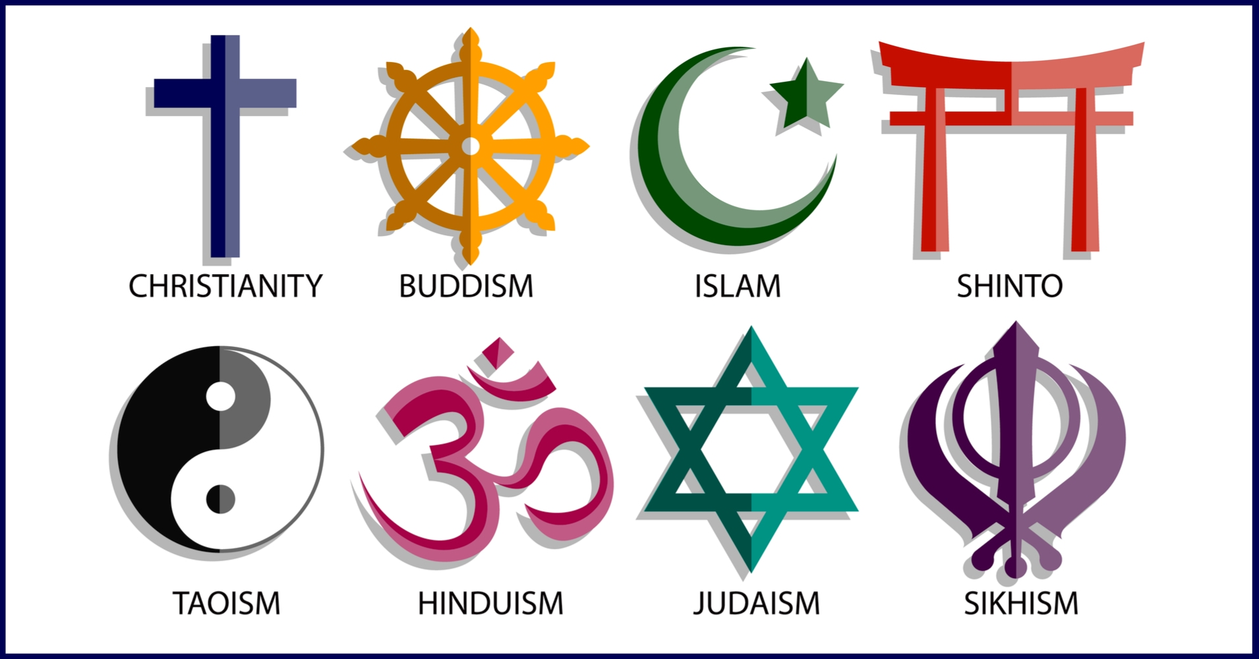
Coherence and Worldviews
A worldview is a set of fundamental beliefs about how the world works.
Many people don’t think carefully about it but everyone has one.
Perceived contradictions lead to cognitive dissonance and belief revision.
People often reject new evidence or arguments that conflicts with their worldview.

Slide 13
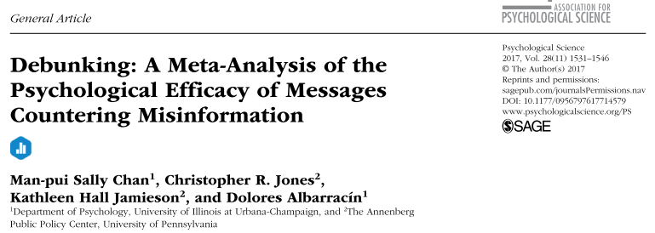
Alternative Explanations
“Corrections that merely encourage people to consider the opposite of initial information often inadvertently strengthen the misinformation. Therefore, offering a well argued, detailed debunking message appears to be necessary to reduce misinformation persistence.”
“Research on mental models suggests that an effective debunking message should be sufficiently detailed to allow recipients to abandon initial information for a new model. Messages that simply label the initial information as incorrect may therefore leave recipients unable to remember what was wrong and offer them no new model to understand the information.”

Slide 14
Alternative Explanations
“In summary, the debunking effect was stronger and the misinformation persistence was weaker when recipients of the misinformation were more likely to counterargue the misinformation.”
“We then assessed whether the level of detail of the debunking message influenced the debunking and misinformation-persistence effects. In line with our expectations, a detailed debunking was associated with a stronger debunking effect than a nondetailed debunking.”

Slide 15
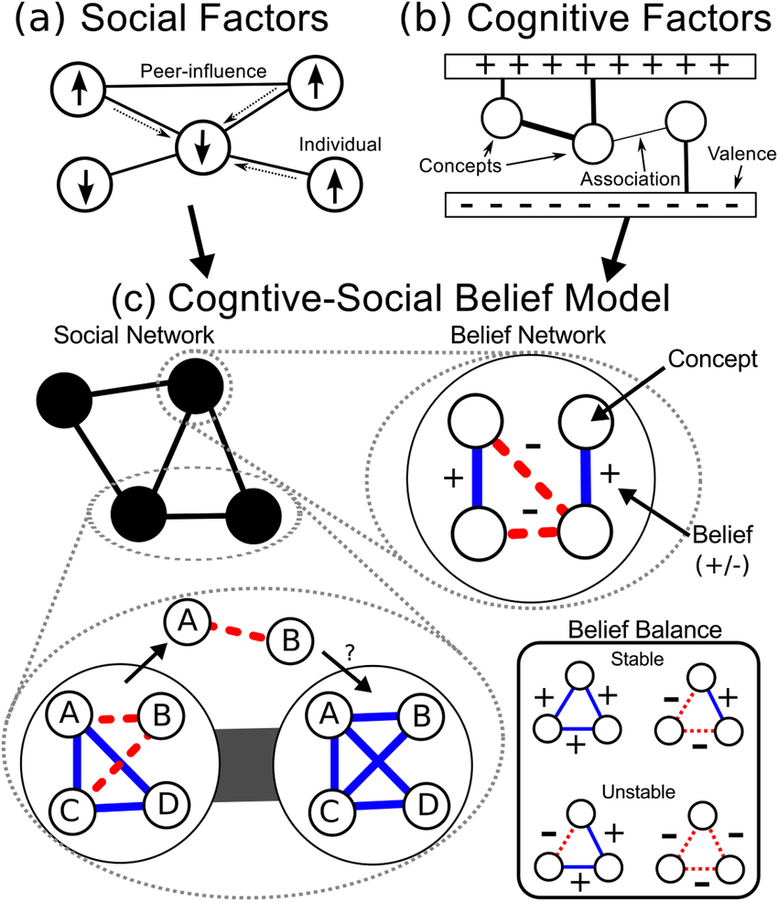
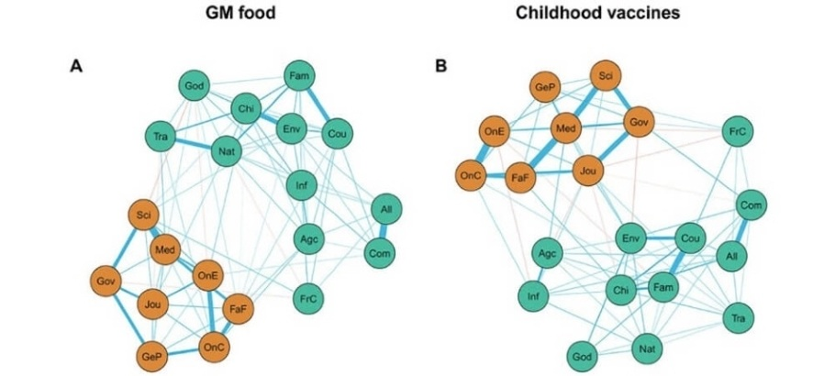
Worldviews are Resistant to Change
Challenging a single belief is difficult – it is embedded in a ‘web of beliefs’.
People interpret evidence in light of their existing beliefs.
People are motivated to accept beliefs that are convenient.
People do not try to think about things in different ways.
Belief Change: A New Predictive Network Model

Slide 16
How to Challenge Belief Systems
Don’t challenge a single belief; present an alternative interpretation.
Provide detail and explanatory coherence to the alternative.
Ask probing questions to highlight tensions in existing worldview.
Show how core values are not really threatened by belief change.
Show how core values are promoted by belief change.

Slide 17
Example: Climate Change
Present an alternative story about climate change and politics.
Ask who funds climate denial groups, why they can’t get published in good journals, how their speech is suppressed but it is also everywhere.
Argue that belief in climate change doesn’t mean socialism or abandonment of technology.
Argue that restricting pollution promotes personal liberty by reducing harm and protecting property rights from imposition.

Slide 18
Conclusions
Belief in misinformation isn’t just due to lack of information.
Need to encourage people to think more carefully and pay attention.
Promote trust in science by explaining why science is trustworthy and how science works to generate knowledge.
Promote rethinking of views by providing alternative coherent explanations and how existing values can be preserved with belief change.

Slide 19
Discussion?

