Slide 1

Philosophy, Critical Thinking, and Misinformation
James Fodor
30th March 2024

Slide 2


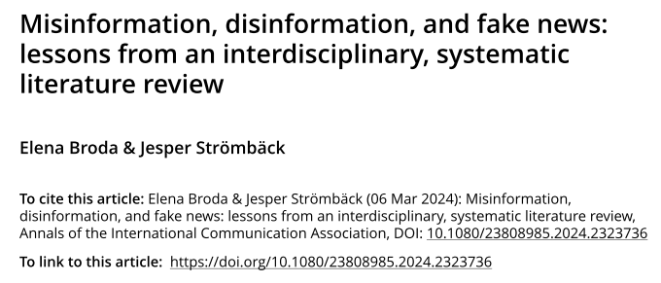
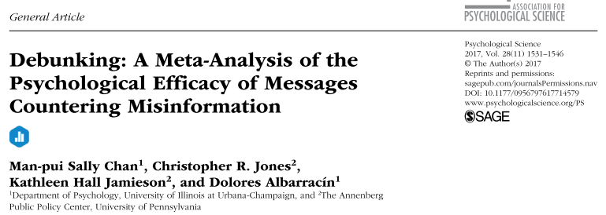
0. Why do People Believe Nonsense?
Lack of knowledge/education.
To fit with an identity group/community.
Provide emotional comfort or outlet.
Coherence with an ideology/worldview.
Personality or demographic characteristics.

Slide 3
0. The Root of the Problem
People do not know how to think critically.
People have a poor epistemology.
Here I will focus on ideas rather than interventions.

Slide 4
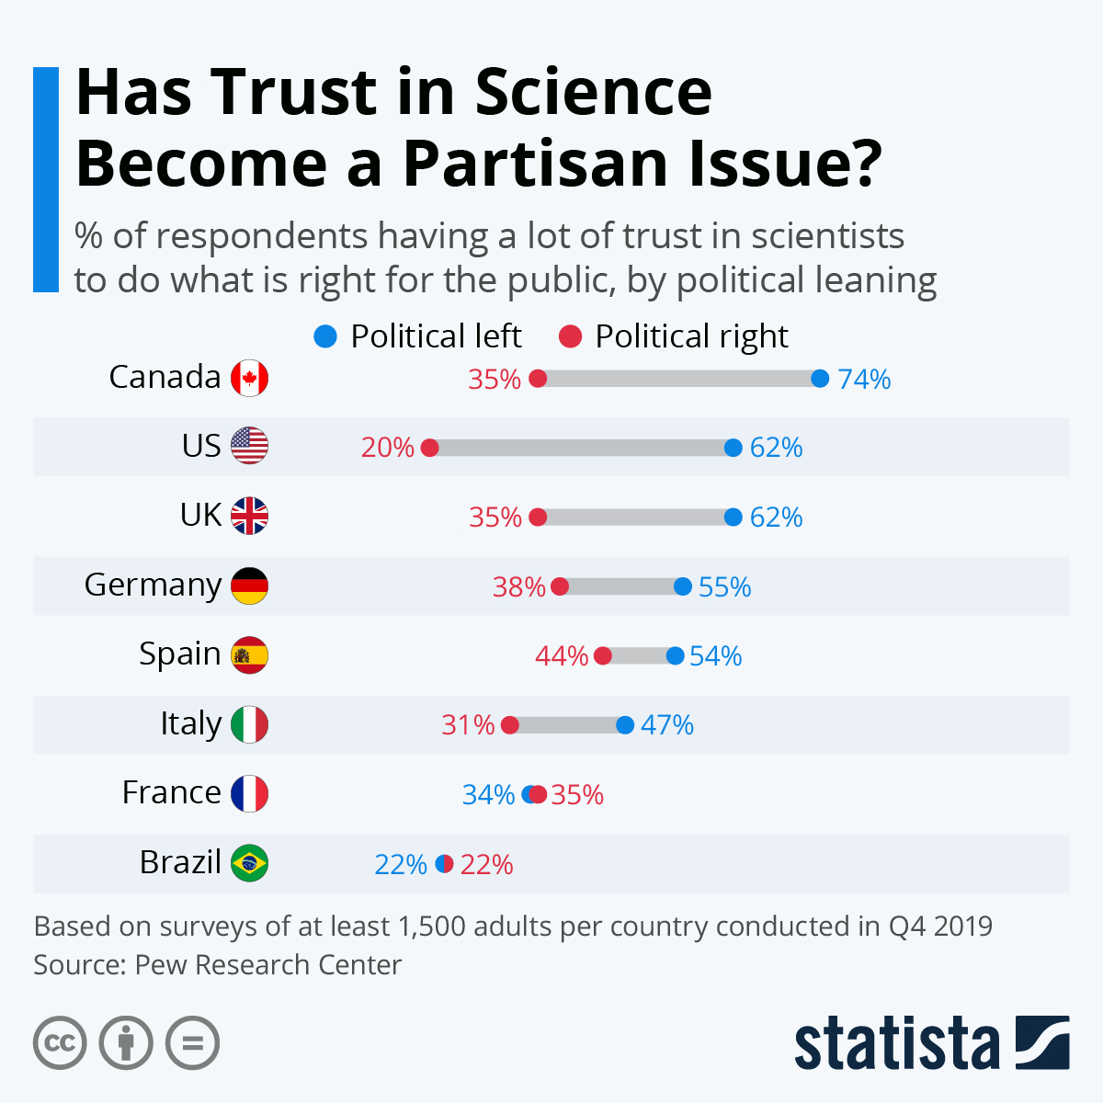
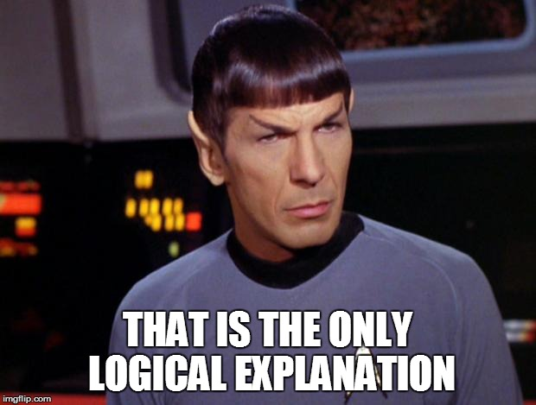
0. Some Ideas from Philosophy
Why trust science?: Appeal to authority and the scientific method
What is the best explanation?: Explanatory coherence and worldview challenges

Slide 5
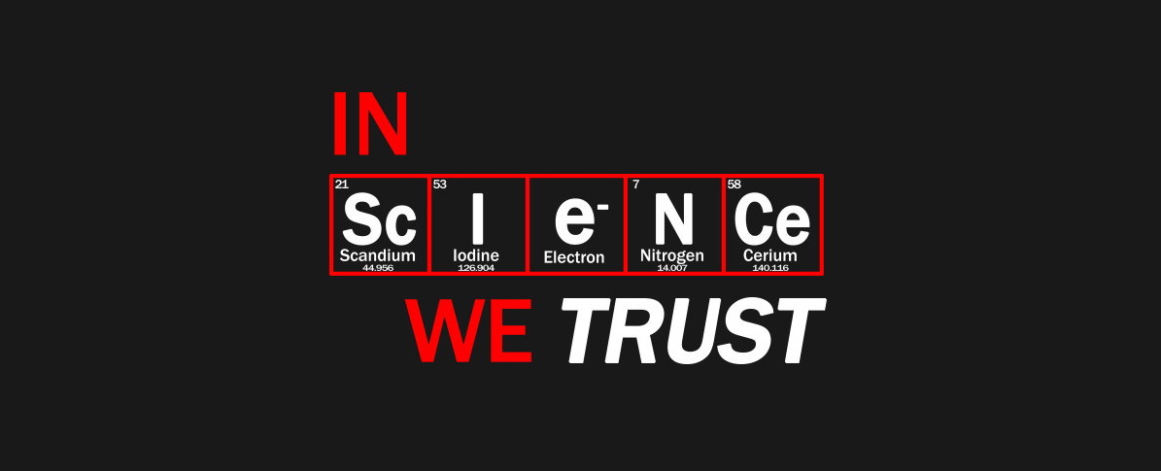
1. Science and Appeals to Authority
We lack the time and knowledge to assess most scientific claims ourselves.
We must trust the expertise of scientists.
But why should we?
What makes ‘science’ more trustworthy than anecdote, religious texts, mystical experiences, political debate, or introspection?

Slide 6
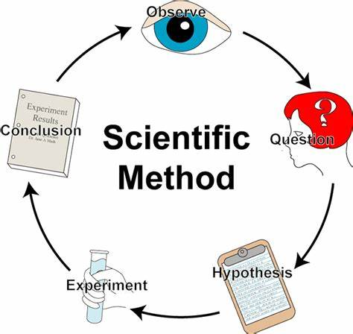
1. Some Poor Answers
Scientists follow the ‘scientific method’.
  Not really any such thing.
  Would need to establish the method was justified.
Individual scientists are responsive to new evidence.
  Scientists are often as stubborn and biased as other people.
  Fields can change very slowly with new evidence or techniques.
Science is based on observable facts rather than speculations or dogma.
  Observations must be interpreted in light of a theory.
  Theologians, mystics, and paranormal investigators also use ‘observable facts’.

Slide 7
1. Some Better Answers
Science is a (fairly) open intellectual endeavour.
  Do not need to sign statements of belief or join a religious order.
  Evidence is presented for public evaluation and comment.
Science takes a critical viewpoint and requires evidence.
  Many fields take a credulous viewpoint and do not have standards of evidence.
  In science nothing is ‘sacred’ or beyond reproach or doubt.
Science has self-correcting mechanisms.
  Findings that cannot be replicated become suspect.
  Research programs that don’t yield results are abandoned.

Slide 8


1. Appeals to Authority
Requirements for valid appeal to authority:
  Genuine expertise in a field.
  Claim must be within that field.
  Field of study must utilise appropriate epistemic standards.
  Predominance of experts in the field must not disagree.

Slide 9

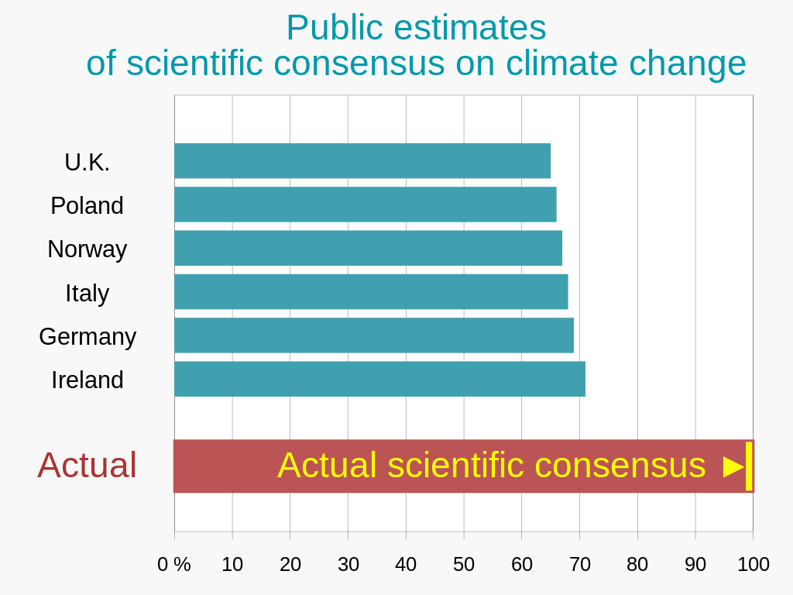

1. Example: Climate Change
Focus on broad range of agreement of researchers across the world.
Discuss the methods used (historical, surface, satellite, modelling).
Emphasise that no plausible alternative explanation to recent warming can be provided by climate deniers.
Challenge claims of bias by asking for specifics of what research is wrong, and why no one with different biases hasn’t shown this.

Slide 10
1. Lessons
Emphasise: diversity of consensus, reliability of methods, lack of alternative explanation, lack of disproof from opponents.
Deemphasise: talk of ‘scientific method’, blind trust, individual qualities of scientists.

Slide 11
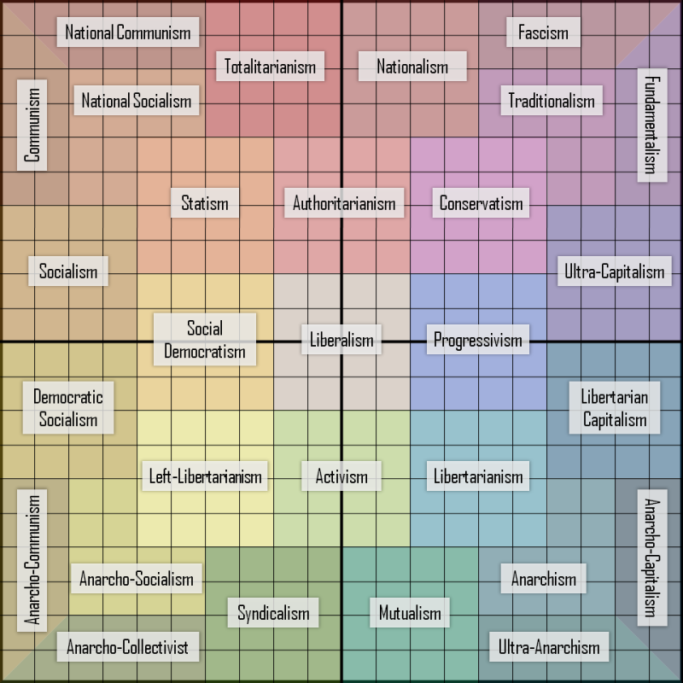
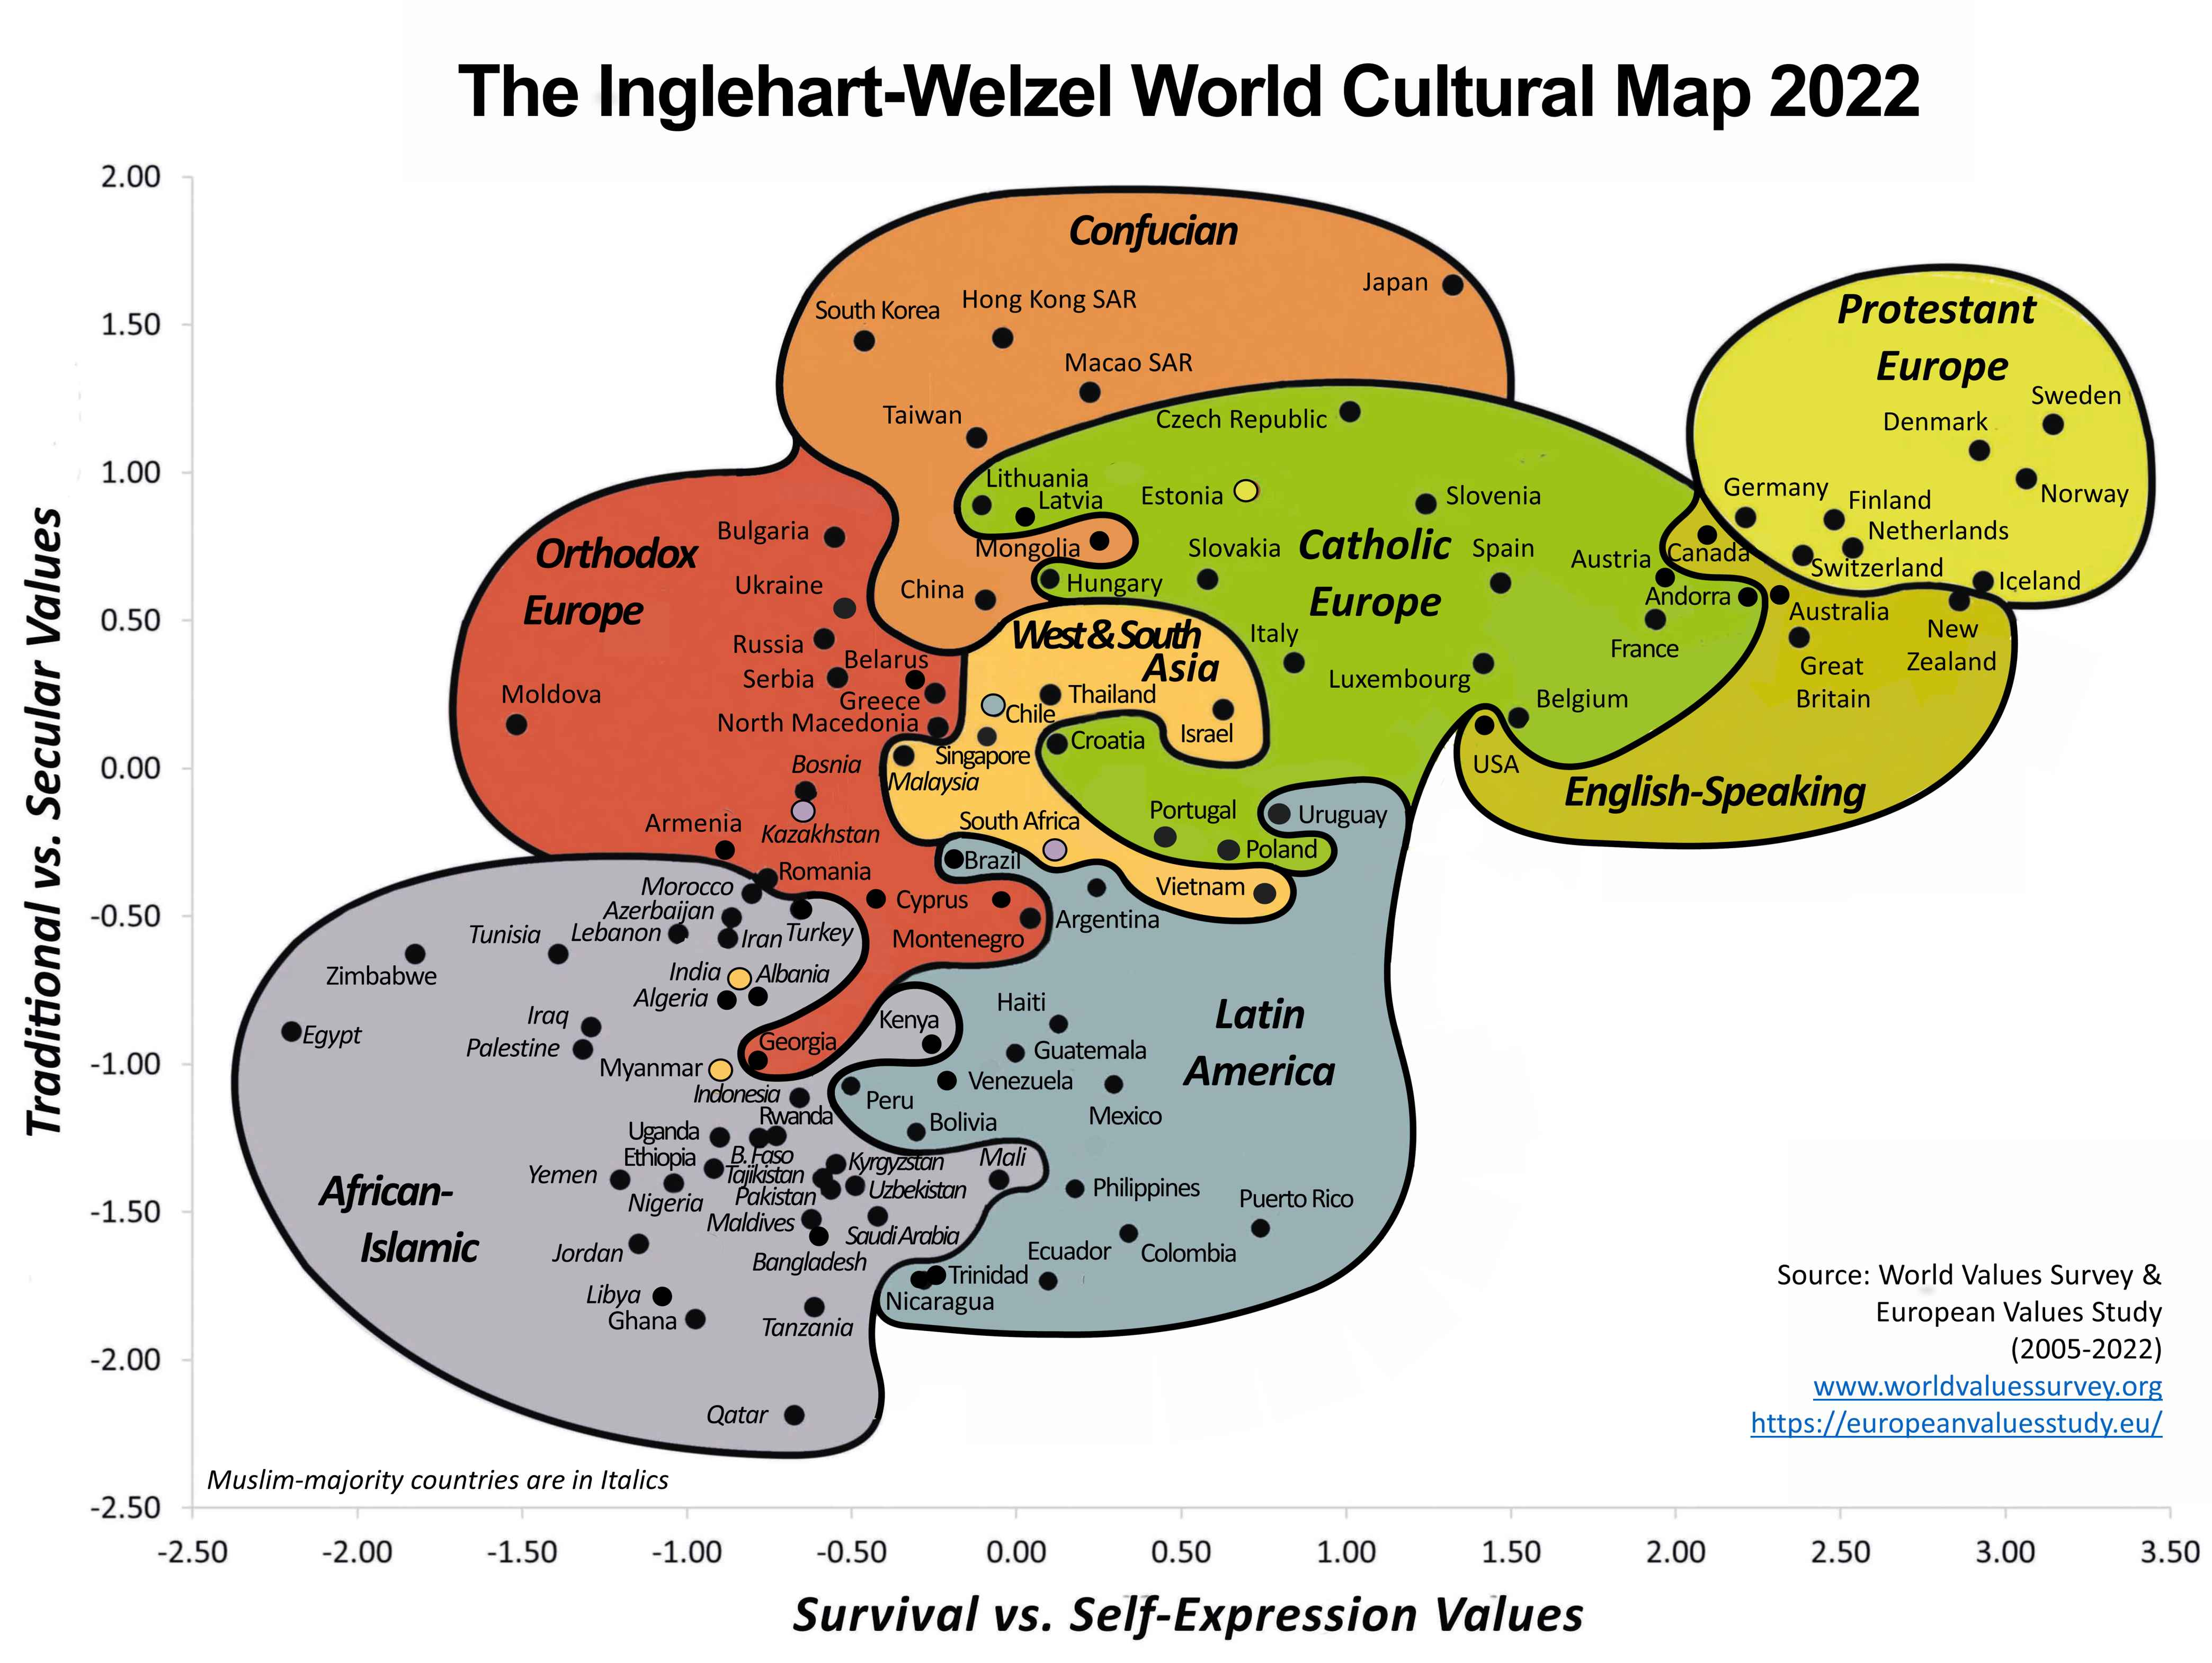

2. Coherence and Worldviews
A worldview is a set of fundamental beliefs about how the world works.
Many people don’t think carefully about it but everyone has one.
Perceived contradictions lead to cognitive dissonance and belief revision.
People often reject new evidence or arguments that conflicts with their worldview.

Slide 12
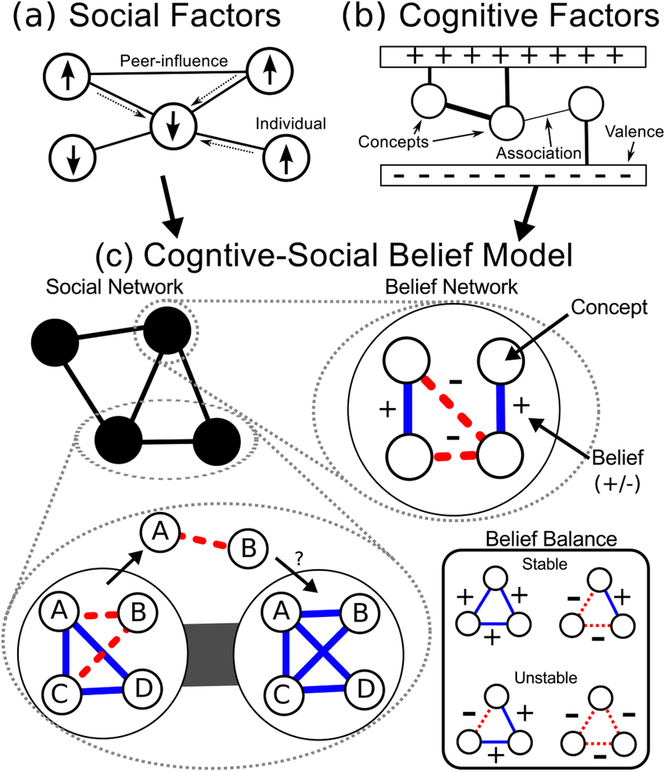
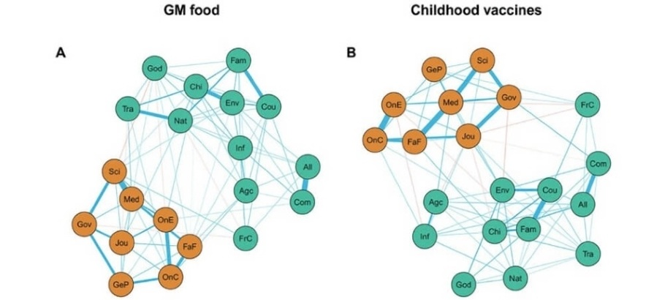
2. Worldviews are Resistant to Change
Challenging a single belief is difficult – it is embedded in a ‘web of beliefs’.
People interpret evidence in light of their existing beliefs.
People are motivated to accept beliefs that are convenient.
People do not try to think about things in different ways.
Belief Change: A New Predictive Network Model

Slide 13
2. How to Challenge Belief Systems
Don’t challenge a single belief; present an alternative interpretation.
Provide detail and explanatory coherence to the alternative.
Ask probing questions to highlight tensions in existing worldview.
Show how core values are not really threatened by belief change.
Show how core values are promoted by belief change.

Slide 14
2. Example: Climate Change
Present an alternative story about climate change and politics.
Ask who funds climate denial groups, why they can’t get published in good journals, how their speech is suppressed but it is also everywhere.
Argue that belief in climate change doesn’t mean socialism or abandonment of technology.
Argue that restricting pollution promotes personal liberty by reducing harm and protecting property rights from imposition.

Slide 15
2. Lessons
Emphasise: tensions in existing worldview, alternative coherent explanations, how existing values can be preserved with belief change.
Deemphasise: focus in single facts or issues, ‘debunking’ individual points, presenting your own values or reasoning.

Slide 16
Conclusions
Belief in misinformation isn’t just due to lack of information.
Need to challenge worldviews that foster such beliefs.
Promote acceptance of science by emphasising diversity of consensus, reliability of methods, lack of alternative explanation, lack of disproof from opponents.
Promote rethinking of views by showing tensions in existing worldview, alternative coherent explanations, how existing values can be preserved with belief change.

Slide 17
Discussion?

