Slide 1

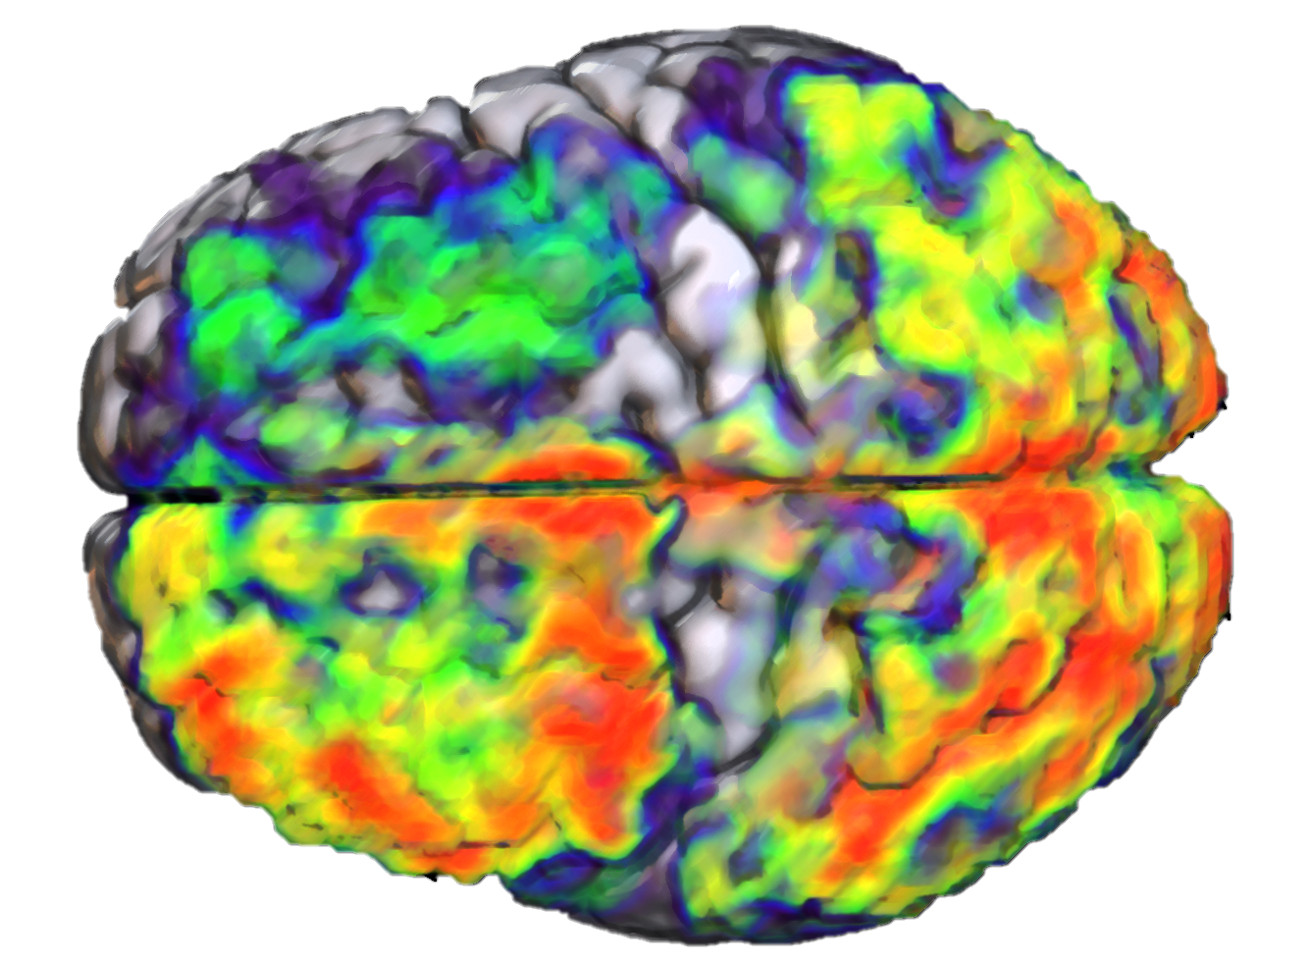
Computational Models of Compositional Semantics in the Mind and Brain
James Fodor
December 2024

Slide 2
Background

Slide 3
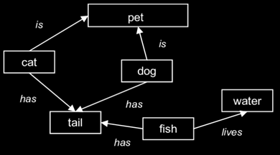
What is Semantics?
Semantics is the study of meaning.
How does the mind/brain represent the meaning of individual words?
How are word representations combined to form into sentence representations?

Slide 4
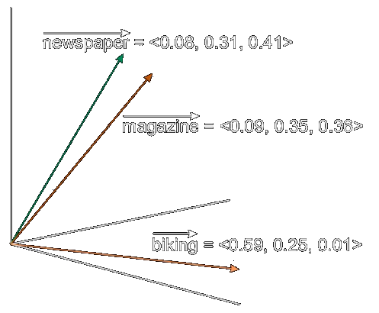
Word Embeddings
Word embeddings represent the meaning of a word as a vector of numbers.
Embeddings live in ‘semantic space’.
More similar vectors = more similar meaning.
Basis for LLMs like ChatGPT.

Slide 5
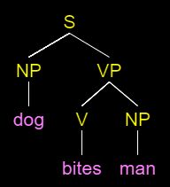

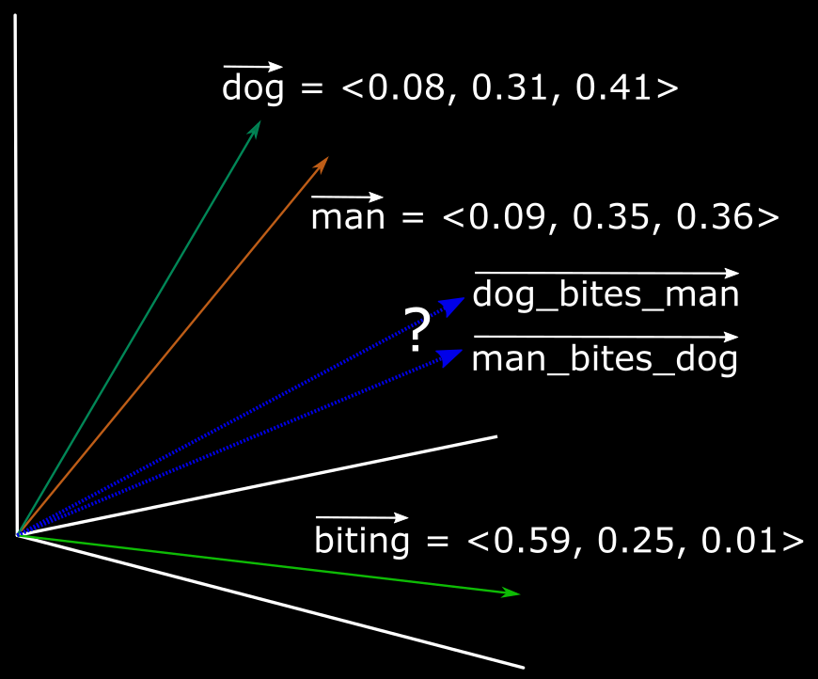
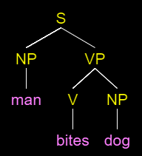
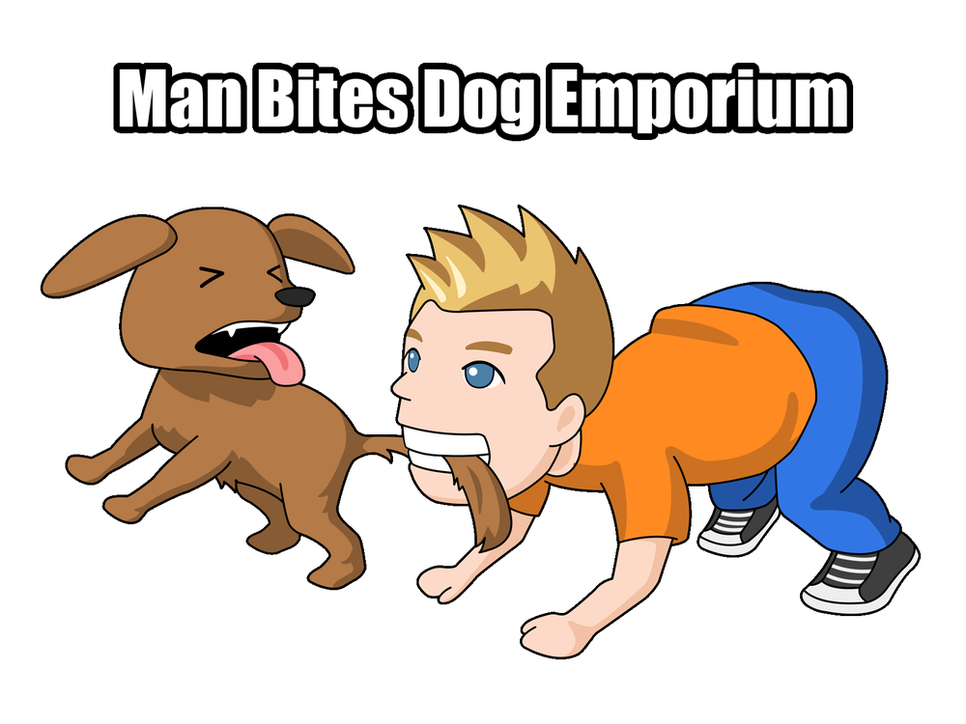
Compositionality
How to represent an entire sentence or phrase?
Compositionality: method for combining word representations together to construct a sentence representation.
Bite(DOG,MAN)
Bite(MAN,DOG)

Slide 6
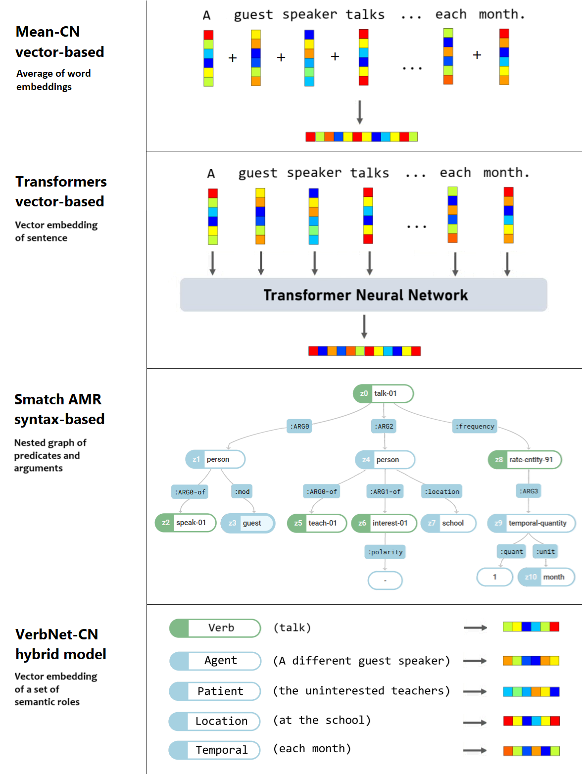
Ways to Represent Sentences
Many proposals for how to form sentence representations.
Example sentence: “A different guest speaker talks to the uninterested teachers at the school each month.”
Four basic classes:
  Simple word-averaging models.
  Connectionist/vector-based.
  Parse trees/syntax-based.
  Hybrid models.

Slide 7
Key Research Question
Which models of compositionality produce representations which are most similar to human representations?
Study 1: Test with behavioural data.
Study 2: Test with fMRI data.

Slide 8
Study 1: Methods

Slide 9
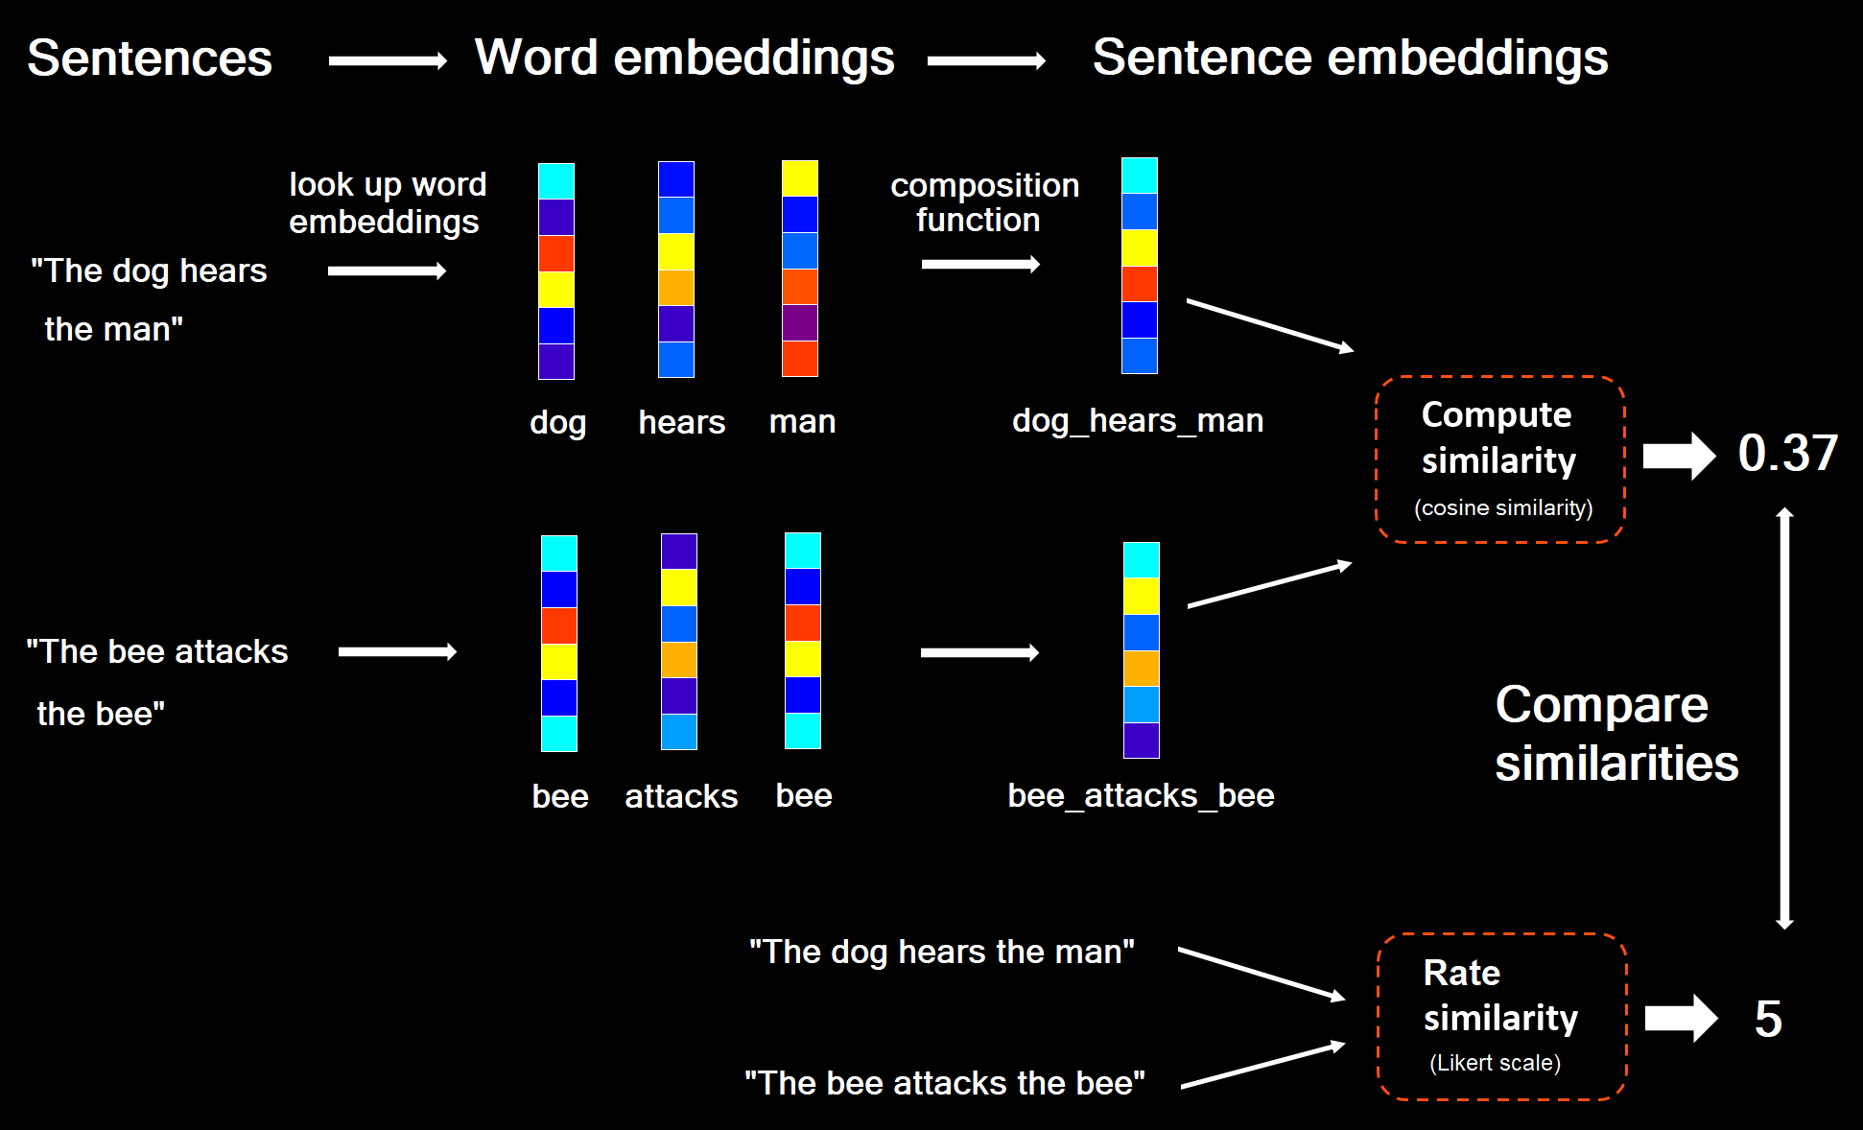

Semantic Textual Similarity
Composition models
Human participants

Slide 10
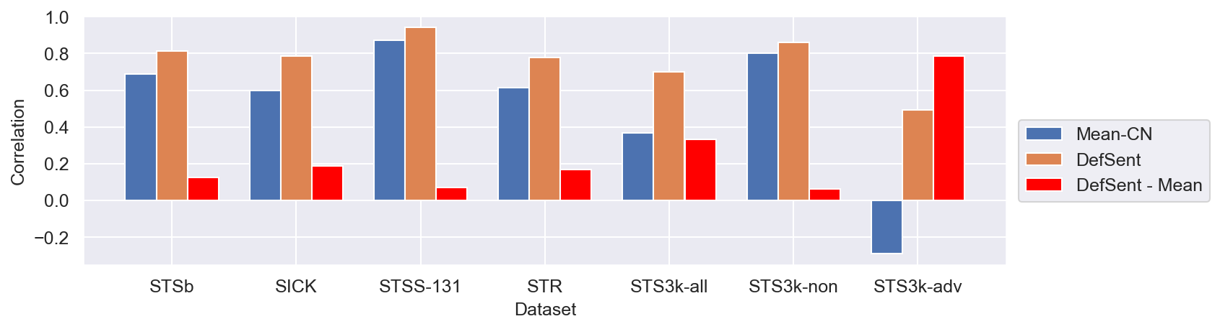
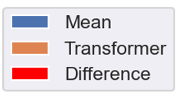
Limitations of Existing Datasets
Existing STS datasets show large lexical confound.
This means we can’t infer much about how models do composition.

Slide 11
The STS3k Dataset
I developed a new dataset designed to test sensitivity to sentence structure.
Pair Type | Adversarial | Example
Non- Adversarial | No | The manager hoped for a better salary. The student hoped for a high mark on the test.
Paraphrase | Yes | Most streams flow out to the ocean. Many rivers empty into the sea.
Added modifiers | Yes | The plane crashed in the desert. The cargo plane crashed in the rocky desert near the oasis at night.
Double Swap | Yes | The professor asked the student for help. The student asked the professor for help.
Triple swap | Yes | The dragon chased the knight on his horse. The knight chased the horse on his dragon.
Quadruple Swap | Yes | The firm paid for the project with the new government. The new government projected increased pay for the firm.

Slide 12
Study 1: Results

Slide 13
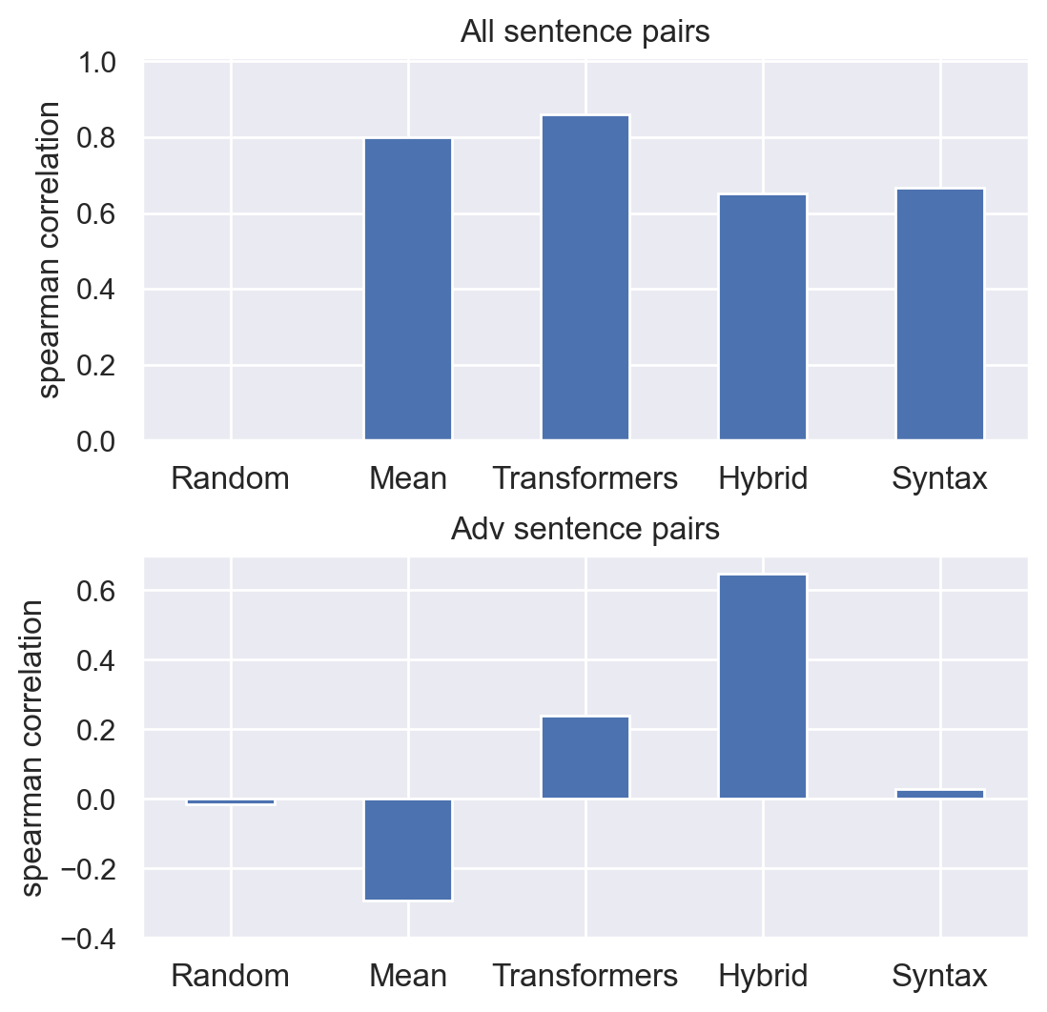
Model vs Behavioural Correlations
Results for four classes of models.
Similar correlations for all sentence pairs.
Major differences for adversarial sentence pairs.
Models
Models

Slide 14
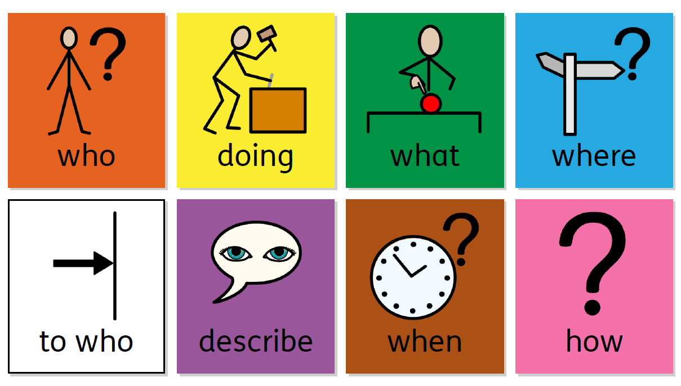
Preliminary Conclusions
Human behavioural judgements are sensitive to subtle structural differences between sentences.
Hybrid representations incorporating semantic roles better match human judgements than transformer representations.

Slide 15
Study 2: Methods

Slide 16
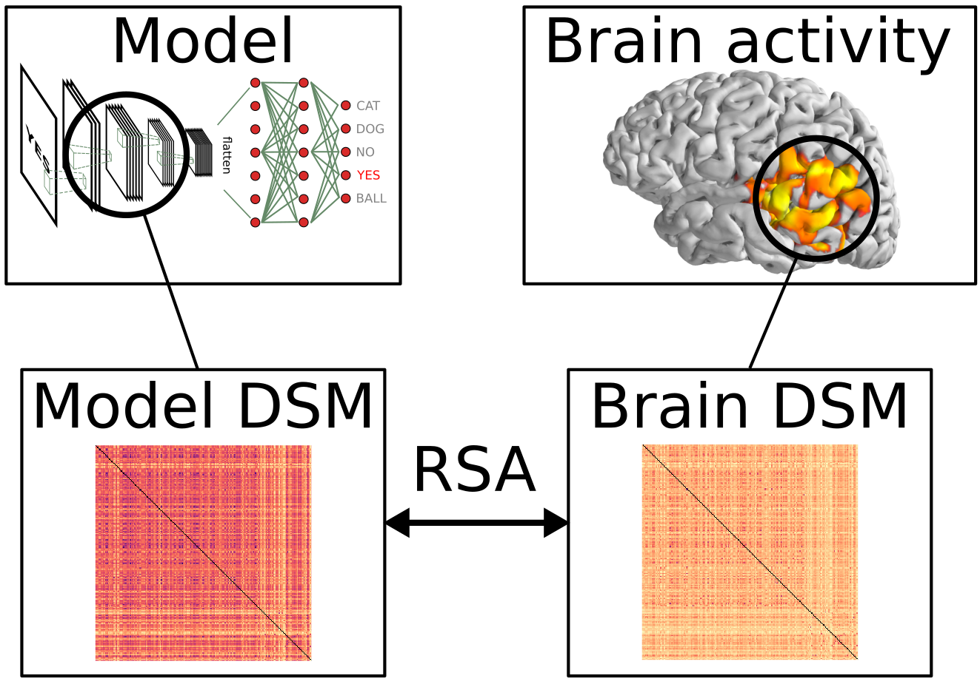
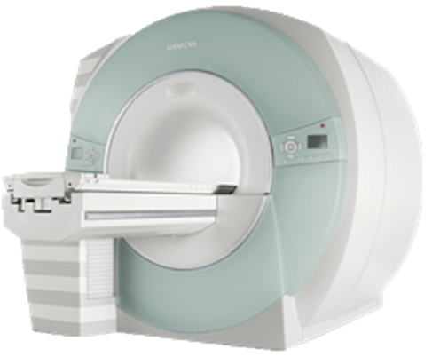
Representational Similarity Analysis
Present written sentences while participant is in the scanner.
Compare brain activity to predictions of different sentence models.
R
R

Slide 17
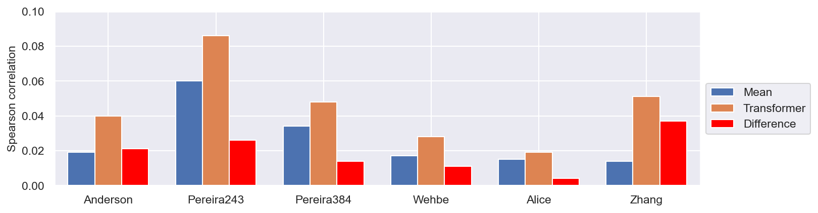
Limitations of Existing Datasets
Existing fMRI language datasets show a lexical confound.
This means we can’t infer much about how the brain does composition.

Slide 18
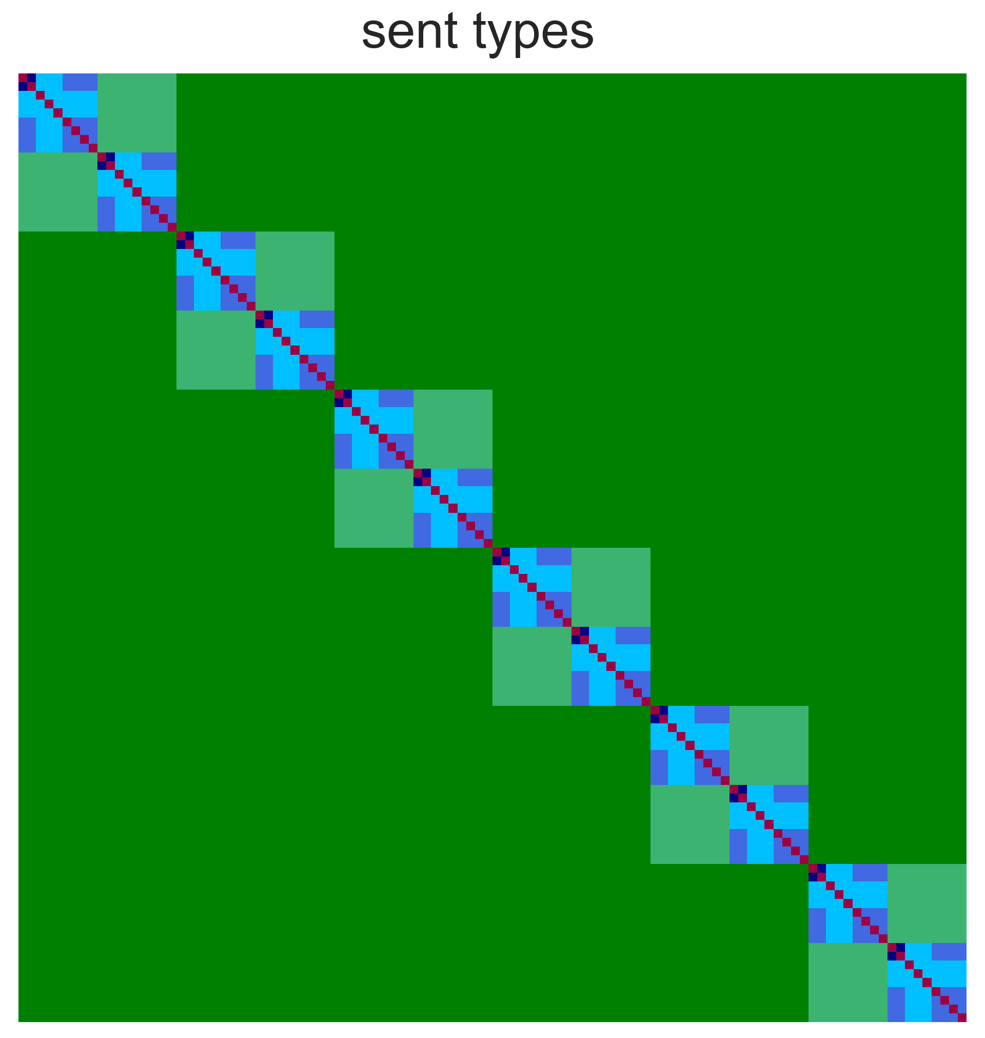
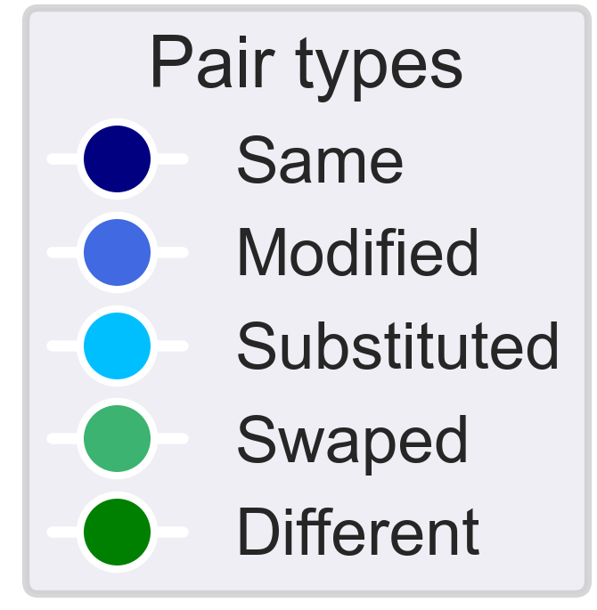
The Fodor2024-108 Dataset
Systematically vary sentence structure to achieve model discrimination.
RSA matrix: each element is the similarity value for one sentence pair.
The cameraman brought the equipment to the director.
The cameraman brought the new equipment to the director.
The cameraman brought the equipment to the director.
A team of cameramen brought all the necessary equipment to the busy director.
The cameraman brought the equipment to the director.
A painter brought the equipment to the director.
The cameraman brought the equipment to the director.
The director brought the cameraman to the equipment.
The cameraman brought the equipment to the director.
The company purchased a valuable painting from the family.
(RSA matrix: each element is the similarity value [0-1] for one sentence pair)
The cameraman brought the equipment to the director.
The cameraman brought the new equipment to the director.
The cameraman brought the equipment to the director.
A team of cameramen brought all the necessary equipment to the busy director.
The cameraman brought the equipment to the director.
A painter brought the equipment to the director.
The cameraman brought the equipment to the director.
The director brought the cameraman to the equipment.
The cameraman brought the equipment to the director.
The company purchased a valuable painting from the family.
The new sentences shows better model discrimination due to varying sentence structure.

Slide 19
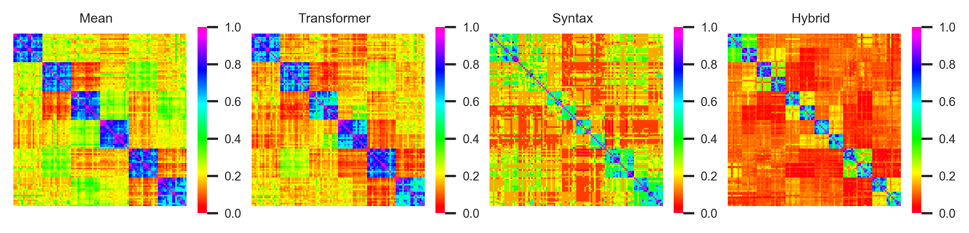
RSA Matrices for New Sentence Set
Clear block-diagonals structure visible.
Coverage from dissimilar to very similar sentences.
Able to distinguish between models.

Slide 20
Study 2: Results

Slide 21
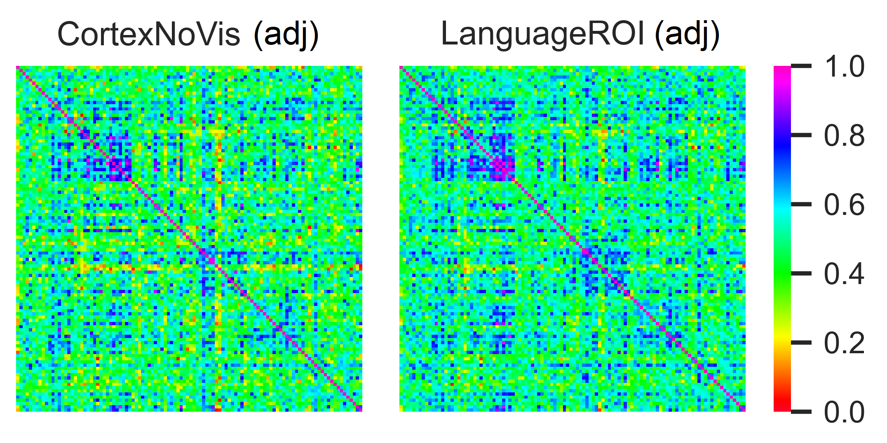
fMRI RSA Matrix Comparison
All sentence pair RSA matrices averaged over all participants.
(Controlling for minimum sentence length effect).

Slide 22
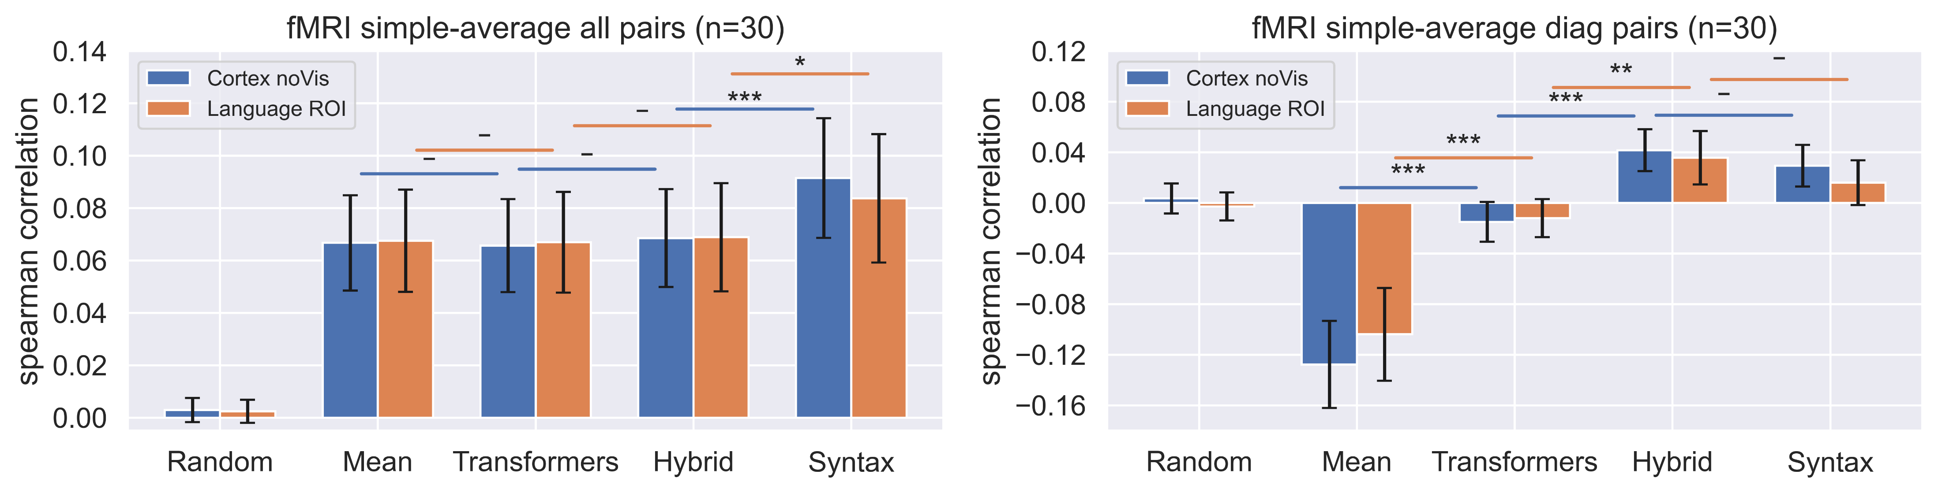
Model vs Brain Correlations
Simple average of subject correlations.
(Partial correlations controlling for sentence length).
Models
Models

Slide 23
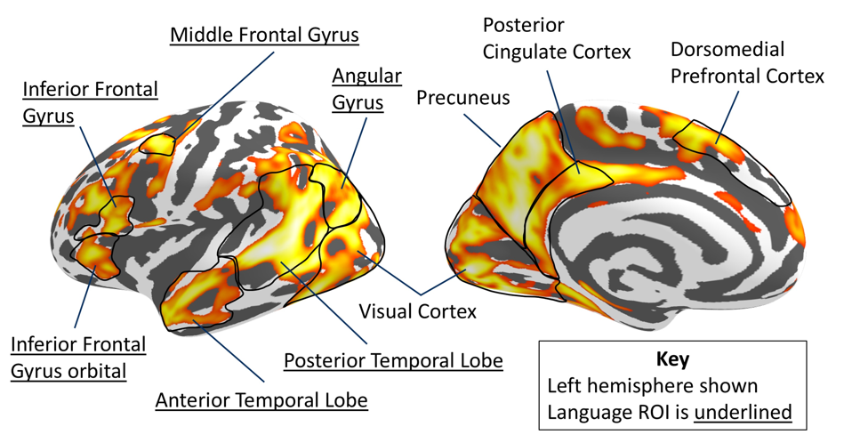
Regions of Activation
Cortical surface map shows regions that correlate with model representations.
Names areas show regions previously associated with semantics.

Slide 24
Discussion

Slide 25
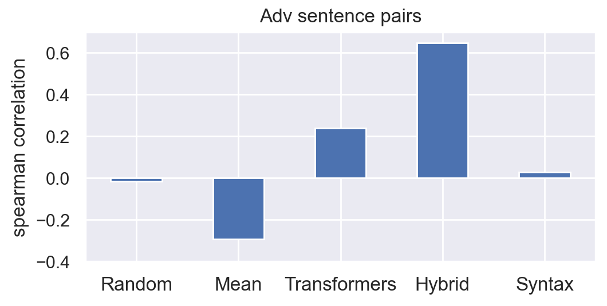
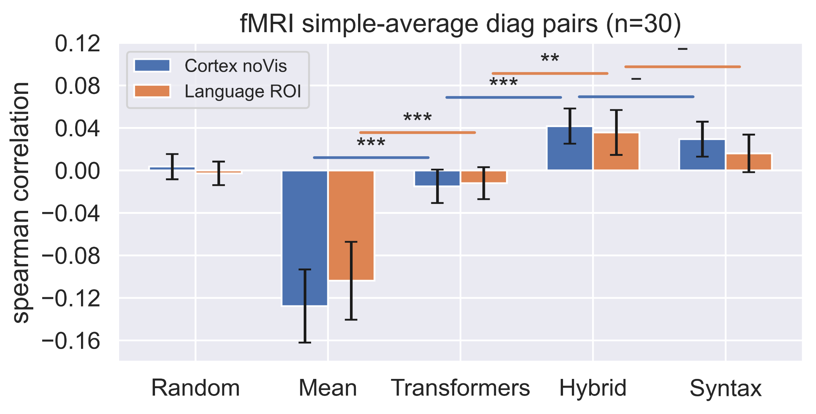
Interpreting Results
Behavioural and fMRI results both highlight the importance of sentence structure for semantic representation and processing.
The mean model consistently performs worst on difficult pairs of sentences.
Transformer representations are better than the mean model but still inferior to the hybrid model.
LLMs have access to all necessary information, but do not seem to combine it to form human-like semantic representations.
May explain why LLMs do well at many language tasks but can fail in unexpected ways, especially when making generalisations.

Slide 26
Next Steps
Investigate more sophisticated hybrid models.
Extend approach to a wider range of sentence types.
Expand analysis to additional fMRI datasets.
Extend approach to representations in other domains, such as problem solving and decision making.

Slide 27
Thanks
To my supervisors Shinsuke, Charles, and Nitin for advice and support.
To my coauthor Simon for helpful comments.
To Carsten and Pablo for help with designing the fMRI study.
To Helena for regular discussions.
To Liz for assistance with ethics, payment, and much more.
To everyone else at the Centre for Brain, Mind, and Markets!

Slide 28
Questions?

Slide 29
Transformers Analysed
Model name | Explanation
ERNIE 2.0 | Based on BERT transformer architecture trained using multi-task learning. We will assess layers 0 as 12.
SentBERT-mpnet | Based on the mpnet-base transformer model, with additional training to predict paired sentences from a large dataset.
DefSent-cls | Based on RoBERTa-large transformer model fine-tuned using about 100,000 words paired with their dictionary definitions.
OpenAI embeddings | Embeddings from the OpenAI API, based on a large transformer architecture based on GPT 3, with additional fine-tuning from human feedback.
AMR-Bart | Derived from the Bart transformer architecture with additional fine-tuning on tasks involving predicting masked graph elements.

Slide 30
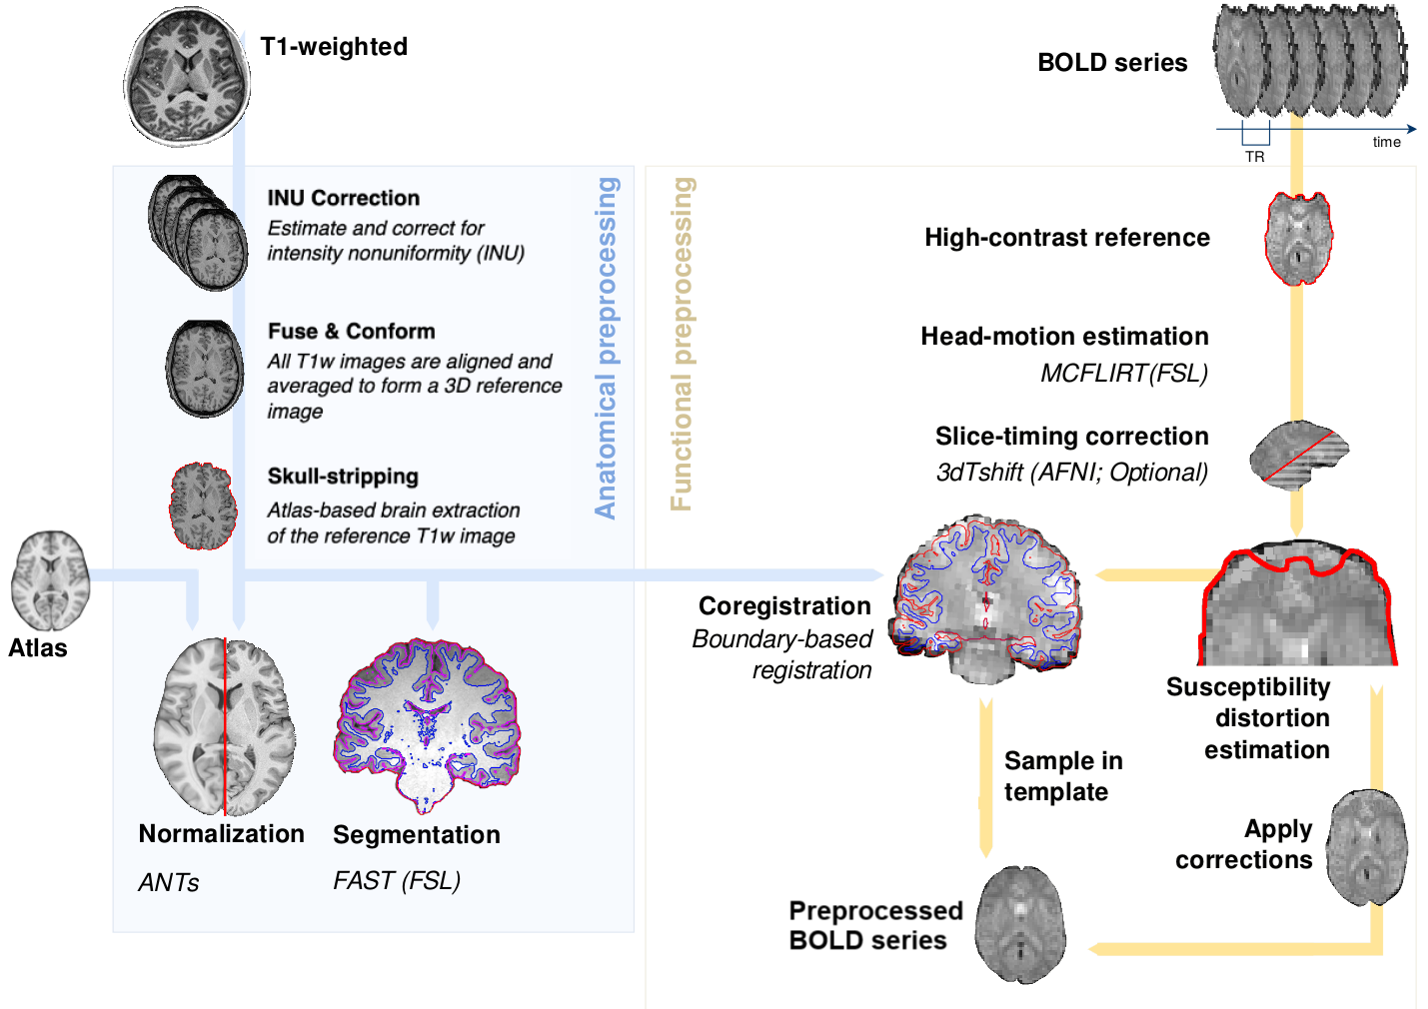
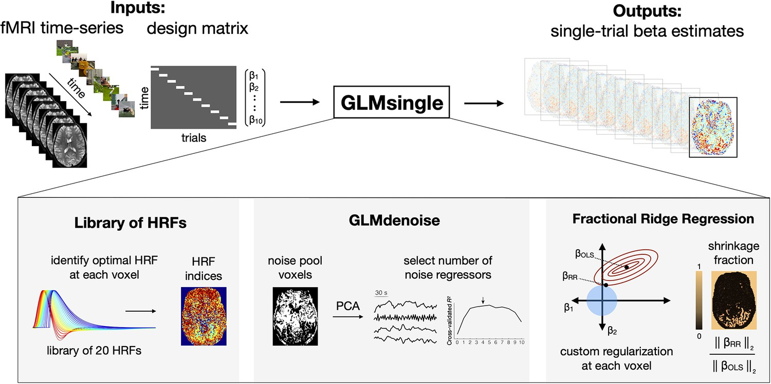
fMRI Preprocessing and GLM
Each sentence shown four times over 8 runs.
Preprocessing done using fMRIprep.
Beta coefficients for each sentence estimated using GLMSingle.
Voxels were selected using ROI and stability score (correlation over repeats).

Slide 31
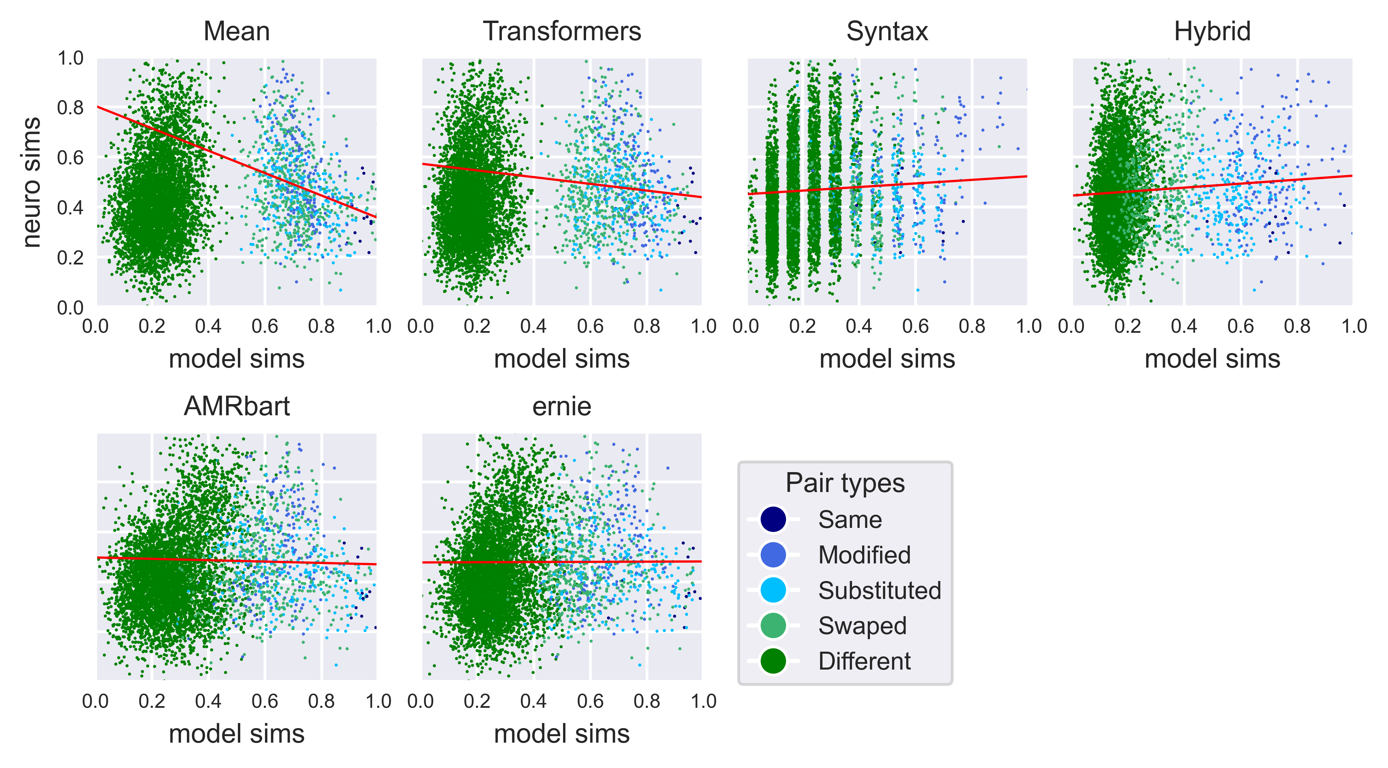
Model vs Brain Correlations
Relative similarities of ‘swapped’ and ‘modified’ pairs leads to differences between models.

Slide 32
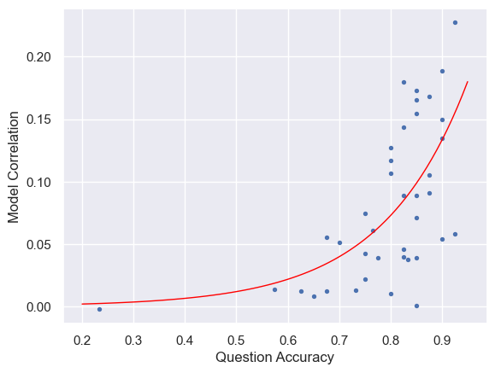
Participant Quality
Attention matters!
R-square = 0.395

Slide 33

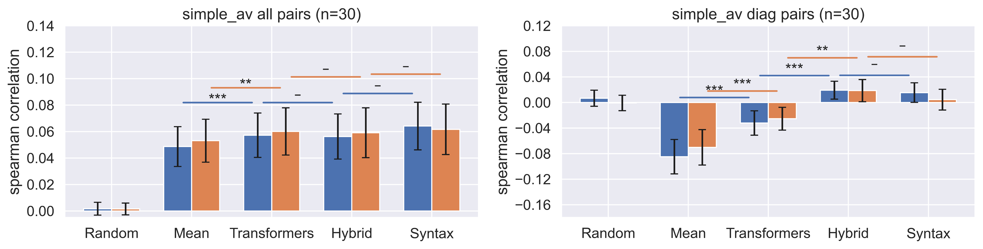
Model vs Brain Correlations
Simple average of subject correlations with length effect removed.

Slide 34
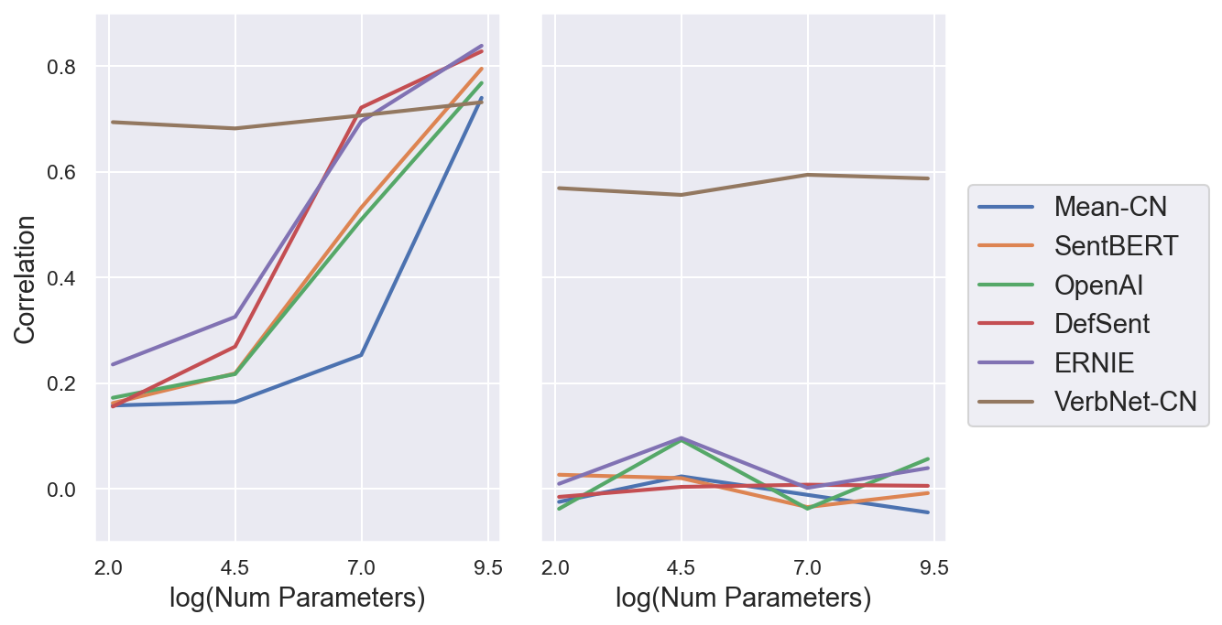
Trying to Learn the Task
We fine-tune the models against the STS3k dataset to see if they learn the task.
Training on random subset (left) they all learn.
Training but on the adversaria only (right) the transformers fail to learn.

