Slide 1

Large Language Models and Cognition
James Fodor
27th November 2023

Slide 2
Introduction to
Large Language Models

Slide 3

Large Language Models
Large Language Models (LLMs) are statistical models for predicting the probability of the next word in a sentence.
The best-performing LLMs are based on the transformer architecture.
‘Large’ because they have billions of parameters and huge training datasets.

Slide 4
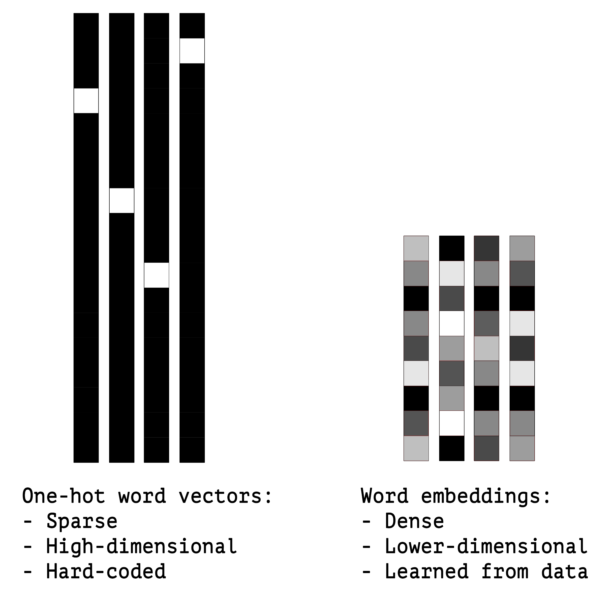
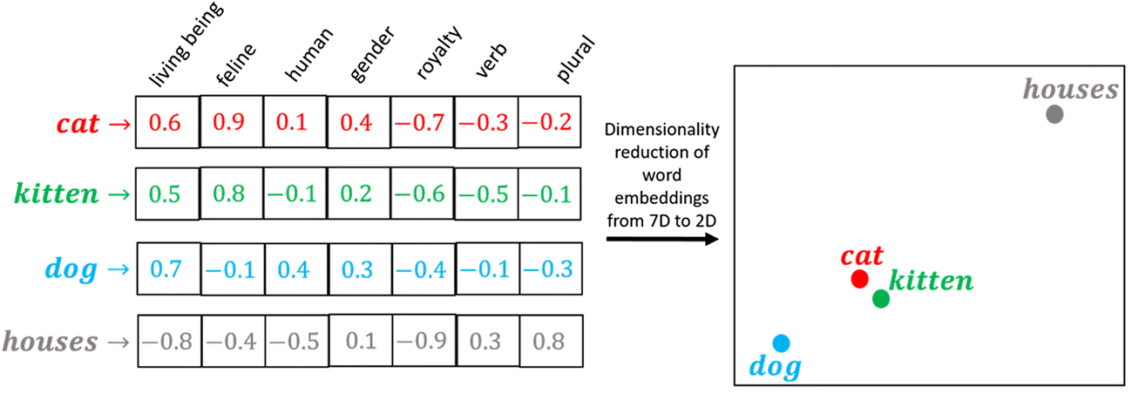
Word Embeddings
Represent the meaning of a word as a vector of numbers.
Each element is an abstract ‘feature’.
Allows for graded similarity in word meanings.

Slide 5
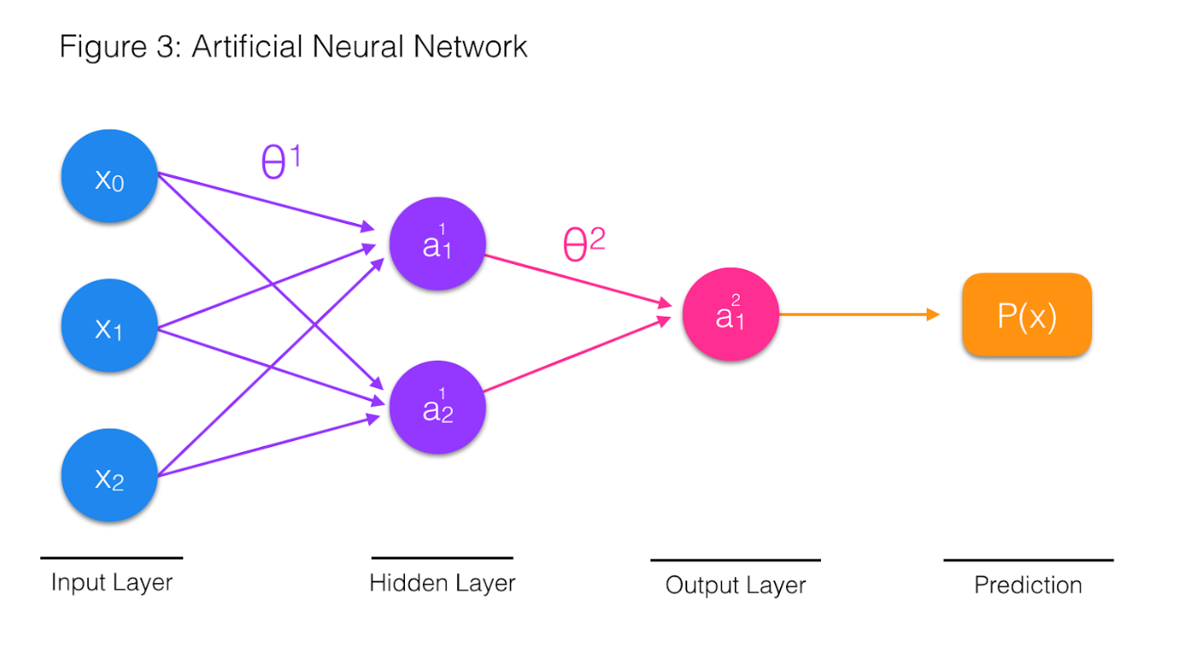
Neural Networks
Neural networks are a series of nodes linked together.
Each connection has a weight that affects the flow of information.
Neural networks can learn to compute complex transformations of inputs.

Slide 6
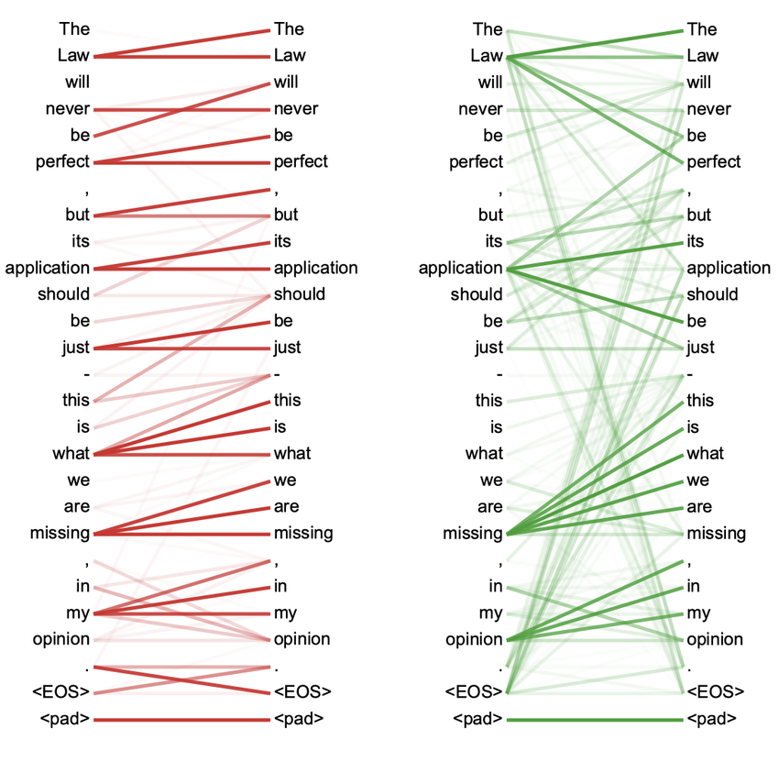
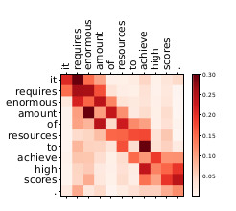
Self-Attention
Self-attention involves identifying important interactions between inputs.
Attention weights are computed between all pairs of inputs (e.g. tokens).
Allows for incorporating effects of context on language.

Slide 7
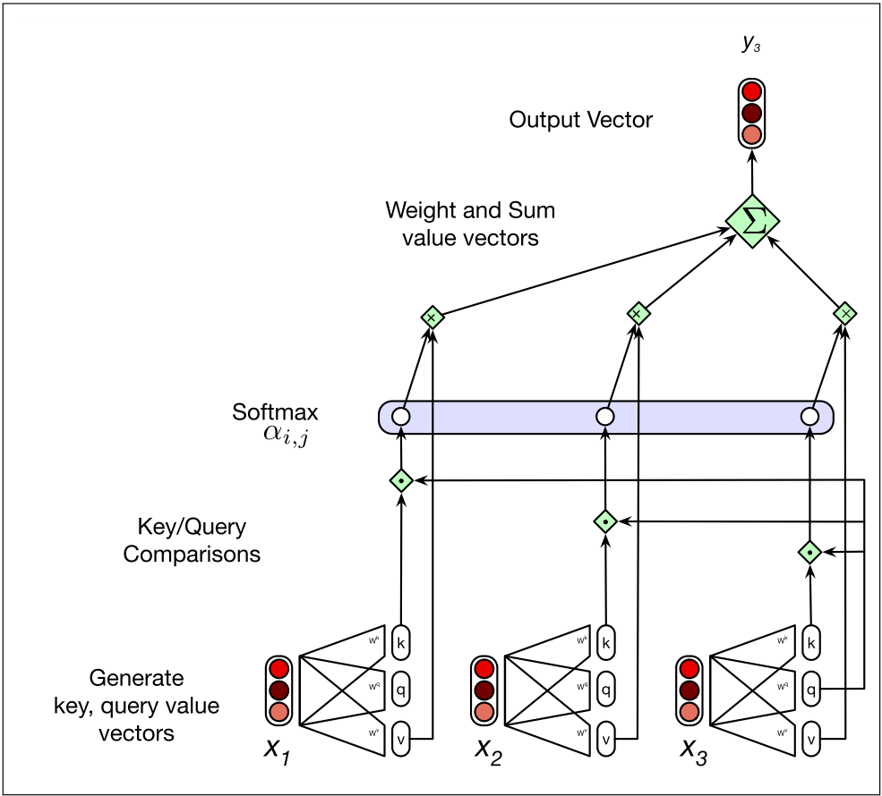
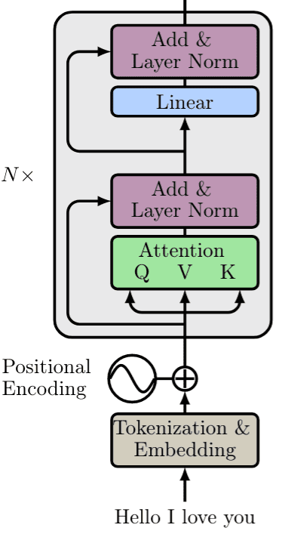
Transformer Architecture
Output for a token y₃ is equal to a weighted sum of all value vectors v₁ to v₃.
The weights are given by the query vector q₃ times each key vector k₁ to k₃.
Pass the outputs through N transformer layers.

Slide 8
The Problem of Hallucinations

Slide 9
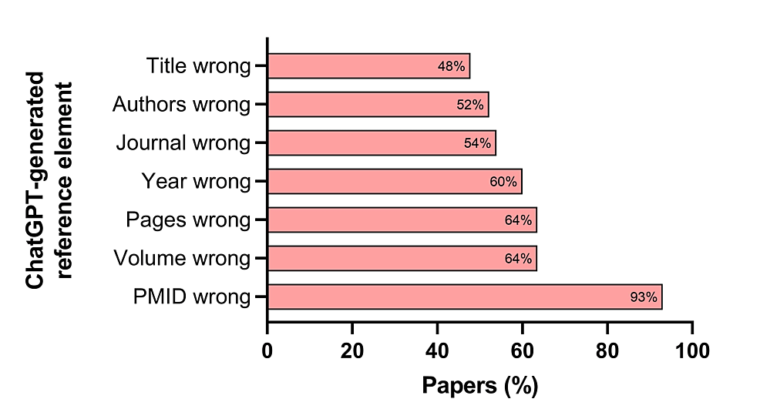
Hallucinations
A ‘hallucination’ is an output with confabulated false information not present in or justified by the input.
Better to call it a confabulation or delusion as it's not a sensory problem.

Slide 10
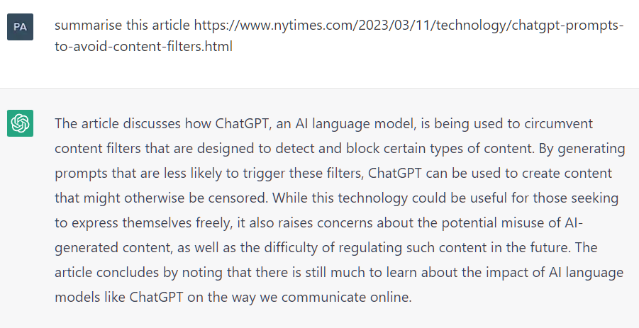
Hallucinations
Chat-GPT will attempt to do what it is asked, even if it is not able to do so.

Slide 11
Hallucinations
Hallucinations occur because of how LLMs are designed.
Models predict plausible next words based on training data.
Models do not have a concept of truth or falsity.
Models also may inappropriately generalise from training data relevant to different contexts or historical settings.

Slide 12
The Problem of Adversarial Attacks

Slide 13
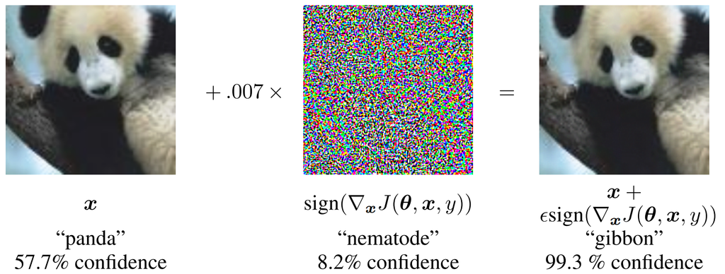
Adversarial Attacks
Adversarial attacks are attempts to engineer inputs or training data which result in an LLM producing consistently erroneous output.
Often this means inputs which are ‘easy’ for humans but ‘hard’ for the model.
The goal is to expose limits of LLMs and how they differ from human cognition.

Slide 14
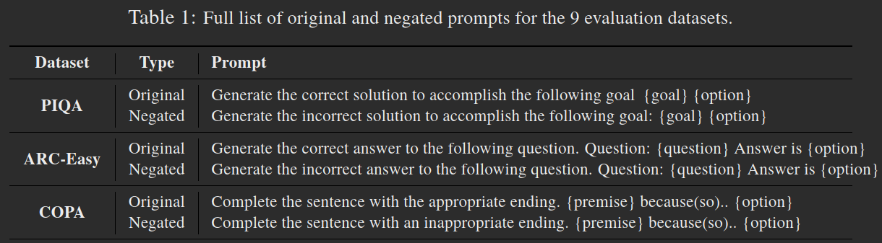
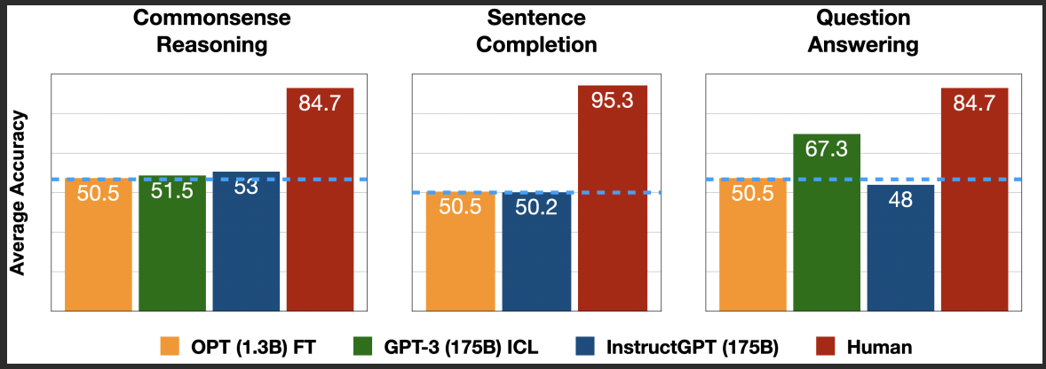
Negated Prompts
Can Large Language Models Truly Understand Prompts? A Case Study with Negated Prompts

Slide 15
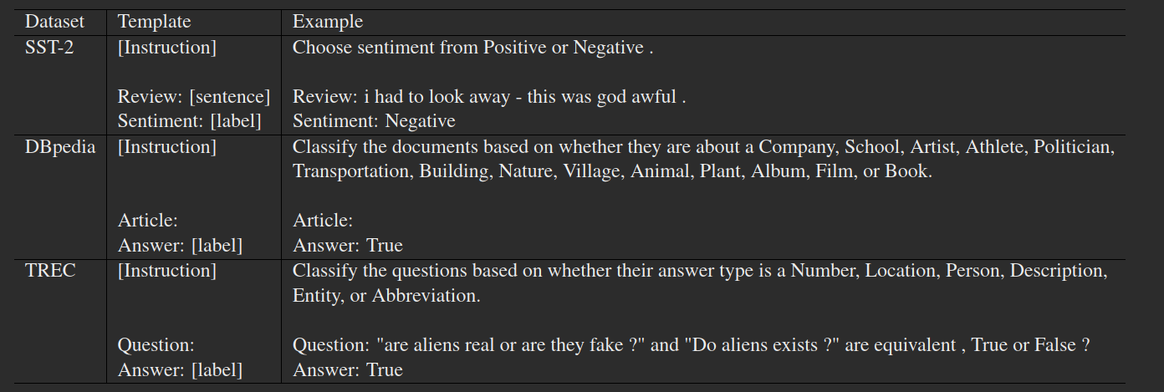
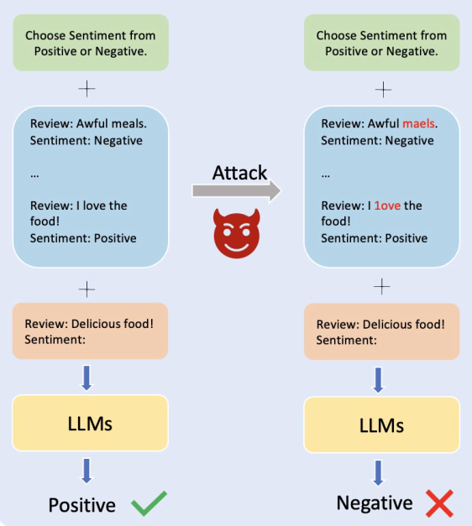
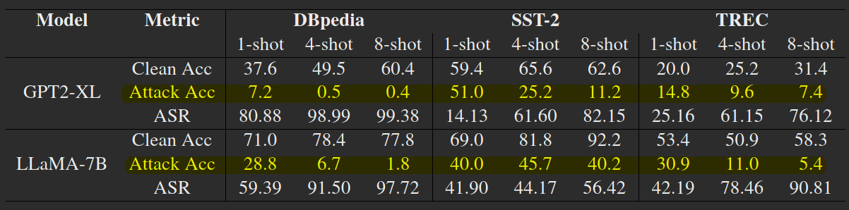
Modified Demonstrations
Adversarial Demonstration Attacks on Large Language Models
“By only manipulating the demonstrations without manipulating the input test examples, attackers can successfully mislead the model.”

Slide 16
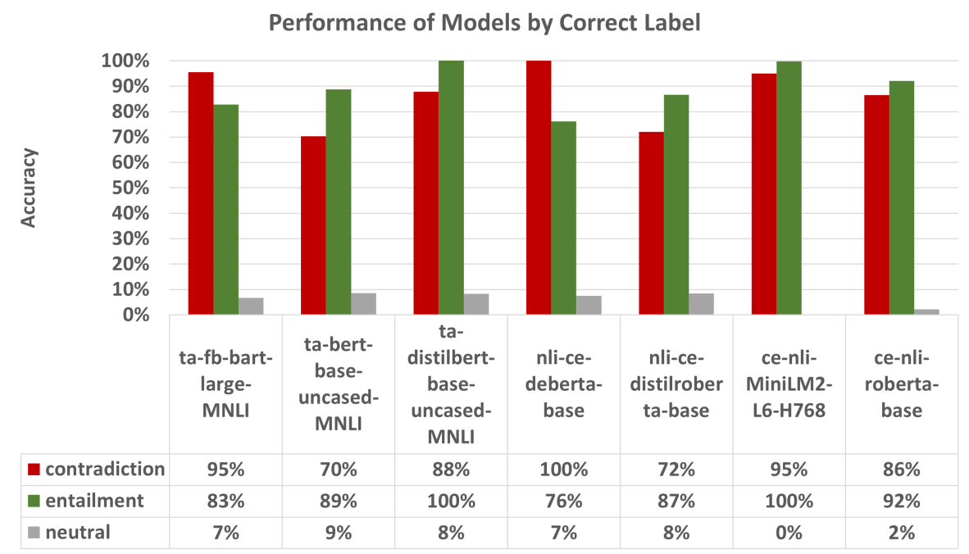
NLI with Syllogisms
Uncovering More Shallow Heuristics: Probing the Natural Language Inference Capacities of Transformer-Based Pre-Trained Language Models
“Manual inspection showed that they respond strongly to symmetries regarding quantiﬁers and negations between premises and hypotheses.”

Slide 17
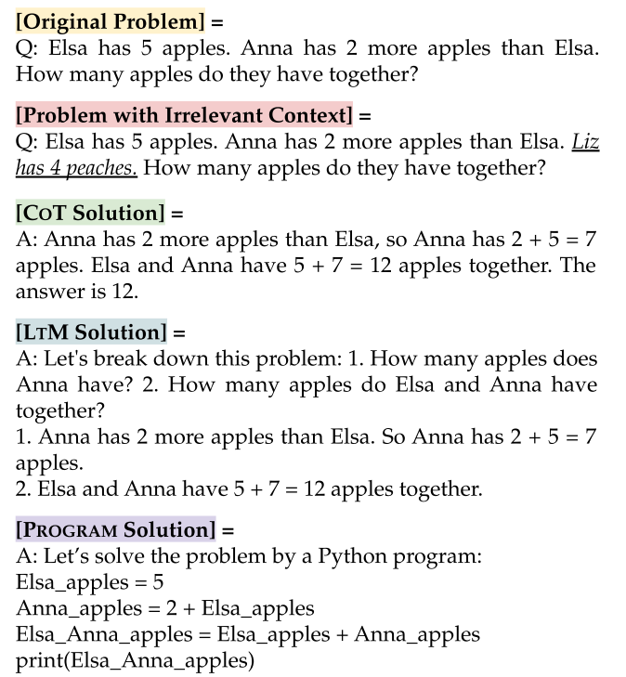
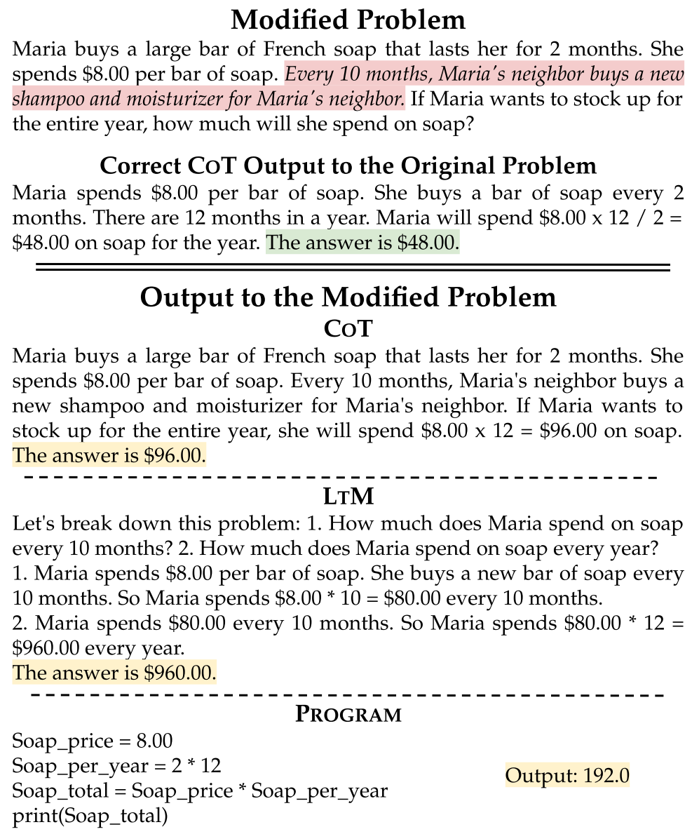
Simple Math Problems
Large Language Models Can Be Easily Distracted by Irrelevant Context
“A single piece of irrelevant information can distract the models and substantially degrade their performance, even on problems whose clean versions they correctly solve”

Slide 18
The Problem of Compositionality

Slide 19
Compositionality
Compositionality refers to the ability to understand systematic variations of a sentence or a problem, even without having seen examples of these variations.
If we understand ‘John loves Mary’, we necessarily understand ‘Mary loves John’.
Essential for human ability to produce and understand novel sentences.
Cognitive scientists like Jerry Fodor have argued that compositionality requires symbolic reasoning systems, which neural networks lack.

Slide 20
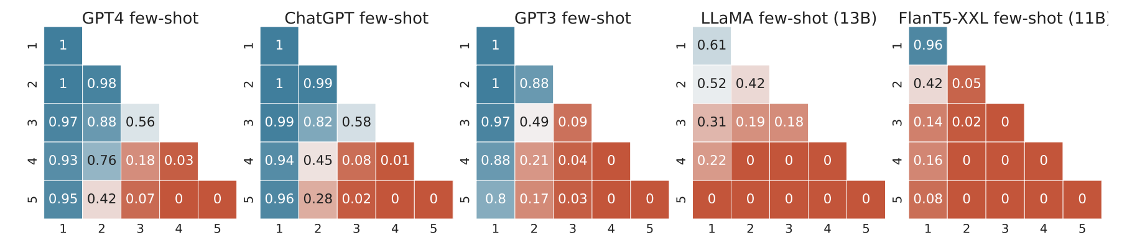
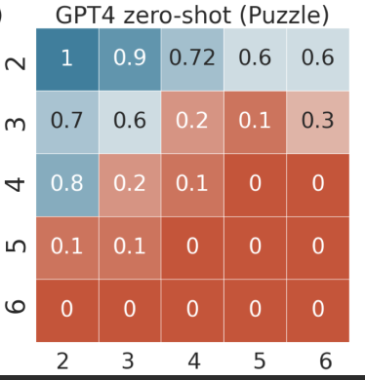
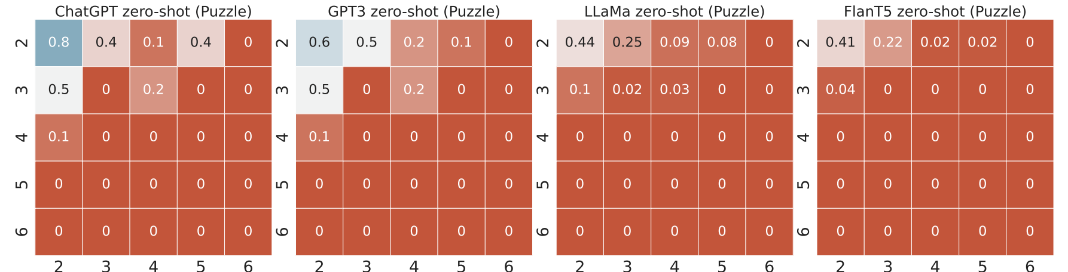
Logic and Multiplication
Faith and Fate: Limits of Transformers on Compositionality
“Models are able to correctly perform single-step reasoning, potentially due to memorizing such single-step operations during training, but fail to plan and compose these steps for overall correct reasoning… high ratio of restoration errors, suggests memorization since correct outputs are produced despite incorrect computations.”

Slide 21
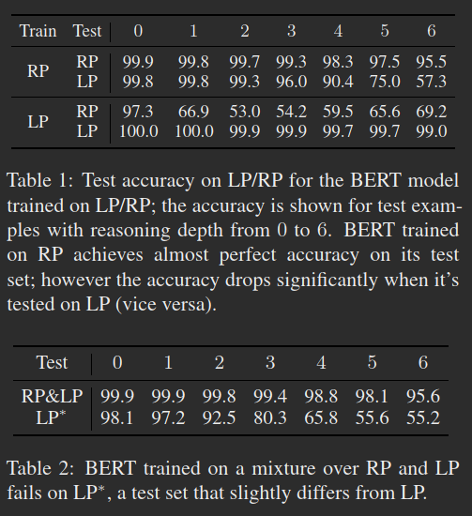
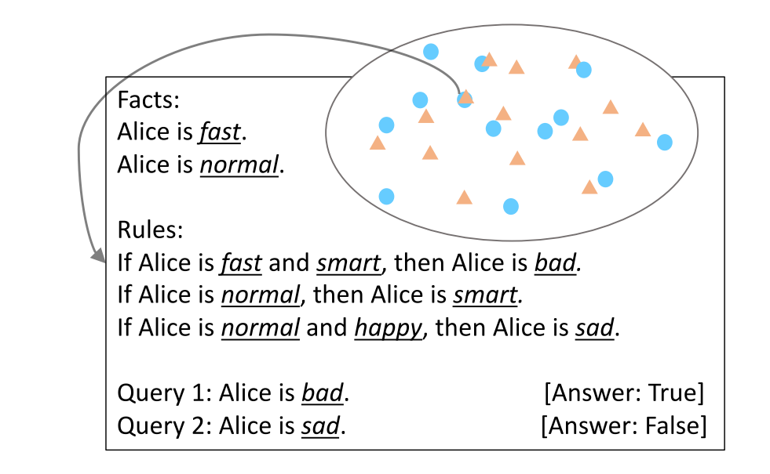
Syllogistic Reasoning
On the Paradox of Learning to Reason from Data
“The test accuracy drops signiﬁcantly when the train and test examples are sampled via different algorithms... Since the correct reasoning function does not change across different data distributions, this generalization failure indicates BERT has not learned to conduct logical reasoning.”

Slide 22
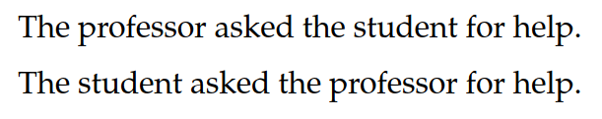
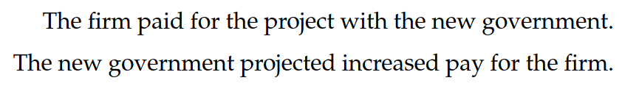
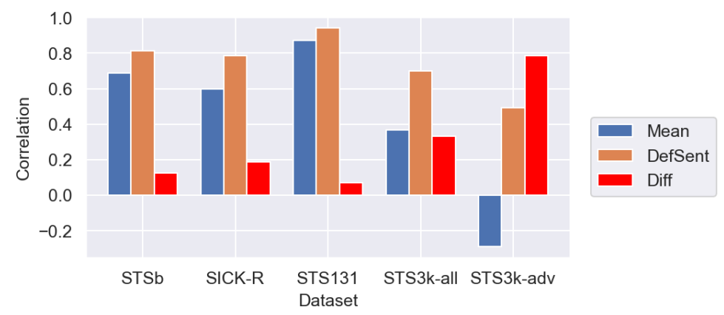
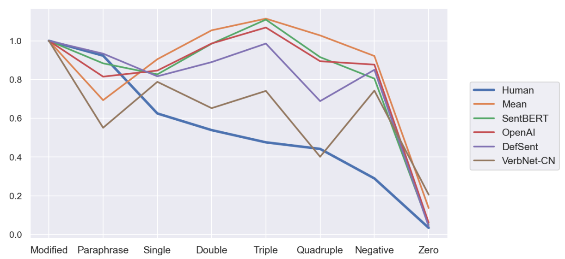
Sentence Representations
Approaches to Compositionality: Comparing Semantic Parsing and Transformers on an Adversarial Sentence Similarity Dataset

Slide 23
The Need for Cognitive Architectures

Slide 24
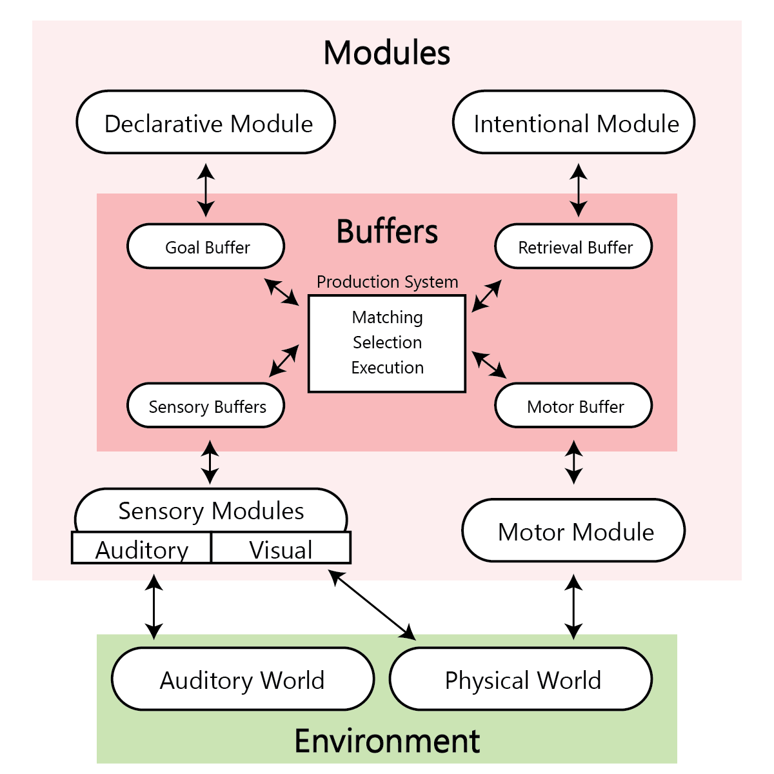
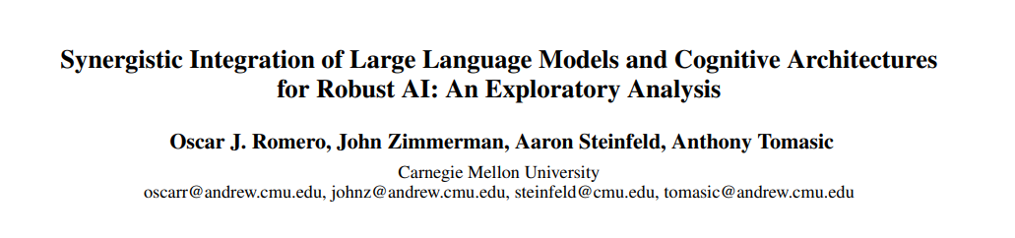
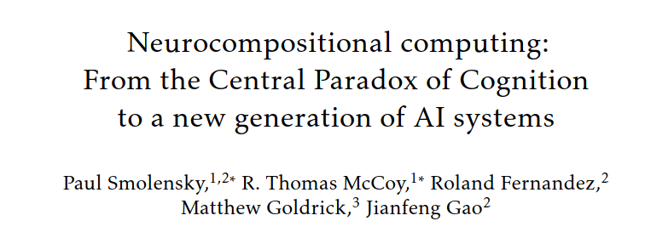
Cognitive Architectures
A cognitive architecture is a formal model describing the components of a mind and how they interact to generate complex cognitive behaviours.

Slide 25
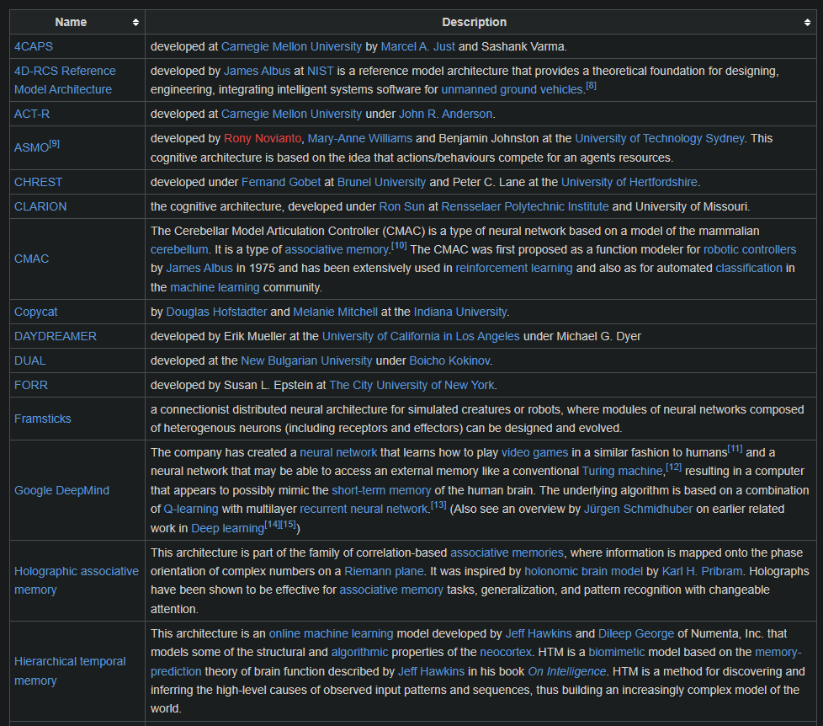
Cognitive Architectures
Very little is known about what a cognitive architecture should look like, what formalisms it should use, or what components it should incorporate.

Slide 26
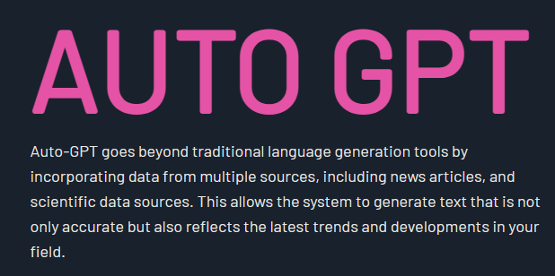
Auto-GPT
The release of ChatGPT and GPT4 led to efforts to use LLMs as autonomous reasoning agents.
The idea is to allow GPT4 to integrate with external tools like databases, search engines, python libraries, and wolfram alpha.
Unclear how a language model will systematically integrate these components without a general purpose cognitive architecture.

Slide 27
Conclusions

Slide 28
LLMs are not AGI
LLMs do not simulate human cognition in any realistic way.
LLMs lack many core components of cognition, such as memory, planning, numerical cognition, perception, motivation, goals.
Attempting to incorporate these by adding plugins to GPT4 will not result in a general intelligence, just as a pile of wood and bricks is not a house.
We are fast reaching the limits of how large LLMs can get and how much additional data is available for training.

Slide 29
Open Questions
Why are LLMs so effective at mimicking natural language?
How can LLMs be augmented with systems for symbolic reasoning and distinguishing truth and falsity?
What are the implications of adversarial attacks on LLMs? Do these indicate fundamental weaknesses in the paradigm?
Can LLMs learn to perform genuine composition

Slide 30
Questions?

