Slide 1

Consciousness Demystified:
A Skeptics Guide to Qualia
James Fodor
16th June 2025

Slide 2
Defining Consciousness

Slide 3
Definitions
No generally accepted philosophical or scientific definition of ‘consciousness’.
Generally, relates to being aware of and responsive to the environment.
Several key aspects:
  Wakefulness: being aware or alert rather than asleep or dormant.
  Self-awareness: having knowledge of oneself as a distinct entity.
  Intentionality: having thoughts that are about something.
  Phenomenal consciousness: feelings and experiences that feel like something; qualia.
I’ll mostly focus on phenomenal aspects, but all are related.

Slide 4
Definitions
“The heart of the problem of consciousness is the issue of ‘experience’ or ‘subjective awareness’. Although no non­-circular definition of these terms can be provided, the target phenomenon can be illuminated through some intuitive distinctions. There is ‘something it is like’ for an organism to be conscious, and what it is like to be in one state of consciousness differs from what it is like to be in another state of consciousness. A comprehen­sive ToC will explain why some organisms or systems are conscious whereas others are not, and it will also explain why states of consciousness differ from each other in the ways that they do.”
Anil K. Seth and Tim Bayne, ‘Theories of consciousness’, Nature Reviews in Neuroscience.

Slide 5
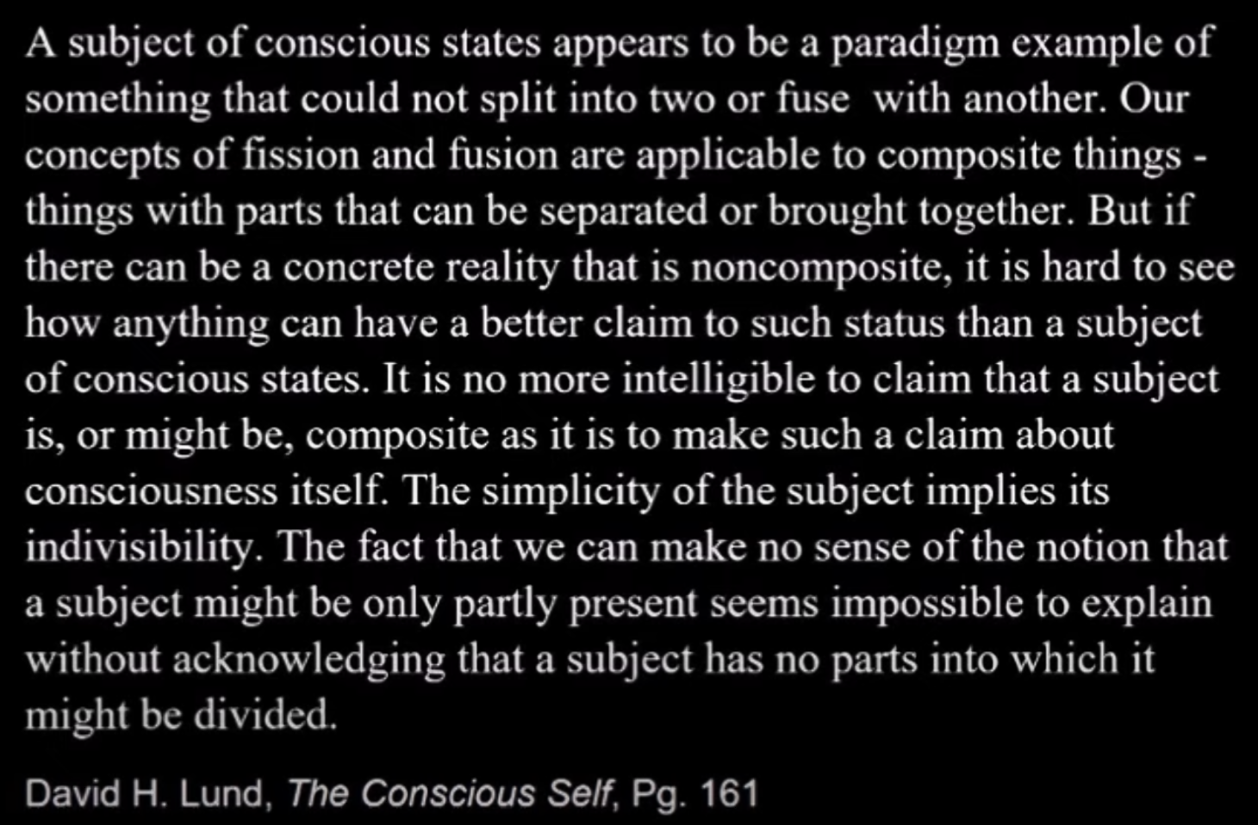
Example of ‘Consciousness Woo’
From youtube video by David Pallman

Slide 6
Avoid Dubious Commitments
“Frankish offers a nice list of dubious commitments that I agree it would be good not to build into the definition of consciousness. Let me now disavow all such commitments... Phenomenally conscious experiences need not be simple, nor ineffable, nor intrinsic, nor private, nor immediately apprehended. They need not have non-physical properties, be inaccessible to third-person science, or be inexplicable in physical terms. My definition by example did not, I believe, commit me on any such questions.”
Eric Schwitzgebel, ‘Phenomenal Consciousness, Defined and Defended as Innocently as I Can Manage’.
(Underlined terms are those objected to by Daniel Dennett).

Slide 7
Definition by Example
Many things can’t be defined rigorously (e.g. game, species, gene, planet…).
We can define consciousness by contrastive examples.
Domain | Conscious | Non-conscious
Vision | Imagery, colours, shapes, motion | Subliminal stimuli, low-level processing, inattentional blindness
Emotion | Fear, joy, surprise, etc | Blood pressure
Memory | Explicit recall of facts and events | Associations, steps of access (‘aha moments’)
Touch | Somatic pain, temperature, texture | How your clothes feel, contact of the chair
Desires | Intentional motivations, explicit wants | Standing intentions, implicit biases, introspection illusion

Slide 8
Avoid Reifying Consciousness
“Since the demise of vitalism, we do not think of life per se as something distinct from living things… life is not itself a further thing, an additional component of reality, some vital force that gets added into living things. We apply the adjectives “living” and “alive” correctly to many things, and in doing so we might be said to be attributing life to them but with no meaning or reality other than that involved in their being living things.
…
One could regard ‘consciousness’ as referring to a component or aspect of reality that manifests itself in conscious states and creatures but is more than merely the abstract nominalization of the adjective ‘conscious’ we apply to them. Though such strongly realist views are not very common at present, they should be included within the logical space of options.”
Robert Van Gulick, Consciousness, Stanford Encyclopedia of Philosophy

Slide 9
What Consciousness is For

Slide 10
Functional vs Phenomenal
Consciousness is often described in phenomenal rather than functional terms.
Phenomenal: what it feels or seems like, how it is experienced.
Functional: what it does, what it is for, what purpose it serves.
Critiques of materialism say we might explain the functional parts of consciousness, but not the phenomenal.

Slide 11
Functional vs Phenomenal
There is no generally-accepted scientific theory of consciousness.
However, existing theories point to common functions.
Brain states are conscious when they constitute an integrated, widely-accessible, motivationally-salient mental representation.

Slide 12
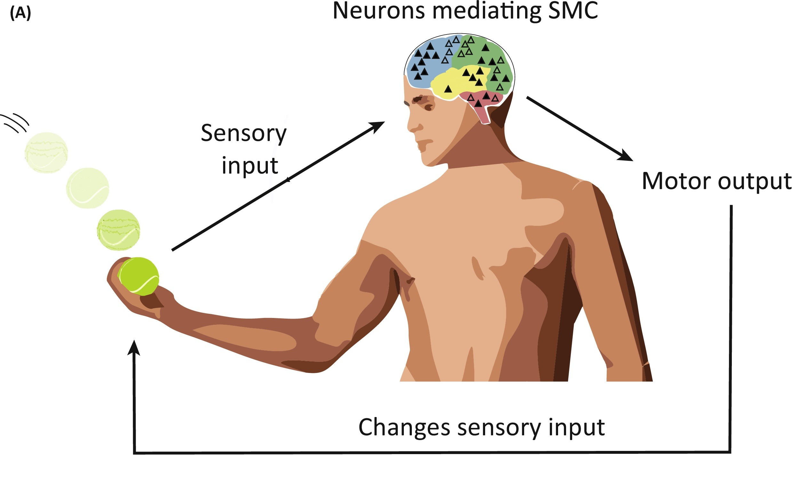
Integrated Representation
Many conscious precepts represent integration of many forms of stimuli.
The conscious state represents something (visual scene, noxious stimuli, exciting opportunity, etc).
“According to the (HOT) account, consciousness involves higher-order brain networks learning to redescribe the representations encoded in lower­ order networks in a way that counts as meta­representational… the phenomenal chara­cter of a state is determined by the properties the relevant meta­ representational state ascribes to it.”
Anil K. Seth and Tim Bayne, ‘Theories of consciousness’, Nature Reviews in Neuroscience.

Slide 13
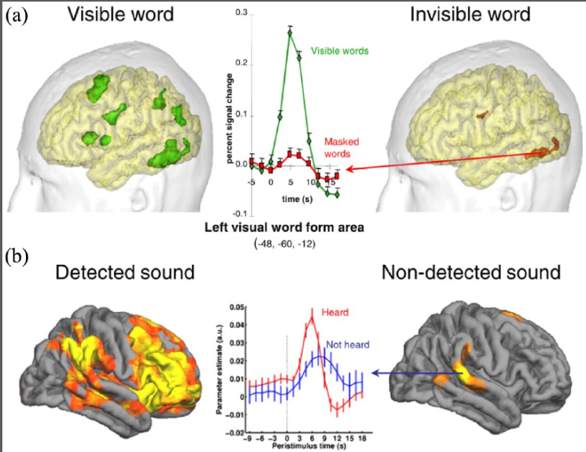
Widely Accessible Information
Some brain information is only needed by local cognitive processes.
Other information is needed by many processes, so becomes broadly accessible.
“The GWT of consciousness … proposes that con­scious mental states are those that are ‘globally avail­able’ to a wide range of cognitive processes including attention, evaluation, memory and verbal report. The core claim of GWTs is that it is the wide accessibility of information to such consumer cognitive systems that constitutes conscious experience”
Anil K. Seth, ‘Consciousness: The last 50 years (and the next)’, Brain and Neuroscience Advances.

Slide 14
Motivational Salience
Pain directs an organism away from a stimulus.
Pleasure aids with learning to find that stimulus.
Peripheral motion directs gaze in a relevant direction.
Desires lead to thoughts and behaviours to achieve a goal.
Consistent linkage between feelings and thoughts leading to an action.

Slide 15
Easy vs Hard Problems
“The easy problems are easy precisely because they concern the explanation of cognitive abilities and functions. To explain a cognitive function, we need only specify a mechanism that can perform the function. The methods of cognitive science are well-suited for this sort of explanation, and so are well-suited to the easy problems of consciousness. By contrast, the hard problem is hard precisely because it is not a problem about the performance of functions. The problem persists even when the performance of all the relevant functions is explained …
To account for conscious experience, we need an extra ingredient in the explanation. This makes for a challenge to those who are serious about the hard problem of consciousness: What is your extra ingredient, and why should that account for conscious experience?”
David J. Chalmers, ‘Facing Up to the Problem of Consciousness’, Journal of Consciousness Studies.

Slide 16
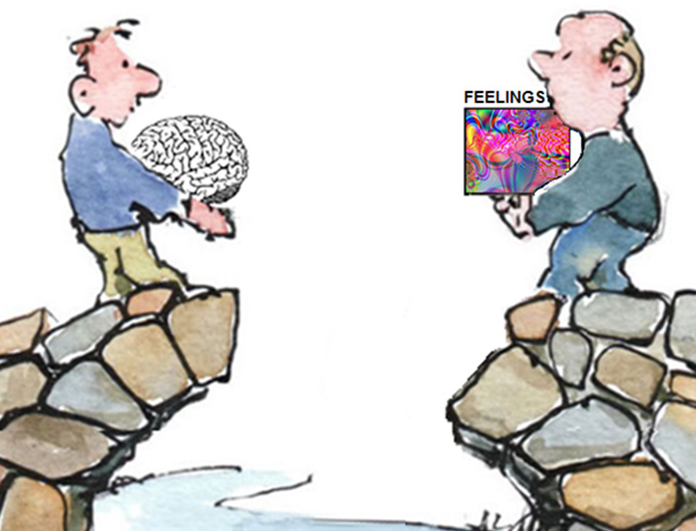
The Explanatory Gap
The gap between any physical explanation and phenomenal consciousness.
“One might suppose that according to this theory, the contents of experience are precisely the contents of the global workspace. But even if this is so, nothing internal to the theory explains why the information within the global workspace is experienced. The best the theory can do is to say that the information is experienced because it is globally accessible. But now the question arises… why should global accessibility give rise to conscious experience? As always, this bridging question is unanswered.”

Slide 17
Functional Explanation Revisited
Consciousness isn’t something otherworldly, immaterial, ineffable, or supernatural.
It is a dynamic cognitive phenomenon that exists to allow for complex behaviours.
Physical world has many complex dynamical states (e.g. life, weather, economies).
Chalmer’s demand for an ‘extra ingredient’ is not well motivated.
Ultimately it is an appeal to an intuition of unsatisfied curiosity.

Slide 18
The P-zombie Argument

Slide 19
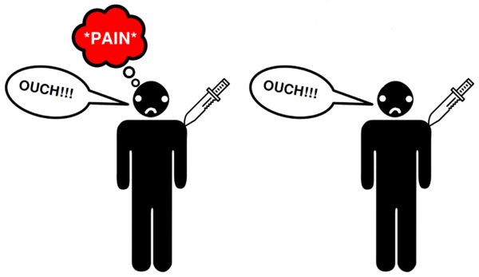
The Zombie Argument
Argument that consciousness cannot be entirely physical.
A philosophical zombie (p-zombie) is an exact physical duplicate of a person without any phenomenal conscious experience.
Here is the argument:
  It is conceivable that zombies exist.
  If something is conceivable, it is possible.
  Therefore, p-zombies are possible.
  But physicalism says zombies are impossible.
  Therefore, physicalism is false.

Slide 20
Conceivability
Core idea: if you conceive of something in enough detail and clarity, surely it is possible. Maybe not in our world, but in some logically-consistent world.
Problem: we can conceive of many things that aren’t possible.
Examples: truth and falsity of mathematical theorems, existence and non-existence of God, time-travel in movies
Response: focus not on actual conceivability but idealist conceivability. (see David J. Chalmers, ‘Does Conceivability Entail Possibility?’).

Slide 21
Epistemic Response
“The central thesis of Daniel Stoljar's book is that we are puzzled about consciousness only because we don't know enough about the non-conscious facts…
Stoljar bolsters his more moderate epistemic view by instancing cases from the history of science. Descartes argued on a priori grounds that a purely physical being could not possibly use language intelligently. C.D. Broad argued similarly that the chemical facts of this world must be metaphysically distinct from the physical facts. In both cases, Stoljar argues, their mistake arose from simple ignorance of relevant facts. Descartes was unfamiliar with the modern notion of computation. Broad did not know about the quantum theory of chemical bonding. Once the ignorance was remedied, later thinkers had no difficulty in seeing how the physical facts determined both language use and chemical bonding.”
David Papineau review of Ignorance and Imagination: The Epistemic Origin of the Problem of Consciousness

Slide 22
The Knowledge Argument

Slide 23

Mary’s Room Argument
Argument that consciousness cannot be entirely physical.
Mary is a brilliant scientist who knows all facts about optics, colour vision, etc.
She lives in a black and white room all her life until one day she goes outside.
Here is the argument:
  Upon seeing colour, Mary learns something new.
  But she already know all relevant physical facts.
  Therefore, she must have learned a non-physical fact.
  But physicalism says there are no non-physical facts.
  Therefore, physicalism is false.

Slide 24
Phenomenal Concept Response
Mary may know all the descriptive physical facts without knowing ‘what it is like’ to see colour.
This is because the same fact can be represented in different ways.
Sense and reference example of Venus as Morning vs Evening star.
Phenomenal concepts are mental representations of some physical state.
The idea is that the only way to obtain a phenomenal concept is to be in the right circumstances to acquire it through experience.
You can’t acquire phenomenal concepts by reading science books.

Slide 25
Phenomenal Concept Response
“Given that properties are constituted by the world and not by our concepts’, Brian Loar comments, ‘it is fair of the physicalist to request a justification of the assumption that conceptually distinct concepts must express metaphysically distinct properties’ He also argues that phenomenal concepts are ‘recognitional’, in contrast to physical concepts, which are ‘theoretical’.
Brian Loar, ‘Phenomenal States’, in Philosophical Perspectives.

Slide 26
Conclusions

Slide 27
Summary
Consciousness is real but nothing ‘mystical’ or non-physical.
We can understand conscious states as brain states that instantiate an integrated, widely-accessible, motivationally-salient mental representation.
Appeals to the need for ‘something extra’ beyond the physical are based on lack of understanding and appeal to subjective sense of explanatory adequacy.

Slide 28
Questions and Discussion

