Slide 1

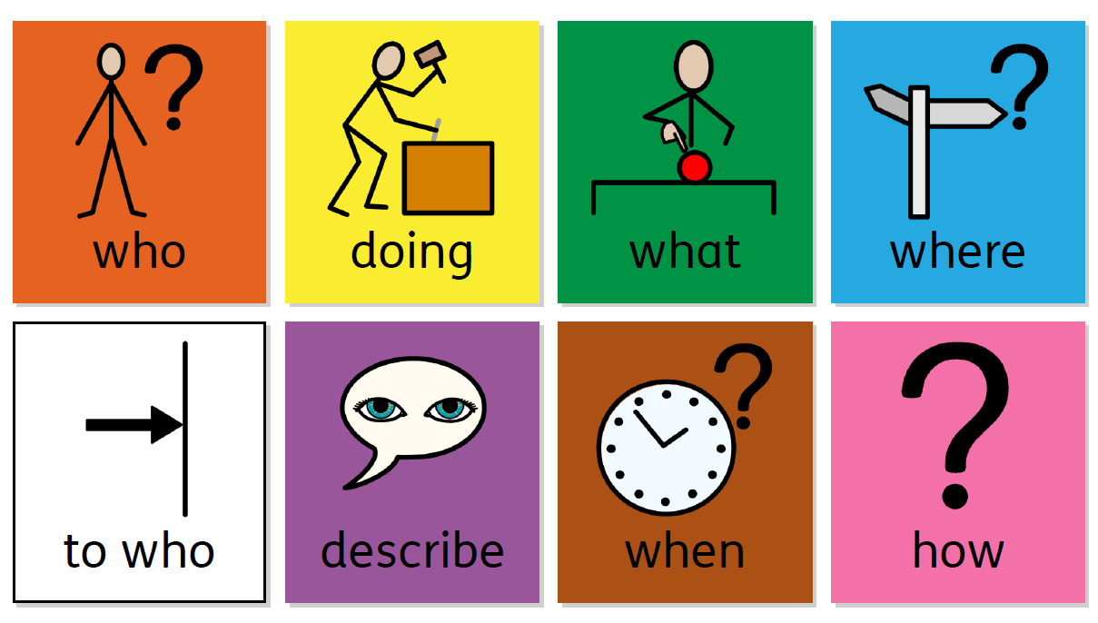
Compositional Semantics in the Brain
James Fodor
22nd August 2023

Slide 2
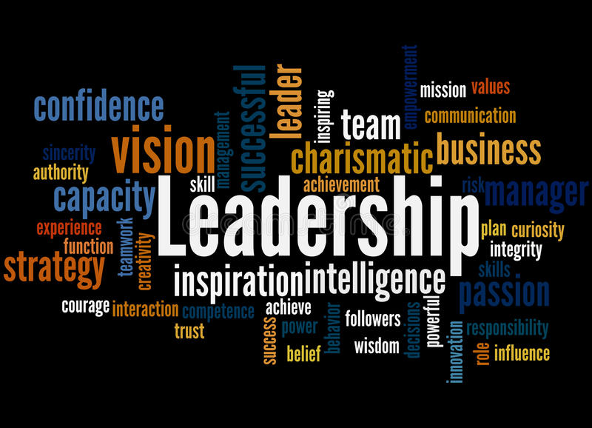
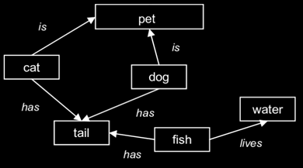
What is Semantics?
Semantics is the study of meaning.
How does the mind/brain represent the meaning of a word?
How do we combine words into sentences?

Slide 3
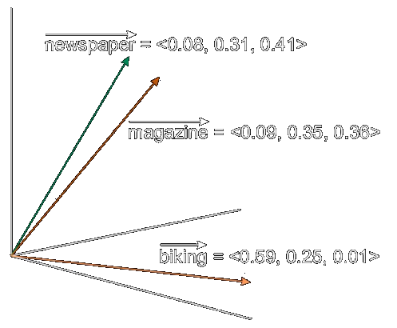
Word Embeddings
Word embeddings represent the meaning of a word as a vector of numbers.
Embeddings live in ‘semantic space’.
More similar vectors = more similar meaning.
Basis for LLMs like ChatGPT.

Slide 4
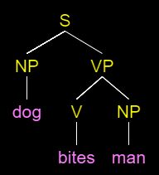

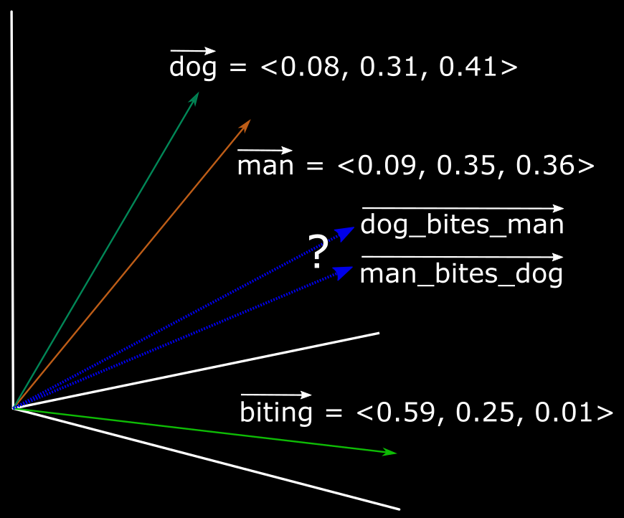
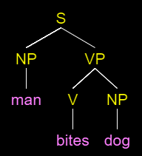
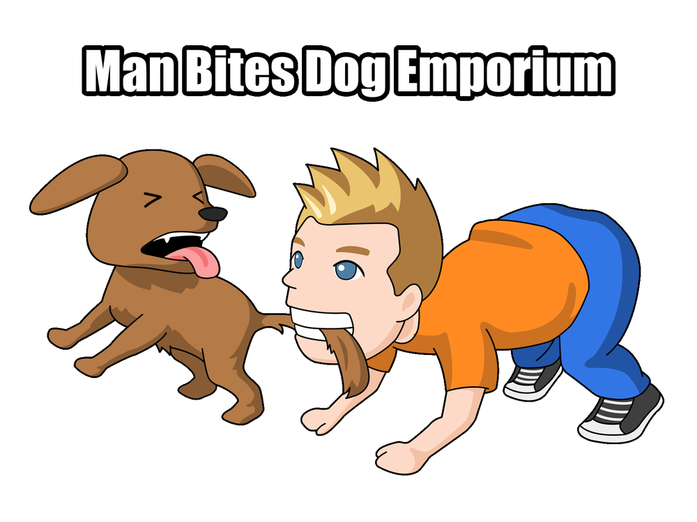
Compositionality
How to represent an entire sentence or phrase?
Order and context of words matter.
Bite(DOG,MAN)
Bite(MAN,DOG)

Slide 5
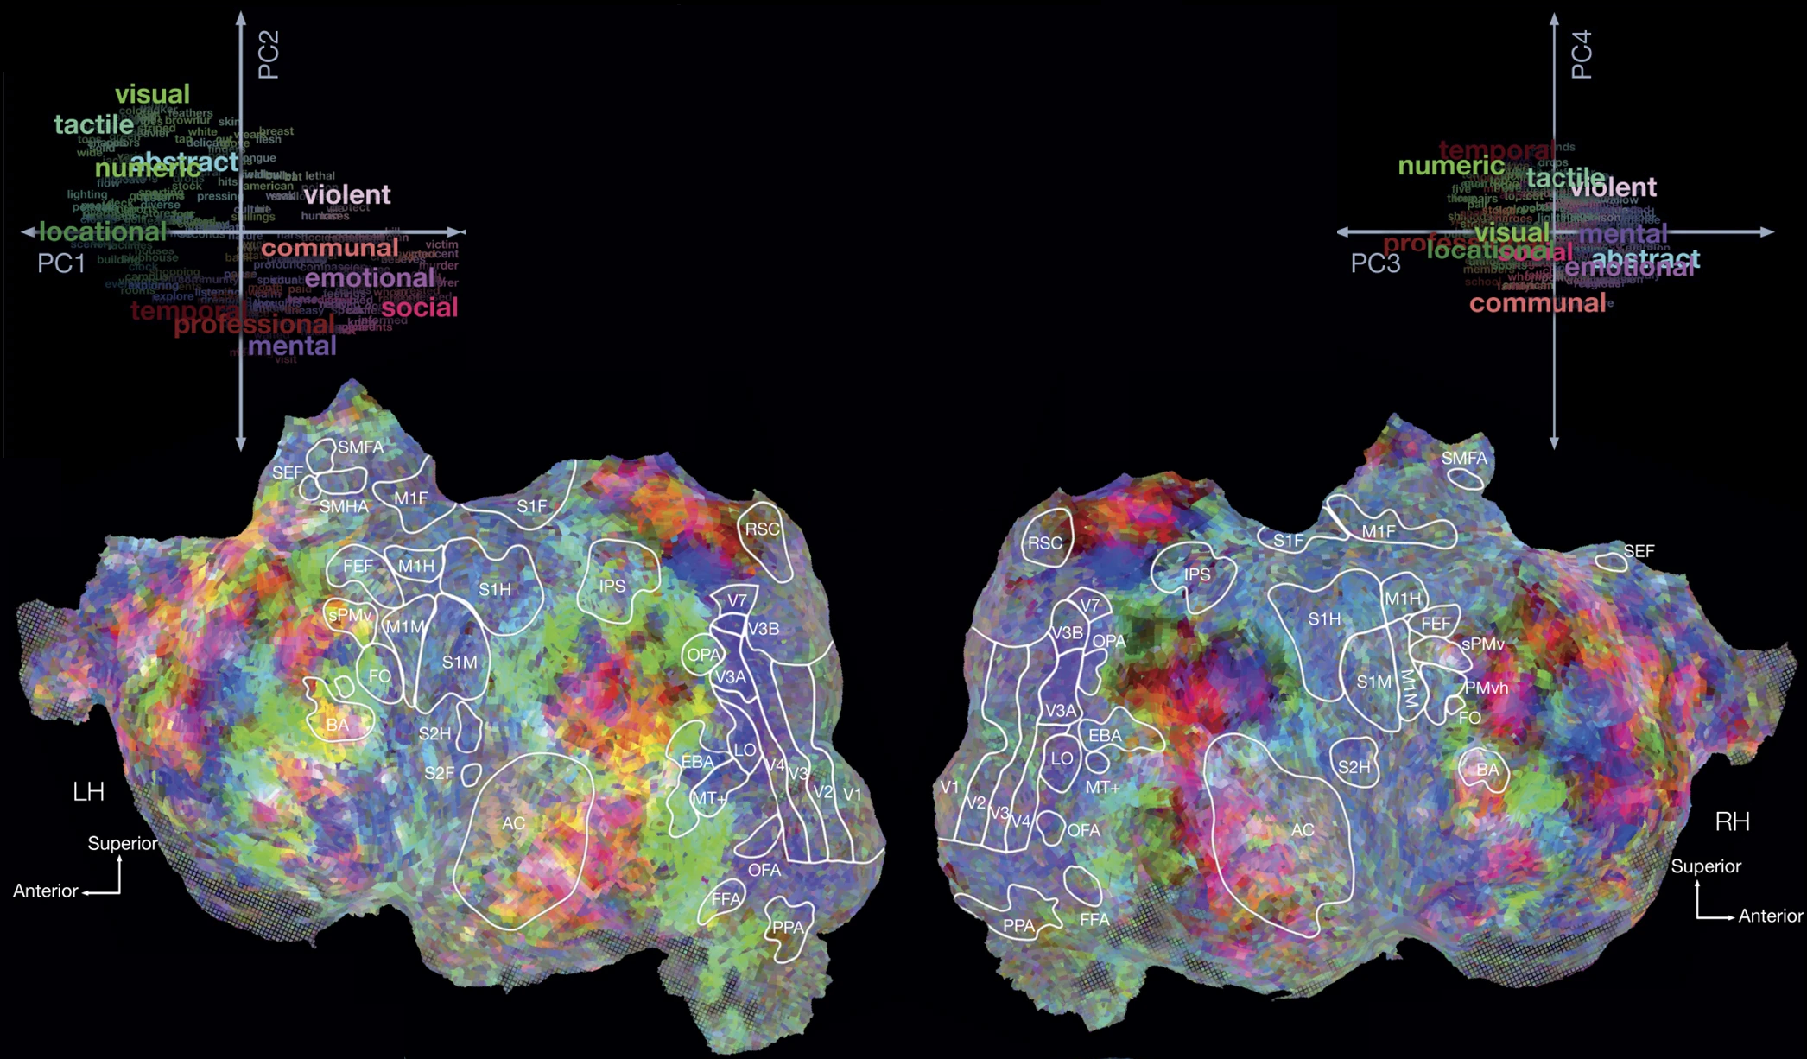
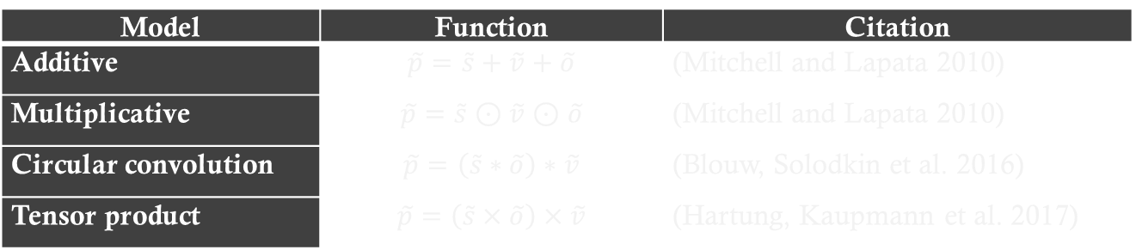
Semantics in the Brain
Several studies have examined brain responses to language using fMRI.
Model | Function | Citation
Additive | $$\tilde{p}=\tilde{s}+\tilde{v}+\tilde{o}$$ | (Mitchell and Lapata 2010)
Multiplicative | $$\tilde{p}=\tilde{s}⊙\tilde{v}⊙\tilde{o}$$ | (Mitchell and Lapata 2010)
Circular convolution | $$\tilde{p}=\left(\tilde{s}∗\tilde{o}\right)∗\tilde{v}$$ | (Blouw, Solodkin et al. 2016)
Tensor product | $$\tilde{p}=\left(\tilde{s}×\tilde{o}\right)×\tilde{v}$$ | (Hartung, Kaupmann et al. 2017)

Slide 6
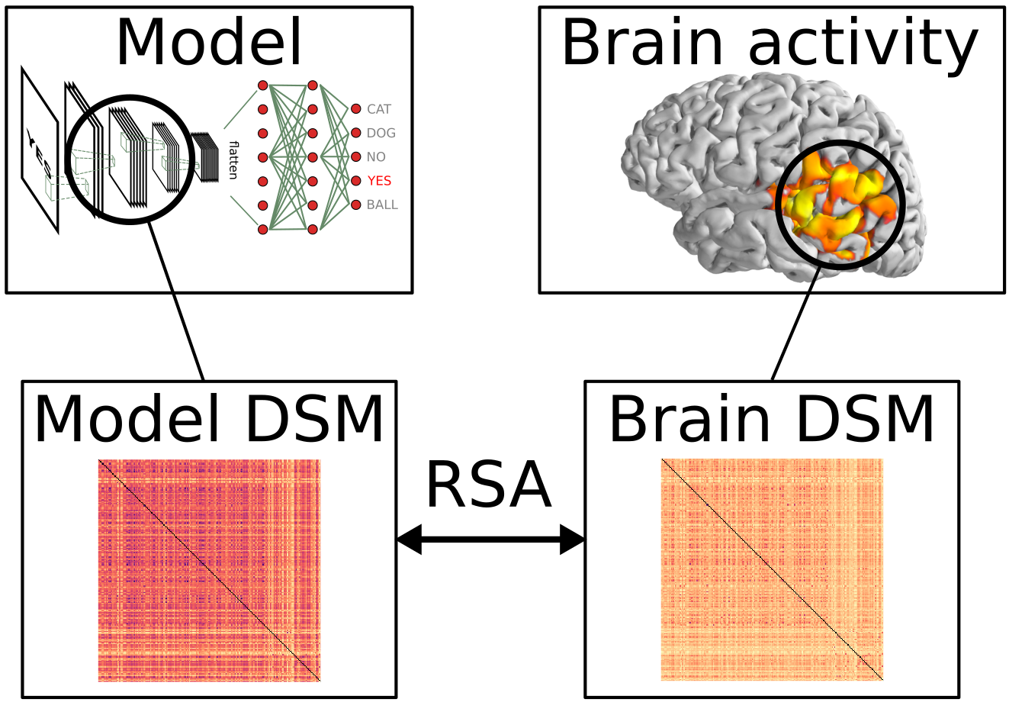
Experimental Paradigm
Present stimuli as text or audio while participant in scanner.
Compare brain activity to predictions of different semantics models.

Slide 7
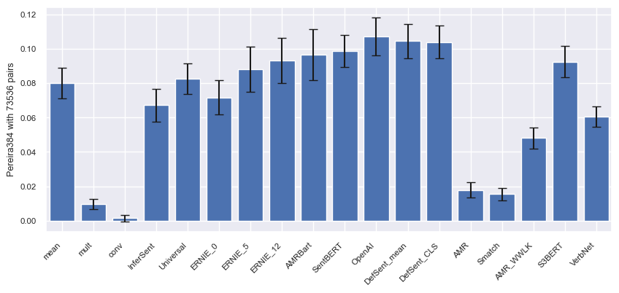
Results by Model (Pereira 2018)
Correlation of pairwise sentence similarities for brain data and models.

Slide 8
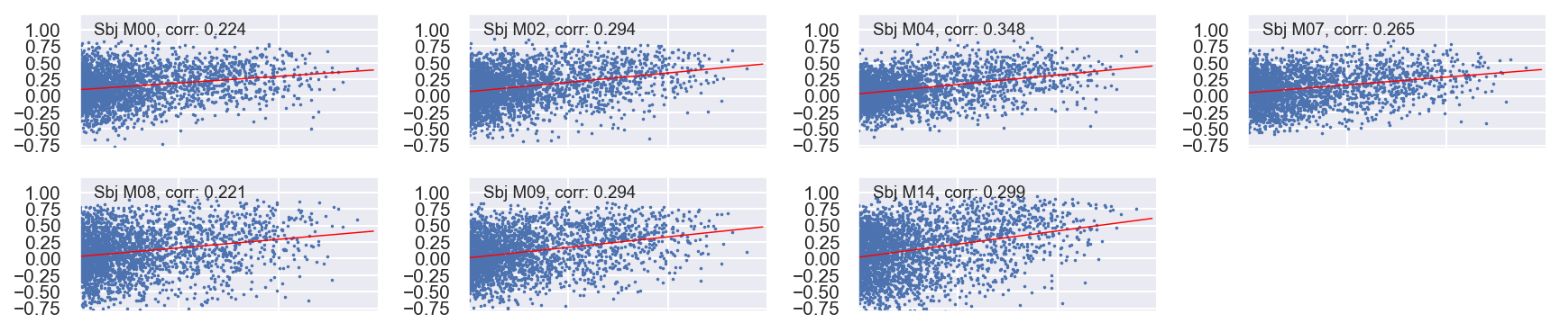
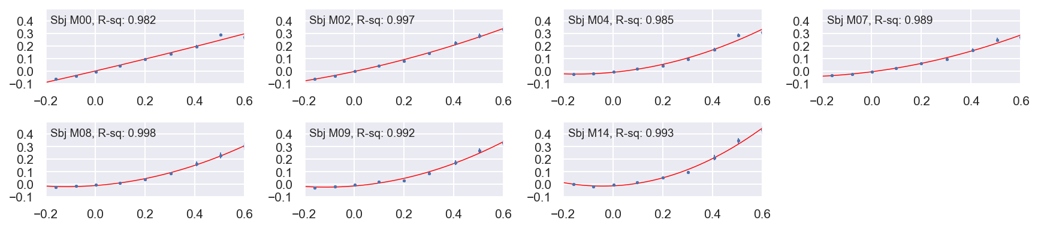
Results by Subject
Brain similarity (vertical) plotted against model similarity (horizontal).

Slide 9
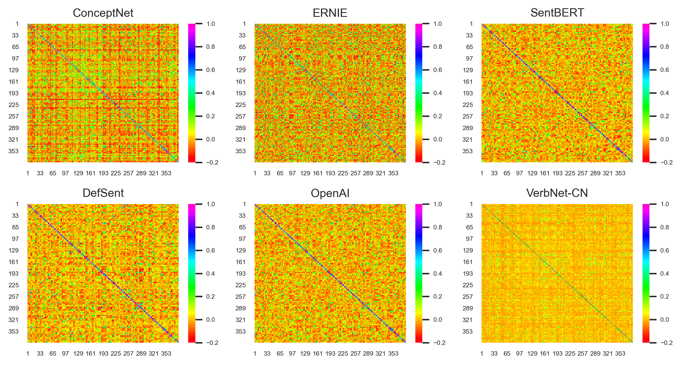
Why no Better Results?
Representational Similarity Matrix for stimuli over six models.

Slide 10
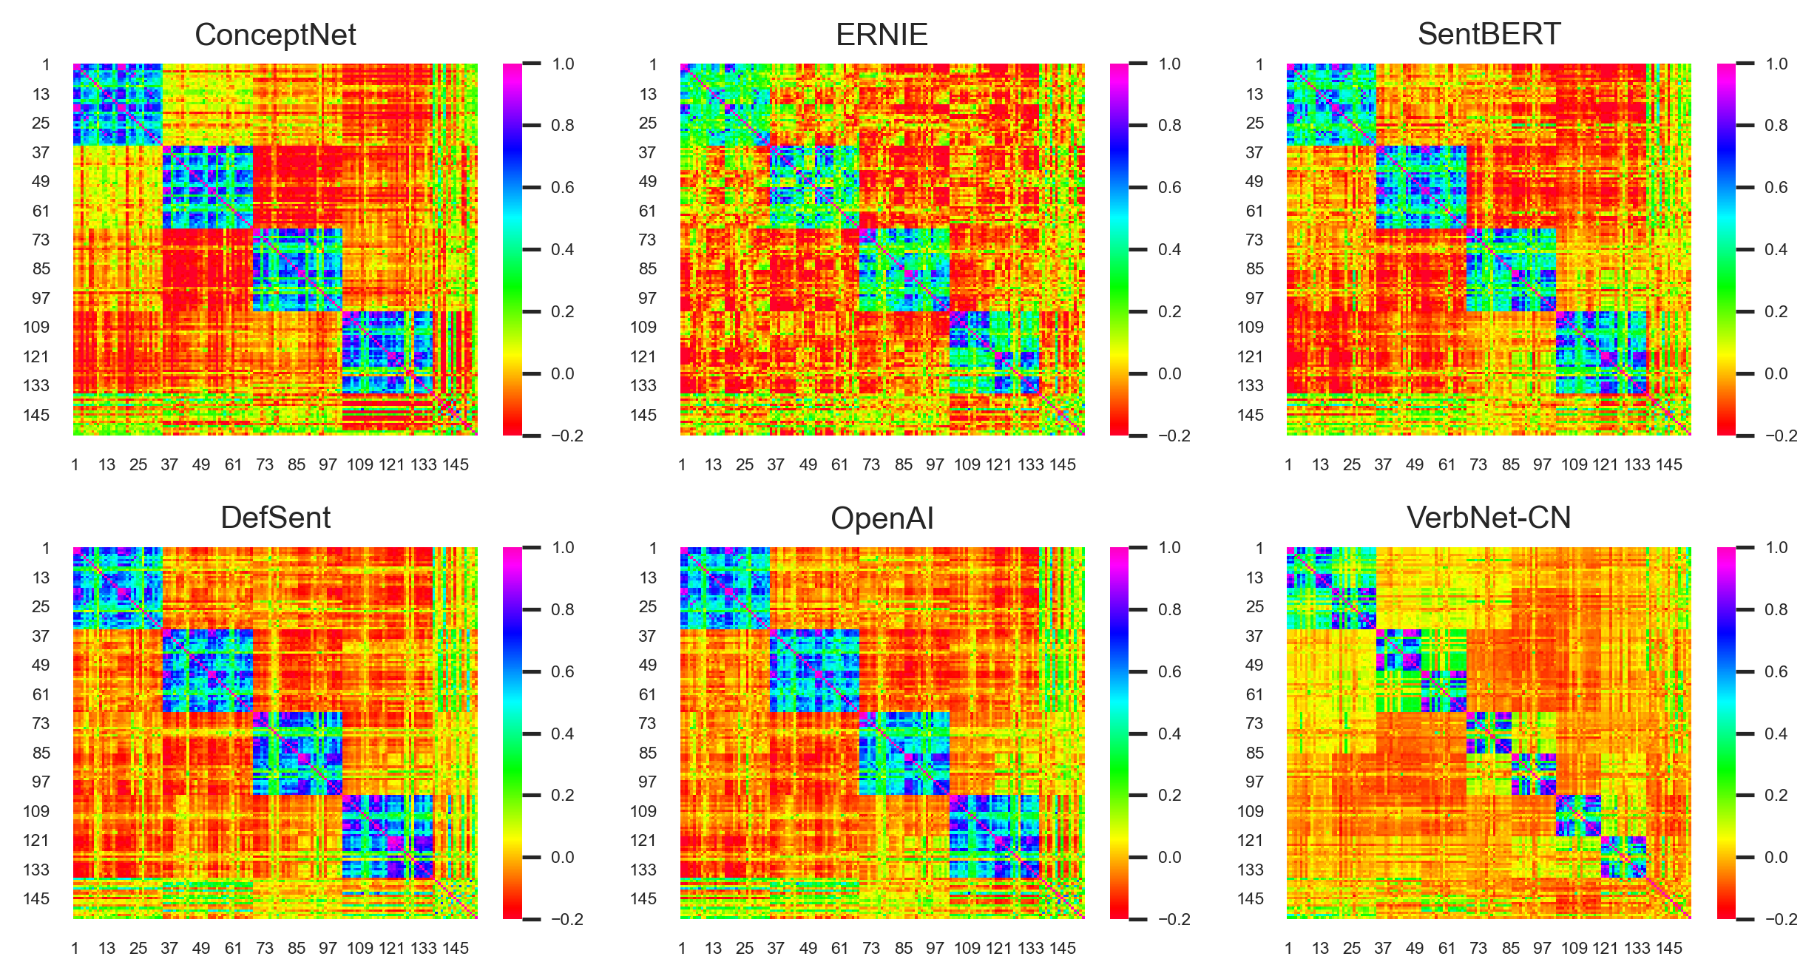
The Need for Better Data…
The company purchased the apartment block from the family.
The family blocked the purchase of the apartment by the company.

Slide 11
Thank you!

