Slide 1


Economic Growth and Development
James Fodor
24th September 2023

Slide 2
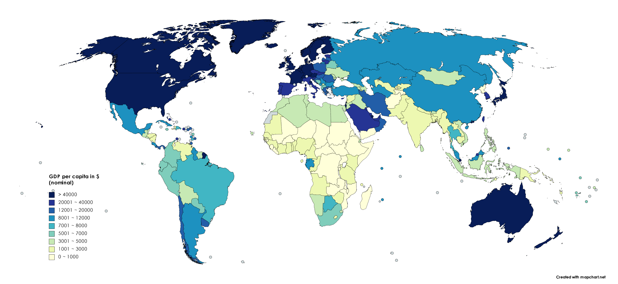
Paradox of Growth

Slide 3
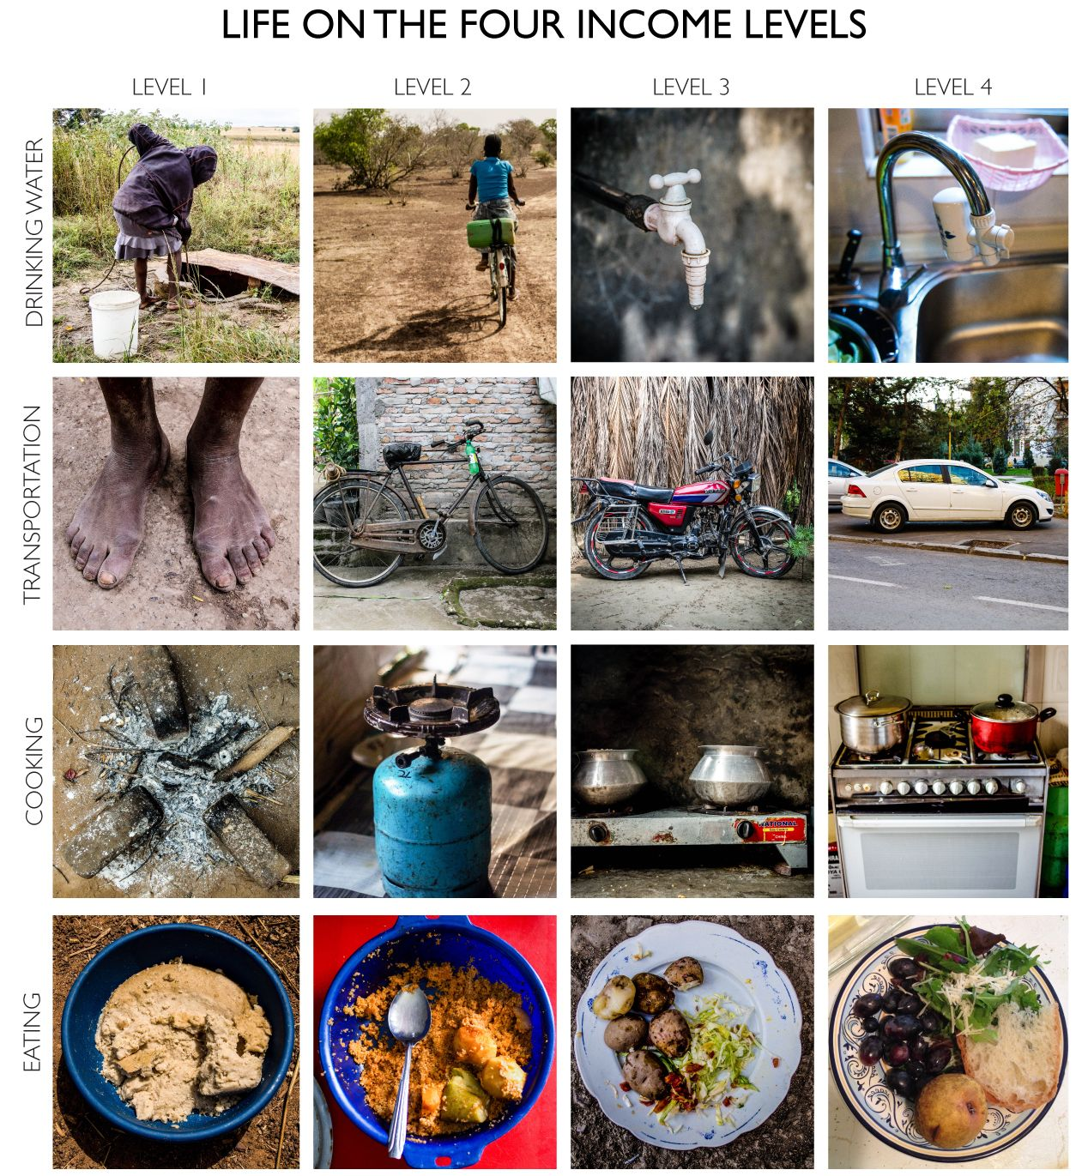

The Human Face of Growth

Slide 4
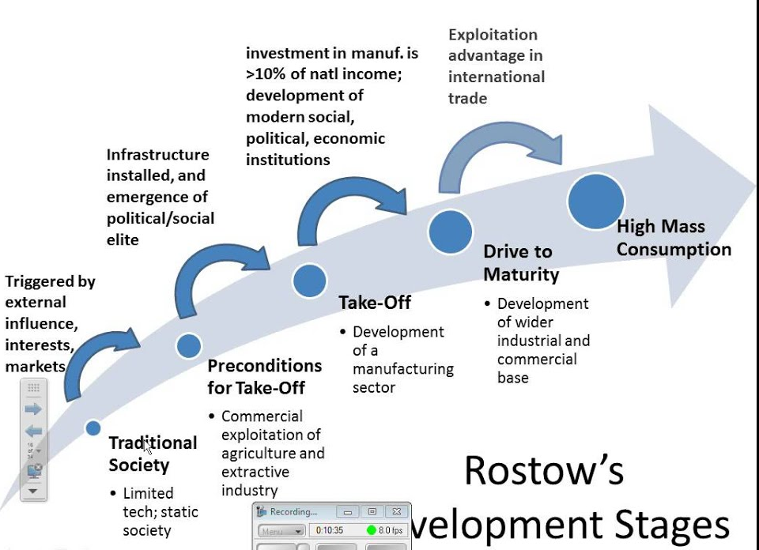
What: Rostow’s Stages of Growth
Traditional society
Preconditions for take-off
Take-off
Drive to maturity
Age of mass consumption

Slide 5
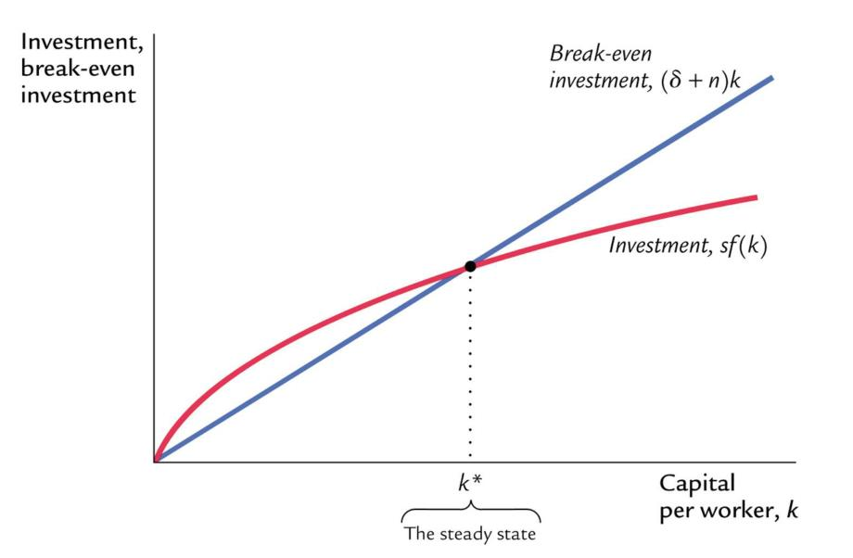
How: Solow Model of Growth
Growth involves accumulation of physical and human capital.
Growth slows down over time due to diminishing returns.
States/regions/nations should convergence over time.

Slide 6
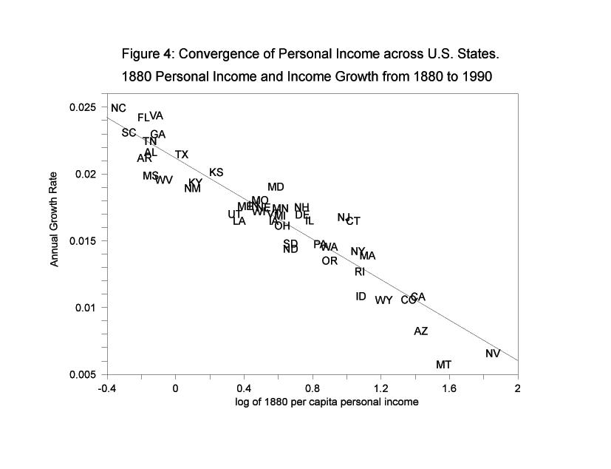
How: Solow Model of Growth
We see ‘conditional’ convergence.
Why only conditional?
What are the barriers to growth?

Slide 7
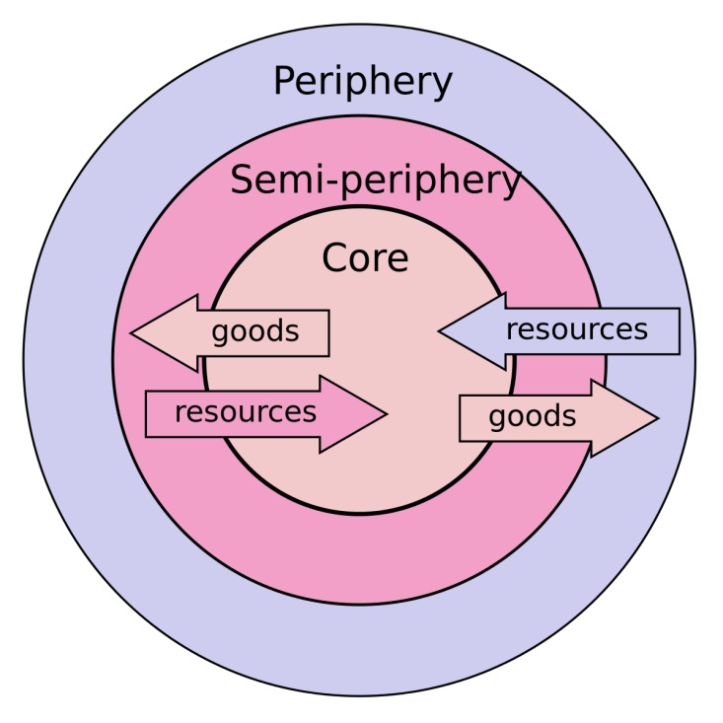
Why: Dependency
Core exploits the periphery.
Institutions which benefit wealthy nations.
Established during colonialism but continued afterwards.
Free trade prevents periphery from industrialising.

Slide 8
Why: Dependency
Does not explain growth spurts of open economies (South Korea, Taiwan, Singapore, Malaysia, China, India, and Chile).
History of colonialism not obviously associated with growth.
Wealth extraction seldom leads to prolonged growth and industrialisation.
Region | Nation | Coloniser | Timespan (GDP year) | GDP at Indep. | GDP in 2018
East Africa | Ethiopia | None | NA (1963) | $763 | $1,794
 | Kenya | Britain | 1895-1963 | $1,800 | $3,077
South East Asia | Thailand | None | NA (1957) | $1,470 | $19,326
 | Malaysia | Britain | 1826-1957 | $3,441 | $31,714
 | Myanmar | Britain | 1886-1948 | $502 | $5,922
Middle East | Iran | None | NA (1950) | $4,981 | $19,091
 | Iraq | Britain | 1919-1954 | $11,752 | $16,303
 | Jordan | Britain | 1919-1946 | $3,698 | $10,175
Caribbean | Haiti | Spain, France | 1492-1804 | $2,637 | $1,656
 | Jamaica | Spain, Britain | 1494-1962 | $5,869 | $8,276
West Africa | Liberia | None | NA (1961) | $1,303 | $1,161
 | Sierra Leone | Britain | 1808-1961 | $1,335 | $1,421

Slide 9
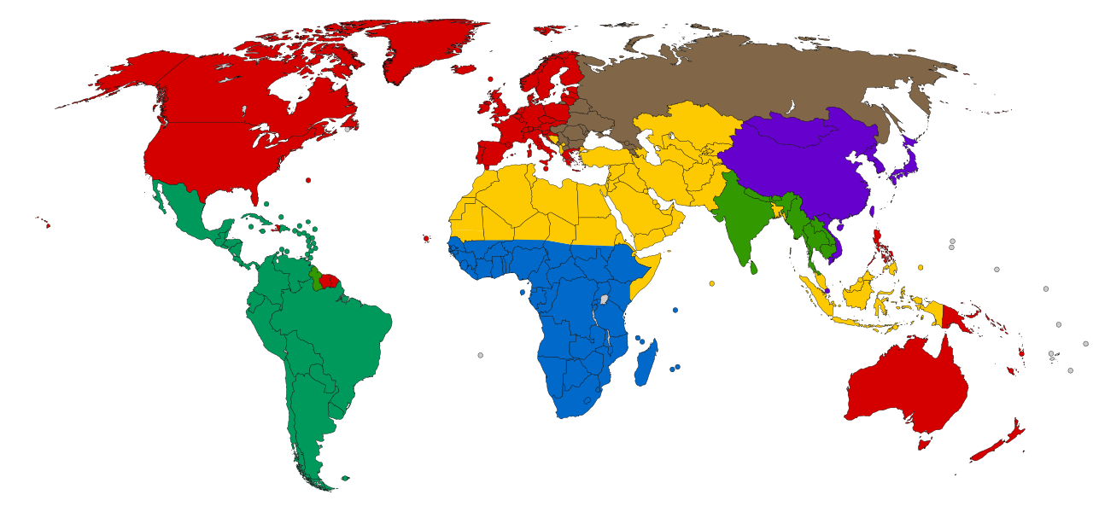
Why: Culture
Max Weber argued that the Protestant work ethic promotes hard work and saving.
Some cultures more individualistic, others more collectivist favouring corruption or ingroup (e.g. Italy, Nigeria).

Slide 10
Why: Culture
Hard to measure or define culture or its elements.
Cultures contain multiple aspects, some good for growth and some not (e.g. ‘Asian values’ debate).
Culture changes over time and with development.
Economic growth miracles happen too fast to be due to cultural change.

Slide 11
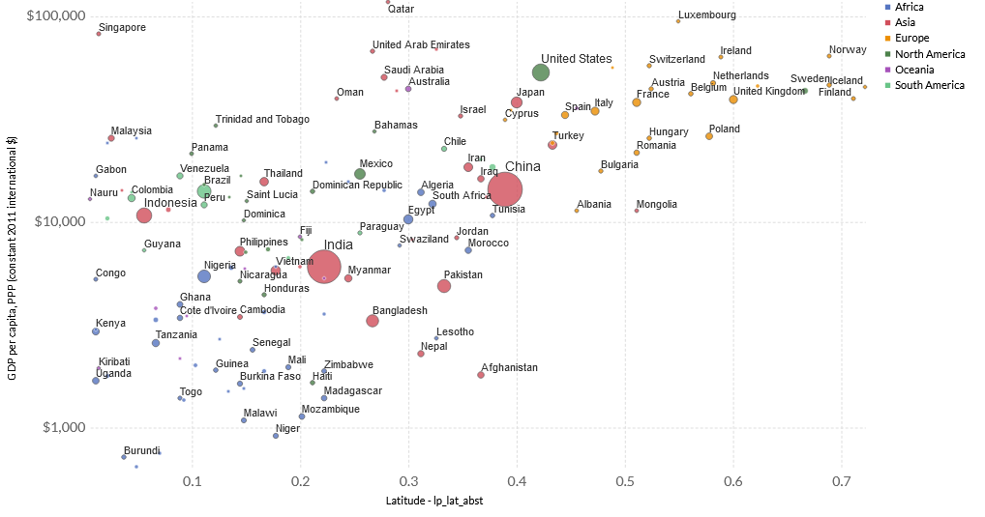
Why: Geography
Fairly strong correlation between latitude and income.
Navigable rivers, good soil, resources, cooler climates all may help growth.

Slide 12
Why: Geography
?
?
?
?
?
?
?

Slide 13

Why: Institutions
North: “institutions are the rules of the game in a society or, more formally, are the humanly devised constraints that shape human interaction”,
Natural experiments involving very similar regions (East and West Germany, North and South Korea, Mainland China and Taiwan/Kong Kong).
Migrants to the US.

Slide 14
Why: Institutions
Protection of property rights.
Enforcement of contracts.
Effective legal system.
Liberalised trade (relatively).
Effective labour market regulations.
Efficient taxation.
Private ownership of capital.
More?

Slide 15
Implications for EA?
Already a lot of work on this, but EAs can help.
Not much focus on this cause area.
Need for better interdisciplinary work.

Slide 16
Conclusions
Growth is a process of structural change.
Once is begins, growth is self-sustaining and tends to lead to convergence.
But growth is difficult to start due to poverty traps.
Need the right institutions to break through the traps.
EAs might be able to contribute to this!

Slide 17


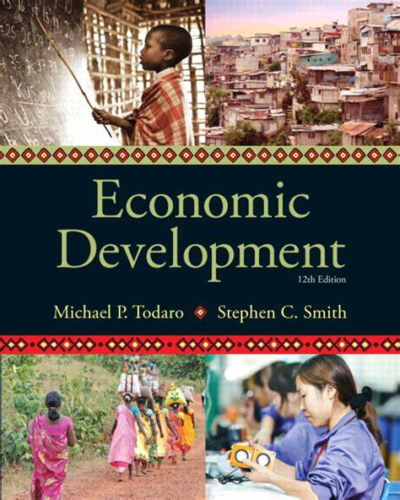


Questions?

