Slide 1

The Meaning of Life
James Fodor, Mar 2021

Slide 2

My Philosophical Views
Atheism: disbelief in existence of God
Naturalism: belief in natural entities only

Slide 3
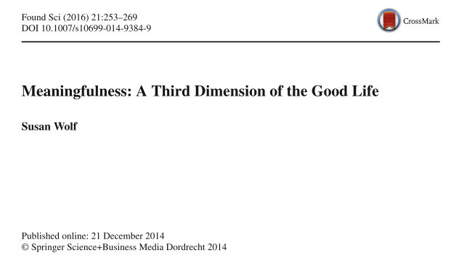
A Theory of Meaning
Susan Wolf’s hybrid theory of meaning (spectrum)
Subjective aspect: the way someone feels
Objective aspect: what exists outside of feelings

Slide 4
Subjective Aspect
Why subjective: Gandhi disillusioned
Meaningful: satisfied, gripped, engaged, fulfilled, interested
Not meaningful: alienated, bored, disengaged, despairing

Slide 5

Objective Aspect
Why objective: Sisyphus fulfilled
Something ‘larger than oneself’ or ‘outside oneself’
Something objectively valuable

Slide 6
A Theory of Value
Intrinsic vs extrinsic value
Joseph Raz’s humanistic principle: ‘the explanation and justification of the goodness or badness of anything derives ultimately from its contribution... to human life (sentient life) and its quality’
Theories of human flourishing (wellbeing):
  Hedonism
  Preference satisfaction
  Objective list theory

Slide 7
The Meaning of Life
“Our interest in being able to see our lives as worthwhile from some point of view external to ourselves... seem to me to be pervasive. By engaging in projects of independent value, by protecting, preserving, creating, realizing value whose source lies outside of oneself, one can satisfy these interests. Indeed, it is hard to see how one could satisfy these interests in any other way.” (Susan Wolf)

Slide 8
The Meaning of Life
“A person’s life is meaningful to the extent that they positively engage in objectively valuable projects.”

Slide 9
The Role of God
Unclear what this adds to the picture
Might affect what is valuable
Not needed for a theory of meaning
Is worship of God meaningful?

Slide 10
Notes
Uthman’s opening
Atheism not a view that is consistent with human life
Meaning is what something is directed towards – reason why it exists
Material objects/entities don’t have any mean in themselves. Meaning must be provided by external agent (mind).
No objective meaning on the materialist worldview
Going from nothing to nowhere. ‘Lost train to nowhere’
Many prominent atheists share this view of atheism
Everything destined to extinction
Design vs purpose vs meaning
You can ‘make up’ meaning/subjective meaning
‘Finding meaning in life even if there is no meaning of life’
Subjective meaning is inadequate
If we make up our own meaning it is fiction. ‘Doesn’t have the grounding.
Our lives are the accidental product of mindless mechanical processes
Alex Rosenberg
Judging worldviews by coherence and justification/grounding
Argument against the coherence of atheism
Meaning while on the train, even though the train came from nothing and is going nowhere

Slide 11
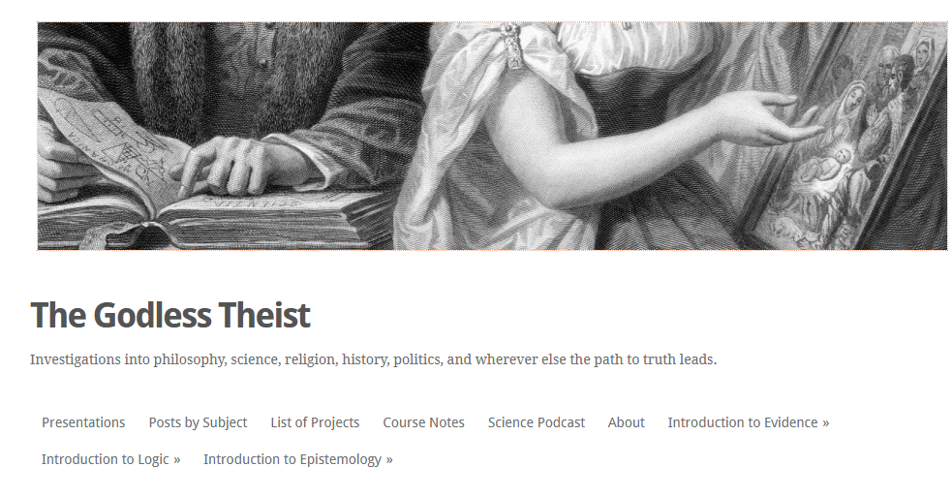
My Blog
Unclear what this adds to the picture
Might affect what is valuable

