Slide 1
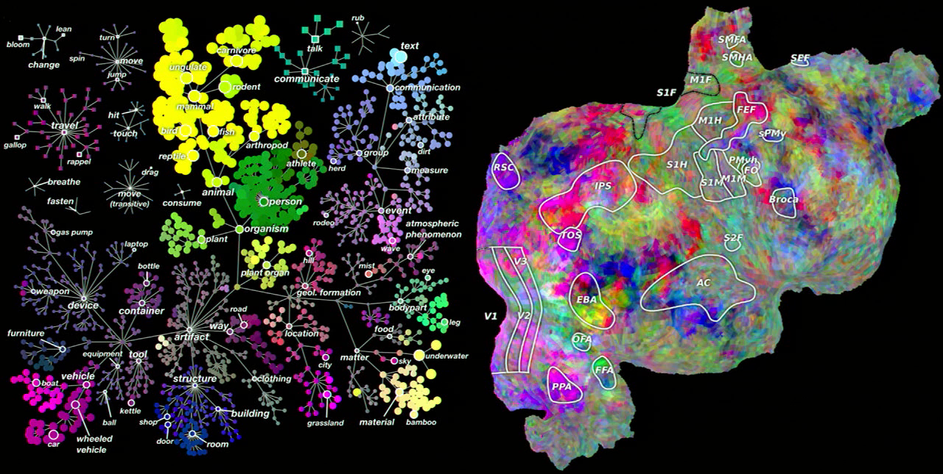
Testing Sentence Embedding Models using Semantic Similarity Judgments of Simple Phrases
Distributional or vector-space models of word meaning provide a widely used framework for modelling the meaning of words as patterns activity in an underlying semantic space. However, it is unclear how to best extend these methods to incorporate the effects of phrase context and word order so as to construct semantic representations for novel phrases. This preliminary study elicits human semantic similarity judgements for simple phrases, and uses these data to test several proposed models of compositionality in vector-space semantic models.
James Fodor, November 2021

Slide 2
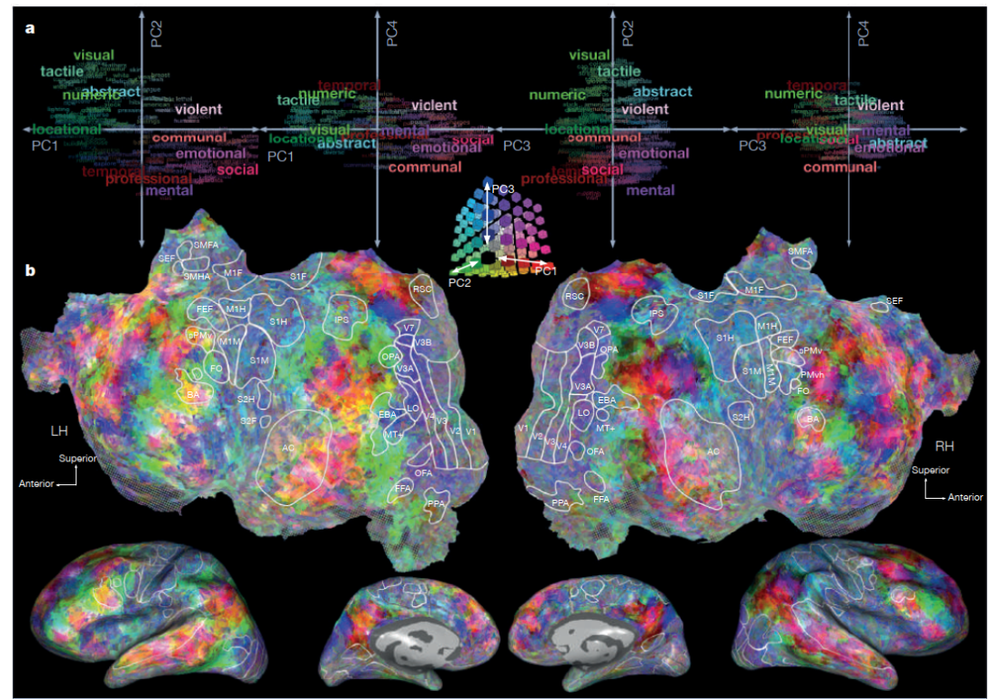
Concept Representation
“A key goal of cognitive neuroscience is to delineate the nature, content, and neuroanatomical distribution of the neural representation of concept knowledge.”
Bauer, Andrew J., and Marcel A. Just. "Neural representations of concept knowledge." The oxford handbook of neurolinguistics (2019): 1-21.
Huth, Alexander G., Wendy A. De Heer, Thomas L. Griffiths, Frédéric E. Theunissen, and Jack L. Gallant. "Natural speech reveals the semantic maps that tile human cerebral cortex." Nature 532, no. 7600 (2016): 453-458.

Slide 3
Concept Representation
“A concept can be defined, in neural terms, as a systematic, distributed pattern of activation across a network of cortical regions that occurs when a person
thinks about that concept.”
Distributional semantics:
Patterns of neural activations -> feature activations
Vargas, Robert, and Marcel Adam Just. "Neural representations of abstract concepts: Identifying underlying neurosemantic dimensions." Cerebral Cortex 30, no. 4 (2020): 2157-2166.

Slide 4
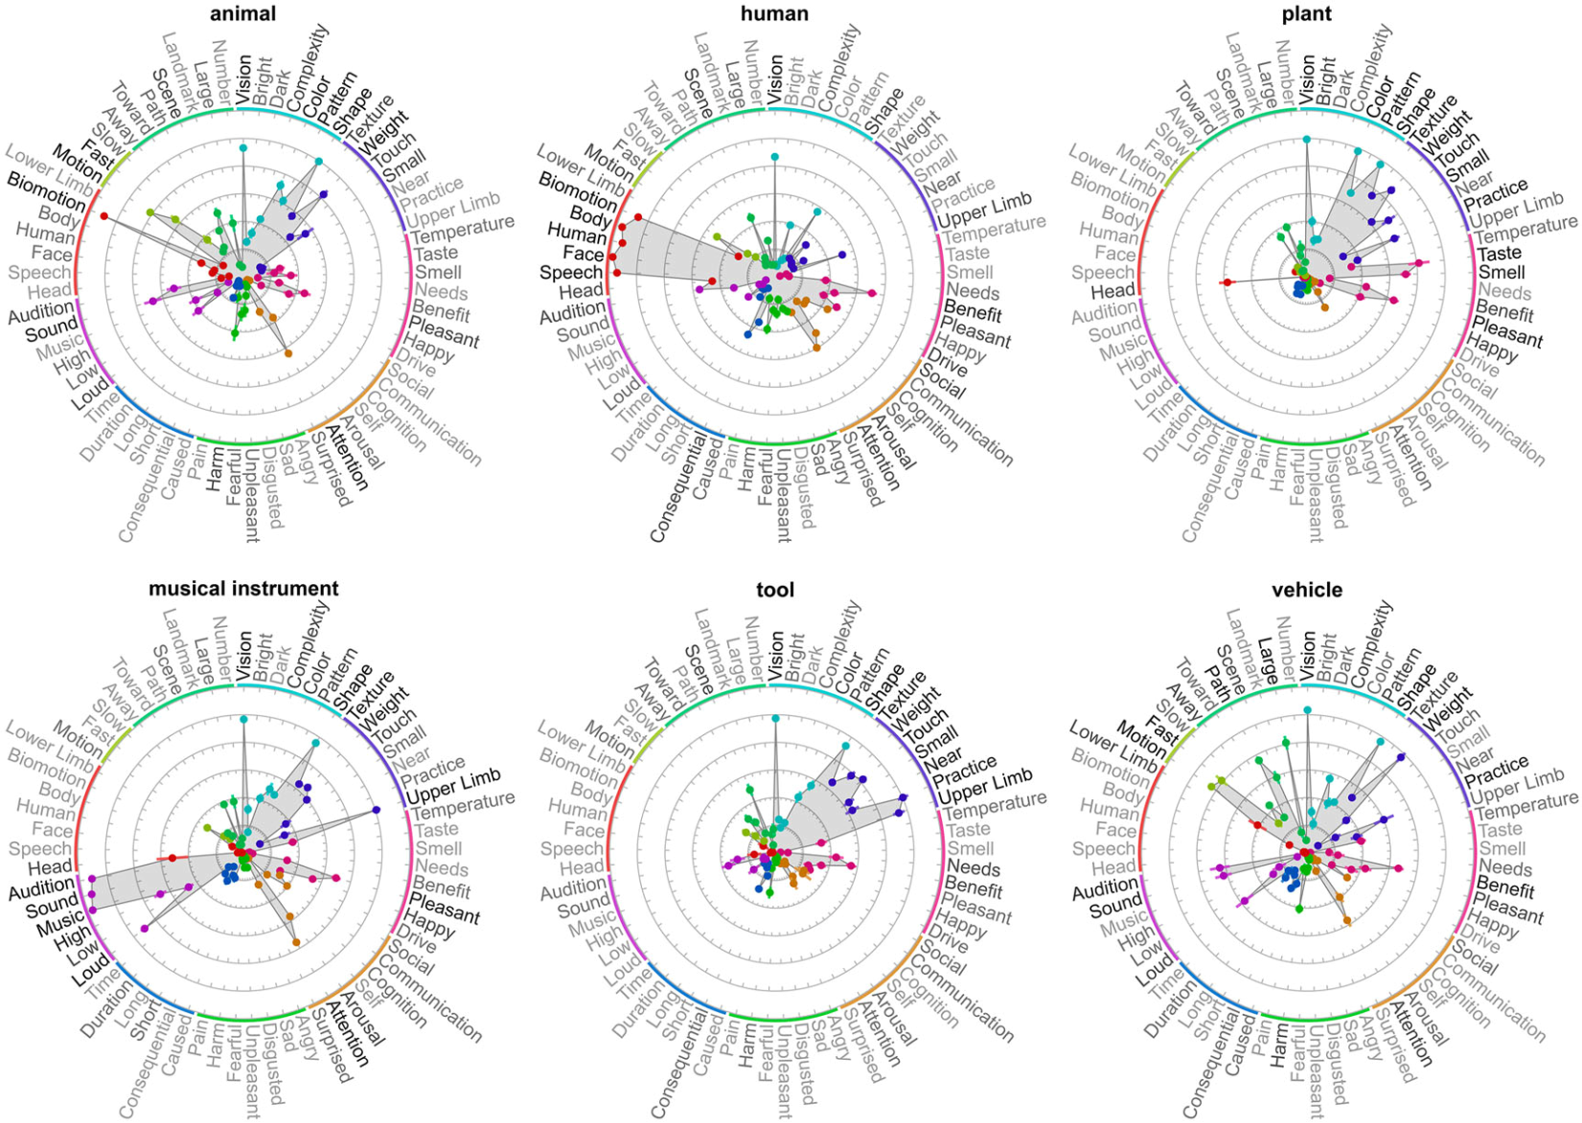
Concept Representation
Binder, Jeffrey R., et al. “Toward a brain-based componential semantic representation.” Cognitive Neuropsychology 33 no. 3-4 (2016): 130-174.

Slide 5
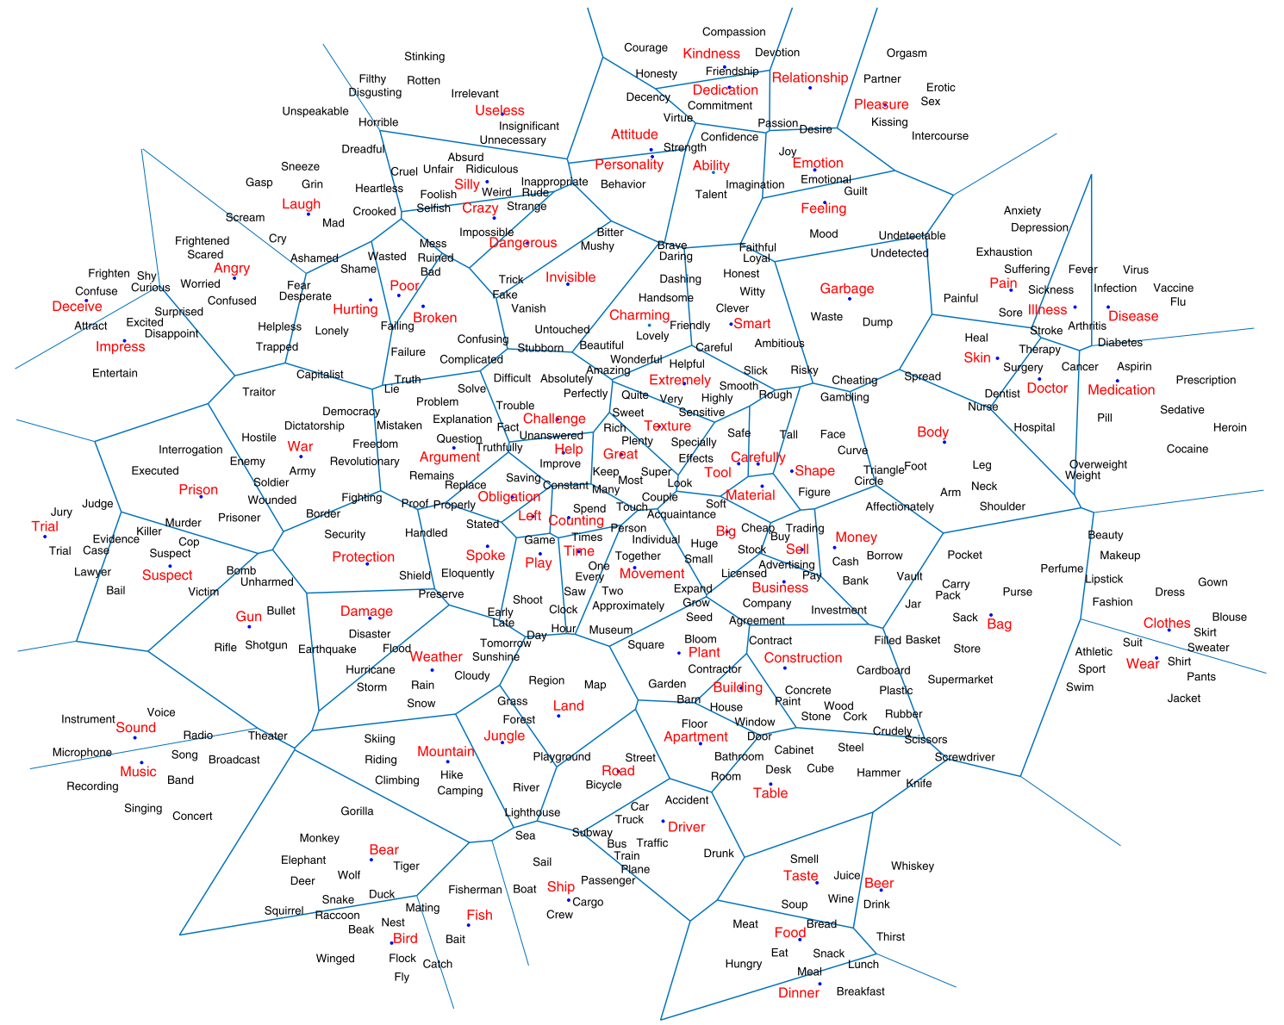
Concept Representation
Pereira, Francisco, et al. "Toward a universal decoder of linguistic meaning from brain activation." Nature communications 9.1 (2018): 1-13.

Slide 6
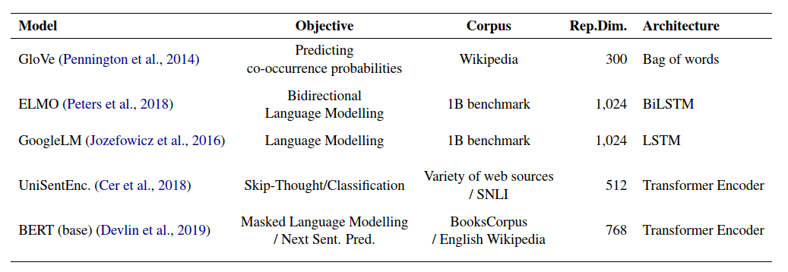
Word Embeddings
Word embeddings are popular way to model concept representation in distributional semantics.
Abnar, Samira, Lisa Beinborn, Rochelle Choenni, and Willem Zuidema. "Blackbox meets blackbox: Representational similarity and stability analysis of neural language models and brains." arXiv preprint arXiv:1906.01539 (2019).

Slide 7
Sentence Embeddings
Question: How to go from word embeddings to sentence embeddings?
How to combine word embeddings in a systematic way to represent sentence structure, modifiers, agent-patient relations, etc?

Slide 8
Compositionality
“Compositionality typically refers to the property that meanings of composed structures are a function
of the meanings of constituent units and the rules used to combine those units into that structure. For example, we combine individual words like ‘Jane’, ‘goes to’ and ‘the store’ to form the sentence ‘Jane goes to the store’.”
Martin, Andrea E., and Leonidas AA Doumas. "Tensors and compositionality in neural systems." Philosophical Transactions of the Royal Society B 375, no. 1791 (2020): 20190306.

Slide 9
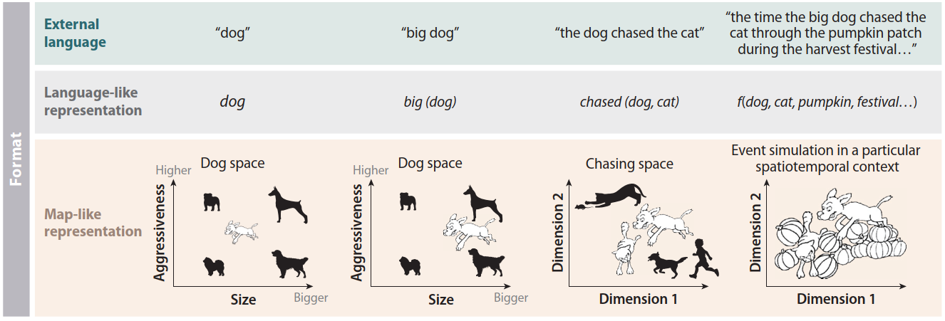
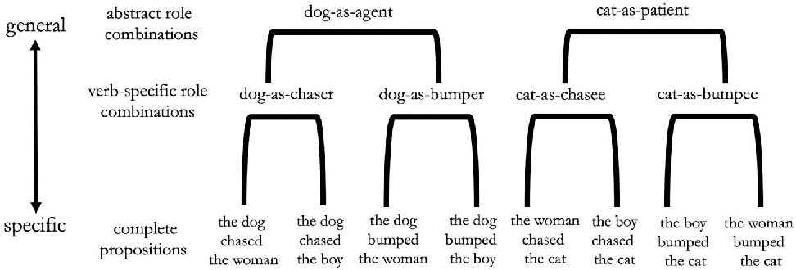
Representing Sentences
Frankland, Steven M., and Joshua D. Greene. "Concepts and compositionality: in search of the brain's language of thought." Annual review of psychology 71 (2020): 273-303.
Frankland, Steven M., and Joshua D. Greene. "Two ways to build a thought: distinct forms of compositional semantic representation across brain regions." Cerebral Cortex 30, no. 6 (2020): 3838-3855.

Slide 10
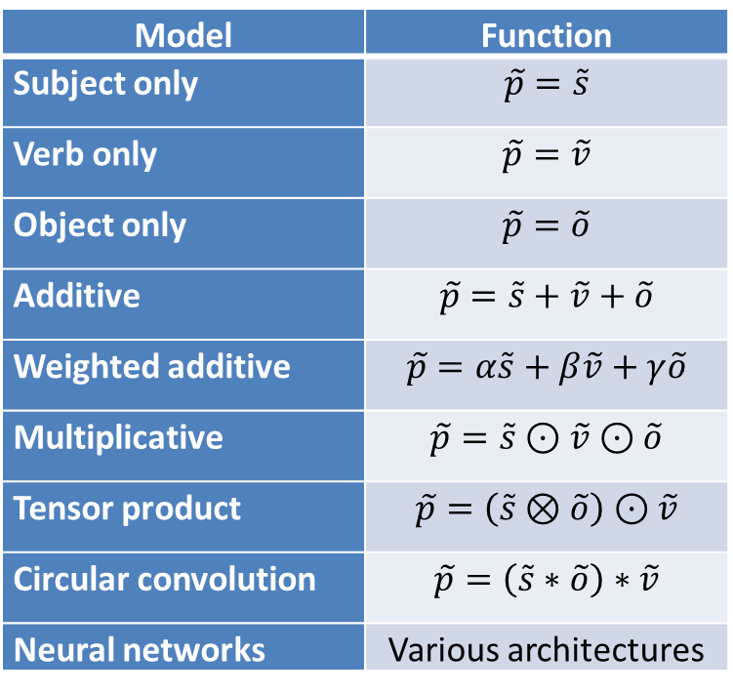
Compositional Embeddings
Many compositional functions have been proposed.
Model | Function
Subject only | $$\tilde{p}=\tilde{s}$$
Verb only | $$\tilde{p}=\tilde{v}$$
Object only | $$\tilde{p}=\tilde{o}$$
Additive | $$\tilde{p}=\tilde{s}+\tilde{v}+\tilde{o}$$
Weighted additive | $$\tilde{p}=α\tilde{s}+β\tilde{v}+γ\tilde{o}$$
Multiplicative | $$\tilde{p}=\tilde{s}⊙\tilde{v}⊙\tilde{o}$$
Tensor product | $$\tilde{p}=\left(\tilde{s}⊗\tilde{o}\right)⊙\tilde{v}$$
Circular convolution | $$\tilde{p}=\left(\tilde{s}∗\tilde{o}\right)∗\tilde{v}$$
Neural networks | Various architectures

Slide 11
My Basic Approach
Can’t ask people to report embeddings ☹.
Instead, ask people to rate similarity of sentences.
Also use compositional embedding models to compute similarity of embeddings.
Then compare similarity structure of experimental ratings with compute embedding similarities.

Slide 12
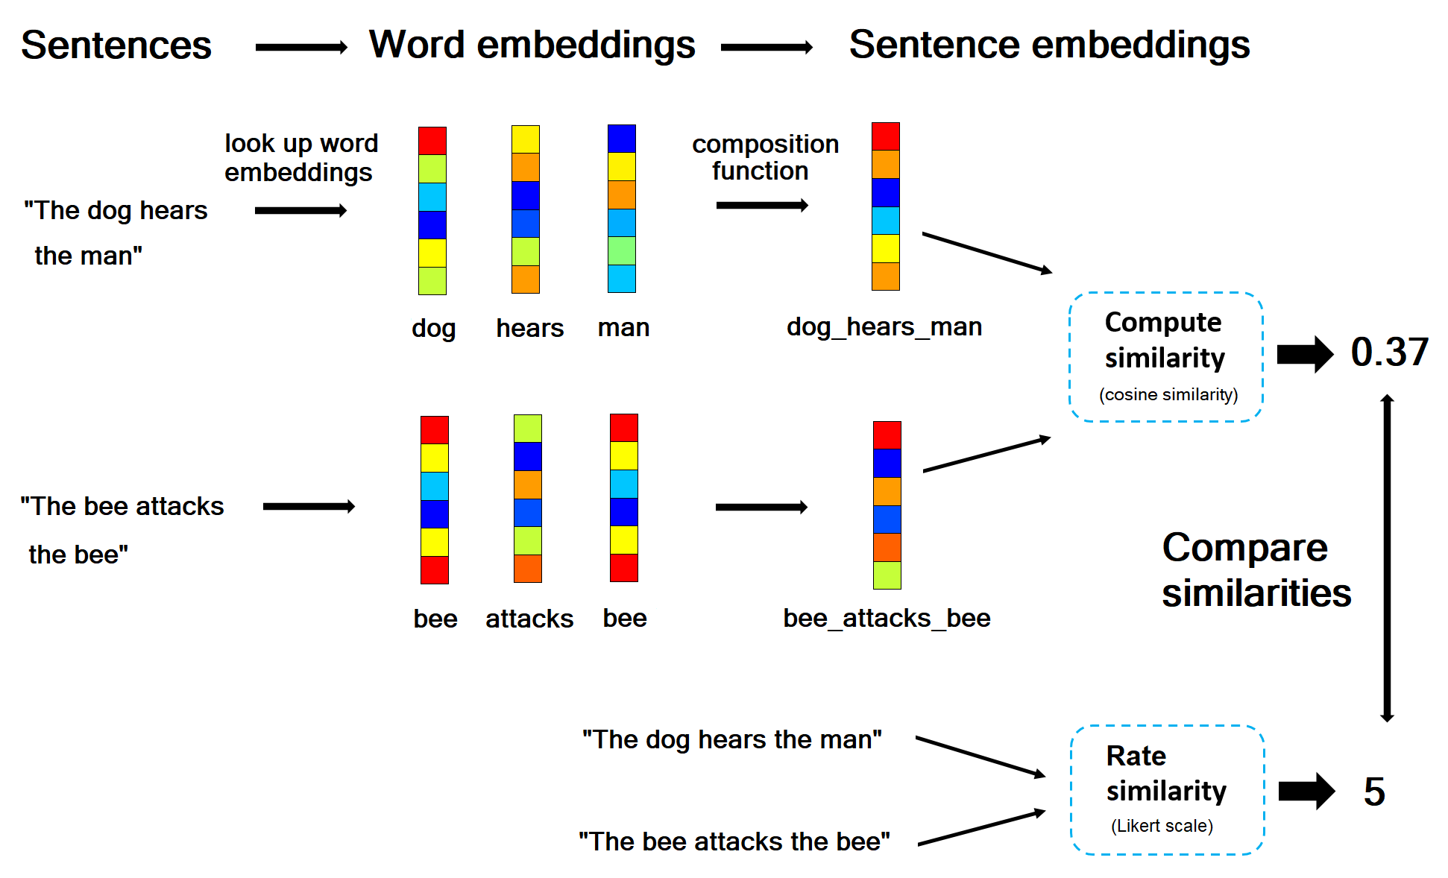
My Basic Approach

Slide 13
Experimental Stimuli
Format
1. The [subject_1] [verb_1s] the [object_1]
2. The [subject_2] [verb_2s] the [object_2]
Word Set
Nouns | Noun category | Verbs | Verb category
Man | Primate | Sees | Sensory
Monkey | Primate | Hears | Sensory
Cat | Pet mammal | Bites | Negative affect
Dog | Pet mammal | Attacks | Negative affect
Ant | Insect | Loves | Positive affect
Bee | Insect | Respects | Positive affect
 |  | Teaches | Social
 |  | Meets | Social

Slide 14

Experimental Stimuli
Examples (107 presented)
1. The dog sees the dog
2. The dog hears the man
1. The bee attacks the bee
2. The man attacks the dog
1. The cat respects the monkey
2. The bee respects the man
Total combinations: 3x3x3 + 2x6x6x3 = 27 + 216 = 243

Slide 15
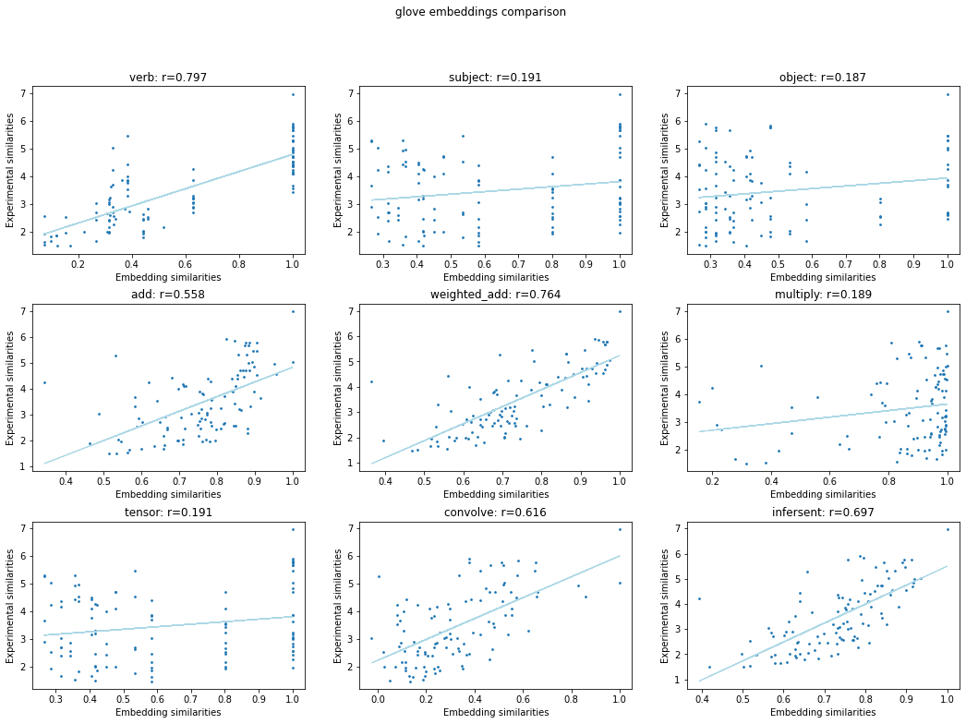
Results (with GloVe)

Slide 16
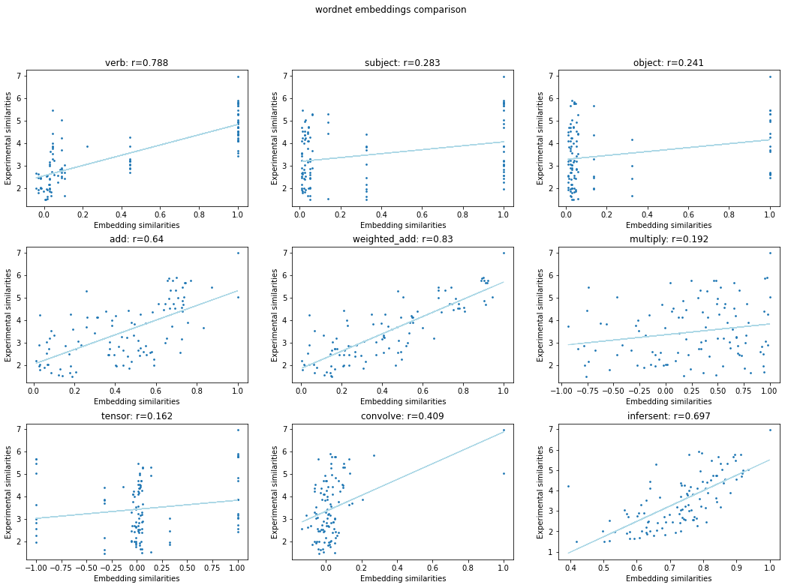
Results (with WordNet)

Slide 17
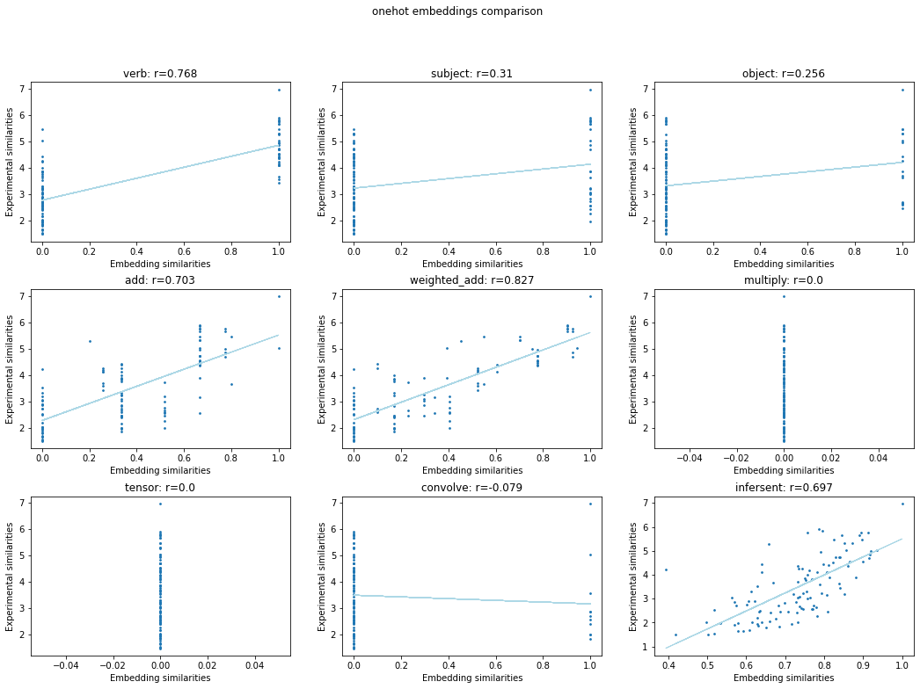
Results (with One-Shot)

Slide 18
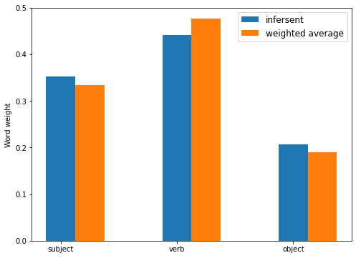
Word Weights
Unexpected concordance between word weights in optimal weighted average and InferSent embeddings.

Slide 19
Key Findings
Can use human sentence similarity judgments for testing sentence embeddings.
Evidence that verbs matter most for sentence meaning.
Optimal weighted averages perform similarly to InferSent neural network model.

Slide 20
Future Directions
Further experiments with a wider range of sentence and word types.
Variation of instructions to ask about relatedness, implications, etc.
Compare a larger number of neural network models of sentence embedding.
Work with more tightly controlled subsets of language.
Longer term, neuroimaging work testing composition functions.

Slide 21
References
Abnar, Samira, Lisa Beinborn, Rochelle Choenni, and Willem Zuidema. "Blackbox meets blackbox: Representational similarity and stability analysis of neural language models and brains." arXiv preprint arXiv:1906.01539 (2019).
Bauer, Andrew J., and Marcel A. Just. "Neural representations of concept knowledge." The oxford handbook of neurolinguistics (2019): 1-21.
Frankland, Steven M., and Joshua D. Greene. "Concepts and compositionality: in search of the brain's language of thought." Annual review of psychology 71 (2020): 273-303.
Frankland, Steven M., and Joshua D. Greene. "Two ways to build a thought: distinct forms of compositional semantic representation across brain regions." Cerebral Cortex 30, no. 6 (2020): 3838-3855.
Huth, Alexander G., Wendy A. De Heer, Thomas L. Griffiths, Frédéric E. Theunissen, and Jack L. Gallant. "Natural speech reveals the semantic maps that tile human cerebral cortex." Nature 532, no. 7600 (2016): 453-458.
Leshinskaya, Anna, Juan Manuel Contreras, Alfonso Caramazza, and Jason P. Mitchell. "Neural representations of belief concepts: a representational similarity approach to social semantics." Cerebral Cortex 27, no. 1 (2017): 344-357.
Loula, Joao, Marco Baroni, and Brenden M. Lake. "Rearranging the familiar: Testing compositional generalization in recurrent networks." arXiv preprint arXiv:1807.07545 (2018).
Pillet, Ineke, Hans Op de Beeck, and Haemy Lee Masson. "A Comparison of Functional Networks Derived From Representational Similarity, Functional Connectivity, and Univariate Analyses." Frontiers in neuroscience 13 (2020): 1348.
Martin, Andrea E., and Leonidas AA Doumas. "Tensors and compositionality in neural systems." Philosophical Transactions of the Royal Society B 375, no. 1791 (2020): 20190306.
Tamir, Diana I., Mark A. Thornton, Juan Manuel Contreras, and Jason P. Mitchell. "Neural evidence that three dimensions organize mental state representation: Rationality, social impact, and valence." Proceedings of the National Academy of Sciences 113, no. 1 (2016): 194-199.
Vargas, Robert, and Marcel Adam Just. "Neural representations of abstract concepts: Identifying underlying neurosemantic dimensions." Cerebral Cortex 30, no. 4 (2020): 2157-2166.
Xu, Haoyan, Brian Murphy, and Alona Fyshe. "Brainbench: A brain-image test suite for distributional semantic models." In Proceedings of the 2016 Conference on Empirical Methods in Natural Language Processing, pp. 2017-2021. 2016.

