Slide 1
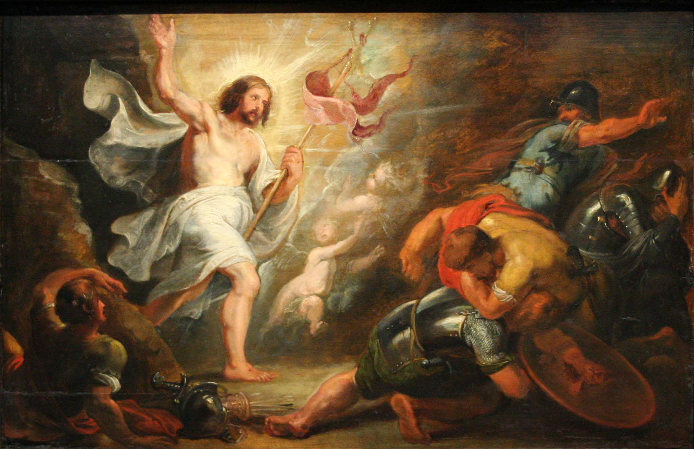
The Resurrection of Jesus: A Skeptical Analysis
James Fodor, Nov 2021

Slide 2
What is an Explanation?
An explanation is a story, picture or ‘model’, which makes sense of the facts to be explained.
In the words of philosopher Charles Pierce, given an explanation, the facts should follow as ‘a matter of course’
Explanations make unusual, strange, or mysterious facts seem to make perfect sense and not be strange at all.
Explanations should account for strange features and render the otherwise inexplicable readily understandable.

Slide 3
Explanatory Quality
Explanatory scope: the range of facts that an explanation can account for.
Explanatory power: how likely the facts are rendered by the explanation.
Plausibility: how plausible are the propositions posited by the explanation given existing background knowledge (outside of the facts to be explained).

Slide 4
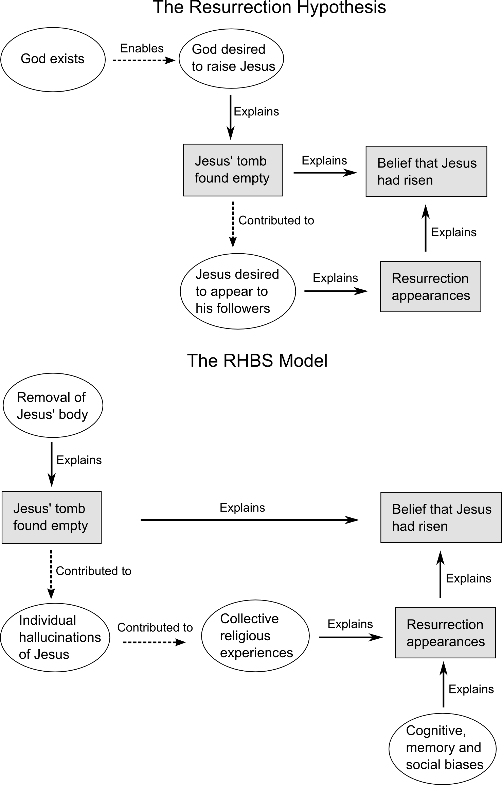
The Resurrection Explanation

Slide 5
The Resurrection Explanation

Slide 6
The RHBS Explanation

Slide 7
The RHBS Model

Slide 8
Plausibility of Reburial
  Jewish law required bodies to be taken down before evening: (Deuteronomy 21:22, in John 19:31 “so that the bodies would not remain on the cross on the Sabbath”).
  The gospels indicate the burial was rushed: Mark 15:42 and John 19:42 “Therefore because of the Jewish day of preparation, since the tomb was nearby, they laid Jesus there”. Also women coming on Sunday shows burial not completed.
  Romans put pressure on the Jews to keep things as quiet and private to reduce the risk of more riots or uprisings.
  Reburial allowed “where a grave is in danger of water seepage or if it is not safe against robbers, etc, transfer is permitted.” (Encyclopaedia Judaica). Also, Mary Magdelene didn’t think reburial was implausible: “they have taken away the Lord out of the tomb.” (John 20:2).

Slide 9
The RHBS Model

Slide 10
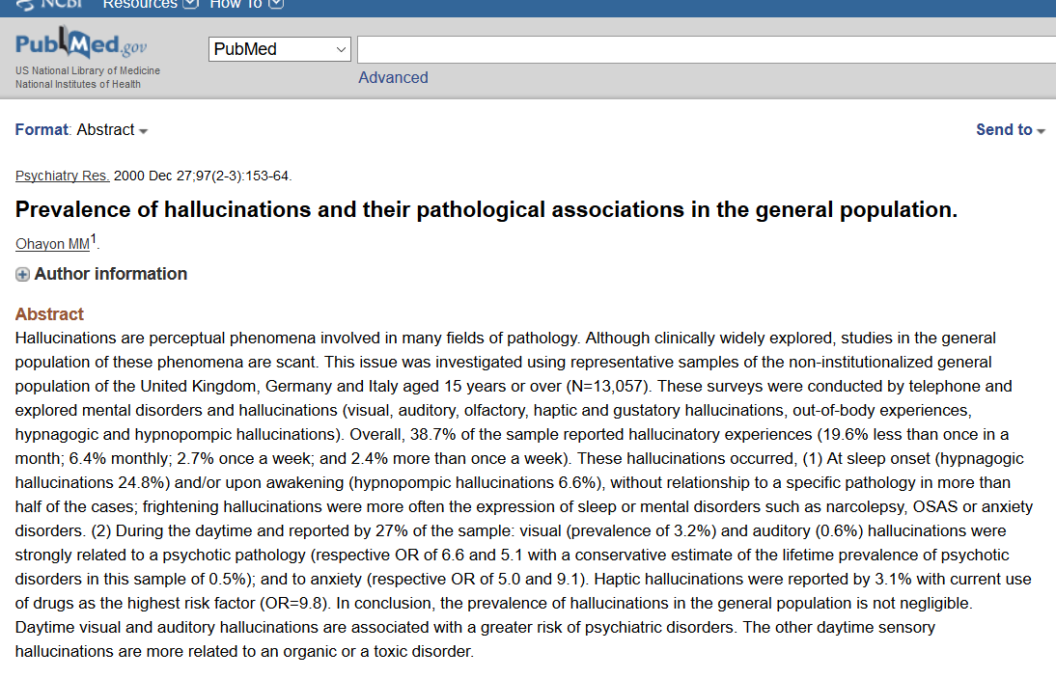
Private Hallucinations

Slide 11
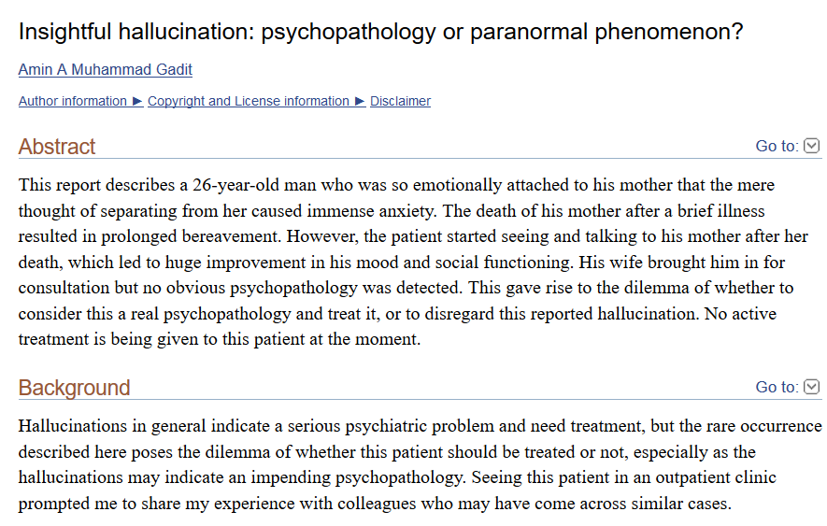
Complicated Bereavement

Slide 12
The RHBS Model

Slide 13
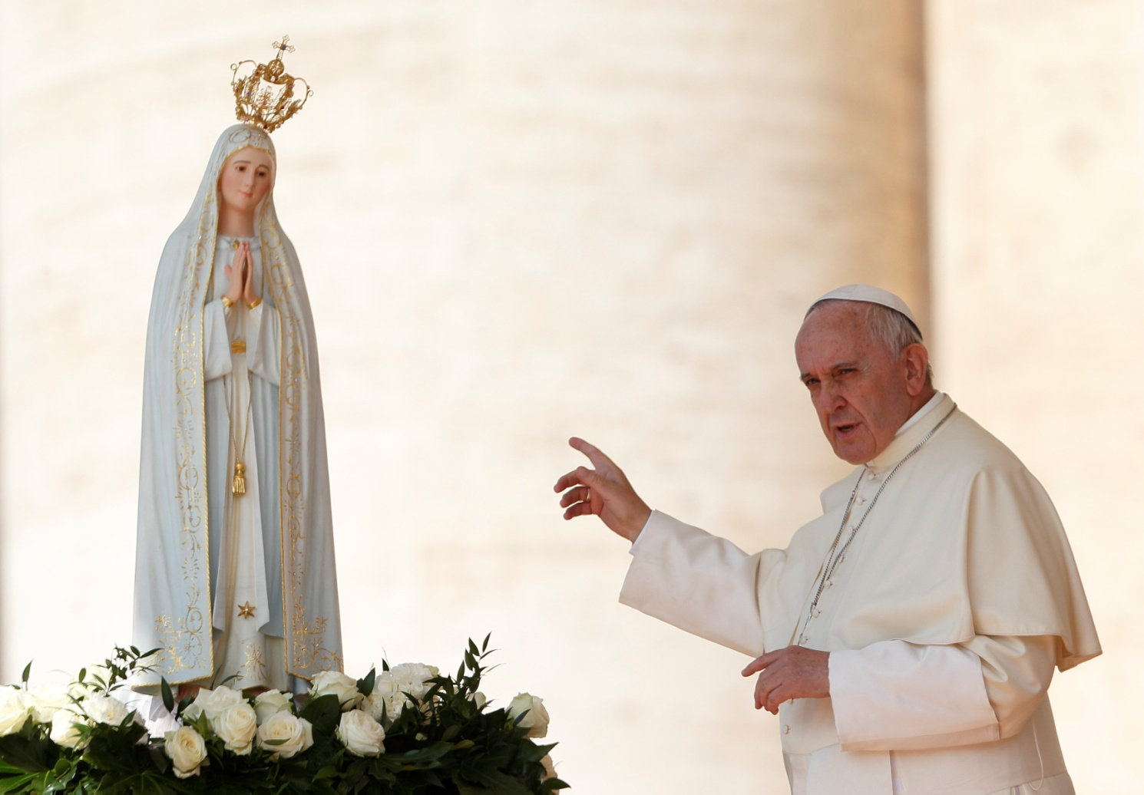
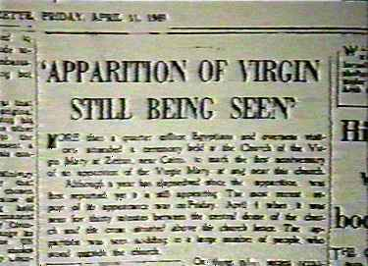
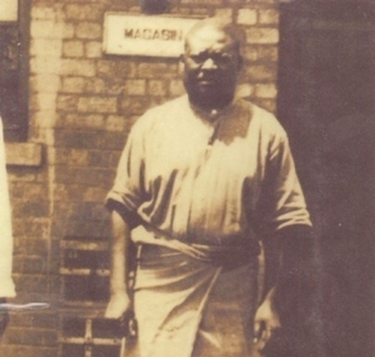
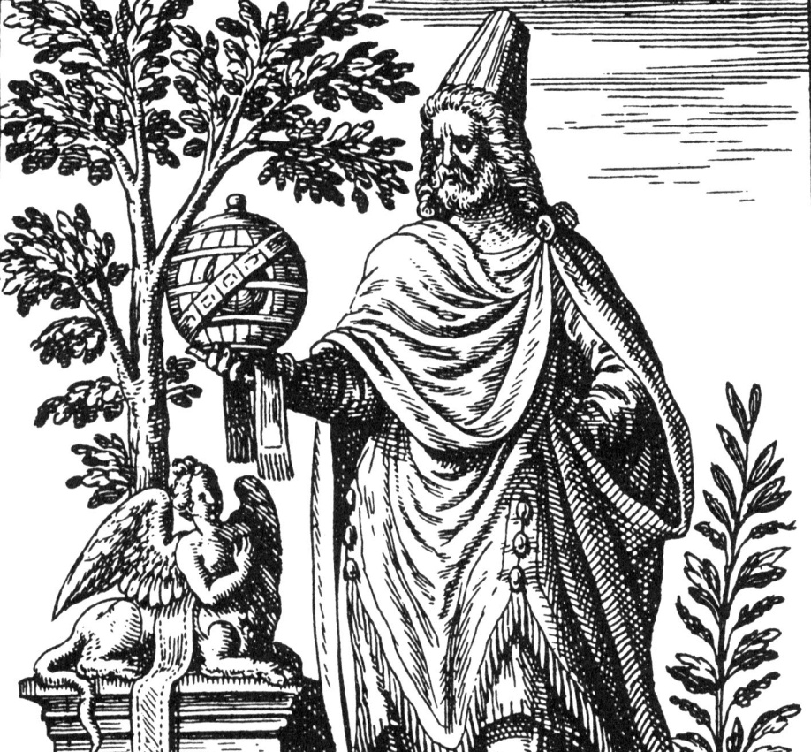
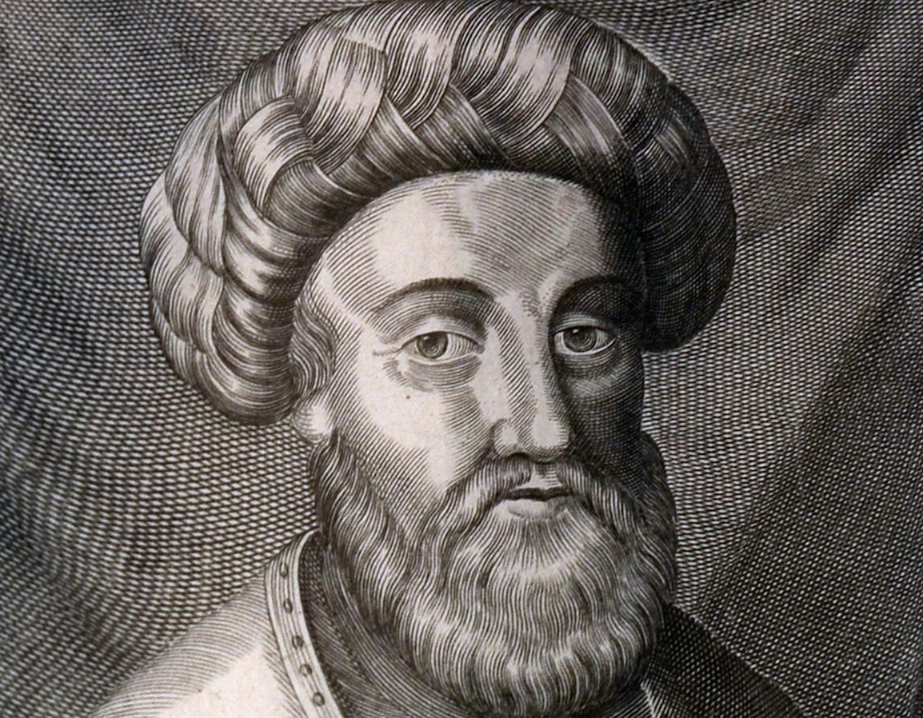
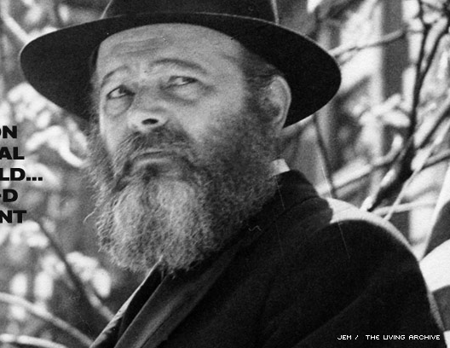
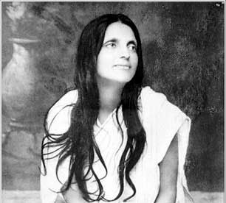
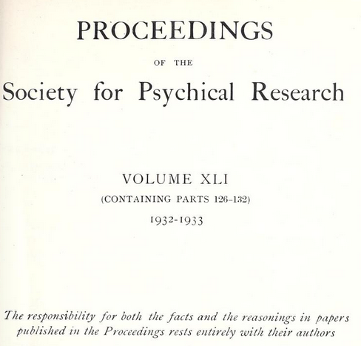
Collective Experiences
Our Lady of Fátima
Our Lady of Zeitoun
Simon Kimbangu
Apollonius of Tyana
Sabbatai Zevi
Menachem Mendel Schneerson
Anandamayi Ma
Parapsychology

Slide 14
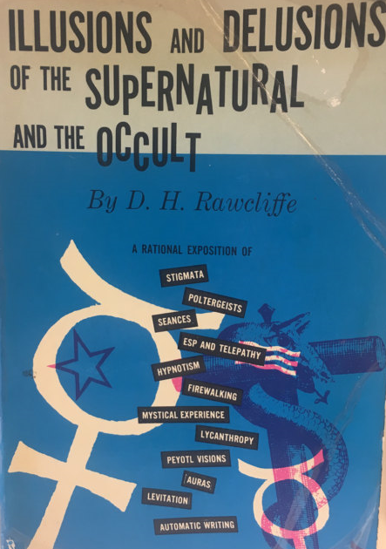
Donovan H. Rawcliffe
“The same factors which operate for a single individual in the induction of hallucinations... may become even more effective in an excited or expectant crowd, and on occasion may result in mass hallucinations. This is not to say that any two people are capable of having precisely the same hallucination identical in every respect. But similar preconceptions and expectations can undoubtedly result in hallucinatory visions so alike that subsequent comparisons would not disclose any major discrepancy... dissimilar hallucinatory experiences often attain a spurious similarity by a process of harmonisation in subsequent recollection and conversation.”

Slide 15
The RHBS Model

Slide 16
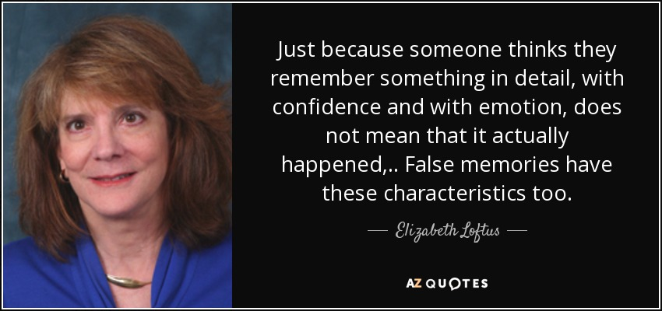
Elizabeth Loftus

Slide 17
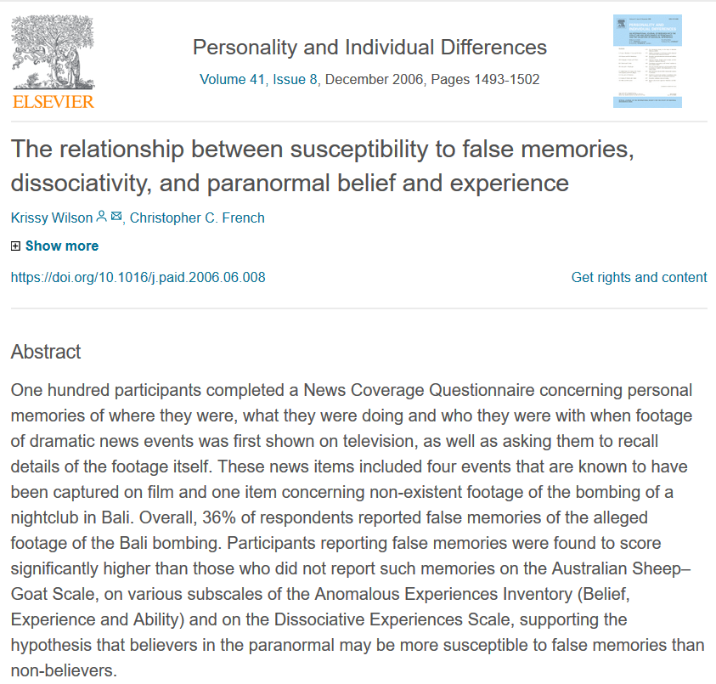
Unreliable Memory

Slide 18
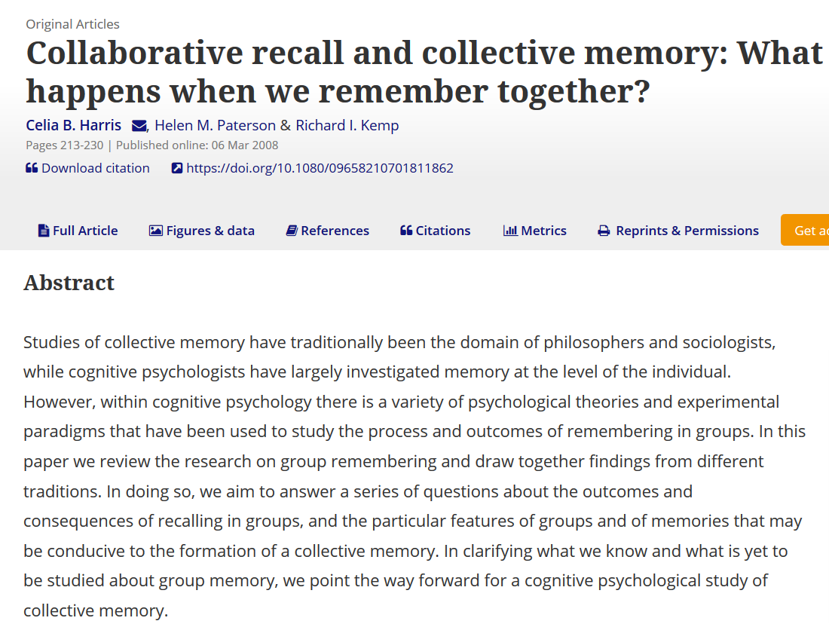
Memory Contamination

Slide 19

Cognitive Dissonance
A famous example was the 1844 so-called “Great Disappointment”, following the failed prediction of the Millerites that Jesus would return in that year. There were many attempted justifications, and some fell away, but the movement continued and gave rise to the contemporary Seventh Day Adventist church.
Other examples:
Andrew Wakefield and the MMR vaccine
Breatharianism
Holocaust denial
Touchless knockouts
Trump election conspiracies

Slide 20
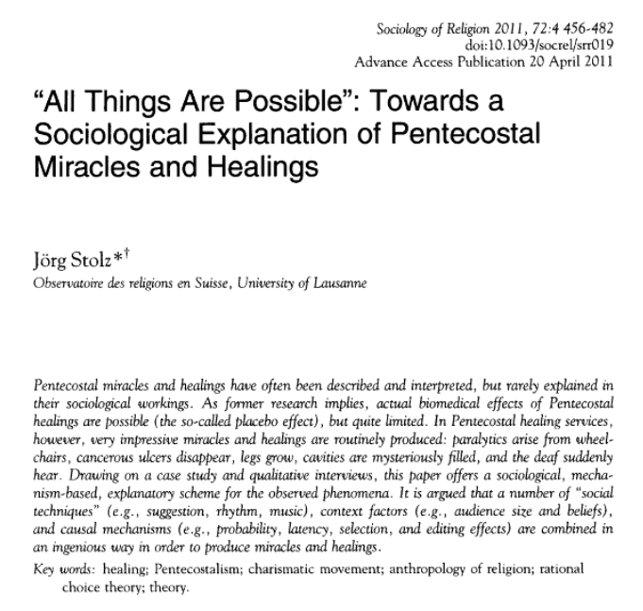
Sociological Effects

Slide 21
Weighing the Explanations

Slide 22
The Resurrection Hypothesis
?
?

Slide 23
The RHBS Model

