Slide 1


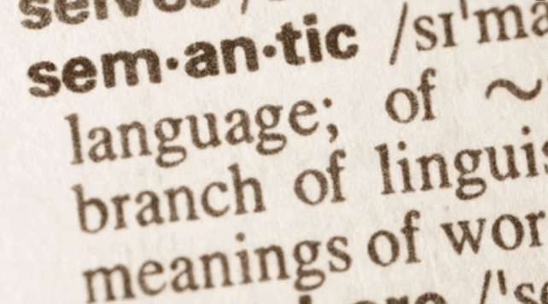
The Importance of Context in Evaluation of Word Embeddings
The Effects of Antonymy and Polysemy
James Fodor
22nd June 2023

Slide 2
Introduction

Slide 3
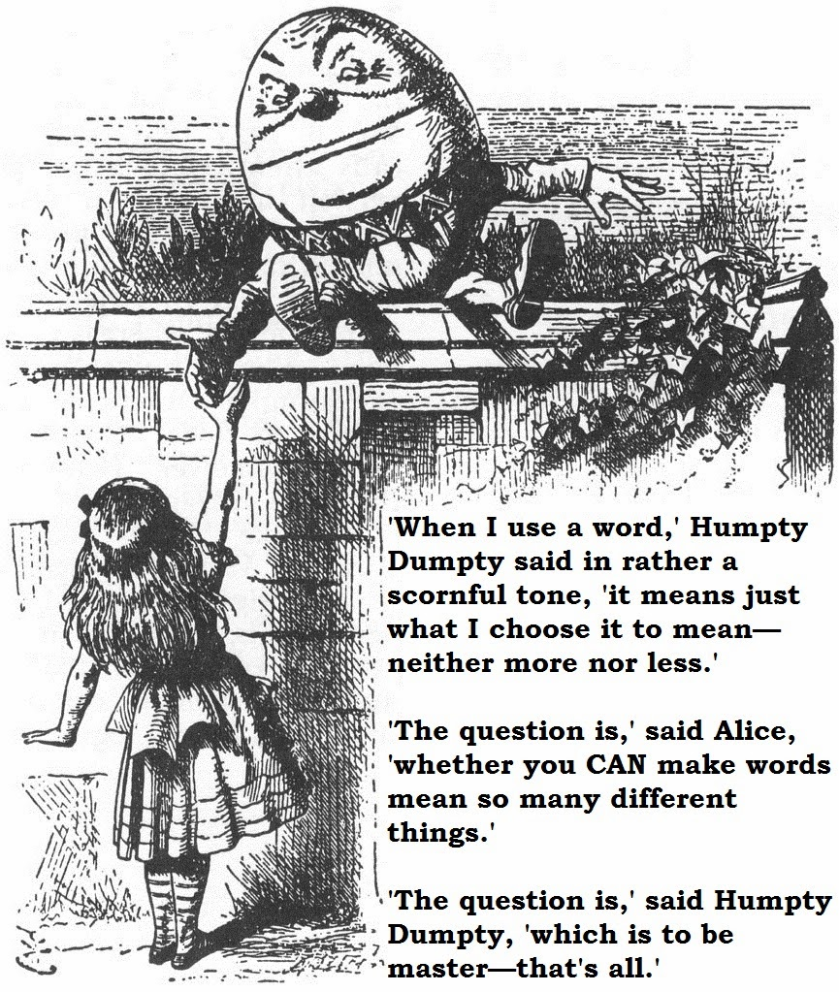
Introduction

Slide 4
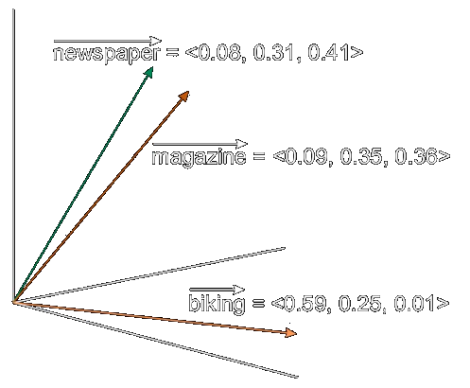
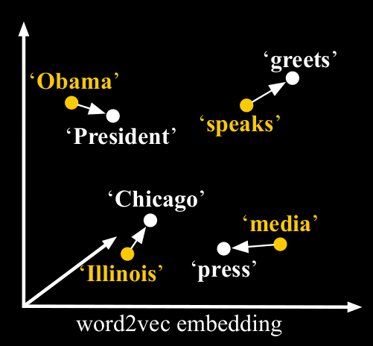
Word Embeddings
Word embeddings represent the meaning of a word as a vector of numbers.
Embeddings live in ‘semantic space’.
More similar vectors = more similar meaning.

Slide 5
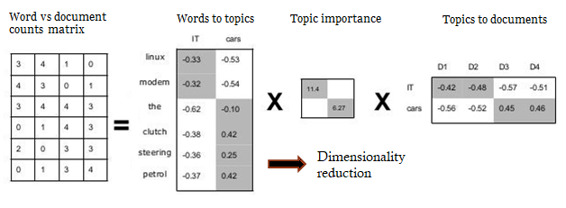
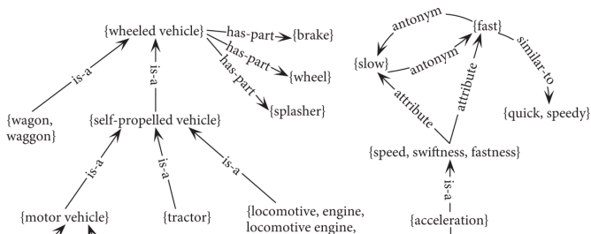
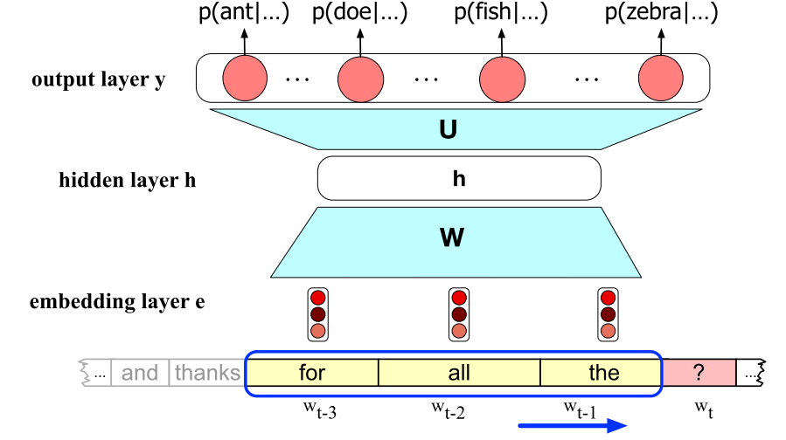
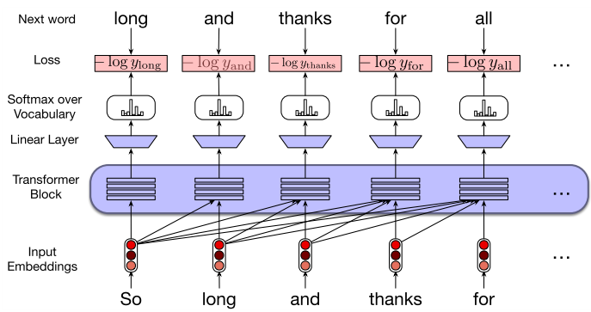
Types of Word Embeddings
1. Count-based
2. Predict-based
3. Knowledge-based
4. Transformers

Slide 6
Testing Word Embeddings
How adequate are word embeddings as models of word meaning (lexical semantics)?
Here we consider semantic similarity judgements as basis for testing.
We will focus on verbs.
Dataset | Size | Judged Property | Citation
RG65 | 65 | Similarity | (Rubenstein & Goodenough, 1965)
YP-130 | 130 | Similarity | (Yang & Powers, 2006)
WordSim-353 | 353 | Relatedness | (Finkelstein et al., 2001)
SimLex-999 | 999 | Similarity | (Hill, et al., 2015)
SimVerb-3500 | 3,500 | Similarity | (Gerz, et al., 2016)
Multi-SimLex | 1,888 | Similarity | (Vulic, Baker, et al., 2020)
MEN | 3,000 | Relatedness | (Bruni et al., 2012)
MTurk-287 | 287 | Relatedness | (Radinsky et al., 2011)
MTurk-771 | 771 | Relatedness | (Halawi et al., 2012)
Stanford-RW | 2,034 | Similarity | (Luong et al., 2013)
Tr9856 | 9,856 | Relatedness | (R. Levy et al., 2015)
SemEval-2017 | 500 | Similarity | (Camacho-Collados et al., 2017)

Slide 7
Context: Polysemy and Antonymy
Context: meaning cannot be determined by each word in isolation.
Antonymy: words that are ‘opposite’ in meaning.
Polysemy: words with distinct but overlapping meanings.
Example | Meanings
Open | To spread out Not covered Honest Available
Run | Move quickly Manage smth Provide smth To flow
Make | To prepare To force To reach smw
Type | Explanation | Example
Gradable | Opposite ends of a spectrum | Walk/gallop
Complementary | Binary pair | Leave/arrive
Relational | Opposing points of view of situation | Buy/sell
Other | More complex or polysemous cases | Breathe/choke Determine/guess

Slide 8
Methods

Slide 9
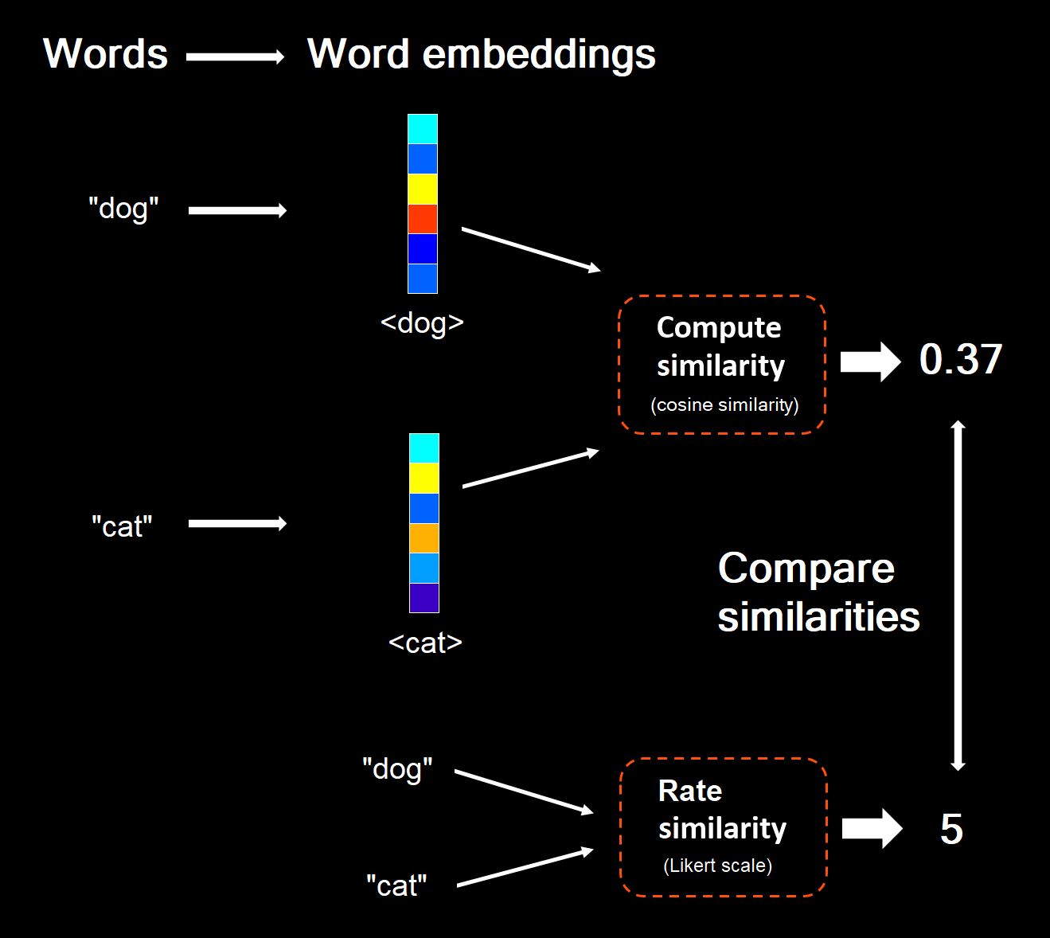
Evaluating Word Embeddings

Slide 10
Methods: Antonymy
Humans and may represent antonyms differently to word embeddings models.
Exclude them and see how much difference this makes to correlations.

Slide 11
Methods: Polysemy
Existing methods incorporate context into datasets (WiC, CoSimLex).
Instead, we incorporate additional context into transformer embeddings (ERNIE).
Examine how much this improves correlations.
Model Name | Explanation | Specificity
ERNIE base | No context provided. | None
ERNIE Wiki Basic | Context provided from a corpus of Wikipedia articles, with words matched using automatic lemmatisation. | Least
ERNIE Wiki Verb | Context provided from a corpus of Wikipedia articles, and only matching words conjugated as verbs. This should avoid matching cases where verbs as used as nouns. | Less
ERNIE Dictionary Word | Context provided by example sentences extracted automatically from Oxford Online Dictionary. This should provide higher-quality and more relevant use cases representative of the words. | More
ERNIE Dictionary Sense | Context provided by a curated set of example sentences separated by sense from the Oxford, Longman, and Collins Online dictionaries. | Most

Slide 12
Results

Slide 13
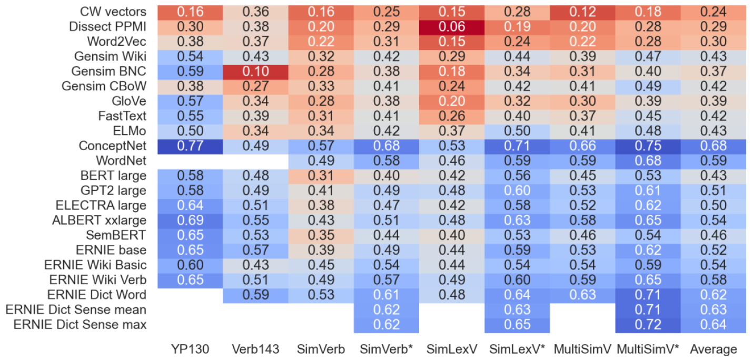
Results: Summary

Slide 14
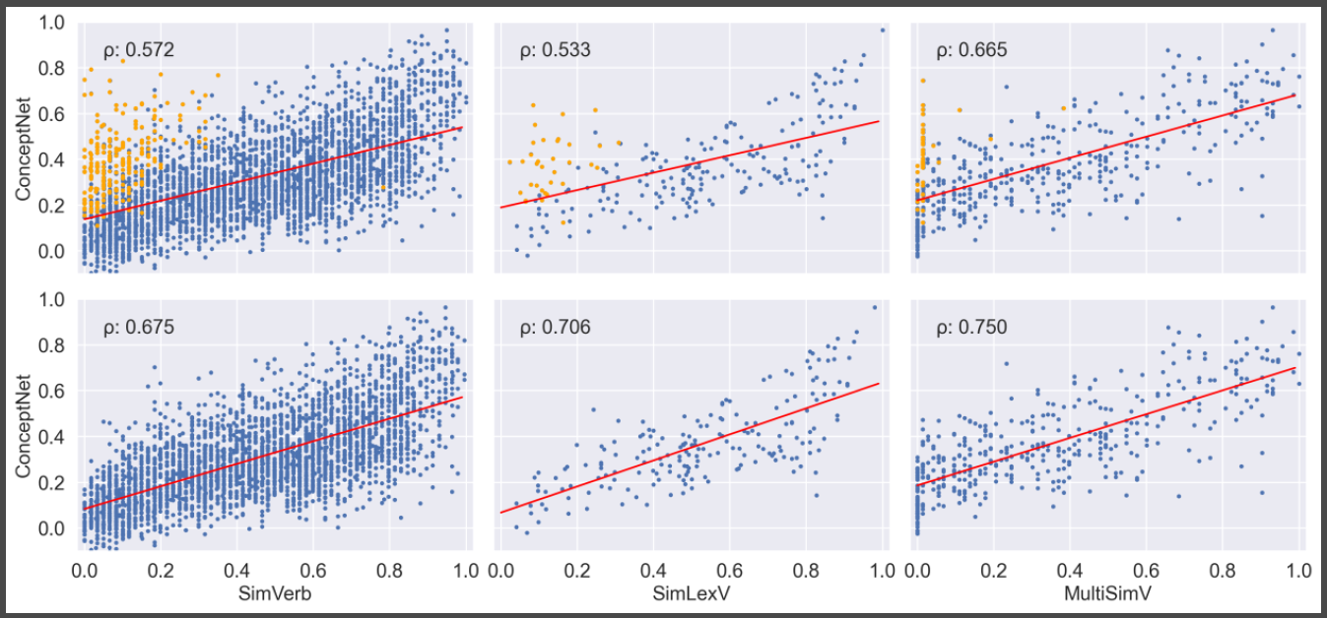
Results: Antonyms

Slide 15
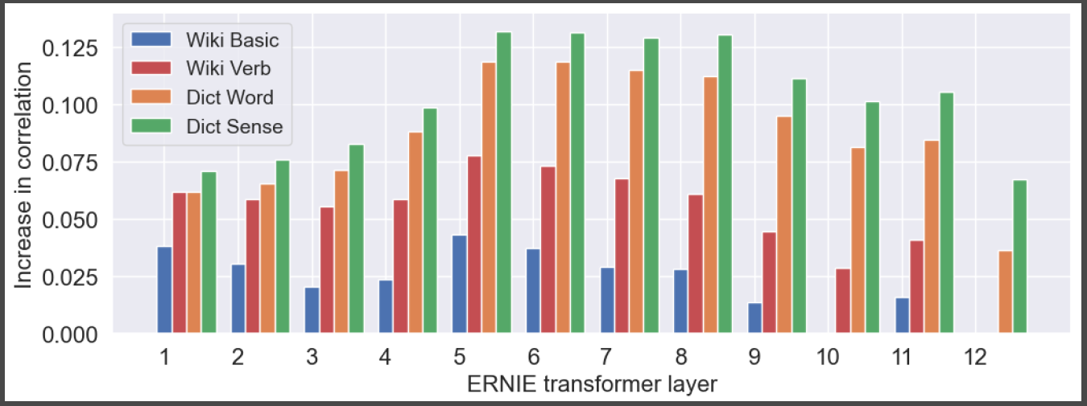
Results: Polysemy

Slide 16
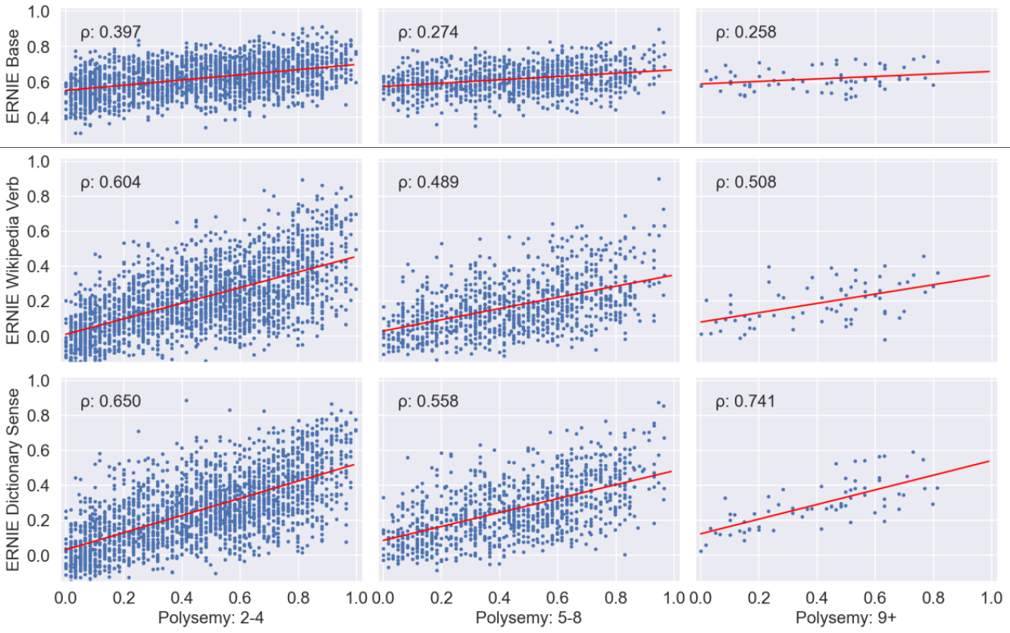
Results: Adding Context

Slide 17
Discussion

Slide 18
Discussion: Antonymy
Correlation of verb datasets significantly limited by antonymy.
Humans: seem to focus on most salient aspect(s) of meaning.
Word embeddings: average over all aspects/features (‘increase’ vs ‘decrease’).
Not necessarily advisable to force cosine similarity to match.
Question: what is the relationship between human judgments and vector direction in semantic spaces?

Slide 19
Discussion: Polysemy
Adding more context to embeddings improves correlation to datasets, especially for highly polysemous pairs.
Humans may focus on senses that maximise similarity of paired words. (‘spring’ vs ‘bounce’).
Word embeddings vs sense embeddings vs contextualised embeddings.
Question: what should embeddings represent, and what is the best scope to represent meaning in computational semantics?

Slide 20
Questions?

