Slide 1
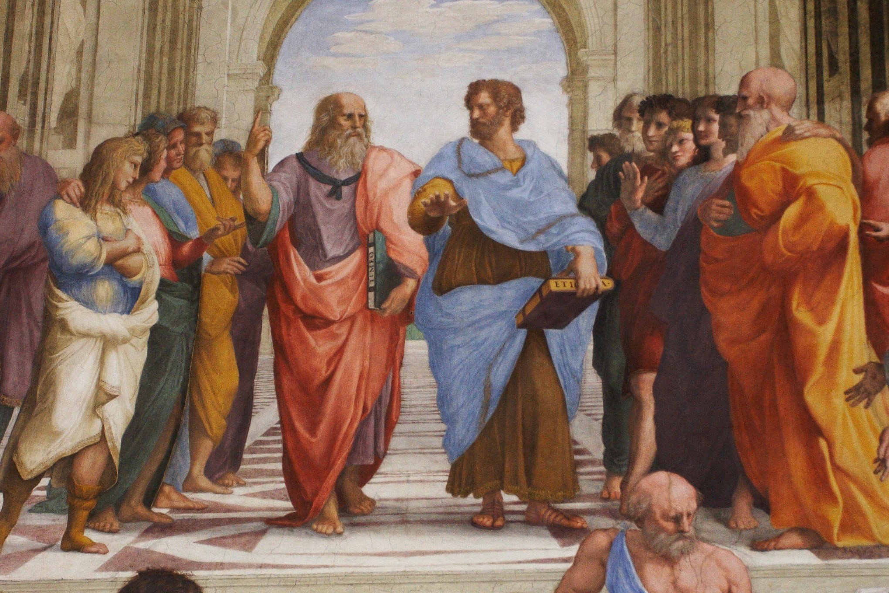
How Are Beliefs Justified?
James Fodor, April 2021

Slide 2
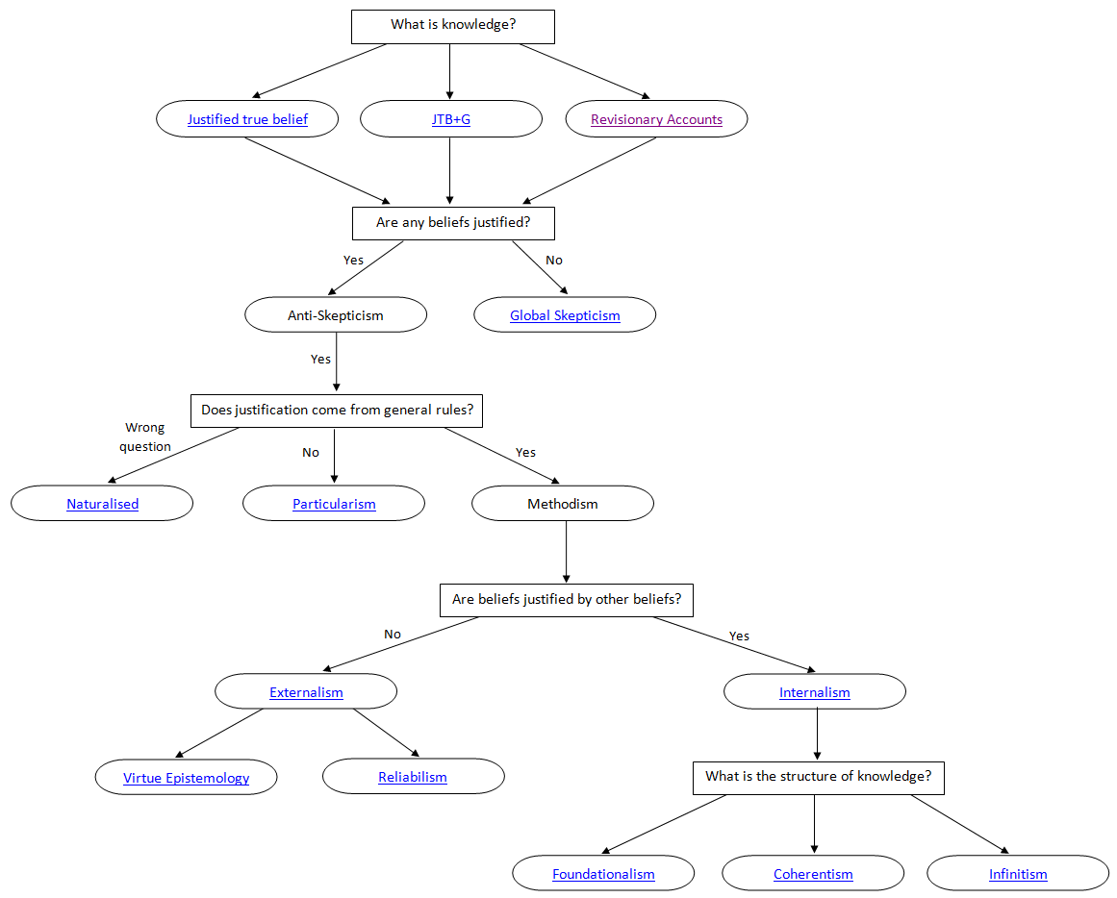
Outline of Epistemology

Slide 3
Internalism vs Externalism
These views address the question of what is needed in order for a belief to be justified.
Internalism: justification is something mental that you can (at least potentially) be aware of.
Externalism: justification is something extra-mental that you need not have any awareness of.

Slide 4
Internalism
One has a justified belief in p only if one can become aware by reflection of all one's justifiers for p.
Requirement for introspective access to the source of justification.

Slide 5
Externalism/Reliabilism
One has a justified belief in p only if that belief is caused by a reliable belief-forming process.
Can have justification despite no internal access to the source of justification.

Slide 6
Arguments for Internalism
Reasons: to be justified in a belief is to have a good reason for holding it.
Deontology: justification is a matter of fulfilling one’s intellectual duties, which is an internal matter.
New Evil Demon: if you are in the matrix, are you unjustified in your beliefs about the world?
BonJour’s Norman: a clairvoyant is not justified in their beliefs unless they know they are clairvoyant.
My view: the purpose of justification is that it is easier to check than truth.

Slide 7
Responses from Externalists
Reasons: deny this principle.
Deontology: deny that belief formation is deontological. Its our relationship to the world.
New Evil Demon: doesn’t matter, its what is reliable in our world.
BonJour’s Norman: clairvoyance isn’t a real process that can reliably cause beliefs.

Slide 8
Arguments for Externalism
Truth Tracking: the objective likelihood of a belief depends on how well the evidence tracks the truth (litmus paper example).
Children and Animals: agents can have justified beliefs even without any access to the justification.
Chicken Sexers: some judgements may be very reliable even though we don’t know how or why.
Skeptical Defence: relying on belief states for justification opens one to skeptical concerns. This is avoided if a belief is caused by facts that make it true.

Slide 9
Responses from Internalists
Truth Tracking: all justifications need to be truth-tracking; externalism doesn’t do a better job on this.
Children and Animals: they do have internal justification, just not about to articulate it.
Chicken Sexers: almost certainly do have internal justification – how else do they make the decision?
Skeptical Defence: there are better responses to skepticism, such as appealing to abduction.

Slide 10
Outline of Epistemology

Slide 11
The Münchhausen Trilemma
The Münchhausen trilemma asserts that there are only three ways of justifying a claim:
A dogmatic argument (foundationalism): the proof ultimately rests on a claim with no further proof.
A circular argument (coherentism): the proof is ultimately supported by that very same claim.
A regressive argument (infinitism): the proof requires a further proof, ad infinitum.

Slide 12
Foundationalism
Some beliefs are properly basic, or otherwise do not need any support outside themselves.
Stopping point: ends the regress problem by providing a stopping point.
Intuitiveness: some beliefs seem to not need any further support (e.g. ‘black is not white’, ‘1+1=2’)
Phenomenal Conservatism: if it seems to me that p then, absent defeaters, I have some justification for believing p.
Alternatives Unclear: coherentism and infinitism are less clear and plausible than foundationalism.

Slide 13
Coherentism
A belief is justified when it is part of a coherent system of beliefs.
Background Beliefs: all beliefs are only ever justified with respect to a large set of background beliefs.
Increased Congruence: more independent sources of evidence increase the justification of a belief.
Avoids Arbitrariness: no need for ‘arbitrary’ stopping points.
BUT: problem of multiple equally-coherent systems of belief.

Slide 14
Naturalised Epistemology
An approach to epistemology that emphasises the importance of applying results from empirical sciences.
Associated with the work of Quine, Goldman, and Kornblith (among others).

Slide 15
Outline of Epistemology

Slide 16
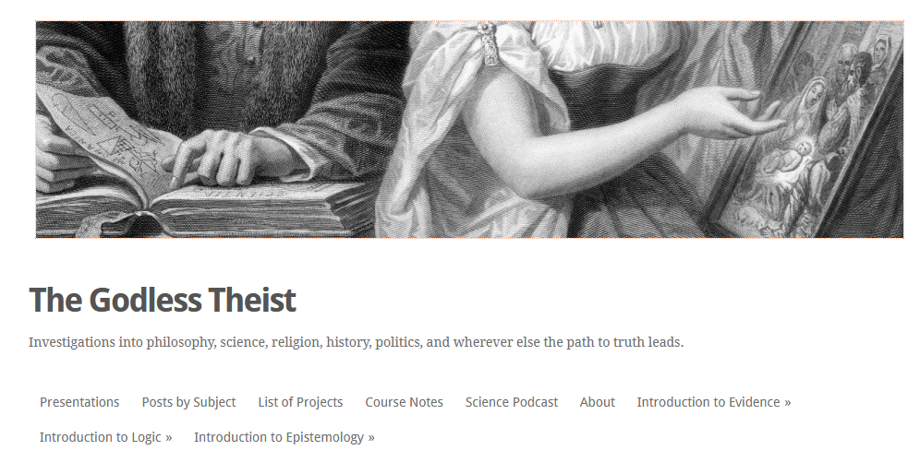
My Blog
Unclear what this adds to the picture
Might affect what is valuable

