Slide 1
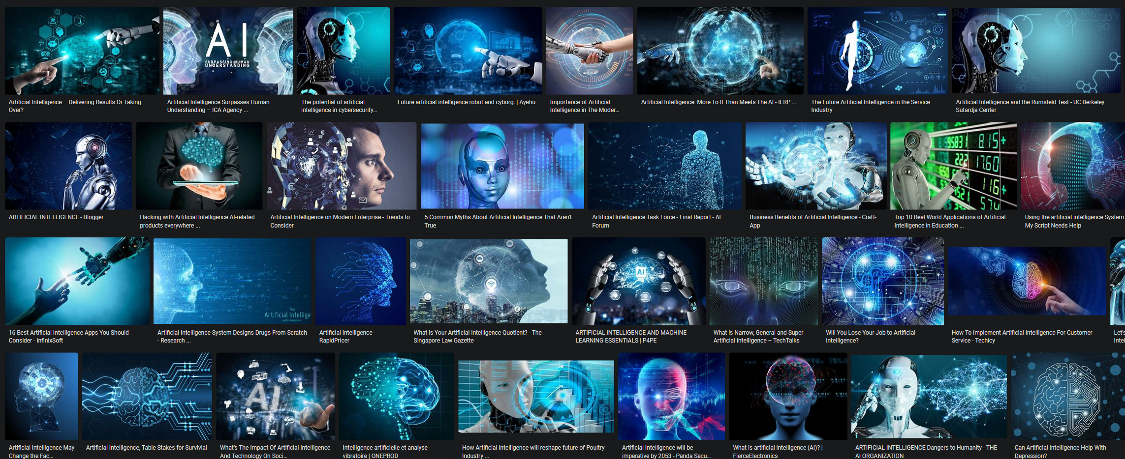
Everything You Wanted to Know about AI but were Afraid to Ask
James Fodor, July 2022

Slide 2
What is AI?
“Artificial intelligence (AI) is intelligence demonstrated by machines, as opposed to the natural intelligence displayed by animals including humans. AI research has been defined as the field of study of intelligent agents, which refers to any system that perceives its environment and takes actions that maximize its chance of achieving its goals.”

Slide 3
What AI is Not
Mimicking human cognition.
Robotics.
Trying to make a conscious machine.
Machine learning.

Slide 4
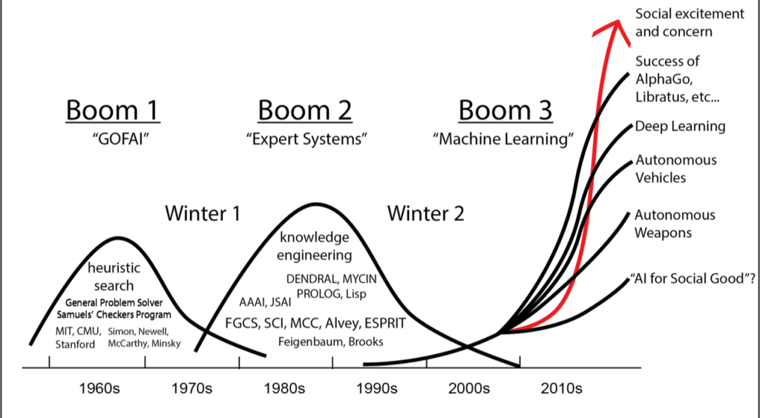
A Short History of AI

Slide 5
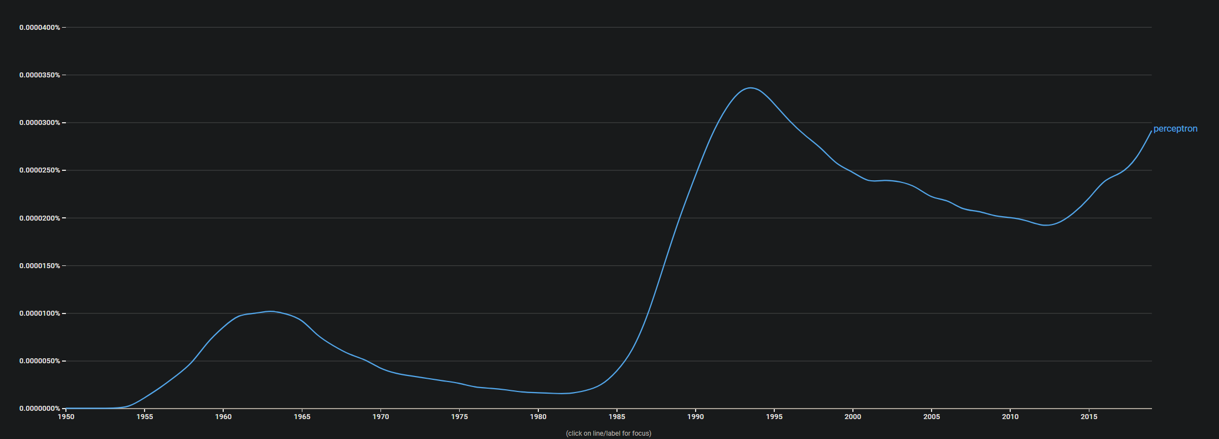
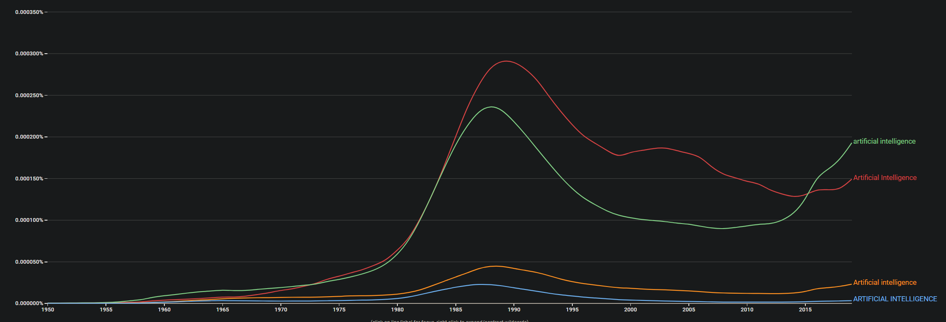
A Short History of AI

Slide 6
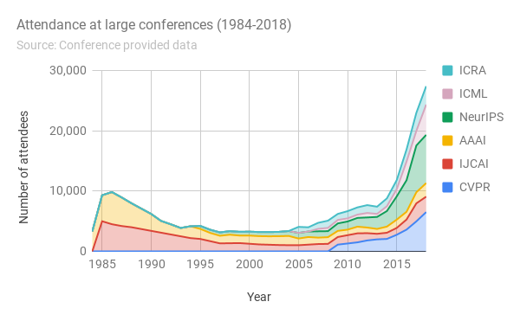
A Short History of AI

Slide 7
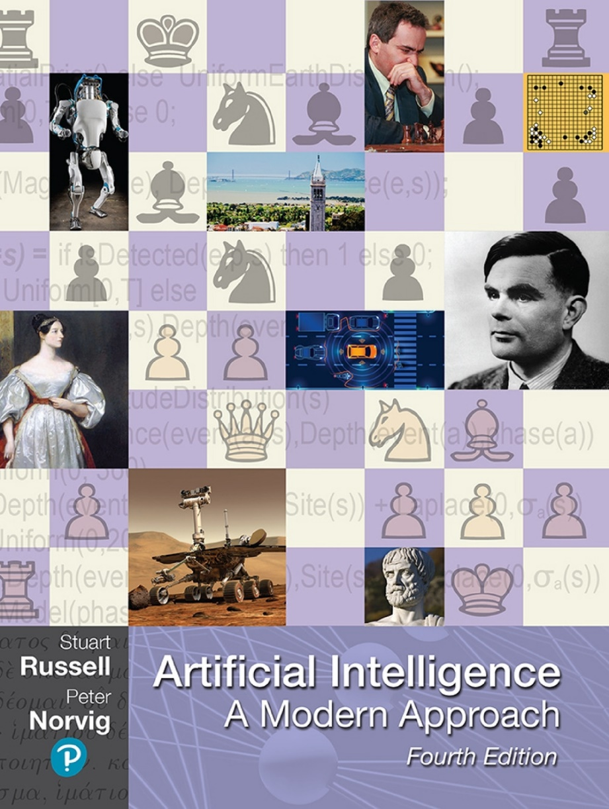
Core Concepts in AI
Search algorithms
Game theory
Logical inference
Bayes theorem
Neural networks
Reinforcement learning

Slide 8
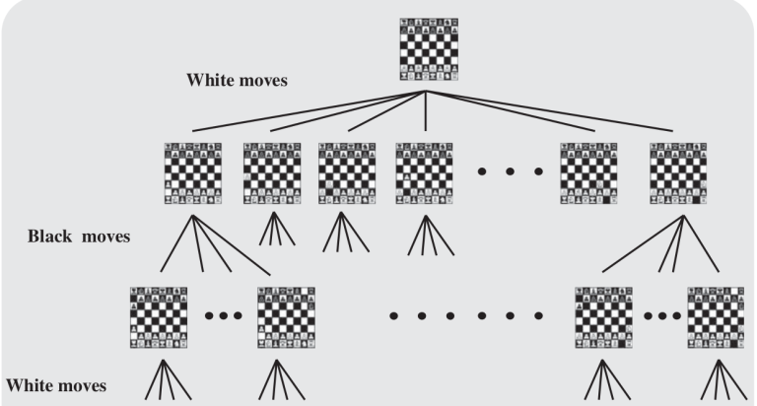
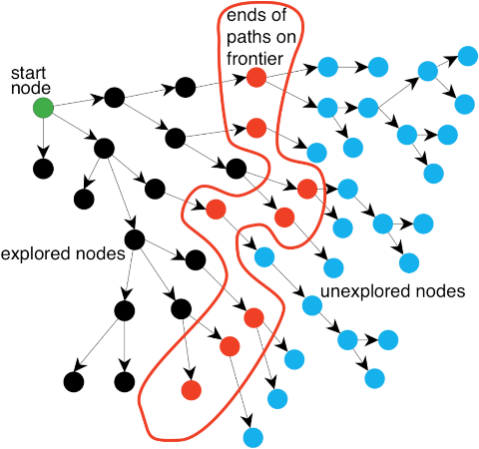
Search Algorithms

Slide 9
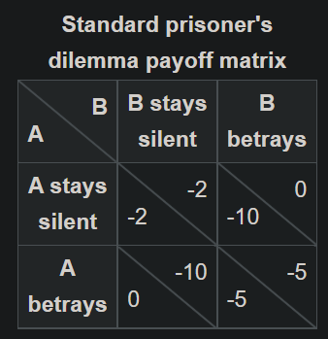
Game Theory

Slide 10
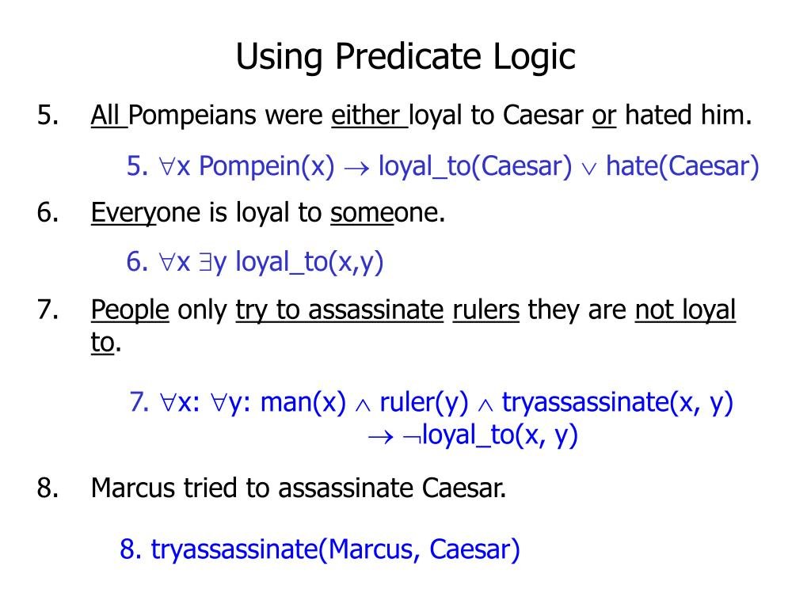
Logical Inference

Slide 11
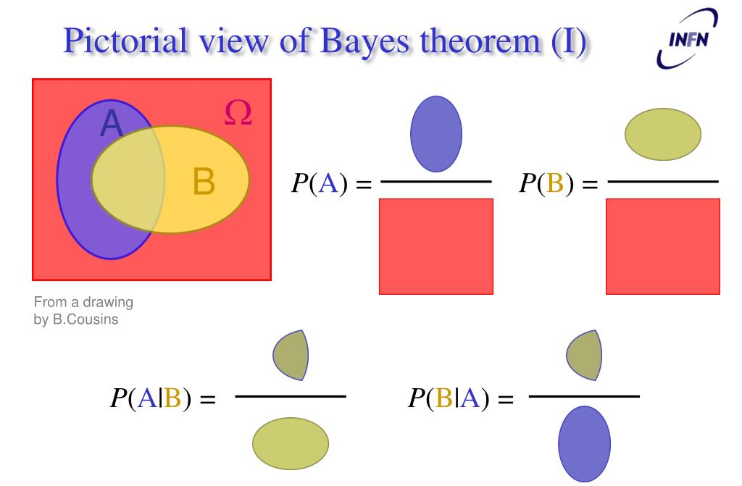
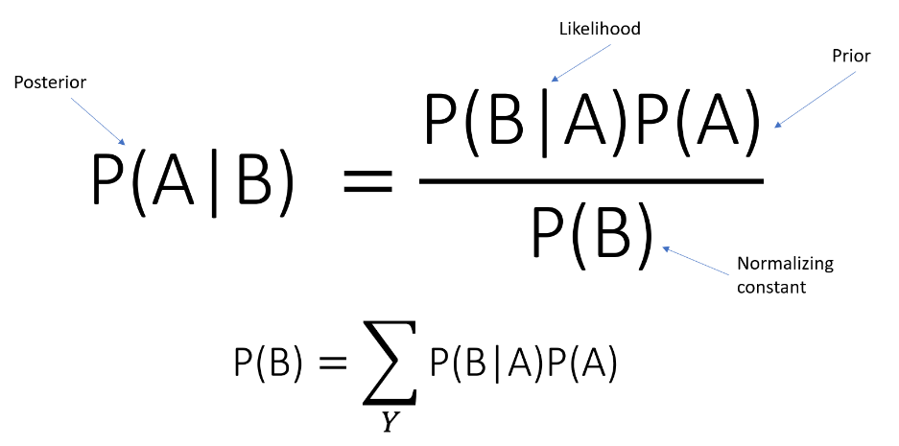
Bayes Theorem

Slide 12
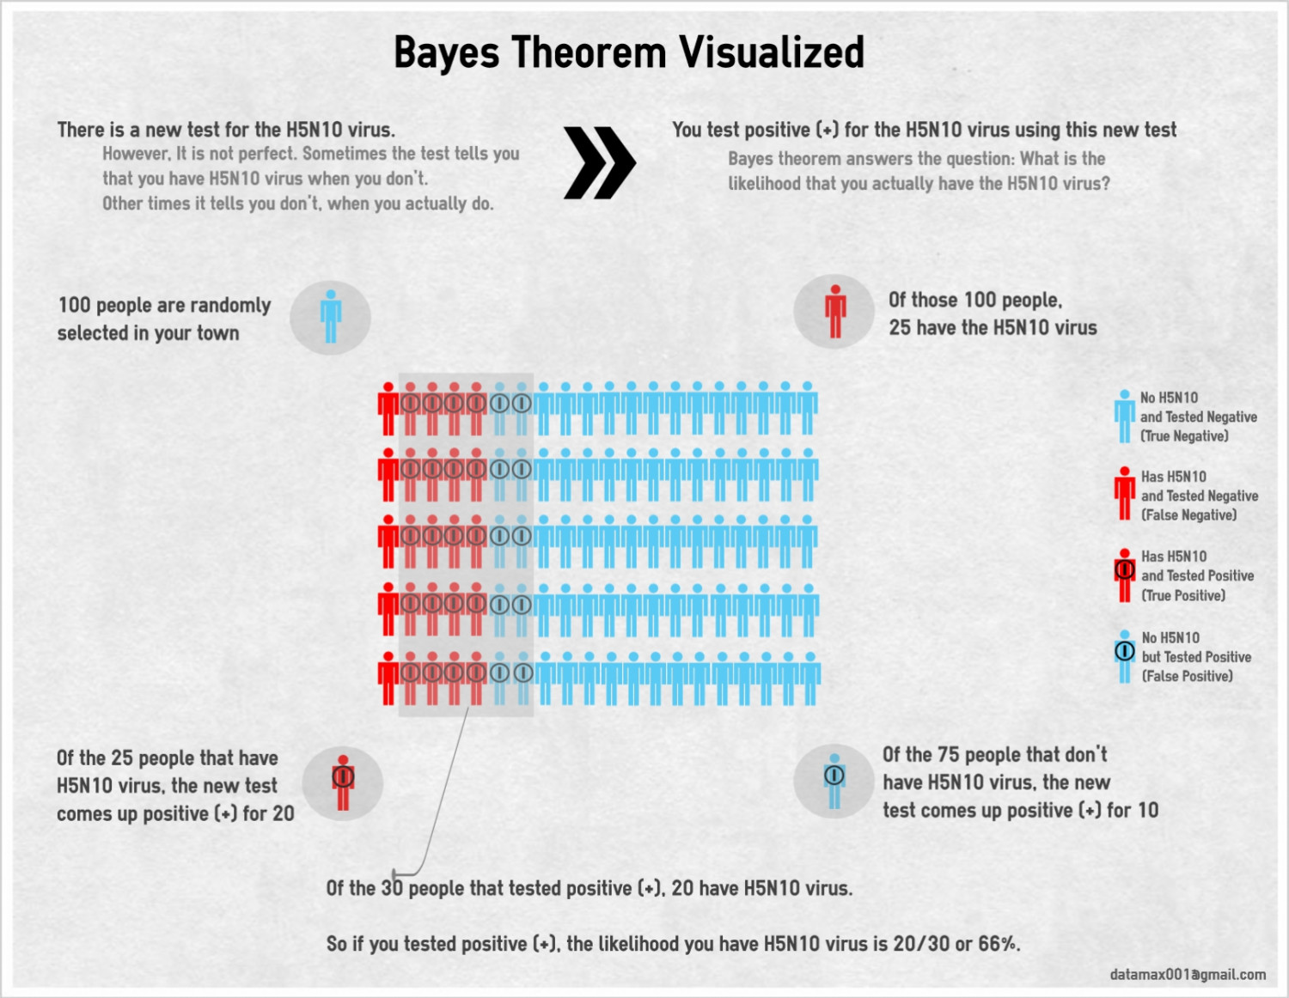
Bayes Theorem

Slide 13
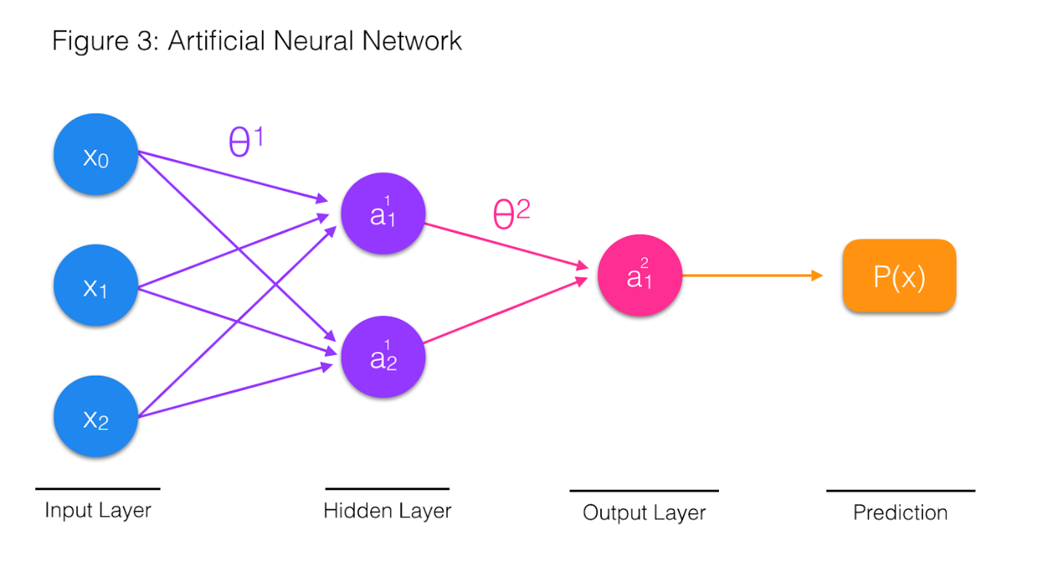
Neural networks

Slide 14
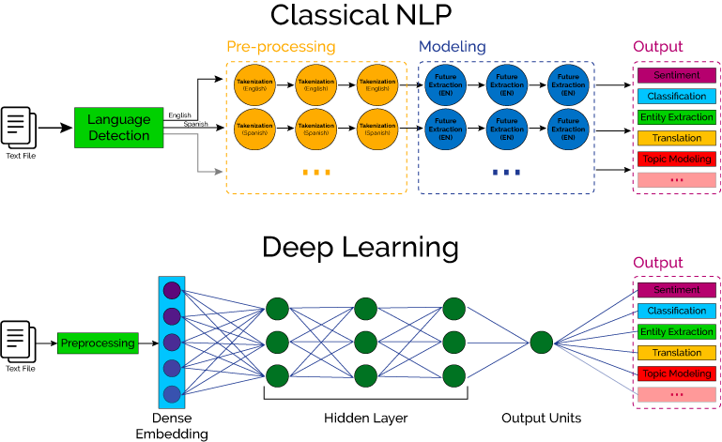
Neural networks

Slide 15
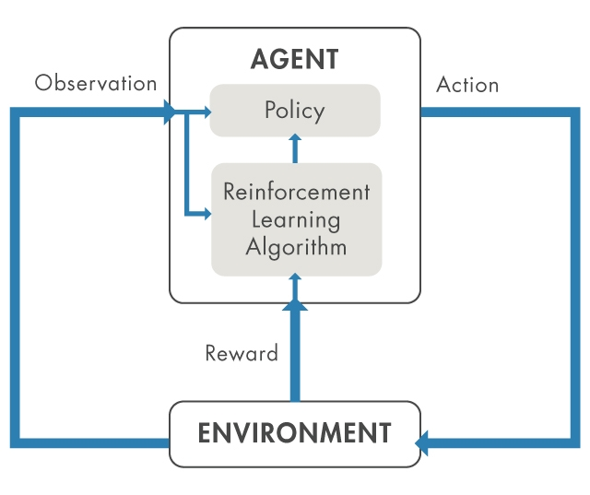
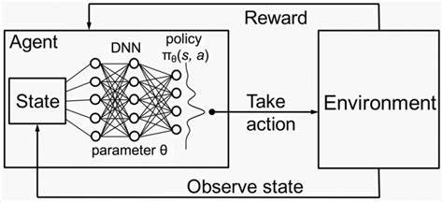
Reinforcement learning

Slide 16
Some Applications
How could we design an algorithm to play chess?
How can we design a search engine?
How can we teach an algorithm to recognise speech?

Slide 17
A technical note: Bayesianism is not logic, statistics is not rationality - EA Forum (effectivealtruism.org)
Complex Systems for AI Safety [Pragmatic AI Safety #3] - EA Forum (effectivealtruism.org)
AGI Ruin: A List of Lethalities - EA Forum (effectivealtruism.org)

