Slide 1

Concept Representation and Compositionality
James Fodor, July 2021

Slide 2
Concept Representation
“A concept can be defined, in neural terms, as a systematic, distributed pattern of activation across a network of cortical regions that occurs when a person
thinks about that concept.”
Vargas, Robert, and Marcel Adam Just. "Neural representations of abstract concepts: Identifying underlying neurosemantic dimensions." Cerebral Cortex 30, no. 4 (2020): 2157-2166.

Slide 3
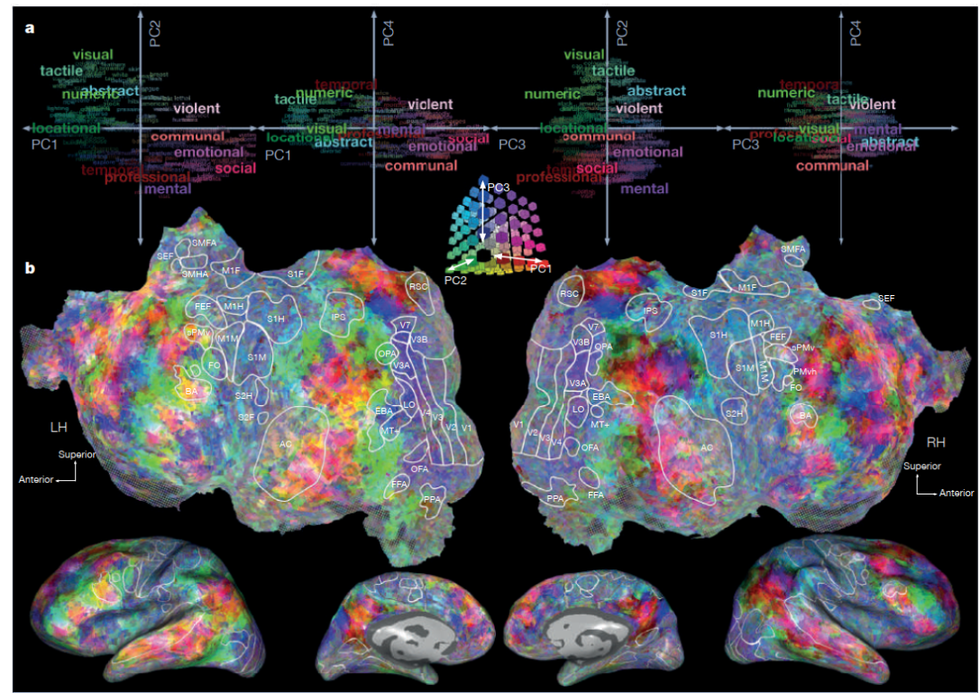
Concept Representation
“A key goal of cognitive neuroscience is to delineate the nature, content, and neuroanatomical distribution of the neural representation of concept knowledge.”
Bauer, Andrew J., and Marcel A. Just. "Neural representations of concept knowledge." The oxford handbook of neurolinguistics (2019): 1-21.
Huth, Alexander G., Wendy A. De Heer, Thomas L. Griffiths, Frédéric E. Theunissen, and Jack L. Gallant. "Natural speech reveals the semantic maps that tile human cerebral cortex." Nature 532, no. 7600 (2016): 453-458.

Slide 4
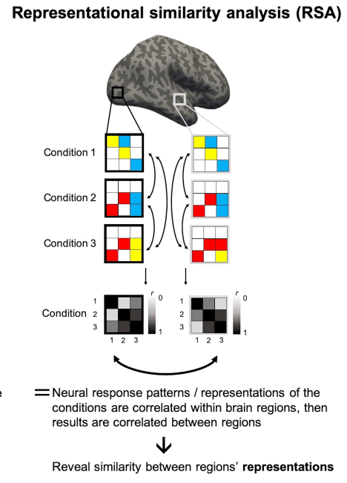
Representational Similarity
Pillet, Ineke, Hans Op de Beeck, and Haemy Lee Masson. "A Comparison of Functional Networks Derived From Representational Similarity, Functional Connectivity, and Univariate Analyses." Frontiers in neuroscience 13 (2020): 1348.

Slide 5
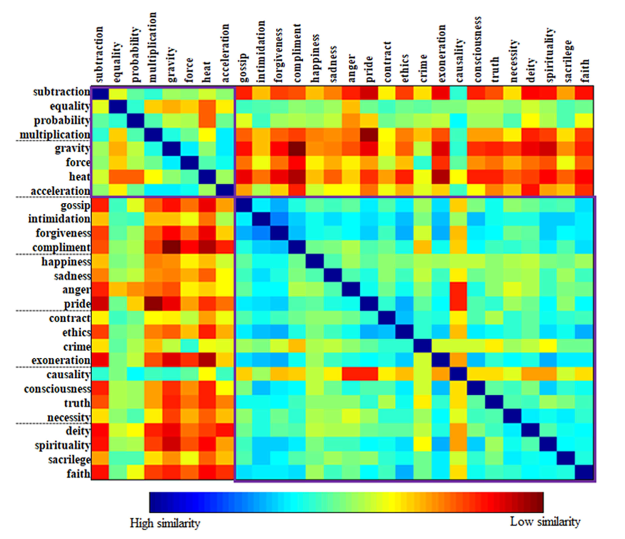
RSA of Abstract Concepts
Vargas, Robert, and Marcel Adam Just. "Neural representations of abstract concepts: Identifying underlying neurosemantic dimensions." Cerebral Cortex 30, no. 4 (2020): 2157-2166.

Slide 6
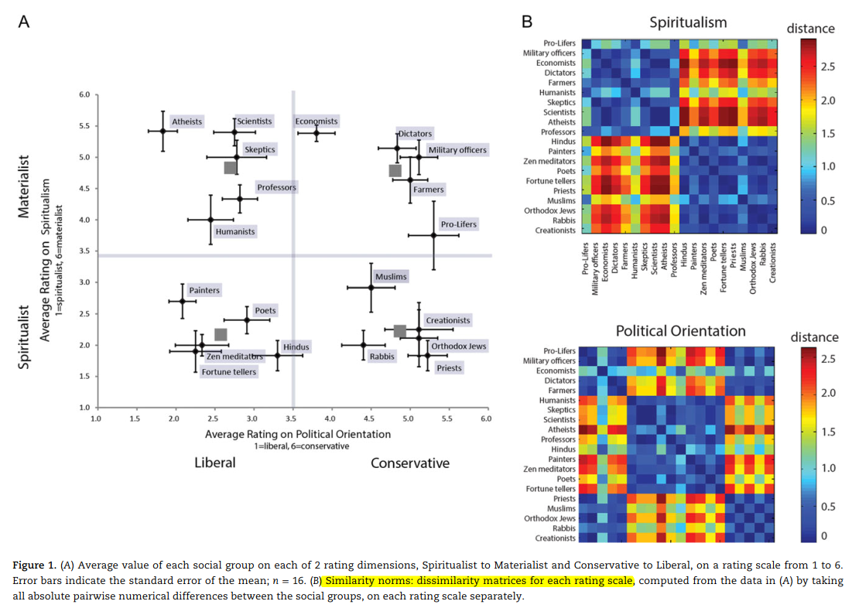
RSA of Abstract Concepts
Leshinskaya, Anna, Juan Manuel Contreras, Alfonso Caramazza, and Jason P. Mitchell. "Neural representations of belief concepts: a representational similarity approach to social semantics." Cerebral Cortex 27, no. 1 (2017): 344-357.

Slide 7
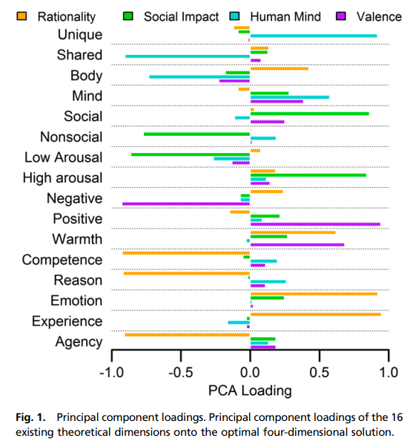
RSA of Abstract Concepts
Tamir, Diana I., Mark A. Thornton, Juan Manuel Contreras, and Jason P. Mitchell. "Neural evidence that three dimensions organize mental state representation: Rationality, social impact, and valence." Proceedings of the National Academy of Sciences 113, no. 1 (2016): 194-199.

Slide 8
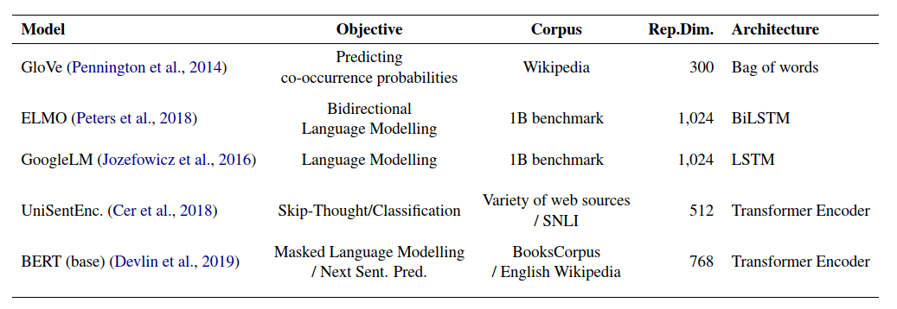
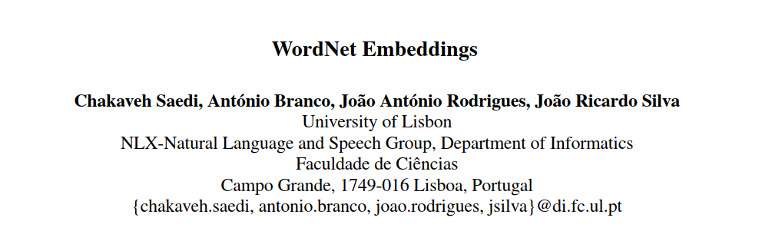
Modelling Concept Representation
Abnar, Samira, Lisa Beinborn, Rochelle Choenni, and Willem Zuidema. "Blackbox meets blackbox: Representational similarity and stability analysis of neural language models and brains." arXiv preprint arXiv:1906.01539 (2019).

Slide 9
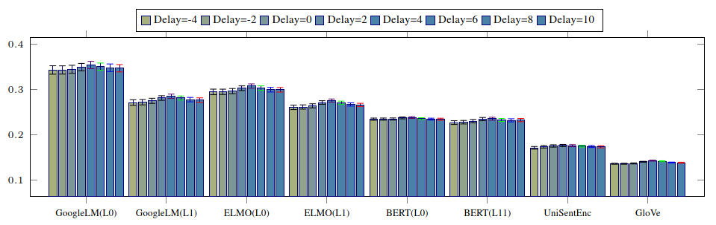
Modelling Concept Representation
Abnar, Samira, Lisa Beinborn, Rochelle Choenni, and Willem Zuidema. "Blackbox meets blackbox: Representational similarity and stability analysis of neural language models and brains." arXiv preprint arXiv:1906.01539 (2019).

Slide 10
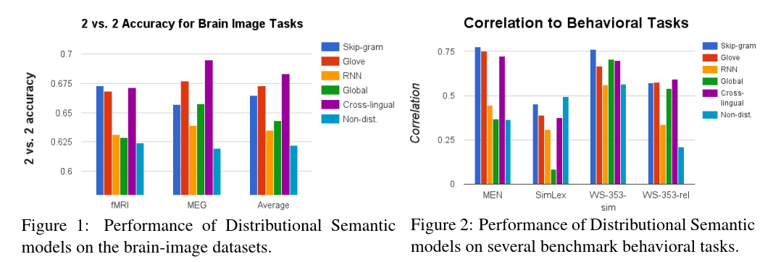
Modelling Concept Representation
Xu, Haoyan, Brian Murphy, and Alona Fyshe. "Brainbench: A brain-image test suite for distributional semantic models." In Proceedings of the 2016 Conference on Empirical Methods in Natural Language Processing, pp. 2017-2021. 2016.

Slide 11
Compositionality
“Compositionality typically refers to the property that meanings of composed structures are a function
of the meanings of constituent units and the rules used to combine those units into that structure. For example, we combine individual words like ‘Jane’, ‘goes to’ and ‘the store’ to form the sentence ‘Jane goes to the store’.”
Martin, Andrea E., and Leonidas AA Doumas. "Tensors and compositionality in neural systems." Philosophical Transactions of the Royal Society B 375, no. 1791 (2020): 20190306.

Slide 12
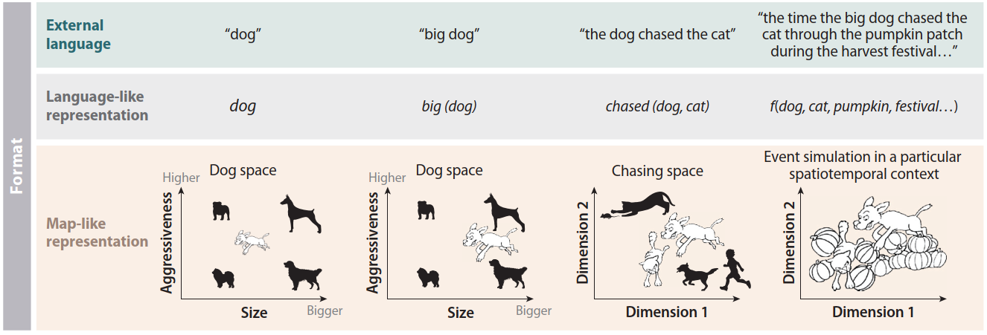
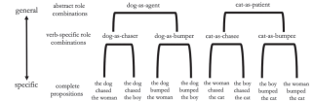
Symbolic vs Distributed
Frankland, Steven M., and Joshua D. Greene. "Concepts and compositionality: in search of the brain's language of thought." Annual review of psychology 71 (2020): 273-303.
Frankland, Steven M., and Joshua D. Greene. "Two ways to build a thought: distinct forms of compositional semantic representation across brain regions." Cerebral Cortex 30, no. 6 (2020): 3838-3855.

Slide 13
Problems for Distributed Models
“The best algorithms require tremendous amounts of training data and struggle with generalization... (and) have been long criticized for lacking systematic compositionality… recent work evaluated contemporary neural networks and found they still fail tests of compositionality.”
Lake, Brenden M., Tal Linzen, and Marco Baroni. "Human few-shot learning of compositional instructions." arXiv preprint arXiv:1901.04587 (2019).

Slide 14
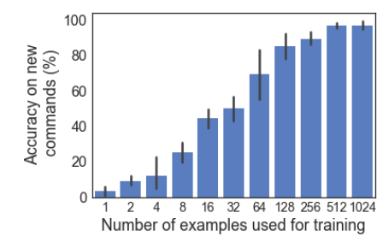
Problems for Distributed Models
Loula, Joao, Marco Baroni, and Brenden M. Lake. "Rearranging the familiar: Testing compositional generalization in recurrent networks." arXiv preprint arXiv:1807.07545 (2018).

Slide 15
Models of Compositionality
Neural blackboard architectures
Binding by synchrony
Tensor product representations
Holographic reduced representations
Recurrent neural network models

Slide 16
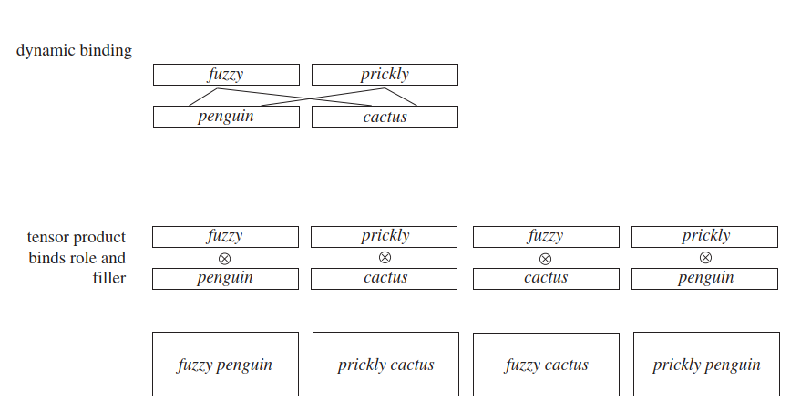
Models of Compositionality
Martin, Andrea E., and Leonidas AA Doumas. "Tensors and compositionality in neural systems." Philosophical Transactions of the Royal Society B 375, no. 1791 (2020): 20190306.

Slide 17
Some Questions
How to bind variables into a single representation?
How are abstract syntactic rules instantiated in the brain?
Do individual terms have invariant representations in each composite structure?
How are novel phrases or concepts understood with no prior learning (systematicity)?

Slide 18
Testing Compositional Models
Compositional models need to be tested along with conceptual embeddings.
Test RNN models based on generalisation accuracy.
Compare with similarity judgements of human subjects.
RSA with fMRI data where subjects view videos or sentences.
Accuracy or time taken by human subjects in applying novel syntactic rules?

Slide 19
References
Abnar, Samira, Lisa Beinborn, Rochelle Choenni, and Willem Zuidema. "Blackbox meets blackbox: Representational similarity and stability analysis of neural language models and brains." arXiv preprint arXiv:1906.01539 (2019).
Bauer, Andrew J., and Marcel A. Just. "Neural representations of concept knowledge." The oxford handbook of neurolinguistics (2019): 1-21.
Frankland, Steven M., and Joshua D. Greene. "Concepts and compositionality: in search of the brain's language of thought." Annual review of psychology 71 (2020): 273-303.
Frankland, Steven M., and Joshua D. Greene. "Two ways to build a thought: distinct forms of compositional semantic representation across brain regions." Cerebral Cortex 30, no. 6 (2020): 3838-3855.
Huth, Alexander G., Wendy A. De Heer, Thomas L. Griffiths, Frédéric E. Theunissen, and Jack L. Gallant. "Natural speech reveals the semantic maps that tile human cerebral cortex." Nature 532, no. 7600 (2016): 453-458.
Leshinskaya, Anna, Juan Manuel Contreras, Alfonso Caramazza, and Jason P. Mitchell. "Neural representations of belief concepts: a representational similarity approach to social semantics." Cerebral Cortex 27, no. 1 (2017): 344-357.
Loula, Joao, Marco Baroni, and Brenden M. Lake. "Rearranging the familiar: Testing compositional generalization in recurrent networks." arXiv preprint arXiv:1807.07545 (2018).
Pillet, Ineke, Hans Op de Beeck, and Haemy Lee Masson. "A Comparison of Functional Networks Derived From Representational Similarity, Functional Connectivity, and Univariate Analyses." Frontiers in neuroscience 13 (2020): 1348.
Martin, Andrea E., and Leonidas AA Doumas. "Tensors and compositionality in neural systems." Philosophical Transactions of the Royal Society B 375, no. 1791 (2020): 20190306.
Tamir, Diana I., Mark A. Thornton, Juan Manuel Contreras, and Jason P. Mitchell. "Neural evidence that three dimensions organize mental state representation: Rationality, social impact, and valence." Proceedings of the National Academy of Sciences 113, no. 1 (2016): 194-199.
Vargas, Robert, and Marcel Adam Just. "Neural representations of abstract concepts: Identifying underlying neurosemantic dimensions." Cerebral Cortex 30, no. 4 (2020): 2157-2166.
Xu, Haoyan, Brian Murphy, and Alona Fyshe. "Brainbench: A brain-image test suite for distributional semantic models." In Proceedings of the 2016 Conference on Empirical Methods in Natural Language Processing, pp. 2017-2021. 2016.

