Slide 1
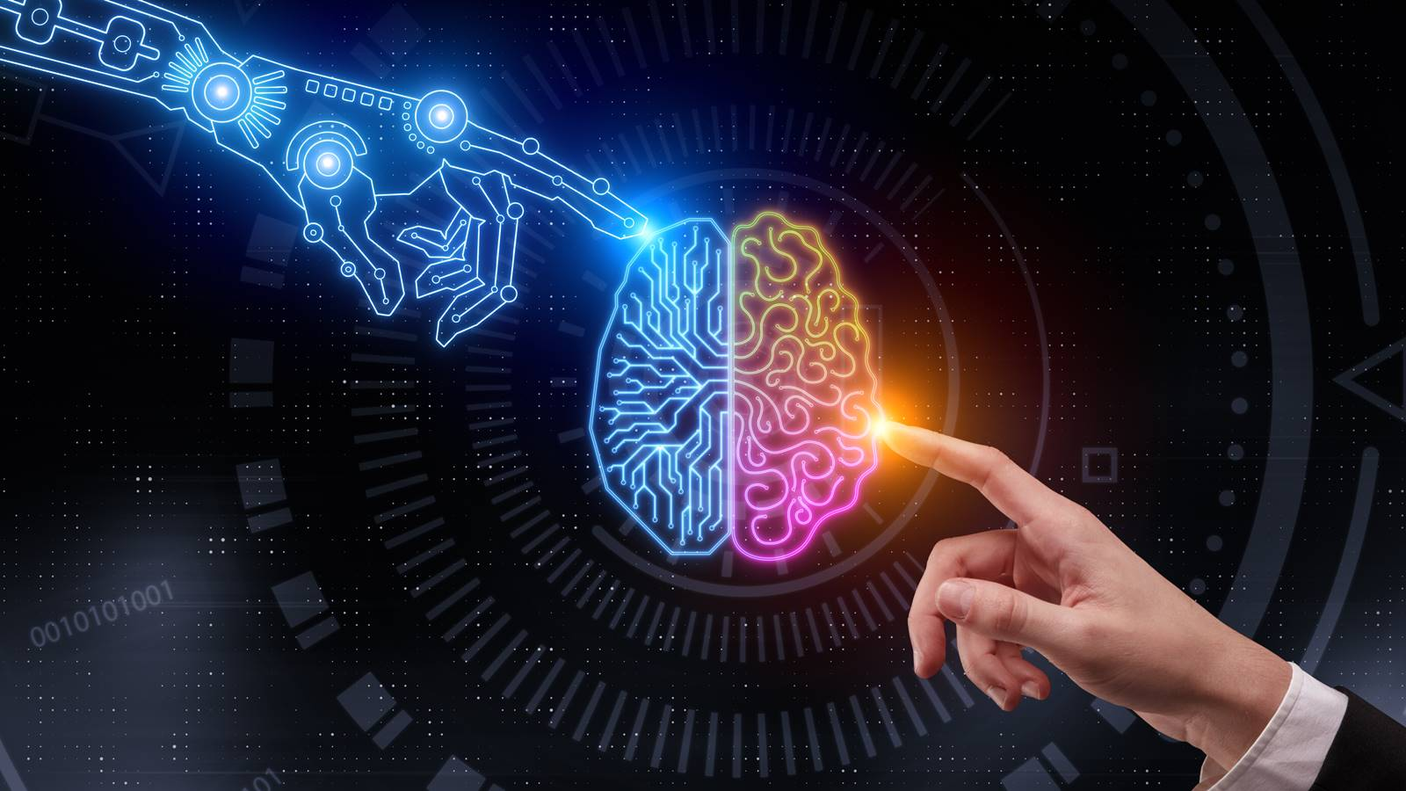
Human vs Machine Learning
James Fodor, July 2022

Slide 2

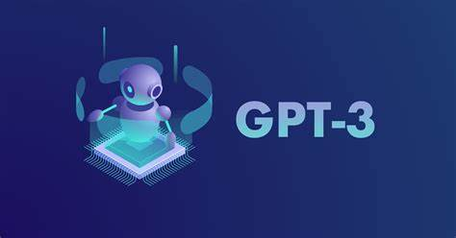
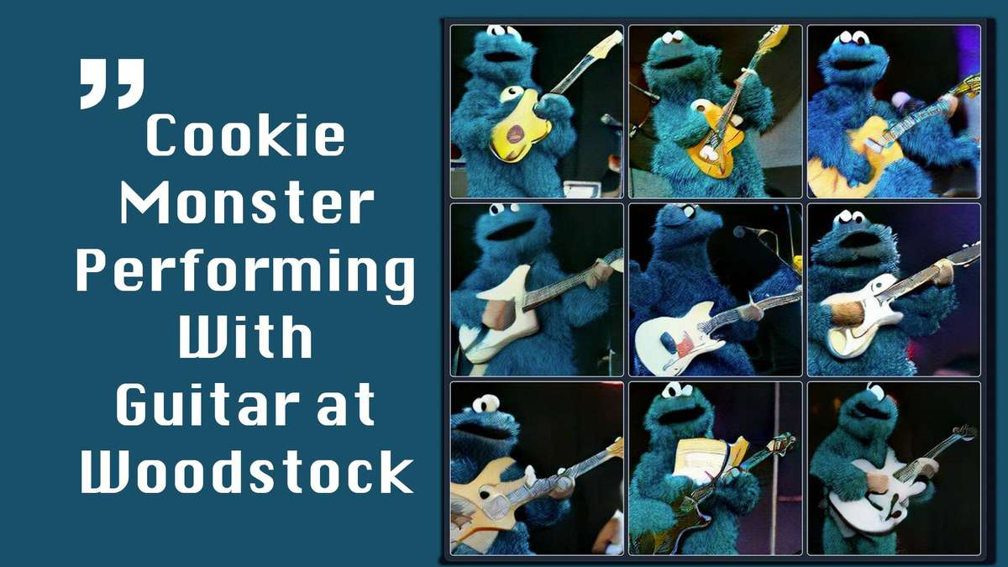

Modern AIs are Impressive

Slide 3


Do AIs Think like Humans?
Human-like performance doesn’t imply human-like thinking.

Slide 4
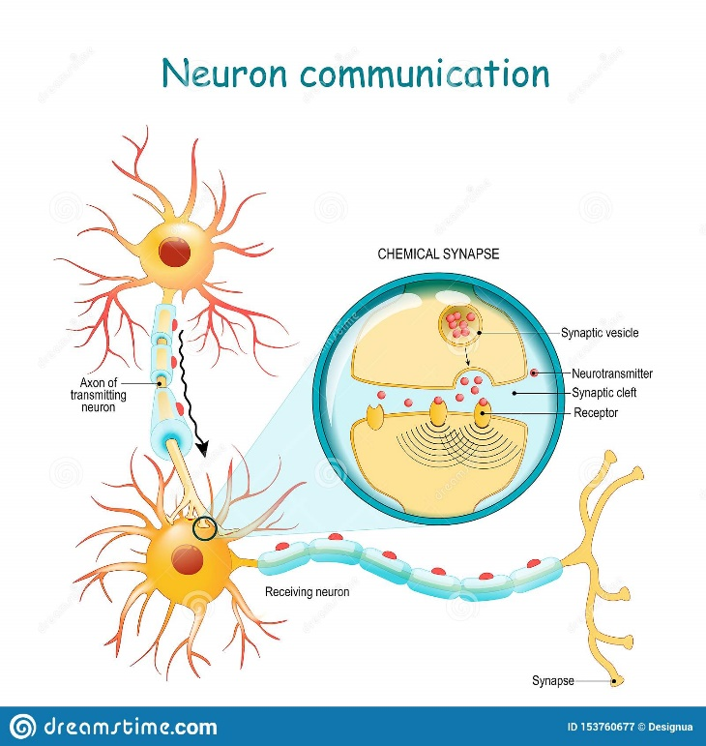
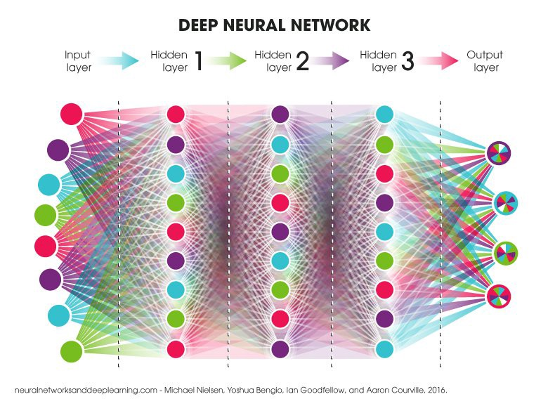
Artificial vs Biological NNs
Artificial neural networks are inspired by biological networks of neurons, but are very different.

Slide 5
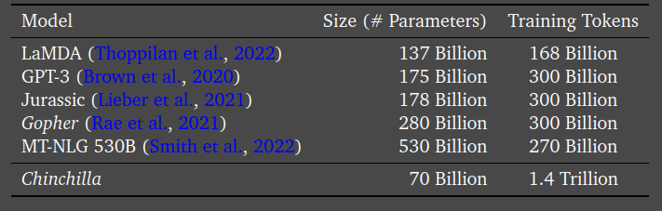
1. Training Data
Most AI models use way more training data than is plausible for humans.
Humans 150 Trillion < 1 Billion

Slide 6
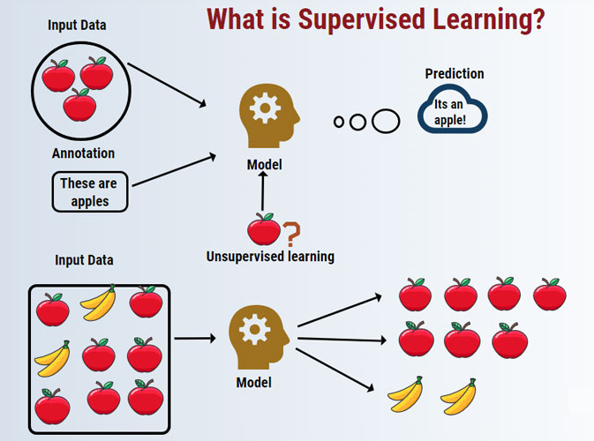
2. Supervised Learning
AI models are told the answer – humans usually aren’t.

Slide 7
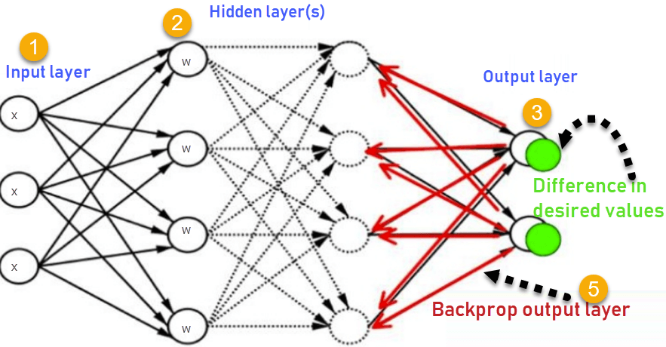
3. Backpropogation
AIs learn using backpropogation, which isn’t plausible in the brain.

Slide 8
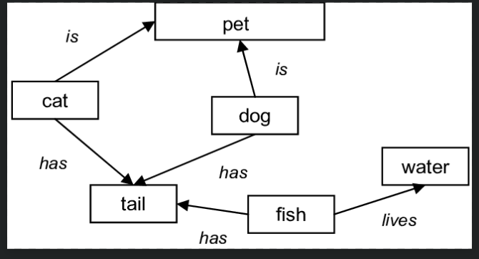
4. Structured Knowledge
Humans represent knowledge in terms of richly structured relations, which AIs often do not learn.

Slide 9
Summary
Compared to humans, current AI:
Rely on much more training data.
Use supervised learning.
Use backpropogation.
Don’t form structured knowledge.

Slide 10
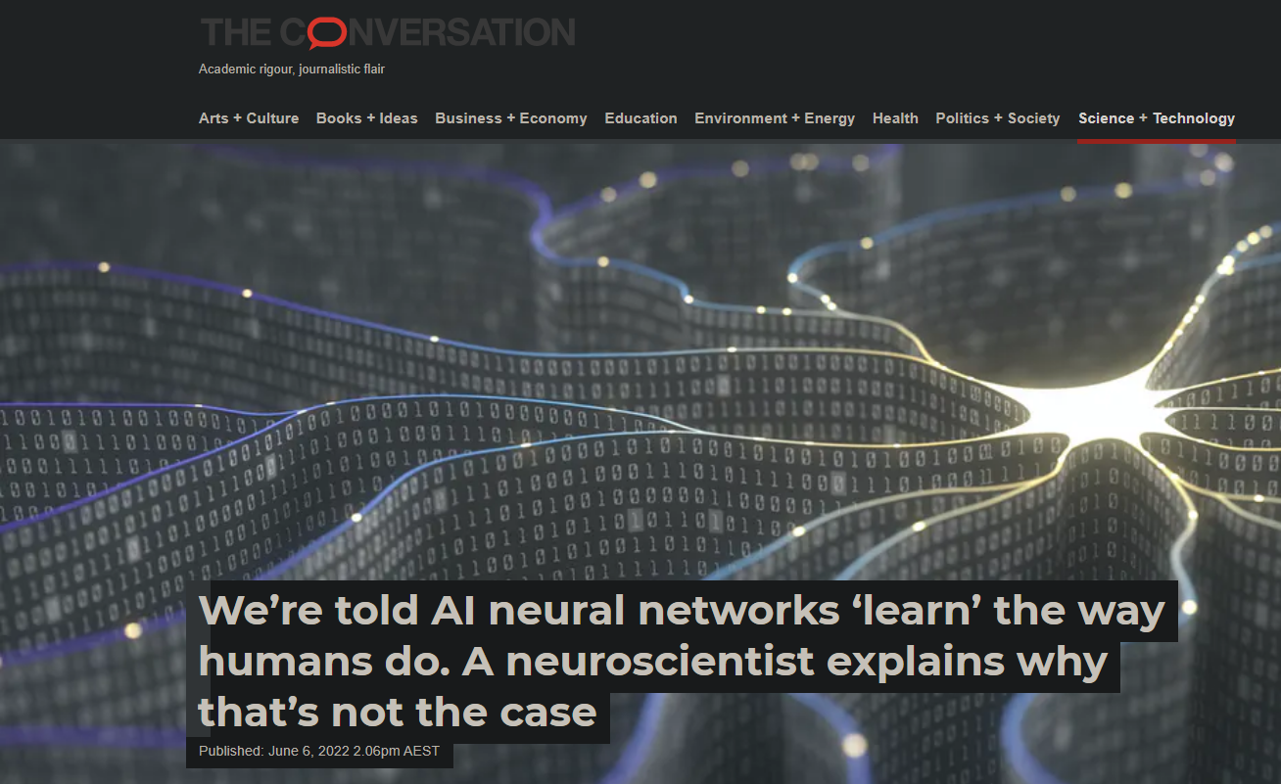
Discussion/Questions?
We still have much to learn about how humans represent and process information.
We're told AI neural networks 'learn' the way humans do. A neuroscientist explains why that's not the case (theconversation.com)

