Slide 1
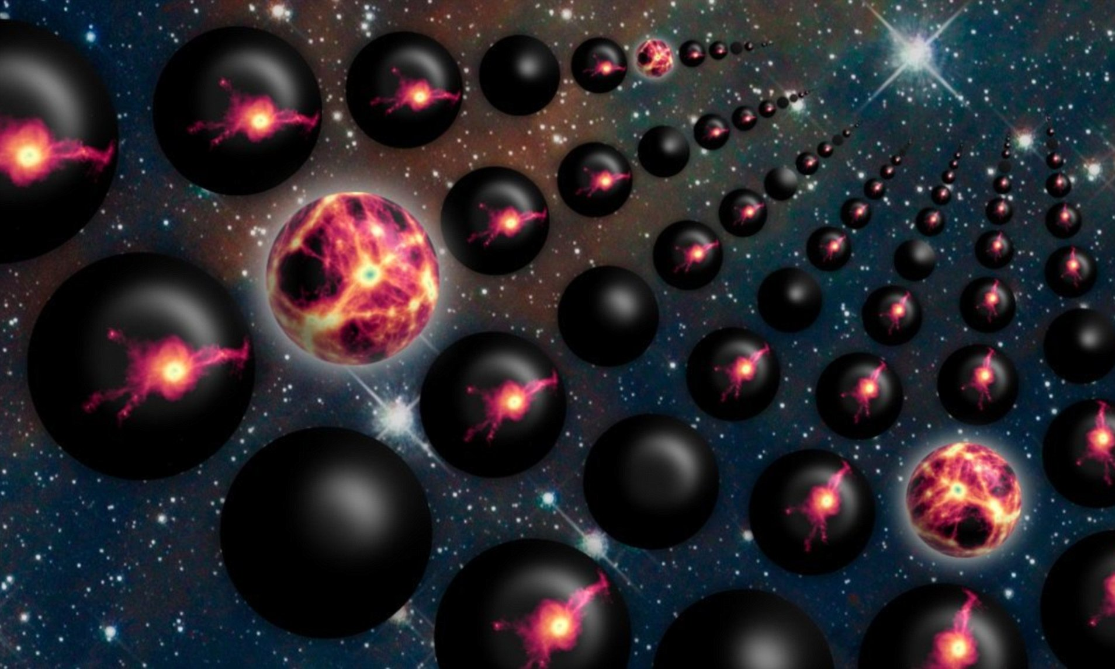
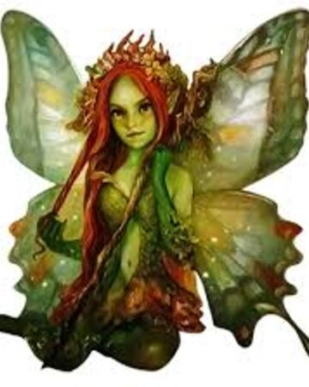
Fine-Tuning:
A Critical Examination
James Fodor, Apr 2021

Slide 2
The Fine-Tuning Argument
The constants of nature are fine-tuned for embodied agents.
The best explanation for this is that the constants were chosen by a designer God.
Therefore, we have strong reason to believe that a designer God exists.

Slide 3
Is Nature Fine-Tuned?
Need to know the conditions for the existence of embodied agents.
Need to know in what proportion of possible universes the conditions would be satisfied.

Slide 4
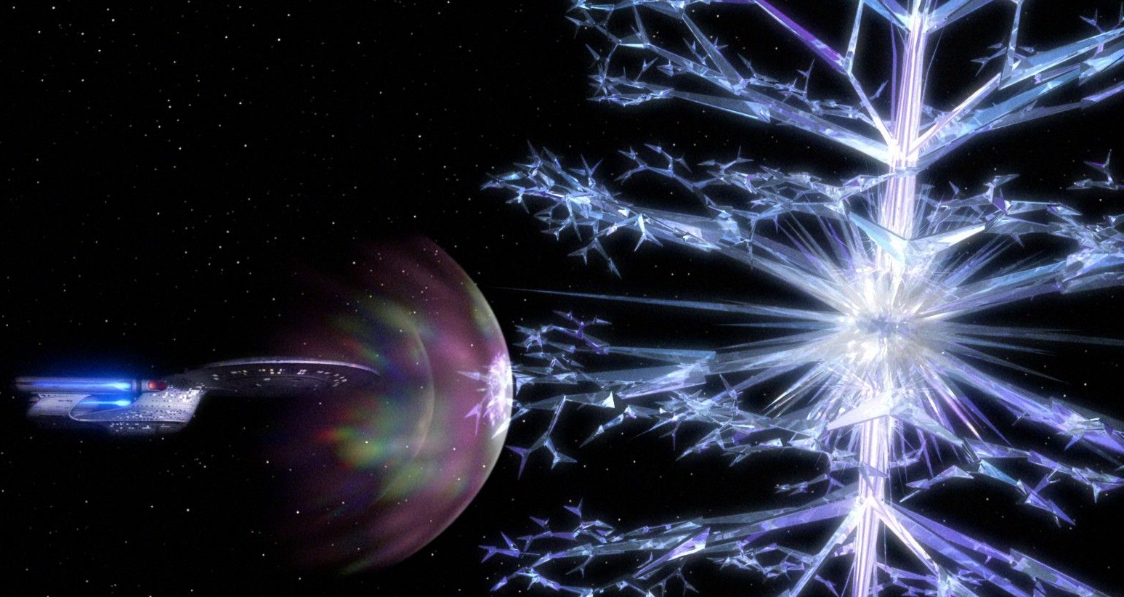
The Problem of Exotic Life
We don’t know the necessary conditions for life.
We have no idea what other universes would be like.

Slide 5
Some Types of Exotic Life
Silicon life
Non-water solvents
Sulfurous life
Metallic life
Crystalline entities
Life waves in dust clouds
Neutron-based life
Weak force bound states
Alternative bound states of strong force
Gravitationally-bound life
Photonic life form
Dark matter life
Life at the quantum scale
Life in heavier generations of matter
Supersymmetric particles

Slide 6
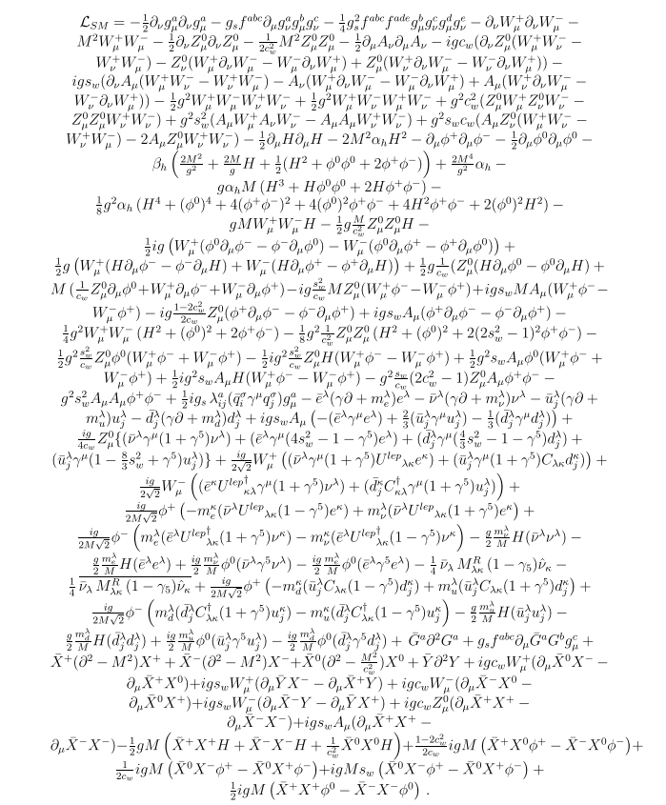
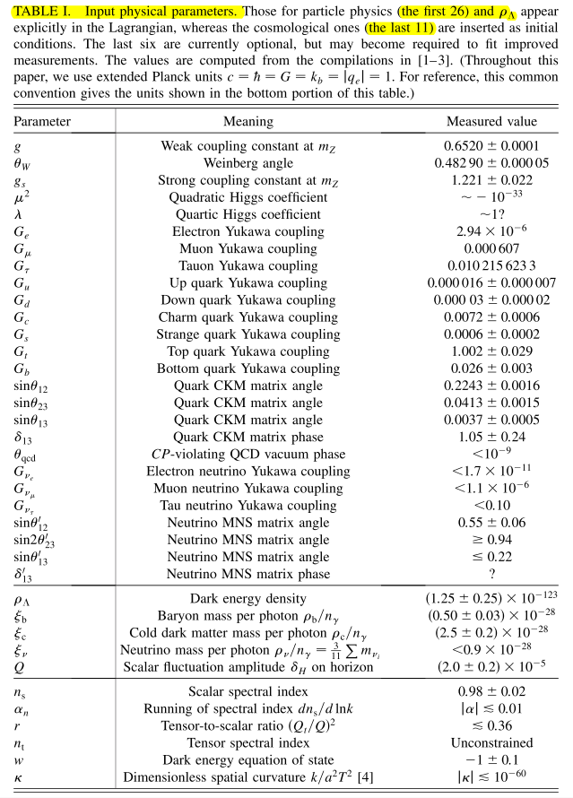
The Laws are Complex
Matilde Marcolli
From Matilde Marcolli

Slide 7
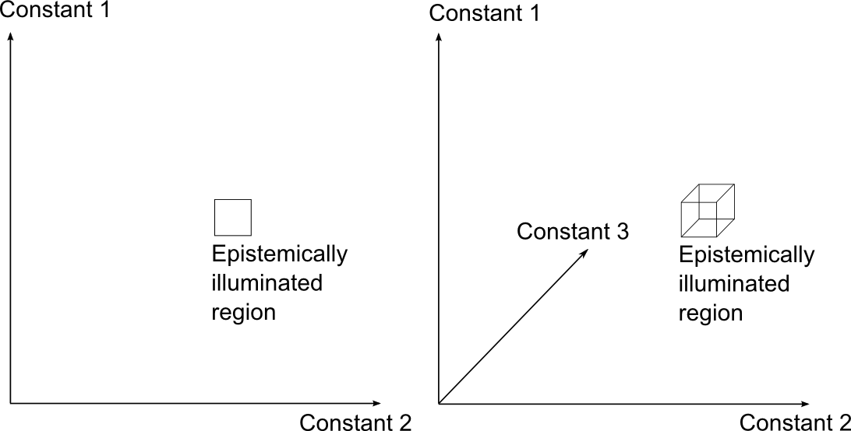
The Dimensionality Problem
More constants, more problems.

Slide 8
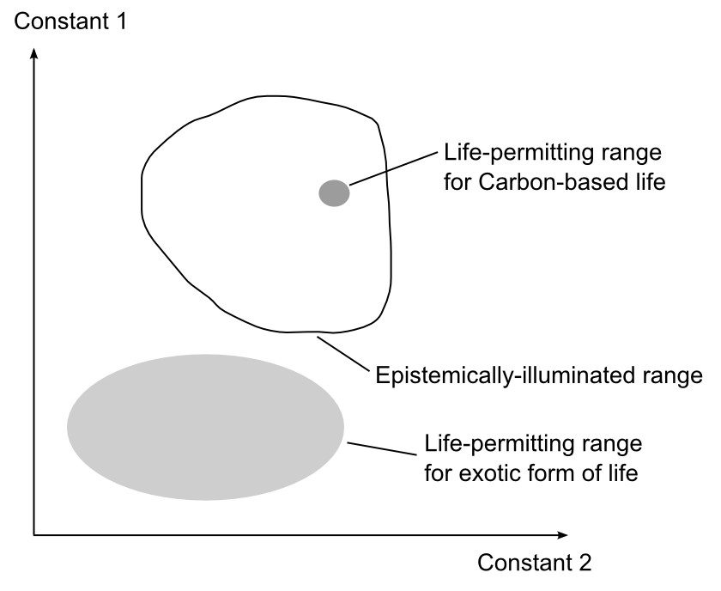
The Representativeness Problem
No reason to think local reason is representative.

Slide 9
Comparing Explanations
If the universe is fine-tuned, possible explanations include:
Necessity
Multiverse
Unknown mechanism
God
Alternative non-natural hypotheses

Slide 10
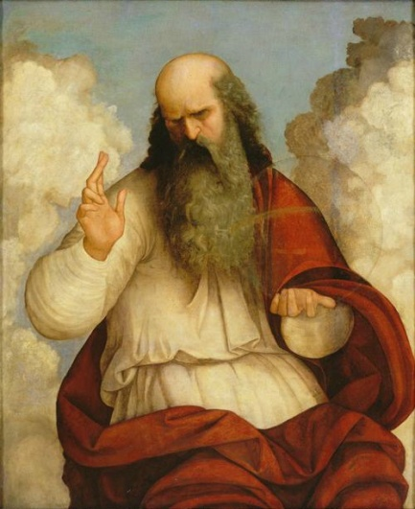
A Proposal: Pixies
Attribute | God | Pixies
Number | Three | Many
Physicality | Non-physical; manifested once in Jesus | Non-physical; like to manifest in various times and places
Morality | Omnibenevolent | Ambiguous; ticksters
Potencies | Omnipotent | Limited
Knowledge | Omniscient | Limited

Slide 11
Problems with God
Why create anything? – Divine aseity
Why create minds? – Good-making properties
Why create embodied minds? – Electrons in love
Why create a fine-tuned universe? – Miracles

Slide 12
Problems with God
Universe is mostly empty.
Universe is extremely old.
Universe is suffused with suffering.

Slide 13
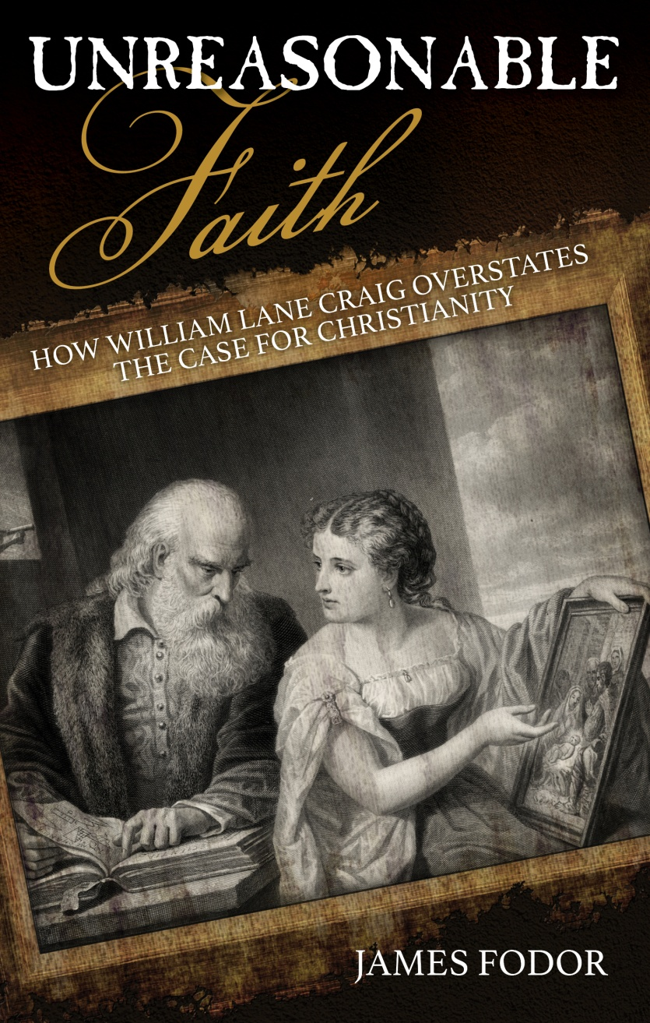
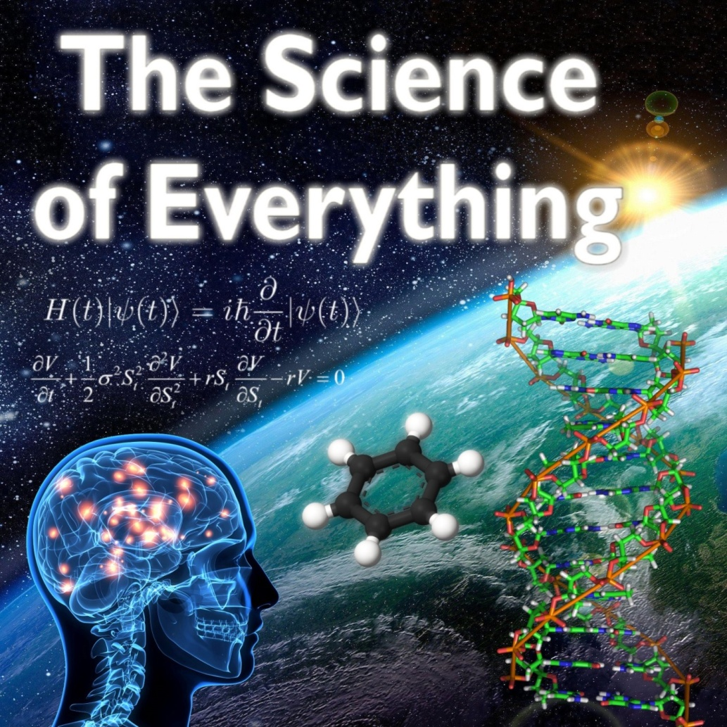
My Book and Podcast

