Slide 1


And Its Critics
James Fodor, July 2022

Slide 2
Criticism of EA
Effective Altruism is a very controversial movement.
Almost every aspect of EA is contested by someone.
Here we will focus on more fundamental philosophical disagreements.
Focus is on understanding not (just) rebutting.
What I call ‘the EA view’ = a common view among EAs, not universal or official view.

Slide 3
Four ‘Isms’ Common in EA
Naturalism
Humeanism
Welfarism
Individualism

Slide 4
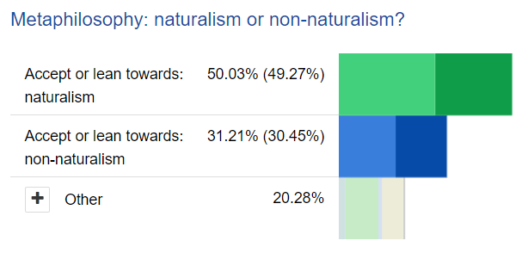
Naturalism
The natural world all there is. Reality is exhausted by nature.
EA view (Naturalism): no Gods, spirits, magic, etc.
Who disagrees: religious believers, spiritualists, panpsychists, dualists.
Relevant for: debates about far future, afterlife, ethics, treatment of animals.
Naturalism (Stanford Encyclopedia of Philosophy)

Slide 5
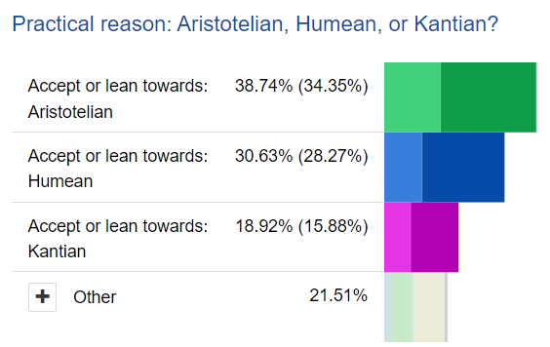
Humeanism
Belief is never sufficient for motivation. Also need a desire (or ‘passion’).
EA view (Humeanism): belief is never sufficient for motivation; also require some desire/passion. (Skeptical of practical rationality).
Who disagrees: philosophers (Parfit, Landau) who think preferences are subject to rational reflection.
Relevant for: some AI alignment debates, EA outreach strategies, theories of rationality.
Moral Motivation (Stanford Encyclopedia of Philosophy)

Slide 6
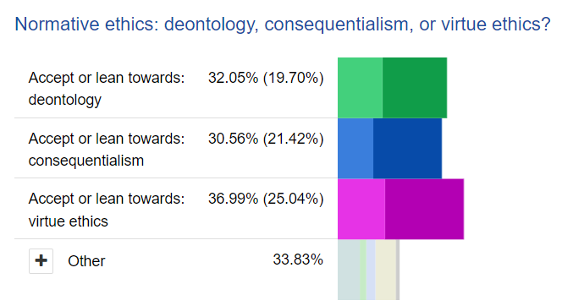
Welfarism
The only thing that is intrinsically morally significant is improving welfare.
EA view (Welfarism): only welfare/wellbeing has intrinsic moral value. Equity is only valuable insofar as it adds to total welfare.
Who disagrees: those focused on most marginalised (e.g. Rawls), egalitarians, desert-based theories.
Relevant for: cause prioritisation, methods of evaluation, global poverty, animal ethics.
Distributive Justice (Stanford Encyclopedia of Philosophy)

Slide 7
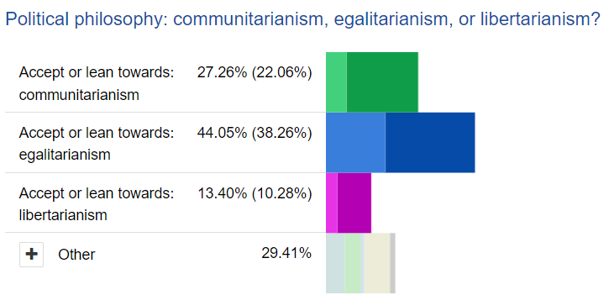
Individualism
The relevant actor/agent to consider for making positive change is the individual or voluntary group.
EA view (Individualism): we should primarily think at the margin about the good we can do as individuals or small groups.
Who disagrees: socialists, communitarians, advocates of critical theory, social democrats.
Relevant for: case prioritisation, evaluation of efficacy, relevance of politics.
Communitarianism (Stanford Encyclopedia of Philosophy)

Slide 8

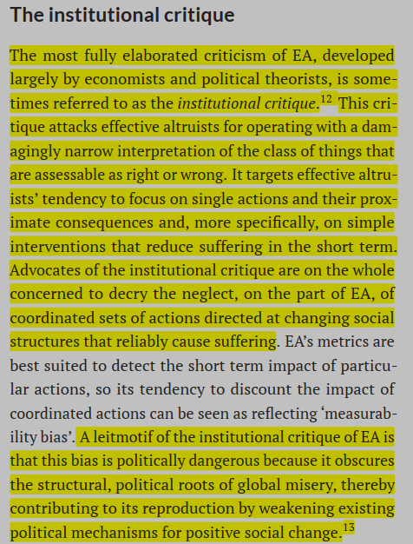

Slide 9
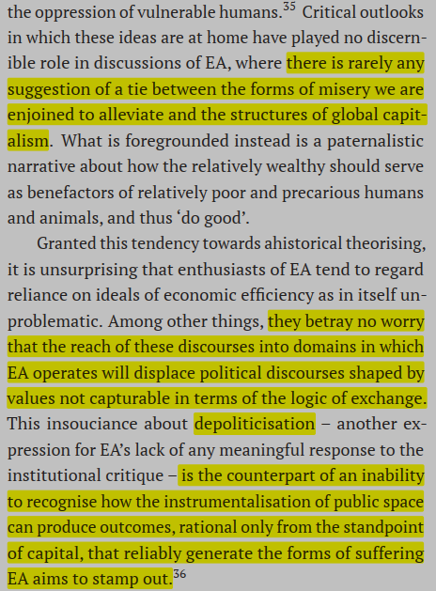

Slide 10
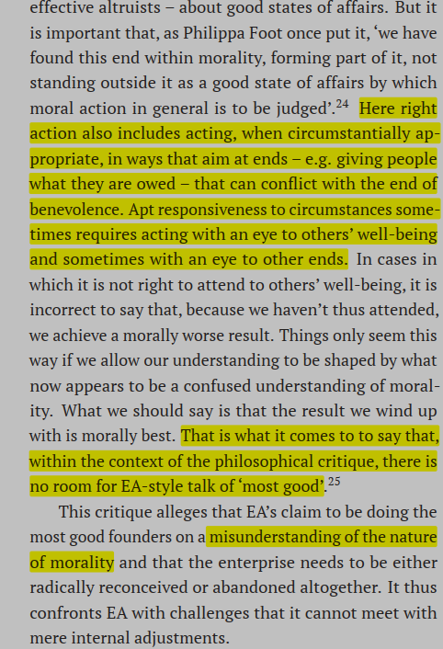

Slide 11
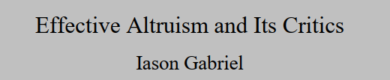
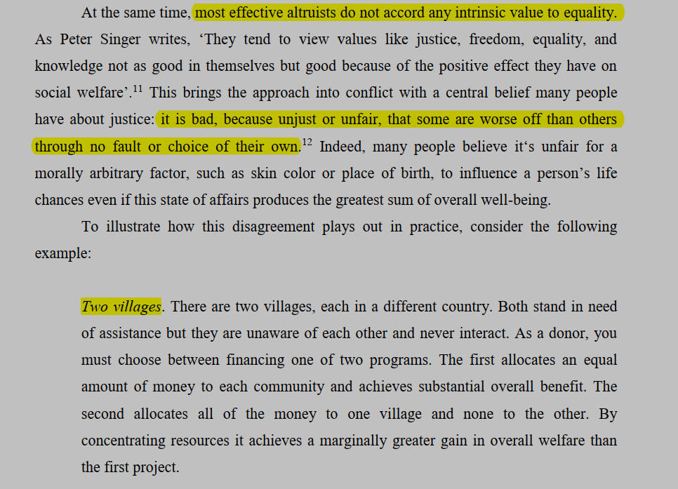

Slide 12
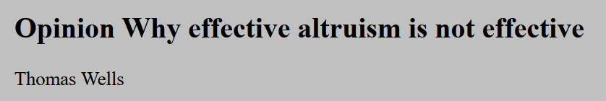
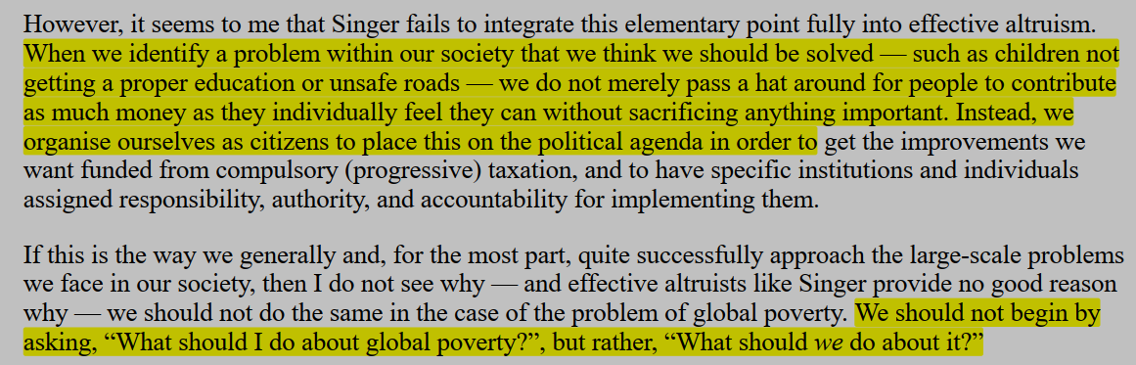

Slide 13
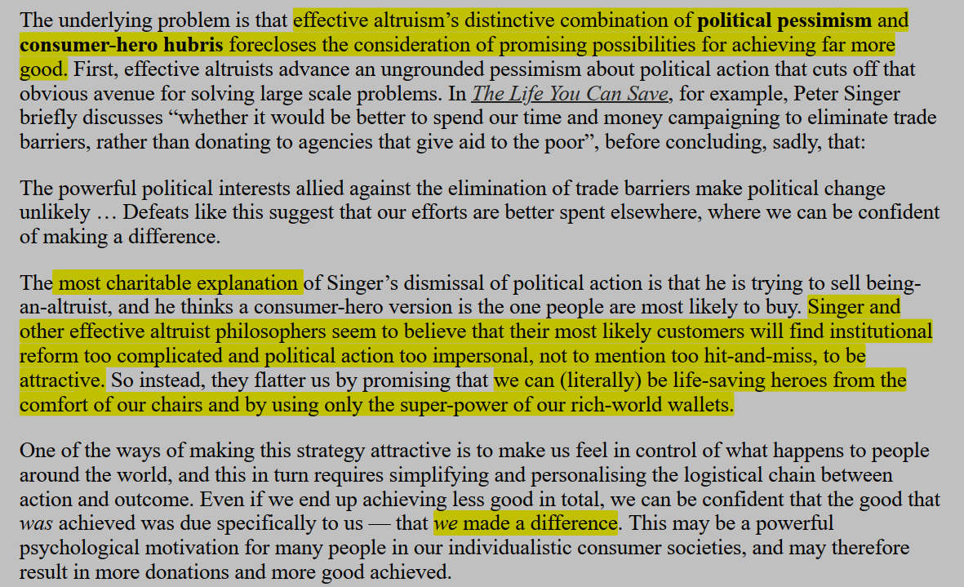

Slide 14
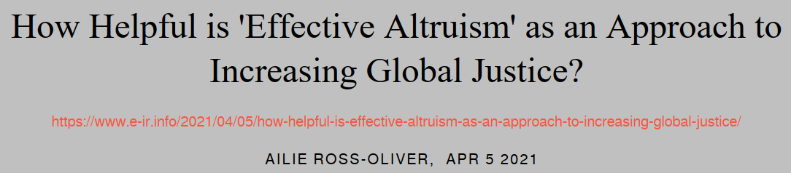
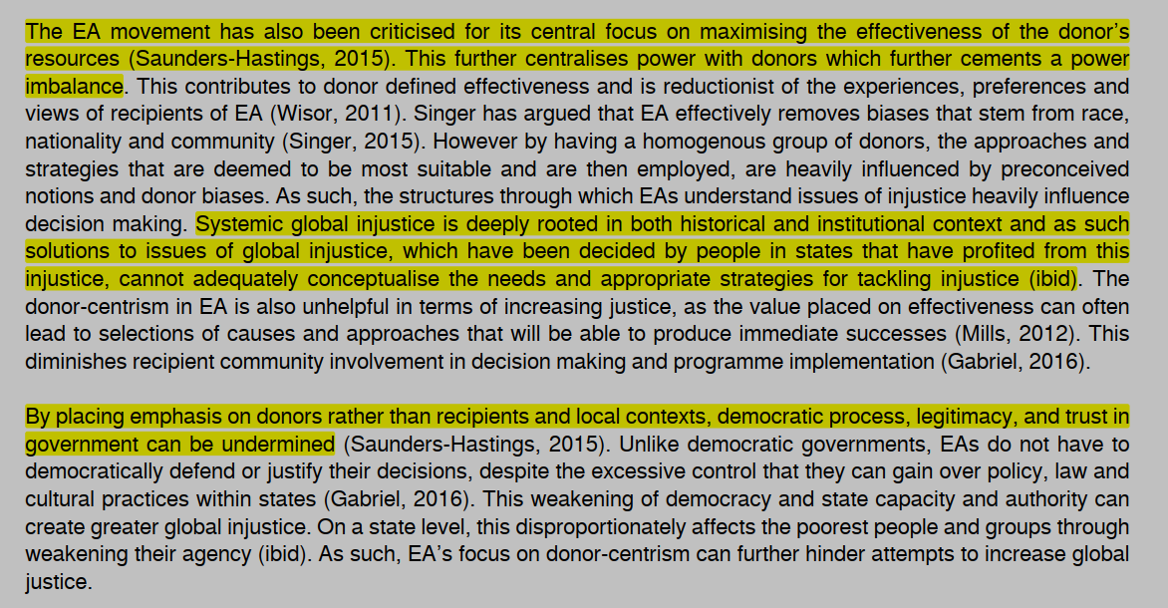

Slide 15
Four ‘Isms’ Common in EA
Naturalism
Humeanism
Welfarism
Individualism

