Slide 1
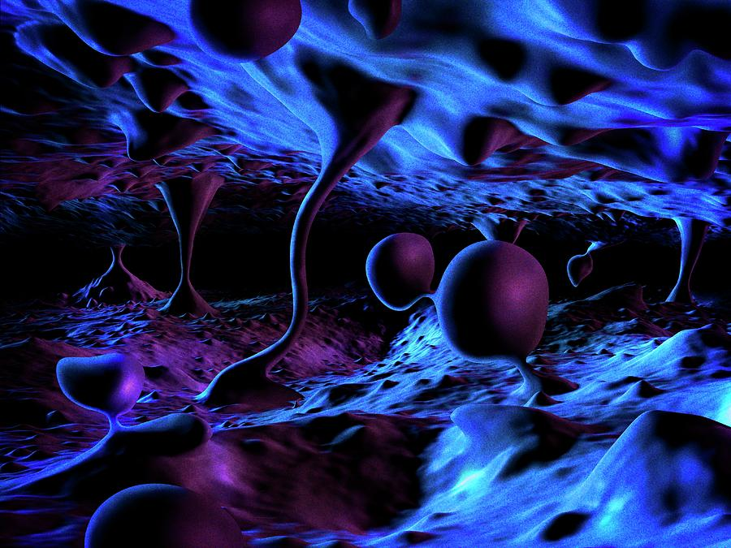
The Digital Physics Argument
James Fodor, May 2021

Slide 2
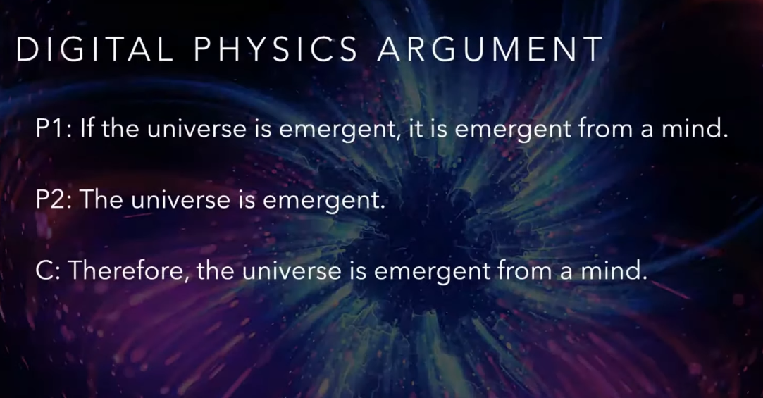
The Digital Physics Argument

Slide 3
P2. The Emergent Universe
It is not known if gravity/space/time are emergent from underlying phenomenon.
Even if it was, this doesn’t make gravity/space/time unreal or an ‘illusion’, just not fundamental.

Slide 4
P1. A Mind Behind the Universe
Quantum cognition models do not support cosmological emergence from a mind.
Quantum mechanical theorems and experiments (Bell, quantum eraser, Leggett, Kochen-Specker, etc) do not support the role of minds in QM.

Slide 5
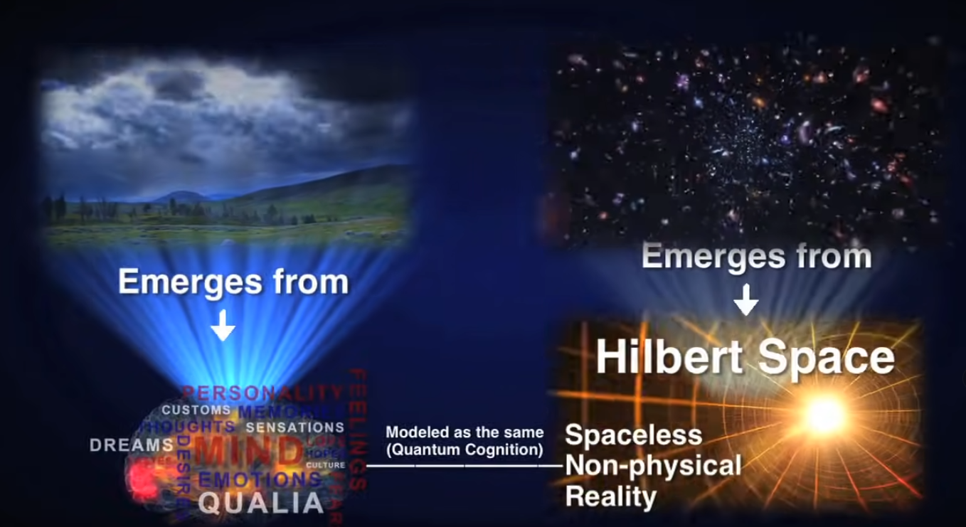
Further Problems
Entire theory is ad hoc and very complicated.
Unclear how to reconcile with Christian theology (e.g. incarnation, God’s perfection, creation ex nihilo)

Slide 6
Is God Sinful?
If we are simulations in the mind of God, then we are part of God.
We are part of God (from DPA and 1).
We are sinful.
If we are sinful and we are part of God, then a part of God is sinful.
A part of God is sinful (from 2, 3, 4).
If a part of God is sinful, then God is sinful simpliciter.
God is sinful simpliciter (from 5, 6).

Slide 7
Quantum Cosmology and God
Classical spacetime emerged from something more fundamental (information, micro-matter, quantum fields, etc).
If classical spacetime emerged from something more fundamental, a cosmic beginning does not imply an immaterial personal cause of the universe.
Therefore, a cosmic beginning does not imply an immaterial personal cause of the universe.

Slide 8

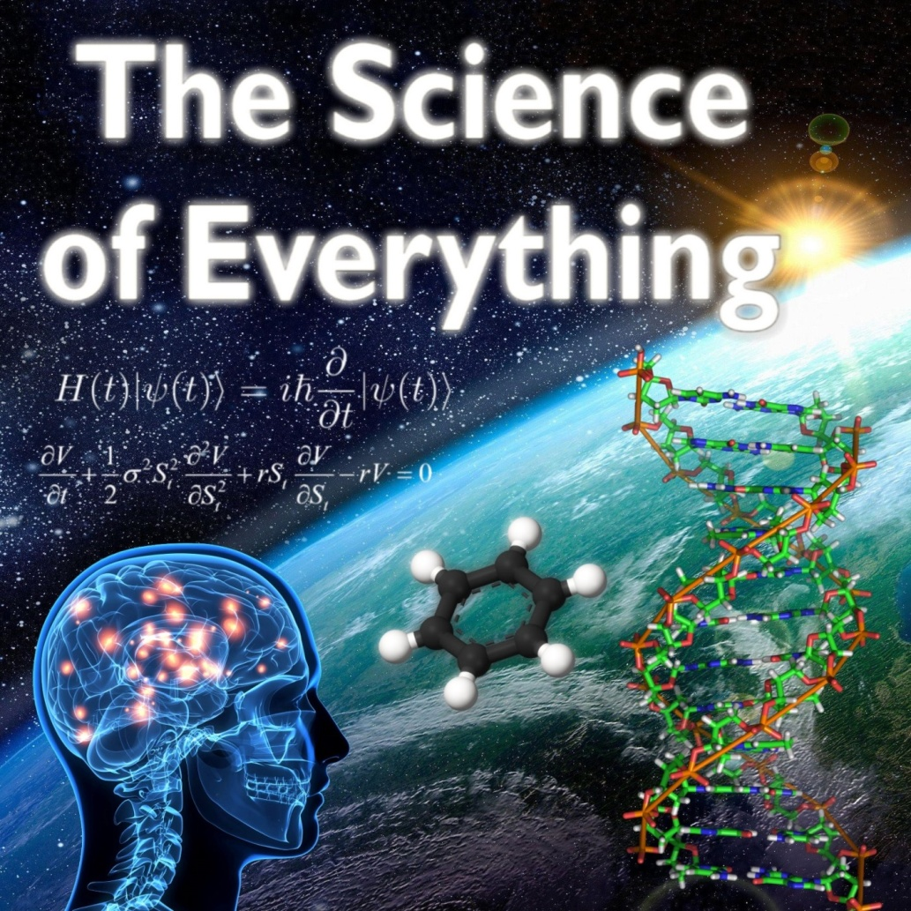
My Book and Podcast

Slide 9
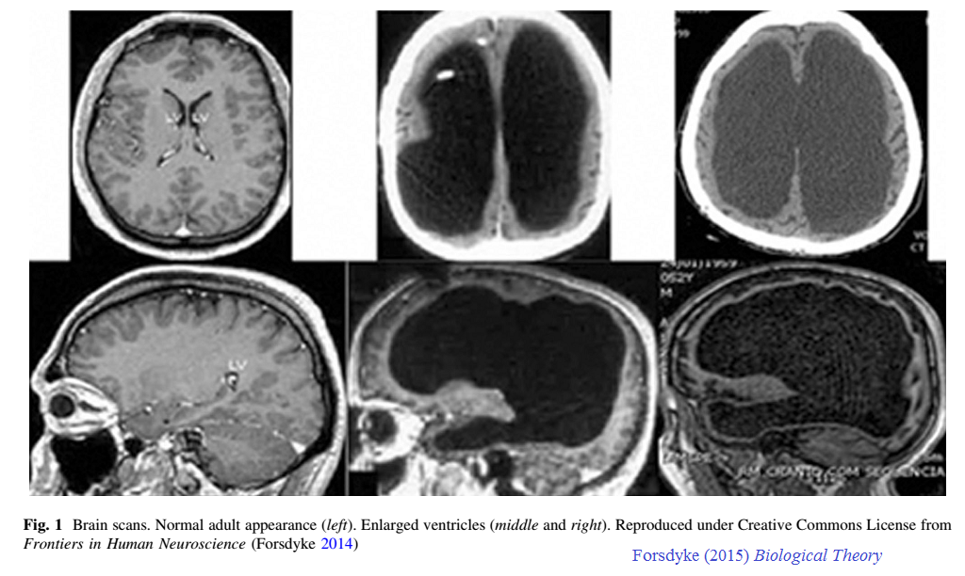
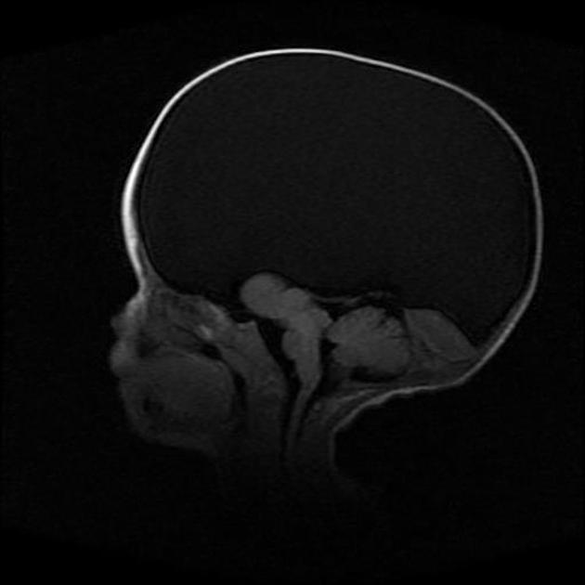
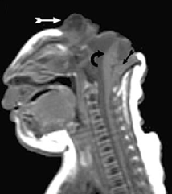
Consciousness and the Brain
fMRI studies correlate brain activity with mental functions.
Brain damage impairs specific mental functions.
Transcranial magnetic simulation can elicit specific memories, smells, etc.
Developmental impairments graded with brain damage (hydrocephalus > hydranencephaly > anencephaly).
Neurons known to carry electrical signals and able to process information in neural ciecuits.
Gradation of animal cognition with brain complexity.
No known example of mental activity without brain.
Searle: “qualitative, unified subjectivity ”

