Slide 1
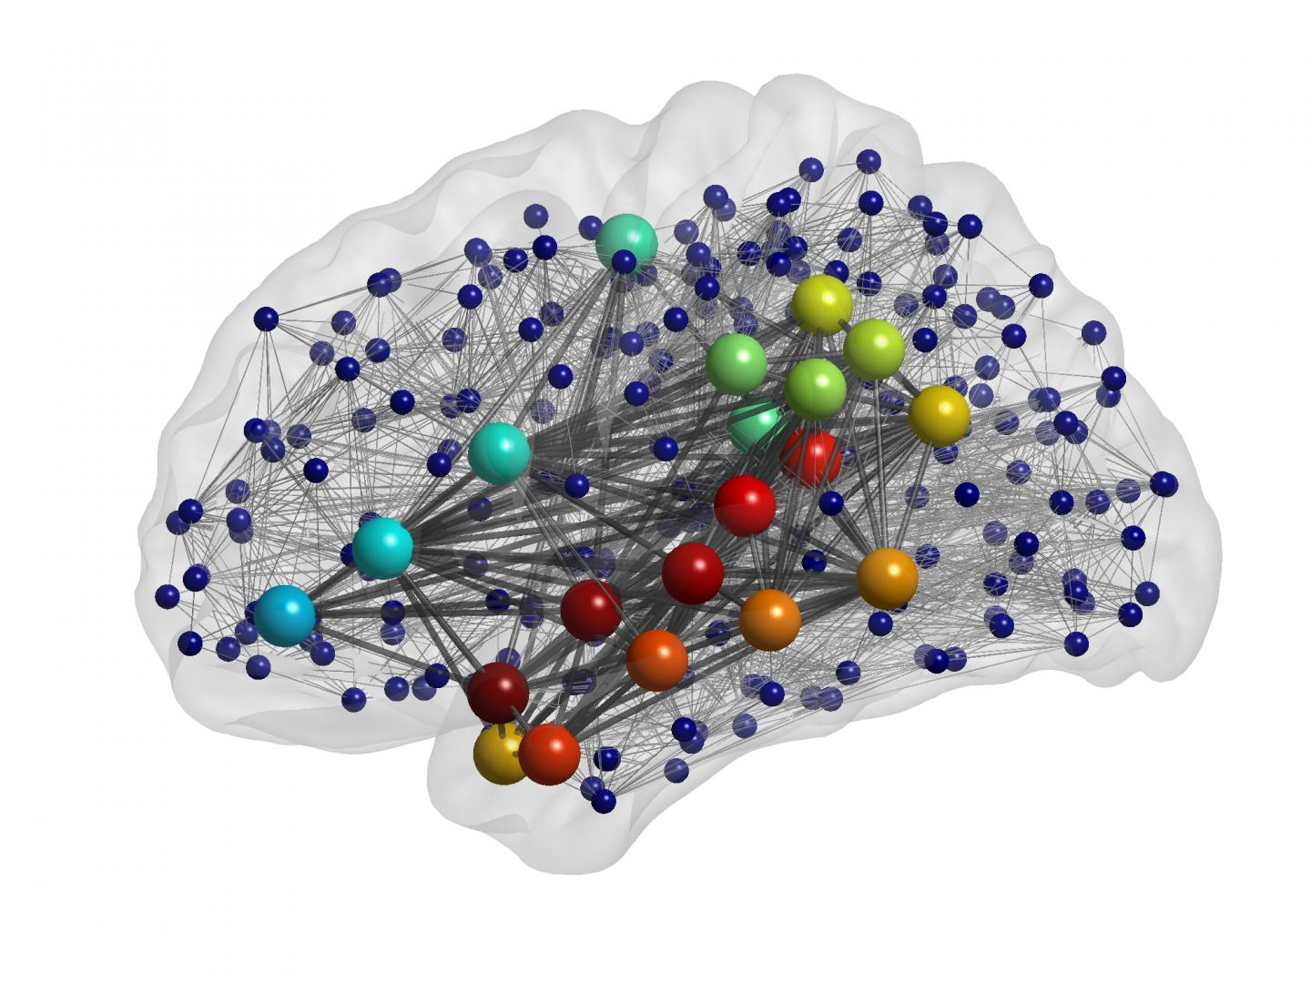
Computational Models and the Mind
James Fodor
7th March 2022

Slide 2
How Does the Mind Work? – Dualism
Descartes’ answer: its an immaterial substance.
Problems:
  Not amenable to scientific inquiry.
  Not a good explanation.
Stimulus → (???) → Response

Slide 3
How Does the Mind Work? – Behaviourism
Behaviourism: forget about the mind, its all about behaviour.
Problems
  Poverty of the stimulus arguments.
  Not enough reinforcement.
  Not plausible for very complex behaviours.
Stimulus → Response

Slide 4
How Does the Mind Work? – CTM
Computational theory of mind: cognition is computation.
Digital computers seem to ‘think’, so maybe the mind works like digital computers.
But what is computation exactly?
Stimulus → Computation → Response

Slide 5
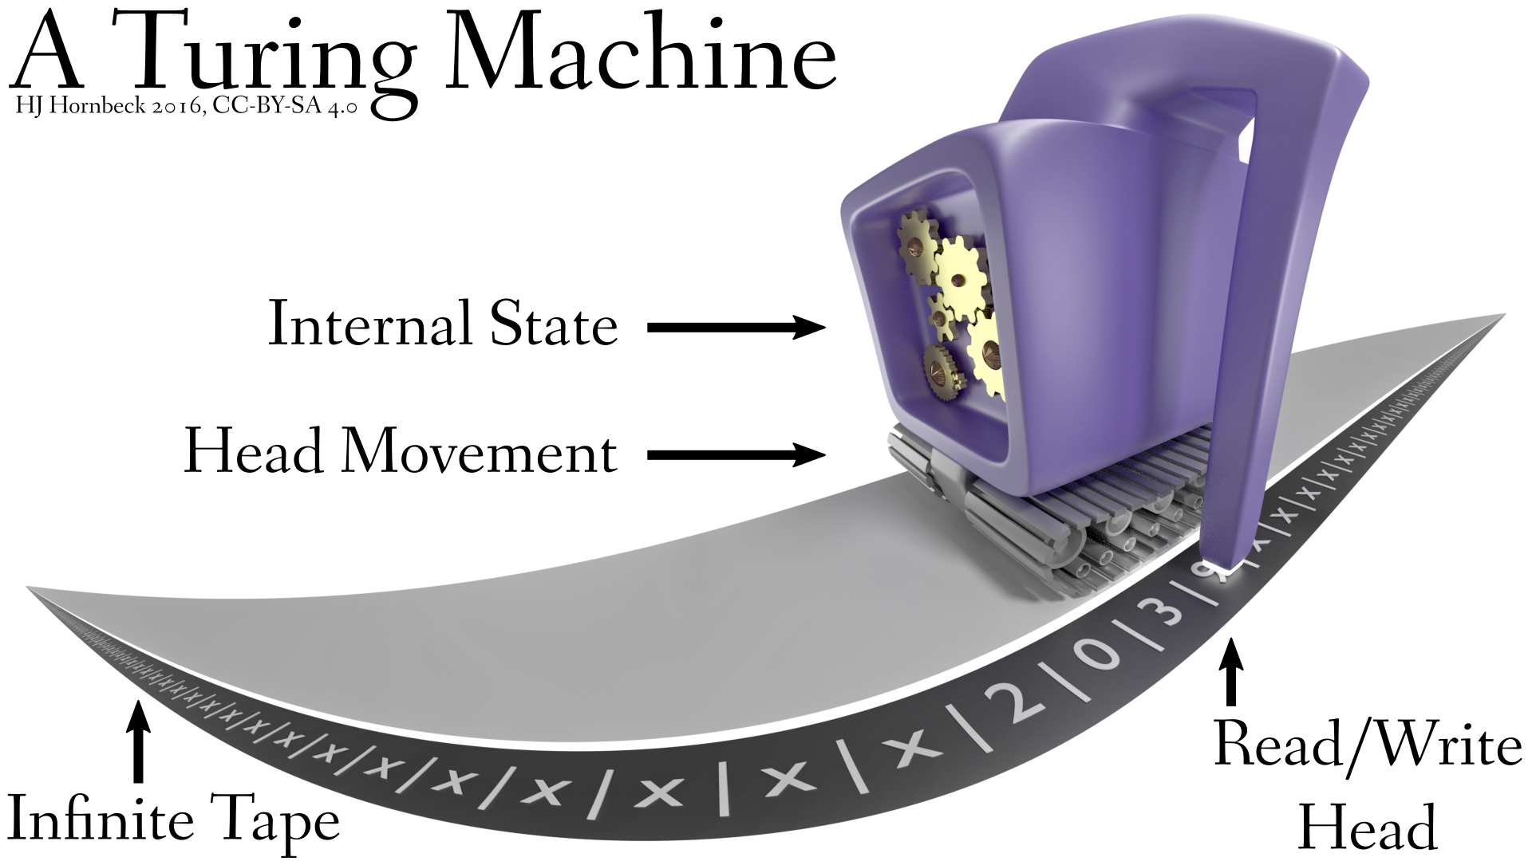
What is Computation?
Computation is a process of symbol manipulation in accordance with a finite set of definite rules.

Slide 6
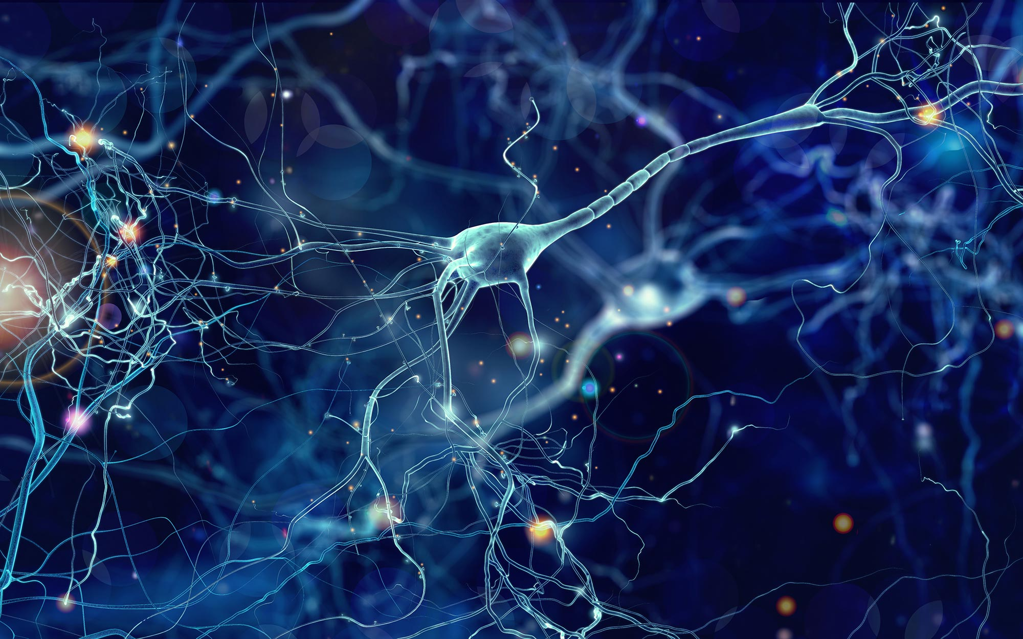
Computation in the Brain?
But how does that work in the brain?
If we could fill in the (???), would we even need the computational account?
Or: if computation is entirely abstract, how explanatory is it?
→ (???) →

Slide 7
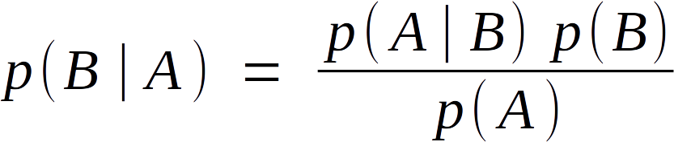
Computation in the Brain?
How explanatory is a purely functional mapping from inputs to outputs?
Such models do not really say ‘how’, or give the causal mechanisms.
Sub-symbolic models provide a potential method to resolve this issue.
Stimulus → → Response

Slide 8
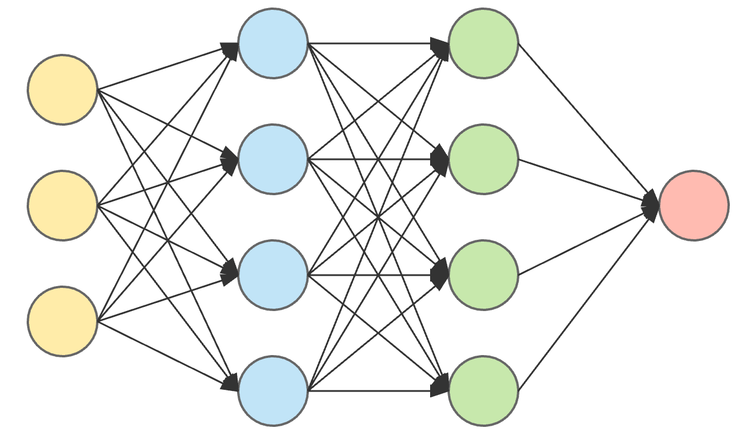
Connectionism
Connectionism describes cognition in terms of spreading patterns of activation modulated by the connectivity pattern of a network of interconnected nodes.
Reconciliation(?): mental computations are implemented by spreading activation patterns.
→ →

Slide 9
The Implementation Hypothesis
How could connectionist models ‘implement’ computational models?
Potential answer:
  Symbols are abstractions of underlying structured representations.
  Rules are abstractions of operational transformations over these structured representations.
Hence a need to study cognitive representations and how they are manipulated in different cognitive tasks.
Stimulus → Representation → Transformation → Response

Slide 10
The Nature of Neural Representation
Much debate about the nature of these mental representations.
Possibilities include:
  Images
  Frames
  Production rules
  Feature values
Connectionist models provide representations most easily interpreted as feature values, though this is not the only possible interpretation.

Slide 11
The Reductionist Objective
Cognitive process
↓
Representations and transformations
↓
Neural networks
↓
Detailed neurophysiology
Language comprehension
↓
Transformer language models
↓
Synaptic plasticity & connectivity
↓
Neurotransmitters, channels, dendritic trees

Slide 12
Testing Cognitive Models
A model is an abstract representation of the key aspects of some system.
Models cannot be evaluated without knowing their goals.
What would ‘complete’ success look like for a particular model?
Validate the model by how close it reaches to complete success (e.g. R-squared value for regression).

Slide 13
Distributed Lexical Semantics
Goal: to model the structure and function of the human conceptual system, in a manner that is amenable to explanation in terms of neural activity.
Not goals:
  To model individual differences in semantic intuitions.
  To construct models that replicate human linguistic performance.
  To describe all aspects of word or phrase meaning.
Success: accurately encode the similarity, relatedness, and featural structures of human concepts, and the mechanisms by which they are combined.
Measurement: correlation of modelled similarity (etc) values to ratings from human subjects. Potential for correlation with fMRI data.

Slide 14
Summary
A fully adequate cognitive science needs to be able to link neural implementation with cognitive processes.
Traditional cognitive models often do not say much about the nature of the representations used in the brain.
Connectionist models are a promising approach to provide such a link.
Cognitive models must be evaluated in accordance with their goals.
Distributed lexical semantics models seek to describe the representation of conceptual information.
Stimulus → Representation → Transformation → Response

