Slide 1

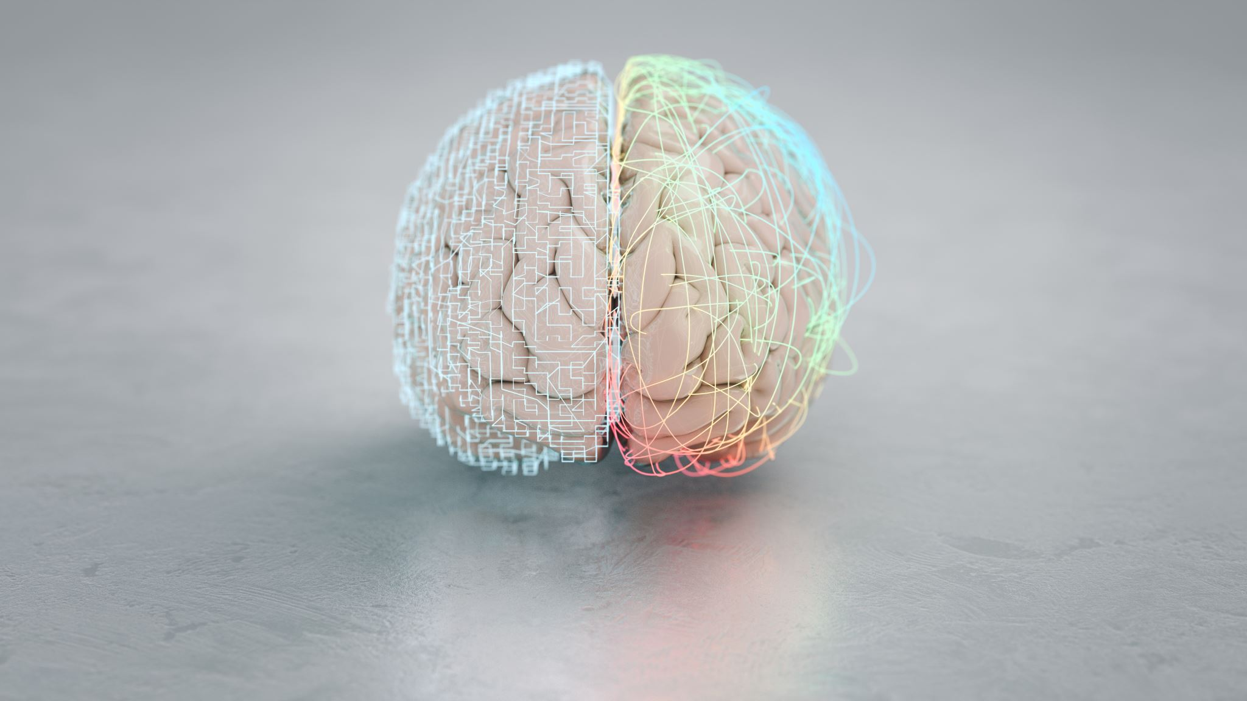
Backpropagation in the Brain
James Fodor
21st February 2023

Slide 2
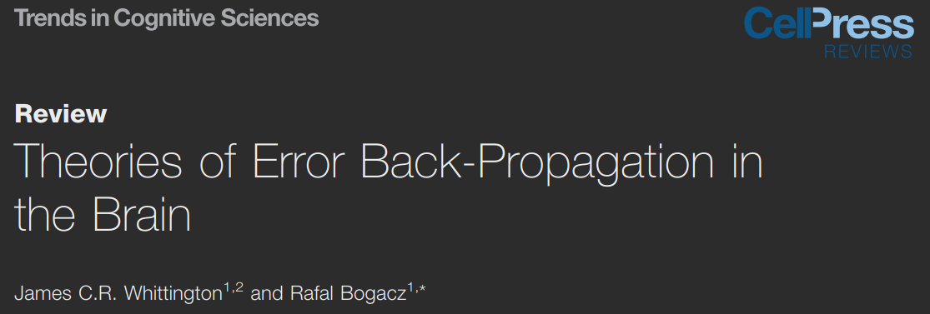
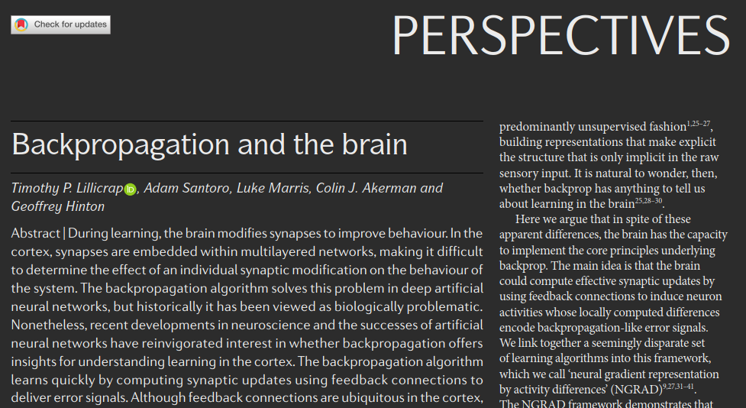

Slide 3
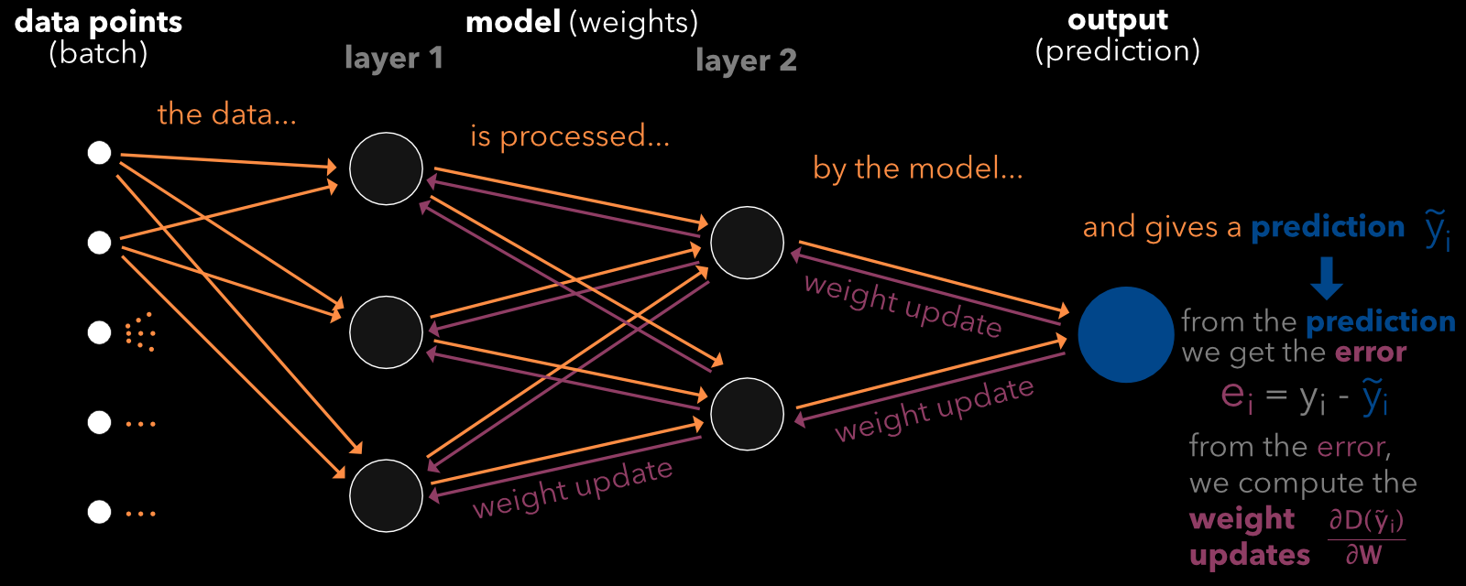
What is Backprop?
Backprop is the main algorithm used for training neural networks.
Essential to modern deep learning methods.
Based on the idea of reducing prediction errors.

Slide 4
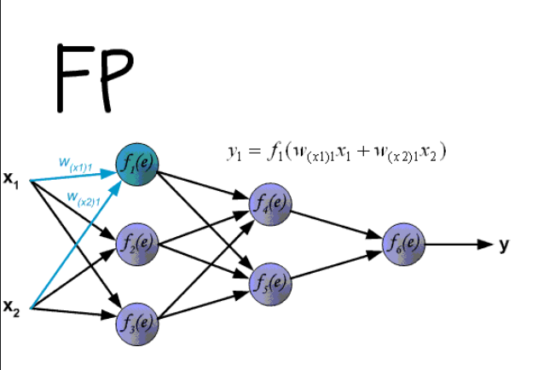
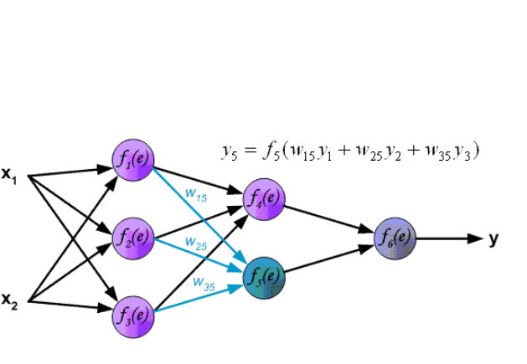
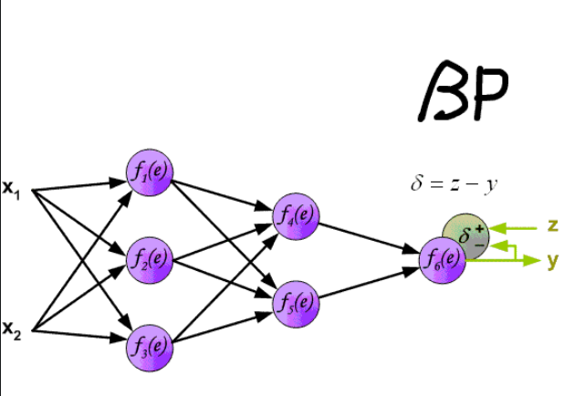
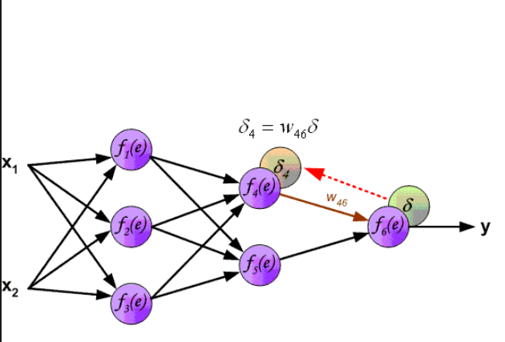
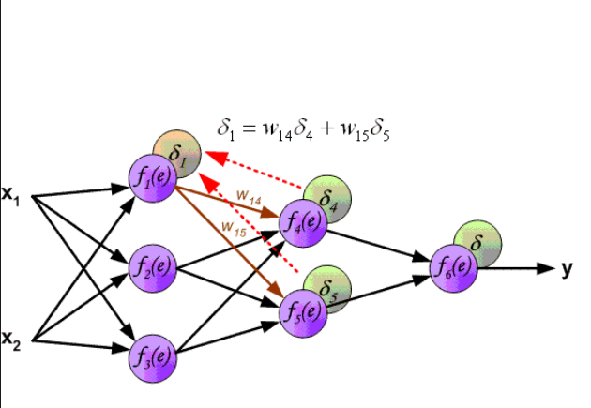
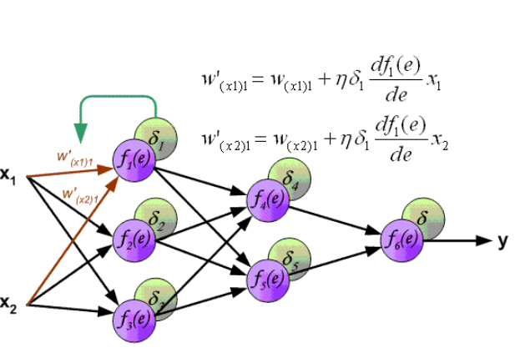
How backprop works

Slide 5
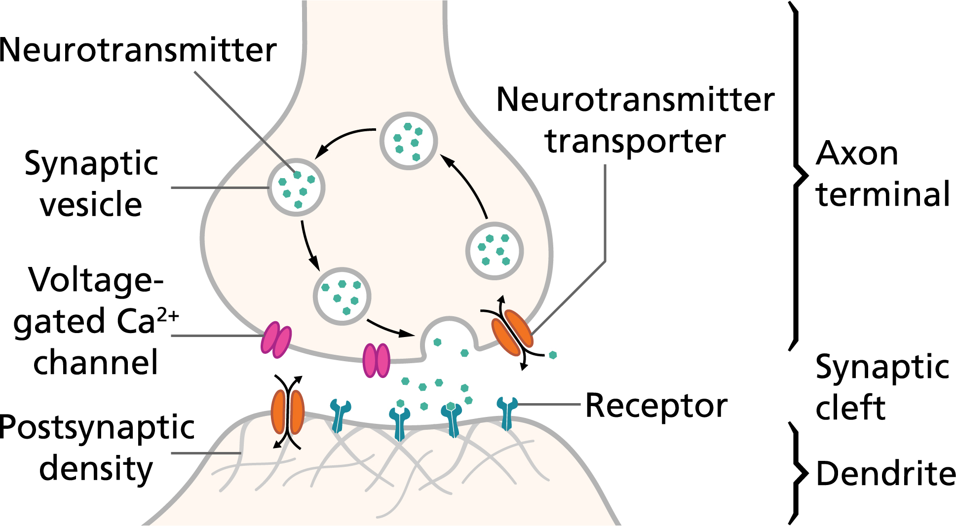
Problems with Backprop
Error signals require non-local information.
Requires symmetric forward and backweight weights.
Uses rate-based coding rather than spiking networks.
Biological synapses can only be excitatory or inhibitory (Dale’s law).

Slide 6
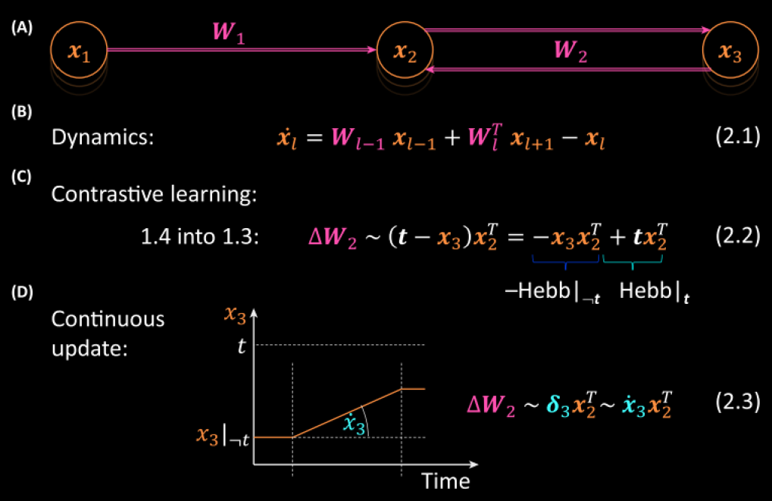
1. Temporal Error Models
Stores errors on the same nodes, but at different times.
Requires separate ‘forward’ and ‘backward’ steps.
Requires a global ‘phase’ signal.
input
output
t: target

Slide 7
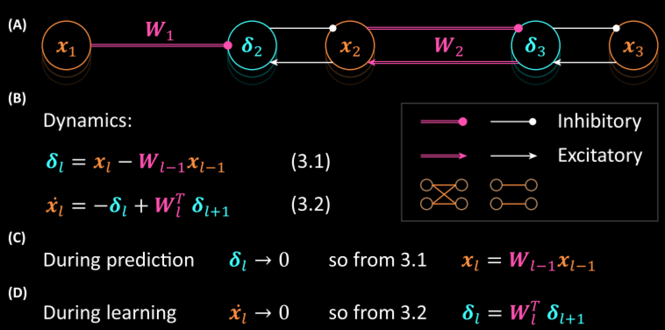
2. Predictive Coding Model
Stores errors on special error nodes.
Requires specialised connectivity.
No need for global ‘phase’ signal.
input
output

Slide 8
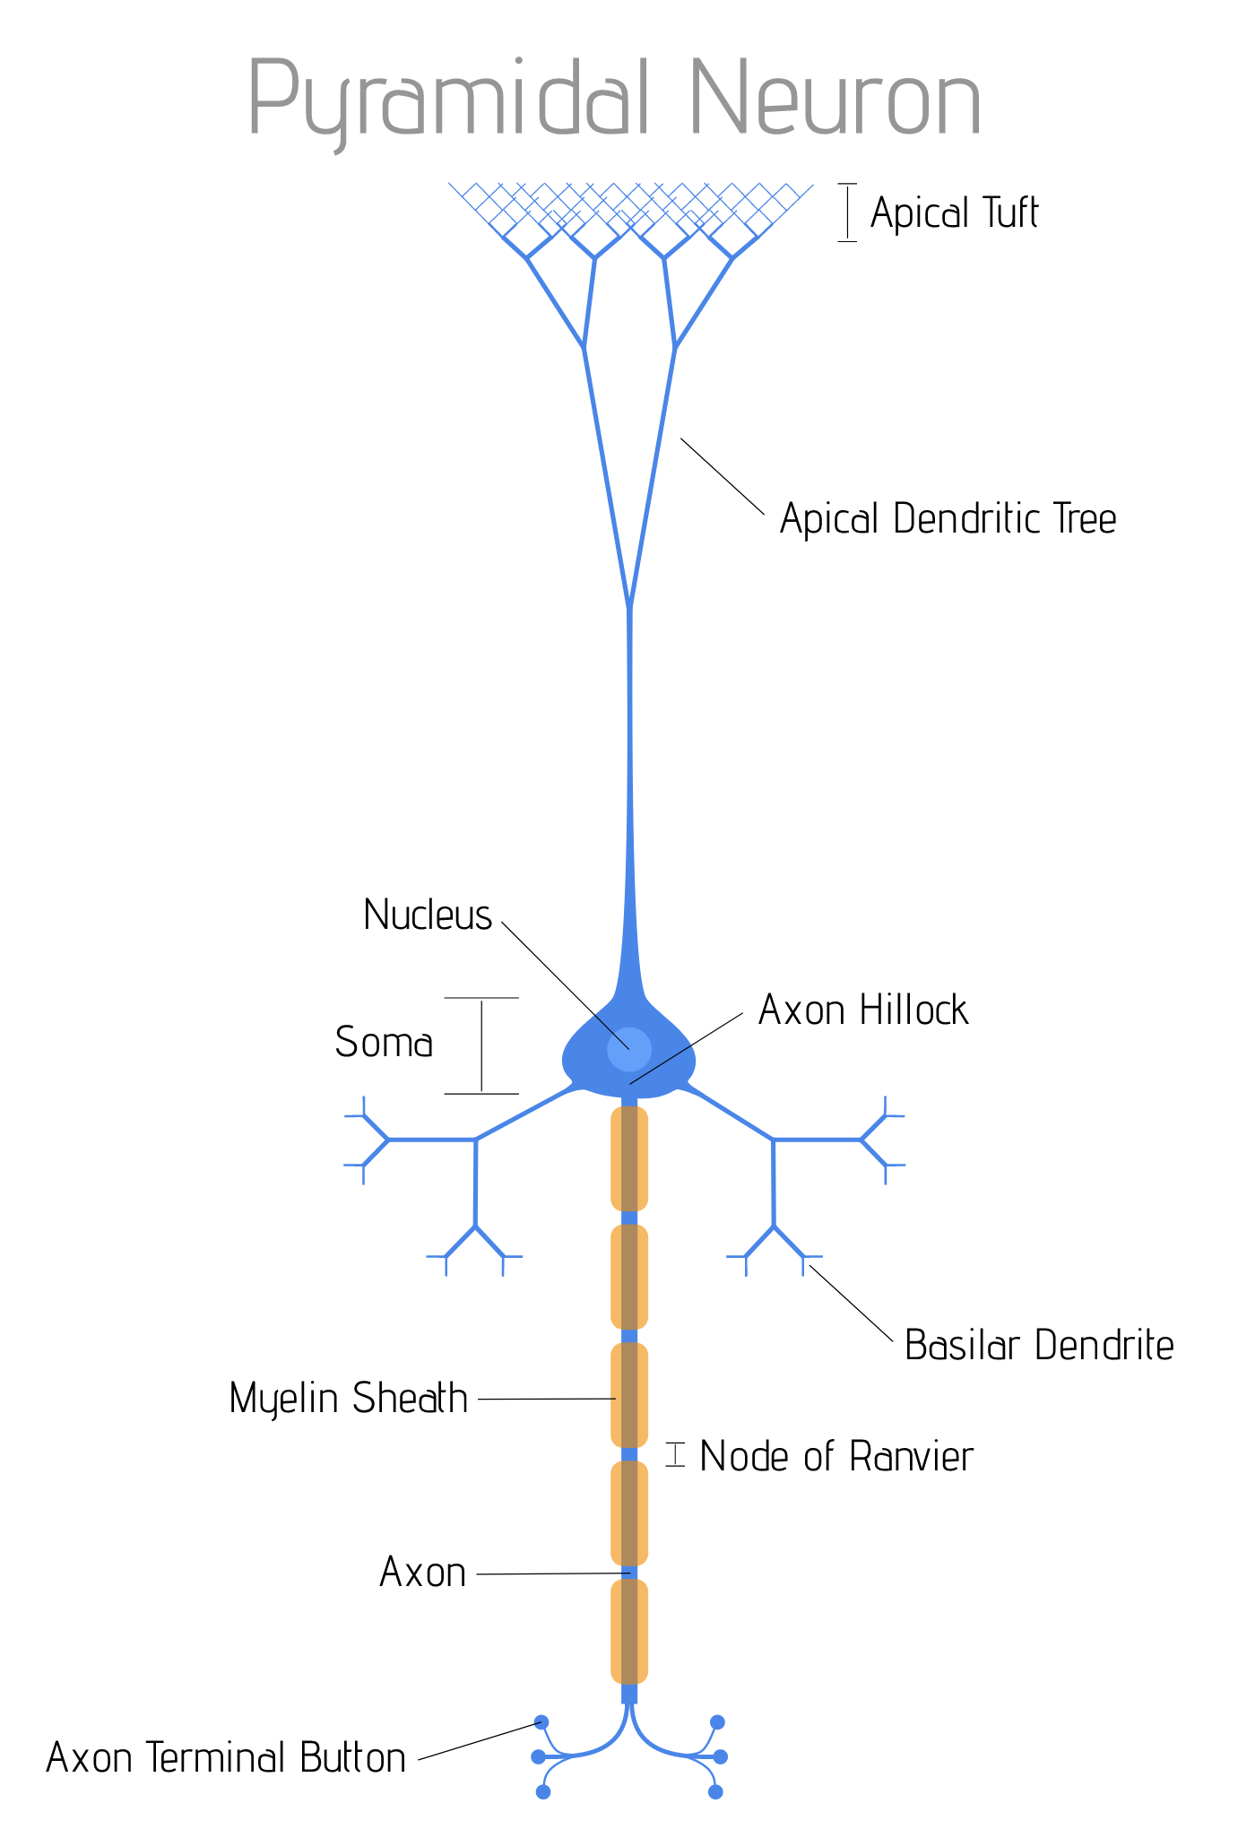
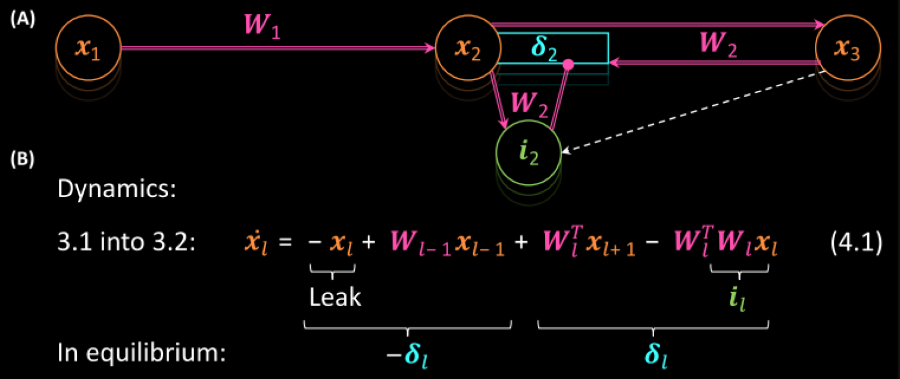
3. Dendritic Error Model
Stores errors on special compartment called ‘apical dendrites’.
Requires inhibitory interneurons with additional connections.
No need for global ‘phase’ signal.
input
output

Slide 9
Additional Considerations
It turns out that symmetric weights are not needed*, but matching signs are.
Unclear if can extend rate-based to spiking models.
Cortex has many back-projections, but function is unclear.
Much debate on nature training signals in the brain.

Slide 10
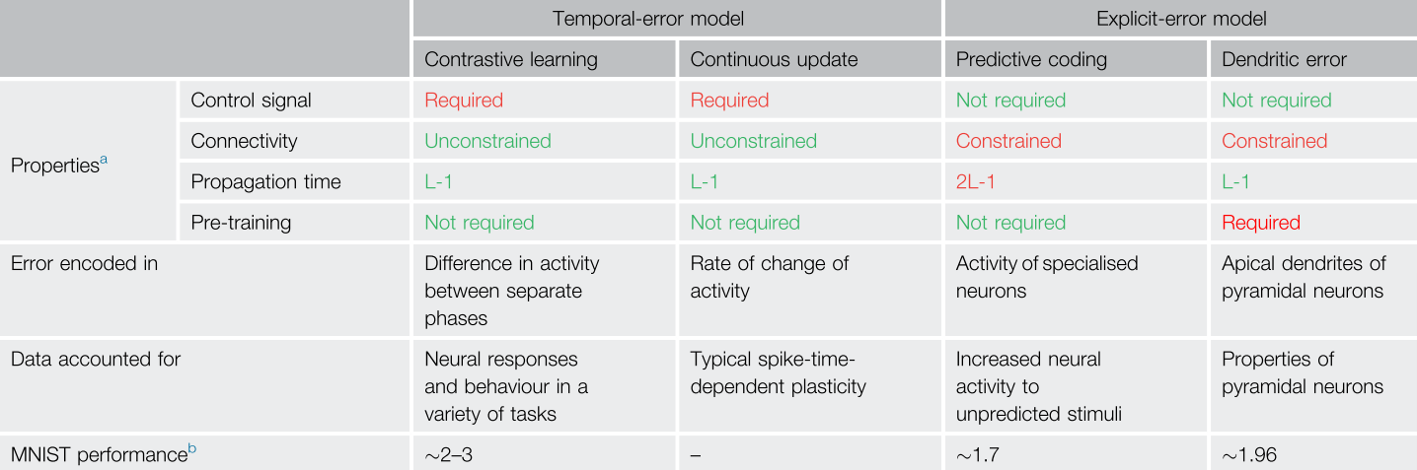
Comparison of Models

Slide 11
Problems with Backprop Revisited
Error signals require non-local information. SOLVABLE (with new assumptions)
Requires symmetric forward and backweight weights. SOLVABLE
Uses rate-based coding rather than spiking networks. UNCLEAR
Biological synapses can only be excitatory or inhibitory (Dale’s law). UNCLEAR

Slide 12
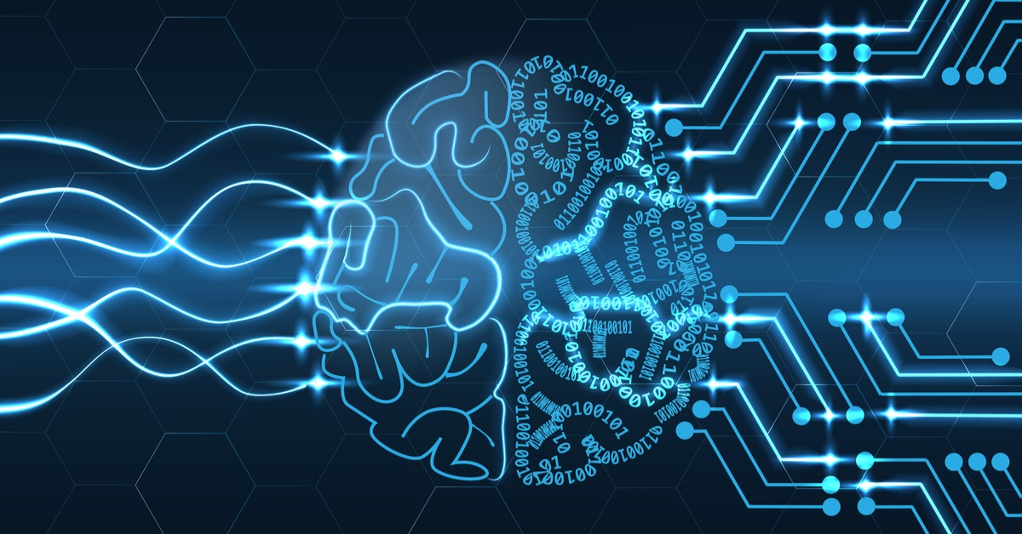
Conclusions
Currently no direct evidence of error-driven learning in the brain.
Backprop-trained representations match brain representations.
Backprop ‘only game in town’ for supervised learning tasks.
General view seems to be the brain does something ‘backprop-like’.

Slide 13
Questions?

