Slide 1

The Case Against
Effective Altruism
James Fodor, May 2019

Slide 2
Outline of my Case
Problems with the community
Views on ethics
Views on politics
Views on evidence

Slide 3
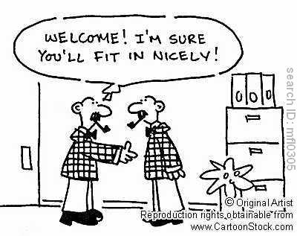
Problems with the Community

Slide 4
Problems with the Community
Not diverse
  Mostly male
  Mostly white
  Highly educated
  Young
  Quantitative fields + philosophy
Homogenous set of viewpoints?

Slide 5
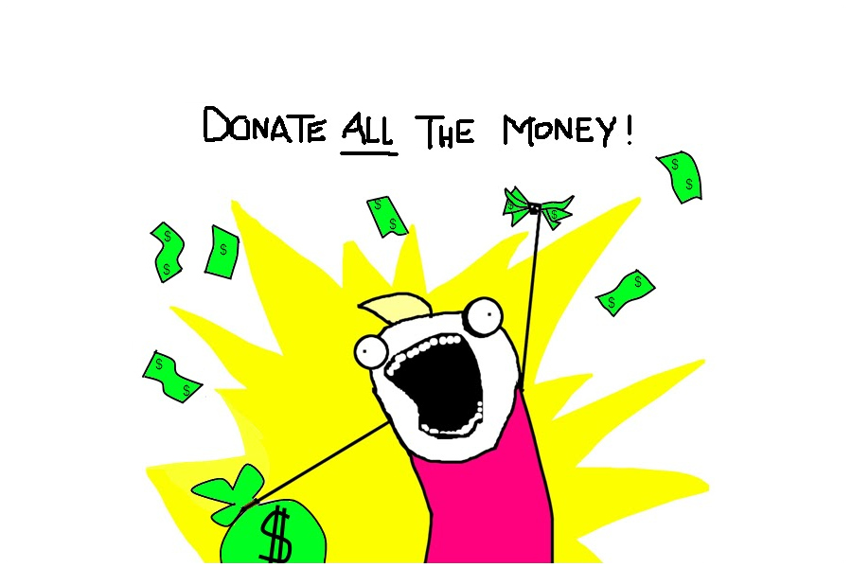
Views on Ethics

Slide 6
Views on Ethics
Only makes sense for utilitarians
  “Do the most good”
  “Maximise”
  “Optimising for”
  https://forum.effectivealtruism.org/posts/FpjQMYQmS3rWewZ83/effective-altruism-is-a-question-not-an-ideology
  X-risk probably only makes sense to utilitarians
Too demanding
  Implies you should impoverish yourself
  Promotes unlivable lifestyle
  Implies you should abandon your family

Slide 7
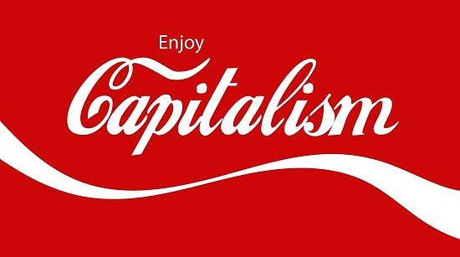
Views on Politics

Slide 8
Views on Politics
Unrecognised neoliberal/pro status quo ideology
  Uncritical adoption of framework of neoclassical economics
  Never talk about power structures in society
  Individualistic focus ignores systematic effects of politics and society
Ignores systemic change
  Focused on symptoms and not the cause of problems
  Never considers reform of geopolitical system
  https://80000hours.org/2015/07/effective-altruists-love-systemic-change/
  Where is EA Marxism/Anarchism?

Slide 9
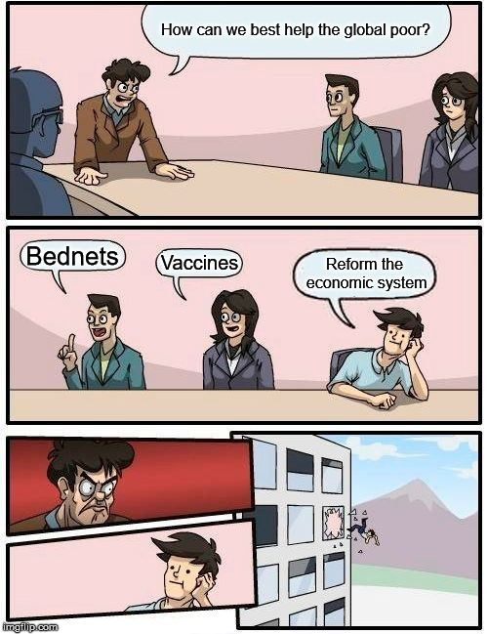


Slide 10
Views on Politics
Unrecognised neoliberal/pro status quo ideology
  Uncritical adoption of framework of neoclassical economics
  Never talk about power structures in society
  Individualistic focus ignores systematic effects of politics and society
Ignores systemic change
  Focused on symptoms and not the cause of problems
  Never considers reform of geopolitical system
  https://80000hours.org/2015/07/effective-altruists-love-systemic-change/
  Where is EA Marxism/Anarchism?

Slide 11
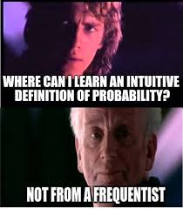
Views on Evidence

Slide 12
Views on Evidence
Too focused on experiments and quantification
  RCTs elevated too highly
  Ignore non-quantifiable forms of evidence
  Dismissive of charities claiming their work is nuanced and cannot be quantified
Too credulous about far future causes
  Interventions not based on any evidence
  Rely on highly uncertain philosophical views
  Claim that this work is nuanced and cannot be quantified
  Often come to extremely implausible results

Slide 13
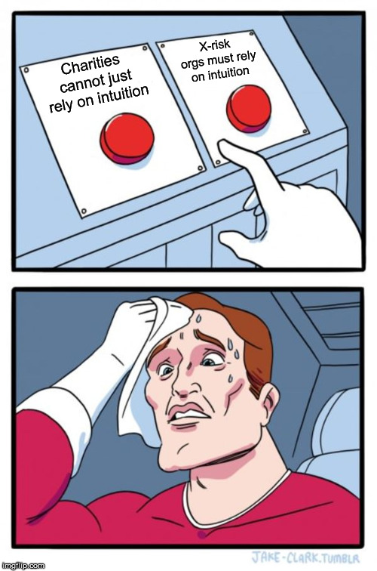

Slide 14
Views on Evidence
Too focused on experiments and quantification
  RCTs elevated too highly
  Ignore non-quantifiable forms of evidence
  Dismissive of charities claiming their work is nuanced and cannot be quantified
Too credulous about far future causes
  Interventions not based on any evidence
  Rely on highly uncertain philosophical views
  Claim that this work is nuanced and cannot be quantified
  Often come to extremely implausible results

Slide 15
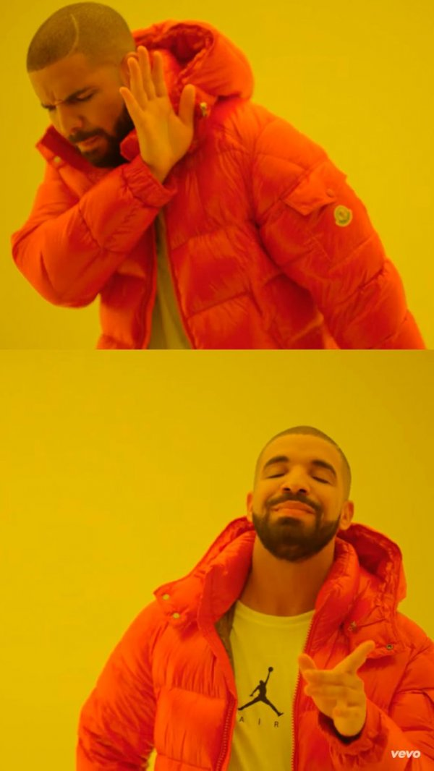
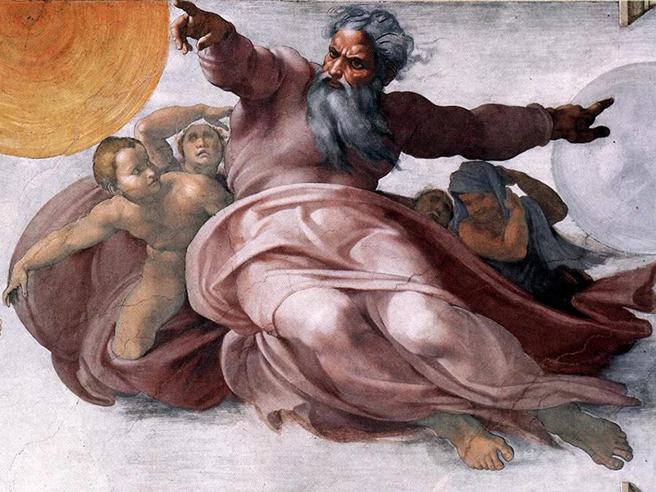


Slide 16
Views on Evidence
Too focused on experiments and quantification
  RCTs elevated too highly
  Ignore non-quantifiable forms of evidence
  Dismissive of charities claiming their work is nuanced and cannot be quantified
Too credulous about far future causes
  Interventions not based on any evidence
  Rely on highly uncertain philosophical views
  Claim that this work is nuanced and cannot be quantified
  Often come to extremely implausible results

Slide 17
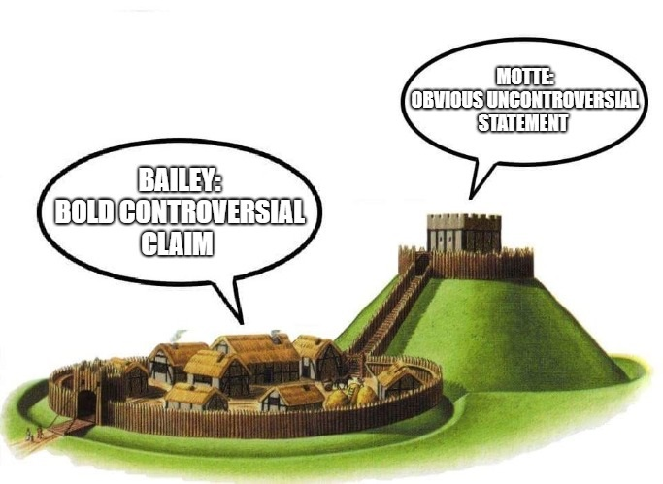

Slide 18
We should use reason and evidence to help do the most good

Slide 19
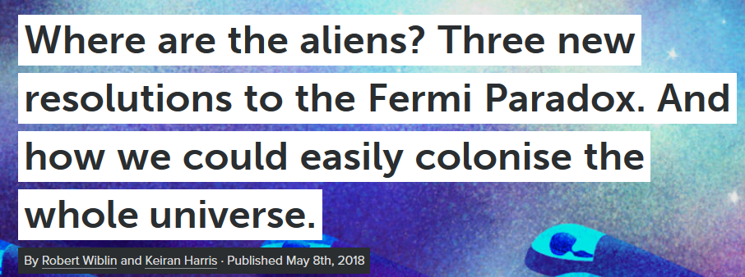
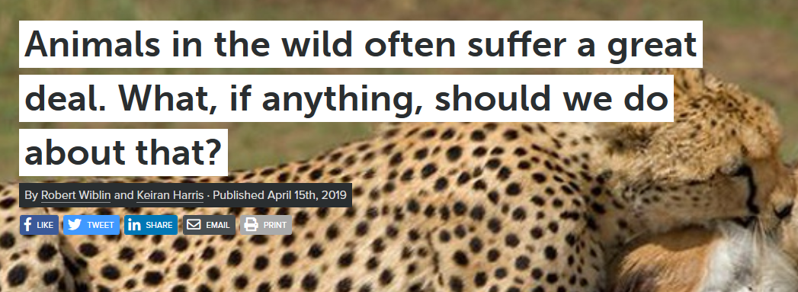
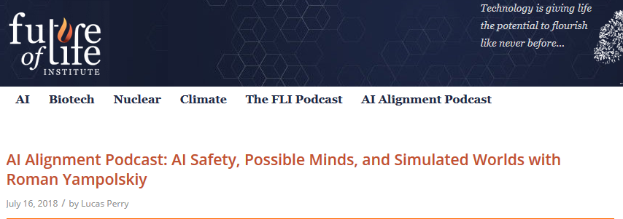
We should use reason and evidence to help do the most good

