Slide 1
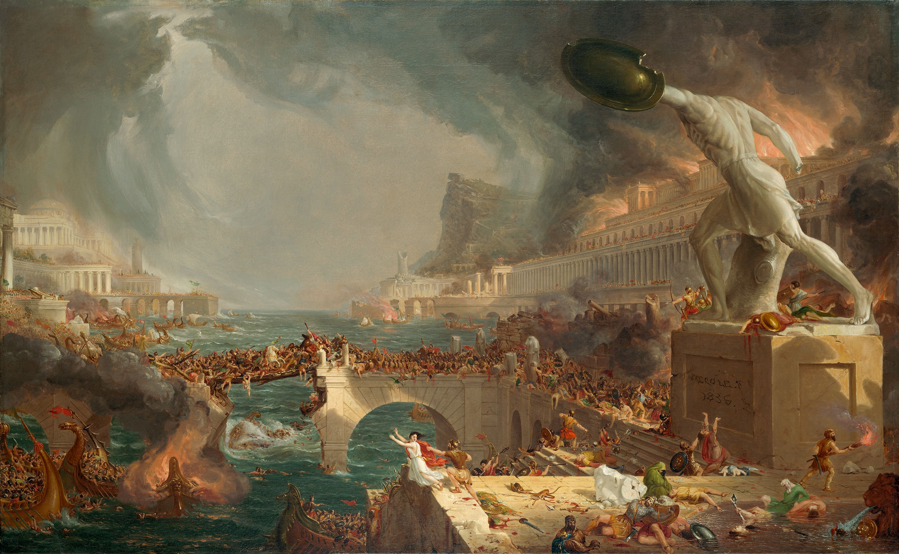
Learning from History
James Fodor, March 2020
Effective Altruism ANU

Slide 2
Synopsis
In Effective Altruism we are often called upon to make difficult decisions about things that are not well understood, such as the impact of different economic policies, the effect of social movements, the trajectory of future technologies, and the development of future human societies. In the absence of extensive data or rigorous experiments, history provides a potentially rich source of knowledge relevant to many such questions. The past, after all, is long and varied, and frequently overlooked as a source of information for informing present decisions. Drawing from examples as diverse as the Roman Empire and World War II, in this talk we will consider a variety of tools, ideas, and examples pertinent to how we can learn applicable and non-obvious lessons from the past. In particular, we will discuss the importance of historical context, methods of quantifying historical trends, methods for finding relevant historical examples, and techniques for estimating historical counterfactuals.

Slide 3
Outline
Good historical research
Base rates and case studies
Simple methods of quantification
Historical counterfactuals

Slide 4

A meme

Slide 5

Good historical research

Slide 6
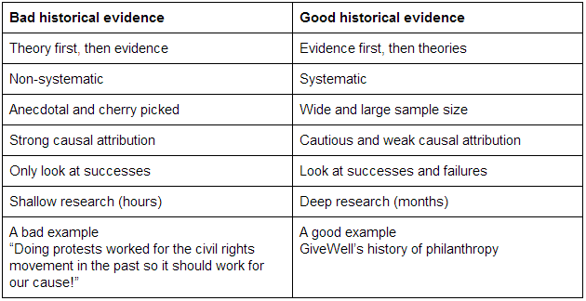
Good historical research
https://www.charityscience.com/blog/historical-evidence
Anachronism
Periodisation

Slide 7
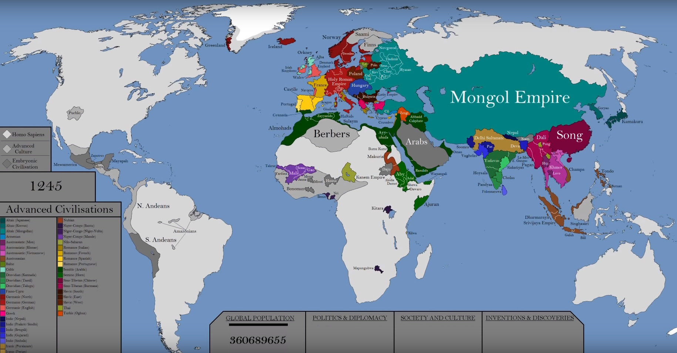
Good historical research

Slide 8
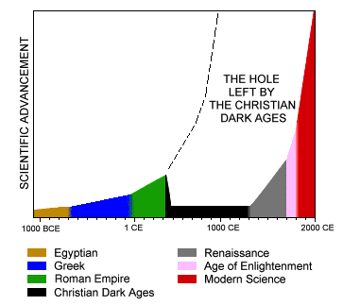
Good historical research

Slide 9
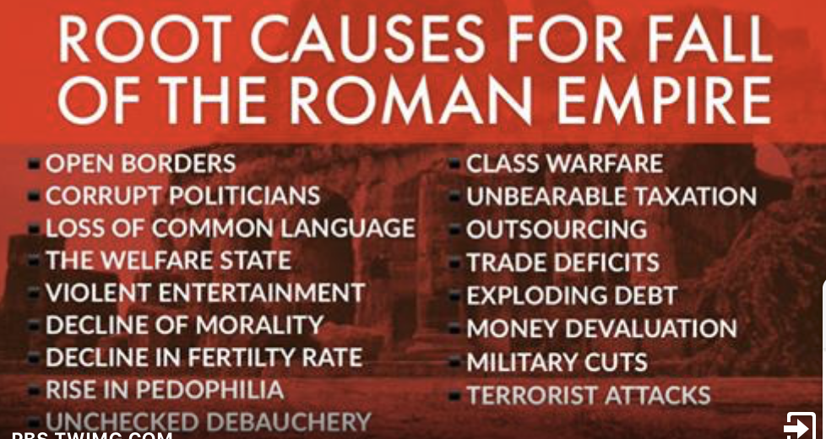
Good historical research

Slide 10
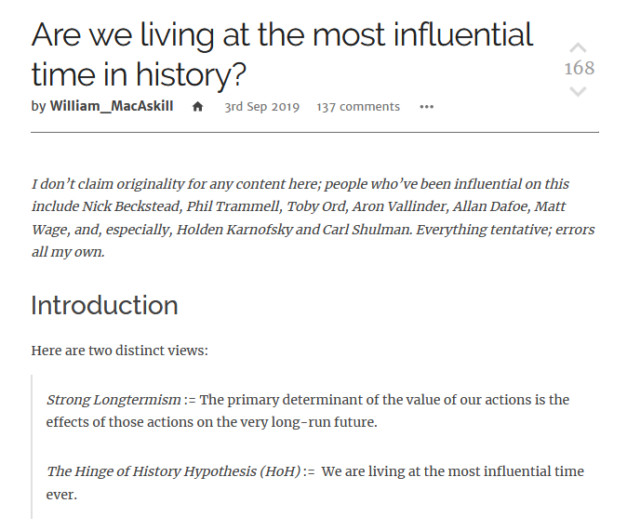
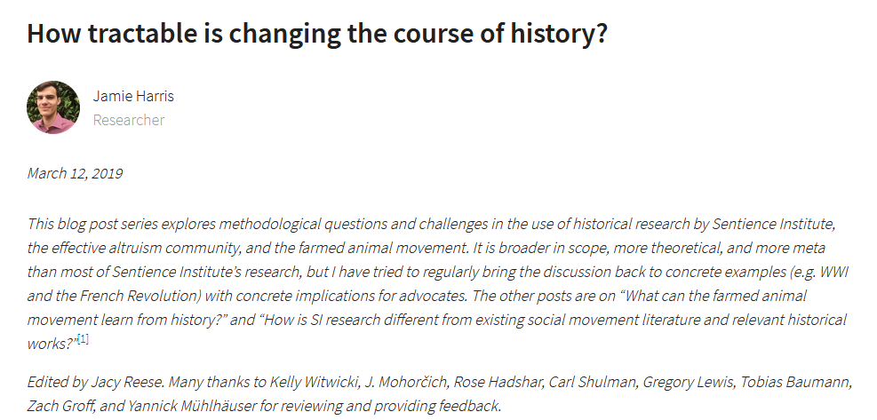
Good historical research
https://forum.effectivealtruism.org/posts/XXLf6FmWujkxna3E6/are-we-living-at-the-most-influential-time-in-history-1
https://www.sentienceinstitute.org/blog/how-tractable-is-changing-the-course-of-history

Slide 11
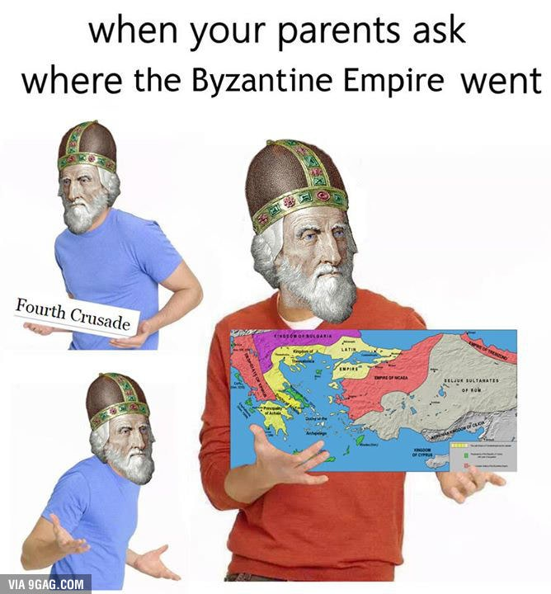
A meme

Slide 12
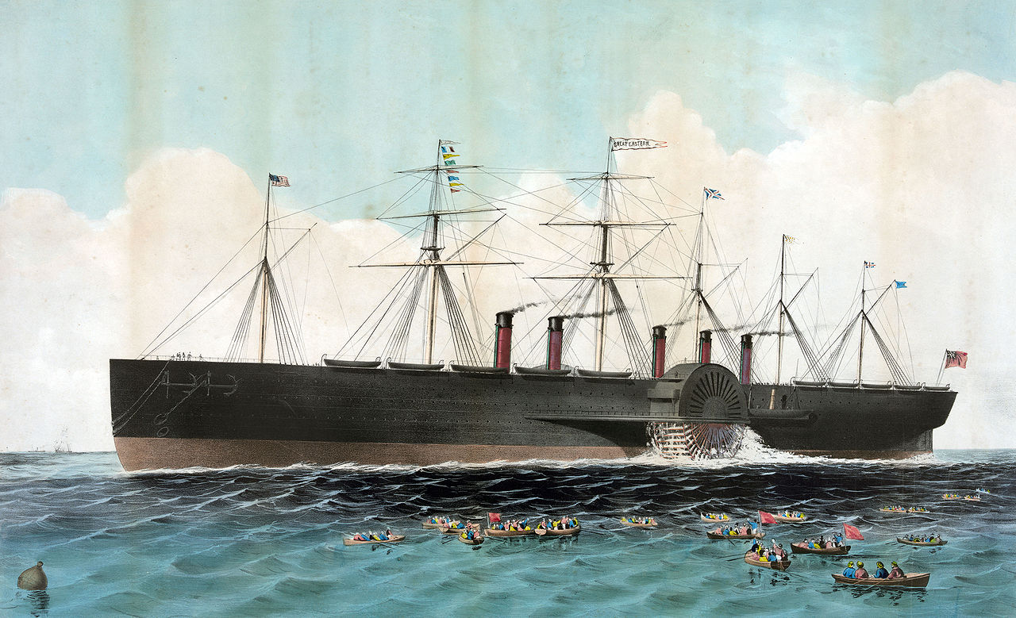
Base rates and case studies

Slide 13
Base rates and case studies
Examples of societal collapse
Collapse of the Western Roman Empire (378-480)
Bronze Age Collapse (1200-1050)
Mayan Collapse (750-900)
Decline of Great Zimbabwe (15th century)
Collapse of the Khmer Empire (15th century)

Slide 14
Base rates and case studies
How bad can things get?
Siege of Leningrad (1941-1944)
The Black Death (1348-53)
The Taiping Rebellion (1850-1864)
Thirty Years’ War (1618-1648)
Partition of India (1947-1948)
Russian Revolution and Civil War (1917-1922)
An Lushan Rebellion (755-763)
Mongol Conquests (1206-1405)

Slide 15
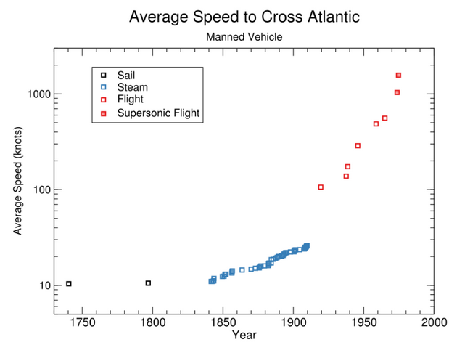
Base rates and case studies
Examples of discontinuous technological progress
https://aiimpacts.org/discontinuous-progress-investigation/

Slide 16
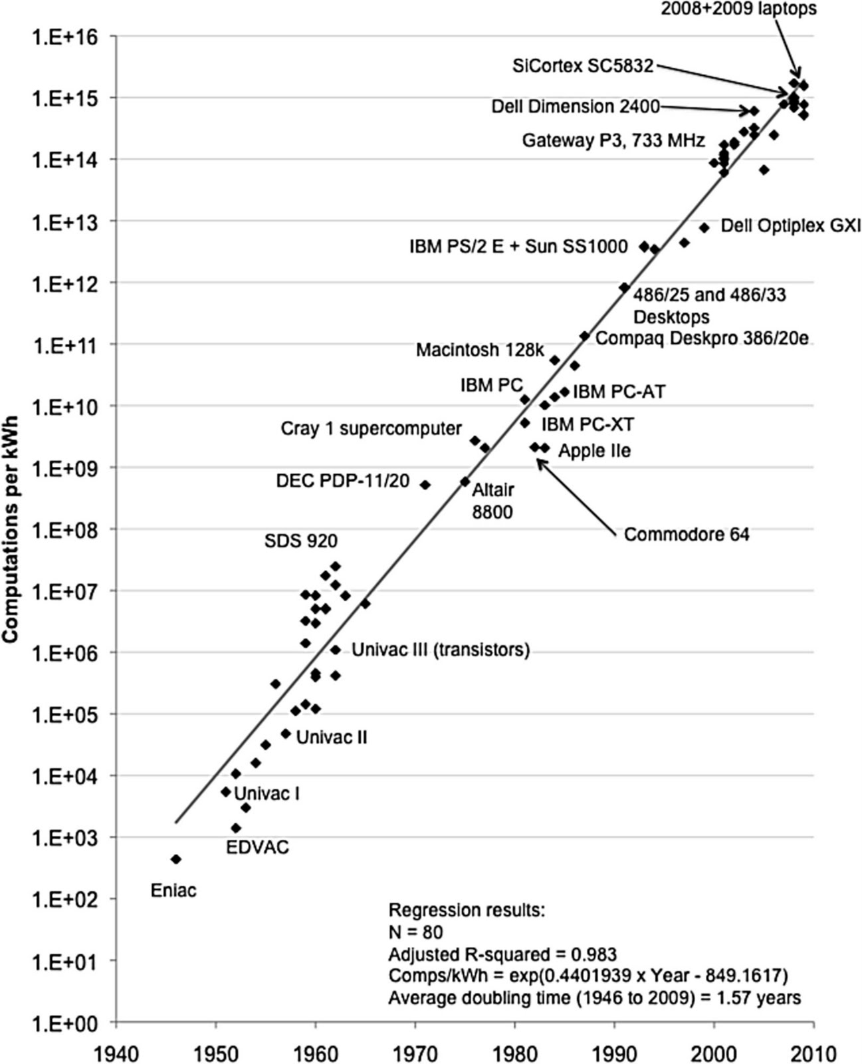
Base rates and case studies
Implications of Historical Trends in the Electrical Efficiency of Computing

Slide 17

A meme

Slide 18
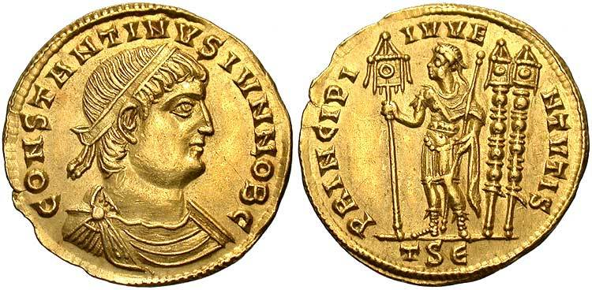
Simple Quantification

Slide 19
Simple Quantification

Slide 20
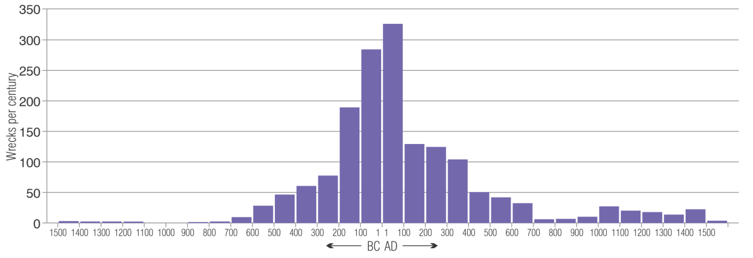
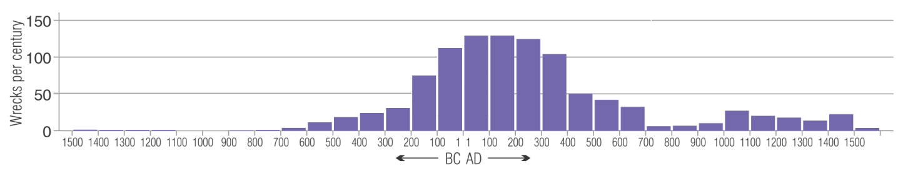
Simple Quantification
Maritime Archaeology and Ancient Trade in the Mediterranean

Slide 21
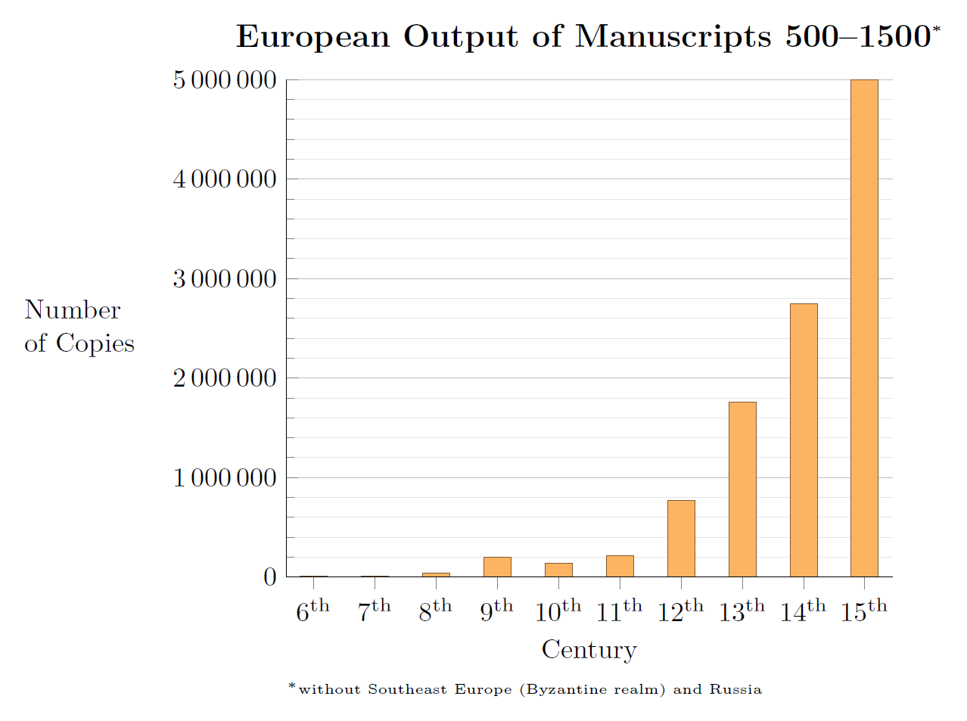
Simple Quantification
Manuscripts and Printed Books in Europe - A Long-Term Perspective from the Sixth through Eighteenth Centuries

Slide 22
Simple Quantification

Slide 23
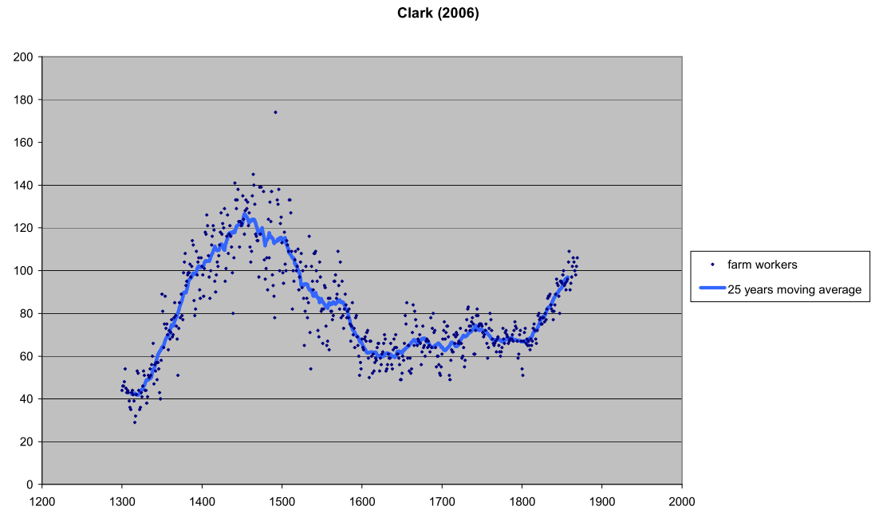
Simple Quantification
GDP per capita or Real Wages? Making sense of conflicting views on pre-industrial Europe.

Slide 24
Simple Quantification
GDP per capita in $2011 international dollars by year, France (blue) and England (pink)

Slide 25

A meme

Slide 26

Counterfactuals

Slide 27

Counterfactuals
“Historical explanations are a form of counterfactual history. To offer an
explanation of what happened, historians have to identify causes, and whenever they identify causes, they immediately conjure up a counterfactual history, a parallel world. No one doubts that there is a great deal of distance between science fiction novelists and the world’s great historians, but along an important dimension, they are playing the same game.”
Historical Explanations Always Involve Counterfactual History

Slide 28
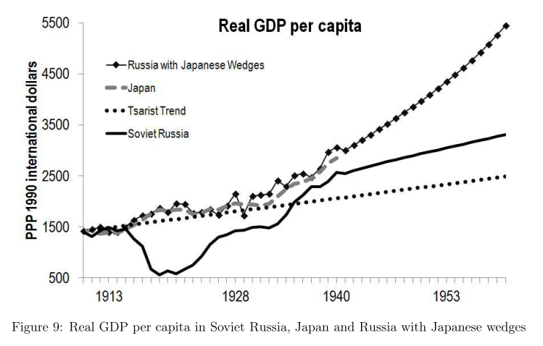
Counterfactuals
Was Stalin Necessary for Russia's Economic Development?

Slide 29
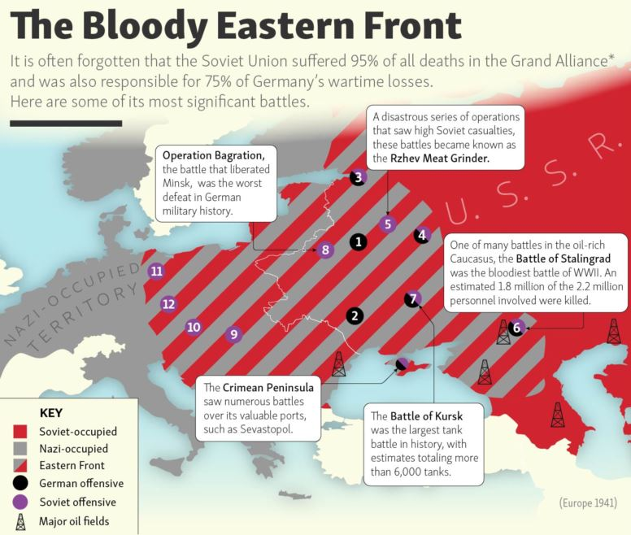
Counterfactuals

Slide 30
Lessons
Principles of good historical research
The value of base rates and case studies
Using simple methods of quantification
Example of estimating historical counterfactuals

Slide 31
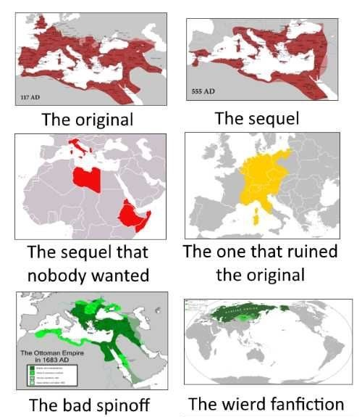
A meme

Slide 32

A meme

Slide 33
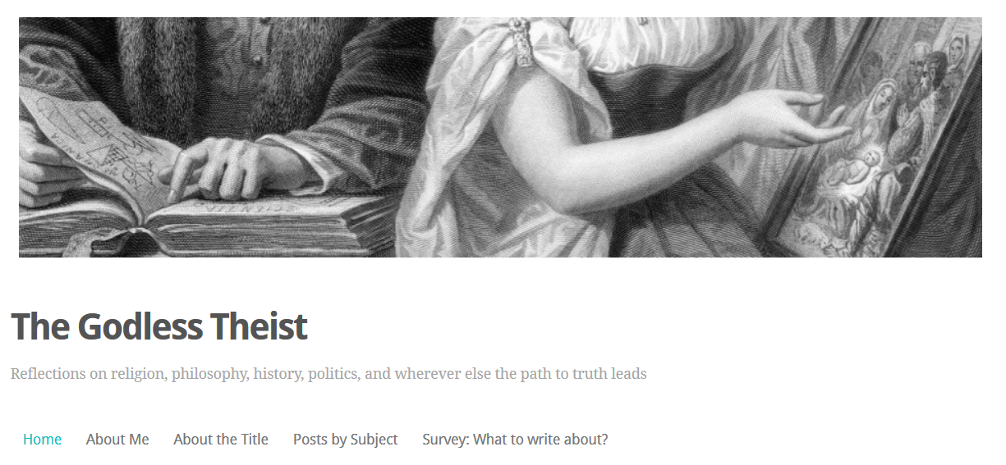
My Blog

