Slide 1
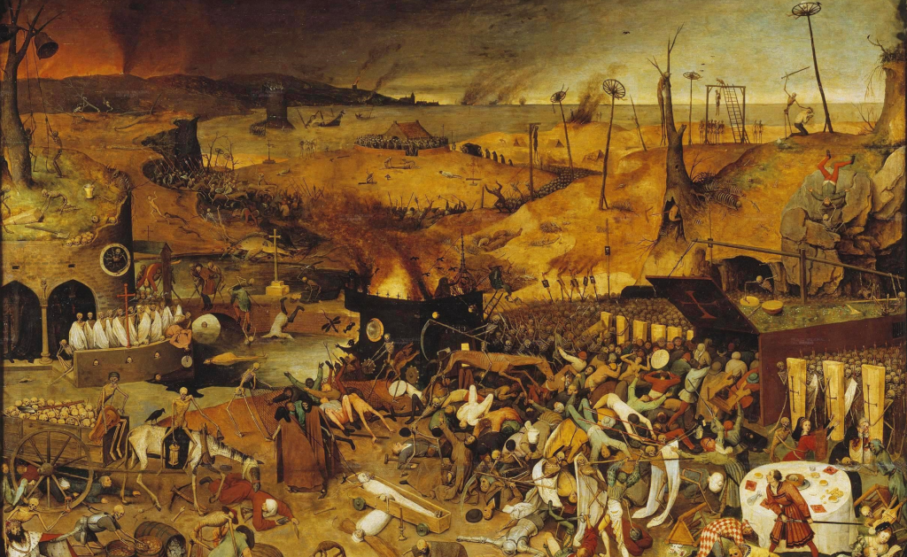
Can we survive a pandemic?
James Fodor and Matthew Wiseman
August 2019

Slide 2
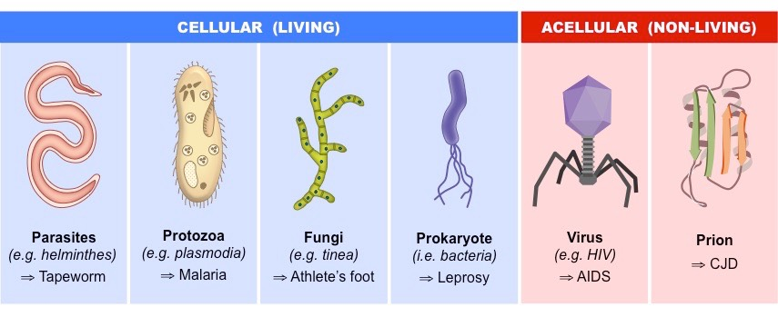


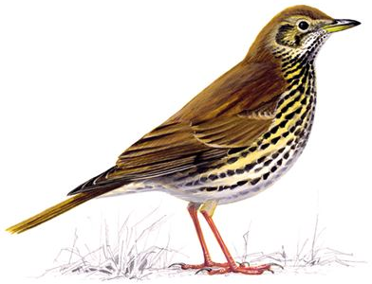
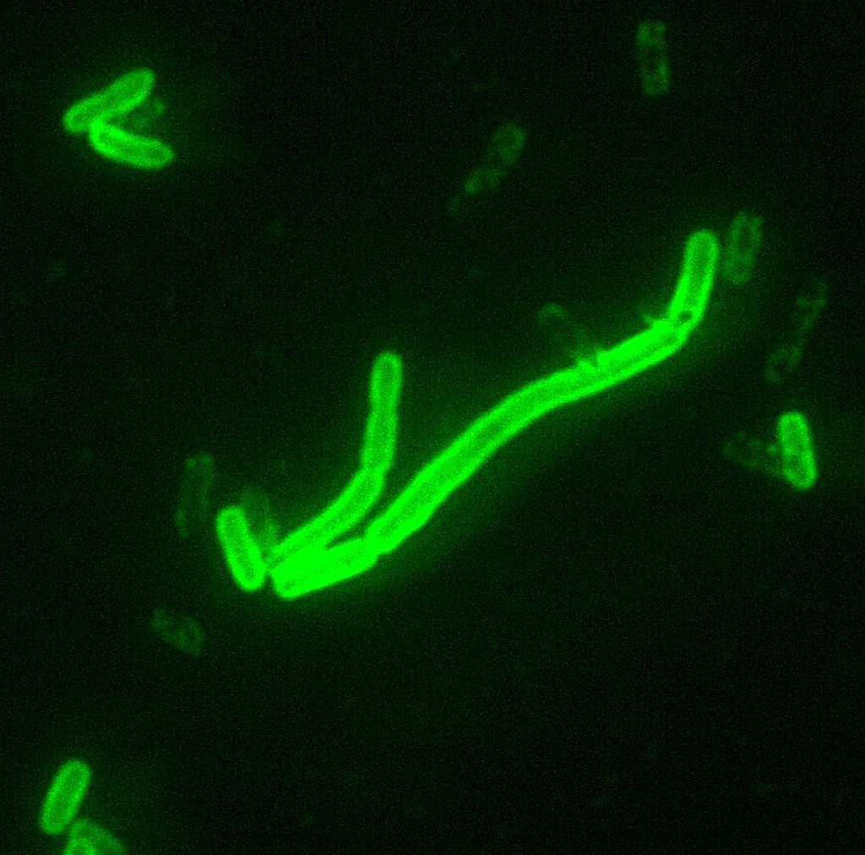


Types of pathogens
Parasitic
Protozoa
Fungal
Bacterial
Viral
Prion
Notes:
Yersinia pestis

Slide 3
Epidemics vs Pandemics
Endemic: A disease is endemic to an area if it exists at a constant rate in that area for a prolonged time
Epidemic: The rapid spread of infectious disease to a large number of people within a short period of time
  Increased virulence (mutations, gene transfer)
  Introduction into a new location (exploration, conquest, trade)
  Changes in host susceptibility (famine, war, other diseases)
Pandemic: An epidemic that has spread across a large region

Slide 4
Factors affecting lethality
Infectivity: direct contact, fomites, vehicles, vectors
Incubation period: time between infection and symptoms
Fatality rate: percent of symptomatic persons who die
Symptomatology
Optimal virulence

Slide 5
Deadliest historical pandemics
Pandemic | Years | Location | Type | Deaths | Deaths %

Slide 6
Deadliest historical pandemics
Pandemic | Years | Location | Type | Deaths | Deaths %
Antonine Plague | 165-180 | Mediterranean | Virus | 5,000,000 | 10

Slide 7
Deadliest historical pandemics
Pandemic | Years | Location | Type | Deaths | Deaths %
Antonine Plague | 165-180 | Mediterranean | Virus | 5,000,000 | 10
Plague of Justinian | 541–542 | Mediterranean and Middle East | Bacteria | 10,000,000 | 25

Slide 8
Deadliest historical pandemics
Pandemic | Years | Location | Type | Deaths | Deaths %
Antonine Plague | 165-180 | Mediterranean | Virus | 5,000,000 | 10
Plague of Justinian | 541–542 | Mediterranean and Middle East | Bacteria | 10,000,000 | 25
Black Death | 1347-1353 | China, Europe, Middle East | Bacteria | 100,000,000 | 30

Slide 9
Deadliest historical pandemics
Pandemic | Years | Location | Type | Deaths | Deaths %
Antonine Plague | 165-180 | Mediterranean | Virus | 5,000,000 | 10
Plague of Justinian | 541–542 | Mediterranean and Middle East | Bacteria | 10,000,000 | 25
Black Death | 1347-1353 | China, Europe, Middle East | Bacteria | 100,000,000 | 30
Cocoliztli epidemic | 1545-1548 | Mexico | Unknown | 5,000,000 | 50

Slide 10
Deadliest historical pandemics
Pandemic | Years | Location | Type | Deaths | Deaths %
Antonine Plague | 165-180 | Mediterranean | Virus | 5,000,000 | 10
Plague of Justinian | 541–542 | Mediterranean and Middle East | Bacteria | 10,000,000 | 25
Black Death | 1347-1353 | China, Europe, Middle East | Bacteria | 100,000,000 | 30
Cocoliztli epidemic | 1545-1548 | Mexico | Unknown | 5,000,000 | 50
Spanish flu | 1918-1919 | Worldwide | Virus | 50,000,000 | 2.5

Slide 11
Deadliest historical pandemics
Pandemic | Years | Location | Type | Deaths | Deaths %
Antonine Plague | 165-180 | Mediterranean | Virus | 5,000,000 | 10
Plague of Justinian | 541–542 | Mediterranean and Middle East | Bacteria | 10,000,000 | 25
Black Death | 1347-1353 | China, Europe, Middle East | Bacteria | 100,000,000 | 30
Cocoliztli epidemic | 1545-1548 | Mexico | Unknown | 5,000,000 | 50
Spanish flu | 1918-1919 | Worldwide | Virus | 50,000,000 | 2.5
HIV/AIDS | 1981- | Worldwide | Virus | 30,000,000 | 0.5

Slide 12
Deadliest historical pandemics
Pandemic | Years | Location | Type | Deaths | Deaths %
Antonine Plague | 165-180 | Mediterranean | Virus | 5,000,000 | 10
Plague of Justinian | 541–542 | Mediterranean and Middle East | Bacteria | 10,000,000 | 25
Black Death | 1347-1353 | China, Europe, Middle East | Bacteria | 100,000,000 | 30
Cocoliztli epidemic | 1545-1548 | Mexico | Unknown | 5,000,000 | 50
Spanish flu | 1918-1919 | Worldwide | Virus | 50,000,000 | 2.5
HIV/AIDS | 1981- | Worldwide | Virus | 30,000,000 | 0.5
World War Two | 1937-1945 | Worldwide | War | 80,000,000 | 3

Slide 13


Slide 14
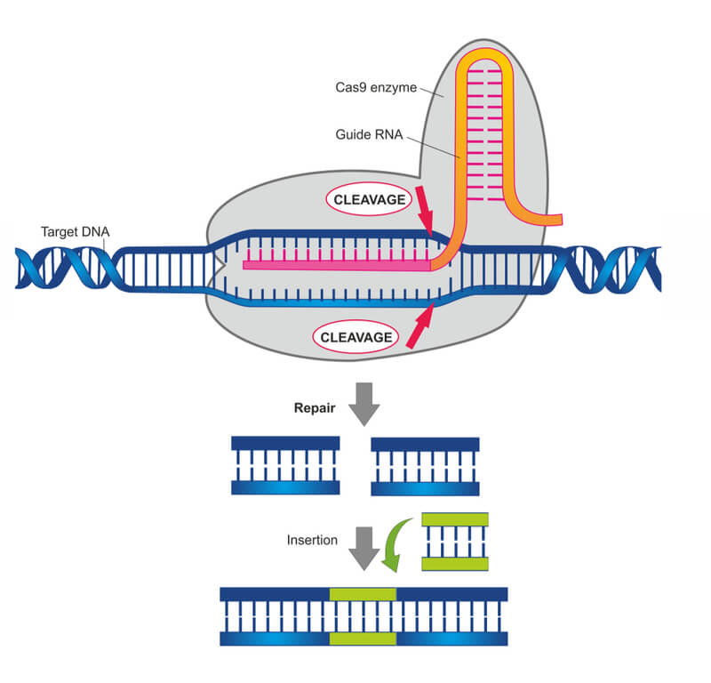
Artificial Pathogens
Revitalised pathogens: smallpox
Noninfectious agents: anthrax
Engineered pathogens
  Gene editing/synthesis
  Regulation of gene expression
  Transformation into host cell
  Immune system avoidance

Slide 15
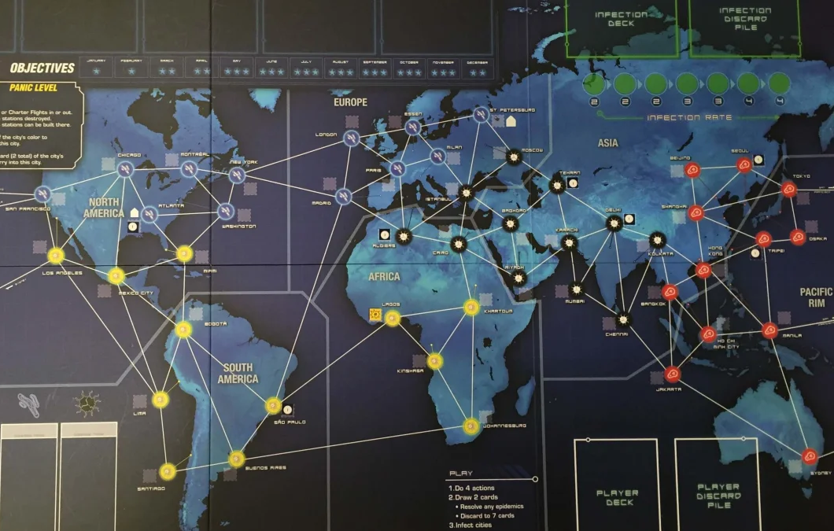
Assessing the Risks
Faster spread now than historically
Hand-washing
Antibiotics and antivirals
Better understanding of public health
Possibility of engineered pathogens

Slide 16
Discussion questions
Do you think the risk of a catastrophic pandemic is higher or lower than in the past?
Do you think natural or engineered pathogens pose a greater threat?

Slide 17

State of play
US: less than $500m annually
Developing countries most affected
There’s no ‘master plan’
WHO - monitors disease outbreaks
Cycle of perpetually insufficient action
Millions of deaths, potentially trillions of losses in GDP

Slide 18
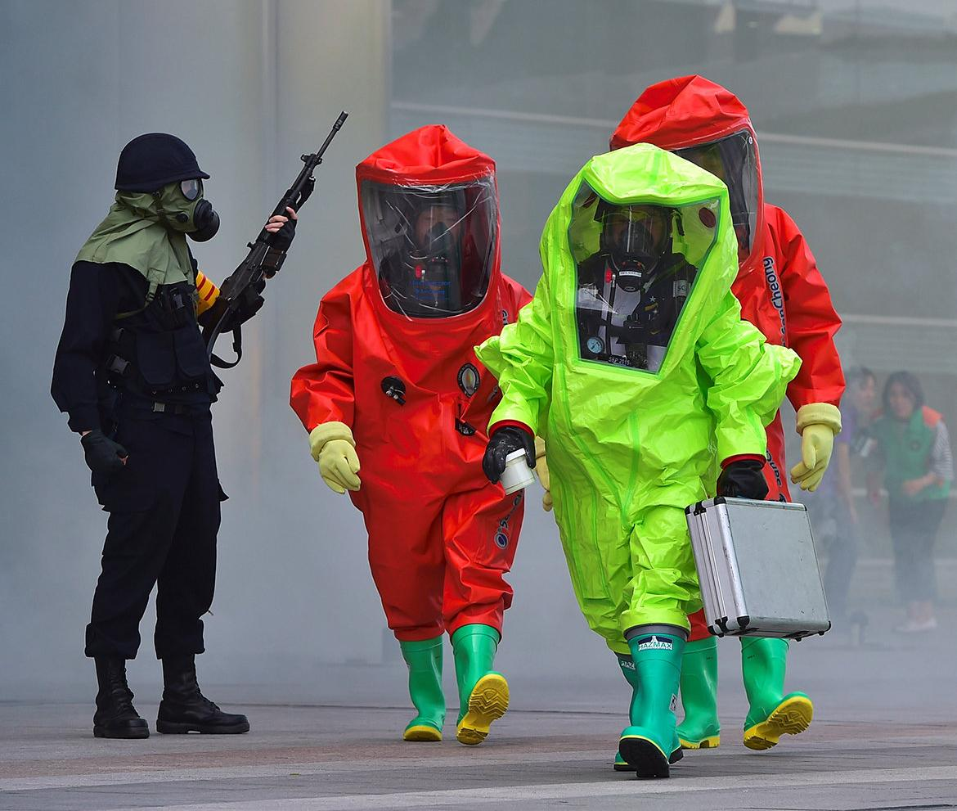
Bioterrorism
Several precedents
Different attack modes
Capabilities vs motives
Increasing access
  States/research facilities
  Speed
  Resources
  Knowledge

Slide 19

Prevention
First line of defence: health systems
Keep in mind: trade-offs
Regulate research/publication
Regulate possession of genomes
‘Soft’ oversight
Laboratory security
Reduce factory farming

Slide 20
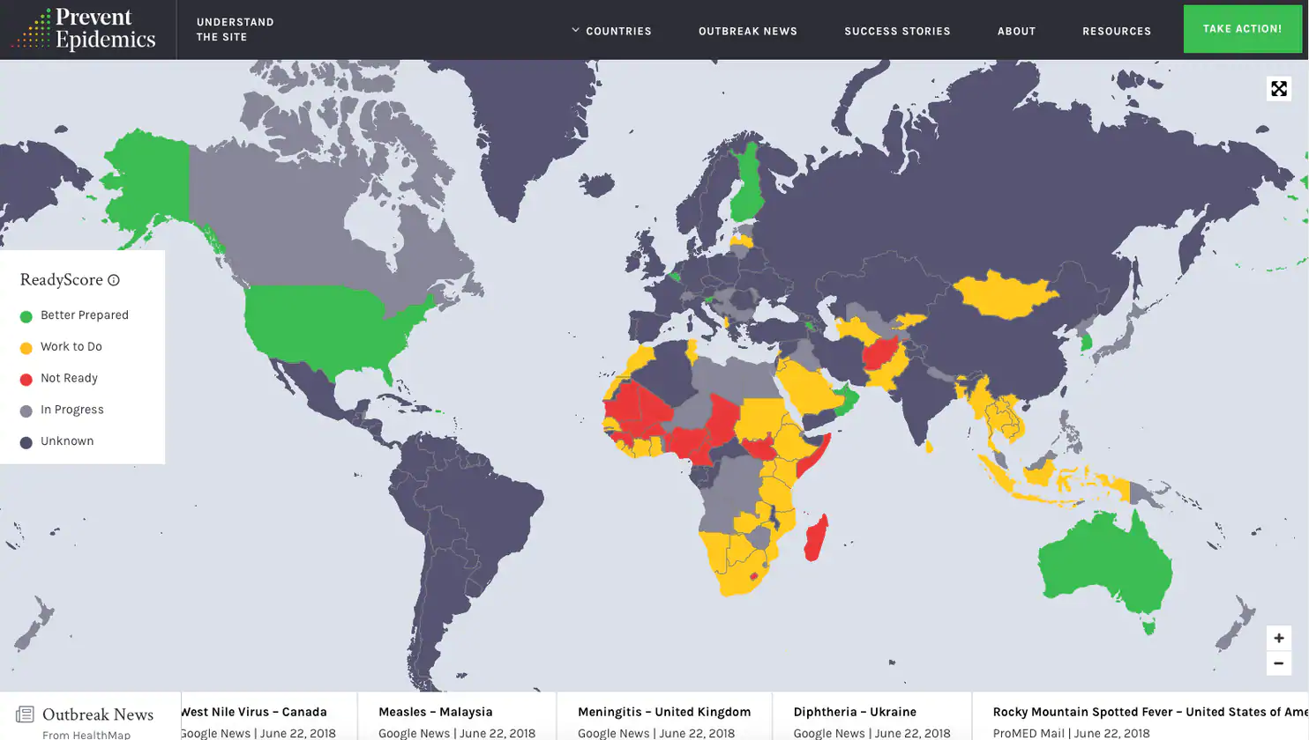
Detection
Goal: increase preparation time
Real threats vs hoaxes
Identify ‘hot zone’
Knowledge of local doctors
Coordinated surveillance
AI

Slide 21
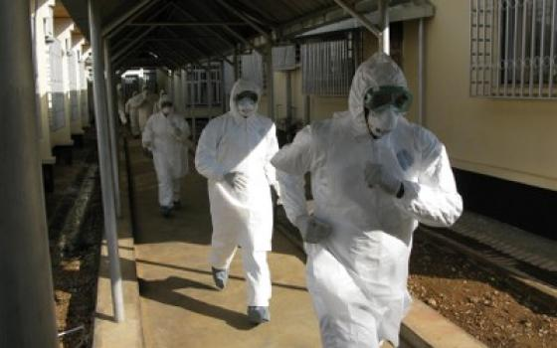
Response
Global coordination, communication
Treating those affected
Vaccines, antibiotics, antivirals
Ring vs herd vaccination
Quicker vaccine availability
Quarantine
Public order

Slide 22
Organisations working on biosecurity
EA orgs
  Future of Humanity Institute
  Cambridge Centre for the Study of Existential Risk
  Global Catastrophic Risk Institute
US government
  Centres for Disease Control and Prevention
  National Institutes of Health
The Skoll Global Threats Fund
The Gates Foundation
Various US think tanks

Slide 24
Sources

