Slide 1

Where does morality come from?
James Fodor, June 2017

Slide 2

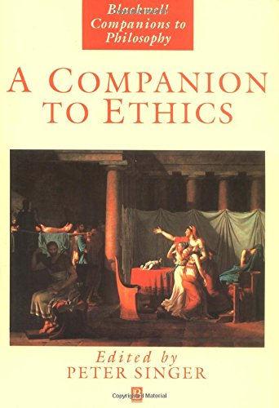

Some sources

Slide 3
Some Ideas to Discuss
What is morality?
Is morality objective and/or universal?
How can we know what is moral/right?
What reasons do we have for acting morally?
How can ethical theory help us to live better?

Slide 4
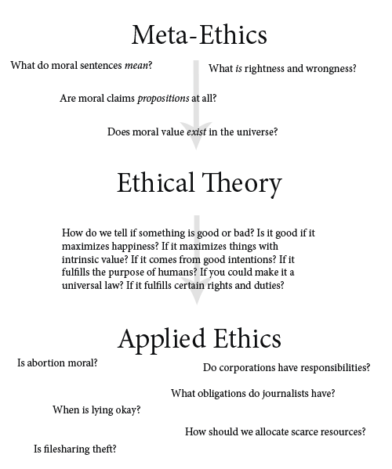
http://commonsenseatheism.com

Slide 5
Attitudes towards morality
Objectivism: facts about what is right or wrong, good or bad, which are true independently of what anyone thinks about those facts
Subjectivism: facts about what is right or wrong are true only with respect to a particular person or society
Nihilism or non-cognitivism: there are no moral facts about what is right or wrong

Slide 6
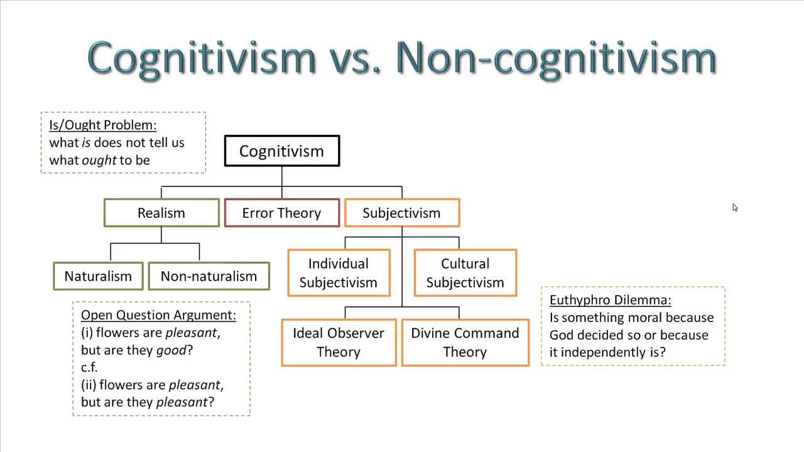
https://i.ytimg.com/vi/BWuzk1ZigcU/maxresdefault.jpg

Slide 7
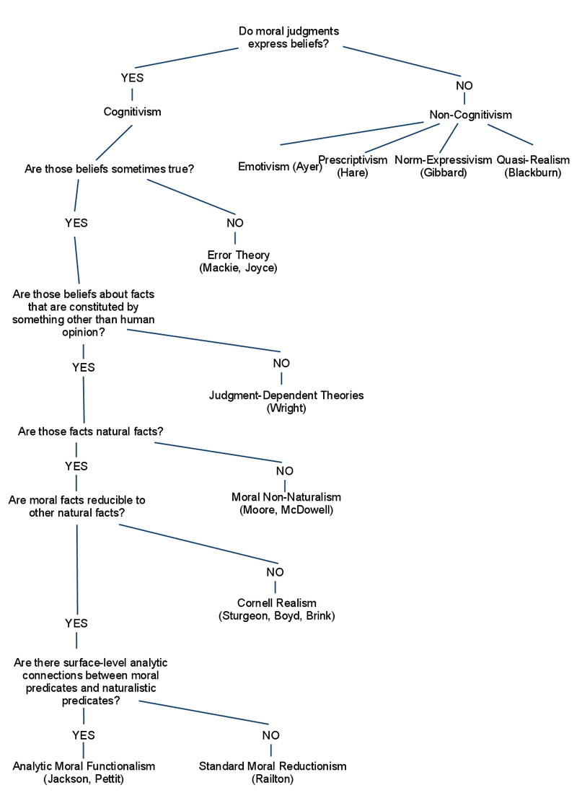
http://commonsenseatheism.com

Slide 8
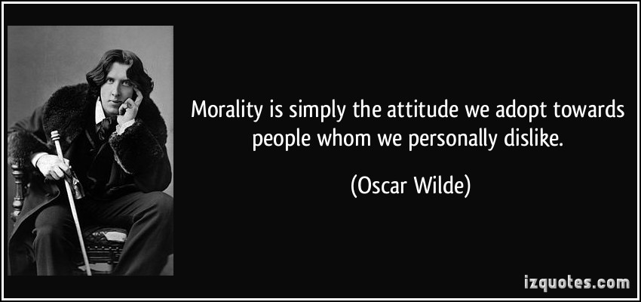
Emotivism

Slide 9
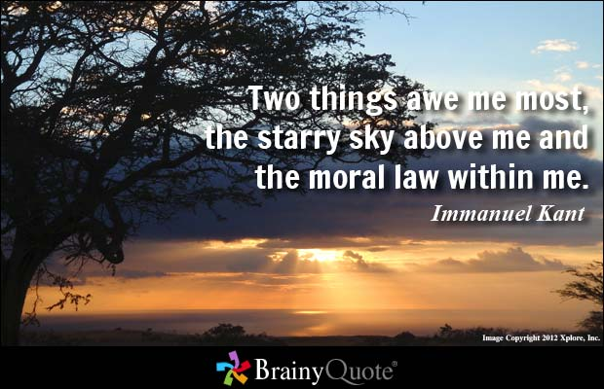
Ethical Intuitionism

Slide 10
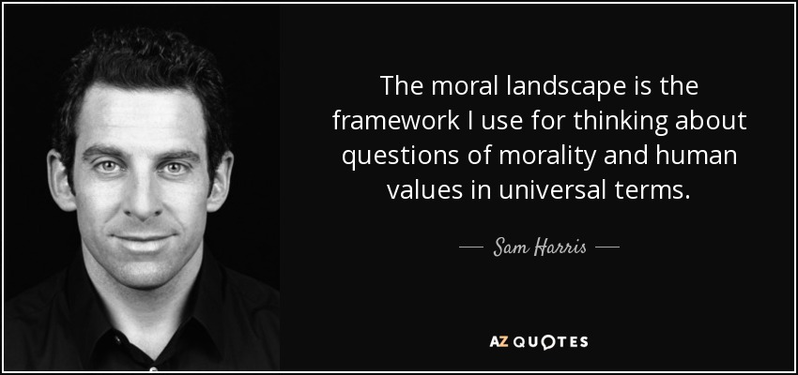
Ethical Naturalism

Slide 11
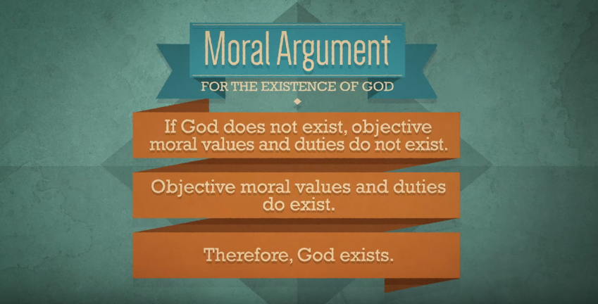
Divine Command Theory

Slide 12
Issues from the Literature
Is morality part of the natural world?
The problem of moral disagreement
What things in the world do moral statements refer to? – open question argument
Are moral judgements intrinsically motivating? – internalism vs externalism
What is the relationship between evolution and morality?

Slide 13
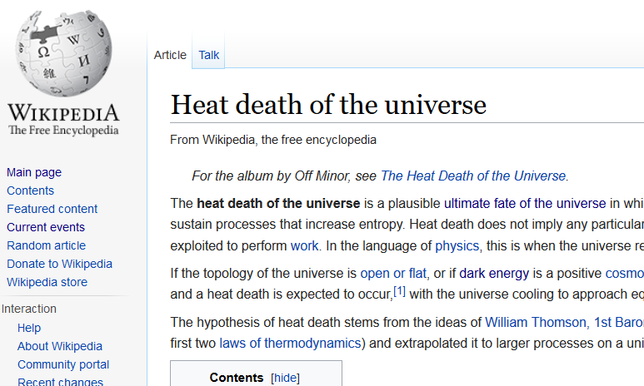
The End

Slide 14
Euthyphro Dilemma
"Is the pious loved by the gods because it is pious, or is it pious because it is loved by the gods?“
"Is what is morally good commanded by God because it is morally good, or is it morally good because it is commanded by God?"

Slide 15
Euthyphro Dilemma
“On the theistic view, objective moral values are rooted in God. God’s own holy and perfectly good nature supplies the absolute standard against which all actions and decisions are measured. God’s moral nature is what Plato called the ‘Good.’ He is the locus and source of moral value. He is by nature loving, generous, just, faithful, kind, and so forth”

Slide 16
Euthyphro Dilemma
“God is by nature good”
What does this mean? What does it mean to predicate “is good” of God?
Is ‘good’ understood with reference to some other properties of God? If so which properties, and what makes them good?
If ‘is good’ means ‘is consistent with God’s nature, then ‘God’s nature is to be good’ means nothing more than ‘God’s nature is to be consistent with his own nature’

