Slide 1


Devil’s Advocate
Week 6: Irrational Beliefs

Slide 2
Do Beliefs Matter?
Actions versus beliefs
Destination versus the journey
Is ‘critical thinking’ about thought processes or beliefs?
Better to be a rational Christian/Muslim/etc than fanatical but uninformed atheist?
Can rational people come to conclusions that others consider to be irrational?

Slide 3


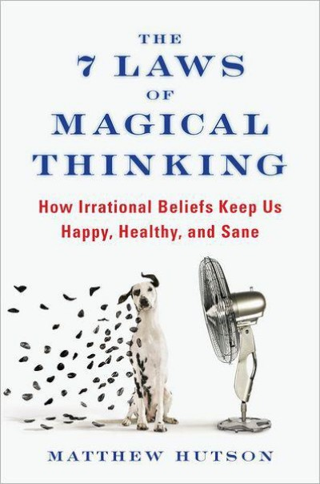
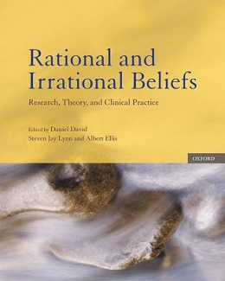

Slide 4
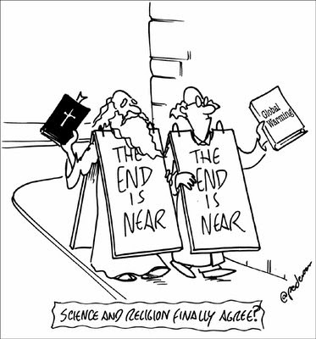

Slide 5
Some Issues
Metaphysical naturalism vs methodological naturalism
Assumptions: uniformitarianism, constant laws of nature, use of maths and logic, induction
Relationship between science and truth
Different ways of explaining the same evidence
Can science ever really prove or disprove anything?

