Slide 1


Devil’s Advocate
Week 4: Is Science an Ideology?

Slide 2
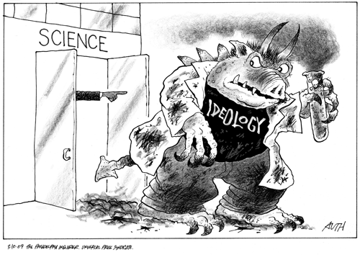
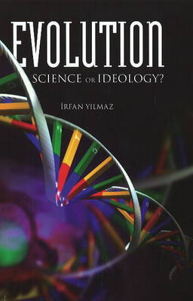
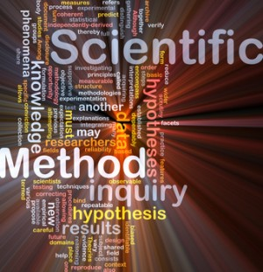
Debates about Science

Slide 3
Creation Ministries Quotes 1
“Is science the search for naturalistic explanations or logical explanations?”
“origins are different to how things work. We can understand how things work today, but we don’t understand where they came from”
(On SETI) “If science cannot detect intelligence, how could they tell what an intelligent message would look like?”
“I cannot understand the irrationality of not understanding/seeing that god made these things” (referring to cellular structure, DNA, etc)

Slide 4
Creation Ministries Quotes 2
Information only comes about by intelligence, and chemistry and physics do not produce information
“Geologists have made a commitment that they will not use Noah’s flood as an explanation”
“Genetics supports the biblical view” through the accumulation of mutations since the fall, Mitochondrial eve and Y-chromosome Adam, common genetic heritage of humans, etc
“The Christian worldview provides the necessary assumptions for science”
“Every dating method is based on assumptions. Its not an observation, its not evidence”

Slide 5
From Wikipedia…
“The foundational premises underlying scientific creationism disqualify it as a science because the answers to all inquiry therein are preordained to conform to Bible doctrine, and because that inquiry is constructed upon theories which are not empirically testable in nature.”
Or…?
“The foundational premises underlying scientific naturalism disqualify it as a science because the answers to all inquiry therein are preordained to conform to a materialistic worldview, and because that inquiry is constructed upon assumptions which are not empirically testable in nature.”

Slide 6
Some Issues
Metaphysical naturalism vs methodological naturalism
Assumptions: uniformitarianism, constant laws of nature, use of maths and logic, induction
Relationship between science and truth
Different ways of explaining the same evidence
Can science ever really prove or disprove anything?

