Slide 1
Scientific Proof
People sometimes make statements like “Science has proven that Creationism is wrong” or “Homeopathy has been scientifically proven not to work”. Are such claims valid? Can science ever “prove” something to be true or false? Are there any limits to the topics science can investigate? Join us for an engaging group discussion of these important issues!

Slide 2
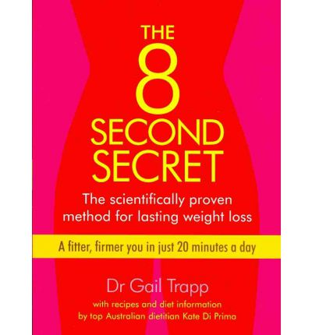

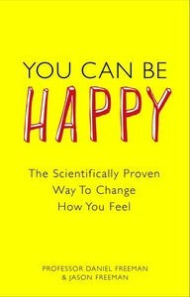
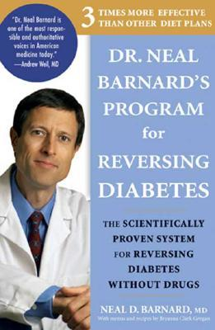
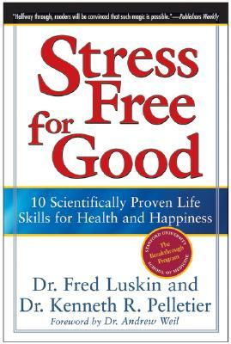
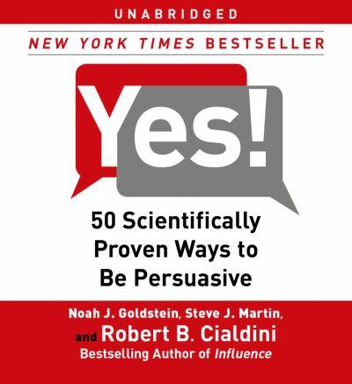

Slide 3
A Critique of ‘Scientific Proof’
Scientific answers are never final, only tentative, so ‘proof’ is far too strong a word
Science does not provide answers or proves, only inferences about possible relationships and causal mechanisms
You can always come up with alternative inferences that explain any given set of data
Proof is a word used in mathematics (and law) when underlying axioms and operations are well defined and universality accepted – outside this framework it should not be used

Slide 4
Obligatory Einstein Quote
“As far as the laws of mathematics refer to reality, they are not certain; and as far as they are certain, they do not refer to reality.”
Albert Einstein, addressing the Prussian Acadamy of Science, Berlin , Jan 27, 1921

Slide 5
Case Study 1: Homeopathy
“In homeopathy, treatment is usually tailored to the individual. A homeopathic prescription is based not only on the symptoms of disease in the patient but also on a host of other factors that are particular to that patient, including lifestyle, emotional health, personality, eating habits and medical history. The “efficacy” of an individualised homeopathic intervention is thus a complex blend of the prescribed medicine together with the other facets of the in-depth consultation and integrated health advice provided by the practitioner; under these circumstances, the specific effect of the medicine itself may be difficult to quantify with precision in RCTs.” (from BHA website)

Slide 6
Case Study 2: Telepathy
Negative energy vibrations of skeptics cause these effects to be reduced or disappear in some studies
“A great deal of reported extrasensory perception is said to occur spontaneously in conditions which are not scientifically controlled. Such experiences have often been reported to be much stronger and more obvious than those observed in laboratory experiments.”

Slide 7
Case Study 3: Creationism
“Creationists and evolutionists, Christians and non-Christians all have the same evidence—the same facts. Think about it: we all have the same earth, the same fossil layers, the same animals and plants, the same stars—the facts are all the same.
The difference is in the way we all interpret the facts. And why do we interpret facts differently? Because we start with different presuppositions. These are things that are assumed to be true, without being able to prove them. These then become the basis for other conclusions. All reasoning is based on presuppositions (also called axioms).”
“That’s why, when discussing the age of the earth, Christians must be ready to explain the importance of starting points and assumptions. Reaching the correct conclusions requires the right starting point. The Bible is that starting point.””

Slide 8
What Saith the Skeptic?
“What can a scientific skeptics’ group say about such (untestable) claims? Only that they are outside the realm of science, and that science can have only an agnostic view toward untestable hypotheses. A rationalist may argue that maintaining an arbitrary opinion about an untestable hypothesis is irrational-and he may be right. But this is a philosophical argument, not a scientific one. If an individual makes a personal choice to maintain a belief regarding an untestable hypothesis with no claims to evidence in support of that belief, then there is no scientific basis on which to challenge the belief.”

Slide 9
Sources
http://www.talkorigins.org/faqs/comdesc/sciproof.html
http://en.wikipedia.org/wiki/Extra-sensory_perception
http://en.wikipedia.org/wiki/Flood_geology
http://en.wikipedia.org/wiki/Homeopathy
http://www.britishhomeopathic.org/research/the_evidence_for_homeopathy.html
http://www.answersingenesis.org/articles/am/v7/n4/ten-best-evidences?utm_source=homepage&utm_medium=banner&utm_campaign=10-evidences-campaign
http://www.genuinethriving.com/2011/04/26/the-scientific-evidence-for-telepathy-psi-phenomena-part-1/
http://www.csicop.org/si/show/scientific_skepticism_csicop_and_the_local_groups

