Slide 1
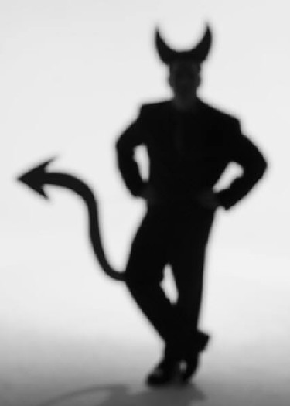
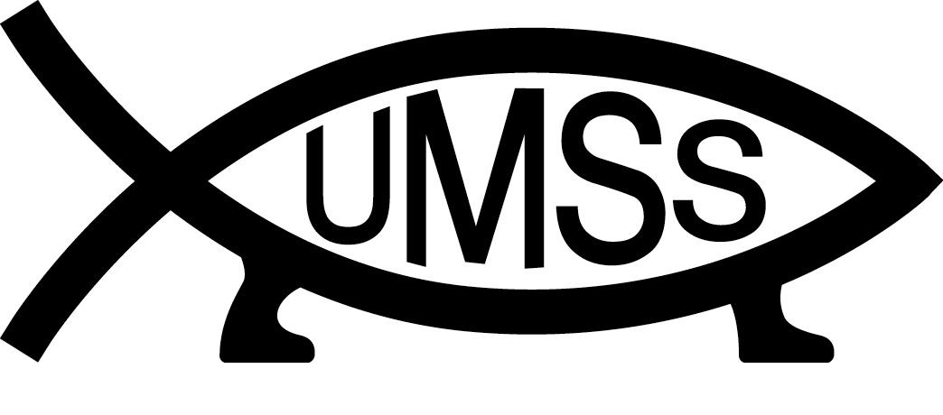
Devil’s Advocate
Week 10: Scientific Proof

Slide 2
A Critique of ‘Scientific Proof’
Scientific answers are never final, only tentative, so ‘proof’ is far too strong a word
Science does not provide answers or proves, only inferences about possible relationships and causal mechanisms
You can always come up with alternative inferences that explain any given set of data
Proof is a word used in mathematics (and law) when underlying axioms and operations are well defined and universality accepted – outside this framework it should not be used

Slide 3
An Example

Slide 4
Obligatory Einstein Quote
“As far as the laws of mathematics refer to reality, they are not certain; and as far as they are certain, they do not refer to reality.”
Albert Einstein, addressing the Prussian Acadamy of Science, Berlin , Jan 27, 1921

Slide 5
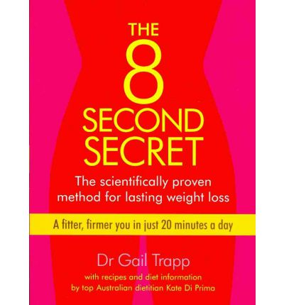

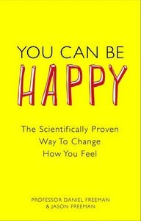
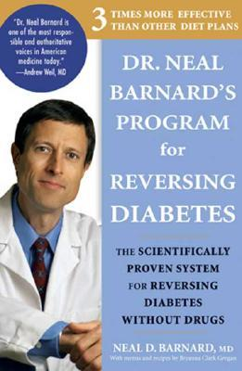
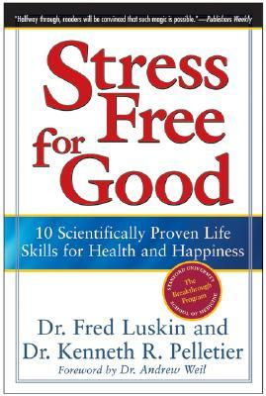
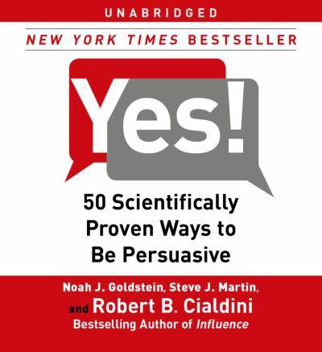

Slide 6
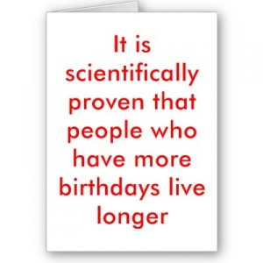

Slide 7
Case Study 1: Homeopathy
“Hahnemann experimented on himself and others for several years before using remedies on patients. His experiments did not initially consist of giving remedies to the sick, because he thought that the most similar remedy, by virtue of its ability to induce symptoms similar to the disease itself, would make it impossible to determine which symptoms came from the remedy and which from the disease itself. Therefore, sick people were excluded from these experiments.”

Slide 8
Case Study 1: Homeopathy
In my experience homeopathy works
Its quantum entanglement/chaos theory/[insert other crap]
“A total of 163 RCTs in homeopathy (on 77 different medical conditions) have been published in good quality scientific journals. 41% of the RCTs have a balance of positive evidence, 7% have a balance of negative evidence, and 52% have not been conclusively positive or negative.” (from BHA website)
Mainstream medicine suppresses positive homeopathy results
We don’t understand how it works we just know it does

Slide 9
Case Study 1: Homeopathy
“In homeopathy, treatment is usually tailored to the individual. A homeopathic prescription is based not only on the symptoms of disease in the patient but also on a host of other factors that are particular to that patient, including lifestyle, emotional health, personality, eating habits and medical history. The “efficacy” of an individualised homeopathic intervention is thus a complex blend of the prescribed medicine together with the other facets of the in-depth consultation and integrated health advice provided by the practitioner; under these circumstances, the specific effect of the medicine itself may be difficult to quantify with precision in RCTs.” (from BHA website)

Slide 10
Case Study 2: Telepathy
“J.B. Rhine, who is considered to be the father of modern parapsychology. He would have participants “read his mind” and guess the shape that was on the card he was holding. Rhine’s studies produced statistically significant results, time and time again. The one downfall to this method of experimenting is that it’s hard to know whether or not Rhine was measuring telepathy or clairvoyance.”

Slide 11
Case Study 2: Telepathy
“Proponents of the ESP phenomena point to numerous studies that cite evidence of the phenomenon‘s existence: the work of J. B. Rhine, Russell Targ, Harold E. Puthoff and physicists at SRI International in the 1970s…”
Negative energy vibrations of skeptics cause these effects to be reduced or disappear in some studies
“A great deal of reported extrasensory perception is said to occur spontaneously in conditions which are not scientifically controlled. Such experiences have often been reported to be much stronger and more obvious than those observed in laboratory experiments.”

Slide 12
Case Study 2: Telepathy
“In all that I have read about telepathy (both from supporters and skeptics), it is clear to me that telepathy is not a fluke or a one-time event. Telepathy is a very real phenomenon. More than that, I believe, we all possess the ability to be telepathic”

Slide 13
Case Study 3: Young Earth Creationism
“Despite this wealth of evidence, it is important to understand that, from the perspective of observational science, no one can prove absolutely how young (or old) the universe is. Only one dating method is absolutely reliable—a witness who doesn’t lie, who has all evidence, and who can reveal to us when the universe began! And we do have such a witness—the God of the Bible!...In the rush to examine all these amazing scientific “evidences,” it’s easy to lose sight of the big picture. Such a mountain of scientific evidence, accumulated by researchers, seems to obviously contradict the supposed billions of years, so why don’t more people rush to accept the truth of a young earth based on the Bible?
The problem is, as we consider the topic of origins, all so-called “evidences” must be interpreted. Facts don’t speak for themselves. Interpreting the facts of the present becomes especially difficult when reconstructing the historical events that produced those present-day facts, because no humans have always been present to observe all the evidence and to record how all the evidence was produced. Forensic scientists must make multiple assumptions about things they cannot observe. How was the original setting different? Were different processes in play? Was the scene later contaminated? Just one wrong assumption or one tiny piece of missing evidence could totally change how they reconstruct the past events that led to the present-day evidence. That’s why, when discussing the age of the earth, Christians must be ready to explain the importance of starting points and assumptions. Reaching the correct conclusions requires the right starting point. The Bible is that starting point.”

Slide 14
Sources
http://www.talkorigins.org/faqs/comdesc/sciproof.html
http://en.wikipedia.org/wiki/Extra-sensory_perception
http://en.wikipedia.org/wiki/Flood_geology
http://en.wikipedia.org/wiki/Homeopathy
http://www.britishhomeopathic.org/research/the_evidence_for_homeopathy.html
http://www.answersingenesis.org/articles/am/v7/n4/ten-best-evidences?utm_source=homepage&utm_medium=banner&utm_campaign=10-evidences-campaign
http://www.genuinethriving.com/2011/04/26/the-scientific-evidence-for-telepathy-psi-phenomena-part-1/

