Slide 1


Devil’s Advocate
Week 1: Accommodationism

Slide 2
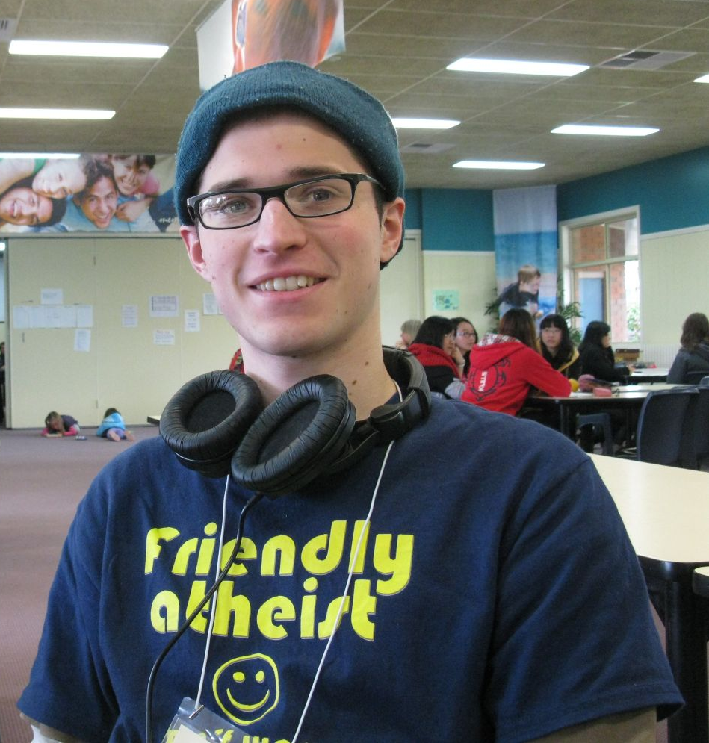

Slide 3

Topics Covered at Summit
Trinity
Jesus as fully human and fully divine
Atonement/Jesus’ death on the cross
Kingdom of God
God and money
Prayer

Slide 4
My Take on Summit
The Good | The Bad
Make lots of intelligent, friendly people | Didn’t much like the singing
No one was rude or confrontational at all | Unfalsifiable claims “sometimes God answers prayers, sometimes he doesn’t”
Learnt more about protestant doctrine and beliefs | Little attention payed to questions of historicity or validity of scripture
Dramatic reading of Luke was excellent | Basic concepts not clearly explained, e.g. Jesus is God and man, Kingdom of God, salvation vs exaltation, free will and divine omnipotence
Had some great discussions about philosophy, probability, theology, history, and Monty Python! | Worship as servile, sycophantic, obsequious, fawning

Slide 5
Operational Definitions
Accommodationalism: leans more towards dialogue, cooperation, finding common ground with religious people. Examples include Chris Mooney, Eugenie Scott
Confrontationalism: leans towards strident criticism of religion or supernatural beliefs and the harm these are said to do to culture, society, etc. Examples include Richard Dawkins, PZ Myers, Sam Harris

Slide 6
A Case for Accommodation/Dialogue
Religion is not monolithic – it’s a wide spectrum
Being confrontational is easy but can backfire
Knowledge of actual doctrines and beliefs helps avoid strawmen and poor arguments
Some religious people are smarter than you are – intellectual honesty requires you deal with this
Increased knowledge of other beliefs/practices/cultures
Make friends!

Slide 7
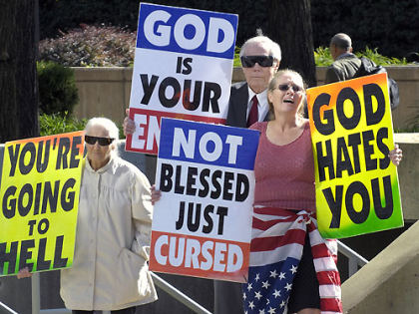


Religion is not Monolithic

Slide 8
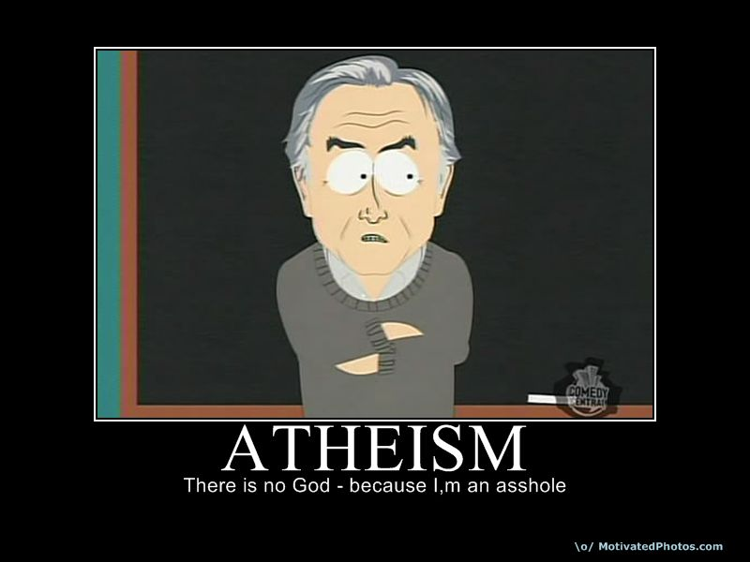
Being Confrontational can Backfire

Slide 9

Avoid Crappy Arguments - 1

Slide 10


Avoid Crappy Arguments - 2

Slide 11
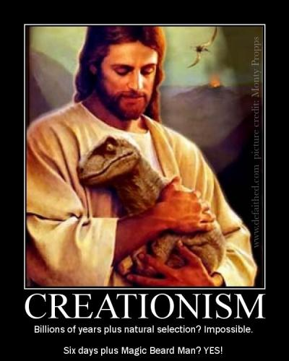
Avoid Crappy Arguments - 3

Slide 12

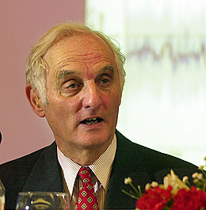
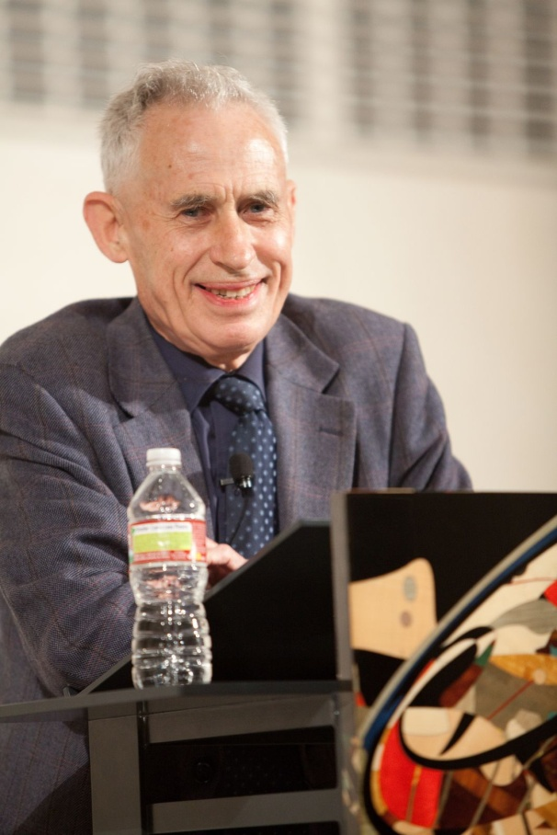
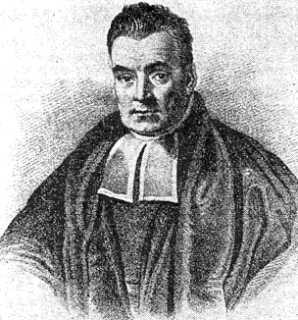
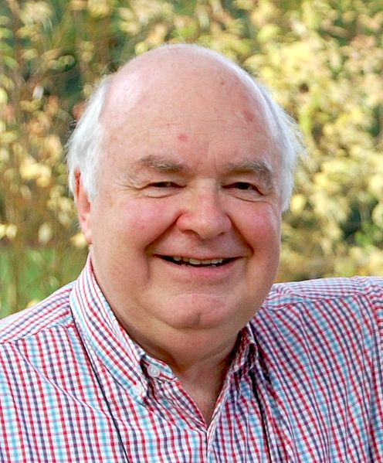

Some Religious People are Smarter than You
Notes:
Francis Collins, John Houghton IPCC, Richard Swinburne, John Lennox, Freeman Dyson, Thomas Bayes

Slide 13



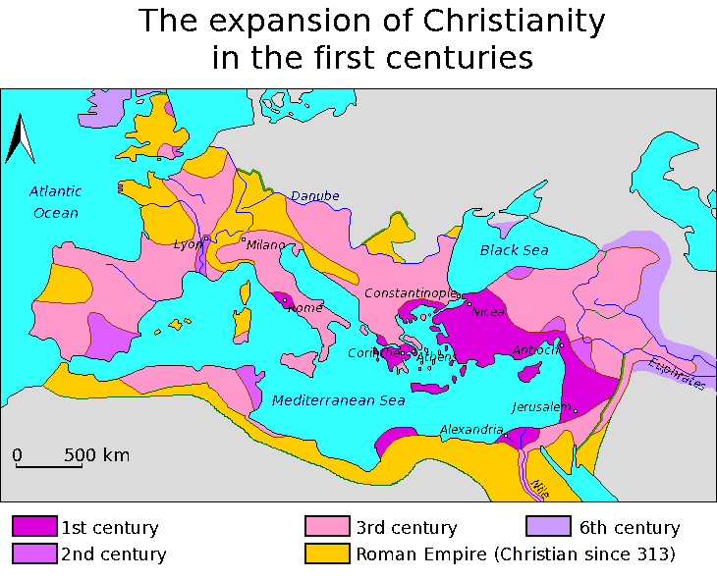

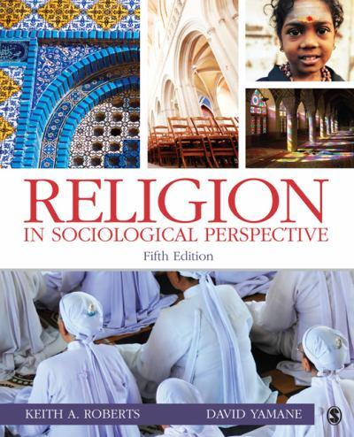




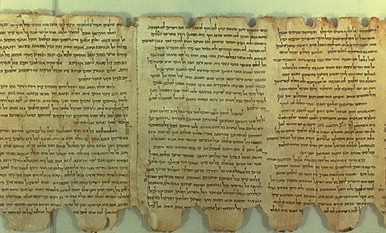

Learn about other Beliefs

Slide 14
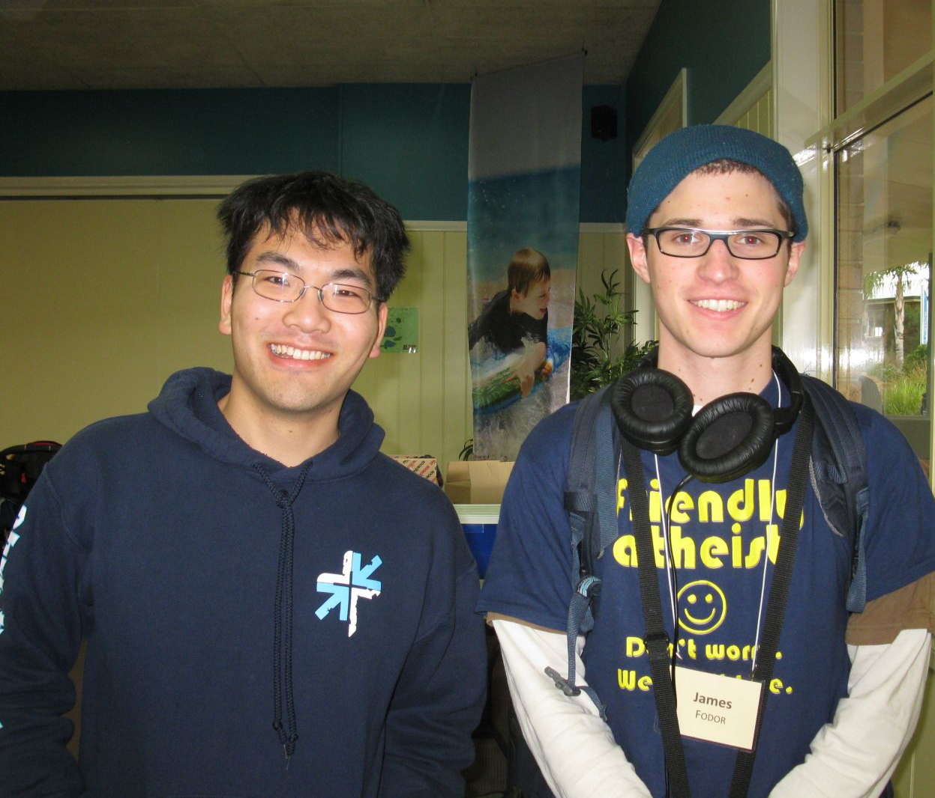
Tom and I at the CU Summit

Slide 15
Links
http://whyevolutionistrue.wordpress.com/2011/10/14/physicist-and-atheist-alan-lightman-goes-accommodationist/
http://freethoughtblogs.com/singham/2012/06/20/the-case-against-accommodationism/
http://www.examiner.com/article/revisiting-the-confrontationalist-vs-accommodationist-feud
http://www.daylightatheism.org/2010/10/tinkerbell-the-accommodationist.html
http://metamagician3000.blogspot.com.au/2011/02/gnu-atheist-does-not-mean-nasty.html
http://www.edge.org/discourse/accomodationism.html

