Slide 1

Tools and Techniques of Program Evaluation
James Fodor, July 2018
Effective Altruism Melbourne

Slide 2
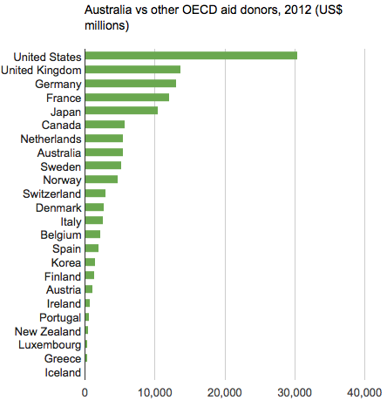
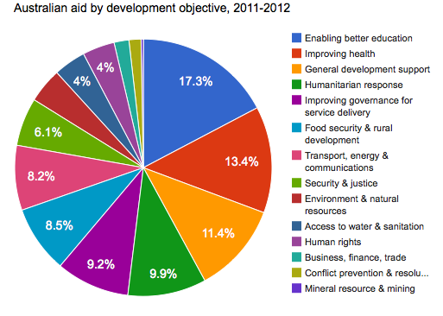
Why Measure?
We will consider the effect of improving education on higher earnings.

Slide 3
How to Measure ‘Education’?
Enrolment rates
Literacy levels
School attendance
National standardised tests
International standardised tests
Employment earnings of graduates
Parent satisfaction with school
Do we trust government data?

Slide 4
How to Measure ‘Income’?
Individual or household earnings?
What period of time? (seasonal work)
How to convert to common currency?
How to value non-market earnings?
Source of data for informal sector?

Slide 5
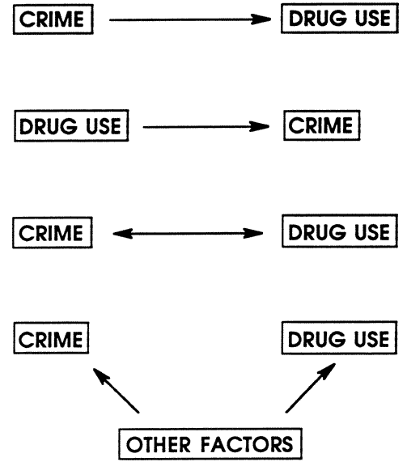
Education and Income
0.
Education
Income
1.
Education
Income
2.
Income
Education
3.
Education
Income
4.
Education
Income

Slide 6
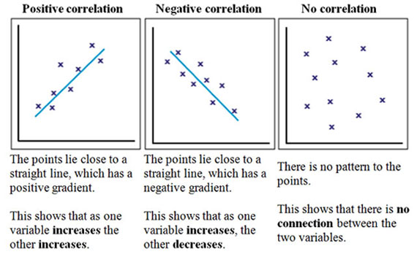
Case 0: Correlation

Slide 7
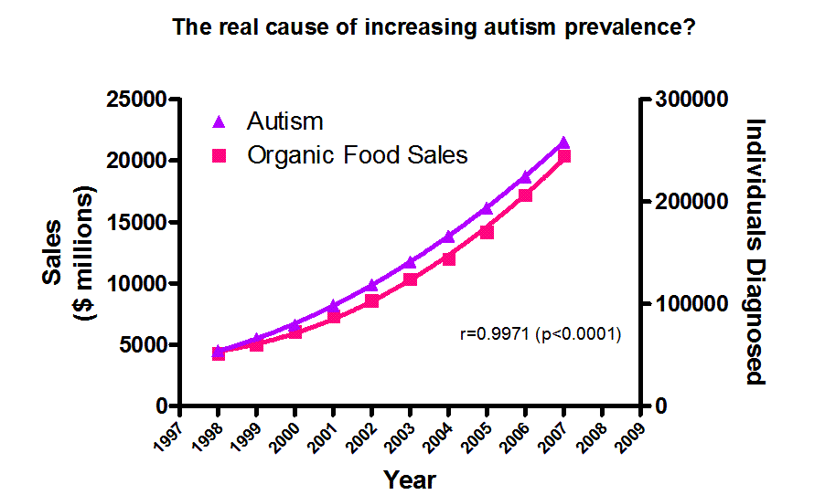
Correlation is Not Causation

Slide 8
Education and Income
Education
Income
Check for correlation
0.
1.
Education
Income
2.
Income
Education
3.
Education
Income
4.
Education
Income

Slide 9
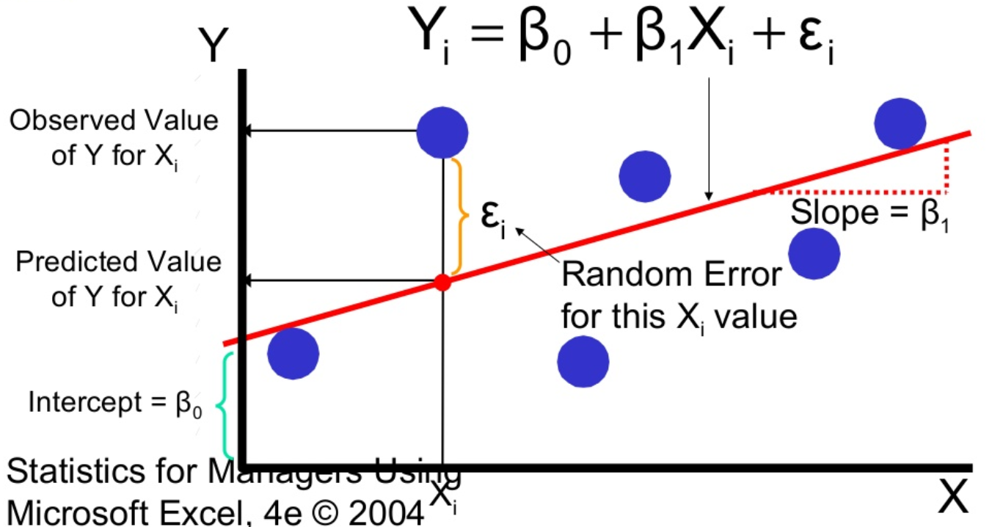
Case 4: Regression Model

Slide 10
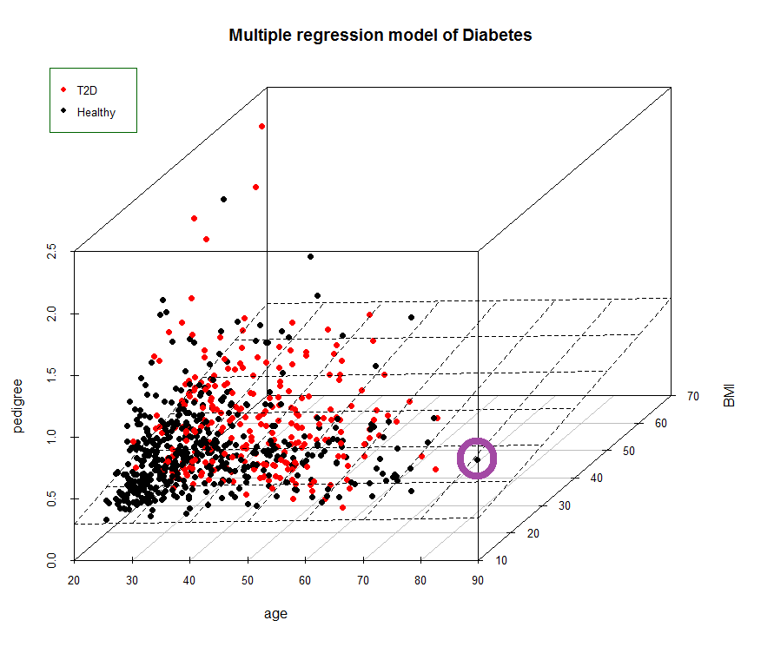
Multiple Regression Model

Slide 11
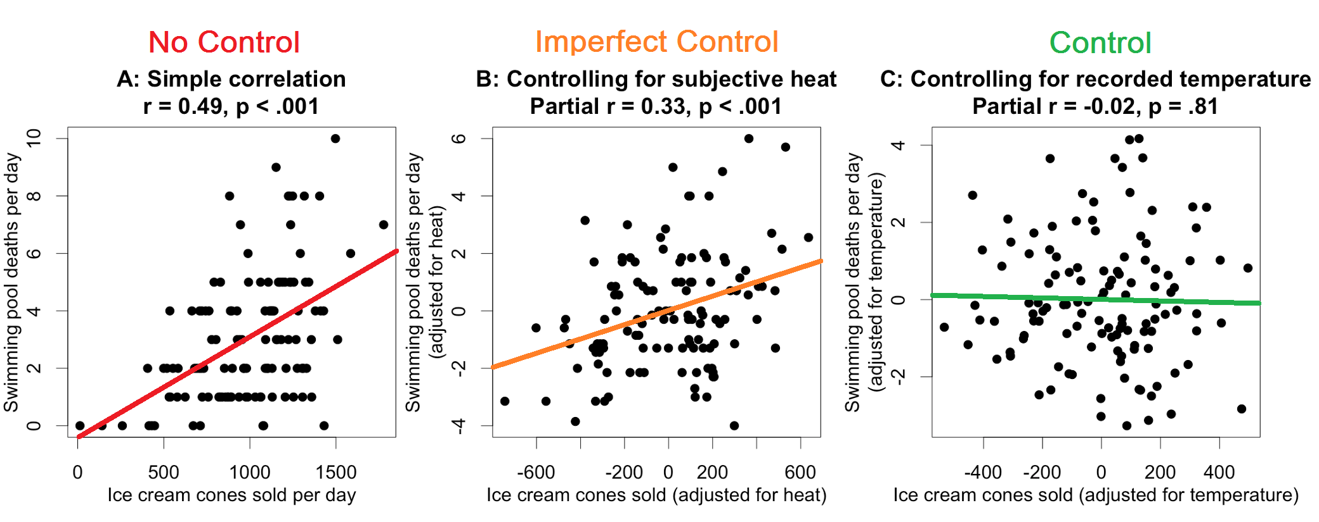
Controlling for Confounds
We can use multiple regression to control for confounding variables.
But our estimates will be biased if we have omitted variables!

Slide 12
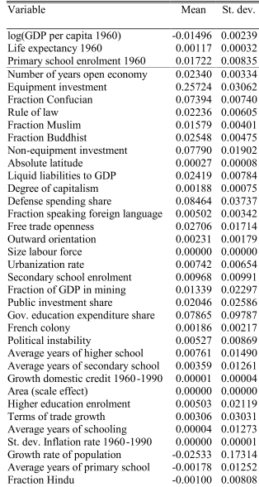
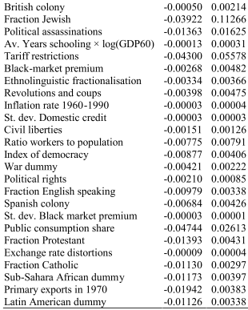
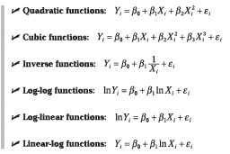
So What is the Right Model?

Slide 13
Education and Income
Education
Income
Check for correlation
0.
1.
Education
Income
2.
Income
Education
3.
Education
Income
4.
Education
Income
Run multiple regression

Slide 14
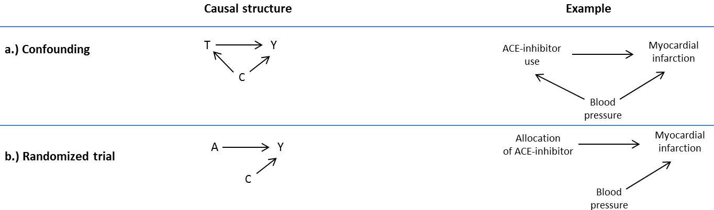
Cases 2-3: Experiments
Instead of trying to control for all confounding variables explicitly, we can just let random variation do the job for us.
If something is decided by chance or by some exogenous factor, it should not be correlated with any unobserved variables!

Slide 15
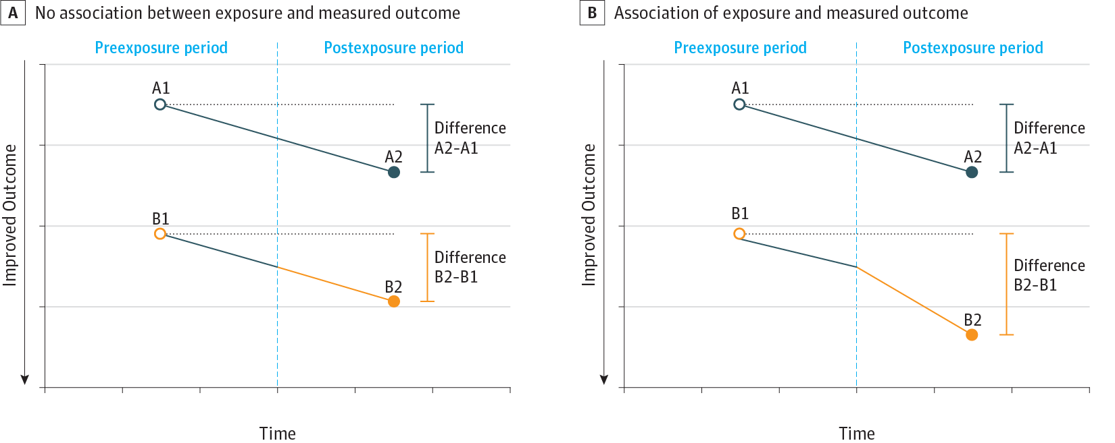
Differences in Differences
Must assume two groups would behave the same absent intervention
Self-selection concerns

Slide 16
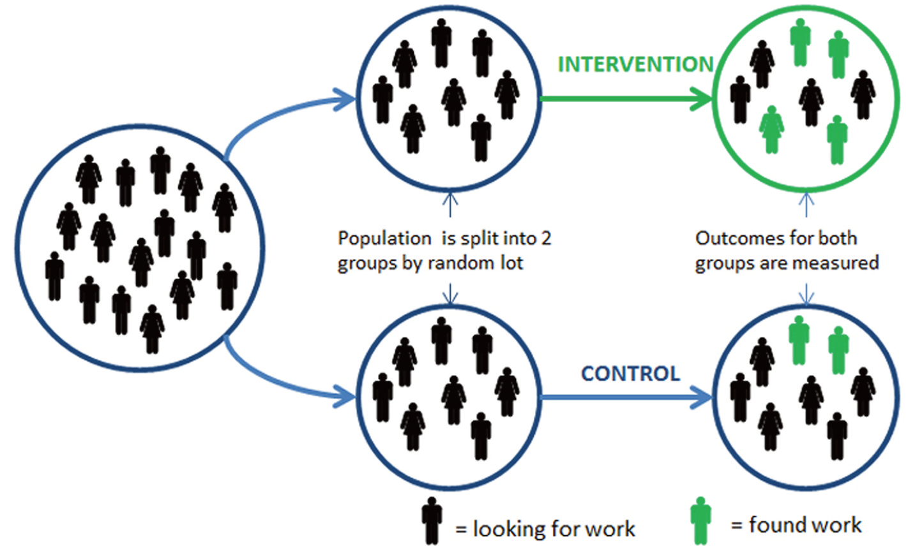
Randomised Controlled Trial
Can be hard/expensive to conduct, but if done properly there cannot be hidden confounds!

Slide 17

Randomised Controlled Trial
?

Slide 18
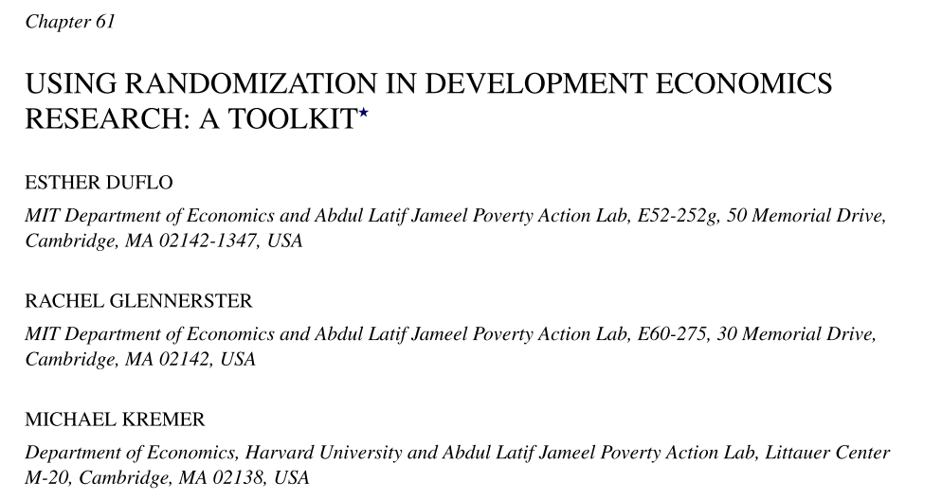
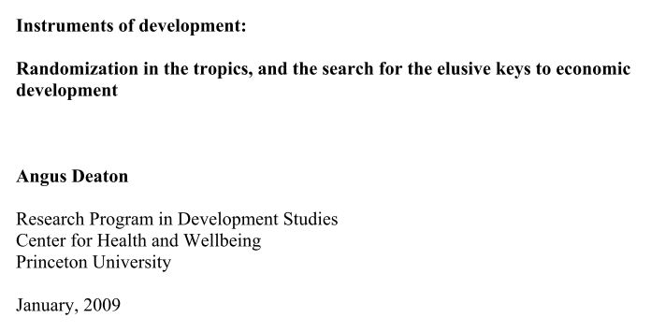
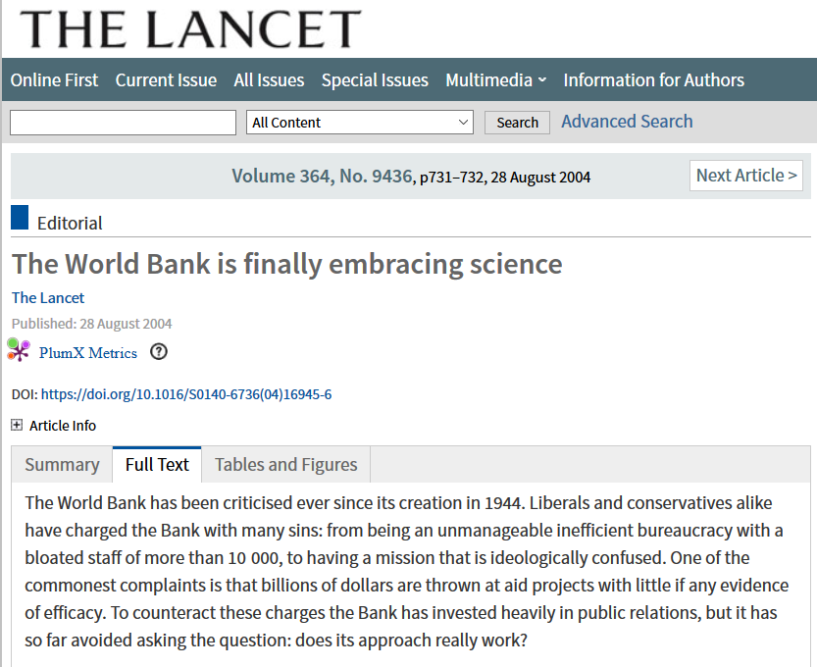

Clash of Econometricians

Slide 19
Limitations of RCTs
Expensive and time consuming, can’t conduct everywhere
Do not incorporate heterogeneity of parameters
Trials differ from full-scale programs
Do not tell us why anything works or doesn’t work

Slide 20
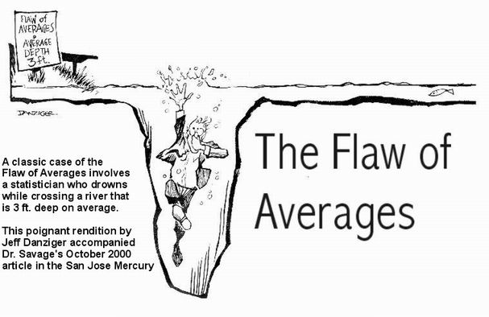
Heterogeneity
RCTs find the true effect size, but only in that exact context. Averaging over contexts is not necessarily helpful either.

Slide 21
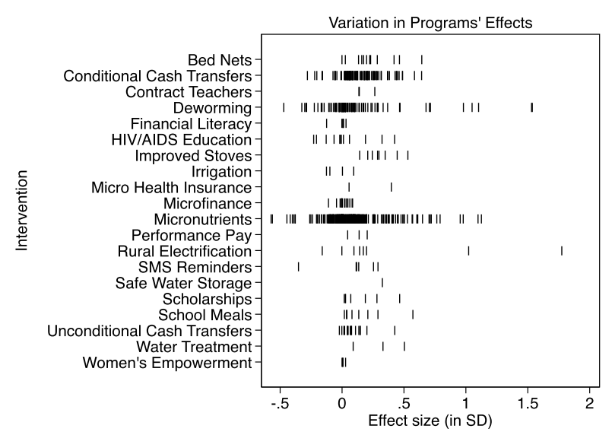
Heterogeneity
Eva Vivalt meta-analysis of RCT results.

Slide 22

Scaling Effects

Slide 23
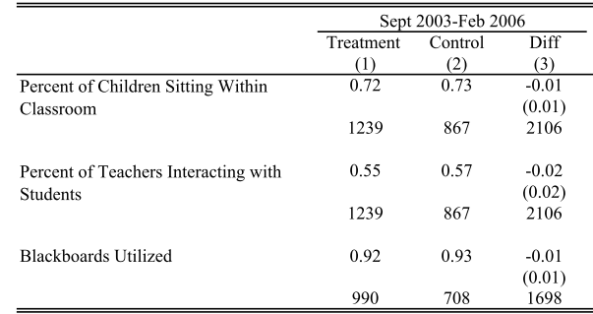
What Do RCTs Tell Us?

Slide 24
Education and Income
Education
Income
Check for correlation
0.
1.
Education
Income
2.
Income
Education
Perform experiments and quasi-experiments
3.
Education
Income
4.
Education
Income
Run multiple regression

Slide 25
More Advanced Stuff
Time series analysis
Panel data
Instrumental variables
Structural modelling
Sensitivity analysis
  Causal modelling

Slide 26

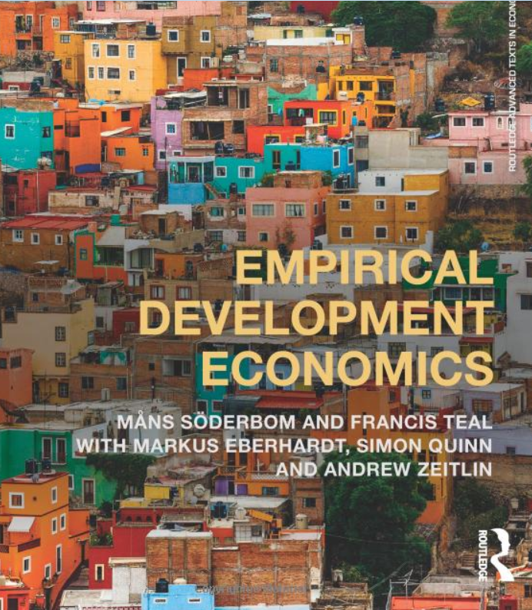
Book Recommendations

Slide 27

My Blog

