Slide 1


The University of Melbourne
Secular Society

Slide 2
Our club aims
(a) to encourage freedom from superstition, irrationalism, and dogma.
(b) to further the acceptance and application of science, reason, and critical thinking on
campus and in the wider community.
(c) to challenge misrepresentations and promote acceptance of non­religious lifestyles.
(d) to promote debate surrounding ideas of religion, science, philosophy, politics and
ethics.
(e) to create a campus community for freethinkers and skeptics.
(f) to cultivate in ourselves — and others — a sense of responsibility to, and compassion
for, humanity.
(g) to counter all forms of religious political extremism.
(h) to defend religious freedom and the separation of church and state.
(i) to defend individual freedoms and civil liberties for all persons, regardless of
race, sex, gender, class, creed, ethnicity, religion, sexual orientation, and disability.
(j) to unite freethinkers, skeptics, atheists, agnostics and humanists in the pursuit of
these common goals.

Slide 3
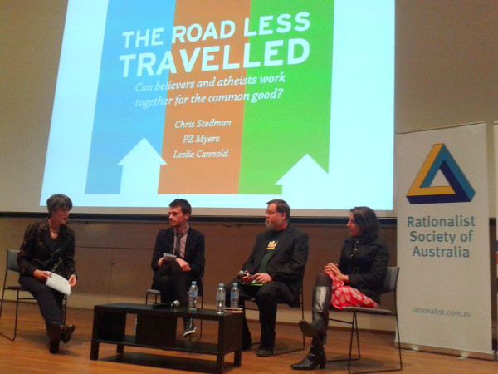

Slide 4
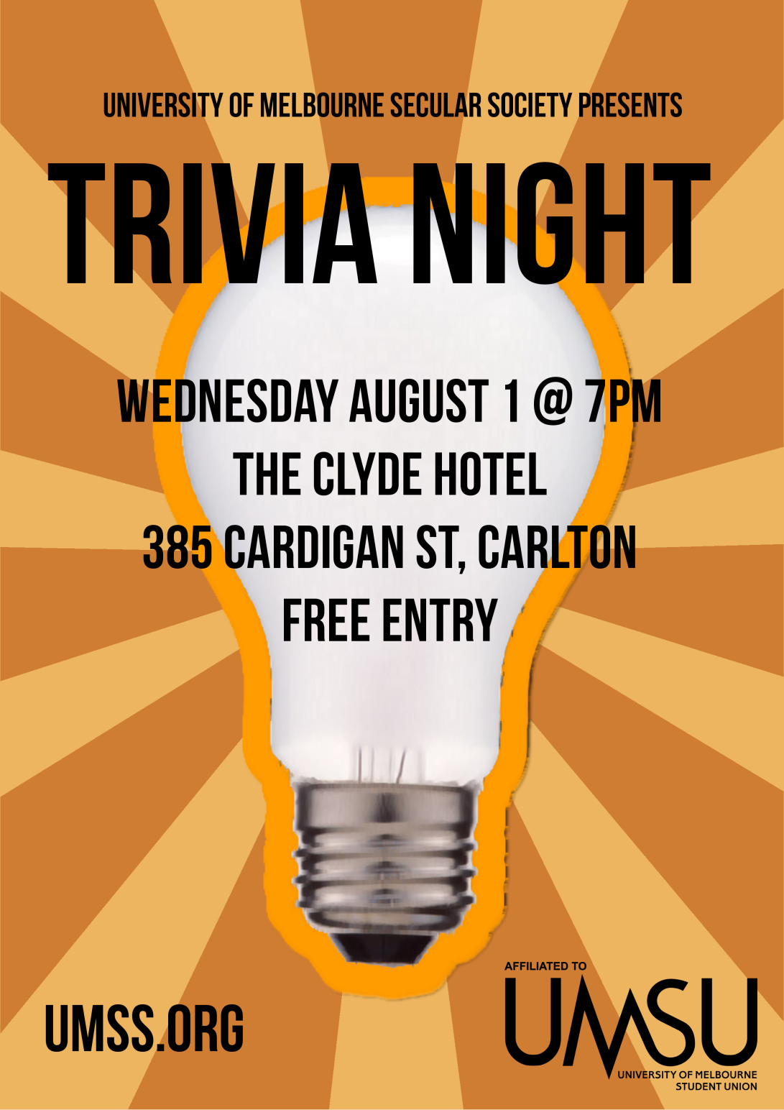

Slide 5


Slide 6
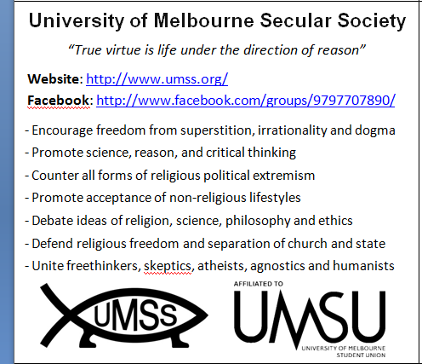

Slide 7
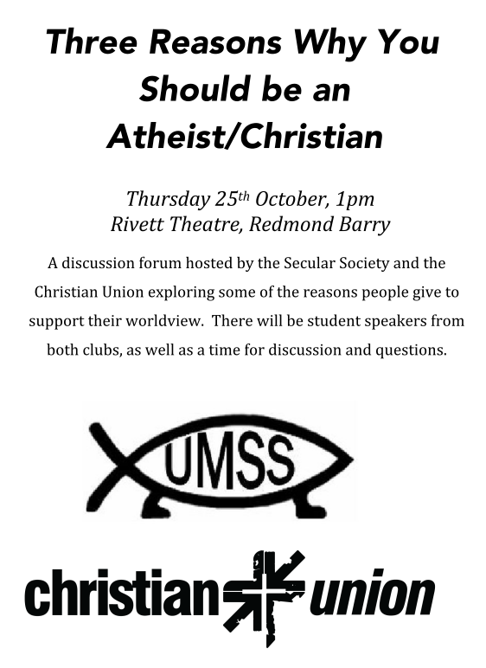

Slide 8
How you can help us
Guest speakers
Printed materials
Cross-promotion
Money!

