Slide 1
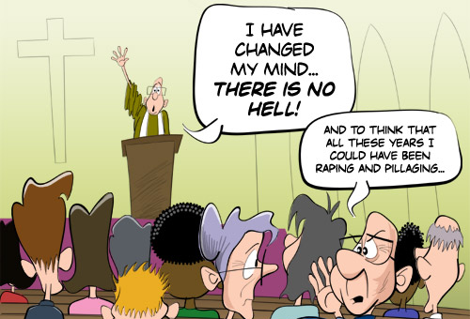
Secular Ethics and Effective Altruism
Synopsis: Can there be a meaningful morality outside of religion? What would such a morality look like? How can we most effectively help others and do good in the world? These are among the questions we will discuss in this event, which will consist of a talk followed by questions and interactive discussion. Come along for a stimulating and enjoyable time.
April 2015

Slide 2
Some Questions
Can there be a secular ethics?
What would secular ethics look like?
What role has Effective Altruism to play?

Slide 3
1. Can there be a Secular Ethics?
Objective moral values: facts about what is right or wrong, good or bad, which are true independently of what anyone thinks about those facts
Subjective moral values: facts about what is right or wrong are true only with respect to a particular person or society
Moral nihilism: there are no moral facts about what is right or wrong

Slide 4
A View on Theistic Ethics
“On the theistic view, objective moral values are rooted in God. God’s own holy and perfectly good nature supplies the absolute standard against which all actions and decisions are measured. God’s moral nature is what Plato called the ‘Good.’ He is the locus and source of moral value. He is by nature loving, generous, just, faithful, kind, and so forth”
http://www.reasonablefaith.org/can-we-be-good-without-god#ixzz3XEhfTXe2

Slide 5
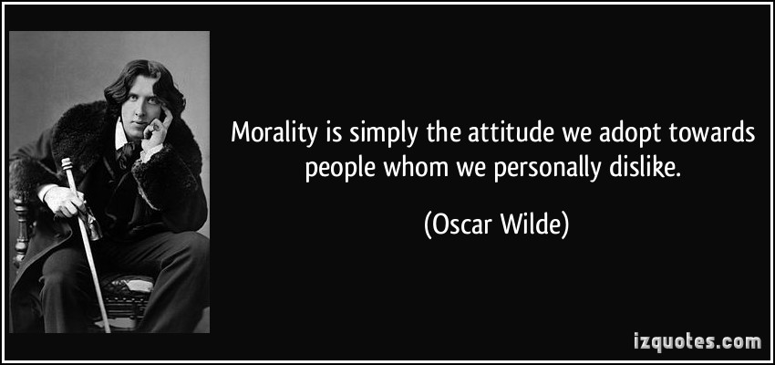
One Perspective

Slide 6
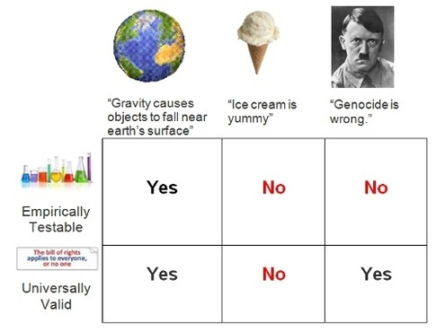
Another Perspective

Slide 7
The Ought-Is Dilemma
“X is a universal moral intuition
“X is part of our evolutionary heritage
“X will maximise happiness/utility/wellbeing
…but is X good?

Slide 8
The Ought-Is Dilemma…for Theists
“X is a universal moral intuition
“X is part of our evolutionary heritage
“X will maximise happiness/utility/wellbeing
“X is commanded by God
“X is an aspect of God’s nature
…but is X good?

Slide 9
Euthyphro Dilemma
"Is the pious loved by the gods because it is pious, or is it pious because it is loved by the gods?“
"Is what is morally good commanded by God because it is morally good, or is it morally good because it is commanded by God?"

Slide 10
God’s nature to be Good
“God is by nature good”
What does this mean? What does it mean to predicate “is good” of God?
Is ‘good’ understood with reference to some other properties of God? If so which properties, and what makes them good?
If ‘is good’ means ‘is consistent with God’s nature, then ‘God’s nature is to be good’ means nothing more than ‘God’s nature is to be consistent with his own nature’

Slide 11
2. What Would a Secular Ethics Look Like?
“On a secular view, objective moral values are rooted in facts about human wellbeing. Human nature, our desires, goals, pains, and pleasures, supplies the absolute standard against which all actions and decisions are measured. This is the locus and source of moral value. It is with reference to promotion of human wellbeing that we understand the value of being loving, generous, just, faithful, kind, and so forth”

Slide 12

The Problem of Relativism?

Slide 13
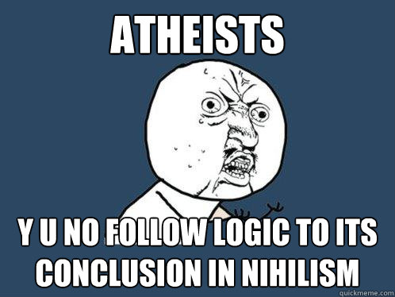
The Problem of Nihilism?

Slide 14
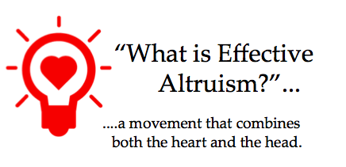
3. Effective Altruism
A social movement concerned with the application of rationality and empirical evidence to determine how to use our limited time and resources to do the most good possible.

Slide 15
Principles of Effective Altruism
It is good, virtuous, right and proper to do good, to help those in need, and to promote human flourishing
We face tradeoffs in the use of our time and resources – we can’t do everything
Some uses of our time and resources will result in helping more people, in doing more good, than others
Careful use of the best empirical evidence can dramatically increase our ability to identify which uses of our time and resources will do most good

Slide 16
Applications of Effective Altruism
What charities should I donate to?
What career should I pursue?
What causes should I volunteer for or help to promote?
How can we determine which causes are most effective?
How can we persuade others to give more and to give more effectively?
How can we balance the demanding ethics of EA with living our own lives?

