Slide 1
Scientific Evidence and Explanation
Synopsis: Many people think about science in a fairly simplistic way: collect evidence, formulate a theory, test the theory. By this method, it is claimed, science can achieve objective knowledge about reality. I will question this simple understanding of science by examining of the key controversies in philosophy of science, including the theory-ladenness of observation, underdetermination, theory choice, and the nature of scientific explanation. I will argue that philosophy of science paints a much richer and messier picture of the relationship between science and truth than many people commonly imagine, and highlight why I think some knowledge of philosophy of science is important for both producers and consumers of scientific knowledge.
James Fodor, 12th October 2014

Slide 2
0. An Overview
“The Scientific Method”
The Theory-Ladenness of Observation
Confirmational Holism
Underdetermination
Models of Scientific Explanation
Conclusions

Slide 3
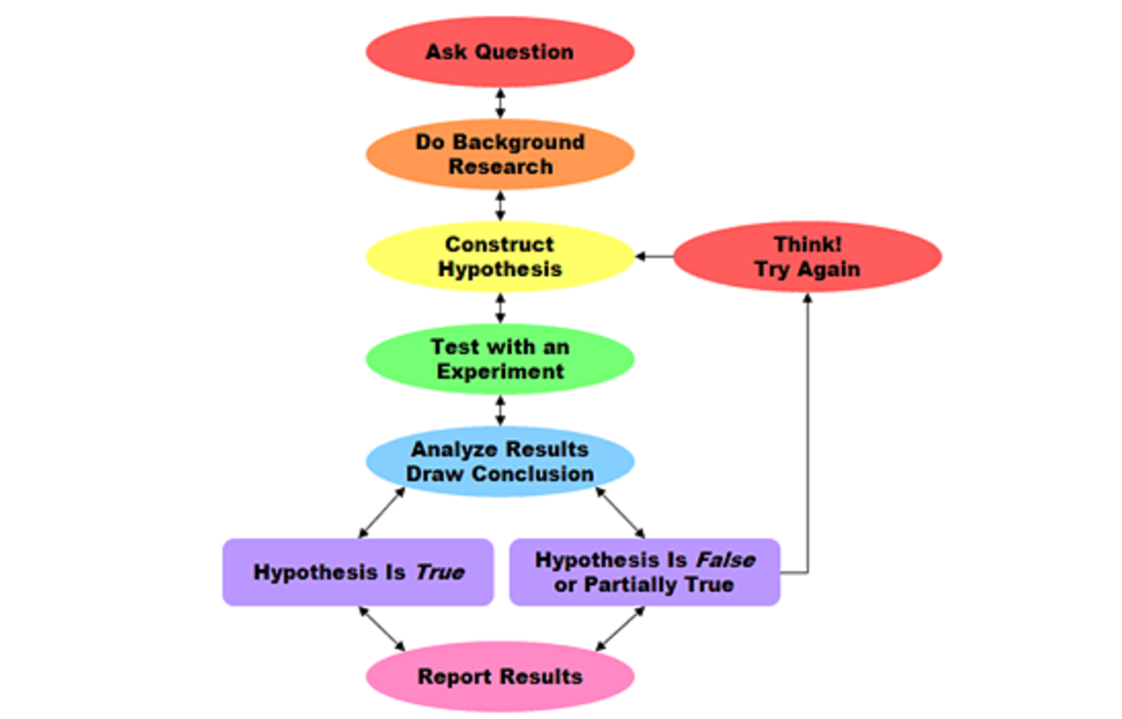
1. “The Scientific Method”

Slide 4
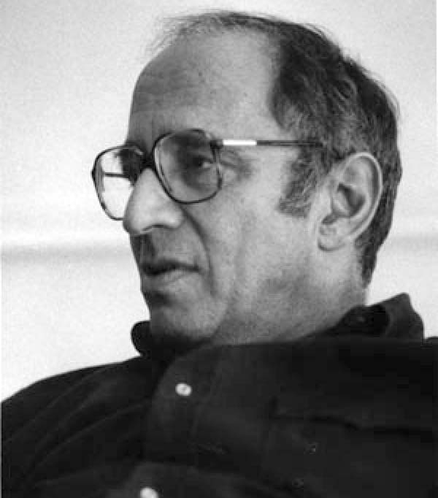
2. Theory-Ladenness of Observation
According to the Scientific Method, we test theories by making empirical observations
But can we make observations without appealing to the framework of some theory?
If observations can only be made with respect to a particular theory, how can any theory be falsified in an absolute sense?
Thomas Kuhn (1922-1996)

Slide 5
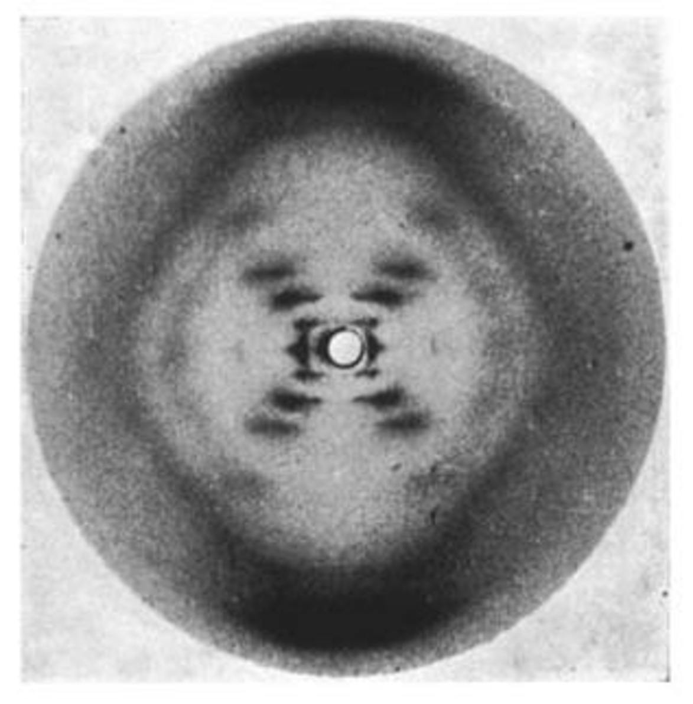
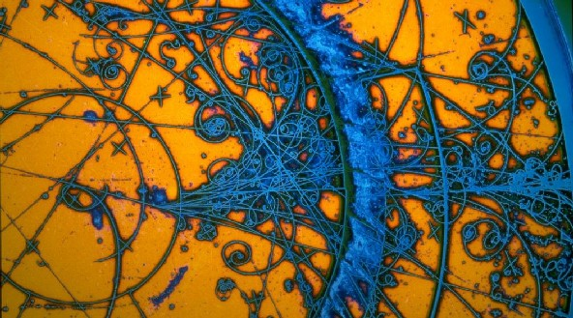
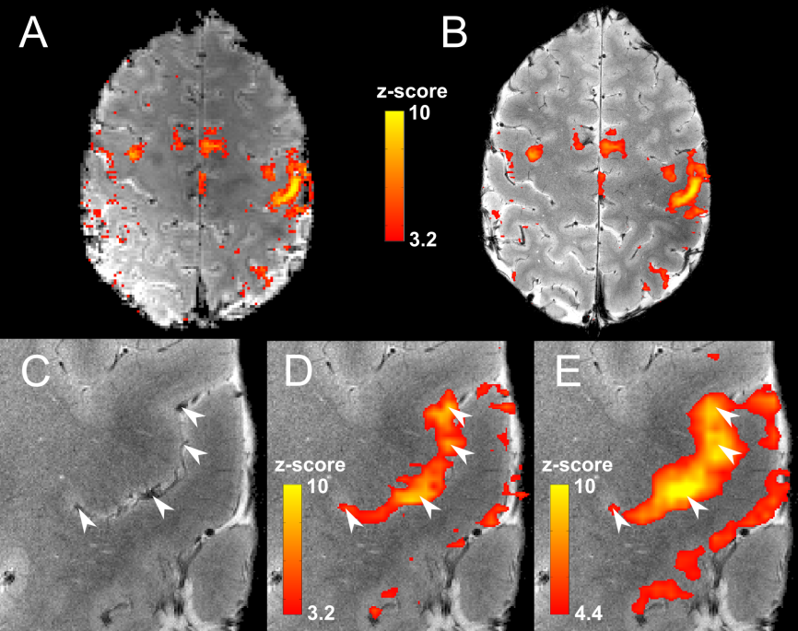
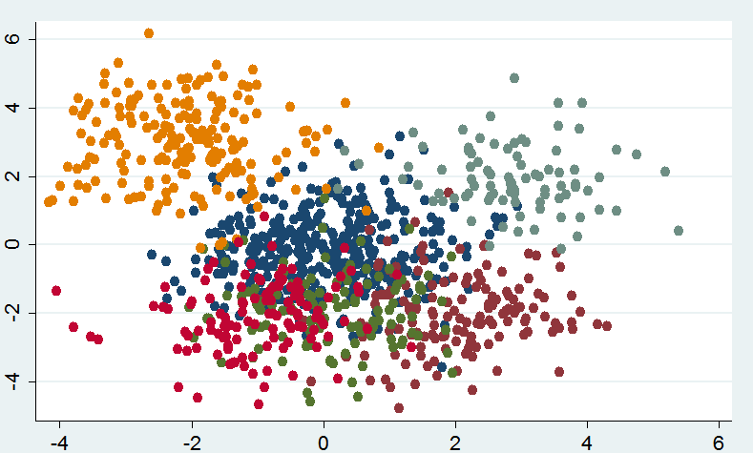
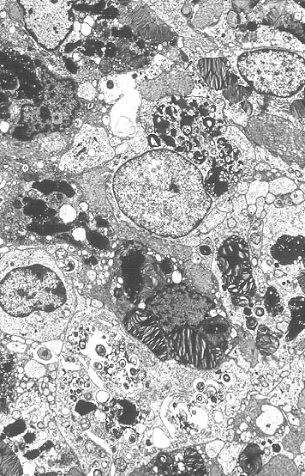
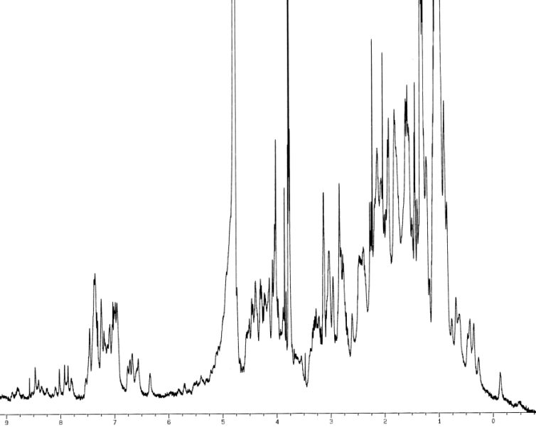
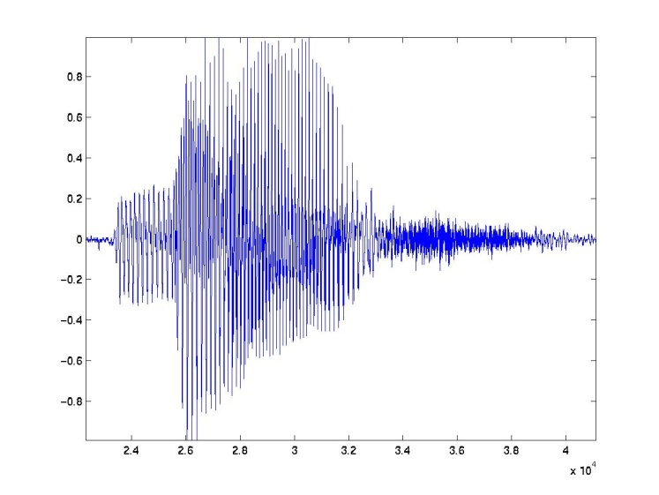
2. Theory-Ladenness of Observation

Slide 6
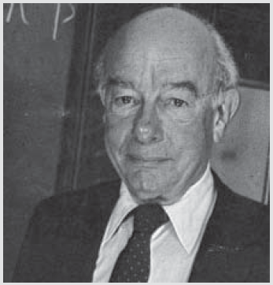
3. Confirmational Holism
If a prediction fails, what exactly do we reject? Hypotheses are conjoined
Example 1: Newton gets orbit of Uranus wrong – reject Newton or posit Neptune?
Example 2: Newton gets orbit of Mercury wrong – reject Newton or posit Vulcan?
Quine: “The unit of empirical significance is the whole of science”
Willard Quine (1908-2000)

Slide 7
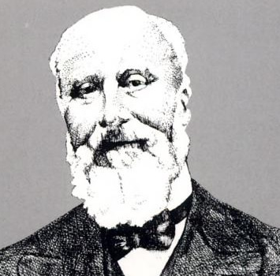
4. Underdetermination
The available evidence is always consistent with a large number of competing theories
How do we choose among these theories?
Problem of unconceived alternatives: ideas we haven’t thought of yet
Pierre Duhem (1861-1916)

Slide 8

4. Underdetermination

Slide 9
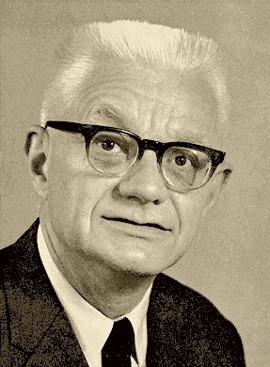
5. Scientific Explanation
A major goal of science is to explain things
But makes a good explanation?
Do explanations have to make predictions? - What about psychology or historical sciences?
How do we judge the ‘simplicity’ of an explanation or theory?
How do we weight up competing virtues (scope, empirical support, simplicity, etc)?
Carl Hempel (1905-1997)

Slide 10
6. Conclusions
Science is messy
Take care making claims about science or its findings
Give up simplistic models of the scientific method
Philosophy helps us to understand what we are doing when we do science
Help to spot snake oil and fake science
Helps us to tell good science from bad. Helps us to avoid things like…

Slide 11
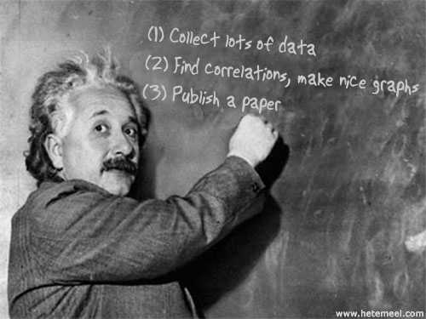
6. Conclusions

Slide 12


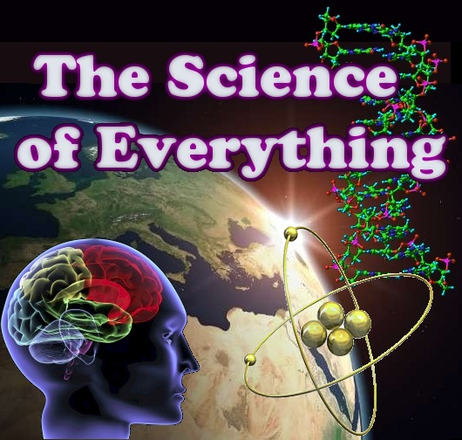
Shameless Self-Promotion
Check out the University of
Melbourne Secular Society
on facebook, or at umss.org
Visit my blog fods12.wordpress.com
Check out my podcast at fods12.podbean.com
Contact me at fods12@gmail.com

