Slide 1

Responding to Religious Apologetics
James Fodor, November 2016

Slide 2
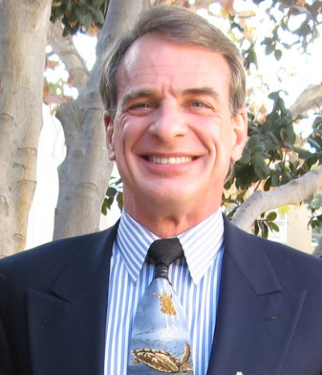
William Lane Craig

Slide 3
1. Cosmological Argument
P1. The universe began to exist
P2. Everything that begins to exist has a cause
P3. If the universe had a cause, that cause was a
personal creator
C. A personal creator exists

Slide 4
Not so good responses
But who created God?
The Big Bang explains the origin of the universe
God is necessarily a more complex explanation
This is a ‘God of the gaps’
Quantum events show that something can come from nothing

Slide 5
Better responses
Time might be ‘tenseless’ so nothing really ‘begins to exist’
The universe might be eternal in the past
The cause of the universe might be something other than a personal being

Slide 6
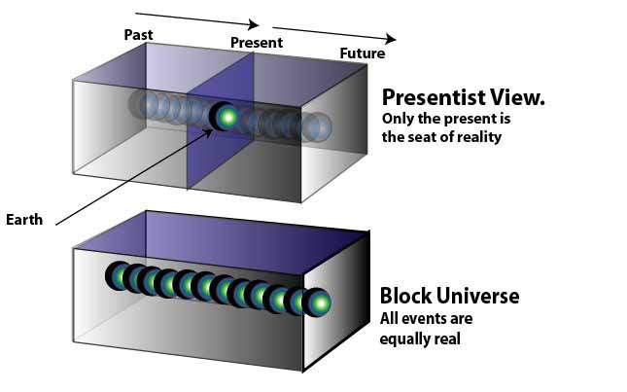
Theories of time

Slide 7
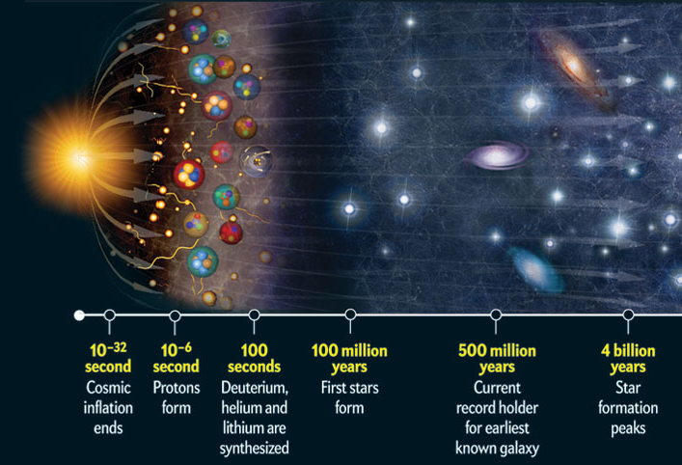
The beginning of time?

Slide 8
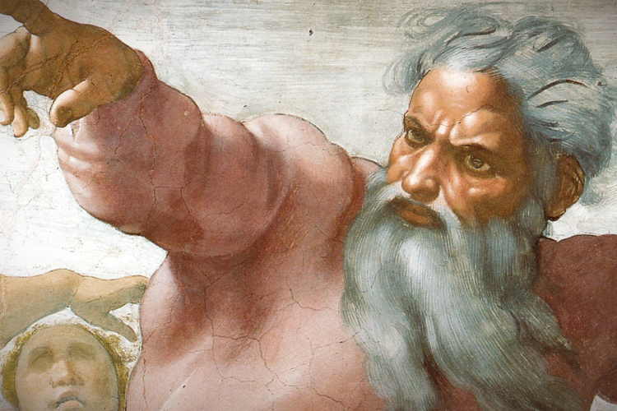

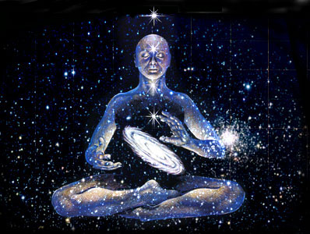

Other possibilities

Slide 9
2. Teleological Argument
P1. The universe is fine-tuned for the existence of
embodied, intelligent life
P2. The only explanations for this fine-tuning are
chance, physical necessity, or design
P3. Chance and physical necessity are not
plausible explanations
Fine-tuning can only be explained by design

Slide 10
Not so good responses
Evolution
Argument from poor design (waste of space)
The universe is not adapted to us, we are adapted to it
The anthropic principle

Slide 11
Better responses
Deny fine-tuning: we don’t know what alternate forms of life might have been possible
Our universe could be part of a larger multiverse
There could be deeper underlying laws

Slide 12
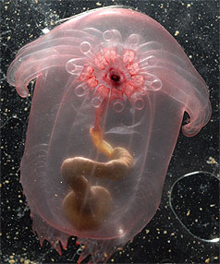
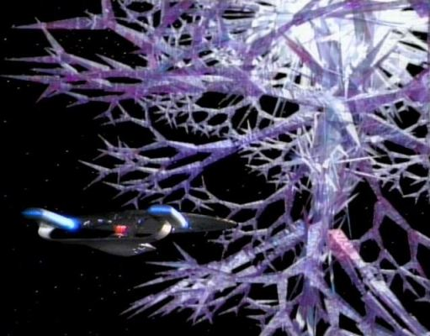

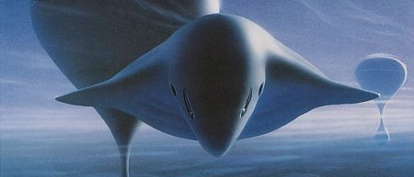
Alternate forms of life

Slide 13
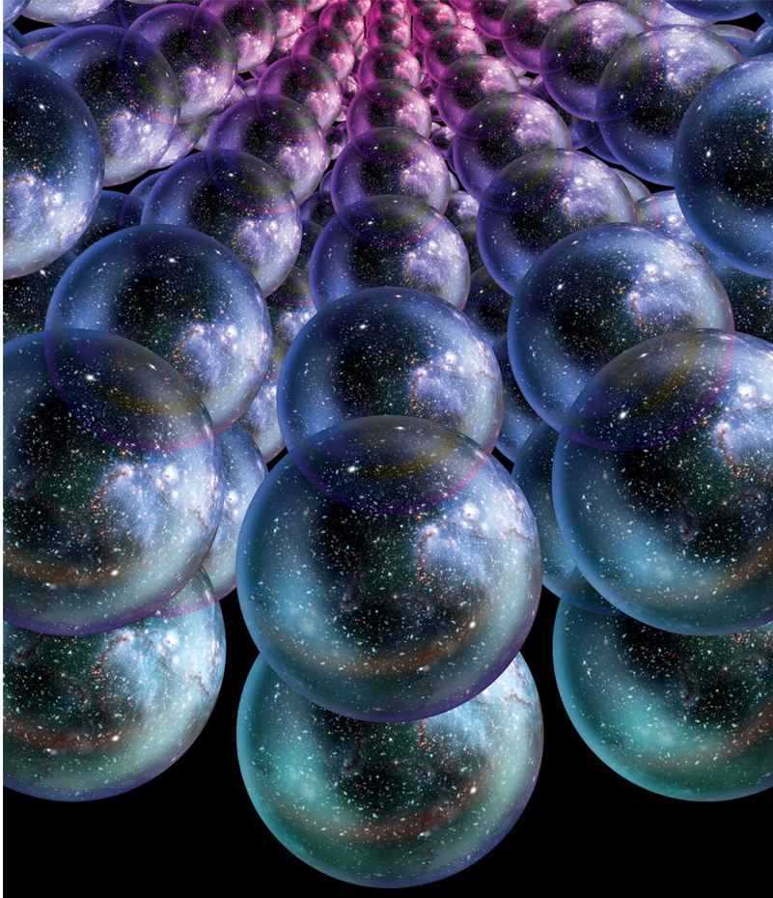
A multiverse

Slide 14
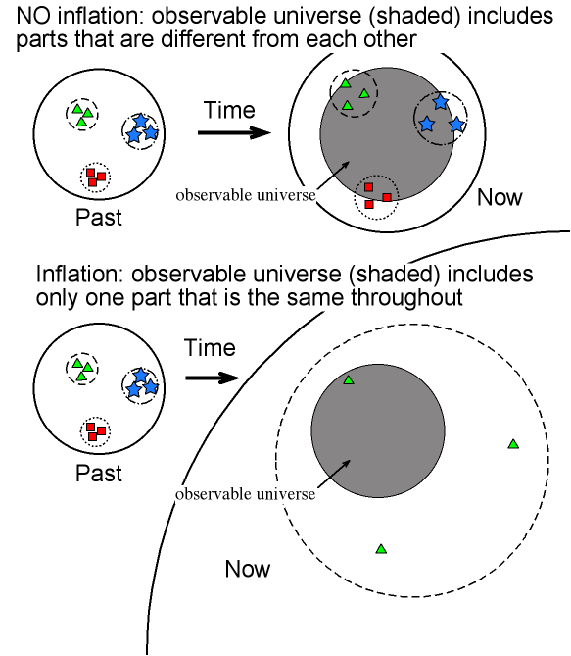
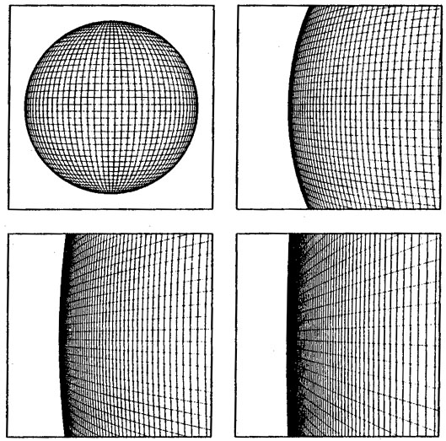
Underlying laws

Slide 15
Conclusions
Listen carefully
Do your homework (philosophical and scientific)
Respond to the premises of the argument
Don’t be a jerk!

Slide 16
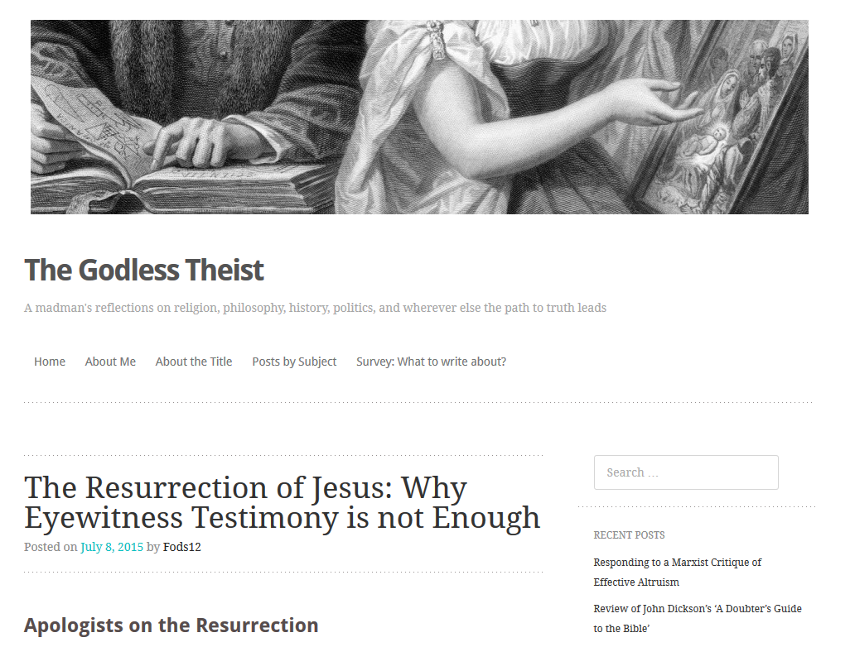
My Blog

