Slide 1
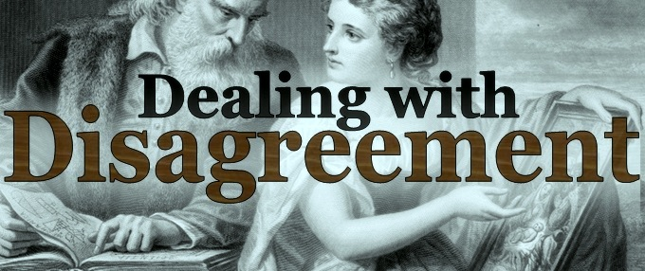
Synopsis: On many important issues of science, philosophy, politics, and religion, equally knowledgeable and intelligent people often disagree with one another. In this presentation I argue that on such matters, it is not epistemically justifiable to hold firmly to the correctness of one’s opinion, defined as one’s own subjective evaluation of the evidence. Rather, I argue that one’s opinion should receive no greater weight in constituting beliefs than does the opinion of any other equally informed person. I conclude by considering some common objections to my argument.
LessWrong, 6th July 2014

Slide 2
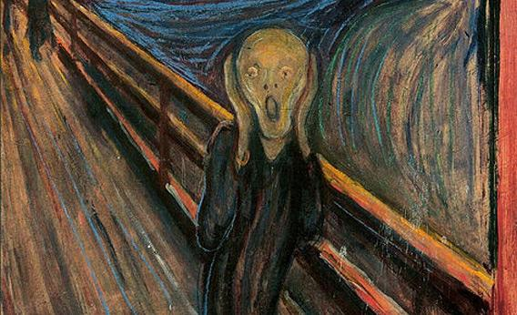
Existential Crisis Warning

Slide 3


Defining Peer Disagreement
Disagreement between people of similar epistemic standing - those who are (roughly) equally intelligent, well informed, honest, rational, etc.

Slide 4

The Core Problem
On many issues of importance, there exists considerable peer disagreement.

Slide 5
Examples of Peer Disagreement
Let A be an arbitrary proposition that is controversial among relevant experts.
“God exists”
“Objective morality is real”
“A priori knowledge is possible”
“AGI poses a severe existential risk”
“Fiscal stimulus is effective”
“The mind is computable”
“Aid is effective in combating poverty”
“String Theory is correct”
“Giving now is more effective than later”
Q

Slide 6
A Spectrum of Responses
Suppose I think “p(A) = 0.1”, and you think “p(A) = 0.9”
When I learn of our disagreement, how should I change my view?
Steadfastness
Conciliationism
0.1
0.5
“No Independent Weight View”
“Total Evidence View”
“Equal Weight View”
Q

Slide 7
Arguments for Steadfastness
  Different Priors (Wedgwood): How we respond to disagreement “is determined by the conditional beliefs it was antecedently rational to believe”
  Rational Egocentric Bias (Wedgewood): “It is rational to have a special sort of ‘fundamental trust’ in one’s own intuitions (and judgements), but it is not even possible to have the same sort of ‘trust’ in the intuitions of others.”
  The David Lewis Problem (Elgin): “Despite the fact that Lewis’ position is brilliantly constructed, admirably defended, and beautifully argued, I find it incredible…I do not even think that Lewis might be right on this matter…(but) nor can I conclude, as advocates of resoluteness think I should, that in this case Lewis’ reasoning is flawed.”
  Mistaken Reasoning Objection (Kelly): A person who reasons correctly is not rationally obliged to update their opinions to conciliate with a person who reasoned incorrectly. “What is quite implausible, I think, is the suggestion that you and I are rationally required to make equally extensive revisions in our original opinions, given that your original opinion was, while mine was not, a reasonable response to our (identical) original evidence”

Slide 8
Rebuttals to Steadfastness
  No God’s Eye View (Kelly): “One should give some weight to one’s peer’s opinion, even when from the God’s-eye point of view one has evaluated the evidence correctly and he has not. But why? Exactly because one does not occupy the God’s-eye point of view.”
  No Privilege (Fumerton): “This reason for thinking that my opponents are probably cognitively defective is also a reason for thinking that I am probably cognitively defective. And now I face the task of trying to argue plausible that I am an exception to the rule. To do so, I am back to the task of trying to convince you that you suffer from specific defects that explain your unreliability, defects that I have somehow managed to avoid.”
  Unreliability (Kornblith): “When the community is composed of individuals each of whom is reasonable believed to be reliable, we must bow to majority opinion, But… if the history of the field gives us no reason for confidence in the judgement of individual practitioners, then this, by itself, gives us reason to suspend judgement on questions that confront the field….It certainly does not give one free rein to believe whatever one pleases.”

Slide 9
Arguments for Equal Weight View
  Sidgwick’s Principle (Sidgwick): “If I find any of my judgements, intuitive or inferential, in direct conflict with a judgement of some other mind, there must be an error somewhere: and if I have no more reason to suspect error in the other mind than in my own, reflective comparison between the two judgements necessarily reduces me to a state of neutrality.”
  Thermometer Analogy (Kelly): We each measure the temperature with historically equally reliable thermometers, and get different values. Clearly there is no basis to prefer my thermometer reading over yours.
  Adding Numbers Analogy (Fumerton): “If I really do have good reason to believe that you are in general just as reliable as I am when it comes to adding columns of numbers, discovering the results of your addition would have precisely the same significance as doing the addition against myself and coming to a different conclusion.”
  When reasoning is observable (Kornblith): “I know that you have thought about the issue as long as I have; that you are as familiar with the arguments on both sides of the issue as I am; and I know that you are just as smart as I am…If this can serve as a reason for doubt when I know nothing if your reasons (e.g. adding numbers case), it is hard to see why it should not equally serve as a reason for doubt when I do know your reasons.”

Slide 10
Rebuttals to Equal Weight View
  Response to Thermometer Analogy (Kelly): Thermometers aren’t like minds, to which we have direct introspective access. “Proponents of the Equal Weight View will endorse: ‘When you correctly recognise that the evidence supports A, you are no more justified in thinking that this is what the evidence supports than you would have been had you mistakenly taken the evidence to support ~A instead.’ But this assumption is quite dubious”
  Litmus Paper Objection (Kelly): “Why should the psychological evidence count for everything, and the non-psychological evidence for nothing, given that the way in which the two kinds of evidence quality as such is exactly the same (i.e. because they are ‘reliable indicators’)?”
  Careful Checking (Christensen): You do the math carefully on paper multiple times, and check your results with several calculators, getting the same answer each time. But then your friend, who was also writing down numbers and pushing calculator buttons, arrives at a different answer. Many feel that very little, if any, conciliation is called for in this case.
  Possible Disagreement (Kelly): “The significance of actual disagreement need be no more intellectually threatening than certain kinds of merely possible disagreement.”

Slide 11
Why Trust your Own Opinion?
I do some thinking and reading about a subject
On the basis of this I form an opinion that p(A) = 0.1
Question: what is the epistemic value of that judgement?
Why should I believe p(A) = 0.1, as opposed to believing a random number generator?

Slide 12
Why Trust your Own Opinion?
Your own opinions:
Are easier to access (via introspection)
Are yours and not someone else’s
Seem to fit better with your overall worldview
Are understood by you more intimately
Subjectively feel very persuasive
But none of these are epistemically relevant!

Slide 13
Example
“Based on their reading and thinking on the matter, some undergrad who thinks they know what they are talking about has come to the opinion that p(A) = 0.1. Thus, I should believe that p(A) = 0.1”
Claim: that is a pretty lousy reason to believe that A is true, given how controversial it is even among experts.

Slide 14
Example
“Based on their reading and thinking on the matter, I have come to the opinion that p(A) = 0.1. Thus, I should believe that p(A) = 0.1”
Claim: changing the subject does not alter the degree of epistemic justification – this is still a lousy reason to believe A.

Slide 15
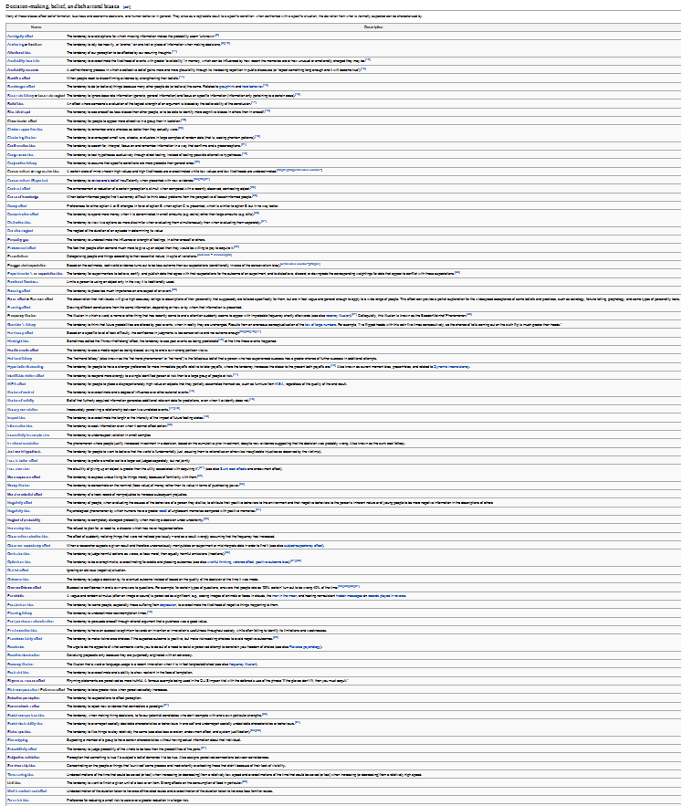
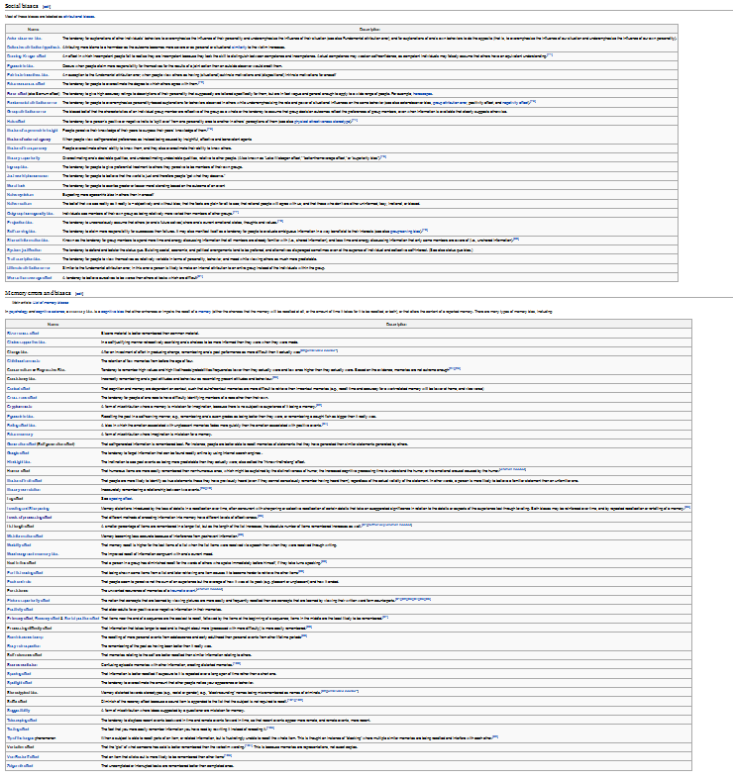
Opinions are Pretty Unreliable

Slide 16
My Approach
  Our minds are ‘black boxes’ – sensory evidence goes in, opinions come out
  Other minds are black boxes in the same way (thought output is harder to access)
  Any reasons to believe the output of our black box apply equally to epistemic peers
  Evidence itself can play no role in supporting beliefs before it is put through a ‘black box’
  When the black boxes of epistemic peers produce conflicting output, we have no basis to prefer one over the other

Slide 17
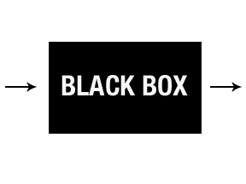

My Approach: Schematic Depiction
My Belief
My mind
My Opinion
Same Evidence
Your mind
Your Opinion
Equivalent as far
as we can tell

Slide 18
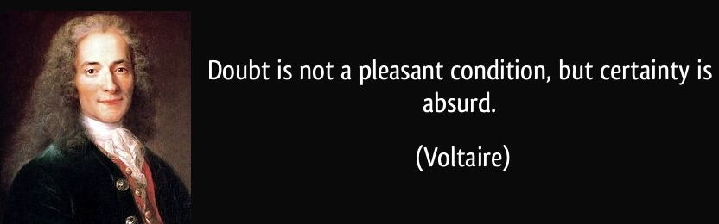
Why Trust your Own Opinion?
You have the right to form an opinion about whatever you like.
You do not have epistemic warrant to treat your own opinion as more significant over that of any other equally informed person.

Slide 19

What is to be Done?
Look for expert consensus
Where experts disagree, remain agnostic
Frequently engage in meta-reasoning
Don’t make yourself into the world expert
Seek disconfirming evidence and viewpoints

Slide 20
Outstanding Problems
Defining and identifying epistemic peerhood
Dispute-independence
Rational Uniqueness versus Permissiveness
Collating expert opinion
Independence of opinions
Past and future opinions
Judging bias
Egocentric Dilemma (Fumerton): “In the final analysis there is really no alternative to the egocentric perspective. Even when my discoveries about what others believe defeat the justification I had, it is my discoveries that are doing the defeating. I can use the discovery of disagreement to weaken my justification only insofar as I trust my reasoning.”

Slide 21


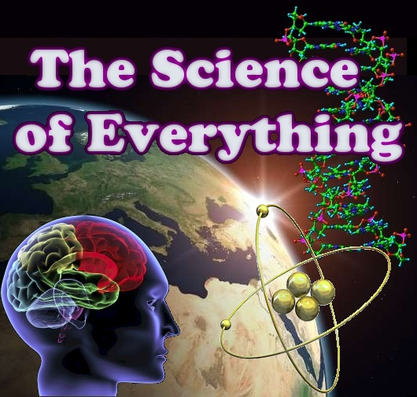
Interested in More of This?
Check out the University of
Melbourne Secular Society
on facebook, or at umss.org
Visit my blog fods12.wordpress.com
Contact me at fods12@gmail.com
Check out my podcast at fods12.podbean.com

Slide 22
How to Disagree 1
Not everyone is your epistemic peer
Ensure that your dispute is not merely semantic
Try to understand their position well enough to argue it for them
Try to break the argument down into very specific items of disagreement, identify those that are worth pursuing, and push those in depth
Don’t get sidetracked by minor points

Slide 23
How to Disagree 2
Figure out what evidence could determine who is right
Identify underlying assumptions (e.g. worldview differences) contributing to the disagreement
Don’t try to defend your position at all cost; try to work out exactly why you disagree
Ideas don’t need respect, but people do

Slide 24
Objection: View is Self-Refuting
“Since most people disagree with you, how can you justify believing your opinion?”
Reply 1: almost any epistemic position can potentially be described as self-refuting
Reply 2: consumer choice magazine example (Elga)

Slide 25
Objection: Still Have to Act
“We still need to make decisions and act in the world.”
Reply: yes, but that doesn’t justify false confidence

