Slide 1
Regressive Left, Alternative Right – Rationality and Politics
James Fodor, March 2017

Slide 2
Warning
This presentation includes memes and other content that are potentially offensive.
The Secular Society does not endorse such content or adopt any political positions other than secularism and protection of rights. The views presented here are to be critically discussed, and are not being promoted by the society.

Slide 3
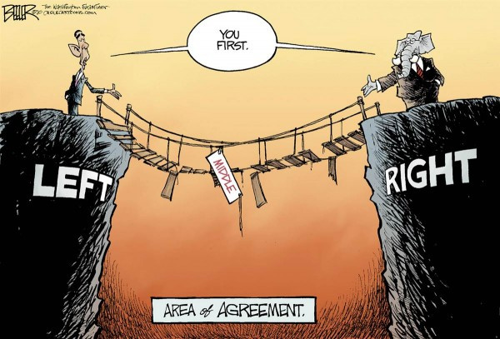
Warning

Slide 4
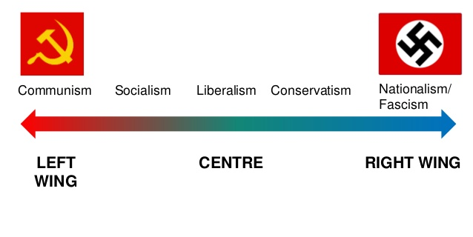
The Political Spectrum

Slide 5
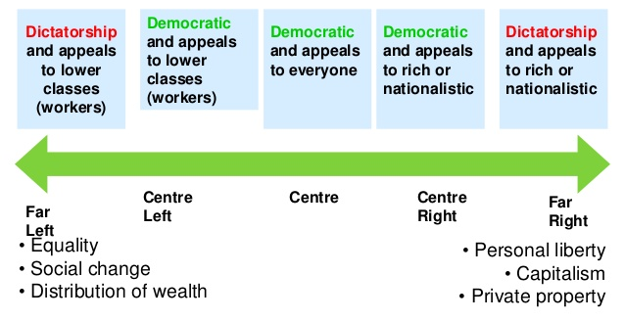
The Political Spectrum

Slide 6

The Political Spectrum

Slide 7
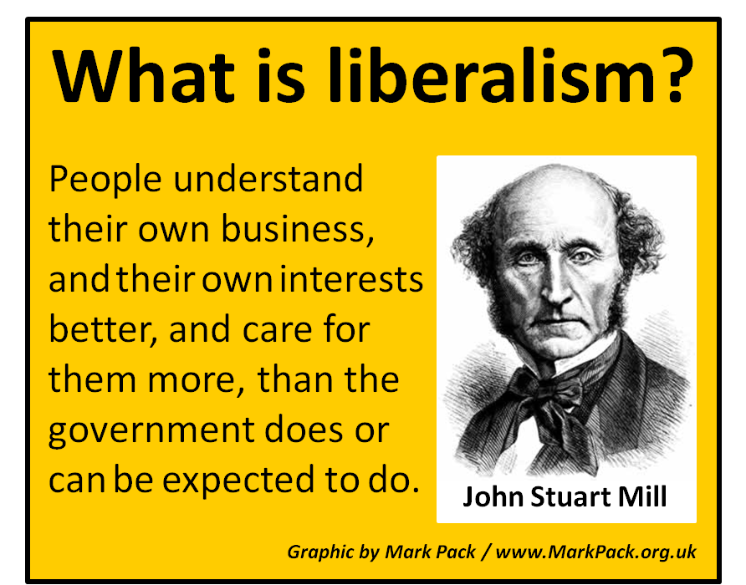


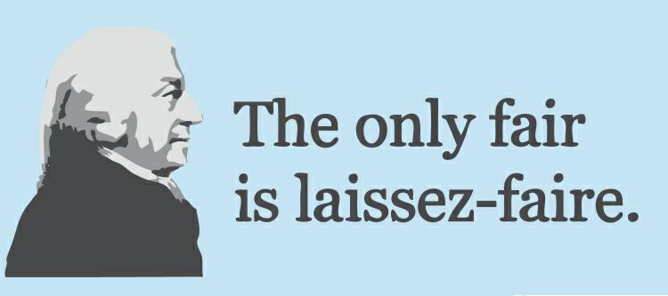
Liberalism

Slide 8


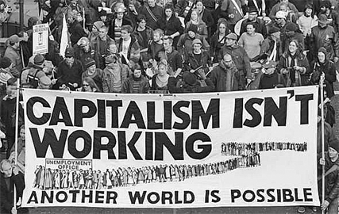
Socialism

Slide 9

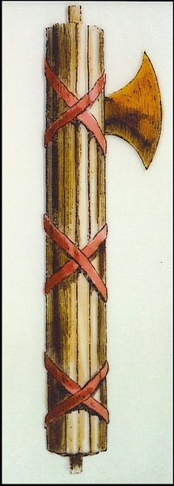
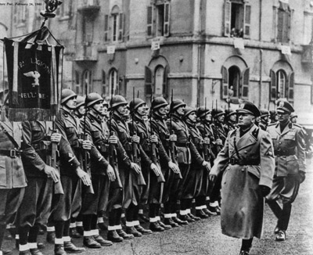
Fascism

Slide 10
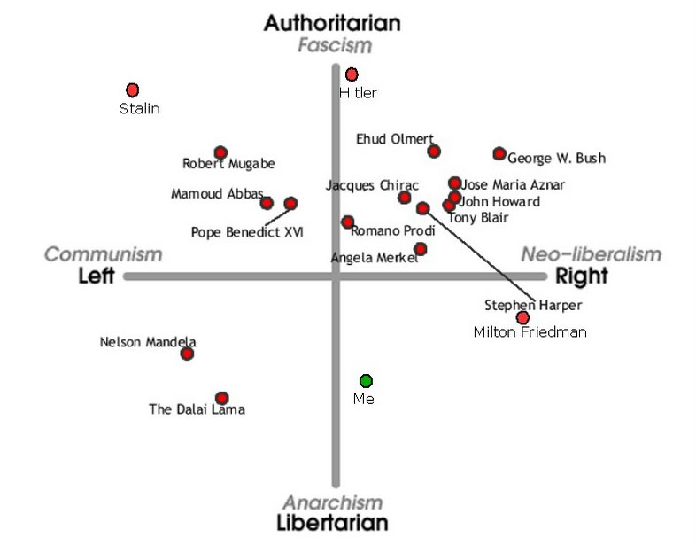
The Political Compass

Slide 11
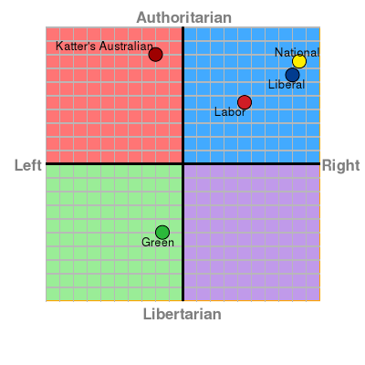
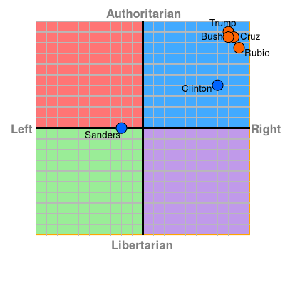
The Political Compass

Slide 12
Alternative Right
Term attributed to Richard Spencer, 2010
A loose collection of ideas and personalities
Mostly based online
Tend to support Donald Trump
Leading outlet is the Breitbart News Network (Steve Bannon)

Slide 13
Alternative Right
White nationalism – protect the white race
Anti-immigration, anti-minority race rights
Strong opposition to political correctness
Often supportive of authoritarianism
Associated with anti-feminist movement

Slide 14




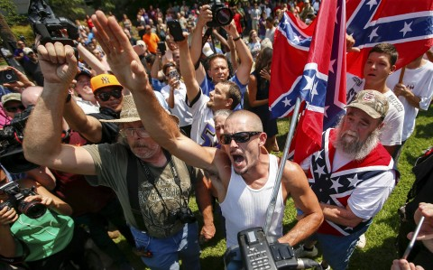
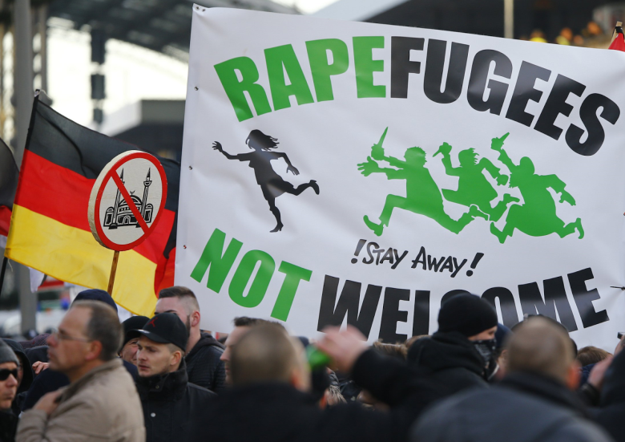
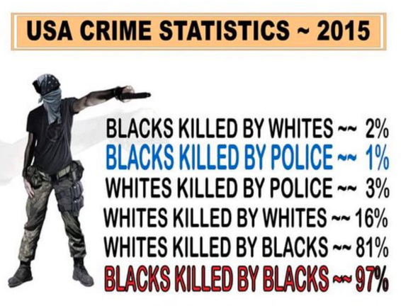

Alternative Right

Slide 15
Regressive Left
Term coined by anti-Islamism activist Maajid Nawaz in 2012
Entirely a pejorative term – not a movement
Used by people on the left and right to refer to certain practices and beliefs they don’t like
Commonly applied to internet ‘social justice warriors’

Slide 16
Regressive Left
“A section of the left (that has)... an inherent hesitation to challenge some of the bigotry that can occur within minority communities ... for the sake of political correctness, for the sake of tolerating what they believe is other cultures and respecting different lifestyles.” - Maajid Nawaz

Slide 17
Regressive Left
Criticism of perceived tolerance of intolerant views, especially Islam
Concern about censorious tendencies (anti free-speech) in some left-wing groups
Critical of excessive focus of minority rights over ‘human rights’
Concern of focus on petty issues and personal offence

Slide 18

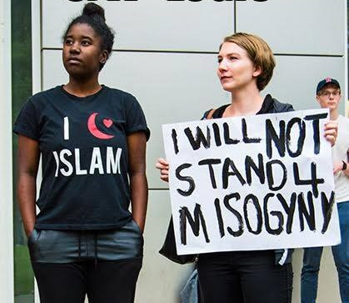

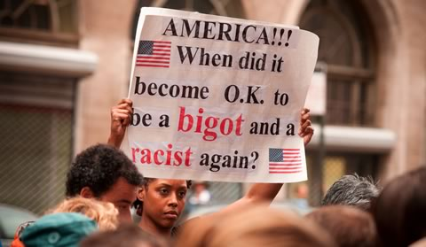
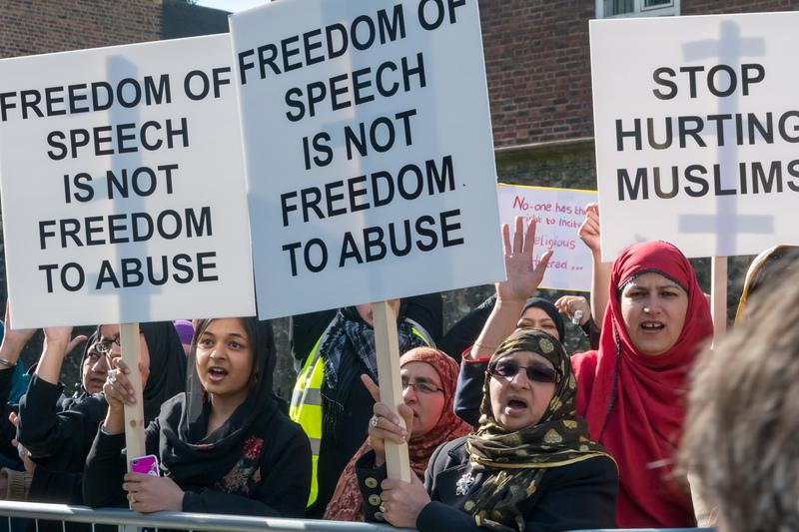
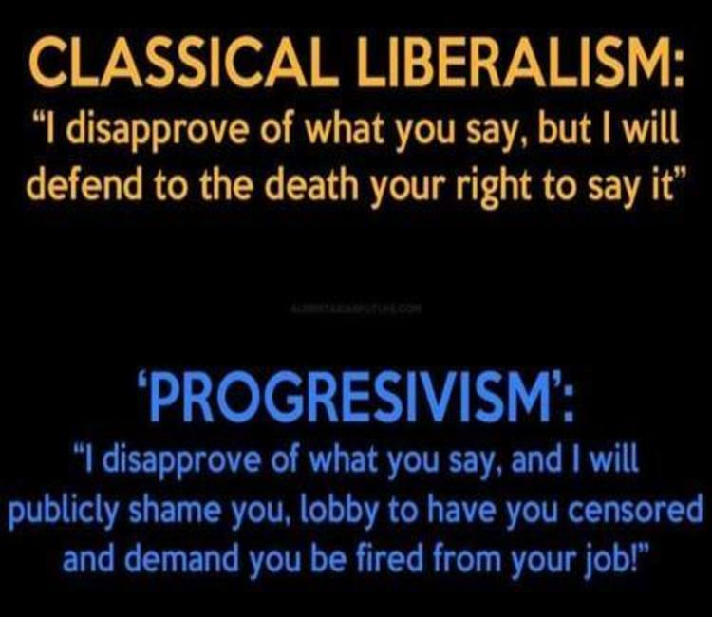
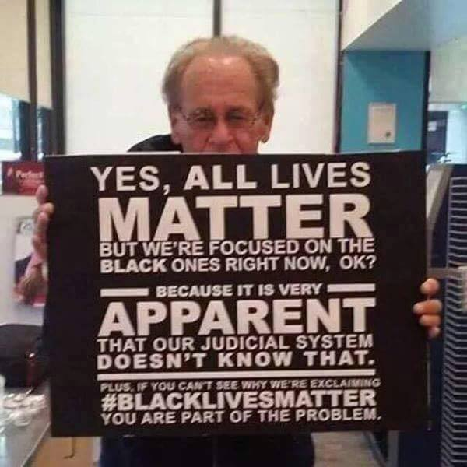


Regressive Left

Slide 19

Alternative Right

