Slide 1

Philosophy of Science:
What Skeptics Need to Know
Synopsis: Many people think about science in a fairly simplistic way: collect evidence, formulate a theory, test the theory. I question this simple understanding of science by examining of the key controversies in philosophy of science, including the theory-ladenness of observation, underdetermination, theory choice, and the nature of scientific explanation. I argue that philosophy of science paints a much richer and messier picture of the relationship between science and truth than many people commonly imagine, and highlight why I think some knowledge of philosophy of science is important for both producers and consumers of scientific knowledge.
James Fodor, 16th Oct 2015

Slide 2
0. Overview
“The” Scientific Method
The Theory-Ladenness of Observation
Confirmational Holism
Underdetermination
Models of Scientific Explanation
Conclusions
Further Reading

Slide 3
2. Theory-Ladenness of Observation
According to the Scientific Method, we test theories by making empirical observations
But we cannot make observations without appealing to some theory?
Evidence doesn’t “speak for itself” – requires theory-laden interpretation

Slide 4
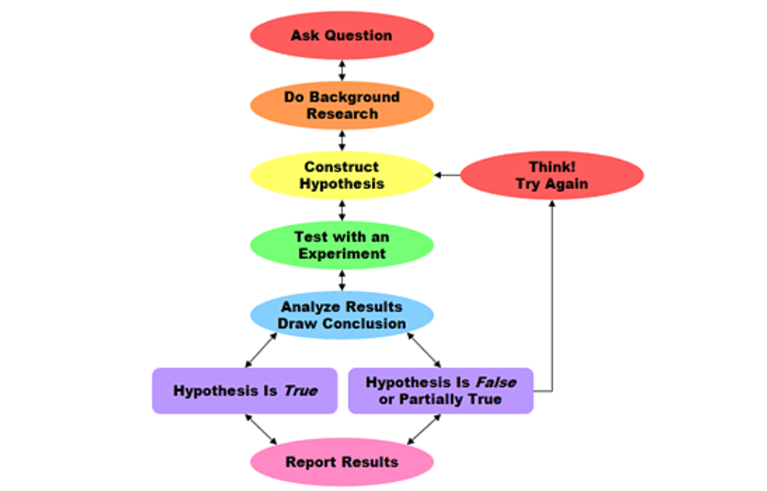
1. “The” Scientific Method

Slide 5
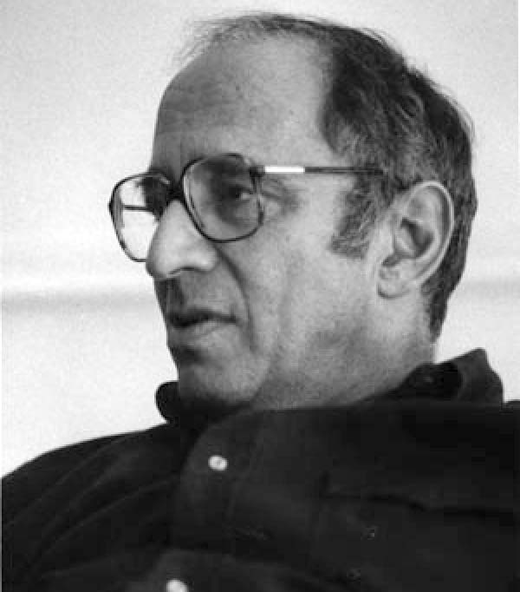
2. Theory-Ladenness of Observation
According to the Scientific Method, we test theories by making empirical observations
But we cannot make observations without appealing to some theory?
Evidence doesn’t “speak for itself” – requires theory-laden interpretation
Thomas Kuhn (1922-1996)

Slide 6
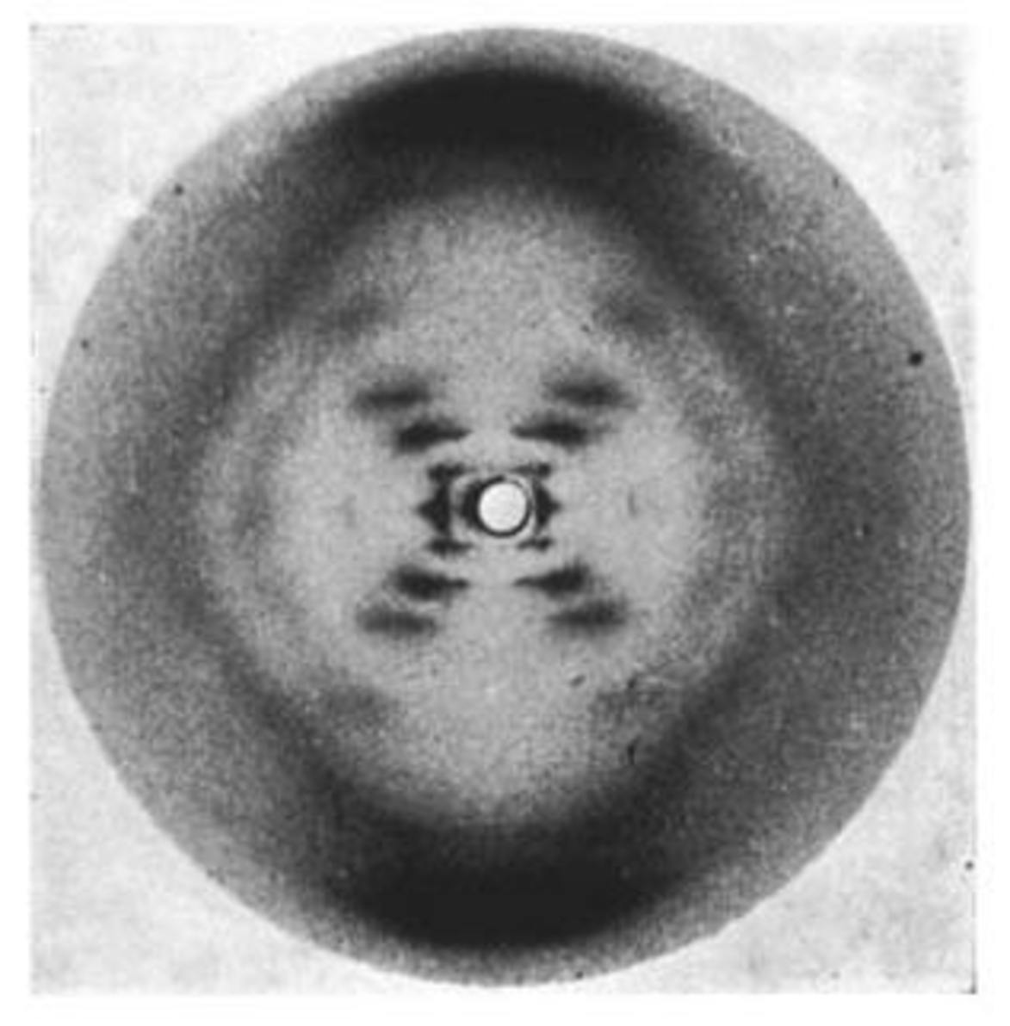
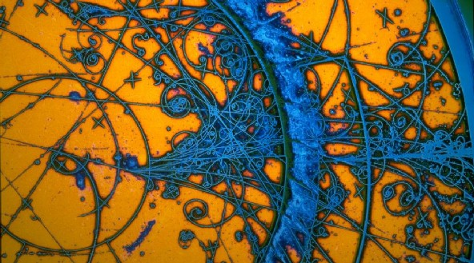
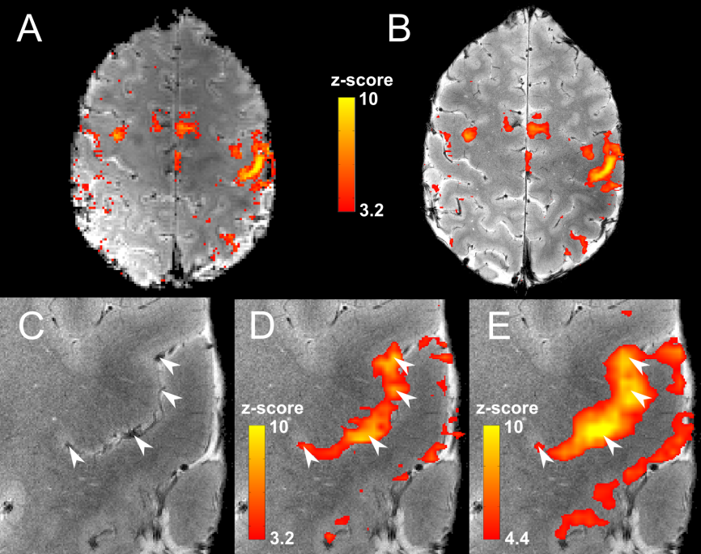
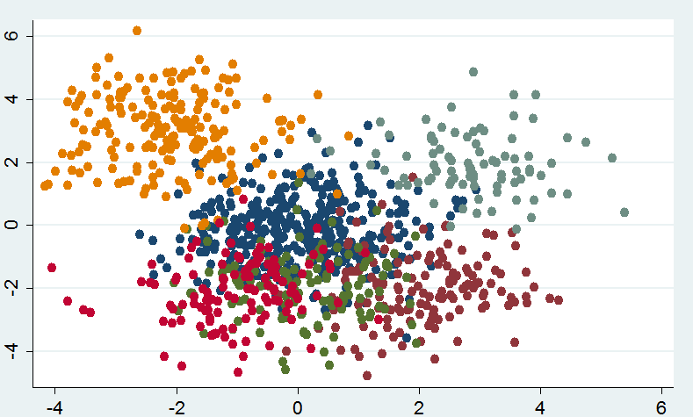
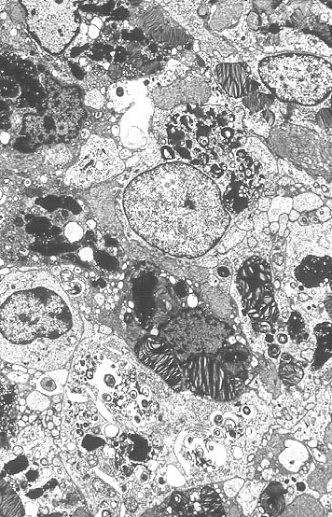
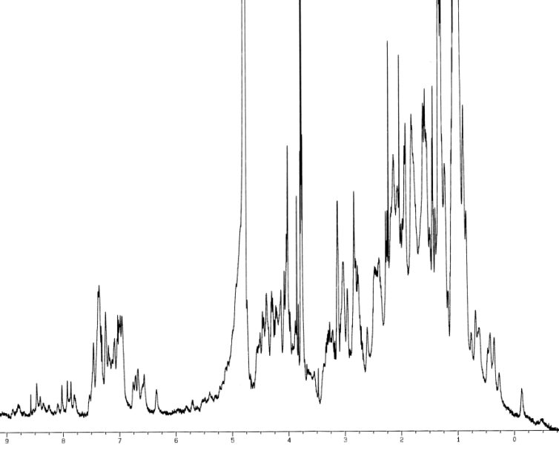
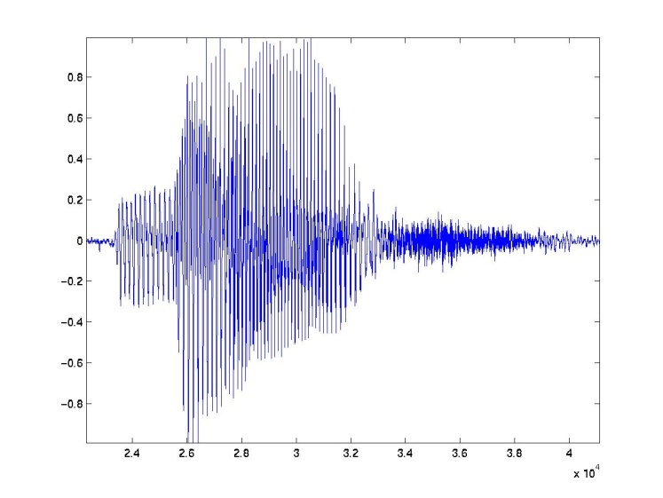
2. Theory-Ladenness of Observation

Slide 7
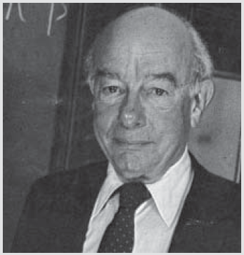
3. Confirmational Holism
If a prediction fails, what exactly do we reject?
Our hypotheses are conjoined
‘At least one of our beliefs is false’
Quine: “The unit of empirical significance is the whole of science”
Willard Quine (1908-2000)

Slide 8
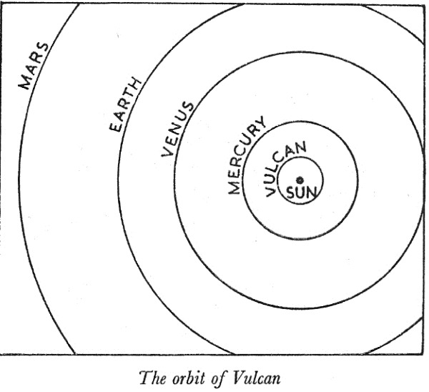
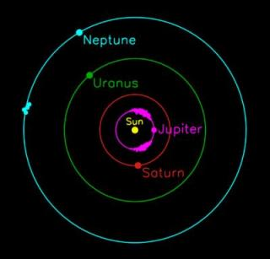
3. Confirmational Holism
1845: Newton gets orbit of Uranus wrong – reject Newton or posit Neptune?
1859: Newton gets orbit of Mercury wrong – reject Newton or posit Vulcan?

Slide 9
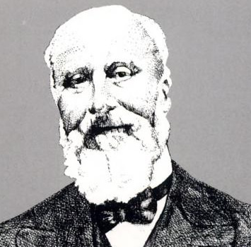
4. Underdetermination
Evidence is always consistent with many competing theories
How do we choose among these theories?
Problem of unconceived alternatives: ideas we haven’t thought of yet
Pierre Duhem (1861-1916)

Slide 10

4. Underdetermination

Slide 11
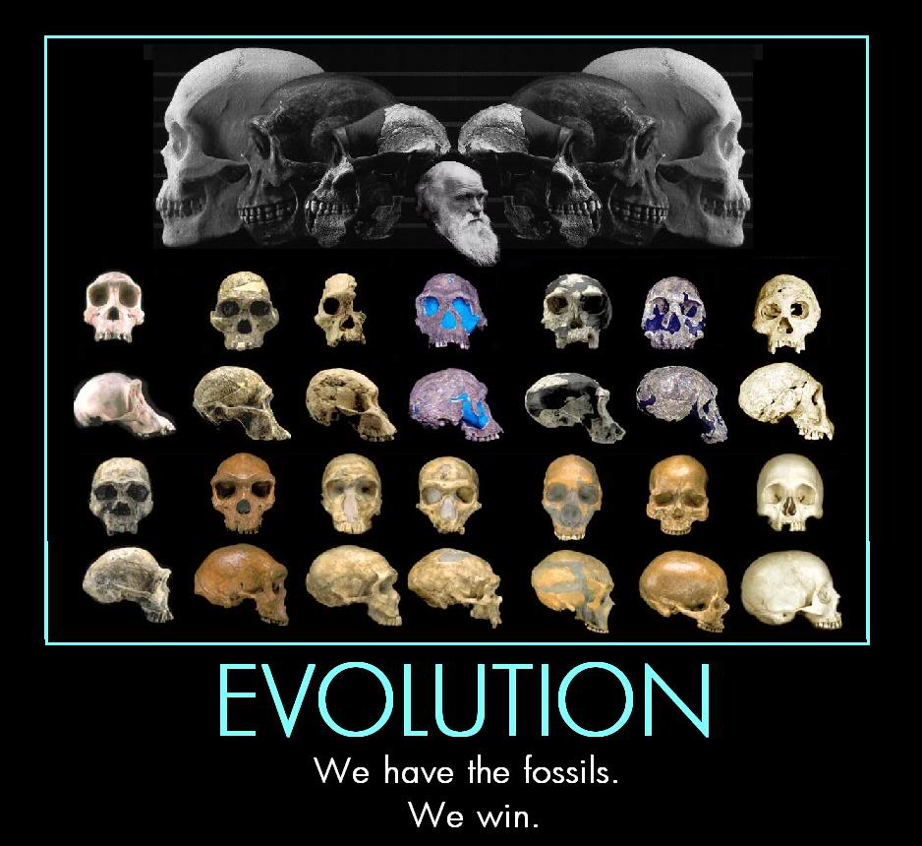
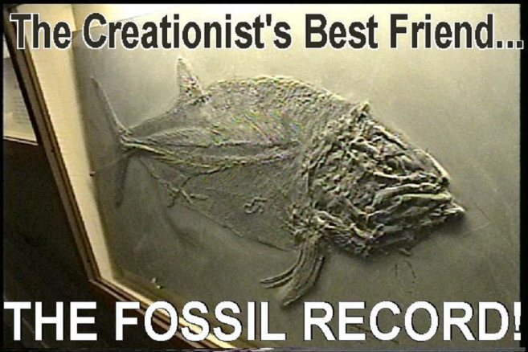
4. Underdetermination

Slide 12
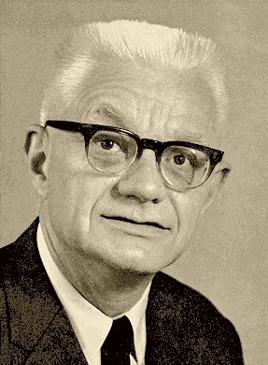
5. Scientific Explanation
A major goal of science is to explain things
But makes a good explanation?
How do we judge ‘simplicity’?
How do we judge ‘explanatory power’?
How to weigh competing virtues?
Carl Hempel (1905-1997)

Slide 13
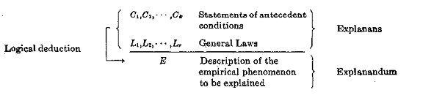
5. Scientific Explanation
DN Model: A phenomenon is scientifically explained if we can logically derive the phenomenon from some laws of nature and specified initial conditions

Slide 14
5. Scientific Explanation
Condition: Hill is 10m high with a 30 degree slope
Laws: F=mg×sin(θ), x=½at²
Explanandum: The ball takes 2.85 seconds to reach the bottom of the hill

Slide 15

5. Scientific Explanation
Condition: Hill is 10m high with a 30 degree slope
Laws: F=mg×sin(θ), x=½at²
Explanandum: The ball takes 2.85 seconds to reach the bottom of the hill
But we could flip this around!

Slide 16
5. Scientific Explanation
Condition: The ball takes 2.85 seconds to reach the bottom of the hill
Laws: F=mg×sin(θ), x=½at²
Explanandum: The hill is 10m high with a 30 degree slope

Slide 17
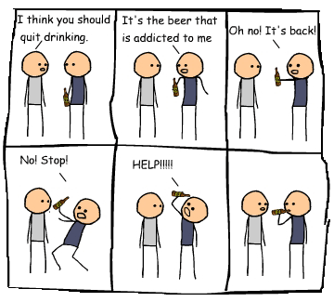
5. Scientific Explanation

Slide 18
6. Conclusions
Science is complicated, not a simple exercise!
Take care making claims about science or its findings
Philosophy helps us to understand what we are doing when we do science
Help to spot snake oil and fake science
Helps us to avoid things like…

Slide 19
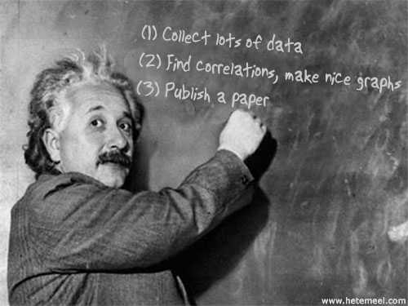
6. Conclusions

Slide 20
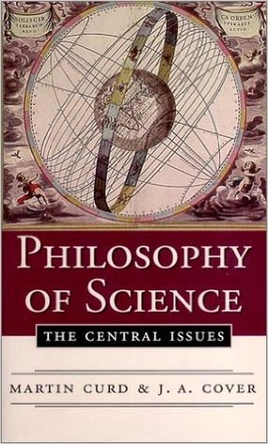


7. Further Reading

Slide 21
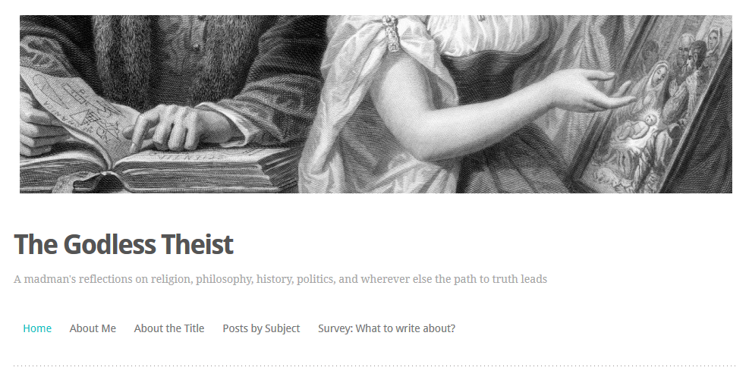
7. Further Reading
Check out my blog at thegodlesstheist.com

