Slide 1

The Shaky Foundations of Science:
An Overview of the Big Issues
Synopsis: Many people think about science in a fairly simplistic way: collect evidence, formulate a theory, test the theory. By this method, it is claimed, science can achieve objective knowledge about reality. I will question this simple understanding of science by examining of the key controversies in philosophy of science, including the problem of induction, the theory-ladenness of observation, the nature of scientific explanation, theory choice, and scientific realism. I will argue that philosophy of science paints a much richer and messier picture of the relationship between science and truth than many people commonly imagine, and highlight why I think some knowledge of philosophy of science is important for both producers and consumers of scientific knowledge.
James Fodor, 23rd August 2014

Slide 2
0. Introduction
How well-grounded is science philosophically?
How certain are the findings of science?
What does philosophy have to say about the methods and practise of science?
Why should you care about philosophy of science?

Slide 3
0. An Overview
Naive Falsificationism
The problem of Induction
The Theory-Ladenness of Observation
Underdetermination
Models of Scientific Explanation
Scientific Realism
Conclusions

Slide 4
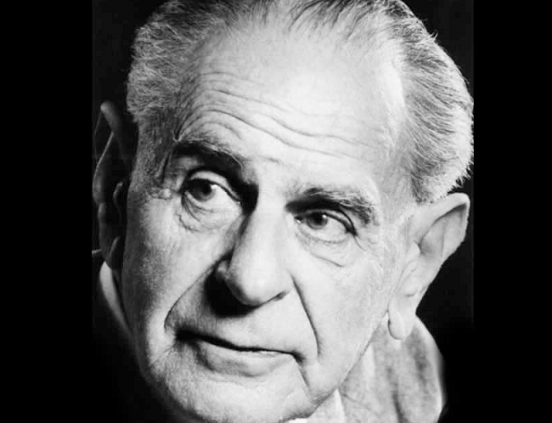
1. Naive Falsificationism
Karl Popper (1902-1994)

Slide 5
1. Naive Falsificationism
A simplistic model of the scientific method
Still generally taught in school and believed by some/many scientists
Often (unfairly) associated with Karl Popper
Not wrong exactly, but (as we will see) problematic and highly incomplete

Slide 6
1. Falsifiability
Falsifiability: possible to prove wrong by some conceivable evidence or argument
Popper said that unfalsifiable beliefs (e.g. astrology) are not scientific
Example:
“This is a year in which your true self may be rediscovered!... With Jupiter in the opposing house of relationships, partnerships and marriage, you will need to find ways to balance the need for independence and self-discovery with the needs of others. This will be your biggest challenge by far.”
(http://www.astrology.com.au/yearly-horoscopes/capricorn.html)

Slide 7
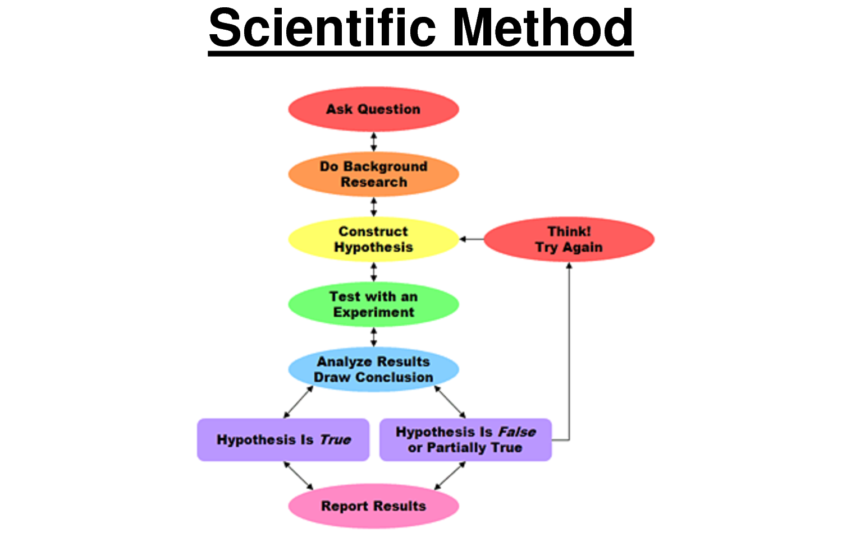
1. The Scientific Method?

Slide 8
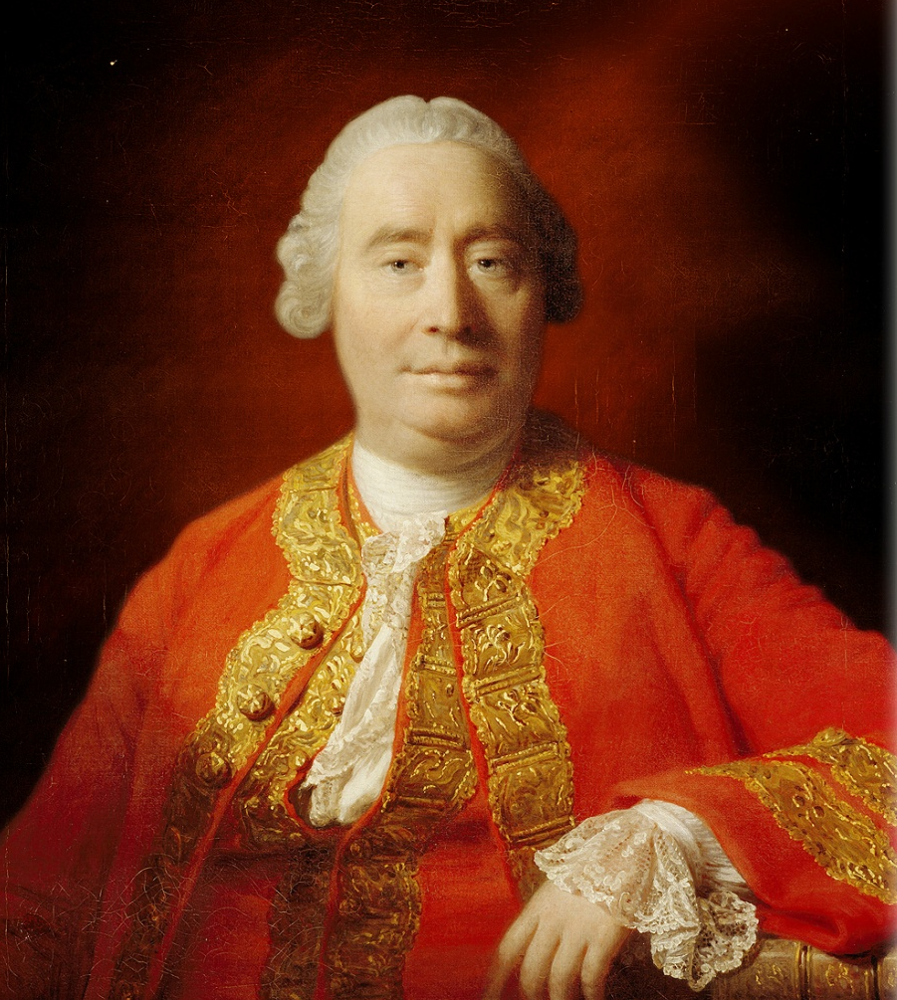
2. Problem of Induction
David Hume (1711-1776)

Slide 9
2. What is Induction?
Induction is a fallible method of inference commonly used in science
Distinct from deduction, which derives certain truths given axioms and rules
Simplistic ‘enumerative induction’: all swans seen so far are white, so all swans are white
Probabilistic version: most swans seen so far are white, so if I see another swan it will probably be white

Slide 10
2. The Problem of Induction
The Problem of Induction concerns how inductive inference can be justified
Inductive arguments don’t follow deductively
“It worked well in the past” – begging the question!
How to justify induction non-circularly?
Good vs bad induction: “If someone dies, it's never me, so probably I won’t die”

Slide 11
2. Potential Responses
Popper: reject induction – theories are not supported but survive attempts at falsification
Armstrong: the rationality of induction is a necessary truth
Reichenbach: if any method will work, it is induction, so it’s our best bet to try
Strawson: use of induction is ‘built in’ to our very notion of what ‘good reasoning’ is
New Riddle of Induction: grue and bleen

Slide 12
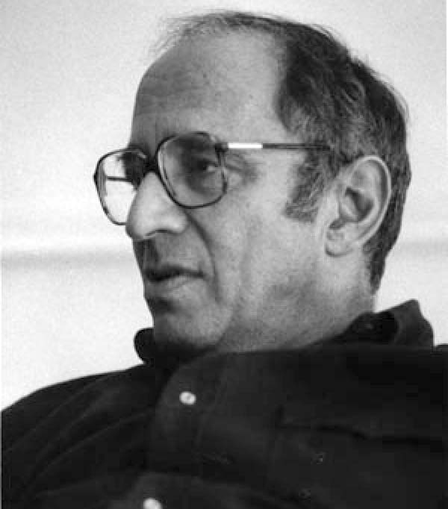
3. Theory-Ladenness of Observation
Thomas Kuhn (1922-1996)

Slide 13
3. Theory-Ladenness of Observation
Naive falsificationism says we test theories by making empirical observations
But can we make observations without appealing to the framework of some theory?
If observations can only be made with respect to a particular theory, how can any theory be falsified in an absolute sense?

Slide 14
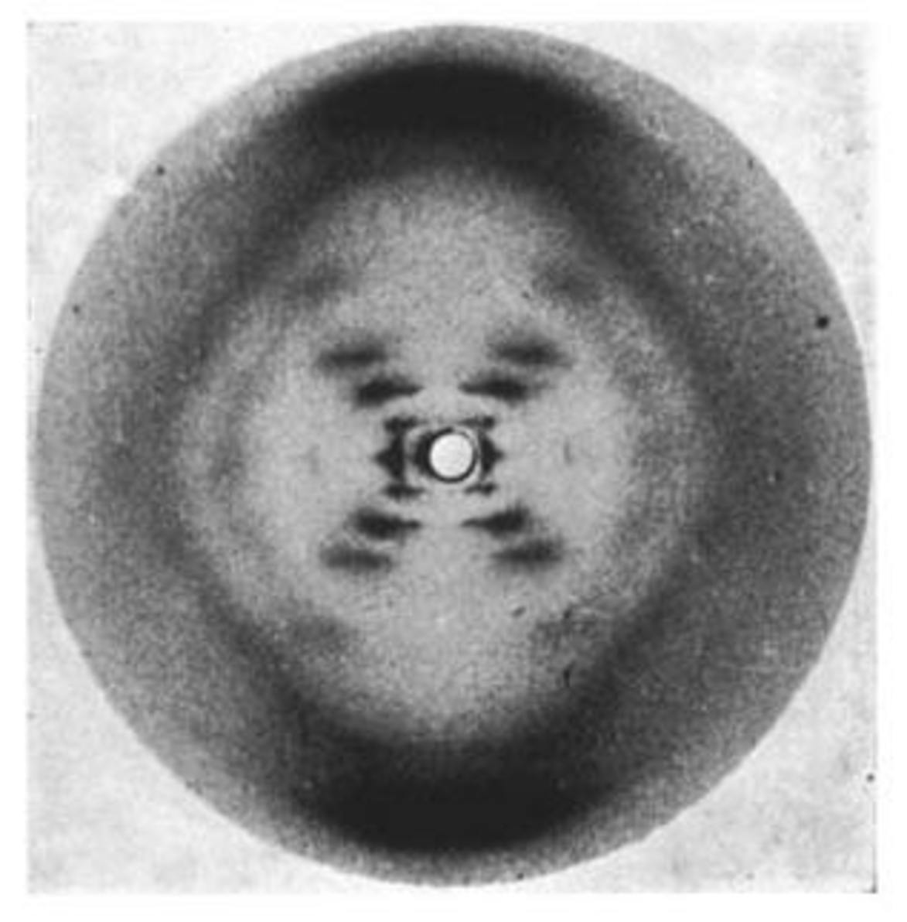
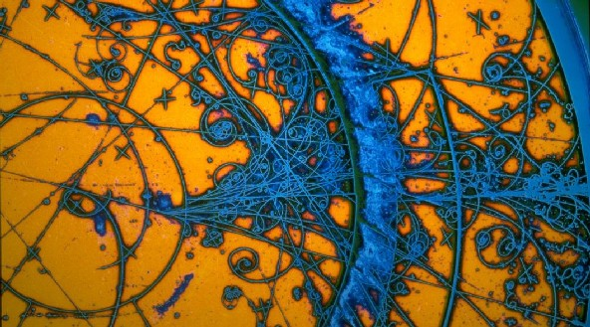
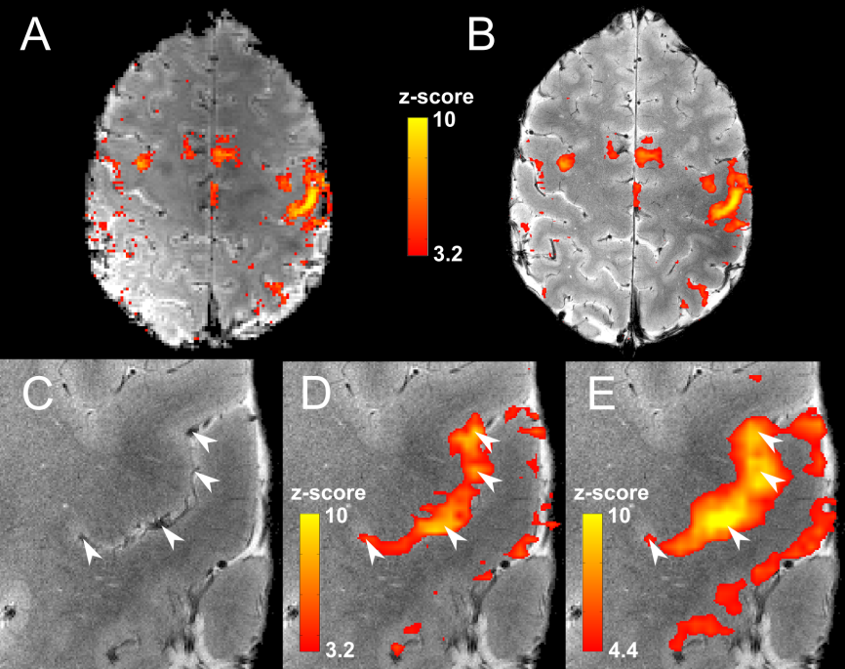
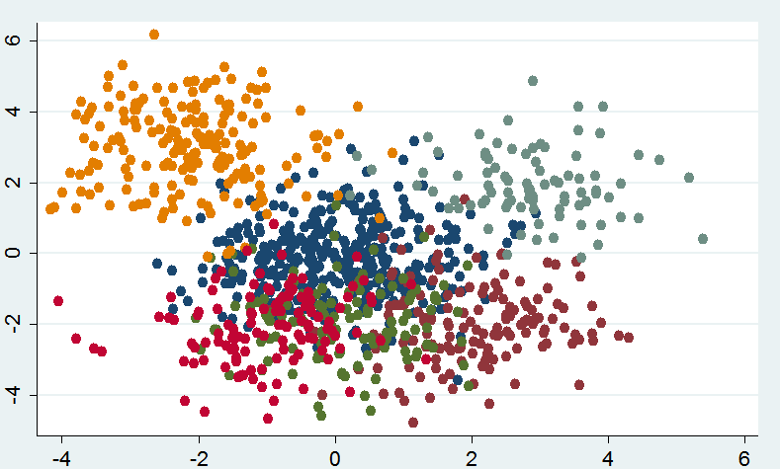
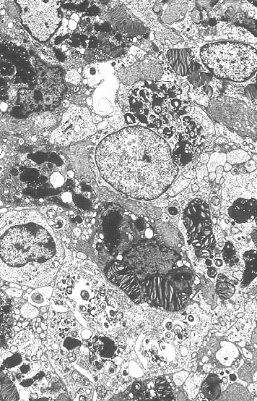
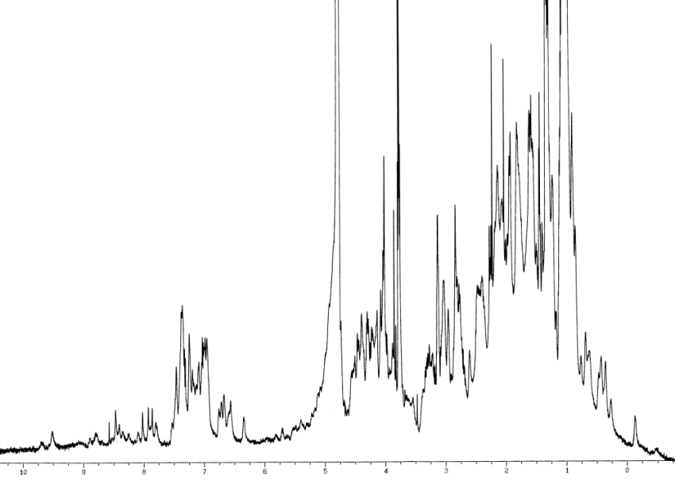
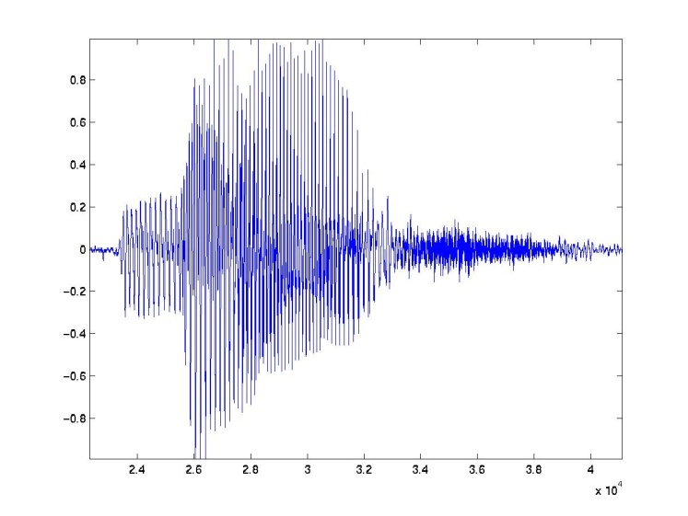
3. Some Examples

Slide 15
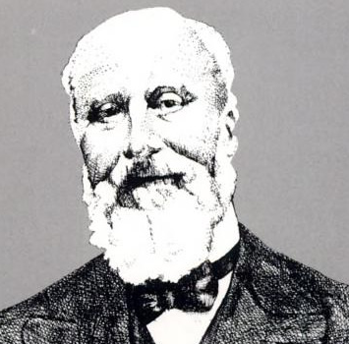
4. Underdetermination
Pierre Duhem (1861-1916)

Slide 16
4. Underdetermination
The available evidence is always consistent with a large number of theories
How do we choose among these theories?
Related to theory-ladenness but more focused on the theorising past
Two versions: confirmation holism and contrastive underdetermination

Slide 17
4. Confirmation holism
If a prediction fails, what exactly do we reject? Hypotheses are conjoined
Example 1: Newton gets orbit of Uranus wrong – reject Newton or posit Neptune?
Example 2: Newton gets orbit of Mercury wrong – reject Newton or posit Vulcan?
Experiment shows some belief is wrong, but which belief?
Quine: “The unit of empirical significance is the whole of science”

Slide 18
4. Contrastive underdetermination
Many theories will fit the data. They are ‘empirically equivalent’. So how to choose?
Problem of unconceived alternatives
Stanford: “the history of scientific inquiry itself offers a straightforward rationale for thinking that there typically are alternatives to our best theories equally well confirmed by the evidence, even when we are unable to conceive of them at the time”

Slide 19
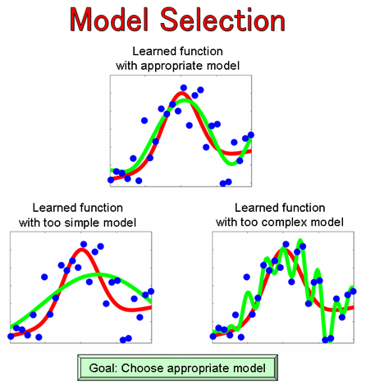
4. Example

Slide 20

4. Example

Slide 21
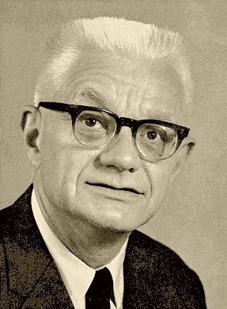
5. Scientific Explanation
Carl Hempel (1905-1997)

Slide 22
5. Scientific Explanation
A major goal of science is to explain things
But makes a good explanation?
Do explanations have to make predictions? - What about psychology or historical sciences?
How do we judge the ‘simplicity’ of an explanation or theory?
How do we weight up competing virtues (scope, empirical support, simplicity, etc)?

Slide 23
5. Deductive-Nomological Model
DN Model: A phenomenon is scientifically explained if we can logically derive the phenomenon some laws of nature
Example: To explain the position of Mars at some future time, begin with Newtons laws, facts about the mass of Mars and the sun (etc), and derive by logic the future position of Mars
Problems: What is a ‘law of nature’? What about the ‘special sciences’?

Slide 24
5. Counterexamples
“The pole has height h because its shadow has length l and the sun is at angle θ”
“John Jones failed to get pregnant because he has been taking birth control pills regularly, and all males who take birth control pills regularly fail to get pregnant”

Slide 25
5. Other Models
Statistical Relevance Model: an explanation is not an argument, but an assembly of statistically relevant properties
Causal Mechanical Model: an explanation is an account of the series of causal processes and interactions leading to some phenomena
Unificationist Account: scientific explanations are logical structures which allow us to derive descriptions of many phenomena using as limited set of initial facts as possible

Slide 26
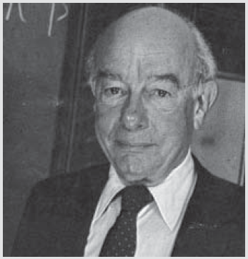
6. Scientific Realism
Willard Quine (1908-2000)

Slide 27
6. Scientific Realism
What does science actually say about the ‘real world’?
Are scientific explanations ‘true’, or merely ‘useful’?
What is the status of ‘theoretical entities’, such as electrons, photons, genes, species?
Realism vs Anti-Realism

Slide 28
6. Some Arguments
(Pro) Success argument: cannot explain the success of science unless its theories refer to real things
(Pro) Corroboration: same entities can be detected by multiple methods
(Con) Pessimistic induction: history shows that many/most theories turn out to be false
(Con) Instrumentalism: it isn’t meaningful or valid to even talk about unobservables

Slide 29
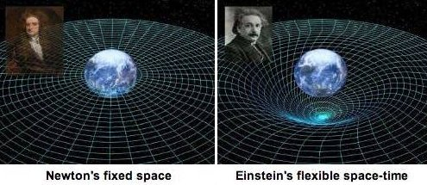
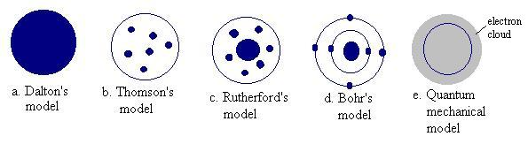
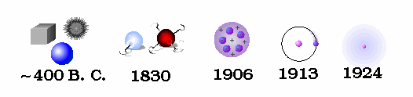
6. Illustrations

Slide 30
7. Conclusions
Science is messy
Must be careful in making claims about science or its findings
Give up simplistically neat models of scientific method
Philosophy helps us to understand what we are doing when we do science
Helps us to tell good science from bad. Helps us to avoid things like…

Slide 31
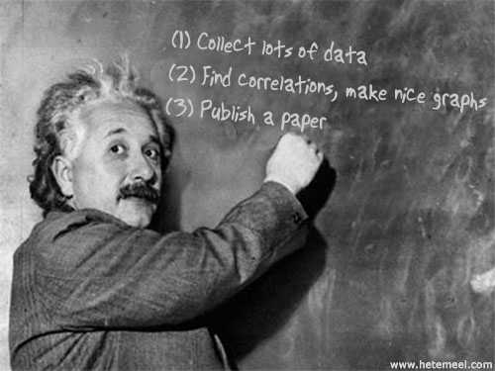
7. Conclusions

Slide 32
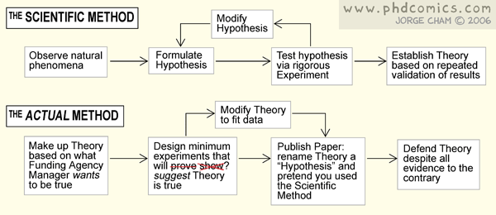
7. Conclusions

Slide 33


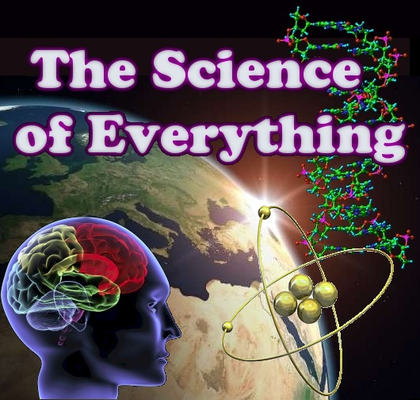
Shameless Self-Promotion
Check out the University of
Melbourne Secular Society
on facebook, or at umss.org
Visit my blog fods12.wordpress.com
Check out my podcast at fods12.podbean.com
Contact me at fods12@gmail.com

Slide 34
References
The Wikipedia
Philosophy of Science: The Central Issues
http://plato.stanford.edu/entries/induction-problem/
http://www.iep.utm.edu/conf-ind/
http://plato.stanford.edu/entries/science-theory-observation/
http://plato.stanford.edu/entries/scientific-underdetermination/
http://plato.stanford.edu/entries/scientific-explanation/
http://www.iep.utm.edu/explanat/
http://plato.stanford.edu/entries/scientific-realism/

