Slide 1

Synopsis: On many important issues of science, philosophy, politics, and religion, equally knowledgeable and intelligent people often disagree with one another. In this presentation I argue that on such matters, it is not epistemically justifiable to hold firmly to the correctness of one’s opinion, defined as one’s own subjective evaluation of the evidence. Rather, I argue that one’s opinion should receive no greater weight in constituting beliefs than does the opinion of any other equally informed person. I conclude by considering some common objections to my argument.
Philosophy Forum, November 2015

Slide 2
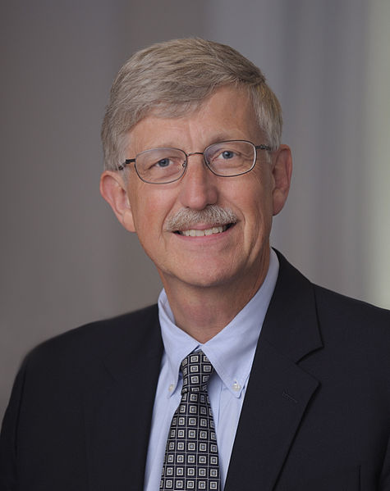

Defining Peer Disagreement
Disagreement between people of similar epistemic standing - those who are (roughly) equally intelligent, well informed, honest, rational, etc.

Slide 3

The Core Problem
On many issues of importance, there exists considerable peer disagreement.

Slide 4
Examples of Peer Disagreement
“God exists”
“Objective morality exists”
“A priori knowledge is possible”
“Fiscal stimulus is effective”
“The mind is computable”
“Aid is effective in combating poverty”
“String Theory is correct”
Question: What should I believe if I want to maximise my chances of being right?

Slide 5


Assessment vs Belief
  My assessment is the result or verdict of my evaluation of the arguments and evidence
  My belief is the cognitive attitude I hold with respect to some proposition
Claim: We do not need to believe our own assessments, and in many cases we should not.

Slide 6
Adding up the Bill Example
We are eating dinner together and the bill arrives, listing each item but no total
We both add up the totals, checking and double-checking our calculations carefully
We both recognise each other as being roughly equally good at arithmetic
At the end, we find we have arrived at different amounts (our assessments)
Question: When I learn of our disagreement, how should I change my view?

Slide 7
A Spectrum of Responses
When I learn of our disagreement, how should I change my view?
Steadfastness
Conciliationism
My Assessment
“Equal Weight View”
Your Assessment
Equal Weight View: I have no greater reason to believe in my assessment than in yours

Slide 8
Why Trust your Own Assessment?
I do some thinking and reading about a particular question
On the basis of this I form a assessment about what I think the evidence and arguments show
Question: what is the epistemic value of that assessment?
Why should I believe that my assessment is the correct one?
Of all the assessments I could pay attention to, why pick my own? Why are mine special?

Slide 9


Why Trust your Own assessment?
Our own judgments:
Are easier to access (via introspection)
Seem to fit better with your overall worldview
Are understood by you more intimately
Subjectively feel very persuasive
But none of these make our assessments more likely to be accurate!

Slide 10

An Illustration
“Based on their reading and thinking on the matter, some reasonably intelligent person has come to the opinion that X is probably true. Thus, I should believe that X is probably true.”
Claim: that is a bad reason to believe X, given how controversial it is among experts

Slide 11
An Illustration
“Based on my reading and thinking on the matter, I have come to the opinion that X is probably true. Thus, I should believe that X is probably true.”
Claim: switching to first person does not make this any a better reason to believe X.

Slide 12
Assessments are Pretty Unreliable
If most experts disagree, then most experts are wrong.
If most experts are wrong, what’s so special about our view?

Slide 13
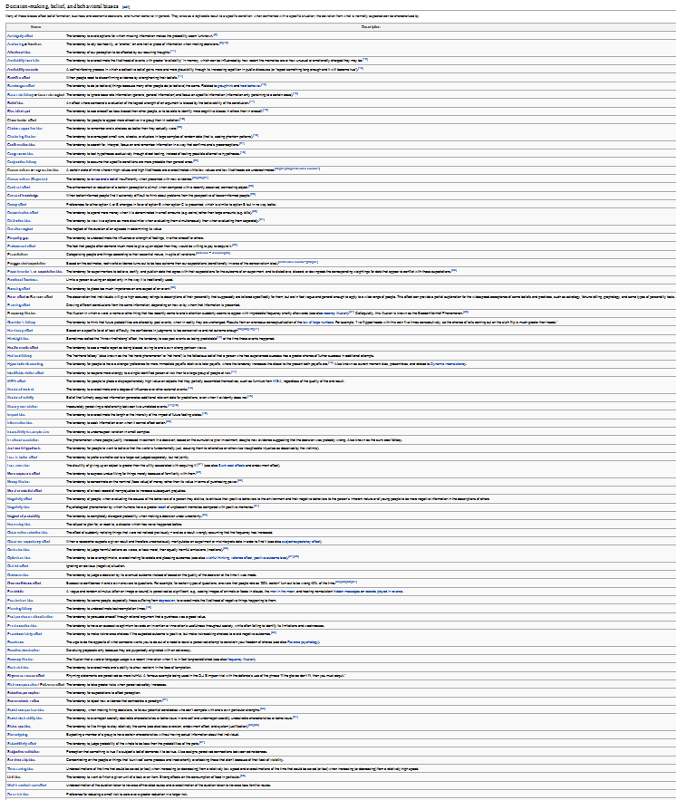
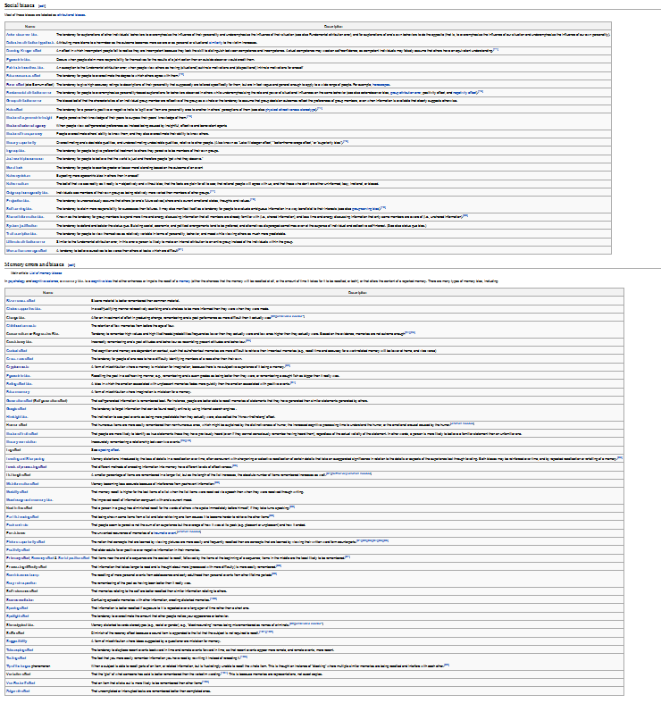
Opinions are Pretty Unreliable

Slide 14
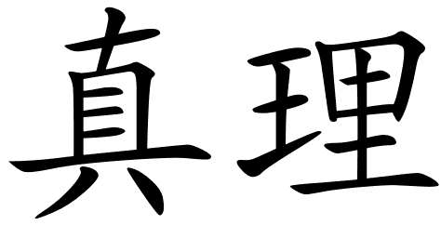
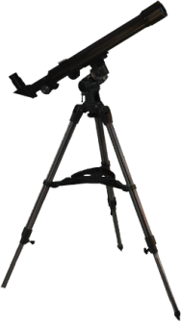


Why Assessments Are Useful

Slide 15
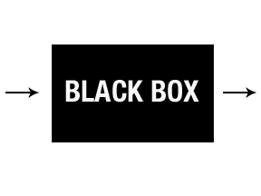

Why Assessments Are Useful
My Belief
My mind
My assessment
Same Evidence
Your mind
Your assessment
Equivalent as far
as we can tell (peers)
- symmetry

Slide 16
Why Assessments Are Useful
  Our assessments are relevant because they are truth-tracking to some degree
  assessments of epistemic peers are truth-tracking to the same degree (on average)
  A combination of peer assessments will track truth more reliably than that of one expert alone
  Thus, we should weight our assessment equally with epistemic peers with forming beliefs
  Key Claim: Conciliation will help us to believe more true things and fewer false things

Slide 17
Statistical Illustration
  Suppose we have 10 epistemic peers, each with a 70% chance of being right in some domain
  Suppose they all form their assessments independently of each other
  Method 1: form our own assessment and adopt that as our belief (steadfastness)
  Method 2: take a ‘vote’ and go with what the majority of experts say (equal weight view)
  Claim: method 2 is correct more often

Slide 18
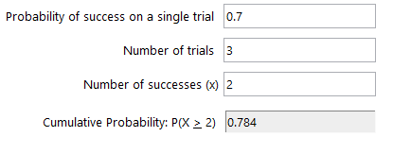
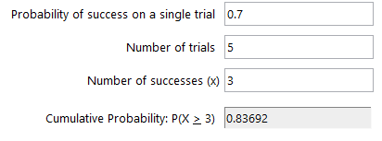
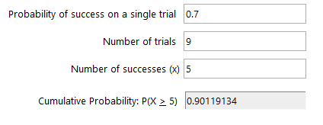
Statistical Illustration
  Binomial distribution with p=0.7

Slide 19
The Pragmatic Objection
Elgin: “It is not obvious that our cognitive objectives are best achieved by everyone’s marching in lock step to the same conclusion. When he reasons favouring each side of a dispute are sparse…or the evidence is equivocal…it may be better for the epistemic community as a whole that some of its members continue to accept each position.”

Slide 20
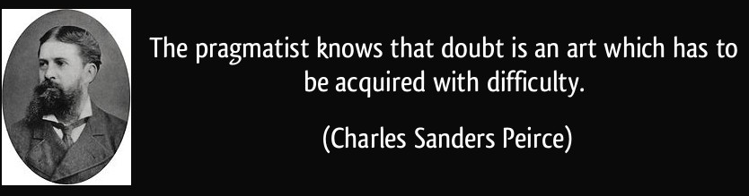
The Pragmatic Objection
This pragmatic consideration moves outside the framework of ‘truth maximisation’ I set out
It is not clear to me that overconfidence in our positions when evidence is weak is necessary for successful and productive discourse
We can argue a position even if deep down we aren’t especially confident about it

Slide 21
The Egocentric Dilemma
Fumerton: “In the final analysis there is really no alternative to the egocentric perspective. Even when my discoveries about what others believe defeat the justification I had, it is my discoveries that are doing the defeating. I can use the discovery of disagreement to weaken my justification only insofar as I trust my reasoning.”

Slide 22
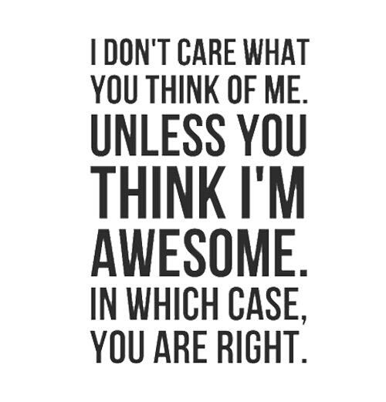
The Egocentric Dilemma

Slide 23
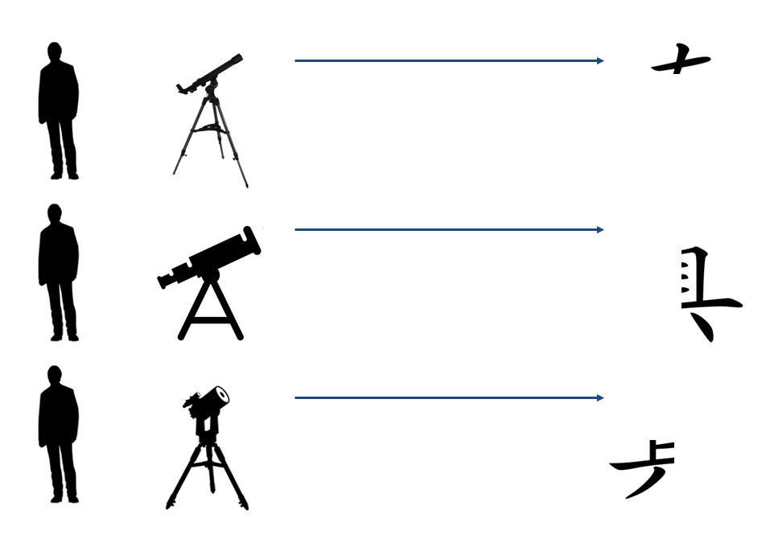

Response to the Dilemma
  Our beliefs are egocentric, but truth is not.
Steadfastness
Conciliationism
  Key Claim: Conciliationism will give as a fuller grasp of a problem and increase our chances of having accurate beliefs. We are leveraging the cognitive capacities of others.

Slide 24
Outstanding Problems
Defining and identifying epistemic peerhood
Dispute-independence
Rational Uniqueness versus Permissiveness
Collating expert opinion
Independence of opinions
Past and future opinions
Judging bias

Slide 25

What is to be Done?
Look for expert consensus
Where experts disagree, remain agnostic
Frequently engage in meta-reasoning
Don’t make yourself into the world expert
Seek disconfirming evidence and viewpoints

Slide 26
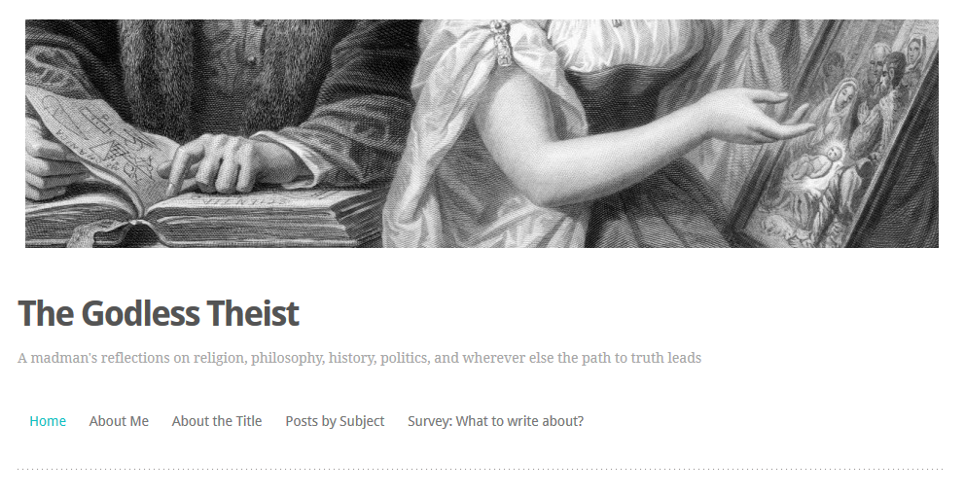
Shameless Self-Promotion
Check out my blog at thegodlesstheist.com
Contact me at fods12@gmail.com

Slide 27
How to Disagree 1
Not everyone is your epistemic peer
Ensure that your dispute is not merely semantic
Try to understand their position well enough to argue it for them
Try to break the argument down into very specific items of disagreement, identify those that are worth pursuing, and push those in depth
Don’t get sidetracked by minor points

Slide 28
How to Disagree 2
Figure out what evidence could determine who is right
Identify underlying assumptions (e.g. worldview differences) contributing to the disagreement
Don’t try to defend your position at all cost; try to work out exactly why you disagree
Ideas don’t need respect, but people do

