Slide 1

Synopsis: On many important issues of science, philosophy, politics, and religion, equally knowledgeable and intelligent people often disagree with one another. In this presentation I argue that on such matters, it is not epistemically justifiable to hold firmly to the correctness of one’s opinion, defined as one’s own subjective evaluation of the evidence. Rather, I argue that one’s opinion should receive no greater weight in constituting beliefs than does the opinion of any other equally informed person. I conclude by considering some common objections to my argument.
Victorian Humanists, March 2015

Slide 2
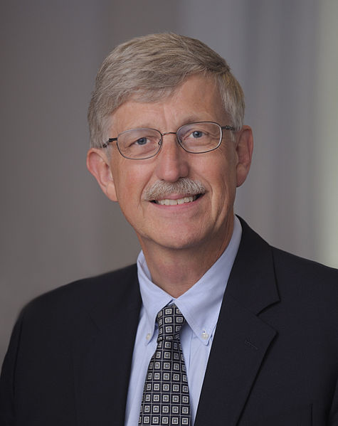

Defining Peer Disagreement
Disagreement between people of similar epistemic standing - those who are (roughly) equally intelligent, well informed, honest, rational, etc.

Slide 3

The Core Problem
On many issues of importance, there exists considerable peer disagreement.

Slide 4
Examples of Peer Disagreement
“God exists”
“Objective morality exists”
“A priori knowledge is possible”
“Fiscal stimulus is effective”
“The mind is computable”
“Aid is effective in combating poverty”
“String Theory is correct”
Question: What should I believe if I want to maximise my chances of being right?

Slide 5
Adding up the Bill Example
We are eating dinner together and the bill arrives, listing each item but no total
We both add up the totals, checking and double-checking our calculations carefully
We both recognise each other as being roughly equally good at arithmetic
At the end, we find we have arrived at different amounts
Question: When I learn of our disagreement, how should I change my view?

Slide 6
A Spectrum of Responses
When I learn of our disagreement, how should I change my view?
Steadfastness
Conciliationism
My Judgment
“Equal Weight View”
Your Judgment
Equal Weight View: I have no greater reason to believe in my judgement than in yours

Slide 7
Why Trust your Own Judgement?
I do some thinking and reading about a particular question
On the basis of this I form a judgement about what I think the evidence and arguments show
Question: what is the epistemic value of that judgement?
Why should I believe that my judgement is the correct one?
Of all the judgements I could pay attention to, why pick my own? Why are mine special?

Slide 8

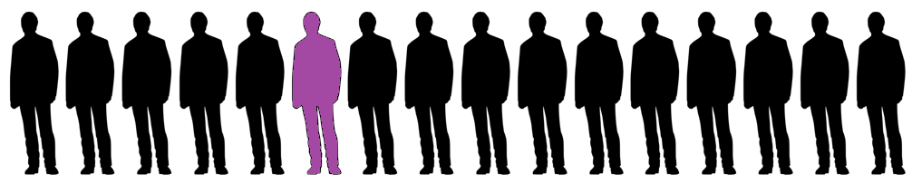
Why Trust your Own Judgement?
Our own judgments:
Are easier to access (via introspection)
Seem to fit better with your overall worldview
Are understood by you more intimately
Subjectively feel very persuasive
But none of these make our judgements more likely to be accurate!

Slide 9

An Illustration
“Based on their reading and thinking on the matter, some reasonably intelligent person has come to the opinion that X is probably true. Thus, I should believe that X is probably true.”
Claim: that is a bad reason to believe X, given how controversial it is among experts

Slide 10
An Illustration
“Based on my reading and thinking on the matter, I have come to the opinion that X is probably true. Thus, I should believe that X is probably true.”
Claim: switching to first person does not make this any a better reason to believe X.

Slide 11
Judgements are Pretty Unreliable
If most experts disagree, then most experts are wrong.
If most experts are wrong, what’s so special about our view?

Slide 12
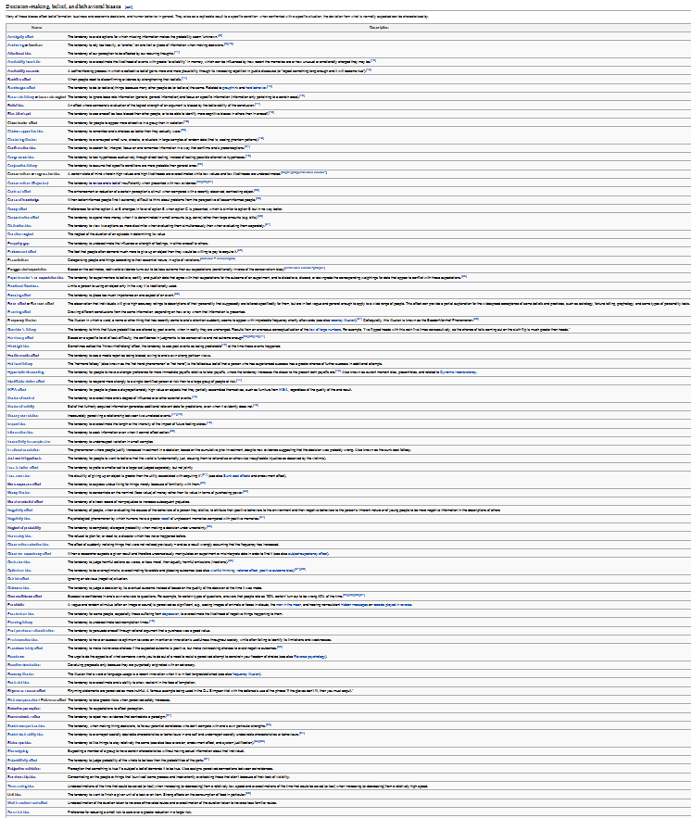
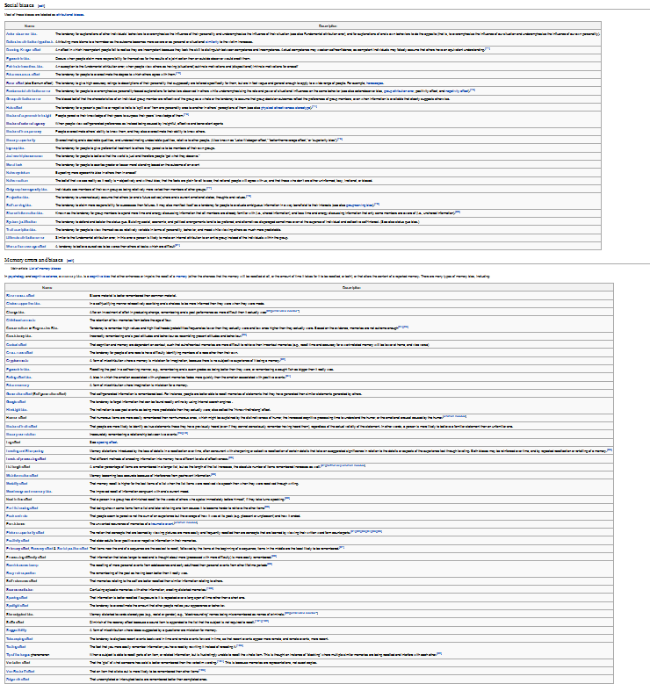
Opinions are Pretty Unreliable

Slide 13


Judgement vs Belief
  My judgement is my considered assessment of the arguments and evidence
  My belief is what I believe is most likely to be the case
Claim: We do not need to believe our own judgements, and in many cases we should not.

Slide 14
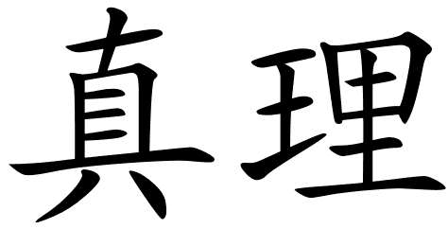
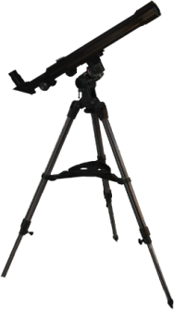


Why Judgements Are Useful

Slide 15
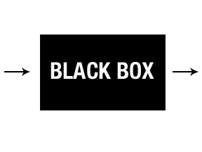

Why Judgements Are Useful
My Belief
My mind
My Judgement
Same Evidence
Your mind
Your Judgement
Equivalent as far
as we can tell (peers)

Slide 16
Why Judgements Are Useful
  Our judgements are relevant because they are truth-tracking to some degree
  Judgements of epistemic peers are truth-tracking to the same degree (on average)
  A combination of peer judgements will track truth more reliably than that of one expert alone
  Thus, we should weight our judgement equally with epistemic peers with forming beliefs
  Key Claim: Conciliation will help us to believe more true things and fewer false things

Slide 17
The Egocentric Dilemma
Fumerton: “In the final analysis there is really no alternative to the egocentric perspective. Even when my discoveries about what others believe defeat the justification I had, it is my discoveries that are doing the defeating. I can use the discovery of disagreement to weaken my justification only insofar as I trust my reasoning.”

Slide 18
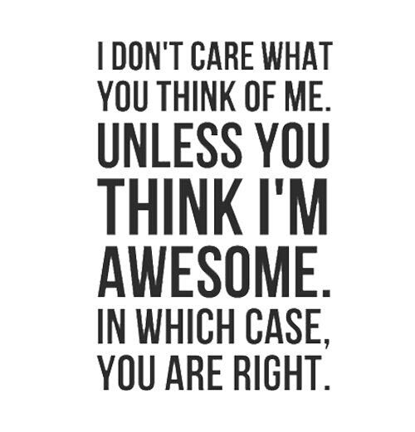
The Egocentric Dilemma

Slide 19
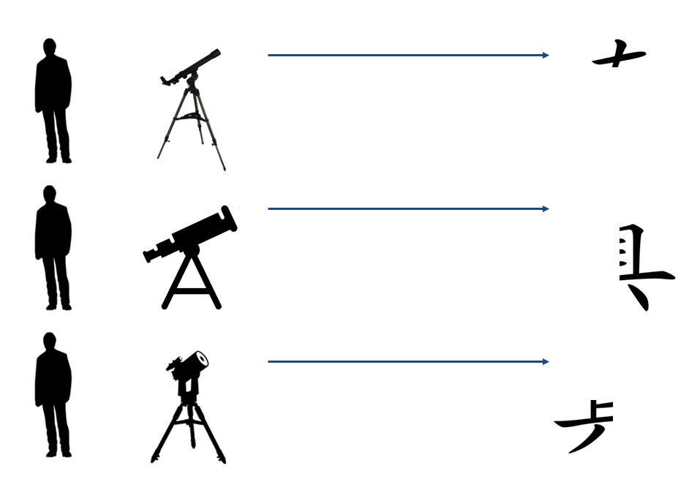

Response to the Dilemma
  But we still have a decision to make: how should we form our beliefs given peer disagreement?
Steadfastness
Conciliationism
  Key Claim: Conciliationism will help us to believe more true things and fewer false things

Slide 20
Outstanding Problems
Defining and identifying epistemic peerhood
Dispute-independence
Rational Uniqueness versus Permissiveness
Collating expert opinion
Independence of opinions
Past and future opinions
Judging bias

Slide 21

What is to be Done?
Look for expert consensus
Where experts disagree, remain agnostic
Frequently engage in meta-reasoning
Don’t make yourself into the world expert
Seek disconfirming evidence and viewpoints

Slide 22



Find this Interesting?
Check out the University of
Melbourne Secular Society
on facebook, or at umss.org
Visit my blog www.thegodlesstheist.com
Contact me at fods12@gmail.com
Check out my podcast at fods12.podbean.com

Slide 23
How to Disagree 1
Not everyone is your epistemic peer
Ensure that your dispute is not merely semantic
Try to understand their position well enough to argue it for them
Try to break the argument down into very specific items of disagreement, identify those that are worth pursuing, and push those in depth
Don’t get sidetracked by minor points

Slide 24
How to Disagree 2
Figure out what evidence could determine who is right
Identify underlying assumptions (e.g. worldview differences) contributing to the disagreement
Don’t try to defend your position at all cost; try to work out exactly why you disagree
Ideas don’t need respect, but people do

Slide 25
Objection: View is Self-Refuting
“Since most people disagree with you, how can you justify believing your opinion?”
Reply 1: almost any epistemic position can potentially be described as self-refuting
Reply 2: consumer choice magazine example (Elga)

Slide 26
Objection: Still Have to Act
“We still need to make decisions and act in the world.”
Reply: yes, but that doesn’t justify false confidence

Slide 27
My Approach
All relevant possibilities
F
A
B
E
G
C
D
Our goal: to determine which possibility is actual

