Slide 1

Atheism and Religion
James Fodor

Slide 2
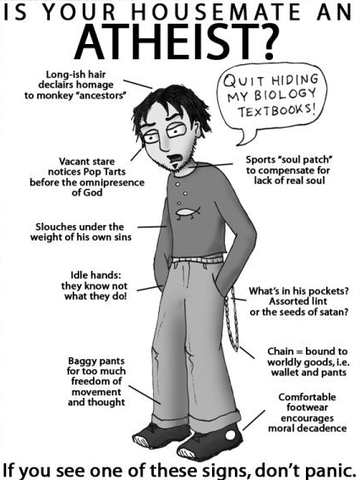

Slide 3
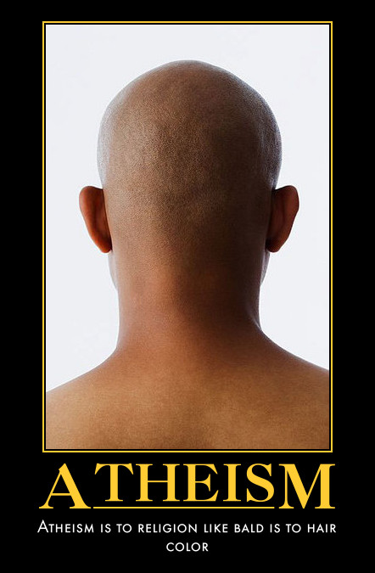
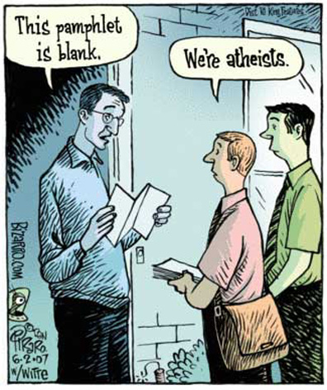
What is Atheism?

Slide 4
What is Atheism?
‘Atheism’ from Greek ‘atheos’, meaning ‘without god’
Atheist: “I do not believe in god/gods”
Agnostic: “I don’t know/I don’t know if we can know if god/gods exist”
Atheism has no positive beliefs of its own
Related movements like Skepticism and Humanism do have positive beliefs

Slide 5







Related Schools of Thought

Slide 6
Why be Atheist?
Two main categories of reasons:
Religion is harmful
Religion is wrong
Not mutually exclusive

Slide 7








Caveat: there are always counter-arguments!

Slide 8

“Religion is Harmful”
Religious war and terrorism
Suppression of science and art
Treatment of women
Indoctrination of children
Destructive practices (faith healing, genital modification, witch hunts)
Corruption and excessive power

Slide 9
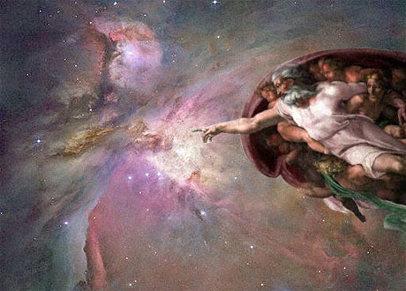
“Religion is Wrong”
The problem of evil
Argument from many faiths
Argument from poor design
Science is sufficient (Occam’s Razor)
Free will/divine omnipotence paradox
Absurdities & contradictions in holy texts
Ignosticism: the concept of ‘God’ doesn’t make sense

Slide 10
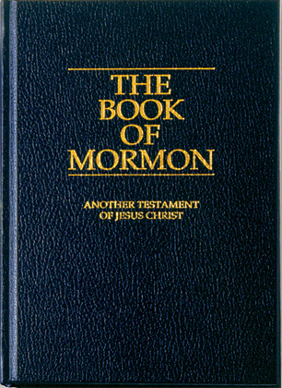
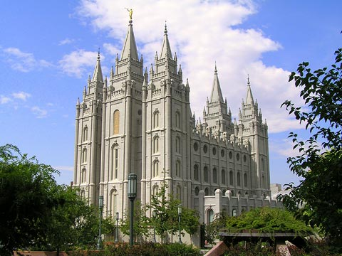
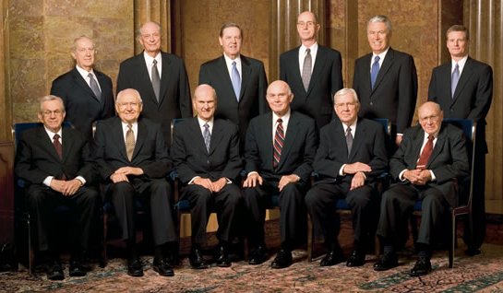
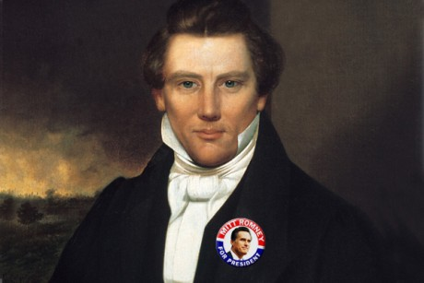
My Experience

Slide 11
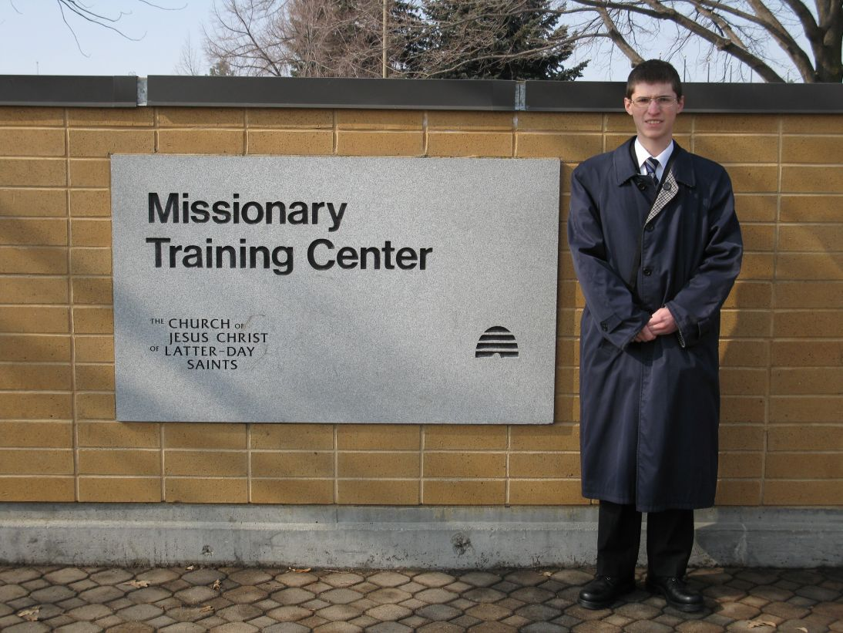
My Experience

Slide 12
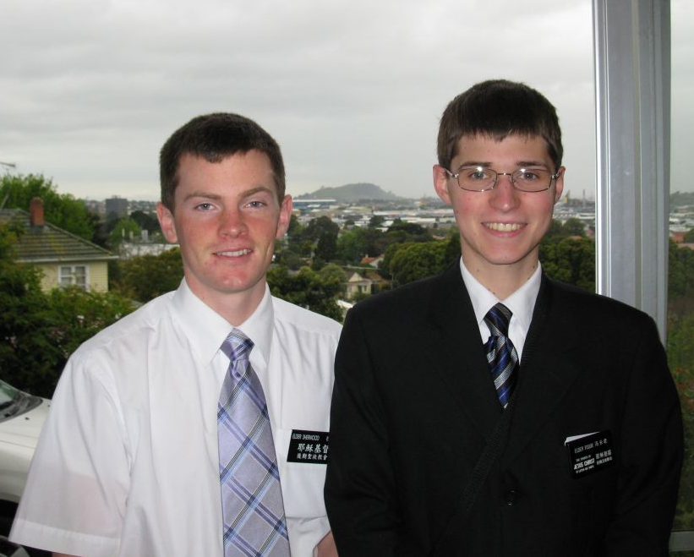
My Experience

Slide 13
Why I Left the Mormon Church
Problems with the Book of Mormon
Issues in church history
Contradictions with science
Dishonesty and secrecy of the church
Incoherent and unreasonable doctrines
Anti-intellectualism in church policy

Slide 14

Leaving Religion Isn’t Easy
Family
Friends
Community
Culture
Beliefs

Slide 15

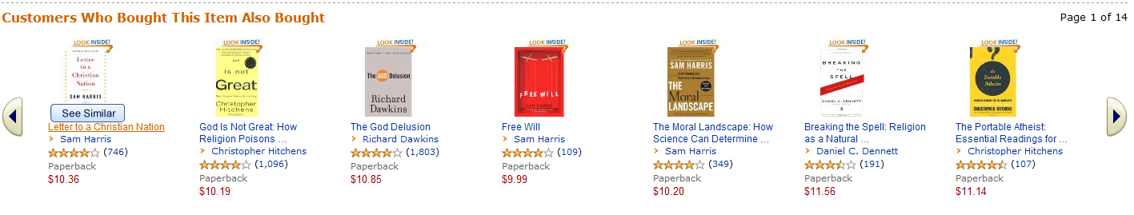
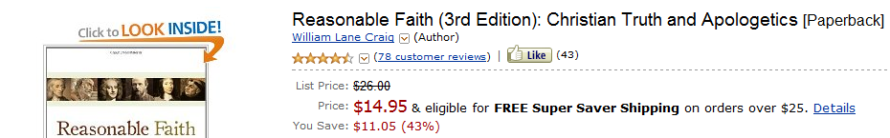
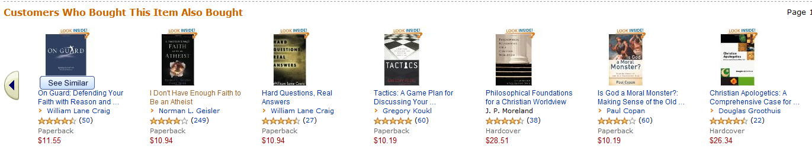
Part of the Problem

Slide 16
Why Genuine Dialogue Matters
Increase understanding of other beliefs
Critically analyse your worldview from new perspectives
Avoid misperceptions and stereotypes
Reduce hatred and bigotry
Build a common front against radicals

Slide 17

Why Genuine Dialogue Matters

Slide 18
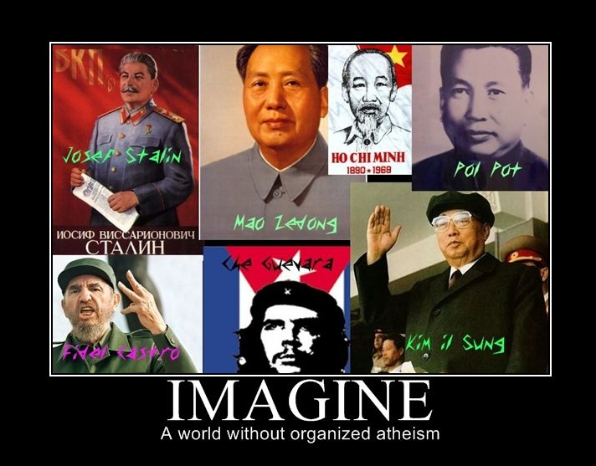
Why Genuine Dialogue Matters

Slide 19
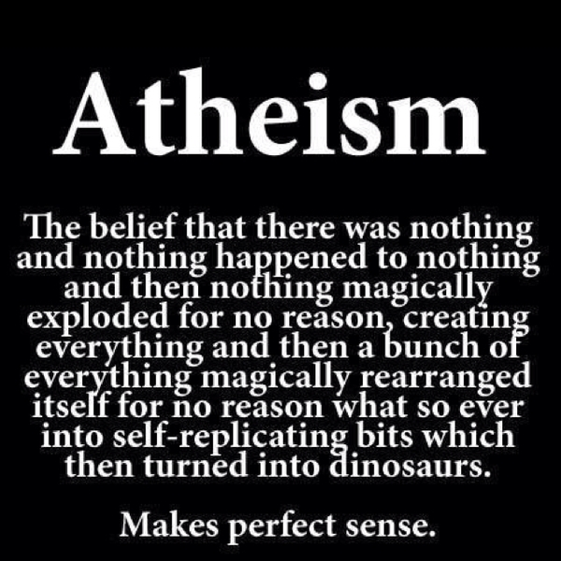
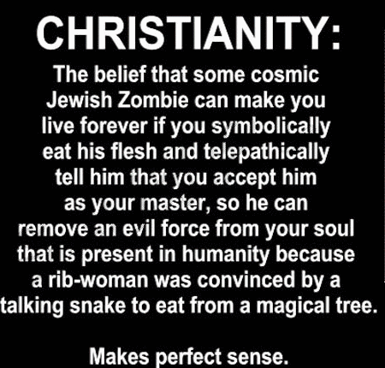
Why Genuine Dialogue Matters

Slide 20

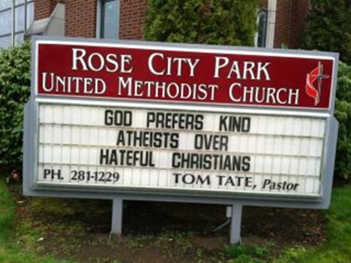
One thing we can Agree on?

