Slide 1

Measuring the Wealth of Nations
James Fodor, June 2018
Effective Altruism Melbourne

Slide 2
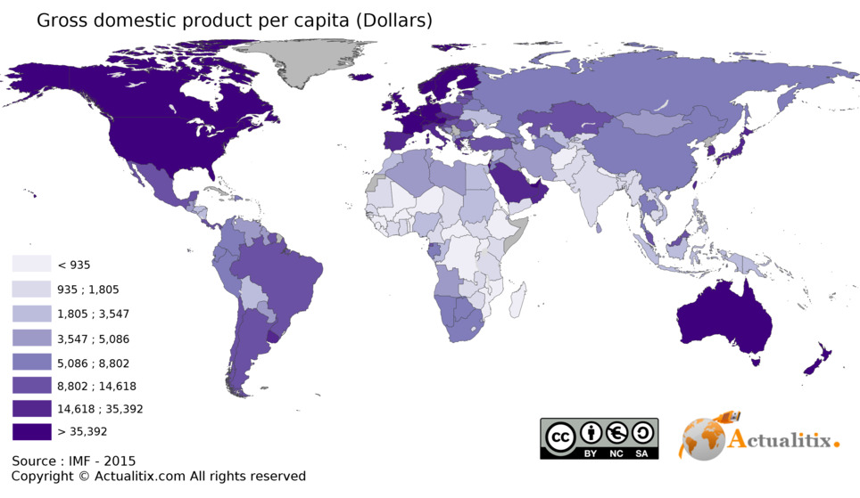
What Causes Development?

Slide 3
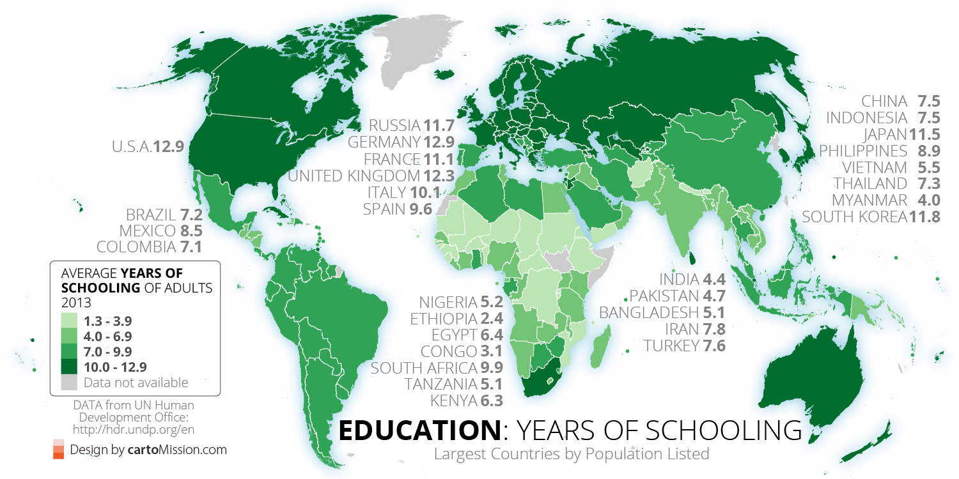
What Causes Development?

Slide 4
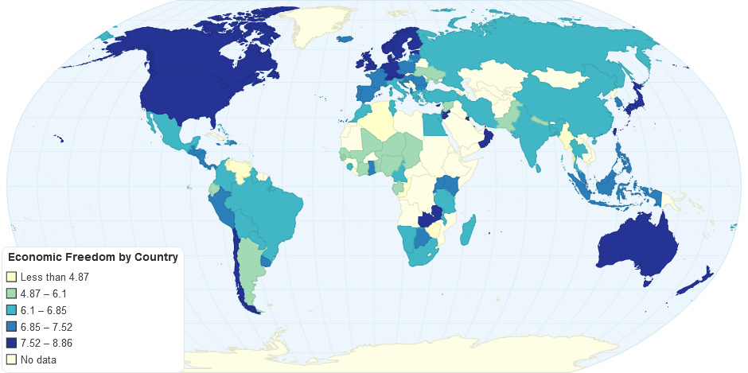
What Causes Development?

Slide 5
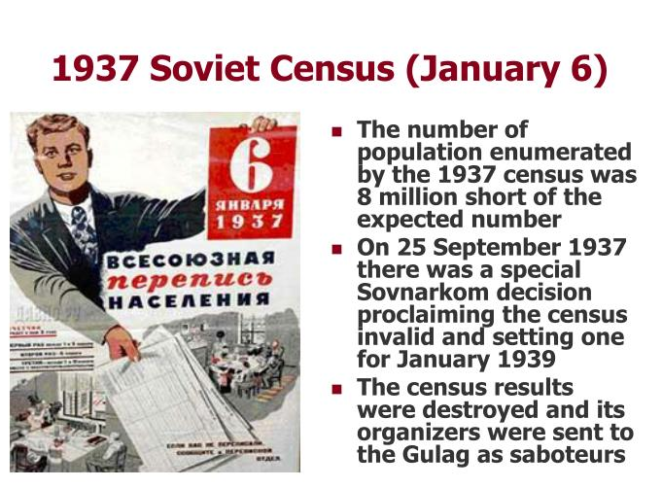
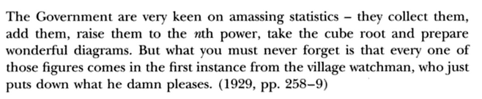
Measurement Problems
Poorest regions have the fewest resources for data collection
Variables not defined in the same way in different countries
Many measures are actually imputed, and formulae often not given
How to survey informal sector or remote rural villages?
Statistics biased for political reasons

Slide 6
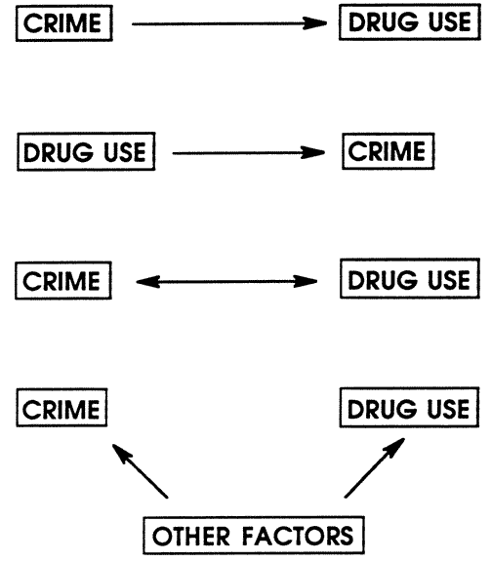
What Causes Development?

Slide 7
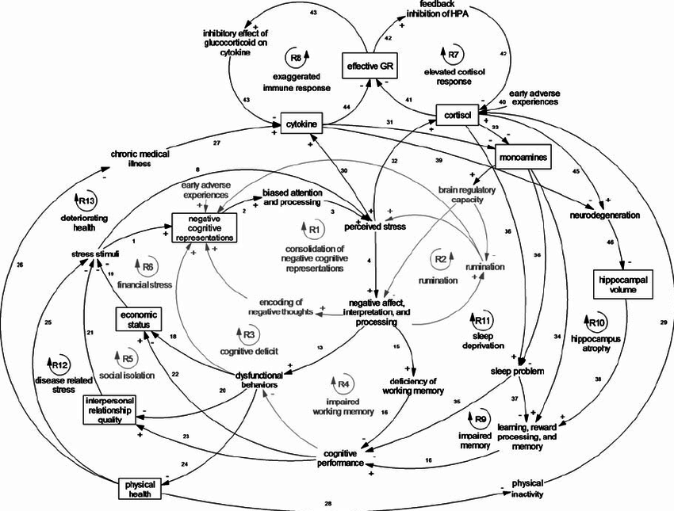
What Causes Development?

Slide 8
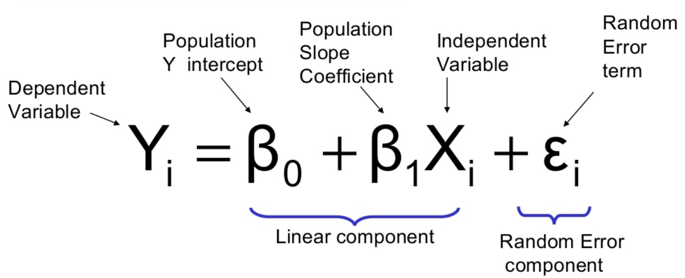
Simple Linear Regression

Slide 9
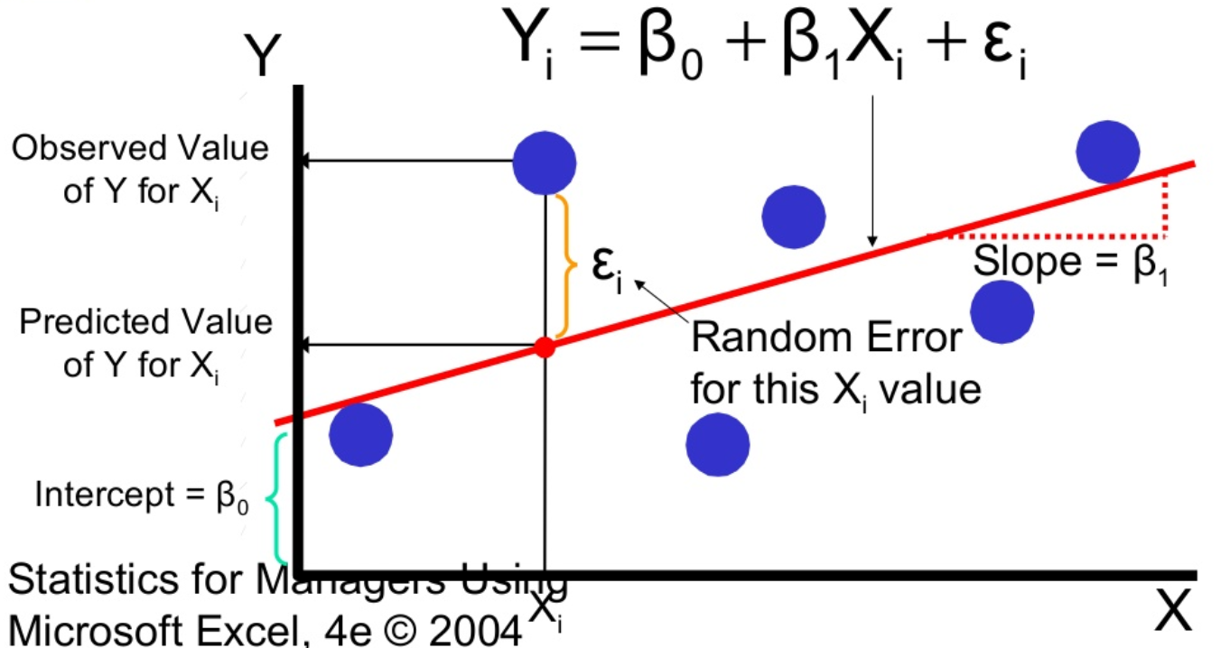
Simple Linear Regression

Slide 10
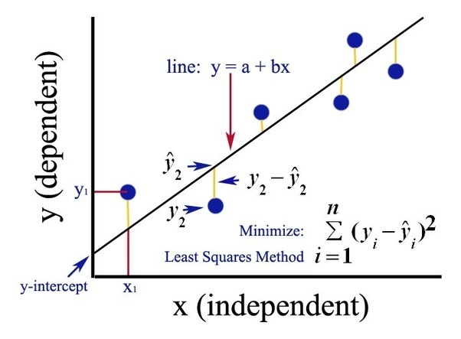
Least Squares Method
The “right” parameters are the ones which minimise the sum of squared residuals of the model. This is called Ordinary Least Squares (OLS).
If our model is correctly specified and we have no endogeneity, OLS gives unbiased estimates for the population parameters.

Slide 11
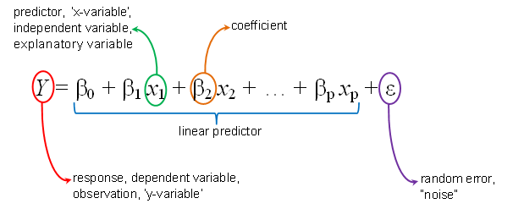
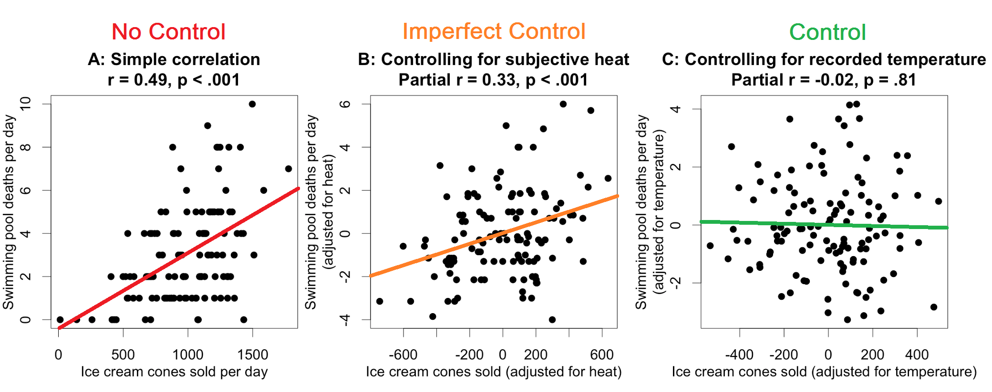
Control for Confounds
We can use multiple regression to control for confounding variables.

Slide 12
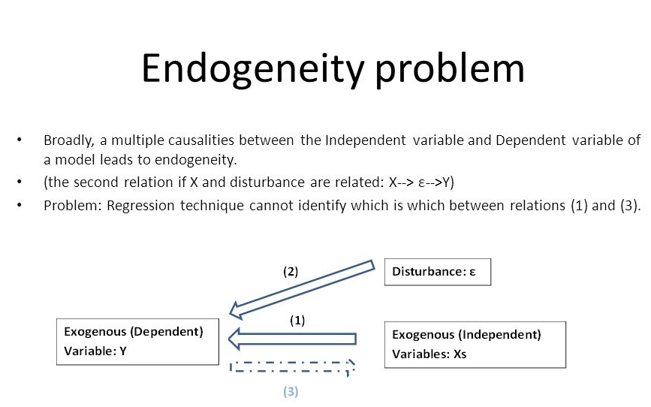
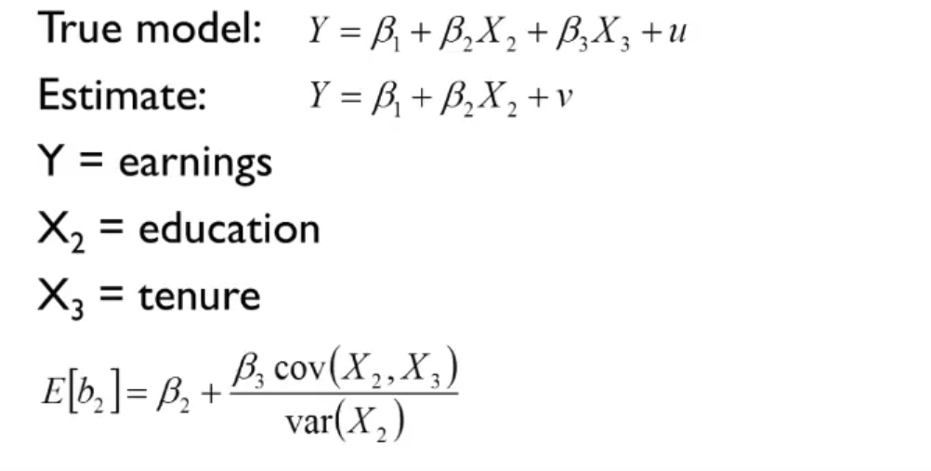
Biased Results
But our estimates will be biased if we have omitted variables or an endogeneity problem.

Slide 13
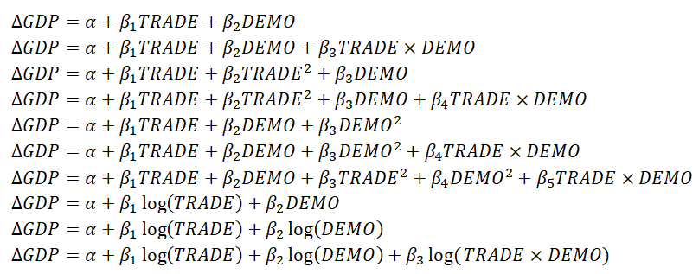
So What is the Right Model?

Slide 14
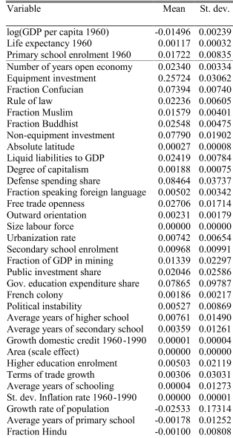
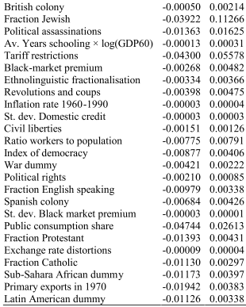
So What is the Right Model?
Nonlinearities?
Interaction terms?
Structural change?

Slide 15
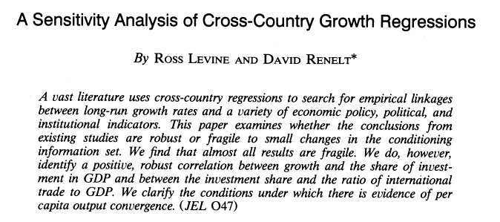
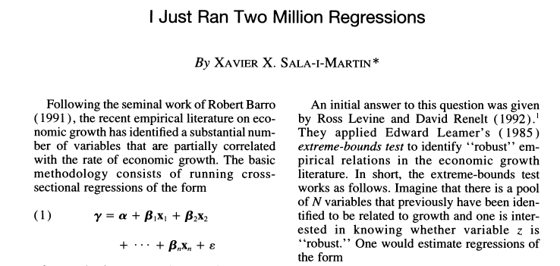
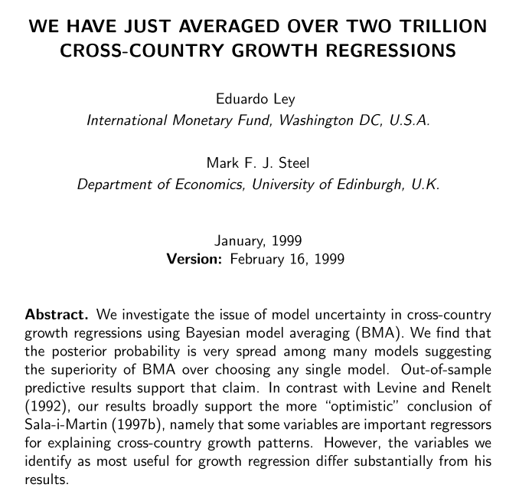
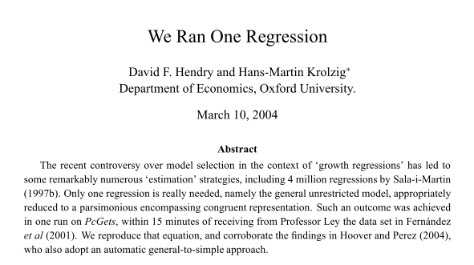
How Many Regressions?
Hundreds?
Millions?
Trillions?
One?

Slide 16

Model Selection is Hard

Slide 17
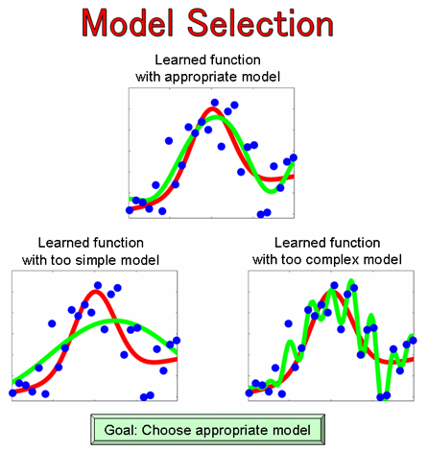
Model Selection is Hard

Slide 18
New Approach
Instead of trying to control for all confounding variables explicitly, we can just let random variation do the job for us.
If something is decided by chance or by some exogenous factor, it should not be correlated with any unobserved variables!

Slide 19
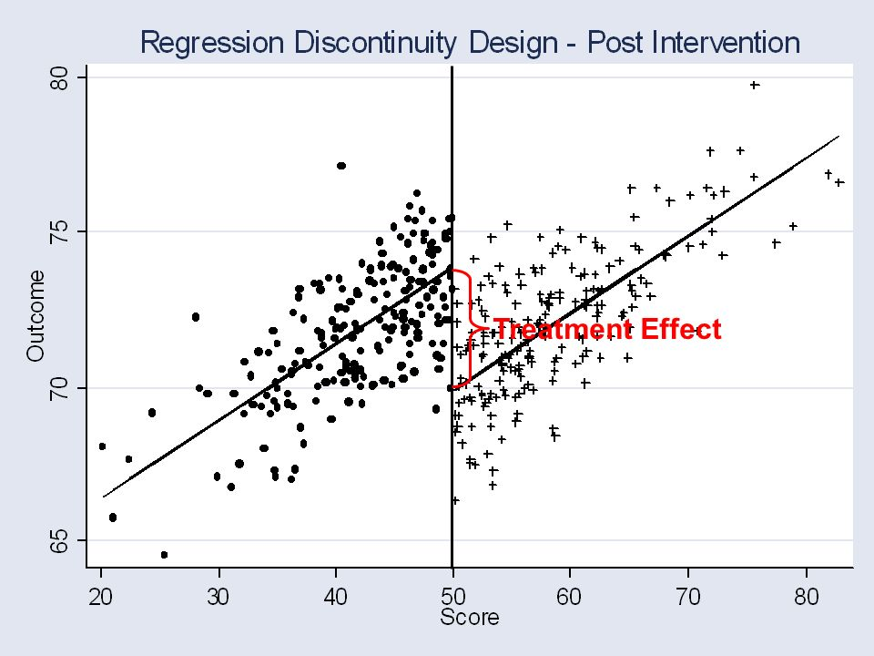
Regression Discontinuity
Need discontinuity to be binding
Need to ensure that subjects are similar on each side
Self-selection concerns

Slide 20
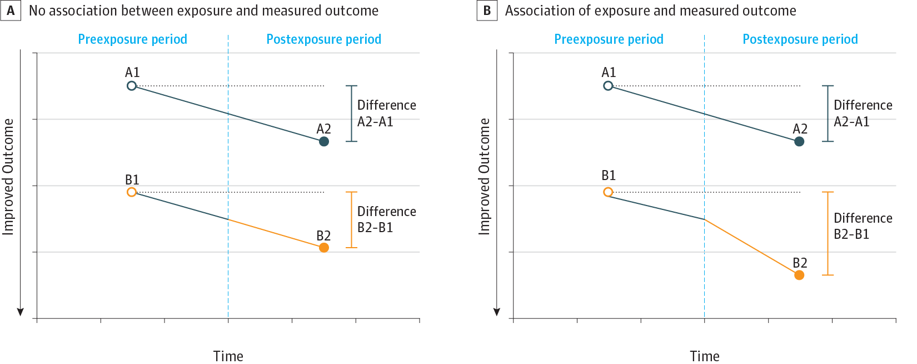
Differences in Differences
Must assume two groups would behave the same absent intervention
Self-selection concerns

Slide 21
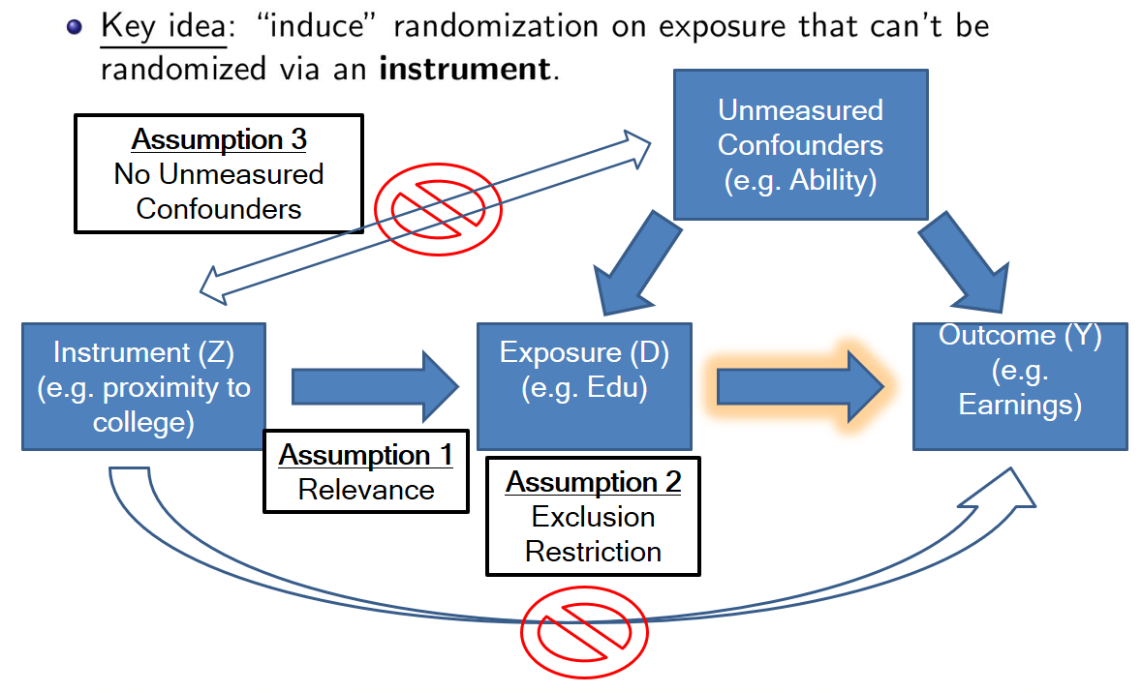
Instrumental Variables
Instrument must be correlated with independent variable (can test)
Instrument must not be correlated with errors (can’t test)
What does the result actually mean? (Local Average Treatment Effect)

Slide 22
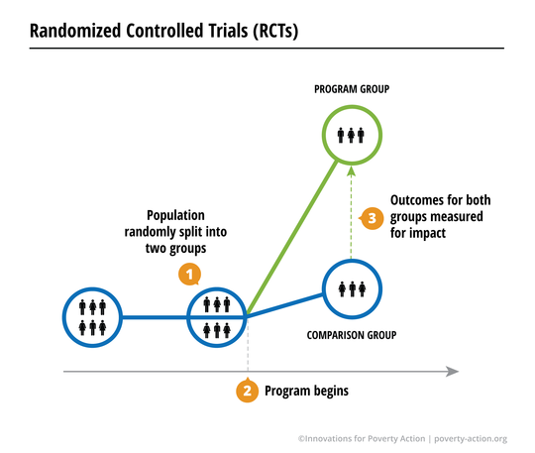

Randomised Controlled Trial
Can be hard/expensive to conduct, but if done properly there cannot be hidden confounds!

Slide 23

Randomised Controlled Trial
?

Slide 24
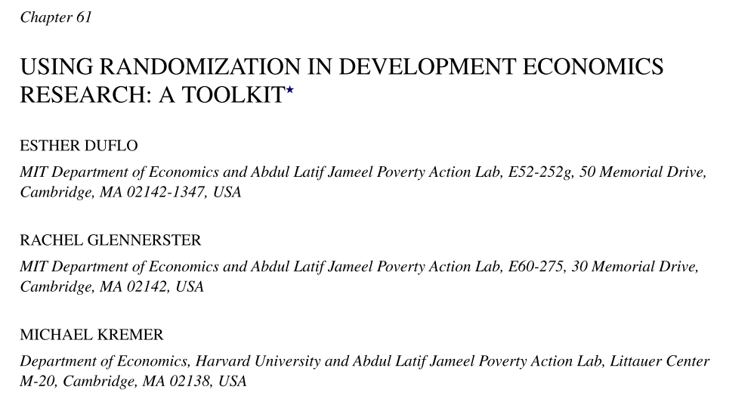
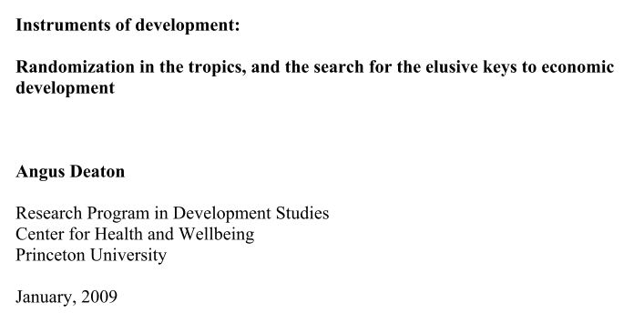
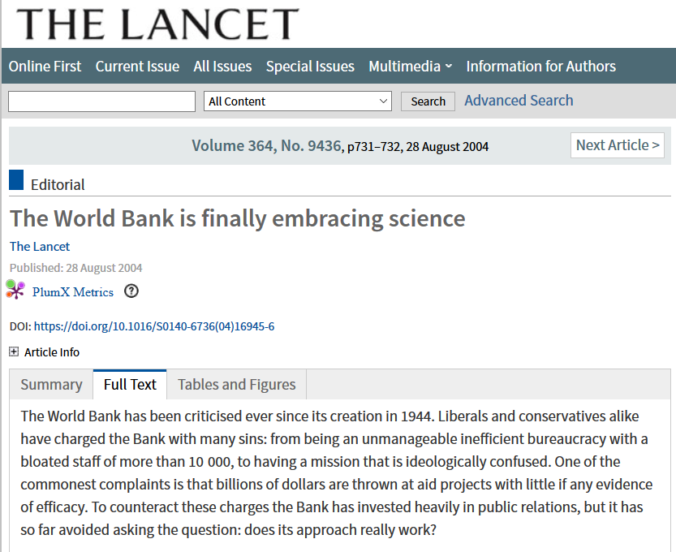
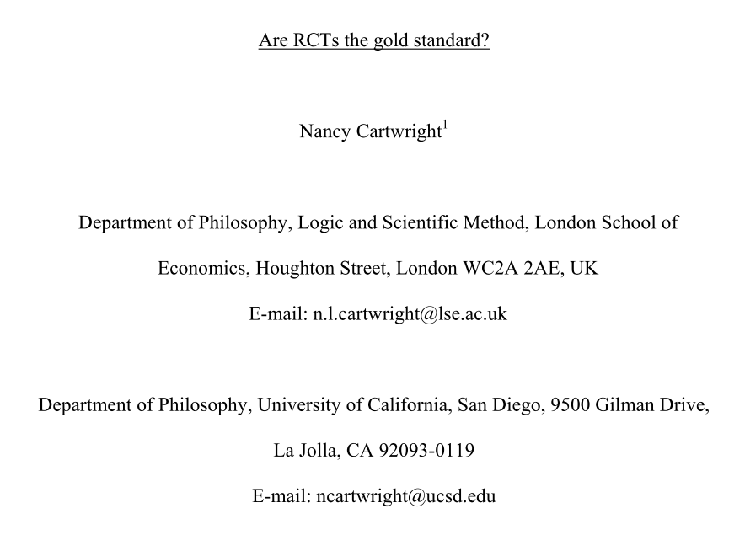
Clash of Econometricians

Slide 25
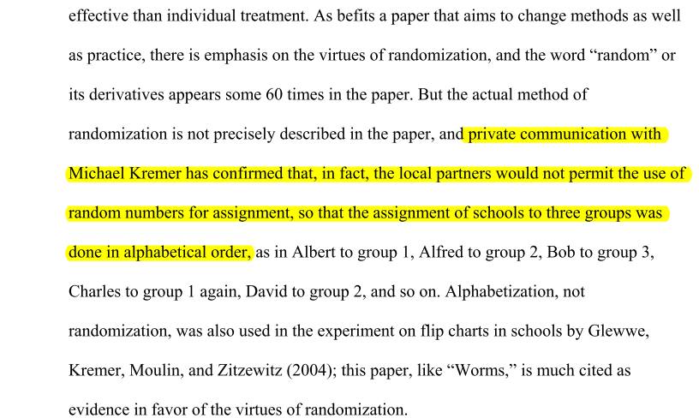
Limitations of RCTs
Expensive and time consuming, can’t conduct everywhere
Do not factor in general equilibrium effects
Do not incorporate heterogeneity of parameters
Trials differ from full-scale programs
Do not tell us why anything works or doesn’t work

Slide 26
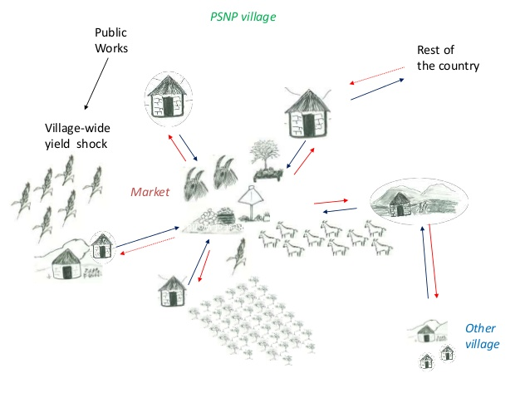
General Equilibrium

Slide 27
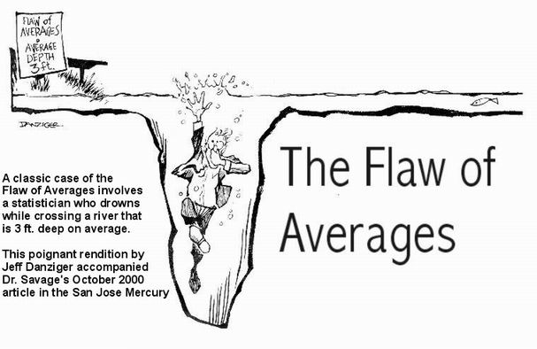
Heterogeneity
RCTs find the true effect size, but only in that exact context. Averaging over contexts is not necessarily helpful either.

Slide 28
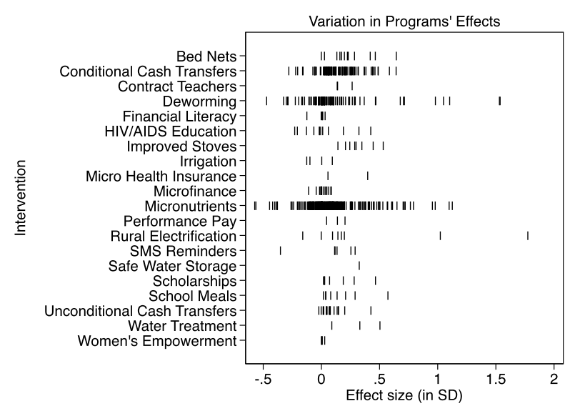
Heterogeneity
Eva Vivalt meta-analysis of RCT results.

Slide 29

Scaling Effects

Slide 30
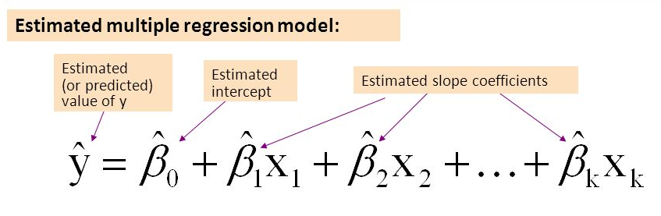
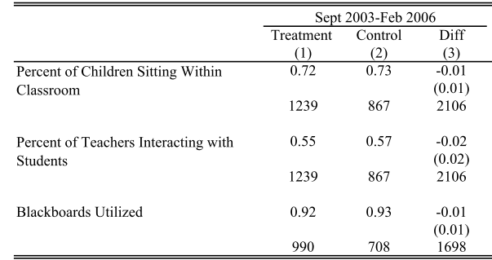
What Do RCTs Tell Us?

Slide 31
Structural Models
These make assumptions about the causal processes that generate results
Typical approach:
  Define utility function
  Define production function or resource constaints
  Define timespan and information available
  Define institutional setup
  Maximise utility subject to constraints over timespan given information
  Derive equation to estimate
  Use data to determine structural parameters

Slide 32
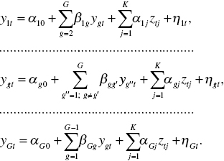
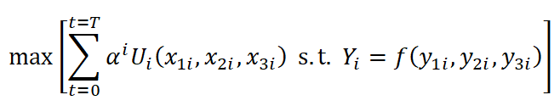
Structural Models
Actually tells you about how the system works
But requires lots of assumptions about functional forms
Also often hard to identify all parameters (not enough data)

Slide 33
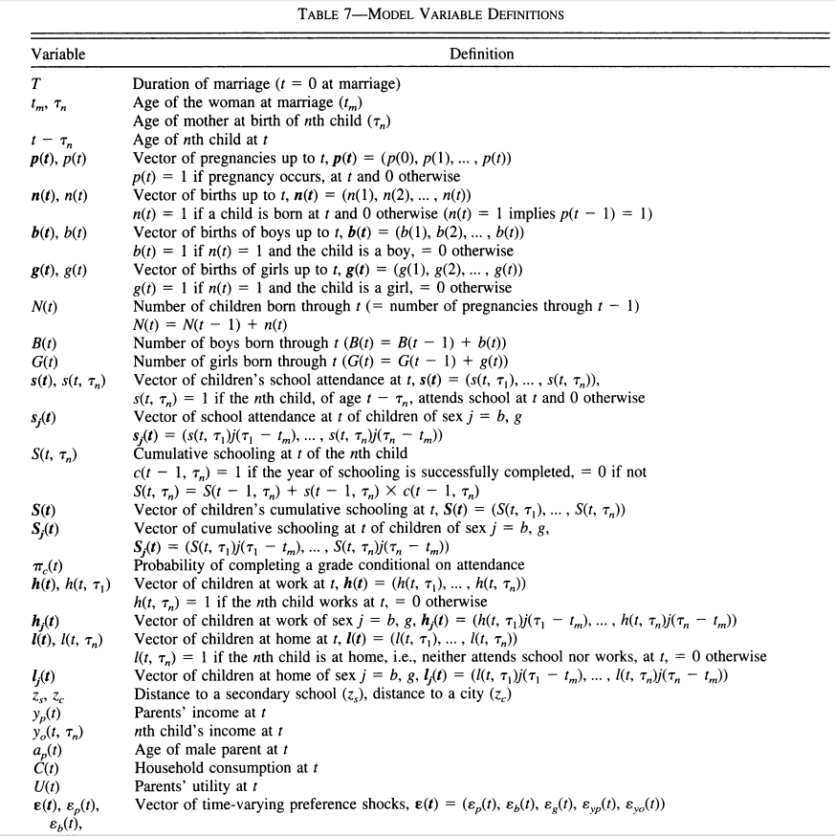
Structural Models

Slide 34
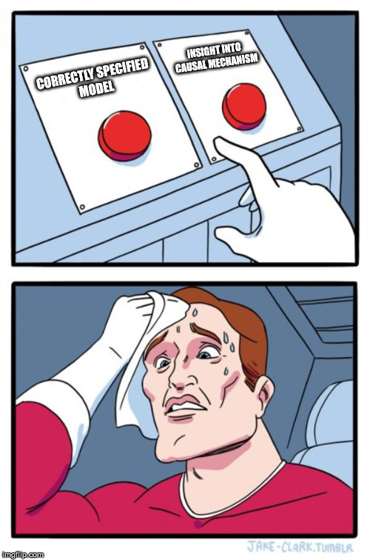
Structural Models or RCTs?

Slide 35
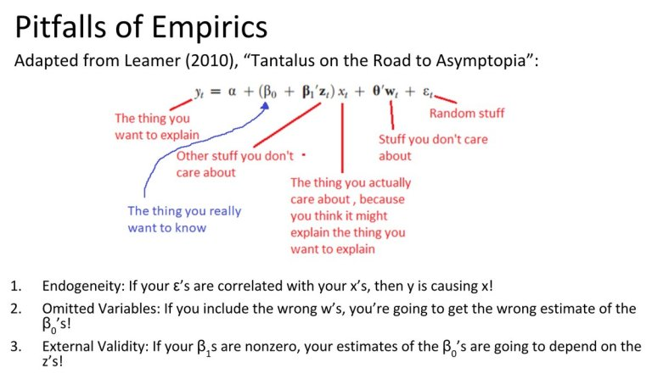
Summary

Slide 36
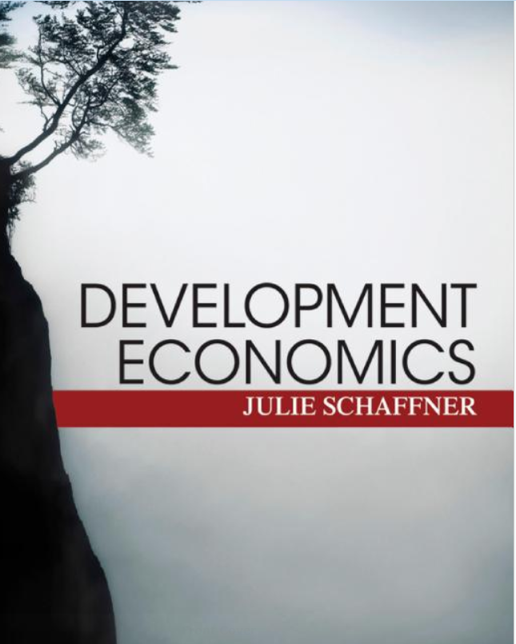

Book Recommendations

Slide 37
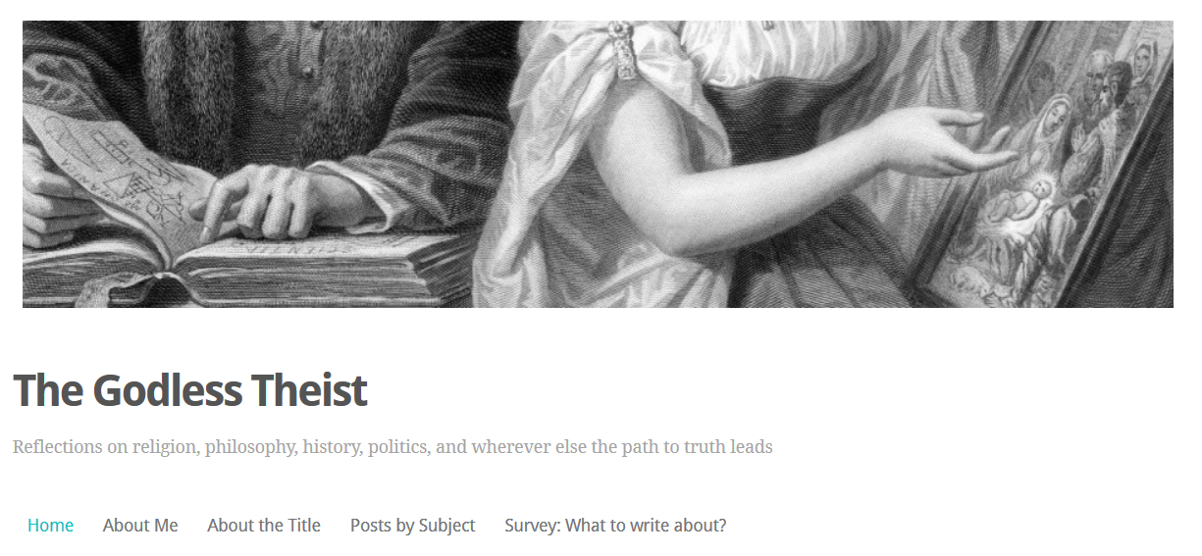
My Blog

Slide 38
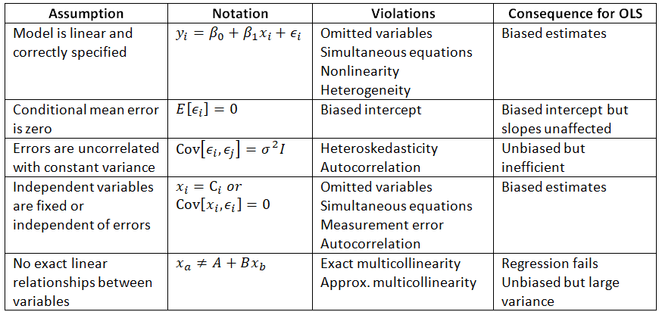
Assumptions of OLS

Slide 39
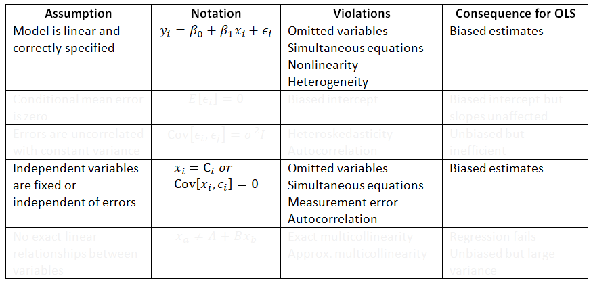
Assumptions of OLS

